Slide 1
FEWS NET Enhanced Flood Monitoring – East Africa, West Africa, southern Africa and Yemen
January 24, 2022, Hazard Briefing
FEWS NET Science Team:
USGS, NASA, NOAA, UCSB+Regional Scientists

Slide 2
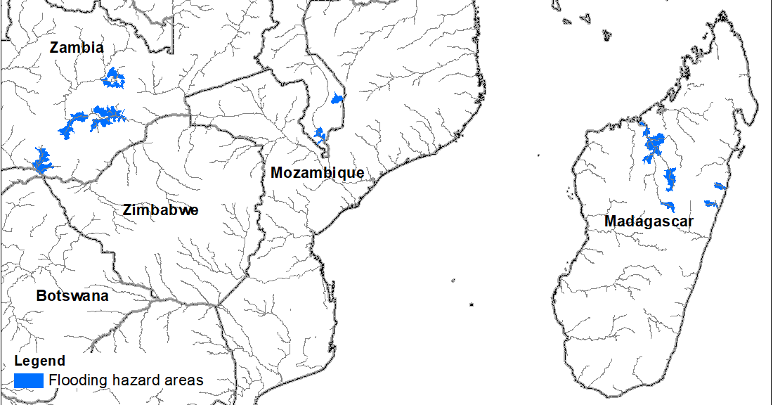
Flooding Polygons

Slide 3
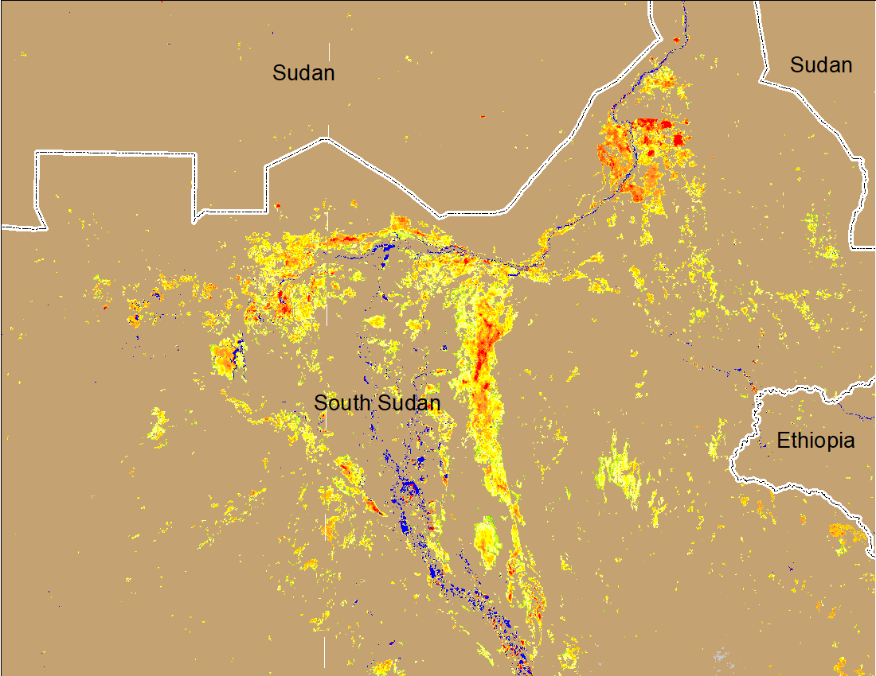
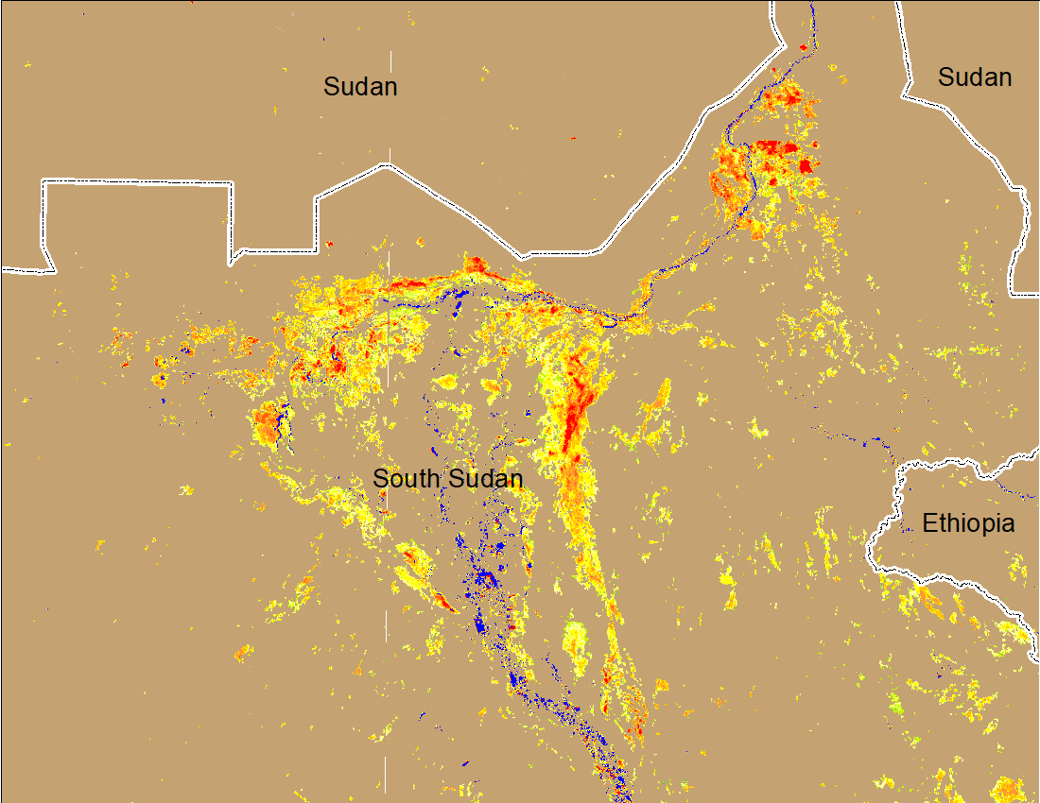
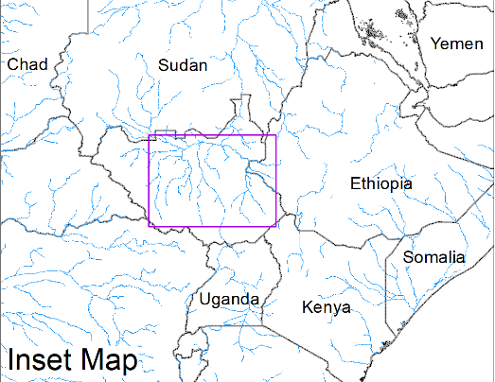
Inundation in the Sudd Wetlands
(% of the pixel)
(% of the pixel)
Northern Sudd Wetlands
Northern Sudd Wetlands
Sobet River
Sobet River
Akobo River
Akobo River
Pibor River
Pibor River
NOAA VIIRS 5-day composite: 11-15 Jan 2022
NOAA VIIRS 5-day composite: 19-23 Jan 2022
Inundation conditions have worsen compared to last week

Slide 4
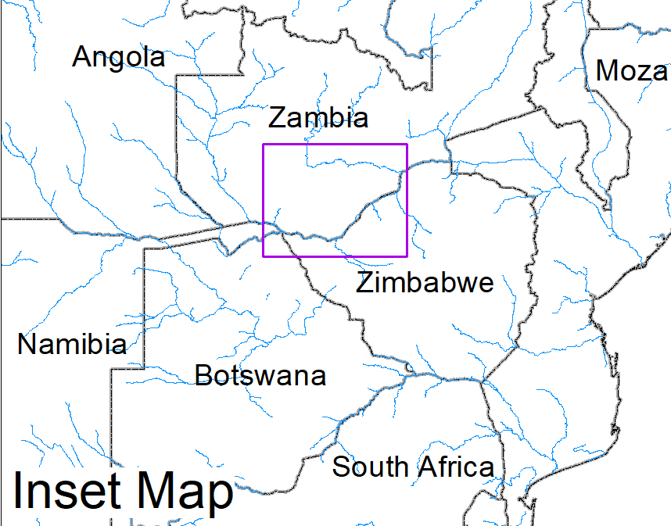
Flooding in Zambia and Southern Malawi
(% of the pixel)
(% of the pixel)
NOAA VIIRS 5-Day composite: 19-23 Jan 2022
NOAA VIIRS 5-Day composite: 19-23 Jan 2022

Slide 5
Flooding in Madagascar
Flooding and landside occurred because of two different tropical weather systems.
The rains were initially driven by ITCZ around 17 Jan, and then increased when a tropical depression made landfall in the east of the country on 22nd Jan.
Capital Antananarivo and Analamanga region are among the most affect areas.
Source: OCHA

Slide 6
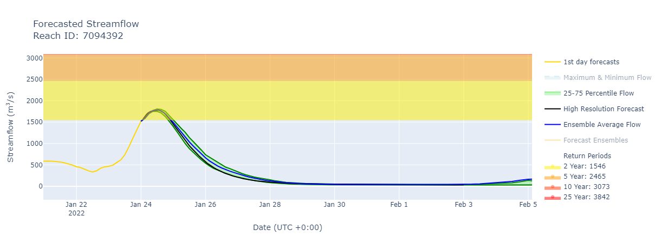
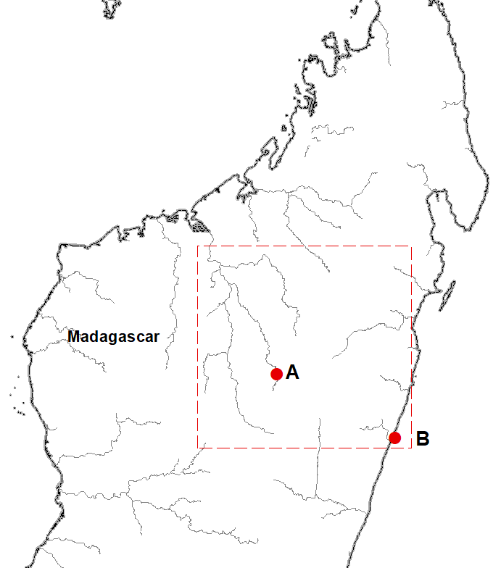
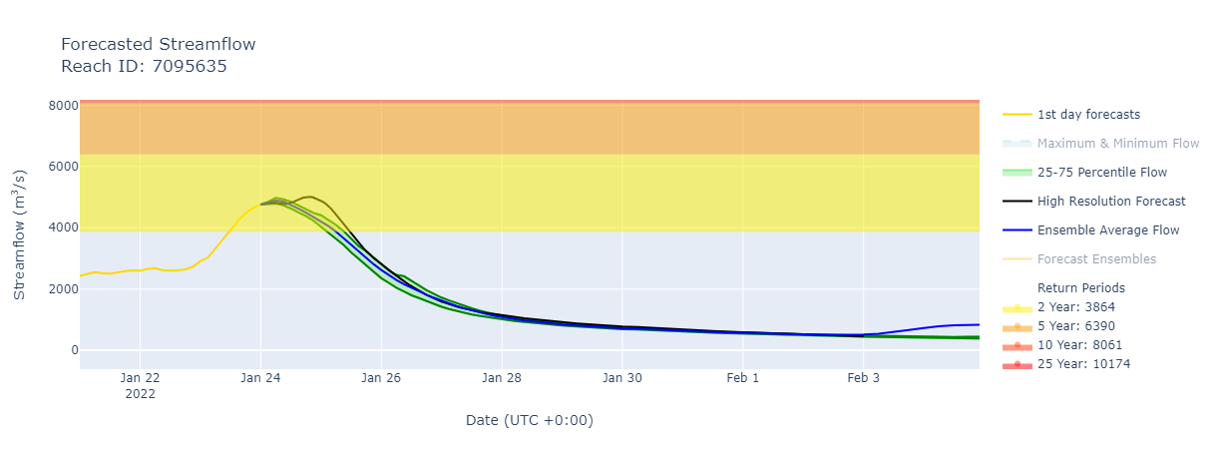
Flooding in Madagascar
(% of the pixel)
A. Betsiboka River
B. Vohitra River
NOAA VIIRS 5-Day composite: 19-23 Jan 2022
GEOGloWS streamflow forecast
Flood maps were difficult to get because of cloud cover
However, streamflow forecast shows rivers near the capital and along the east coast will be at 2-year return period level.

Slide 7
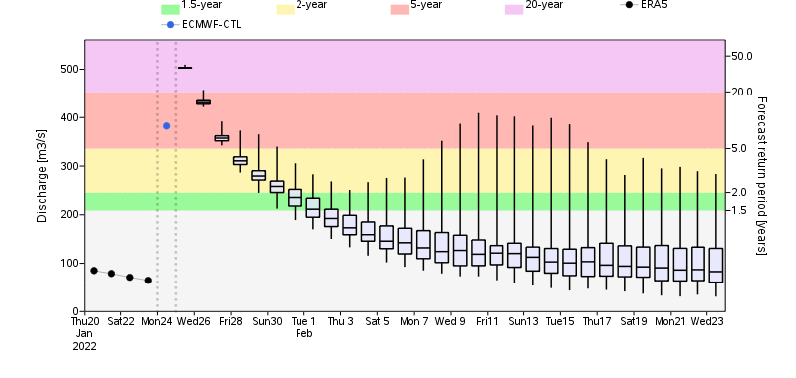
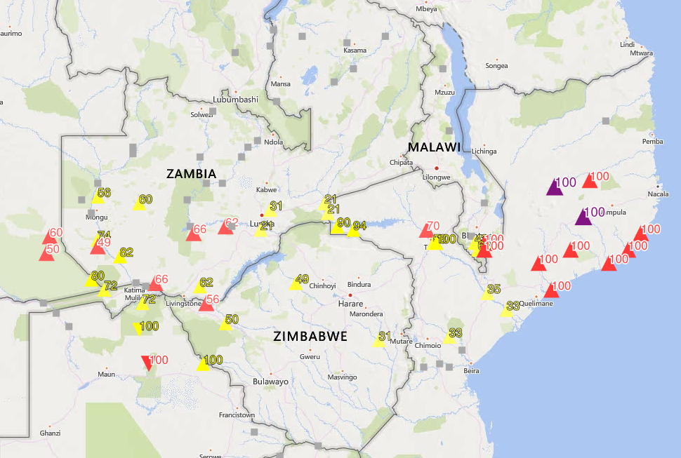
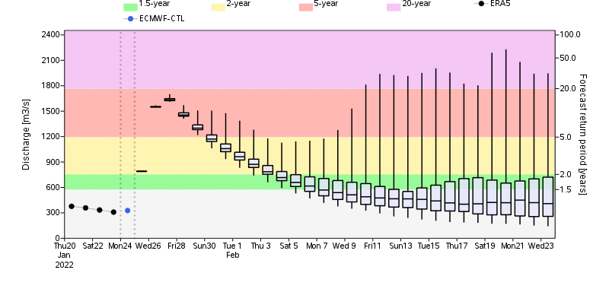
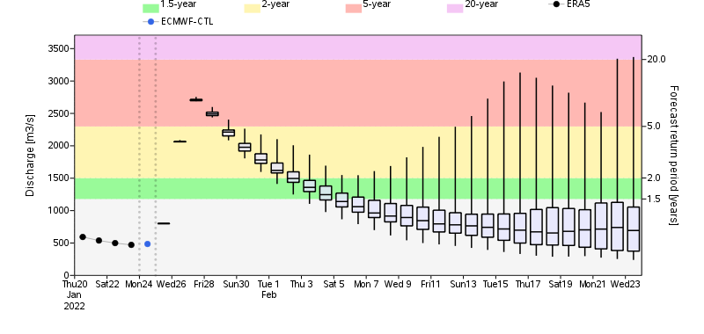
Possible Flooding Risk in Mozambique
Yellow=2-yr, Red=5-yr, Purple=20-yr return period
GloFAS monthly streamflow forecast
Discharge at levels of 5 and 20-year return period is expected in the rivers in Mozambique.

