Slide 1
FEWS NET Enhanced Flood Monitoring – East Africa, West Africa, southern Africa and Yemen
January 18, 2022, Hazard Briefing
FEWS NET Science Team:
USGS, NASA, NOAA, UCSB+Regional Scientists

Slide 2
Flooding Polygons

Slide 3
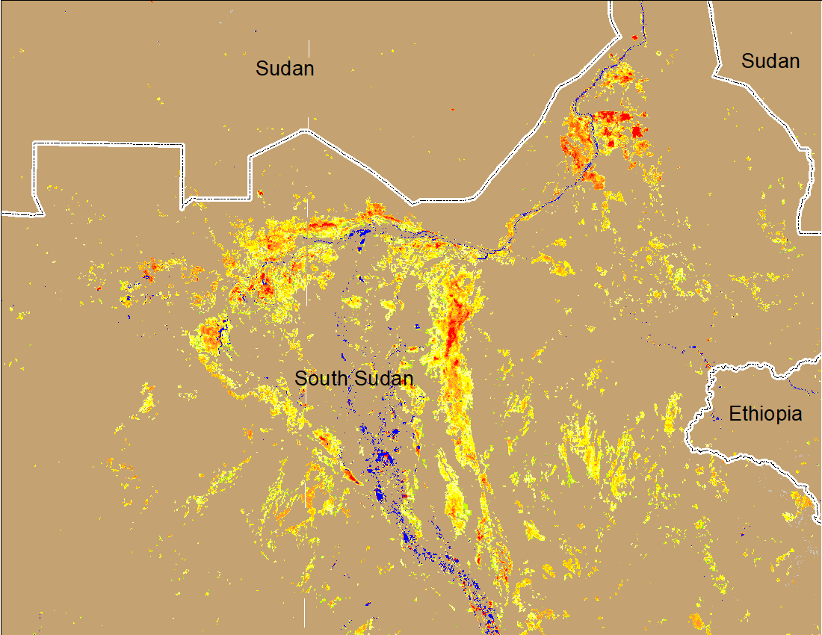
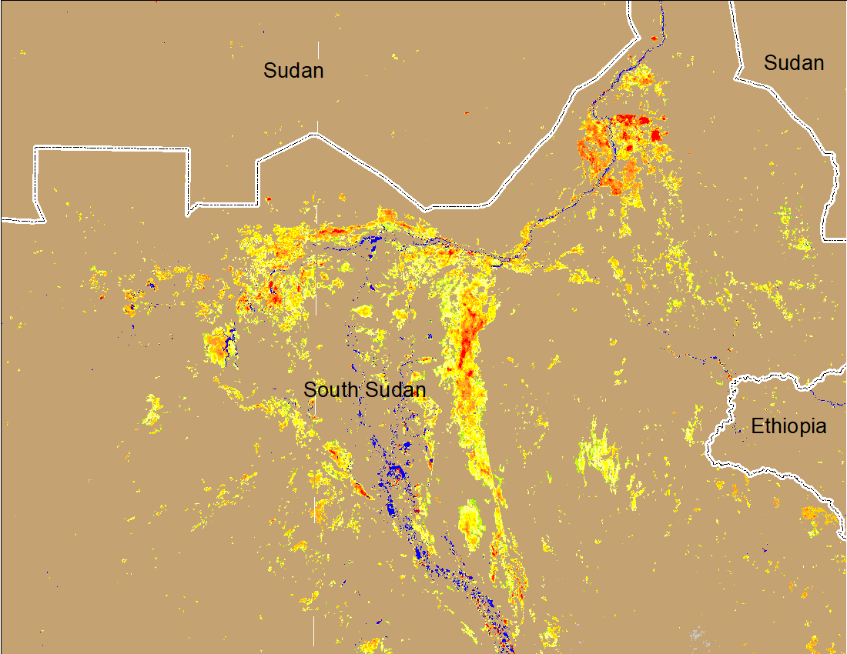
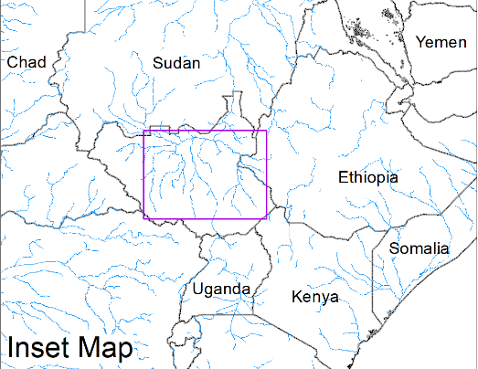
Inundation in the Sudd Wetlands
(% of the pixel)
(% of the pixel)
Northern Sudd Wetlands
Northern Sudd Wetlands
Sobet River
Sobet River
Akobo River
Akobo River
Pibor River
Pibor River
NOAA VIIRS 5-day composite: 5-9 Jan 2022
NOAA VIIRS 5-day composite: 11-15 Jan 2022
Little to no change in the inundation compared to last week

Slide 4
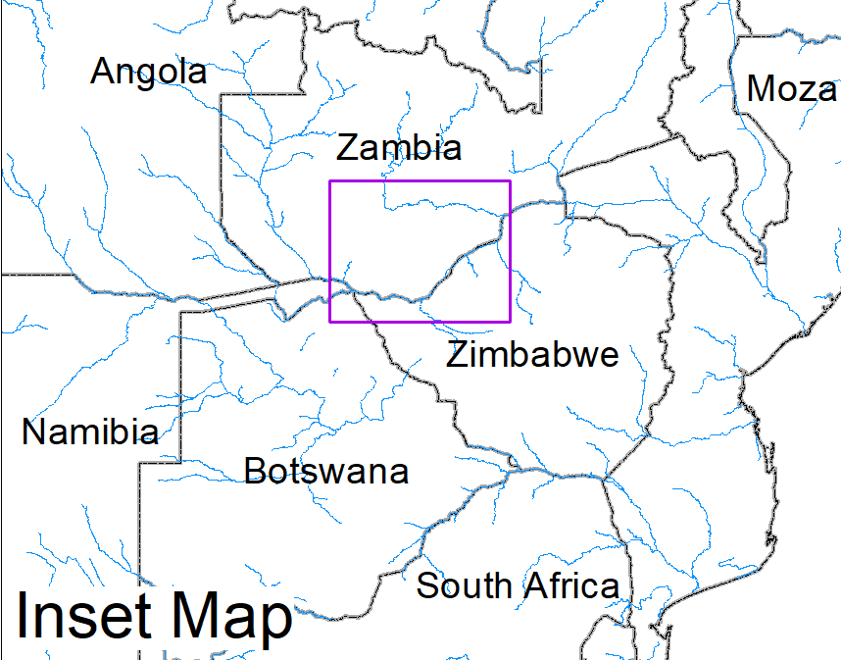
Flooding in Zambia and Southern Malawi
NOAA VIIRS 5-Day composite: 12-16 Jan 2022
NOAA VIIRS 5-Day composite: 12-16 Jan 2022
Flooding near Blantyre City in Southern Malawi

