Slide 1
FEWS NET Enhanced Flood Monitoring – East Africa, West Africa, southern Africa and Yemen
January 10, 2022, Hazard Briefing
FEWS NET Science Team:
USGS, NASA, NOAA, UCSB+Regional Scientists

Slide 2
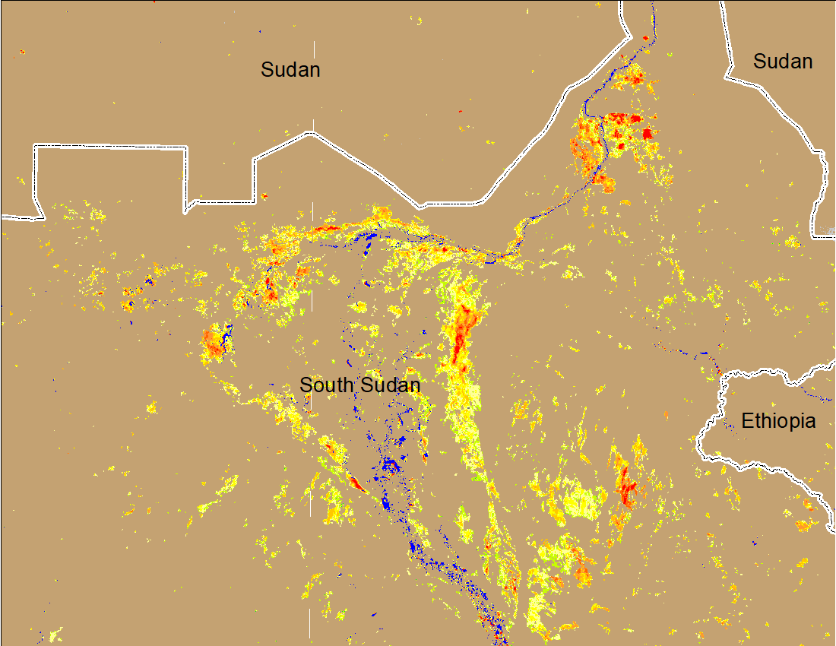
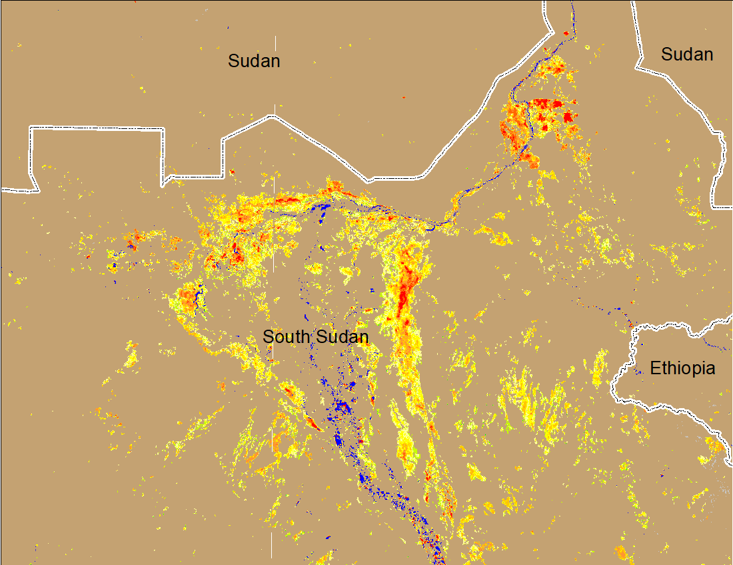

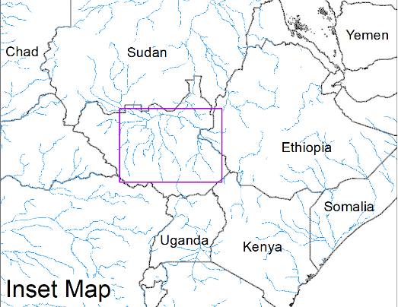
Worsening Conditions Continue in the Sudd Wetlands
(% of the pixel)
(% of the pixel)
Northern Sudd Wetlands
Northern Sudd Wetlands
Sobet River
Sobet River
Akobo River
Akobo River
Pibor River
Pibor River
NOAA VIIRS 5-day composite: 29 Dec 2021- 2 Jan 2022
NOAA VIIRS 5-day composite: 5-9 Jan 2022
Conditions have deteriorated specially along the White Nile

