Slide 1
FEWS NET Enhanced Flood Monitoring – East Africa, West Africa, southern Africa and Yemen
February 07, 2022, Hazard Briefing
FEWS NET Science Team:
USGS, NASA, NOAA, UCSB+Regional Scientists

Slide 2
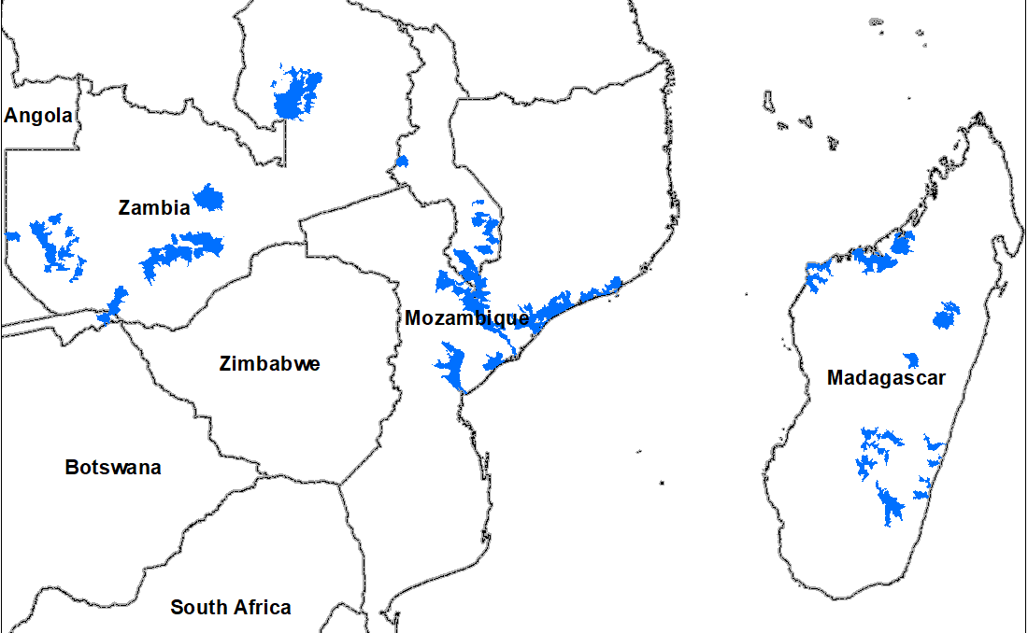
Flooding Polygons

Slide 3
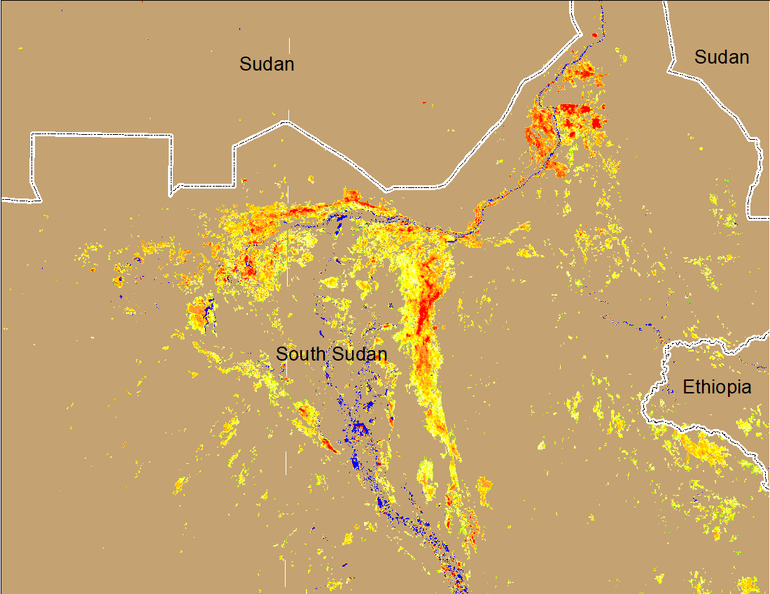
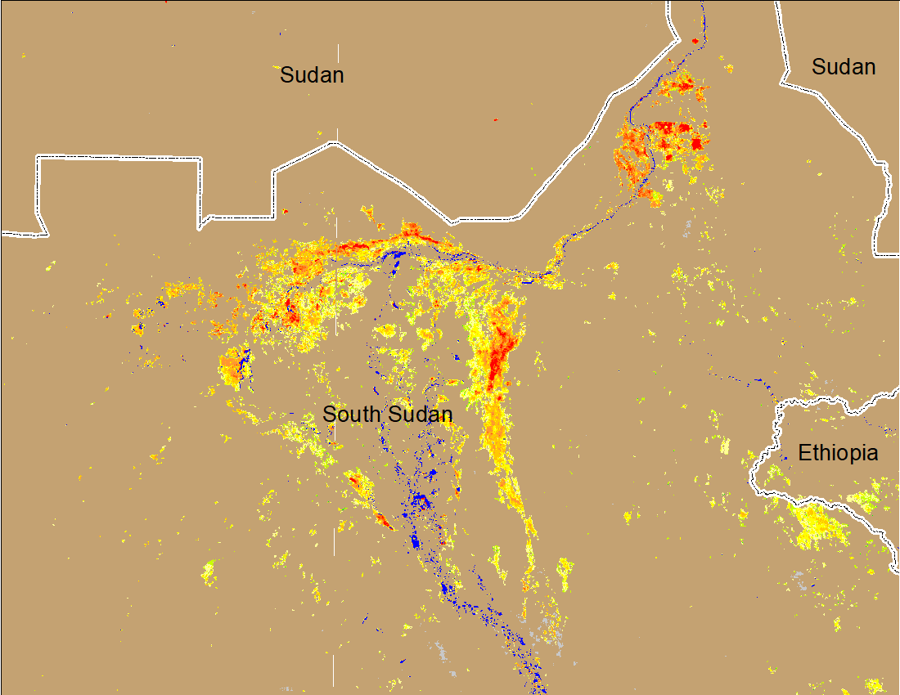
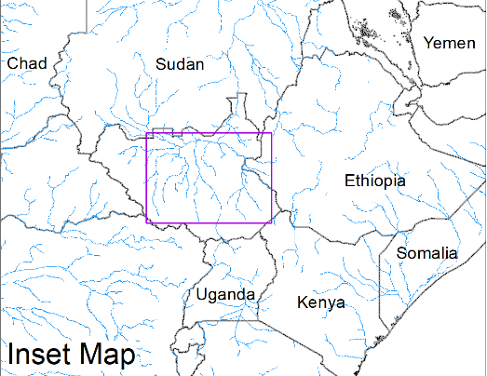
Inundation in the Sudd Wetlands
(% of the pixel)
(% of the pixel)
Northern Sudd Wetlands
Northern Sudd Wetlands
Sobet River
Sobet River
Akobo River
Akobo River
Pibor River
Pibor River
NOAA VIIRS 5-day composite: 26-30 Jan 2022
NOAA VIIRS 5-day composite: 2-7 Feb 2022
Inundation conditions remain unchanged

Slide 4
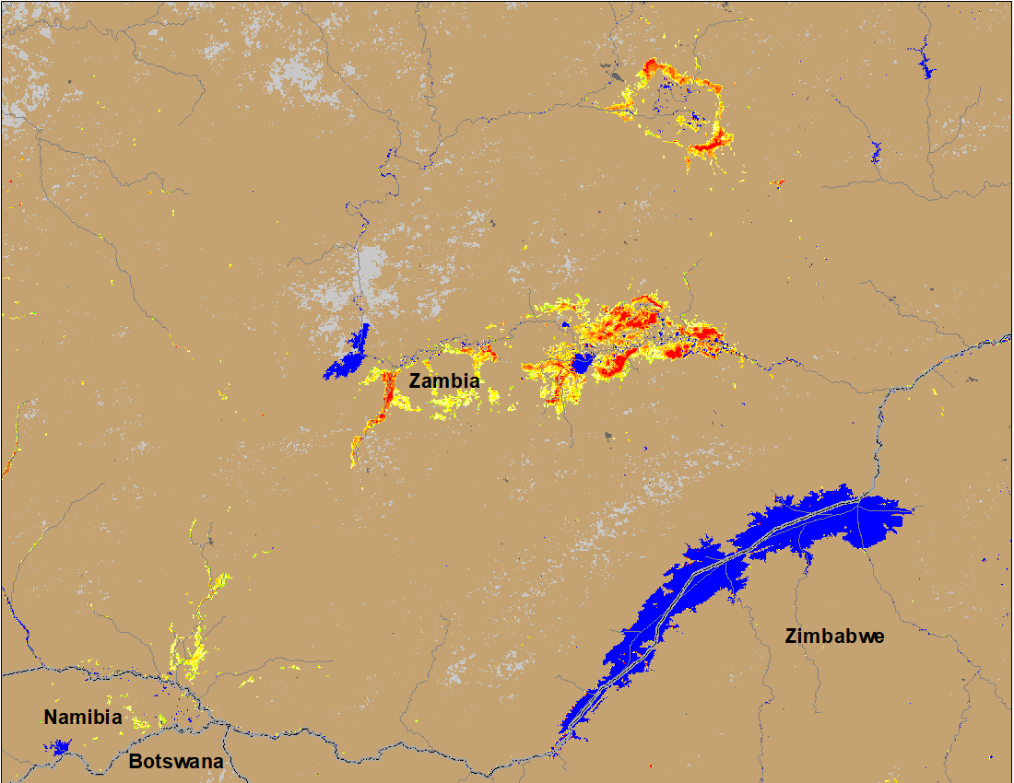
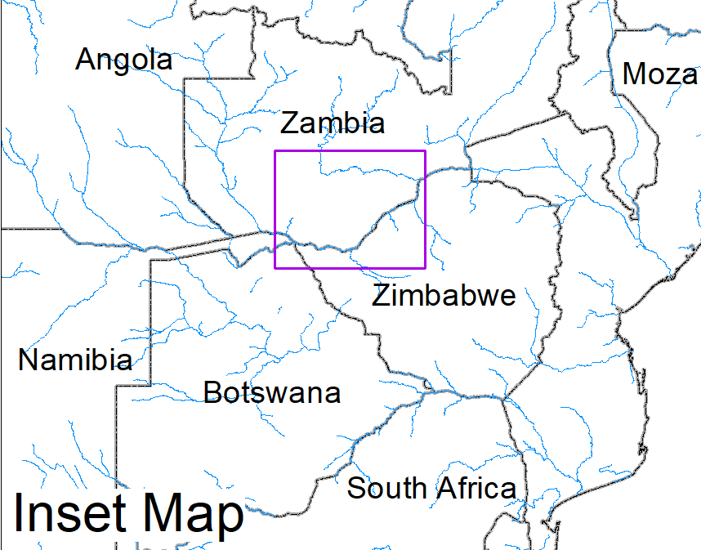
Flooding in Zambia
(% of the pixel)
(% of the pixel)
NOAA VIIRS 5-Day composite: 26-30 Jan 2022
NOAA VIIRS 5-Day composite: 2-7 Feb 2022
Flooding conditions worsened in the past 5 days with newly inundated areas along the Zambia and Namibia boarder

Slide 5
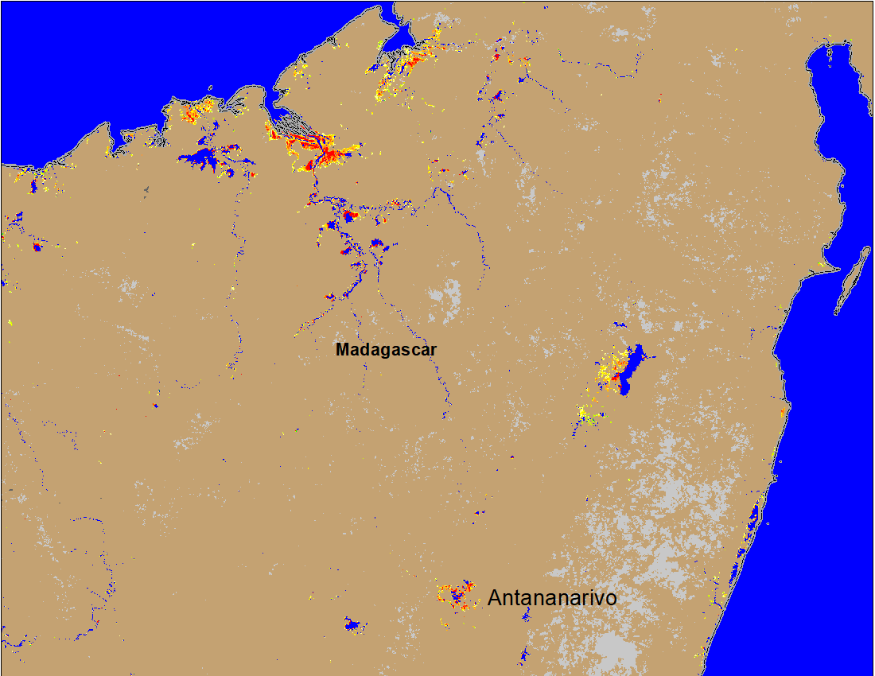
Flooding in Madagascar
Flooded areas from Tropical Cyclone Ana have declined substantially
(% of the pixel)
NOAA VIIRS 5-Day composite: 2-6 Feb 2022

Slide 6
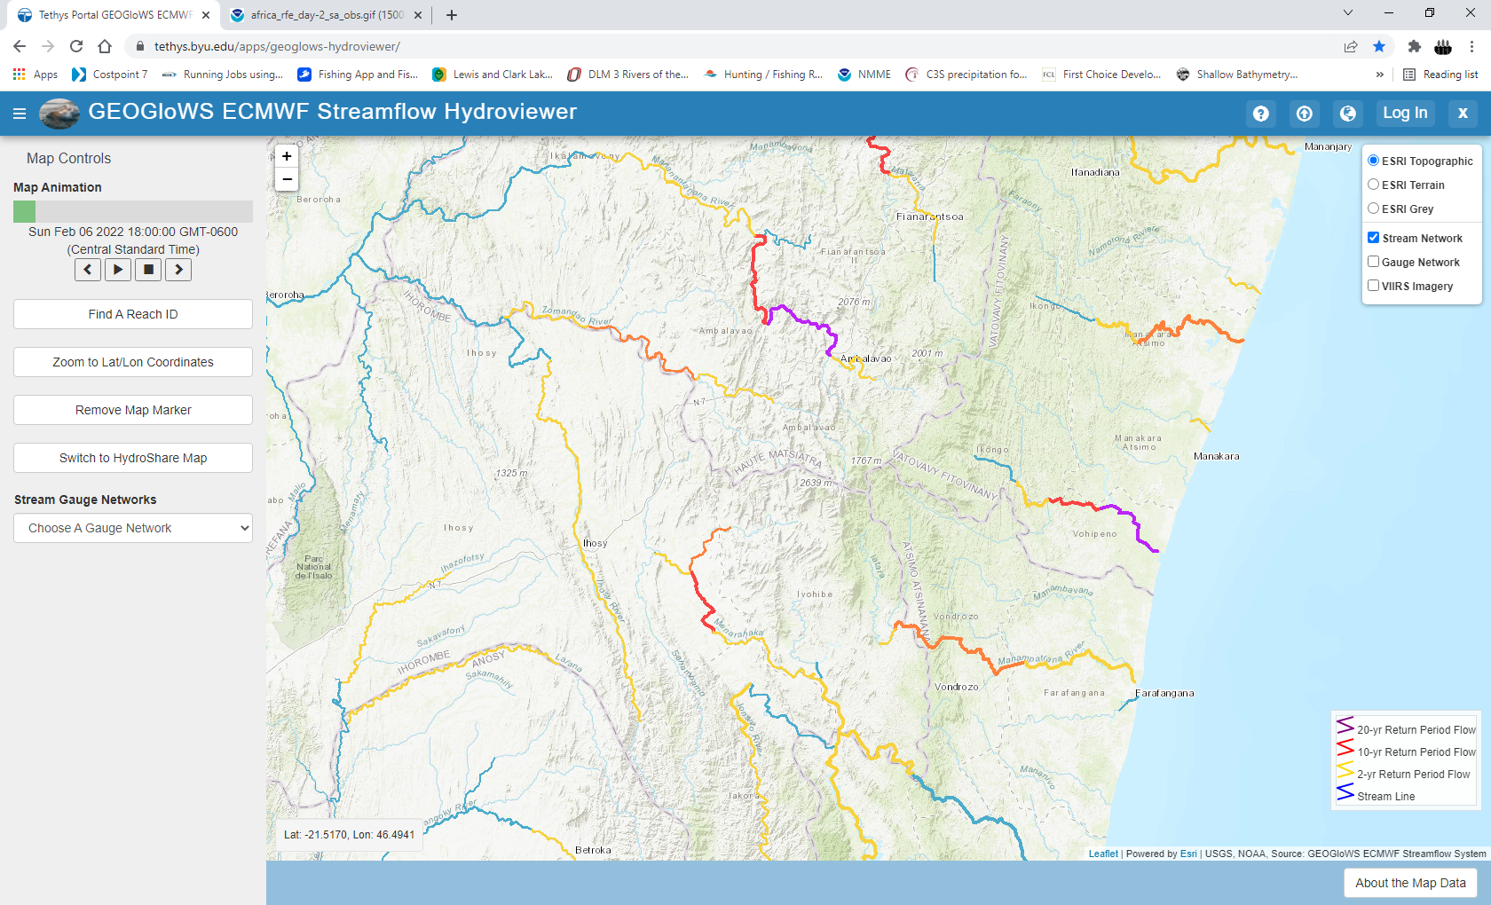
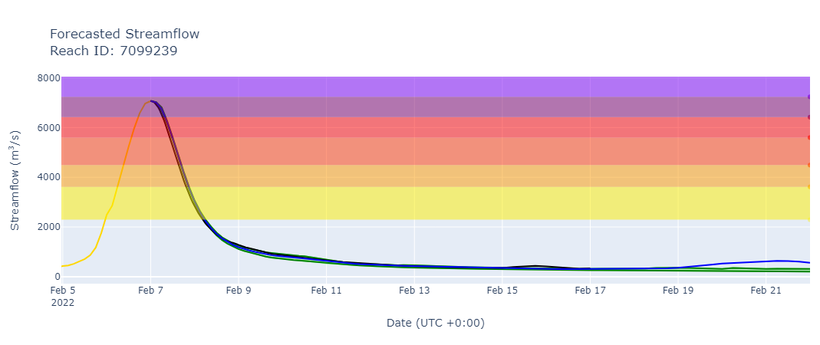
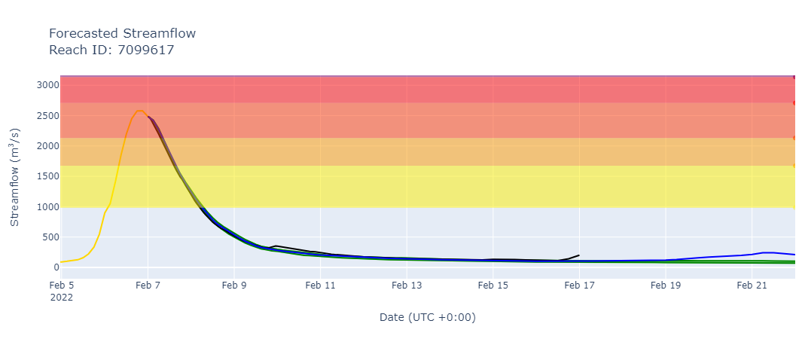
Flooding in Madagascar (Tropical Cyclone Batsirai)
Zomandao River
Matatana River
Manampatrana River
GEOGloWS streamflow forecast Feb 5-20, 2022
Discharges at many rivers were expected to be between 2 to 25-yr return period levels

Slide 7
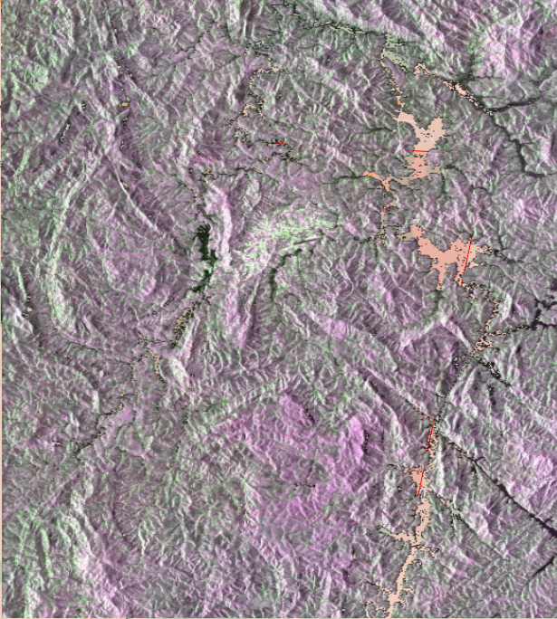
Flooding in Madagascar (Tropical Cyclone Batsirai)
Flooded areas
Flooded areas
Source: International Charter (RADARSAT Constellation Mission) ~1.3m resolution
SAR-Saocom 1B

Slide 8
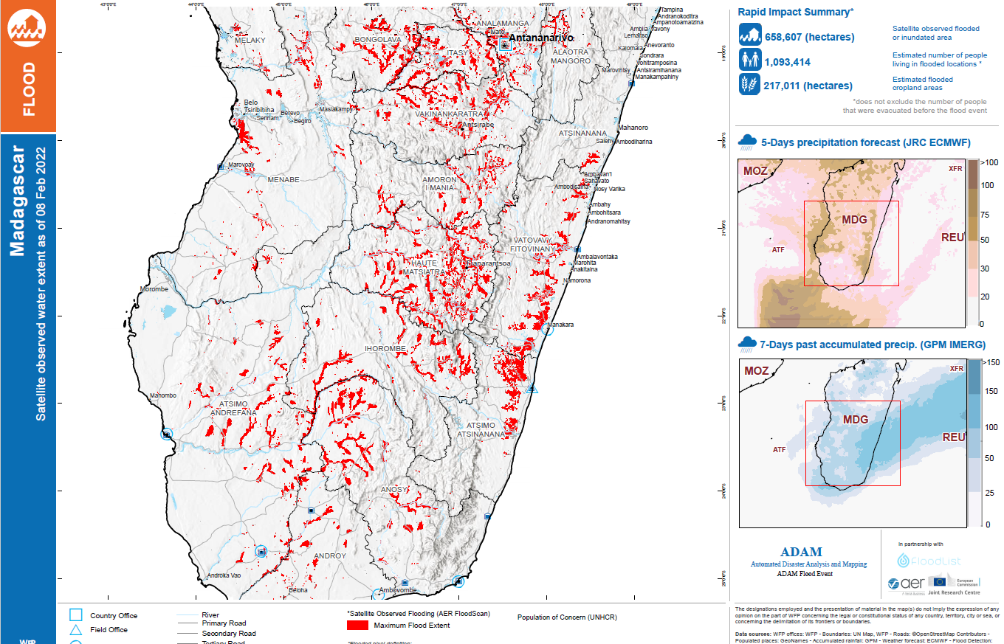
First Rapid Flooding Impact of Batsirai
As of Feb 8, 2022
Based on JAXA AMSR2 and NASA GMI data

Slide 9
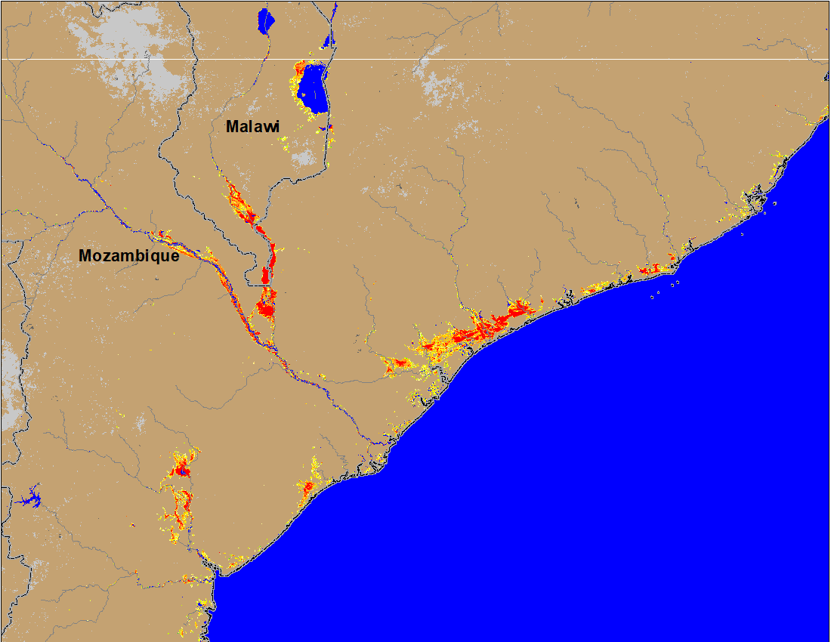
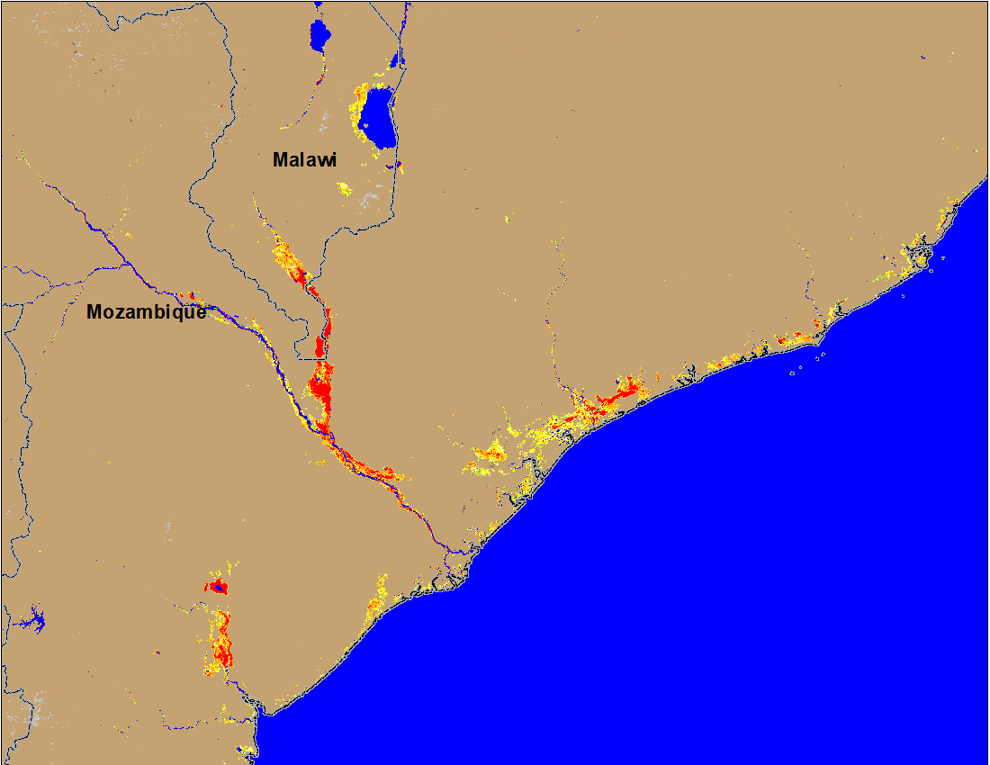
Flooding in Mozambique and Malawi
(% of the pixel)
(% of the pixel)
NOAA VIIRS 5-Day composite: 26-30 Jan 2022
NOAA VIIRS 5-Day composite: 2-6 Feb 2022
No significant change in the flooded areas compared to last week, Batsirai impact restricted to Madagascar

