Slide 1
FEWS NET Enhanced Flood Monitoring – East Africa, West Africa, southern Africa and Yemen
February 28, 2022, Hazard Briefing
FEWS NET Science Team:
USGS, NASA, NOAA, UCSB+Regional Scientists

Slide 2
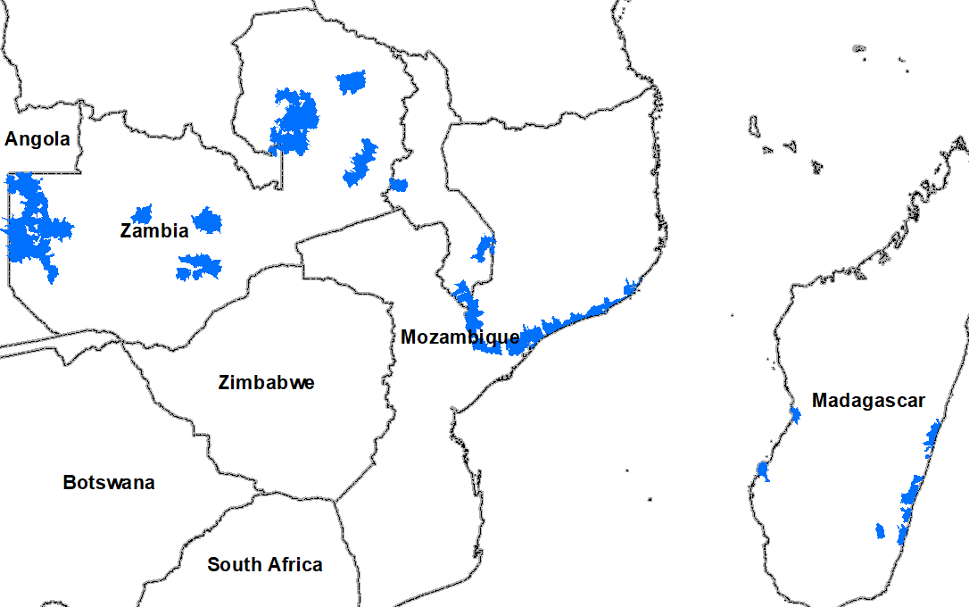
Flooding Polygons

Slide 3
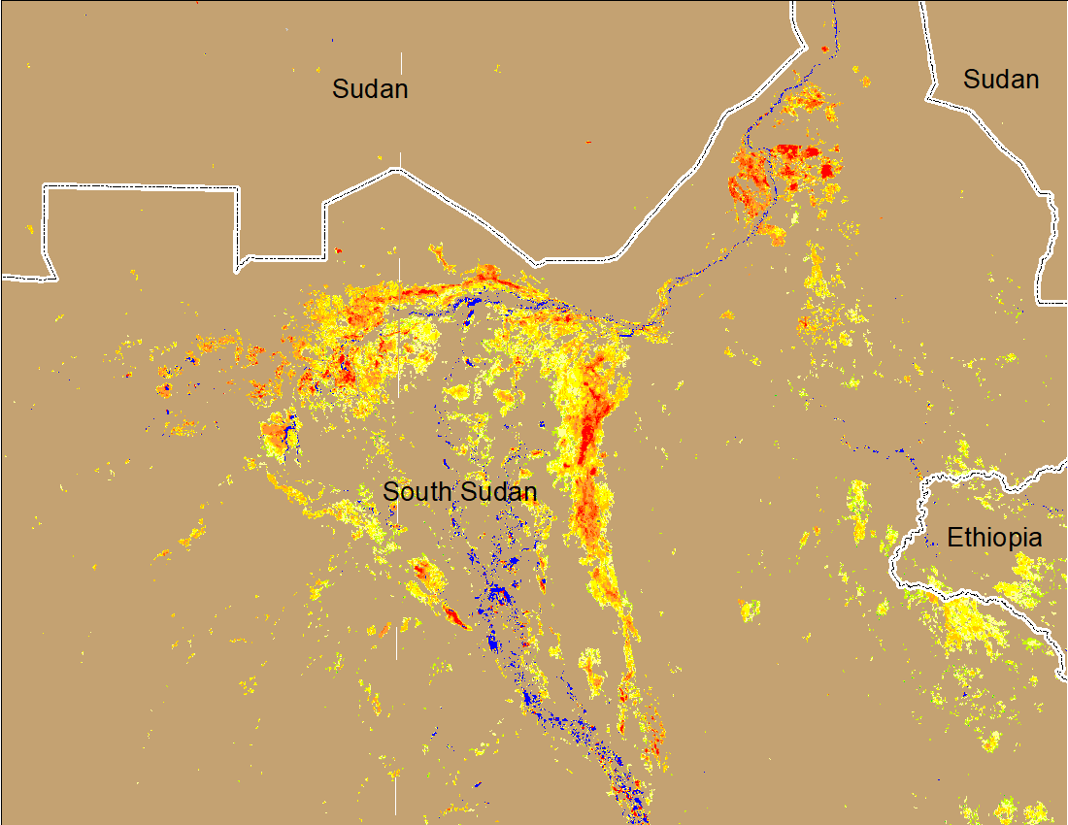
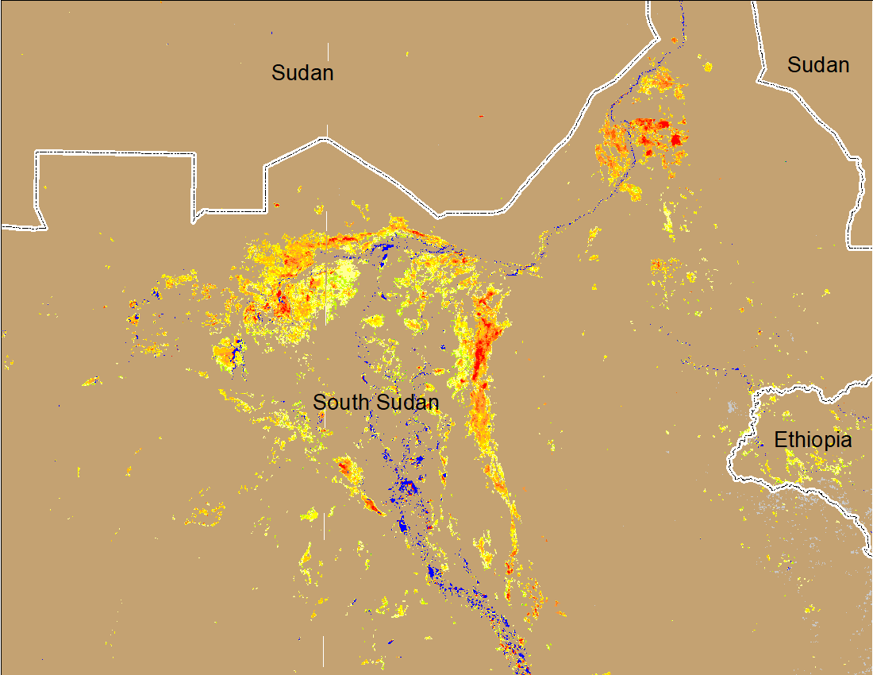
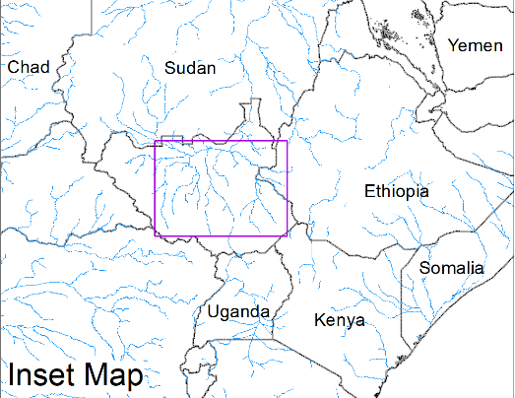
Inundation in the Sudd Wetlands
(% of the pixel)
(% of the pixel)
Northern Sudd Wetlands
Northern Sudd Wetlands
Sobet River
Sobet River
Akobo River
Akobo River
Pibor River
Pibor River
NOAA VIIRS 5-day composite: 8-12 Feb 2022
NOAA VIIRS 5-day composite: 23-27 Feb 2022
Improvements in inundation along Akobo and Pibor Rivers catchments are noticeable, but they remained unchanged elsewhere.

Slide 4
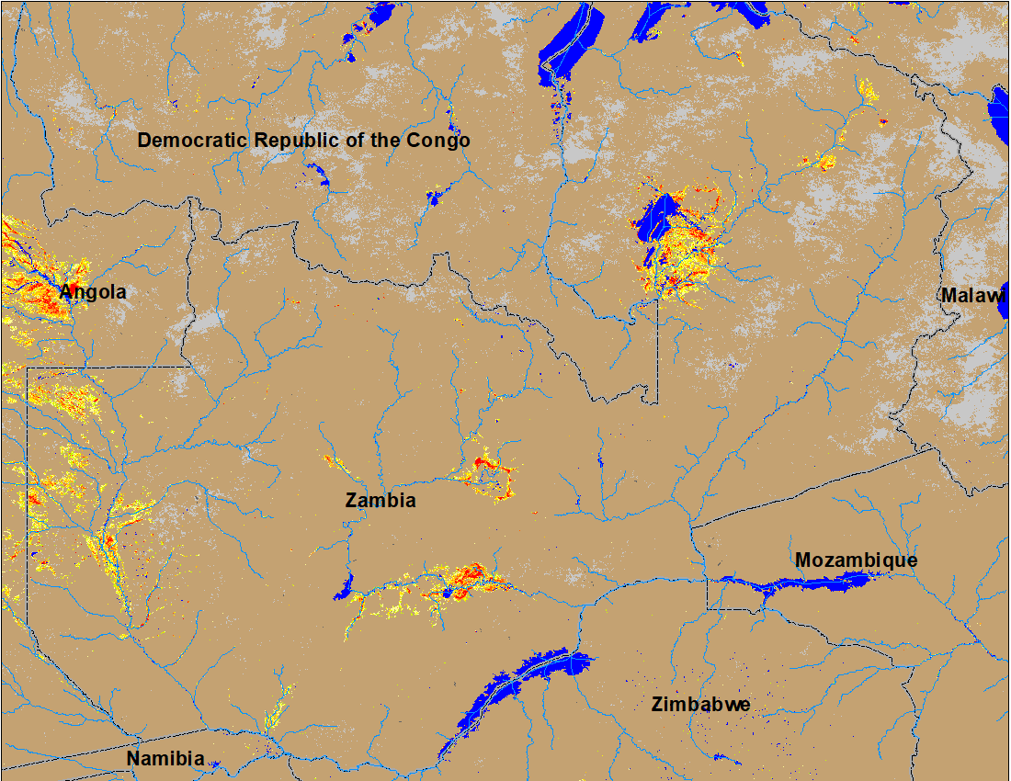
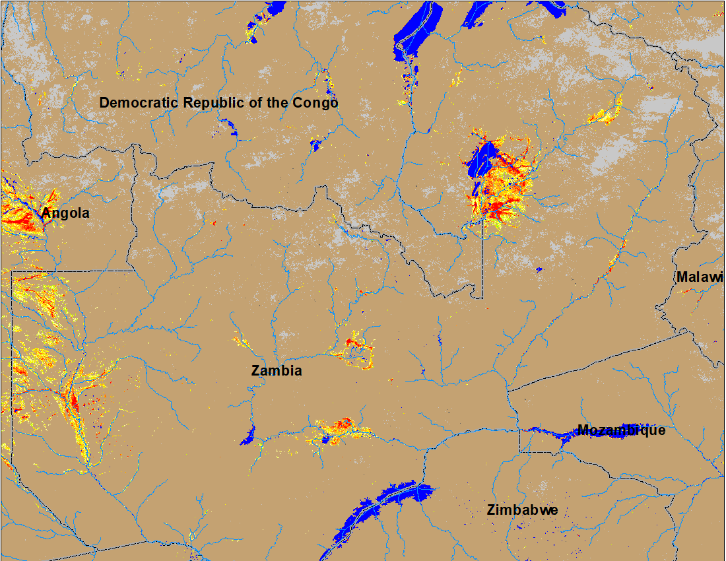
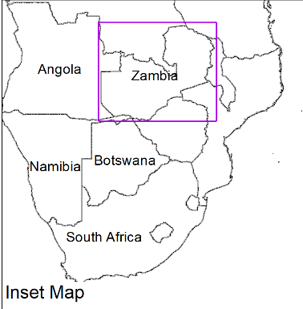
Flooding in Zambia
(% of the pixel)
(% of the pixel)
NOAA VIIRS 5-Day composite: 8-12 Feb 2022
NOAA VIIRS 5-Day composite: 23-27 Feb 2022
More flooding can be seen in the upper reaches of Zambezi River in western Zambia.

Slide 5
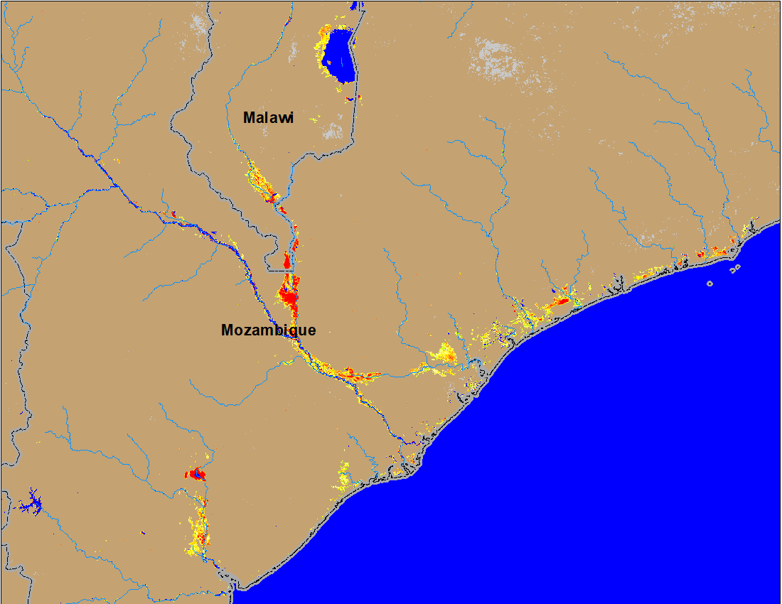
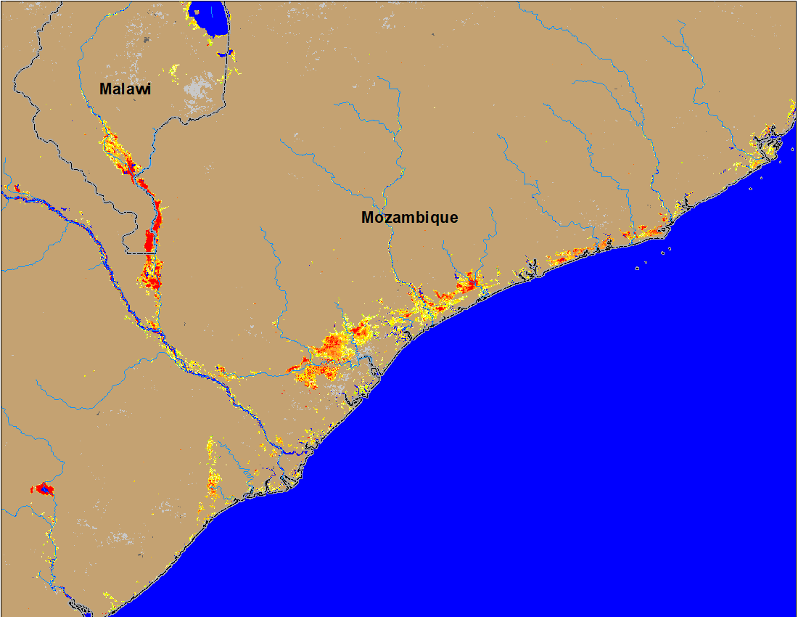
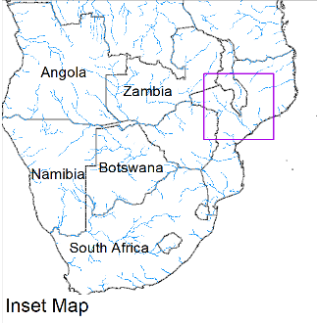
Flooding in Mozambique and Malawi
(% of the pixel)
(% of the pixel)
NOAA VIIRS 5-Day composite: 8-12 Feb 2022
NOAA VIIRS 5-Day composite: 23-27 Feb 2022
More areas become flooded along the Shire River in the Southern Malawi and into Mozambique.
Inundation conditions worsened along the coastal areas of Mozambique.

Slide 6
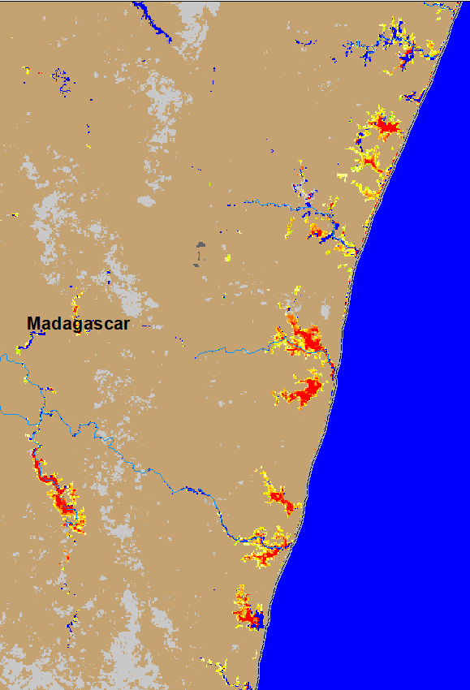
Flooding in Madagascar Caused by Tropical Cyclone Emnati
(% of the pixel)
ADAM Flood Map: 27 Feb 2022
NOAA VIIRS 5-day composite: 23-27 Feb 2022
TC Emnati caused flooding mostly along the southeastern coastal areas of Madagascar.
Inundation caused by Ana/Batsirai/Dumako has been receded in other parts of Madagascar.

Slide 7
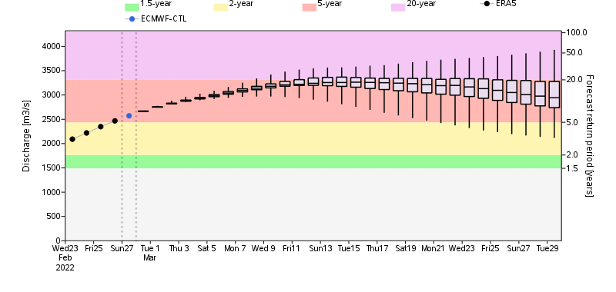
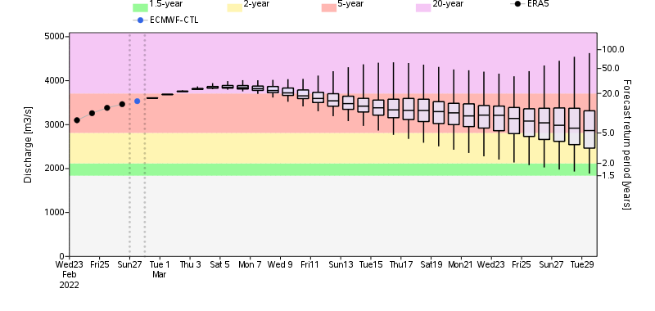
GloFAS Monthly Streamflow Forecast
Luapula River in Zambia
Discharges in many rivers in Zambia and Malawi are expected to be between 2 and 20-yr return period levels by mid-March.
Luangwa River (a tributary of Zambezi) in Zambia

