Slide 1
FEWS NET Enhanced Flood Monitoring – East Africa, West Africa, southern Africa and Yemen
February 14, 2022, Hazard Briefing
FEWS NET Science Team:
USGS, NASA, NOAA, UCSB+Regional Scientists

Slide 2
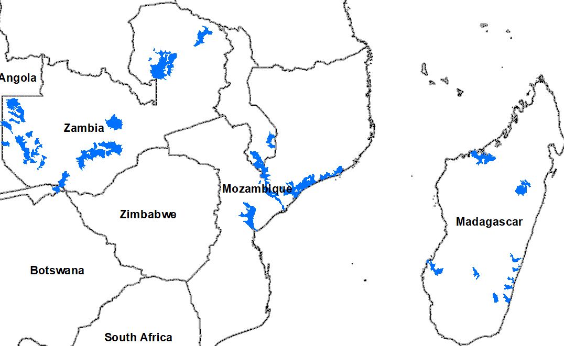
Flooding Polygons

Slide 3
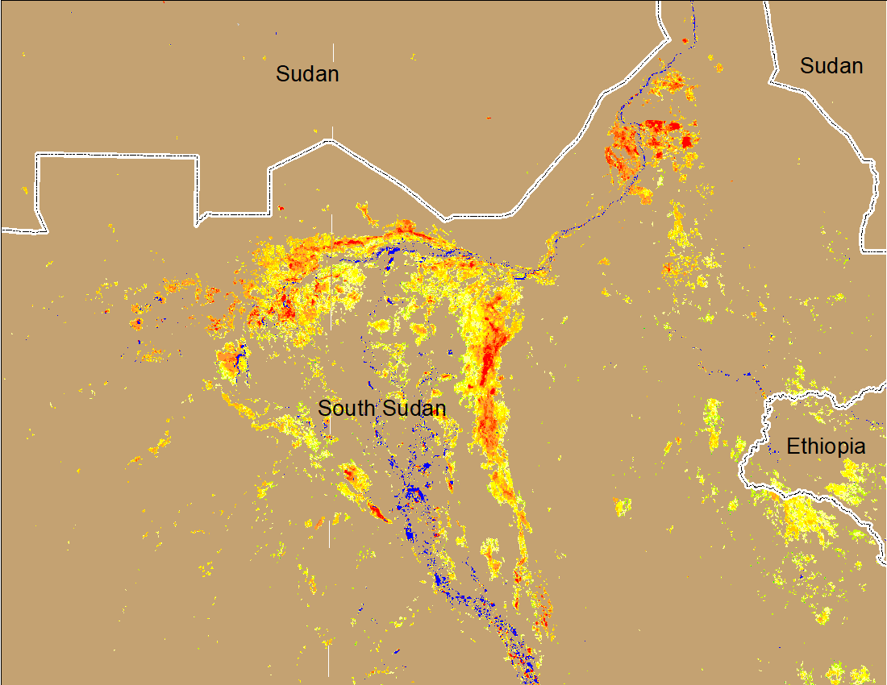
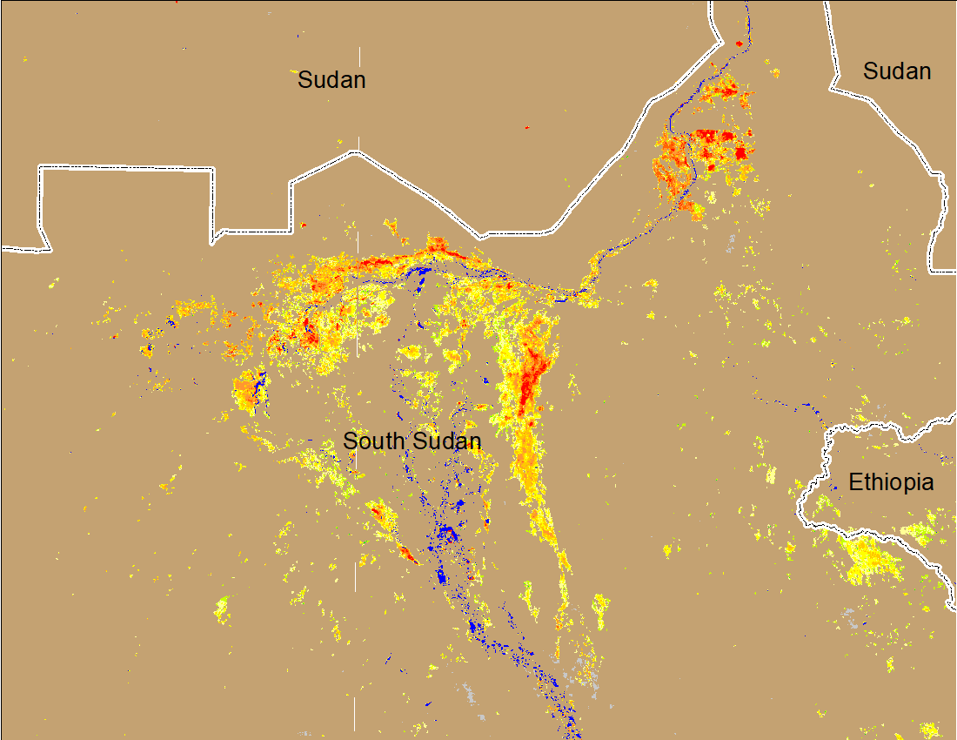
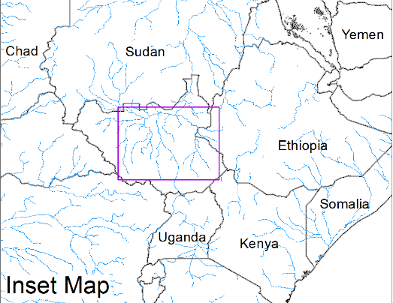
Inundation in the Sudd Wetlands
(% of the pixel)
(% of the pixel)
Northern Sudd Wetlands
Northern Sudd Wetlands
Sobet River
Sobet River
Akobo River
Akobo River
Pibor River
Pibor River
NOAA VIIRS 5-day composite: 2-7 Feb 2022
NOAA VIIRS 5-day composite: 8-12 Feb 2022
Inundation conditions mostly remain unchanged

Slide 4
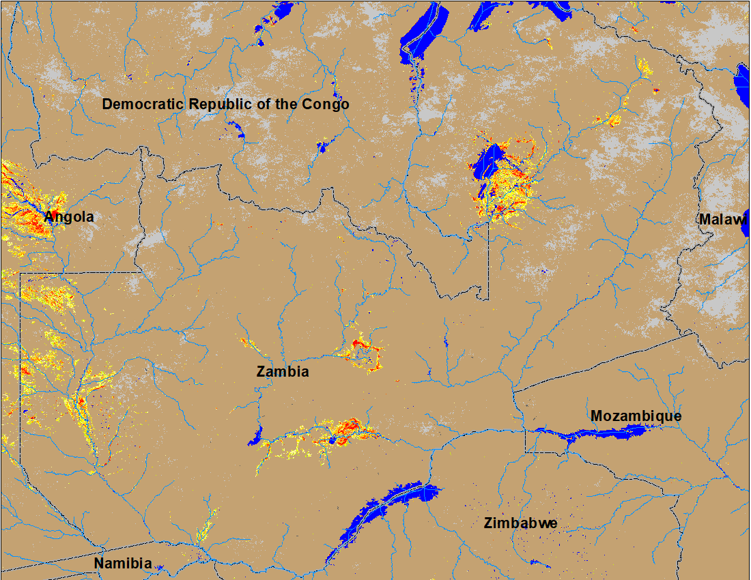
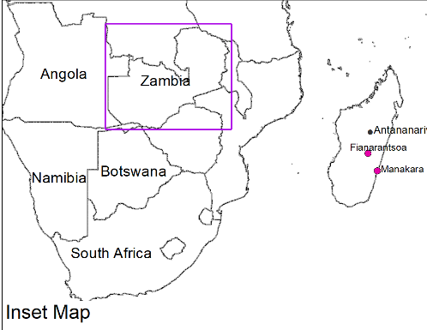
Flooding in Zambia
(% of the pixel)
Flooding continues in the upper reaches of Zambezi River in Zambia.
NOAA VIIRS 5-Day composite: 8-12 Feb 2022

Slide 5
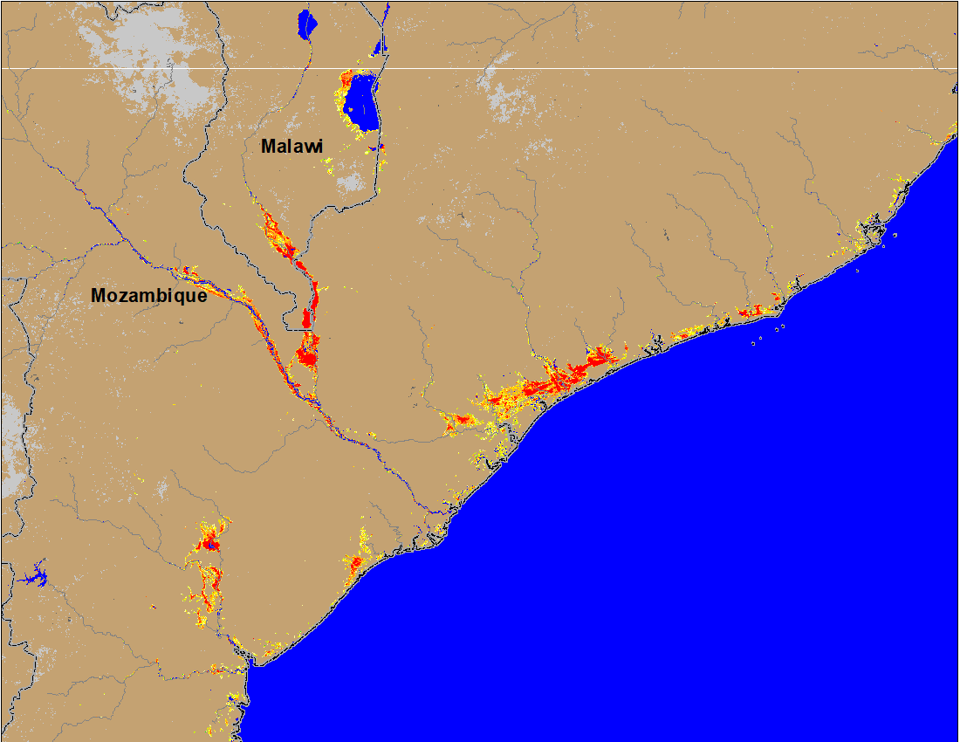
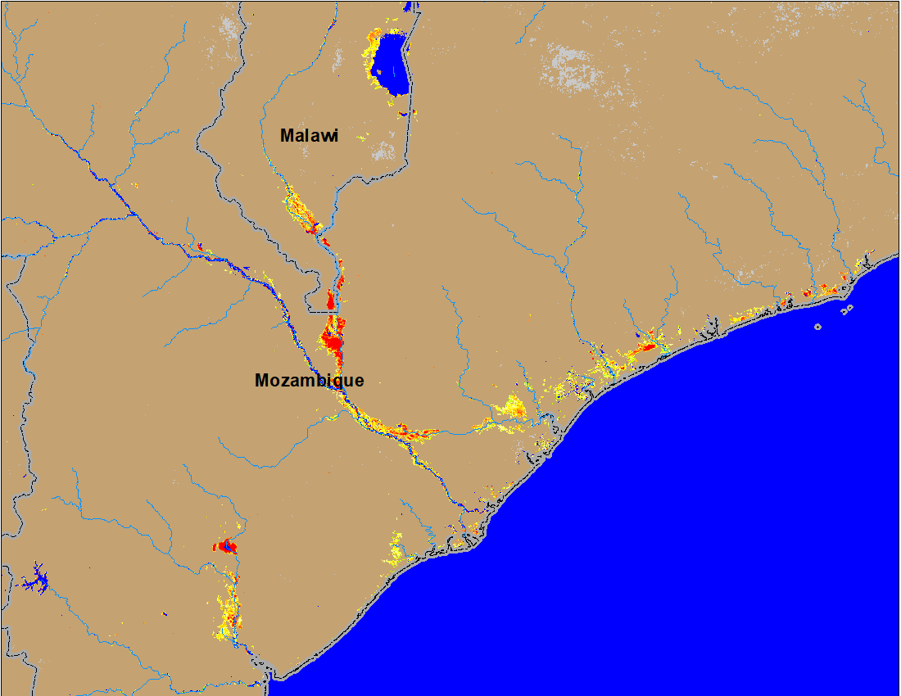
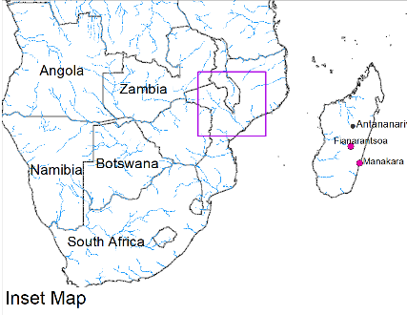
Flooding in Mozambique and Malawi Caused by TC Ana
(% of the pixel)
(% of the pixel)
NOAA VIIRS 5-Day composite: 26-30 Jan 2022
NOAA VIIRS 5-Day composite: 8-12 Feb 2022
Flooded areas due to TC Ana have been significantly retreaded in Malawi and Mozambique.

Slide 6
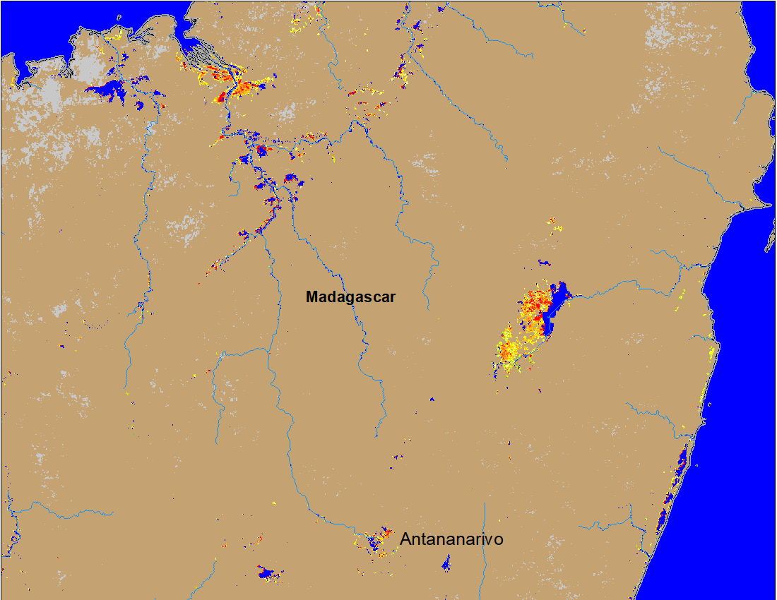
Flooding in Madagascar Caused by Tropical Cyclone Ana
(% of the pixel)
Flooded areas
Flooded areas
RADARSAT Jan 25-29, 2022 (Int. Charter)
NOAA VIIRS 5-Day composite: 8-12 Feb 2022
SAOCOM Jan 25-29, 2022 (Int. Charter)
Similarly flooded areas in northern Madagascar due to TC Ana have also been retreaded.

Slide 7
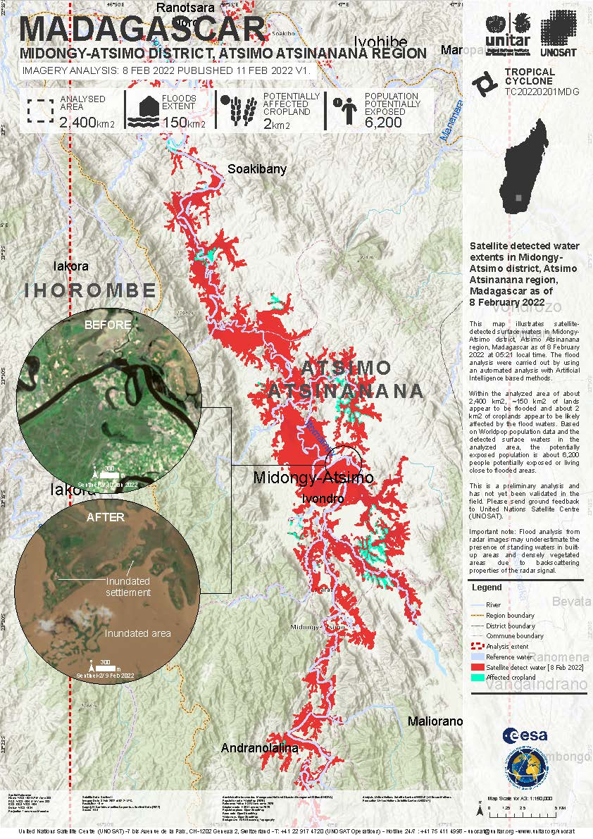
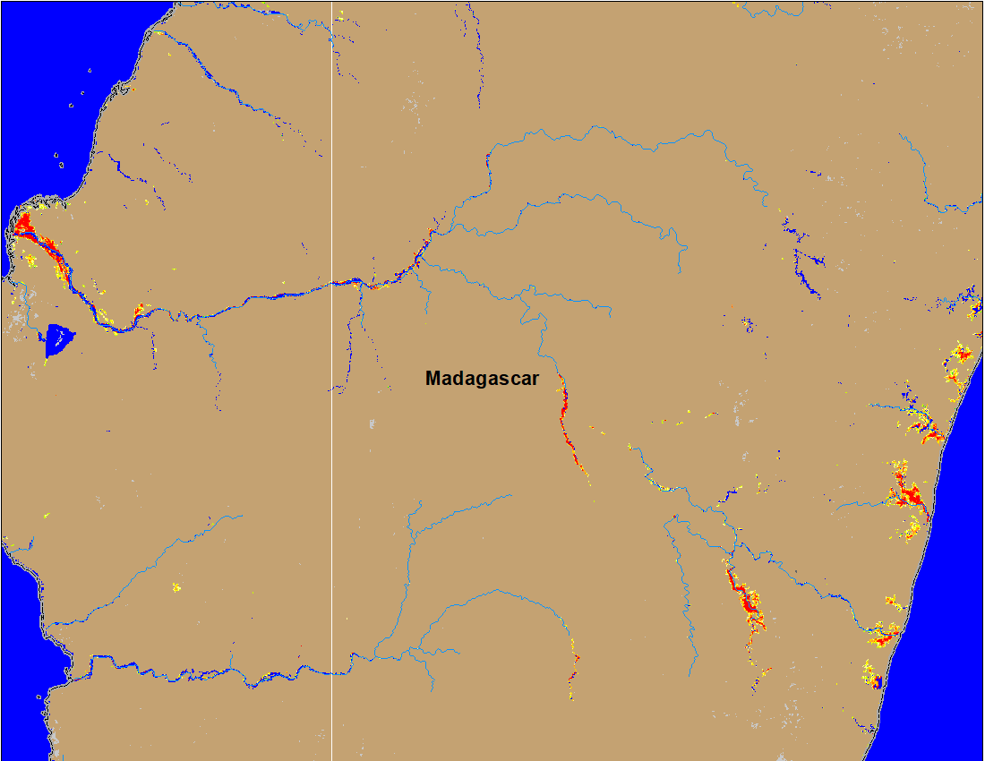
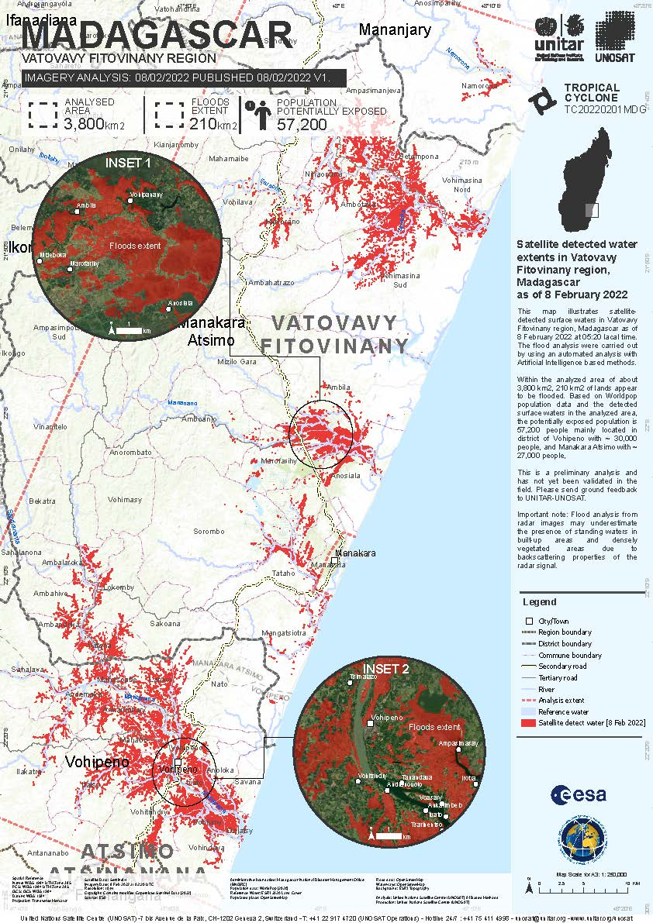
Flooding in Madagascar Caused by Tropical Cyclone Batsirai
(% of the pixel)
Sentinel 1: 8 Feb 2022 (Int. Charter)
NOAA VIIRS 5-Day composite: 8-12 Feb 2022
Sentinel 1: 8 Feb 2022 (Int. Charter)
TC Batsirai caused flooding mostly in southeastern Madagascar.

Slide 8
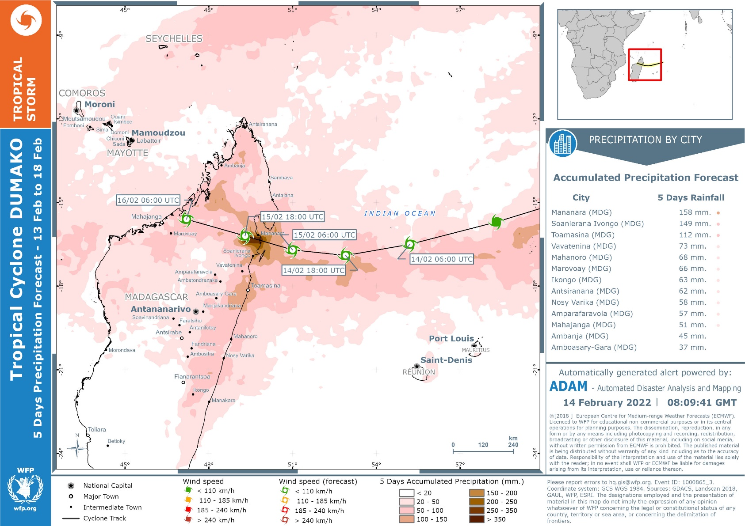
Another Tropical Cyclone is Brewing
Third Tropical Cyclone (Dumako), within less than a month, is expected to make landfall in Feb 15.
Rainfall up to 300 mm is expected over 5-day period mostly in the northern Madagascar.

Slide 9
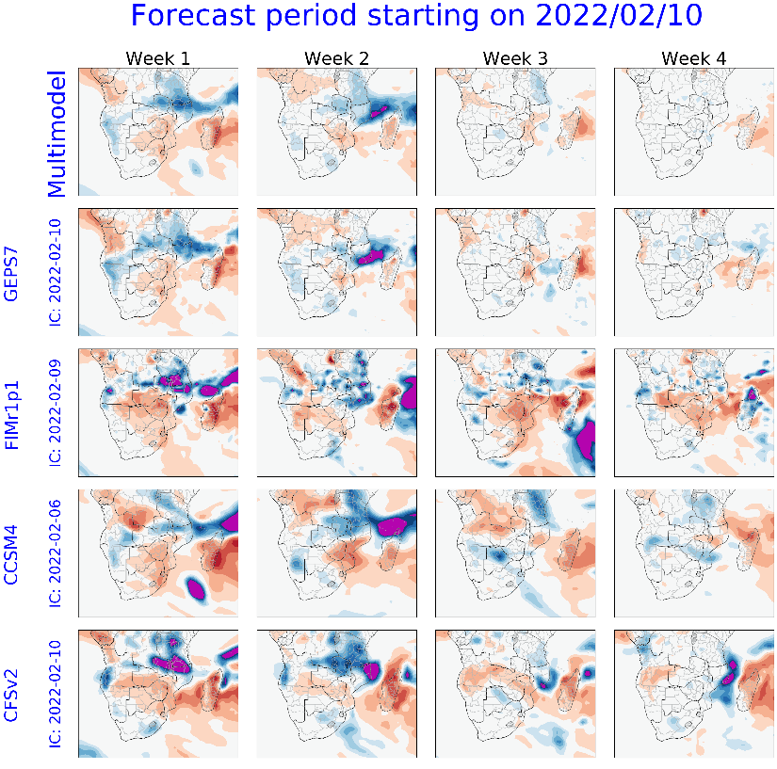
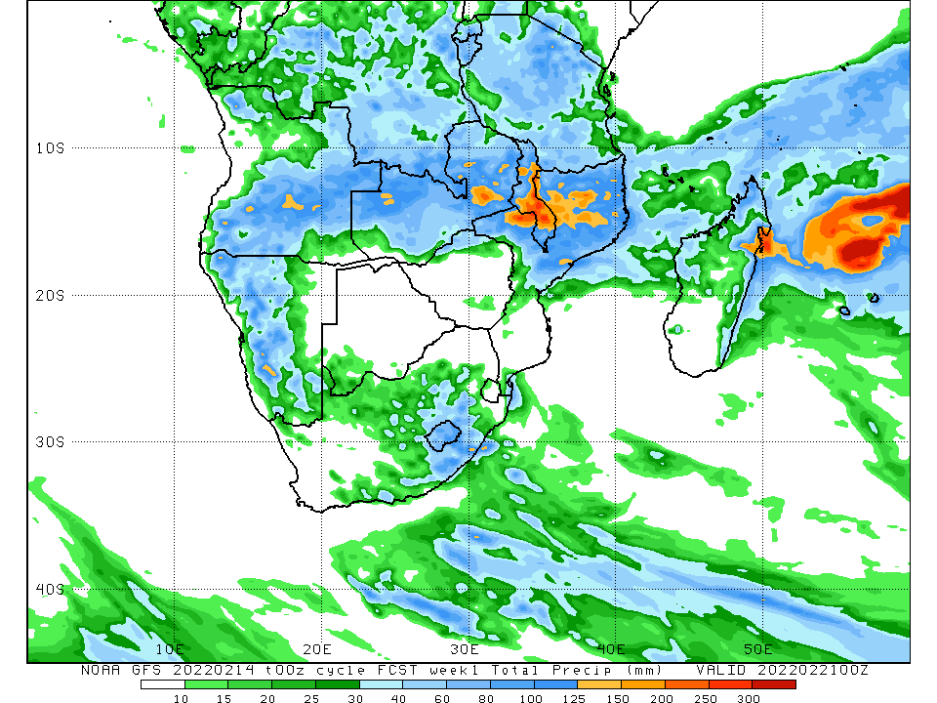
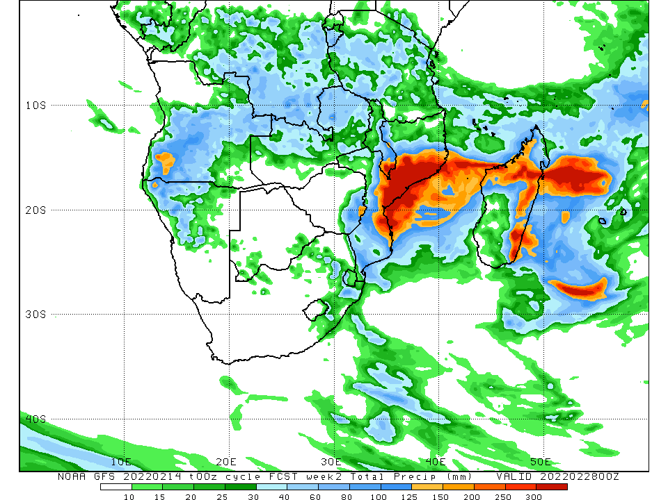
Short Term Rainfall Forecast
GFS week 1 ending on Feb 21
GFS week 2 ending on Feb 28
SubX forecast
Up to 250 mm of rainfall is expected over the flooded areas in Malawi, and in northeastern Madagascar by Feb 21, and another round of rainfall in excess of 300 mm is expected over the already saturated areas from TC Ana and Batsirai in Malawi, central Mozambique, and north and eastern Madagascar by Feb 28.
Retrieved flooded areas from TC Ana and Batsirai are expected to be flooded again.

Slide 10
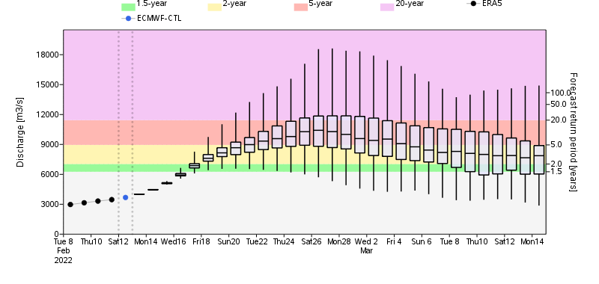
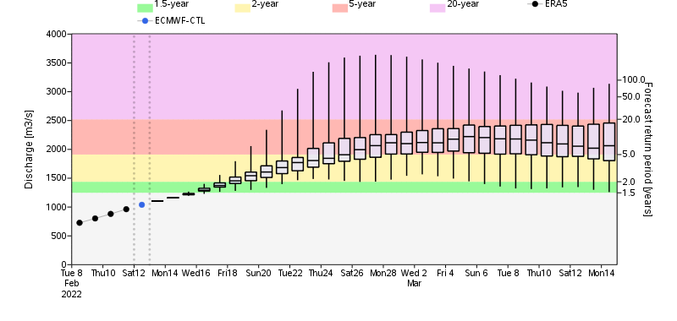
GloFAS Monthly Streamflow Forecast
Rio Livenda River, Mozambique/Tanzania
Discharges in many rivers in Zambia, Malawi, and Mozambique are expected to be between 2 and 5-yr return period levels by the end of February.
Zambezi River in Zambia

