Slide 1
FEWS NET Enhanced Flood Monitoring – East Africa, West Africa, southern Africa and Yemen
August 29, 2022, Hazard Briefing
FEWS NET Science Team:
USGS, NASA, NOAA, UCSB+Regional Scientists

Slide 2
Potential Flooding Polygons

Slide 3
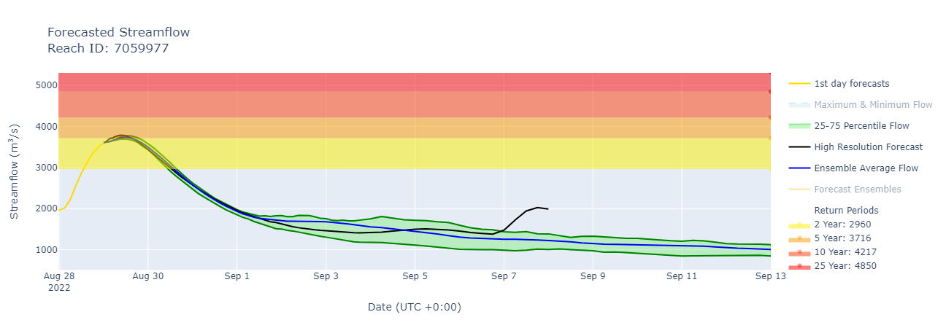
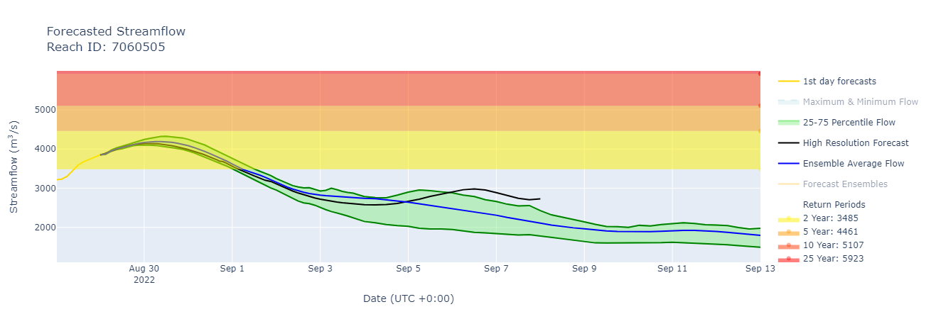
Expected Flooding in Libera
(% of the pixel)
Lofa River, Libera
Nianda River, Libera
GEOGloWS SF Forecast.: 30 Aug – 13 Sep 2022
GEOGloWS streamflow forecast 30 Aug to 13 Sep 2022
In response to decent rainfall forecast, coastal rivers in Sierra Leone and Liberia are expecting discharge at 2 to 5-yr return period level.

Slide 4
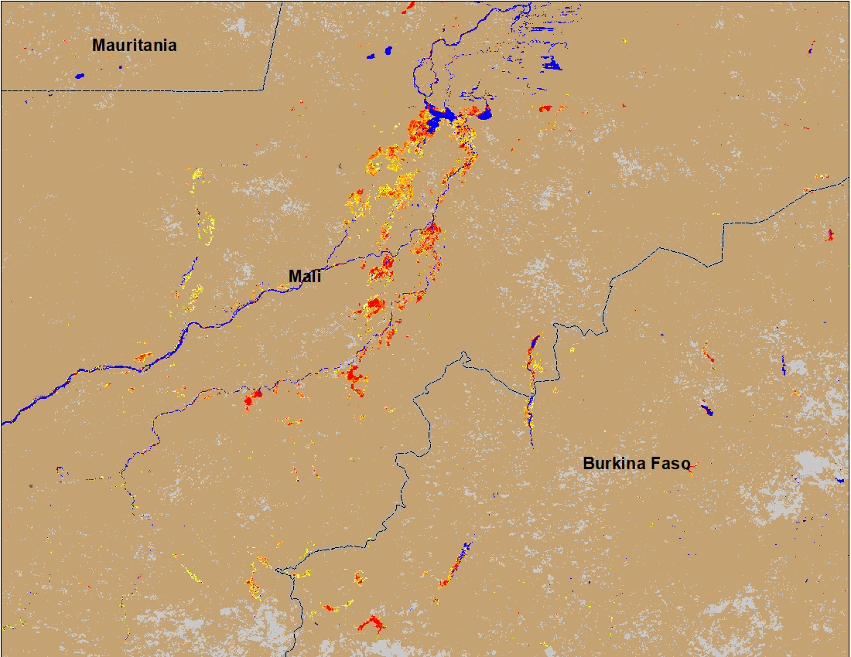
Flooding Conditions in Central Mali
(% of the pixel)
NOAA VIIRS 5-day comp.: 24-28 Aug 2022
ADAM Forecast: 1-in-20-yr Inundation forecast for next six days (until Sep 3)
With >100 mm of expected rainfall, 1-in-20-yr return period level inundation is expected in central Mali in the next six days.

Slide 5
Flooding Conditions in Burkina Faso
(% of the pixel)
NOAA VIIRS 5-day comp.: 24-28 Aug 2022
ADAM Forecast: 1-in-20-yr Inundation forecast for next six days (until Sep 3)
With >100 mm expected rainfall over western Burkina Faso, inundation is expected to be at 1-in-20-yr return period level in the six days.

Slide 6
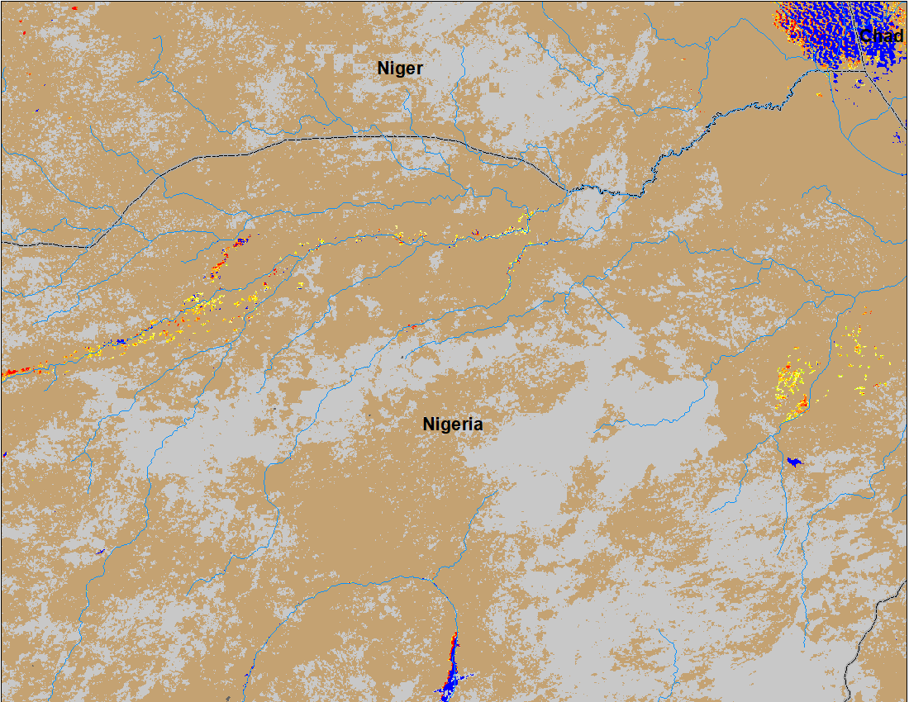
Flooding Conditions in Nigeria
(% of the pixel)
NOAA VIIRS 5-day comp.: 24-28 Aug 2022
ADAM Forecast: 1-in-20-yr Inundation forecast for next six days (until Sep 3)
Currently flooding is occurring along the Komadugu Rivers in northern Nigeria and in Adamawa State in eastern Nigeria.
But this is expected to change in next six days. Major flooding expected along Sokoto, komadugu, Niger and Benue Rivers

Slide 7
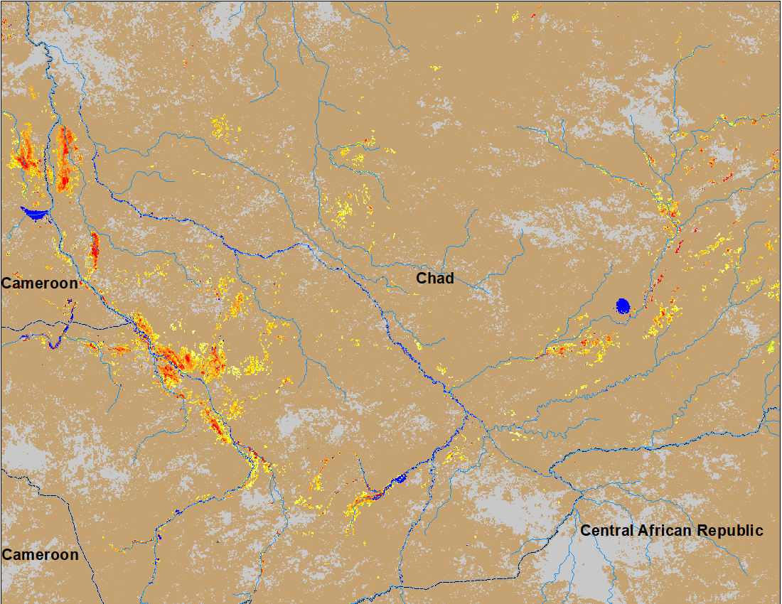
Flooding Conditions in Chad
(% of the pixel)
ADAM Forecast: 1-in-20-yr Inundation forecast for next six days (until Sep 3)
NOAA VIIRS 5-day comp.: 24-28 Aug 2022
New inundation along many rivers are expected in next six days in response to high rainfall forecast.

Slide 8
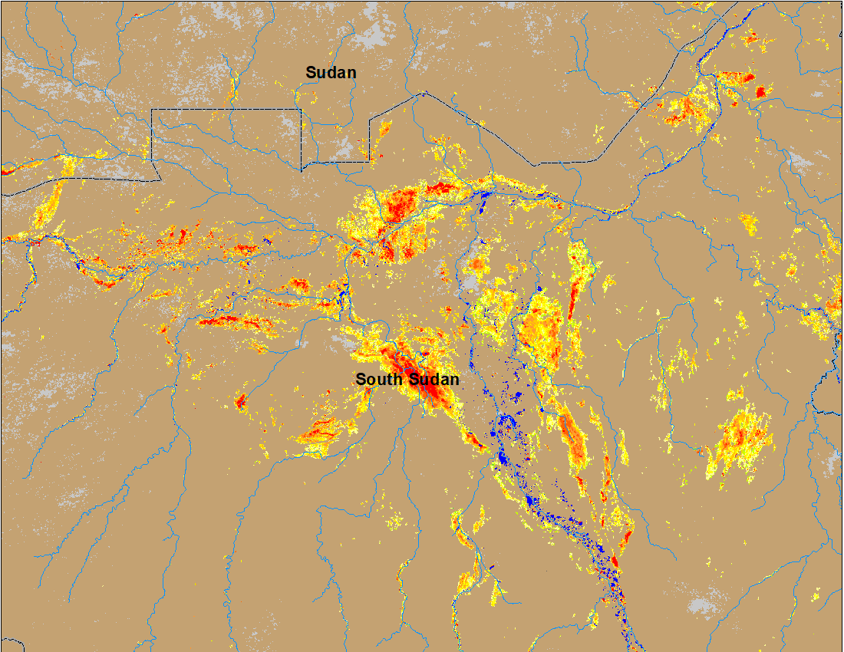
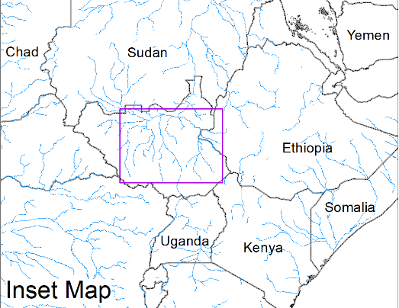
Inundation in the Sudd Wetlands
(% of the pixel)
(% of the pixel)
Northern Sudd Wetlands
Northern Sudd Wetlands
Sobet River
Akobo River
Pibor River
ADAM Flood event: 24 Aug 2022
NOAA VIIRS 5-day comp.: 24-28 Aug 2022
Flooding conditions worsen in South Sudan and in Sudan with newly inundated areas along Sobet and Akobo Rivers in South Sudan and along the Nile in Southern Darfur and eastern Sudan.

Slide 9
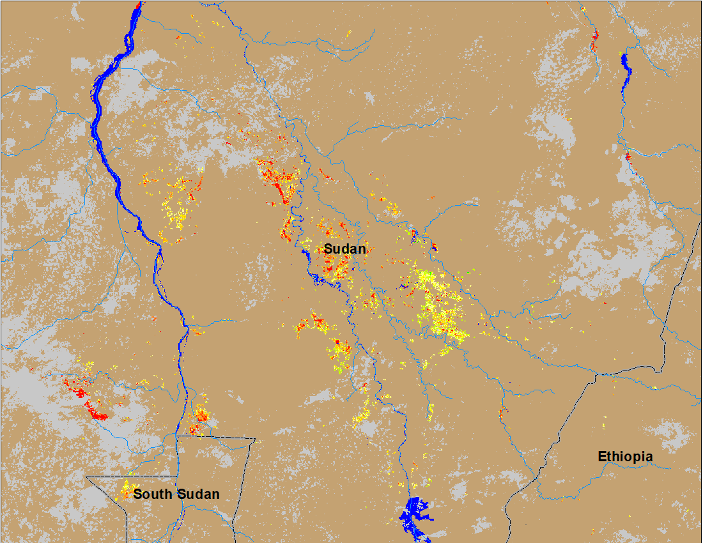
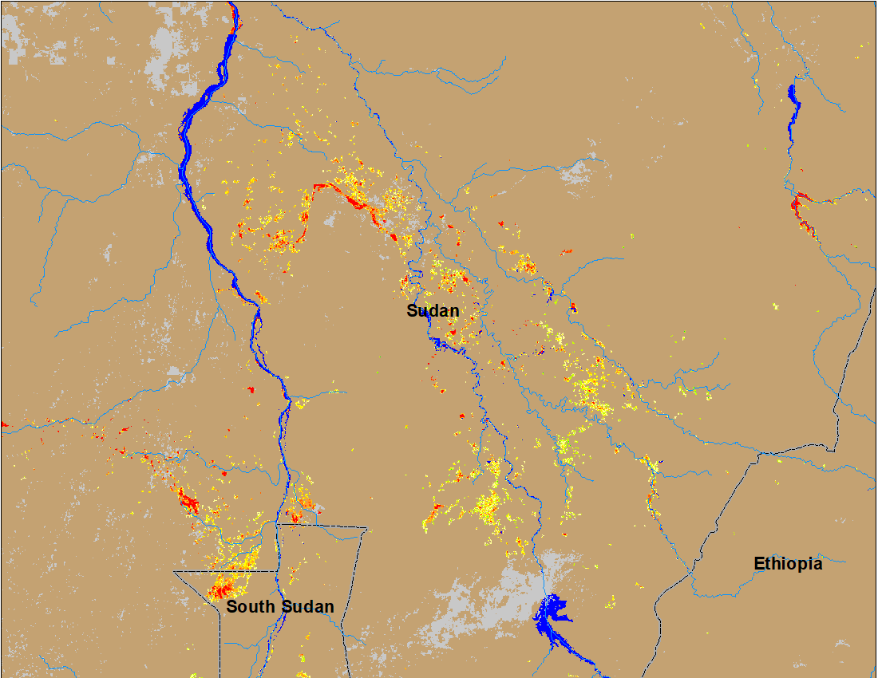
Inundation in Eastern Sudan
(% of the pixel)
(% of the pixel)
NOAA VIIRS 5-day composite: 17-21 Aug 2022
NOAA VIIRS 5-day comp.: 24-28 Aug 2022
Flooding in the Blue Nile also spreading over new areas.

Slide 10
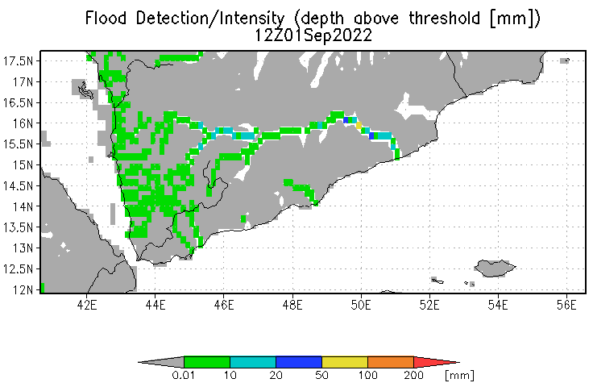
Inundation in Yemen
Flooding is expected along the western and central Wadis in Yemen.
UMD depth above threshold map: Valid for Sep 01, 2022

