Slide 1
FEWS NET Enhanced Flood Monitoring – East Africa, West Africa, southern Africa and Yemen
August 22, 2022, Hazard Briefing
FEWS NET Science Team:
USGS, NASA, NOAA, UCSB+Regional Scientists

Slide 2
Potential Flooding Polygons

Slide 3
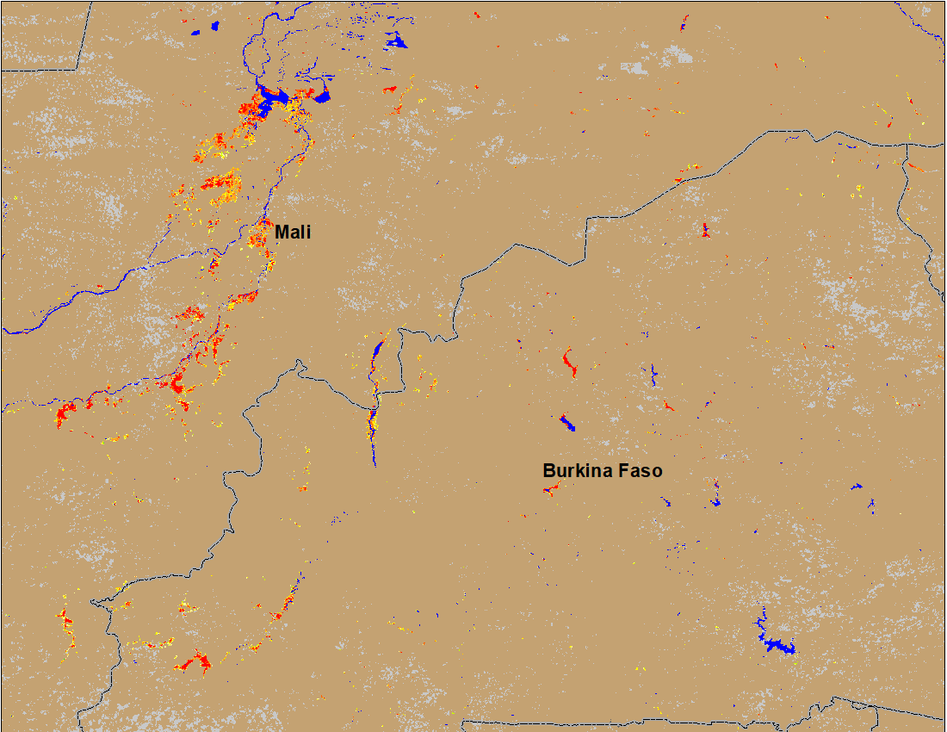
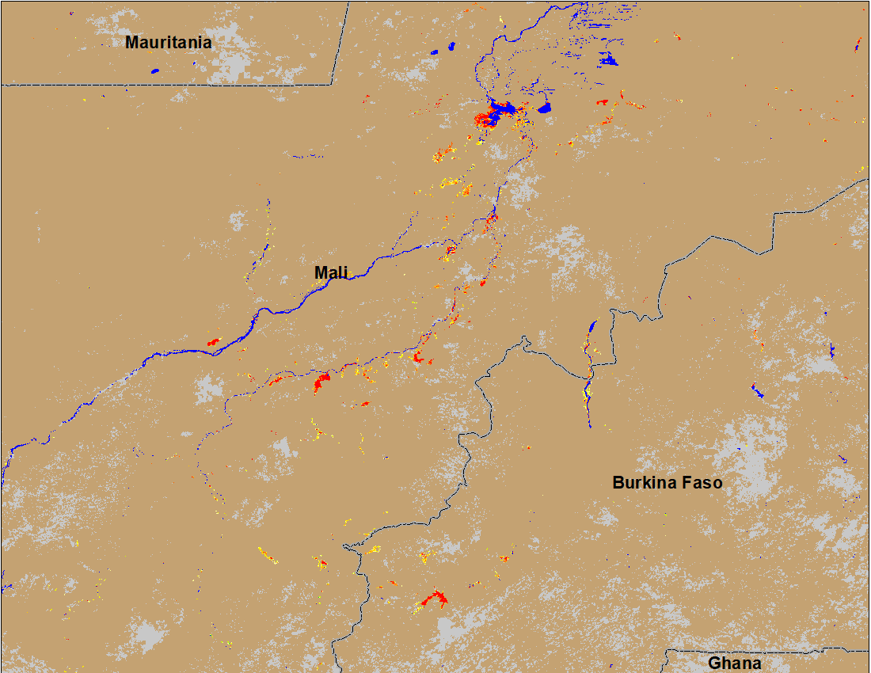
Flooding Conditions in Central Mali
(% of the pixel)
(% of the pixel)
NOAA VIIRS 5-day comp.: 9-13 Aug 2022
NOAA VIIRS 5-day comp.: 17-21 Aug 2022
Flooding conditions worsen in central Mali with newly flooded areas in Burkina Faso.

Slide 4
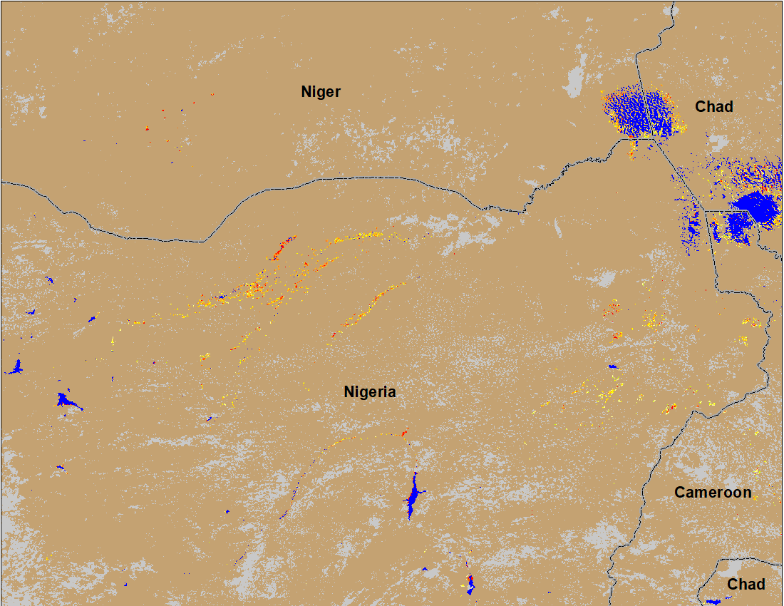
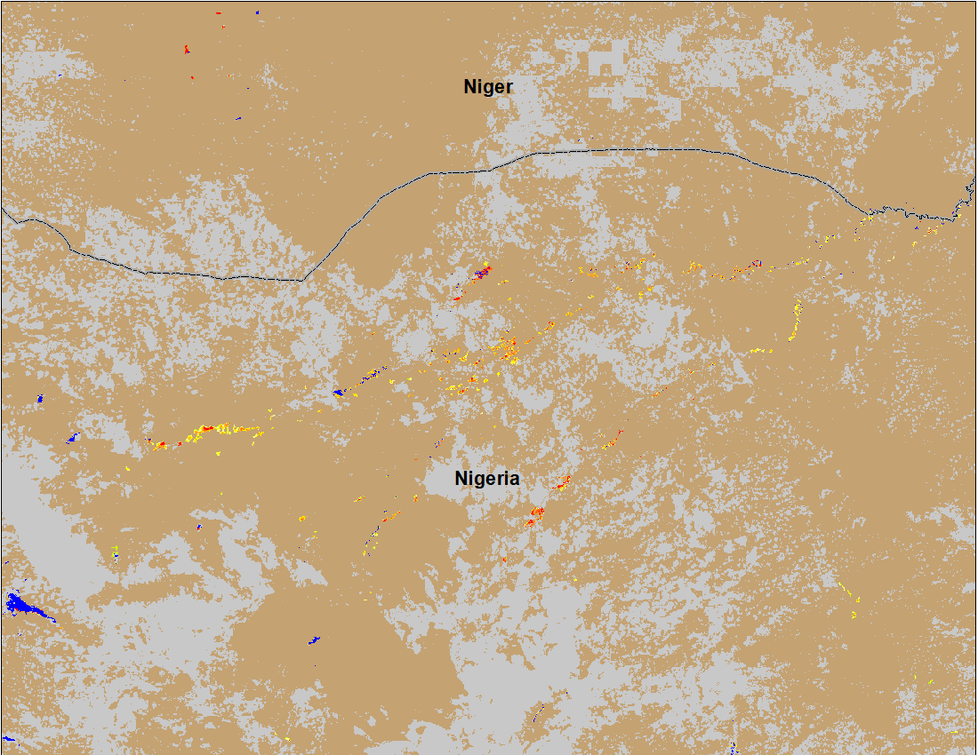
Flooding Conditions in Nigeria
(% of the pixel)
(% of the pixel)
NOAA VIIRS 5-day comp.: 9-13 Aug 2022
NOAA VIIRS 5-day comp.: 17-21 Aug 2022
Flooding conditions have improved both along Sokoto and Komadugu Rivers in northern Nigeria.

Slide 5
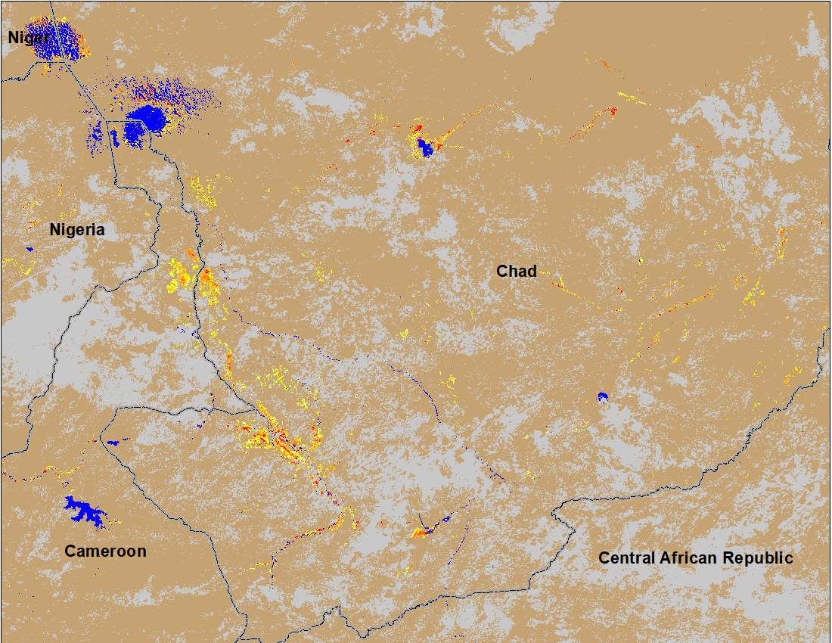
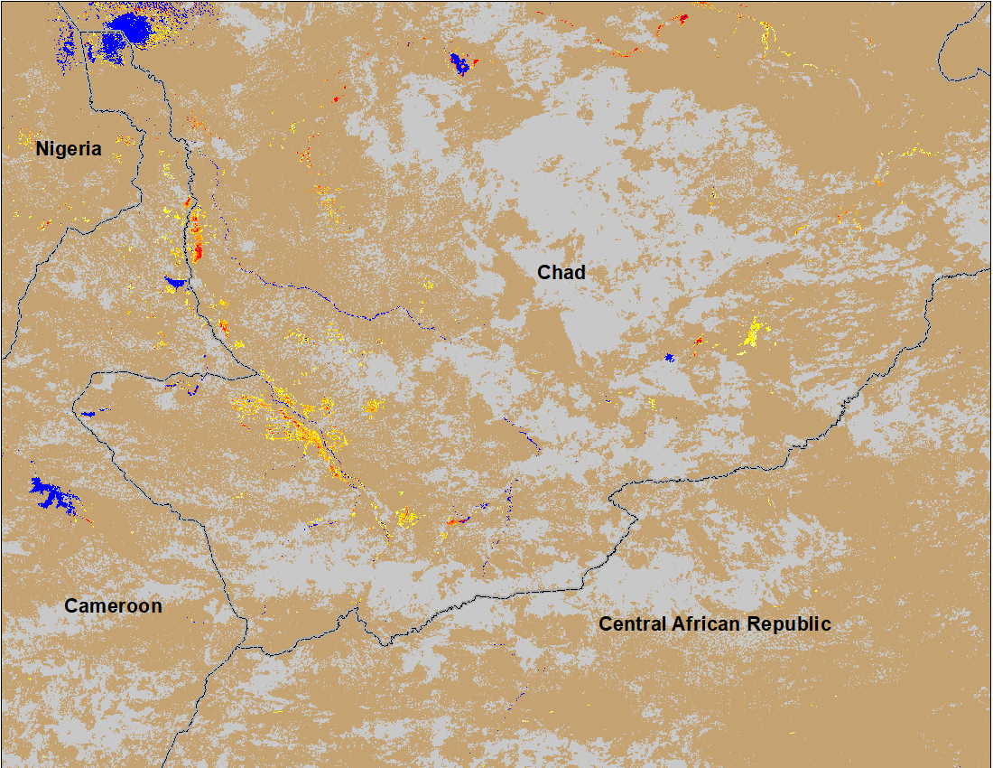
Flooding Conditions in Chad
(% of the pixel)
(% of the pixel)
NOAA VIIRS 5-day comp.: 9-13 Aug 2022
NOAA VIIRS 5-day comp.: 17-21 Aug 2022
Flooding conditions worsen in southern Chad.

Slide 6
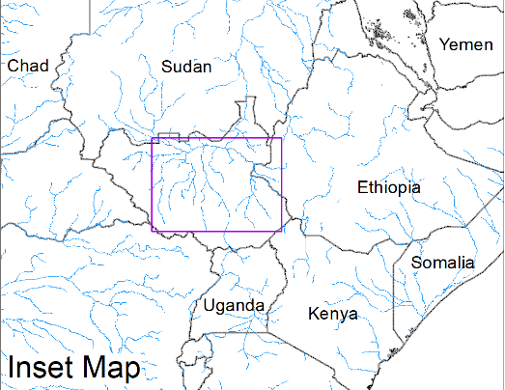
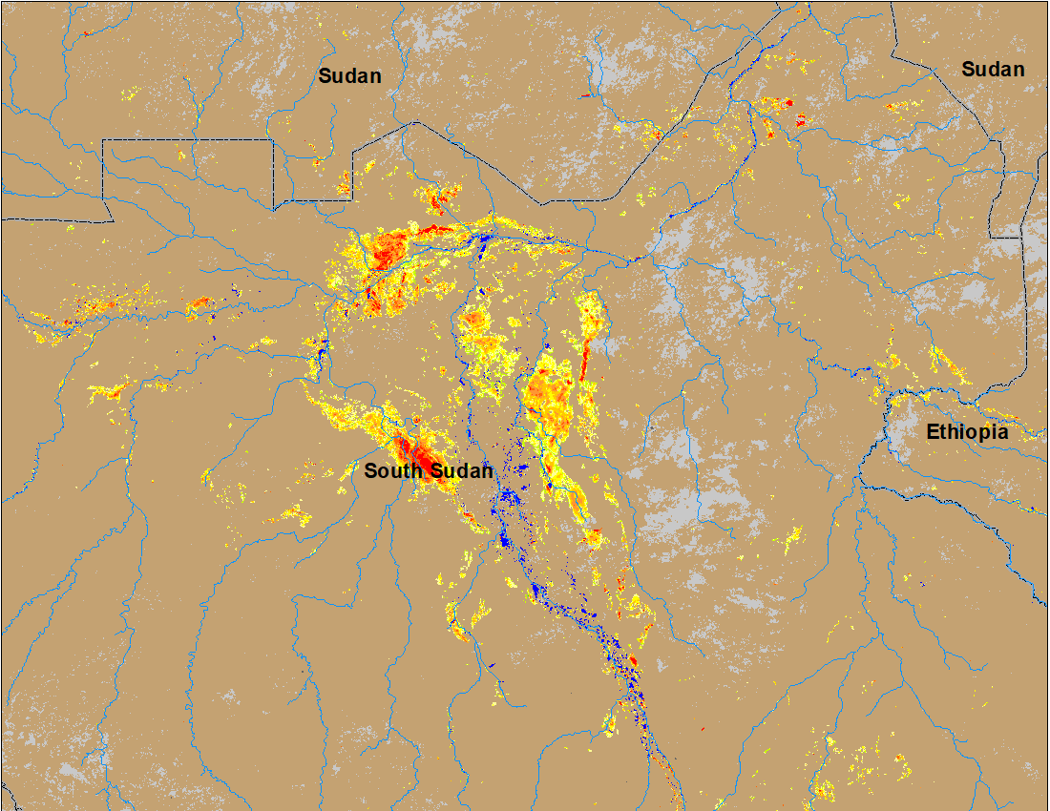
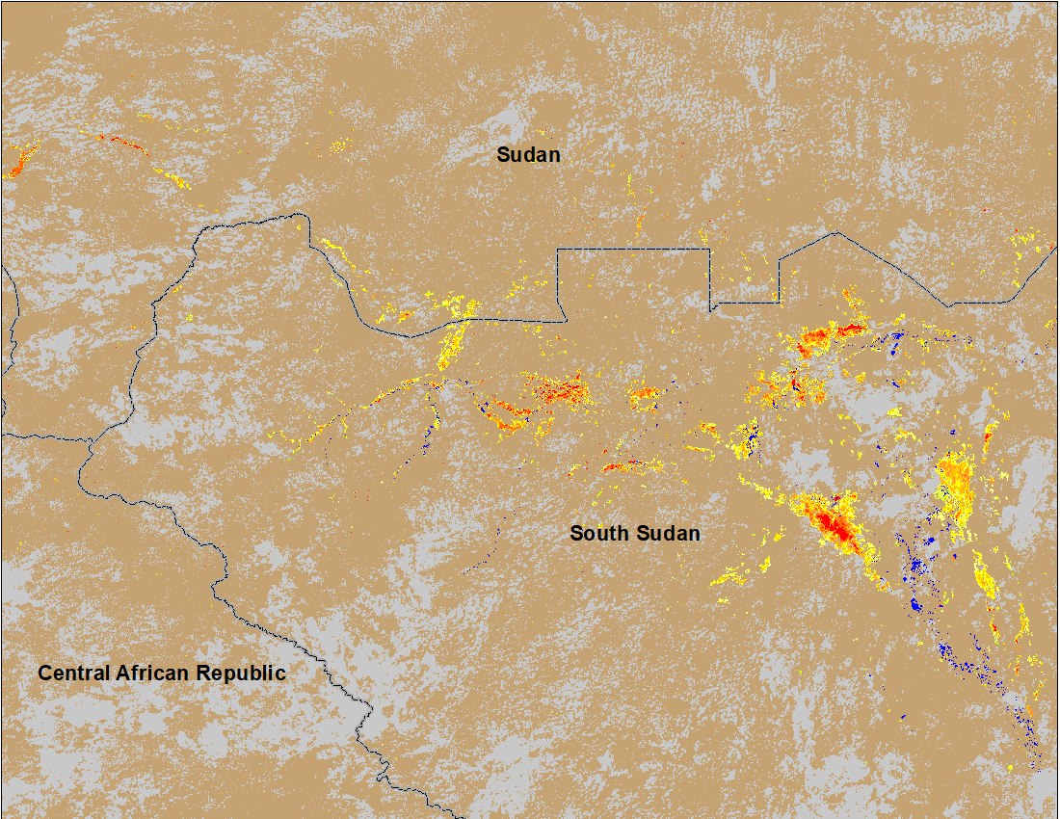
Inundation in the Sudd Wetlands
(% of the pixel)
(% of the pixel)
Northern Sudd Wetlands
Northern Sudd Wetlands
Sobet River
Akobo River
Pibor River
NOAA VIIRS 5-day composite: 3 - 7 Aug 2022
NOAA VIIRS 5-day comp.: 17-21 Aug 2022
Flooding conditions worsen in South Sudan with newly inundated areas in the northwestern South Sudan.

Slide 7
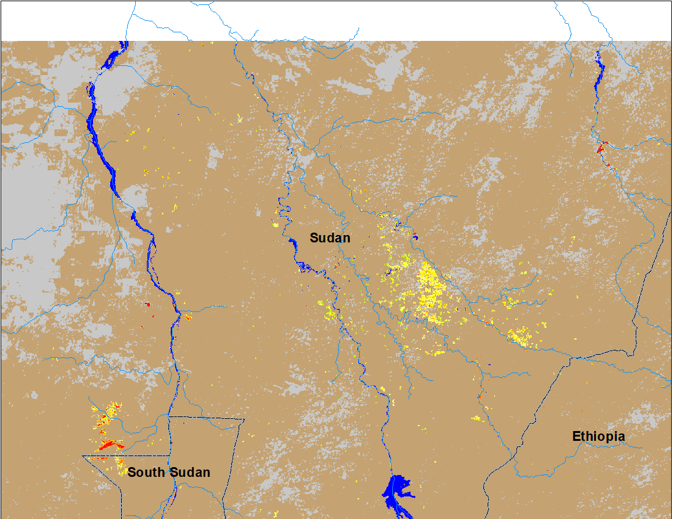
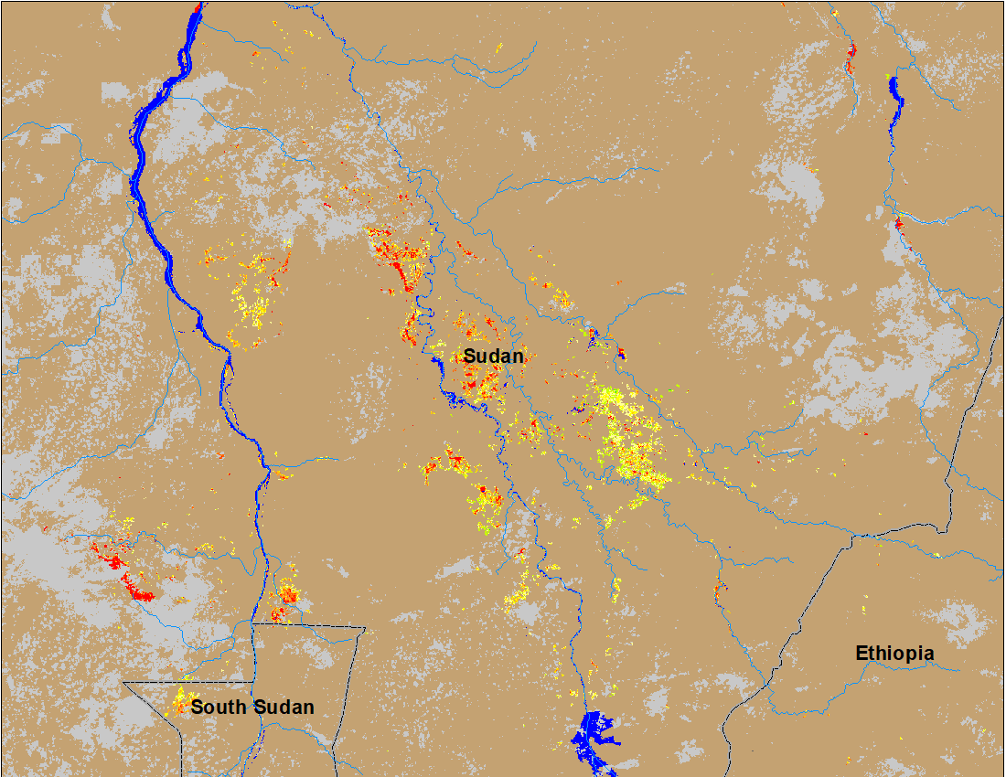
Inundation in Eastern Sudan
(% of the pixel)
(% of the pixel)
NOAA VIIRS 5-day composite: 3 - 7 Aug 2022
NOAA VIIRS 5-day comp.: 17-21 Aug 2022
Flooding conditions worsen in eastern Sudan with newly flooded areas along both White and Blue Nile Rivers.

Slide 8
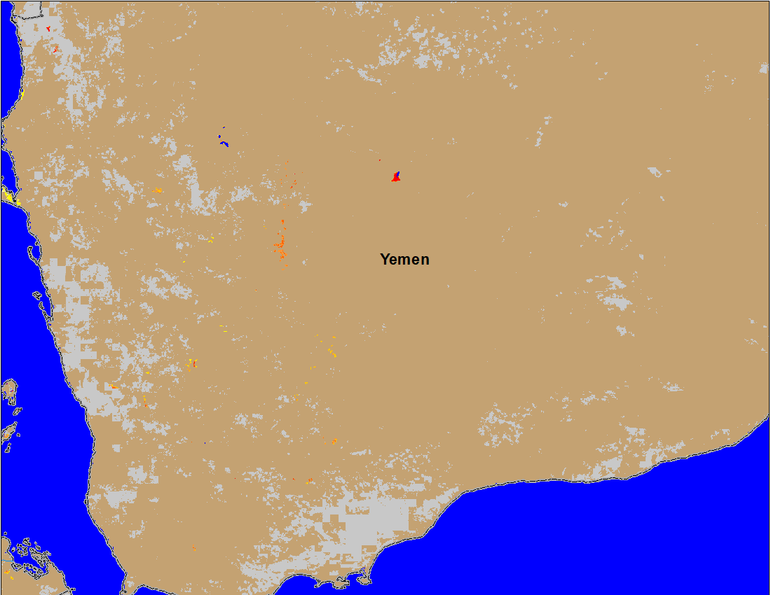
Inundation in Yemen
(% of the pixel)
NOAA VIIRS 5-day comp.: 17-21 Aug 2022
Flooding in the western and southwestern Wadis in Yemen.

