Slide 1
FEWS NET Enhanced Flood Monitoring – East Africa, West Africa, southern Africa and Yemen
August 15, 2022, Hazard Briefing
FEWS NET Science Team:
USGS, NASA, NOAA, UCSB+Regional Scientists

Slide 2
Potential Flooding Polygons

Slide 3
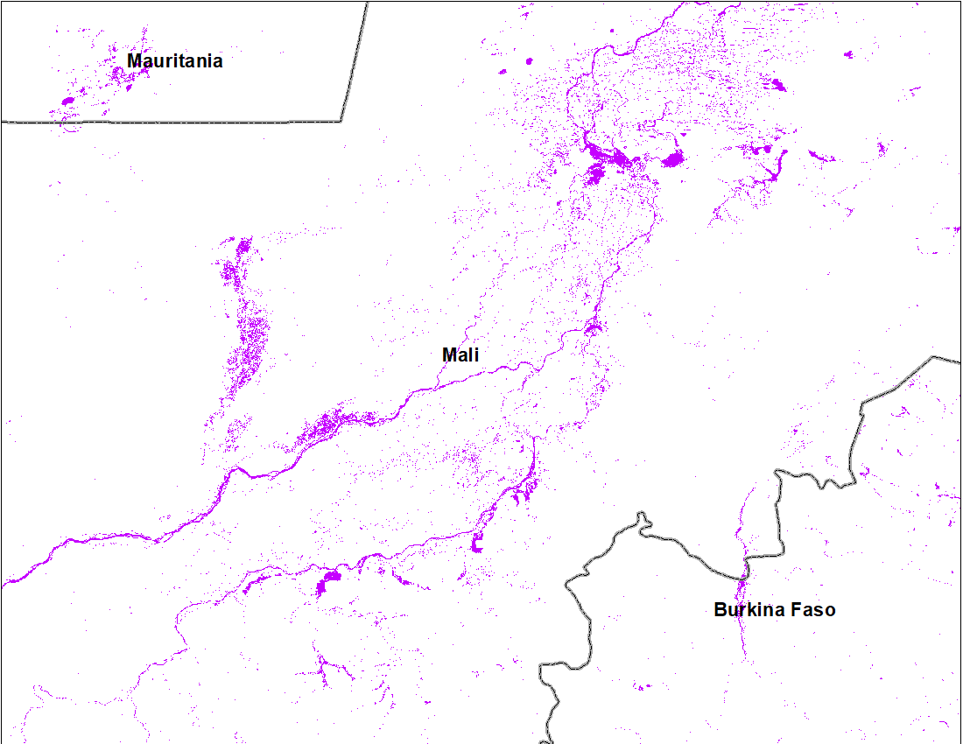
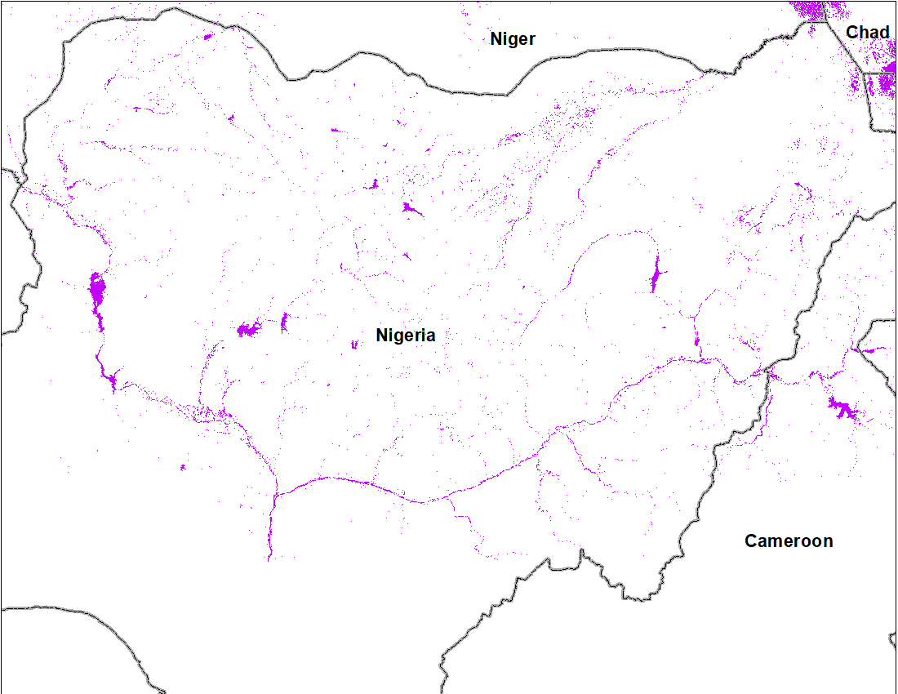
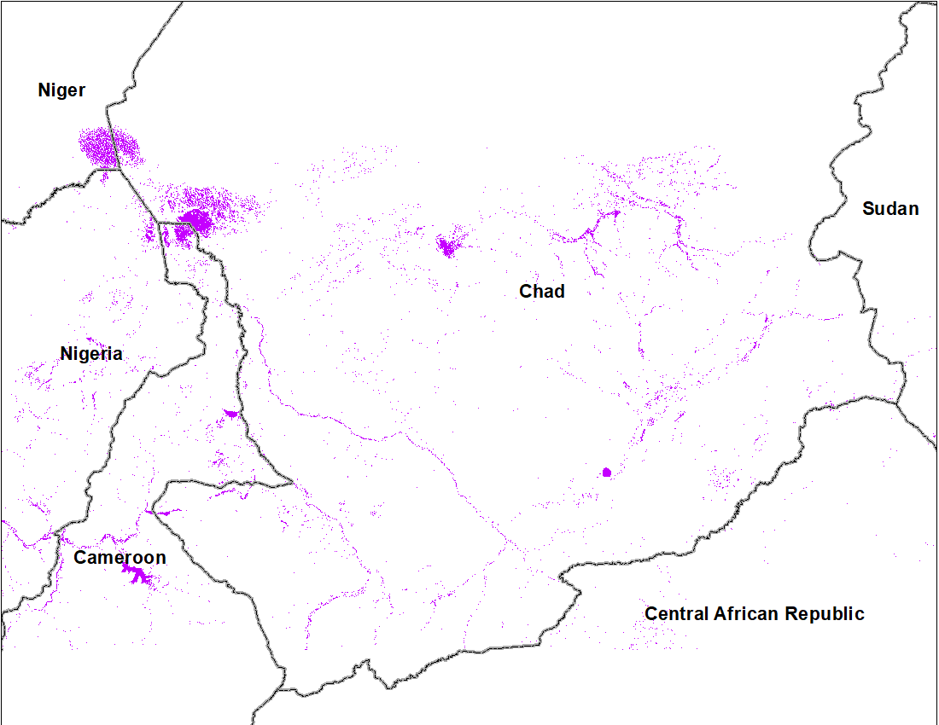
July Flooding Conditions in West Africa
Central Mali
Northern Nigeria
Southern Chad
Cloud to Street flood map: July 2022
Inundated area
Flooding began in July especially along the Niger River in central Mali, along the Sokoto and Komadugu Rivers in northern Nigeria, and along the rivers in southern Chad.

Slide 4
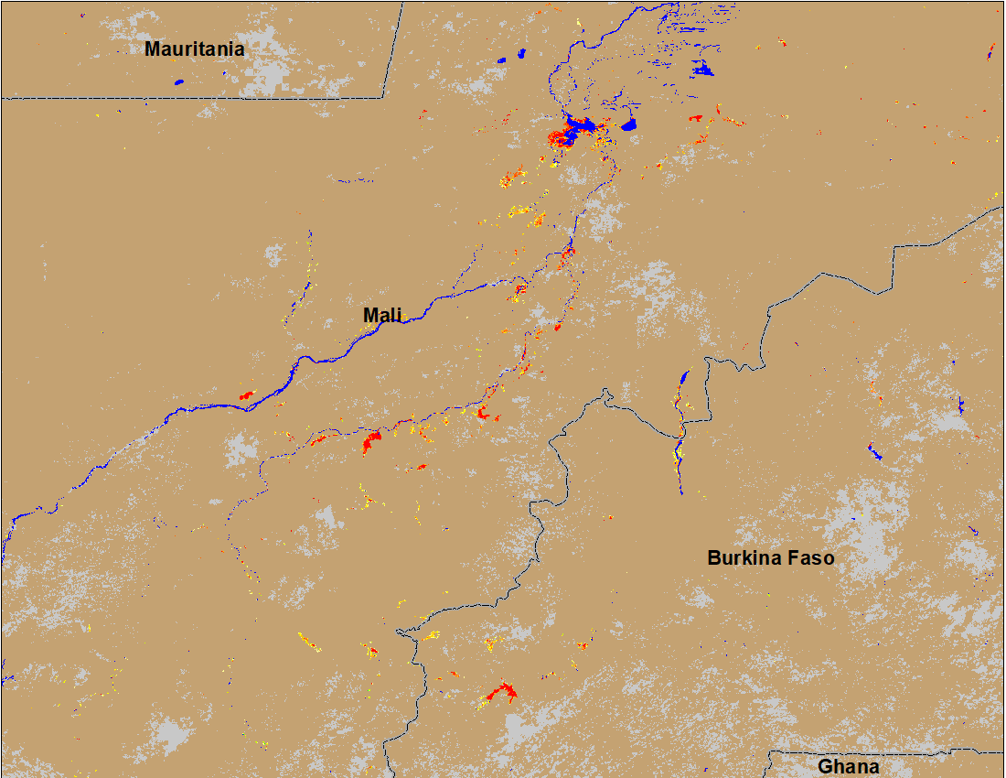
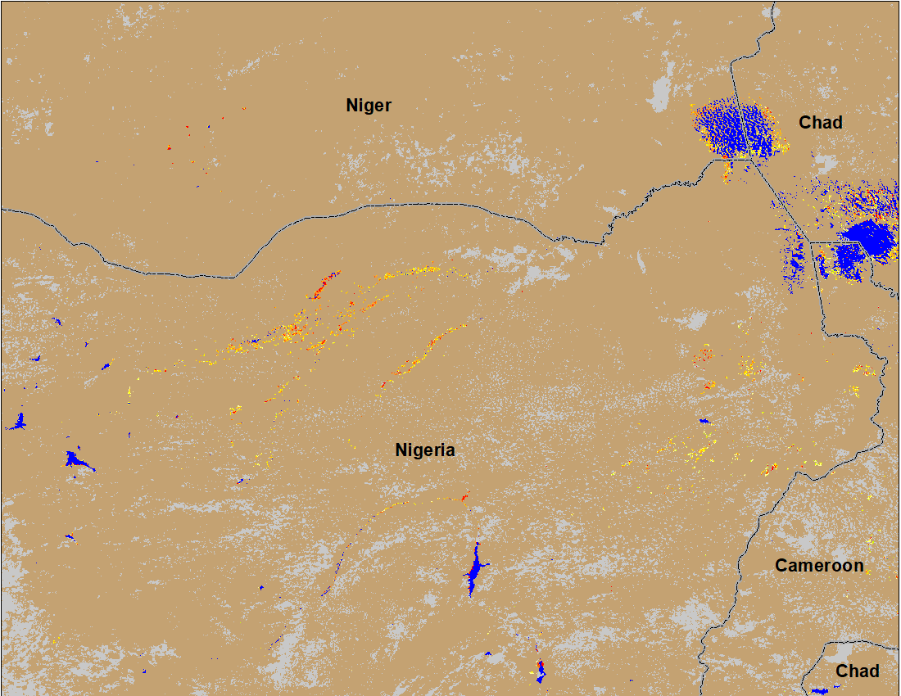
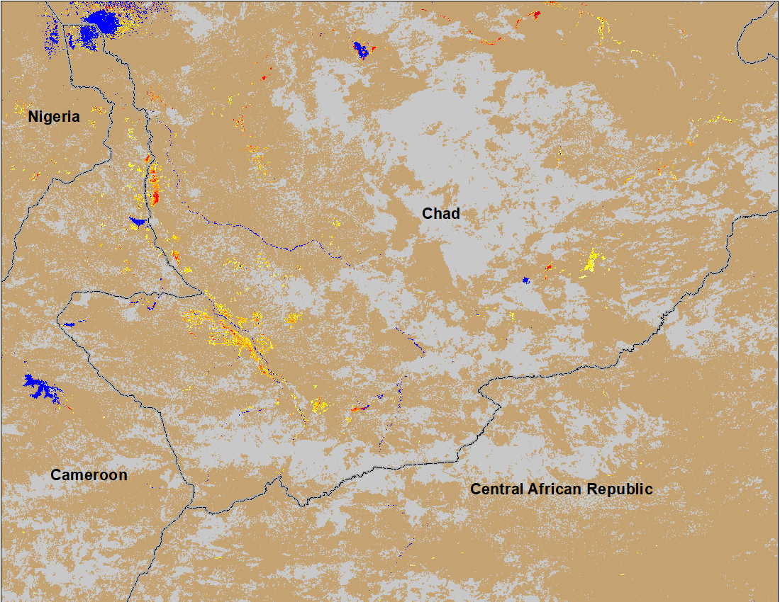
Recent Flooding Conditions
(% of the pixel)
(% of the pixel)
(% of the pixel)
Central Mali
Northern Nigeria
Southern Chad
NOAA VIIRS 5-day comp.: 9-13 Aug 2022
While flooding conditions improved in central Mali since July, the conditions worsen in Komadugu River in northeastern Nigeria, and in southern Chad.

Slide 5
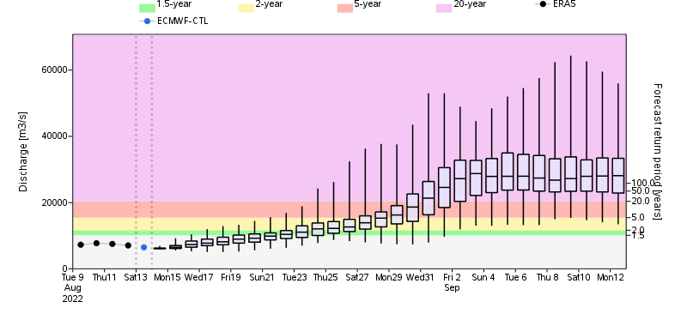
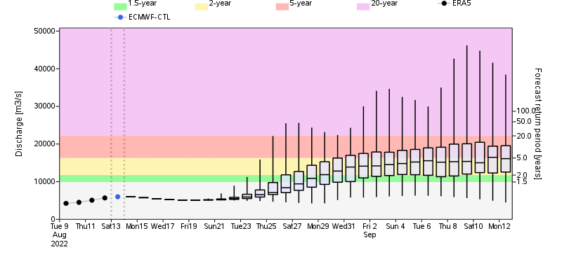
GloFAS Monthly Streamflow Forecast
GloFAS 30-day streamflow forecast (Aug 13 – Sep 12)
@ Point A: Niger River in Nigeria
B
A
> 20% probability of
@ Point B: River in Senegal
1-in-20yr RP discharge
1-in-5yr RP discharge
1-in-2yr RP discharge
Streamflow across Sahel is on the rise. Rivers in Senegal to southern Mali are expected to have between 2 to 5-yr RP level flow.
While the rivers from central Mail to southern Chad can potentially rise to 20-yr RP level in early September.
GloFAS 30-day streamflow forecast (Aug 13 – Sep 12, 2022)

Slide 6
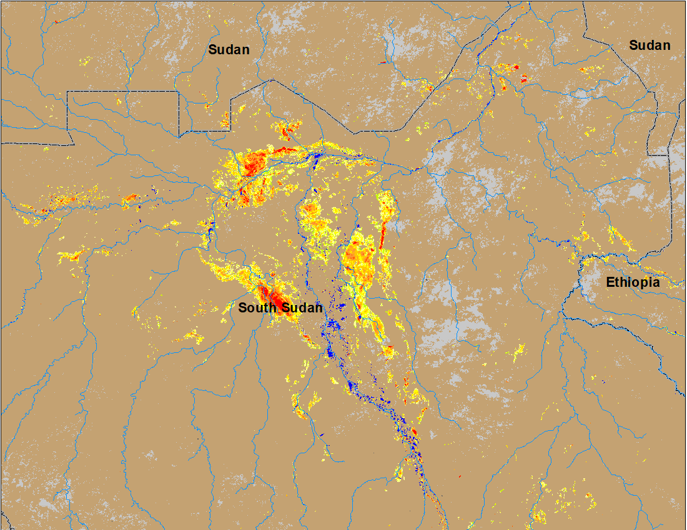
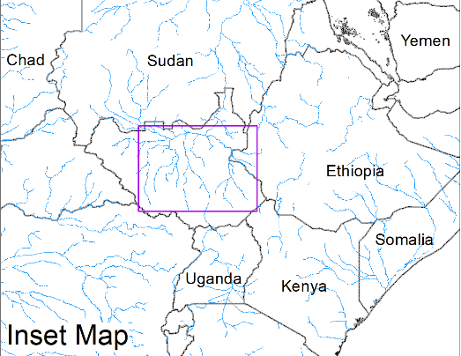
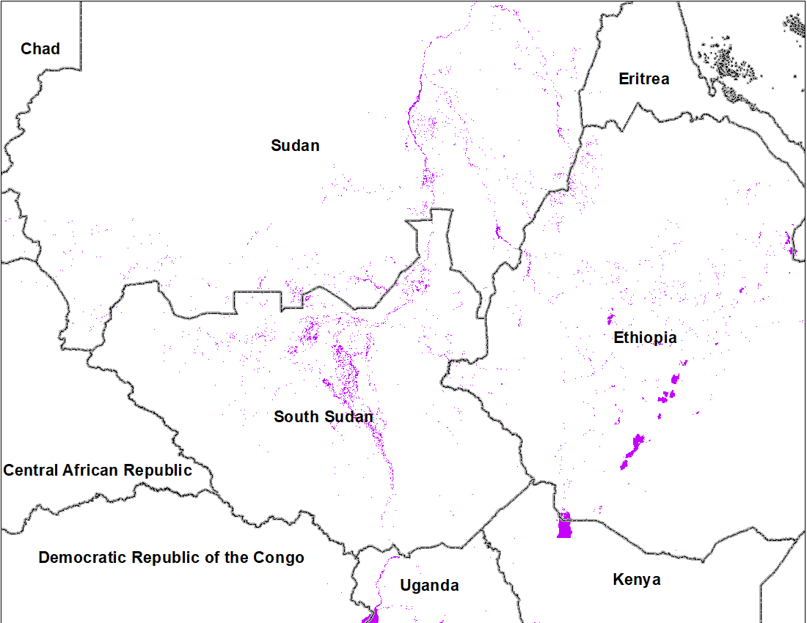
Inundation in the Sudd Wetlands
(% of the pixel)
(% of the pixel)
Northern Sudd Wetlands
Northern Sudd Wetlands
Sobet River
Sobet River
Akobo River
Akobo River
Pibor River
Pibor River
Inundated area
NOAA VIIRS 5-day composite: 3 - 7 Aug 2022
Cloud to Street flood map: July 2022
Inundation gradually increasing in the Sudd Wetlands including in the catchments of Akobo and Pibor Rivers.

Slide 7
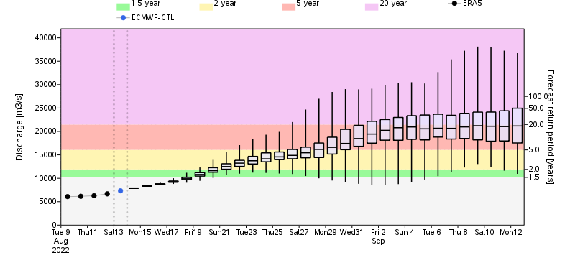
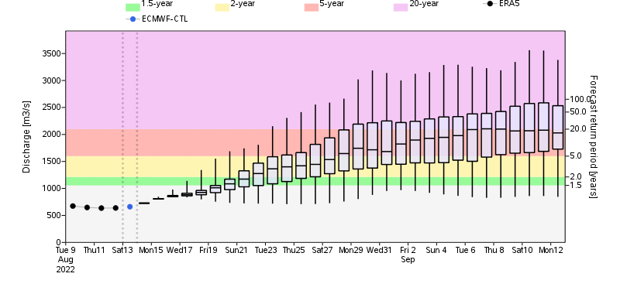
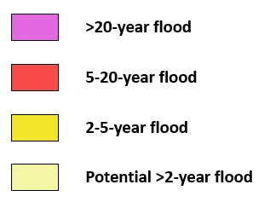
GloFAS Monthly Streamflow Forecast
GloFAS 30-day streamflow forecast (Aug 13 – Sep 12)
@ Point A: White Nile
B
@ Point B: Blue Nile
A
Flooding risk is very high (1-in-20-yr RP level) in the catchments of White Nile, Blue Nile and Atbara Rivers in late August early September.
GloFAS 30-day streamflow forecast (Aug 13 – Sep 12, 2022)

Slide 8
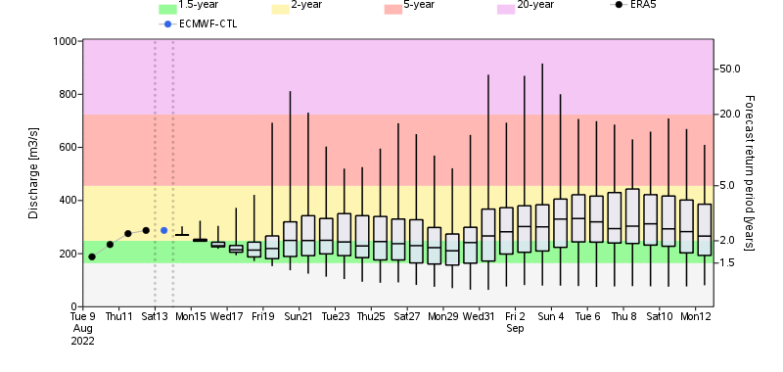
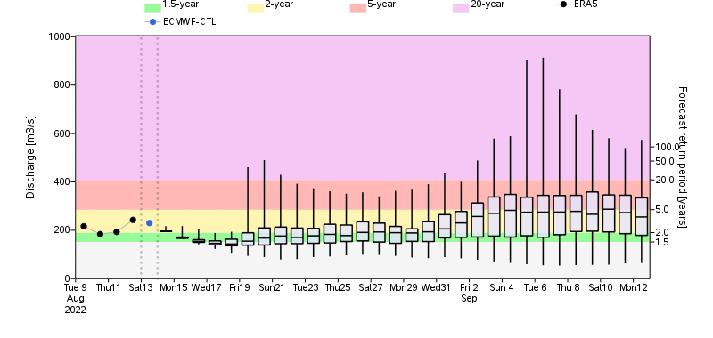
GloFAS Monthly Streamflow Forecast (Yemen)
@ Point A
A
B
@ Point B
GloFAS 30-day streamflow forecast (Aug 13 – Sep 12, 2022)
Western Wadis in Yemen are expected to have streamflow at 1-in-2-year RP level in late August to early September.

