Slide 1
FEWS NET Enhanced Flood Monitoring – East Africa, West Africa, southern Africa and Yemen
August 08, 2022, Hazard Briefing
FEWS NET Science Team:
USGS, NASA, NOAA, UCSB+Regional Scientists

Slide 2
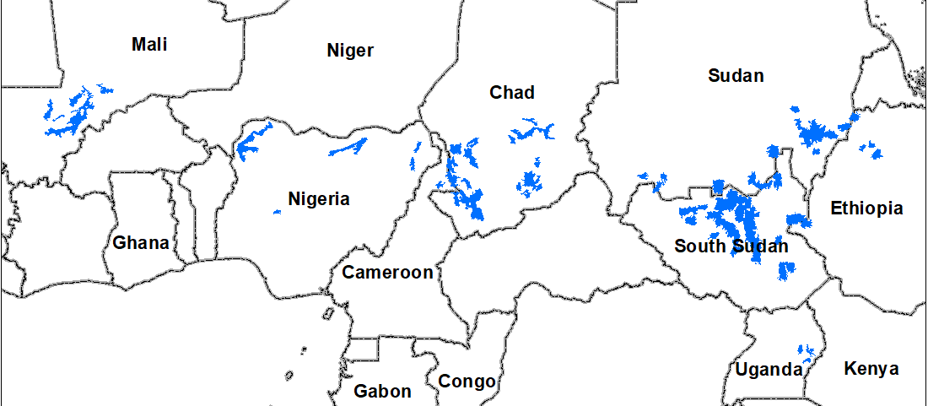
Potential Flooding Polygons

Slide 3
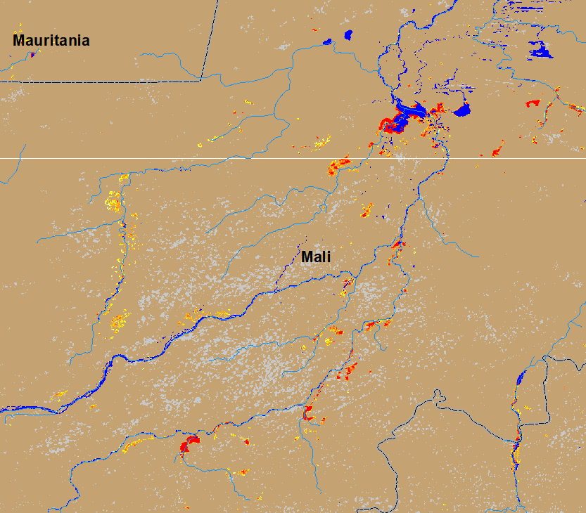
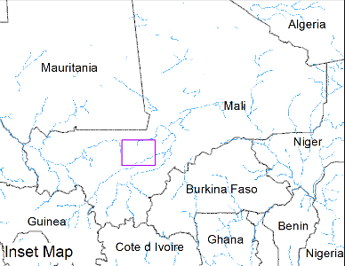
Flooding Along Niger River in Central Mali
(% of the pixel)
NOAA VIIRS 5-day composite: 3 - 7 August 2022
ADAM Flood Event : 08 August 2022
Flooding gradually occurring along the Niger River in Central Mali.

Slide 4
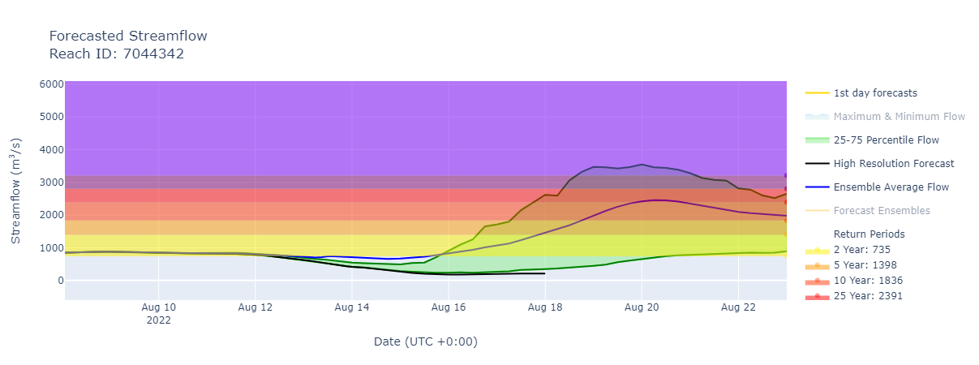
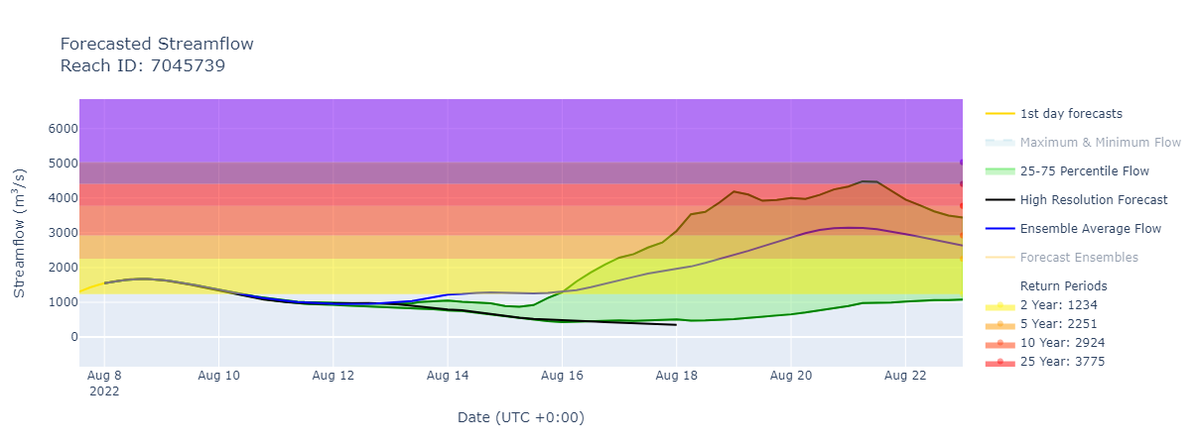
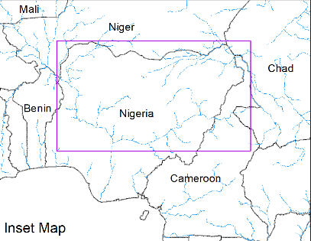
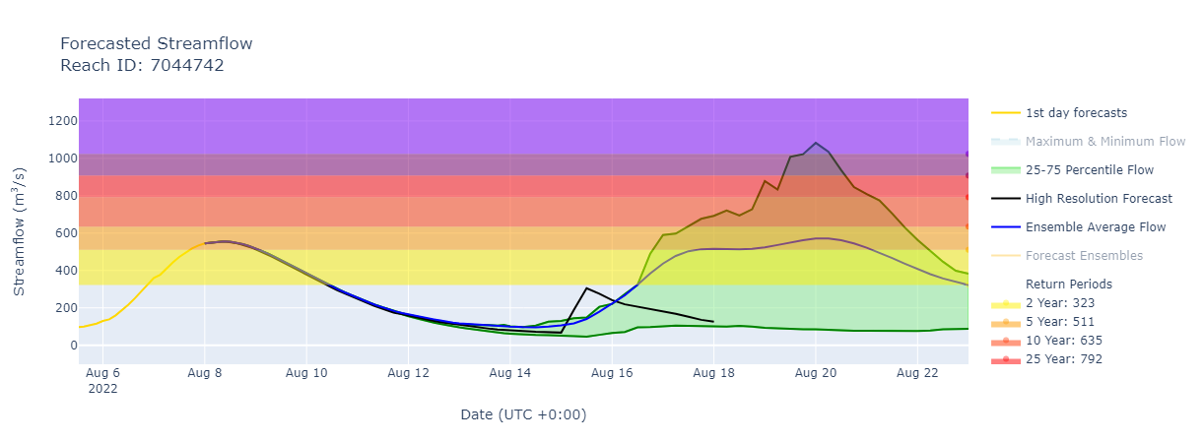
Flooding Expected in Northern Nigeria
A: Sokoto River (expected discharge 1-in-10yr RP)
A
B
C
B: Zamfara River (expected discharge 1-in-10yr RP)
GEOGloWS Streamflow forecast 8-22 Aug 2022
C: Upstream Komadugu River (expected discharge 1-in-5yr RP)
1-in-10yr RP discharge is expected in Sokoto River, and 1-in-5yr RP discharge is expected in upstream Komadugu River by August 20.

Slide 5
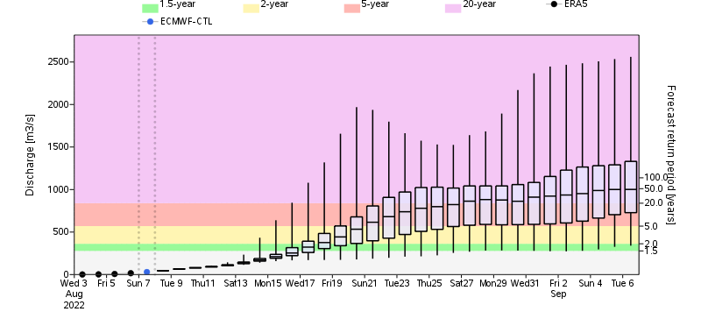
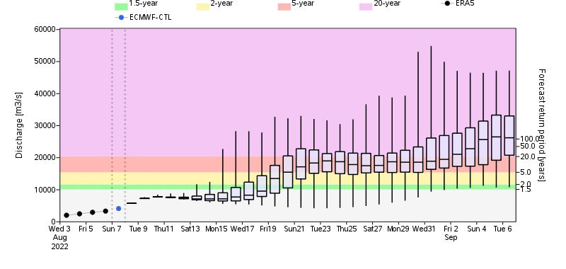
1-in-20yr RP Discharge Possible During Late Aug Early Sep
Upstream Komadugu River
Niger River
> 20% probability of
1-in-20yr RP discharge
1-in-5yr RP discharge
1-in-2yr RP discharge
GloFAS monthly streamflow forecast: 7 Aug – 6 Sep

Slide 6
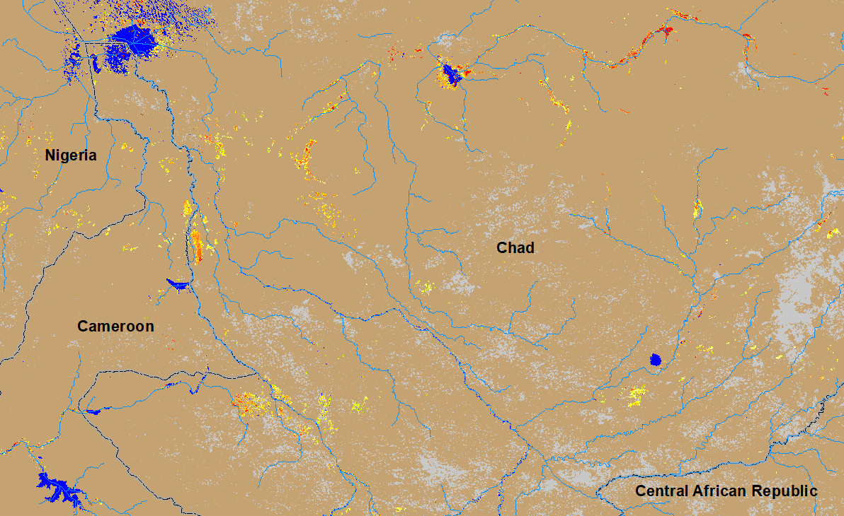
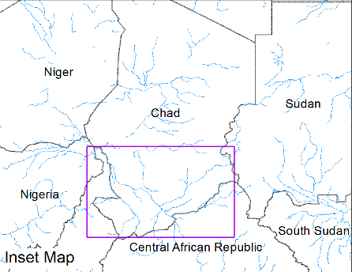
Flooding in Chad
(% of the pixel)
> 20% probability of
1-in-20yr RP discharge
1-in-5yr RP discharge
1-in-2yr RP discharge
NOAA VIIRS 5-day composite: 3-7 Aug 2022
GloFAS monthly streamflow forecast 7 Aug-6 Sep
Inundation is gradually increasing with expected 1-in-5yr RP discharge especially along the rivers in southern Chad in next 30 days.

Slide 7
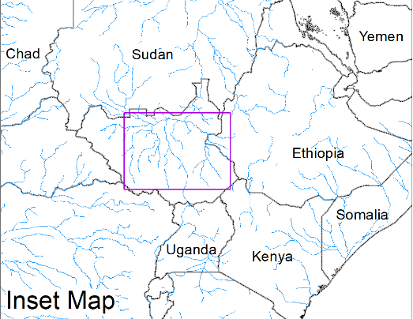
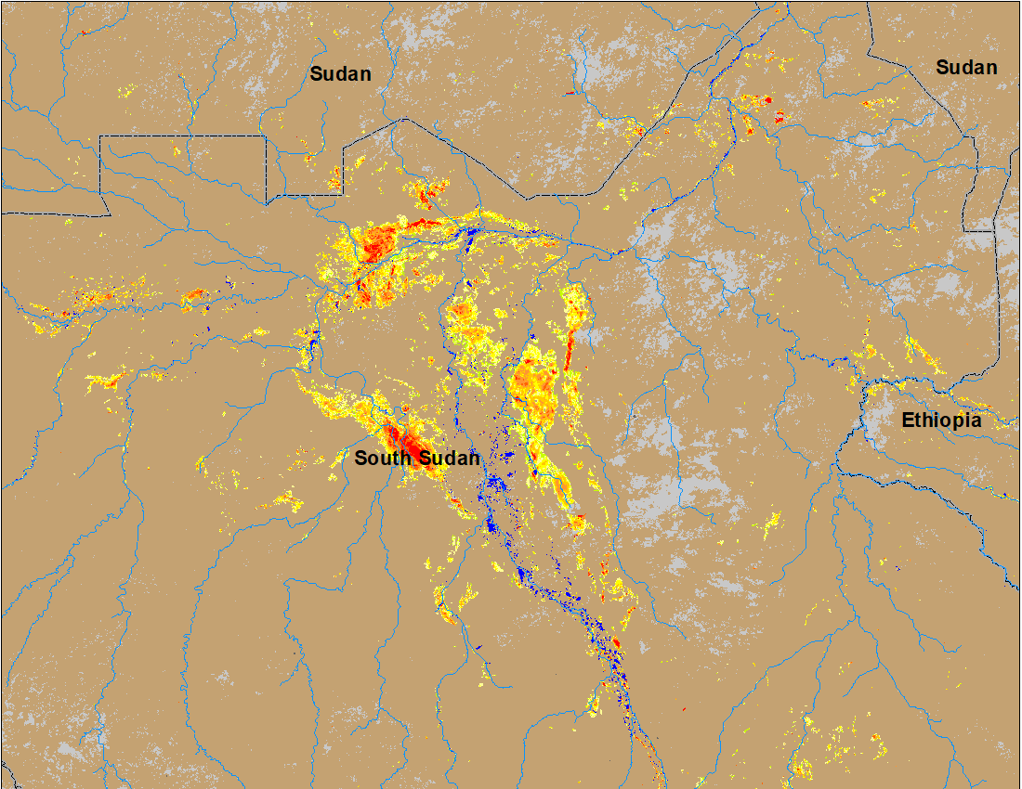
Inundation in the Sudd Wetlands
(% of the pixel)
(% of the pixel)
Northern Sudd Wetlands
Northern Sudd Wetlands
Sobet River
Sobet River
Akobo River
Akobo River
Pibor River
Pibor River
NOAA VIIRS : 23 July 2022
NOAA VIIRS 5-day composite: 3-7 Aug 2022
Inundation gradually increasing in the Sudd Wetlands including in the catchments of Akobo and Pibor Rivers.

Slide 8
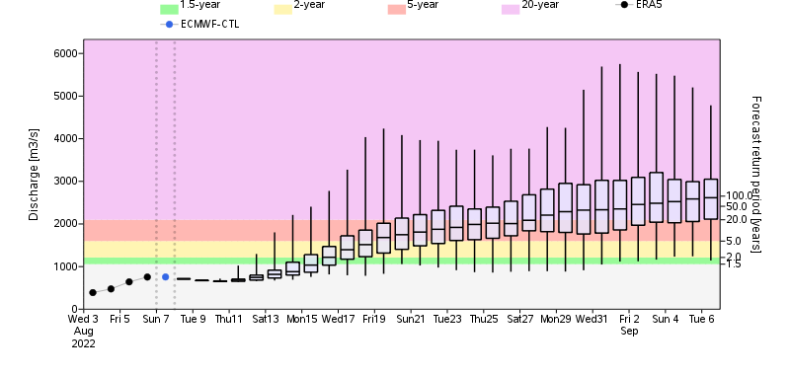
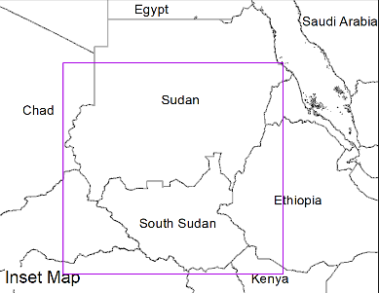
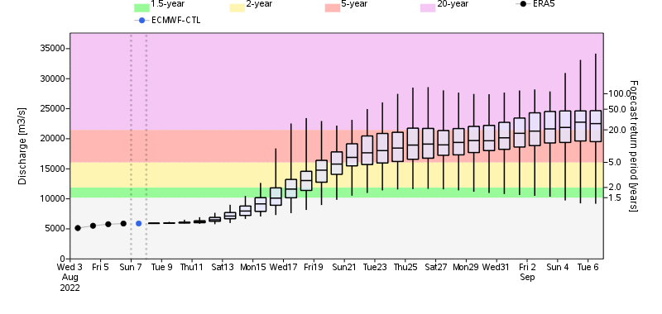
1-in-20yr RP Discharge Possible in White and Blue Nile in August
Blue Nile in Sudan
White Nile in South Sudan
> 20% probability of
1-in-20yr RP discharge
1-in-5yr RP discharge
1-in-2yr RP discharge
GloFAS monthly streamflow forecast 07 Aug - 06 Sep

Slide 9
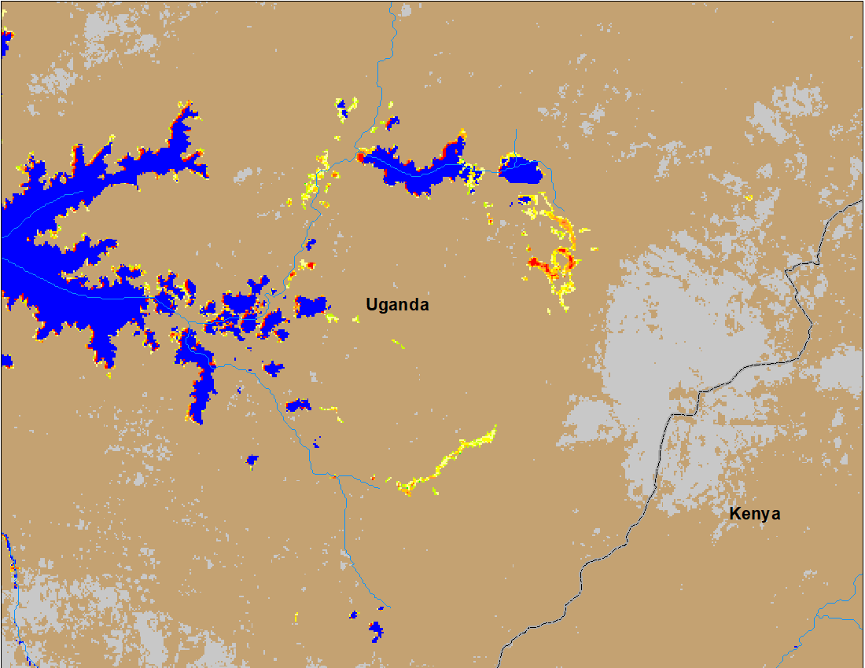
First Flooding of the Season in Southern Uganda
(% of the pixel)
NOAA VIIRS 5-day composite: 03 - 07 Aug 2022
ADAM Flood Event : 08 August 2022

Slide 10
Flooding in Yemen
(% of the pixel)
NOAA VIIRS 5-day composite: 03 - 07 Aug 2022
Few isolated flooding can be seen in the southwestern Yemen.

