Slide 1
FEWS NET Enhanced Flood Monitoring – East Africa, West Africa, southern Africa and Yemen
April 4, 2022, Hazard Briefing
FEWS NET Science Team:
USGS, NASA, NOAA, UCSB+Regional Scientists

Slide 2
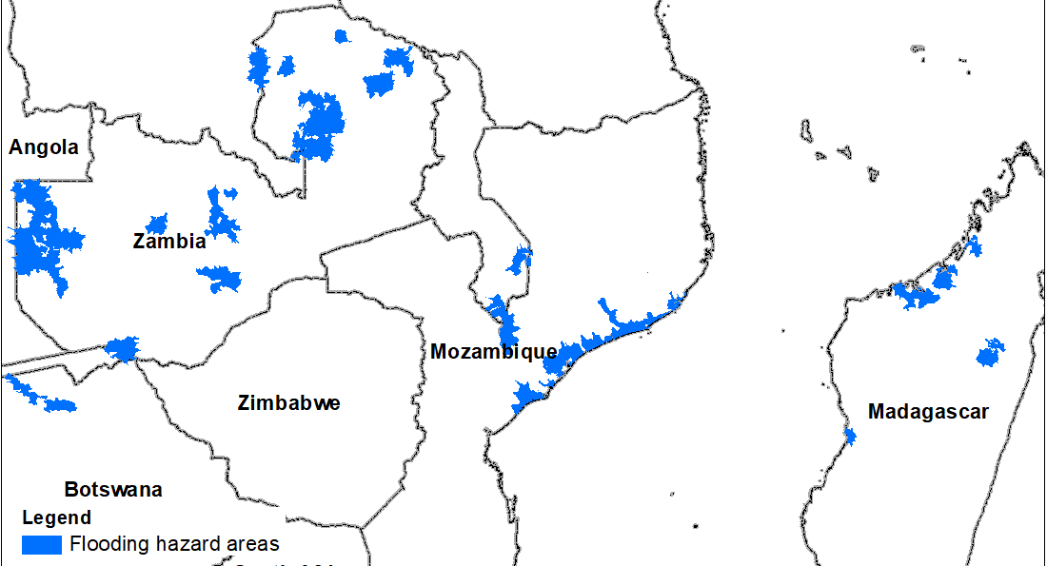
Flooding Polygons

Slide 3
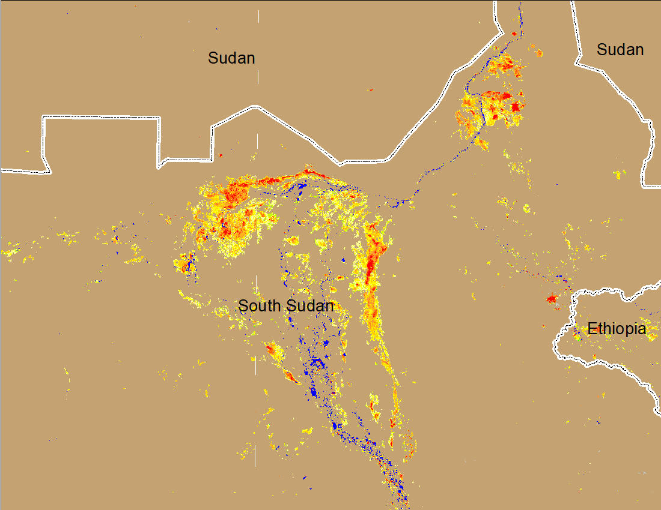
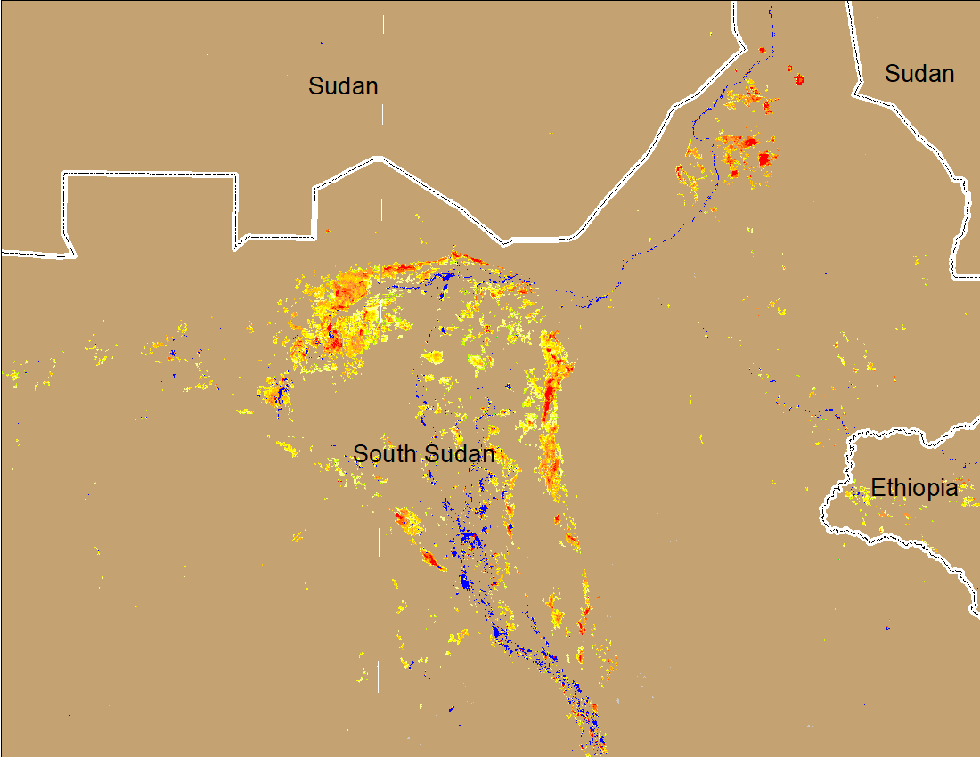
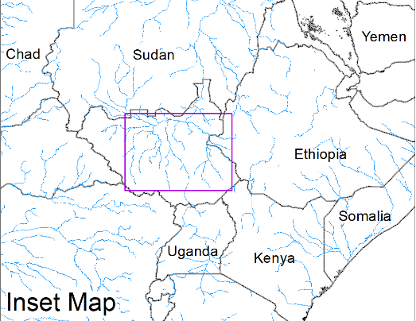
Inundation in the Sudd Wetlands
(% of the pixel)
(% of the pixel)
Northern Sudd Wetlands
Northern Sudd Wetlands
Sobet River
Sobet River
Akobo River
Akobo River
Pibor River
Pibor River
NOAA VIIRS 5-day composite: 23-37 Mar 2022
NOAA VIIRS 5-day composite: 30 Mar – 04 Apr 2022
Improving flooding conditions in the Sudd Wetlands.

Slide 4
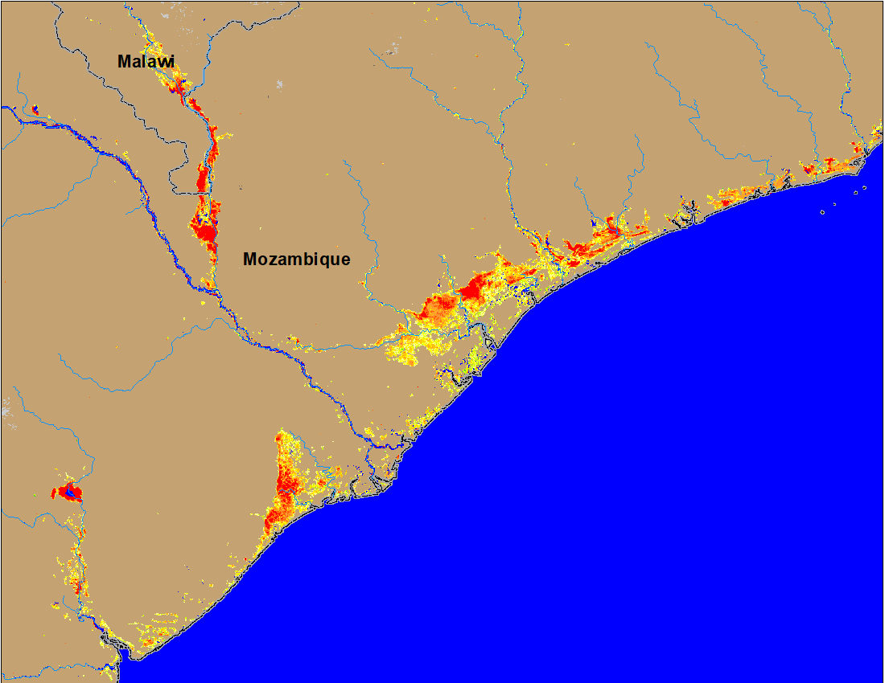
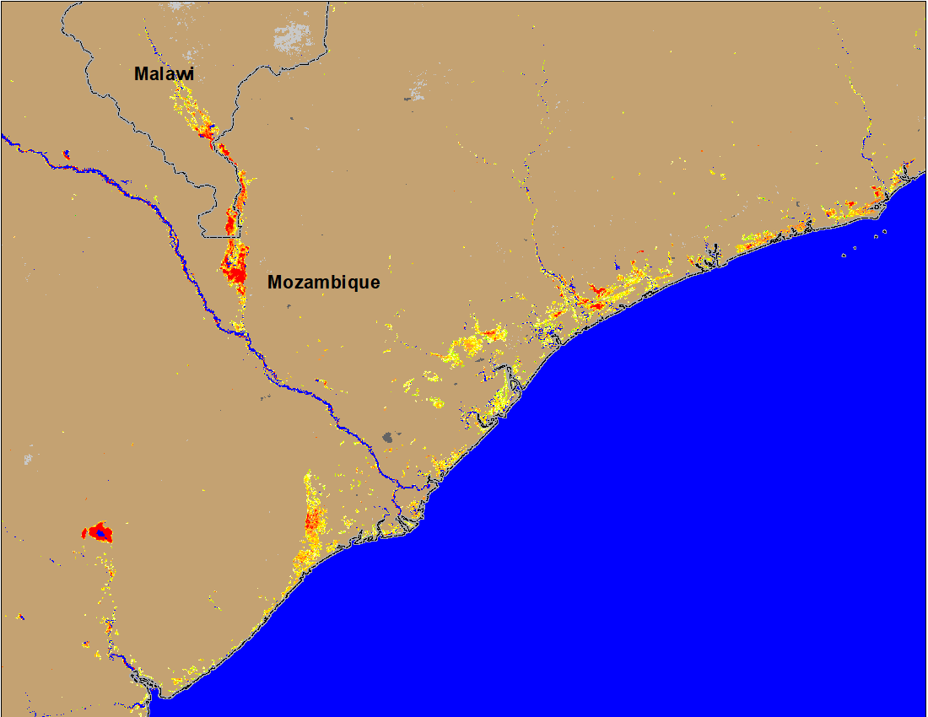
Flooding in Malawi and Mozambique
(% of the pixel)
(% of the pixel)
NOAA VIIRS 5-Day composite: 23 - 27 Mar 2022
NOAA VIIRS 5-Day composite: 30 Mar - 04 Apr 2022
Flooding conditions improved significantly over the past week.

Slide 5
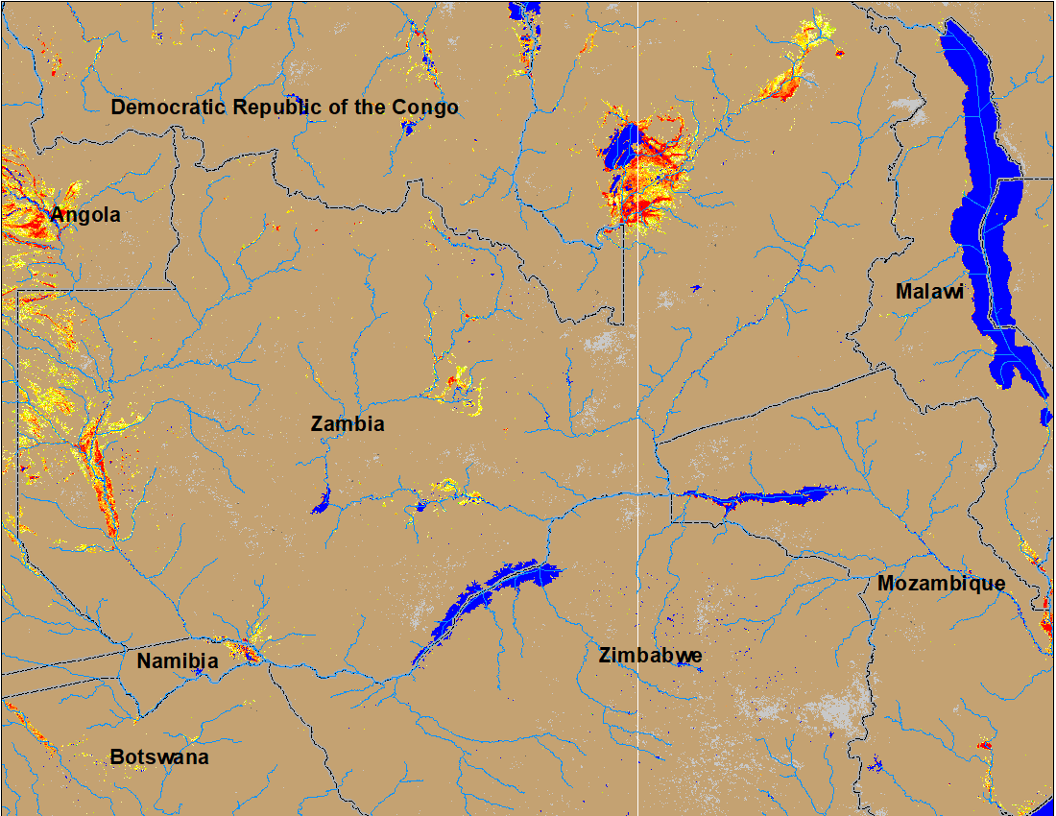
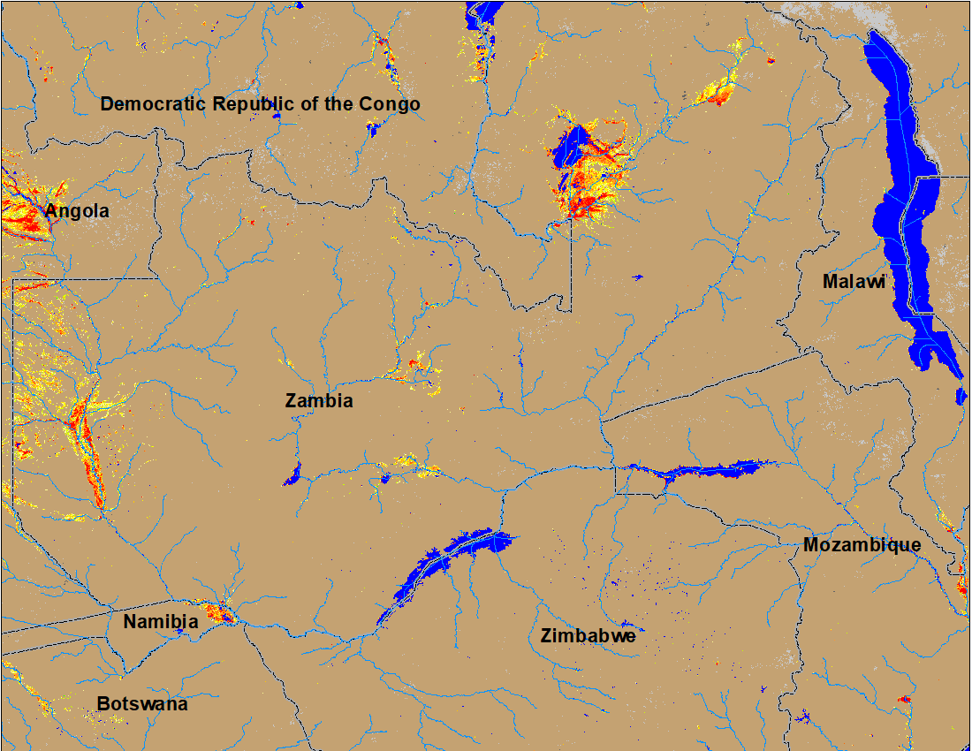
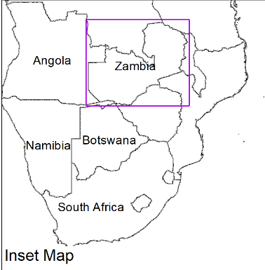
Flooding in Zambia Continues
(% of the pixel)
(% of the pixel)
NOAA VIIRS 5-Day composite: 23-27 March 2022
NOAA VIIRS 5-Day composite: 30 Mar – 04 Apr 2022
No noticeable improvement in the flooding conditions in Zambia, Botswana and Namibia.

Slide 6
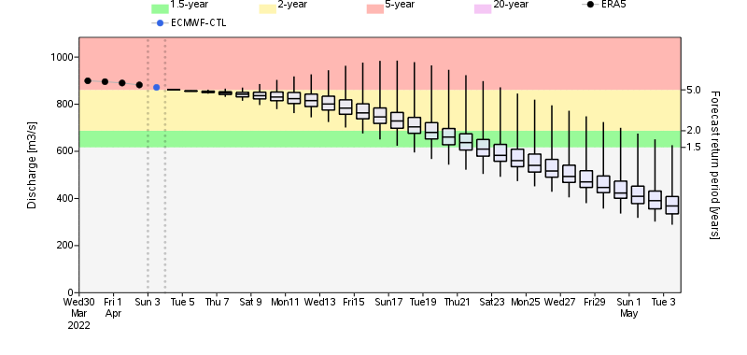
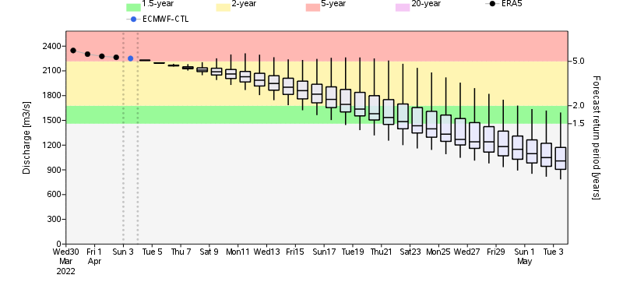
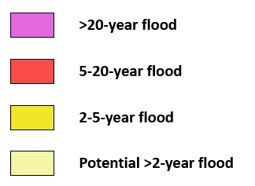
Flooding Likely to Continue in Zambia
Luanga River in Zambia
Luanga River
Luangwa River
GloFAS streamflow forecast suggest, Luanga and Luangwa Rivers (both are tributaries of Zambezi River) are expected to produce discharge at 2 to 5-yr return period level in next two weeks.
Luangwa River in Zambia

Slide 7
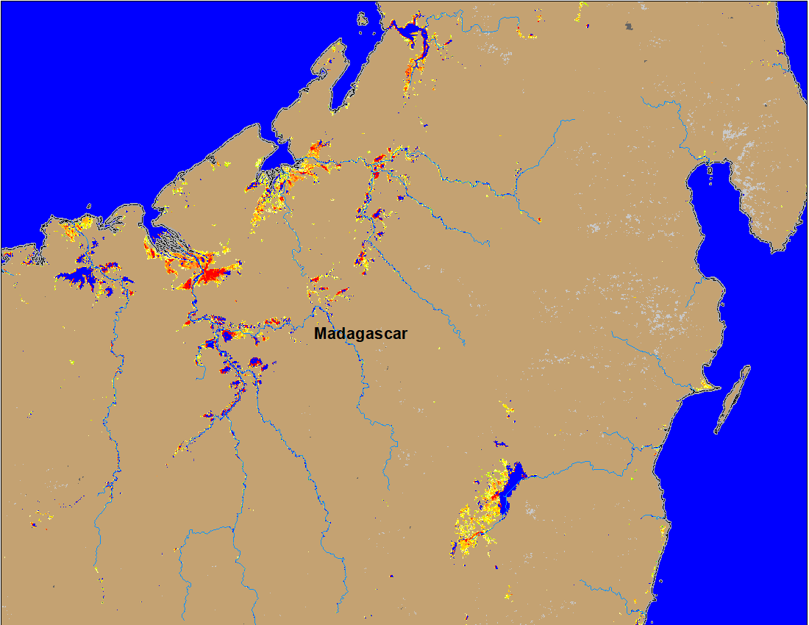
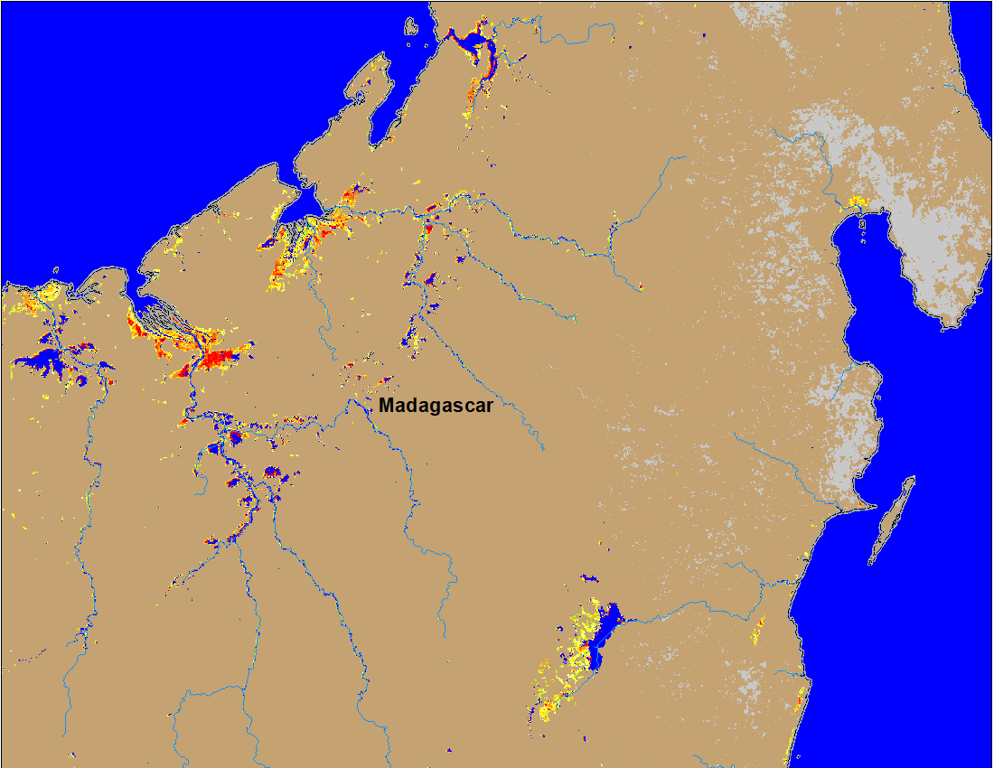
Flooding in Madagascar
(% of the pixel)
(% of the pixel)
NOAA VIIRS 5-day composite: 23-27 Mar 2022
NOAA VIIRS 5-day composite: 30 Mar – 04 Apr 2022
Flooding conditions remained unchanged in northern Madagascar.

