Slide 1
FEWS NET Enhanced Flood Monitoring – East Africa, West Africa, southern Africa and Yemen
April 24, 2022, Hazard Briefing
FEWS NET Science Team:
USGS, NASA, NOAA, UCSB+Regional Scientists

Slide 2
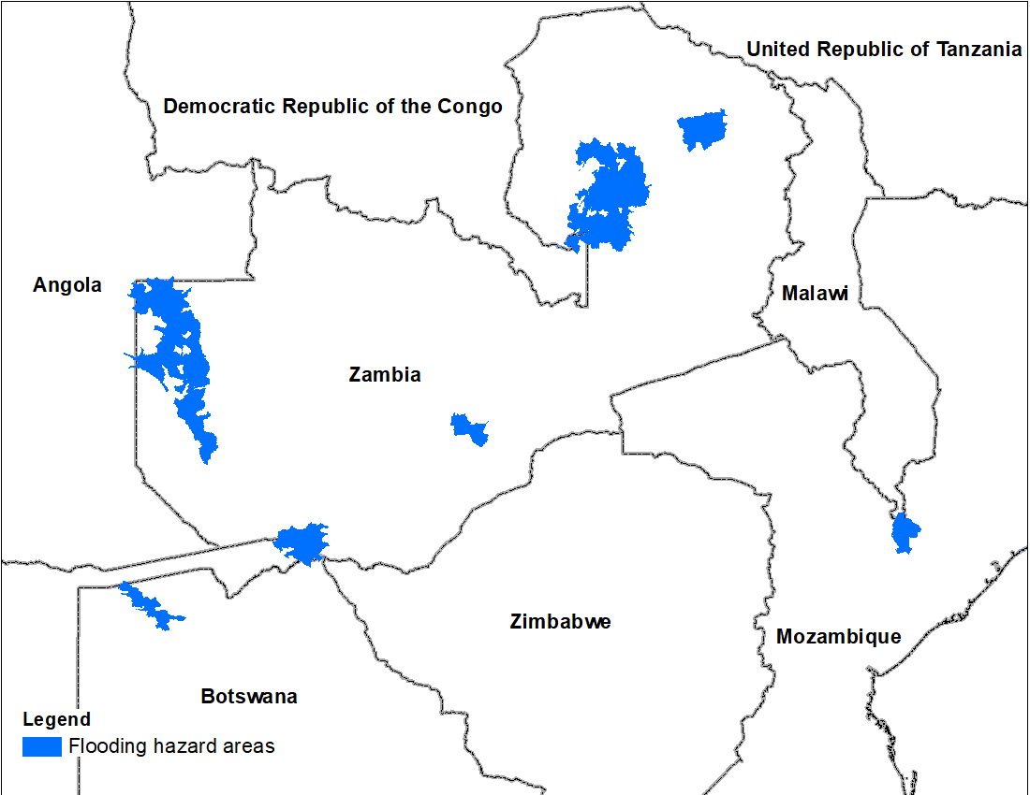
Flooding Polygons

Slide 3
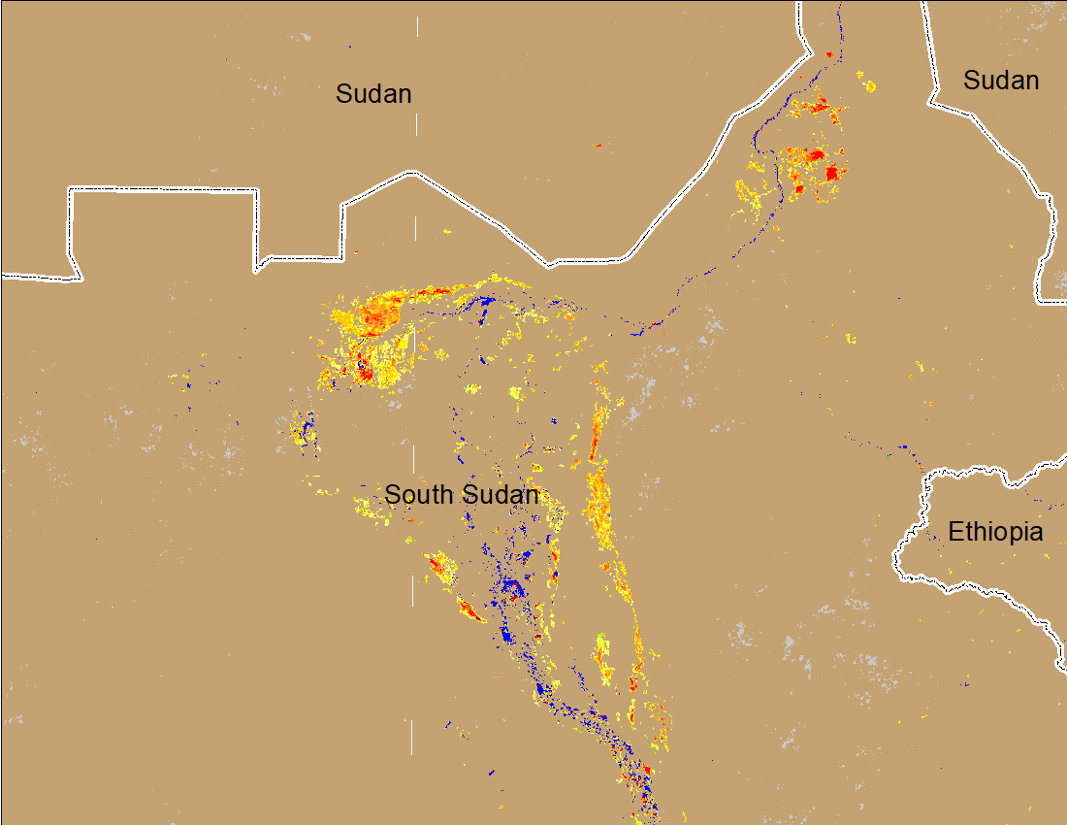
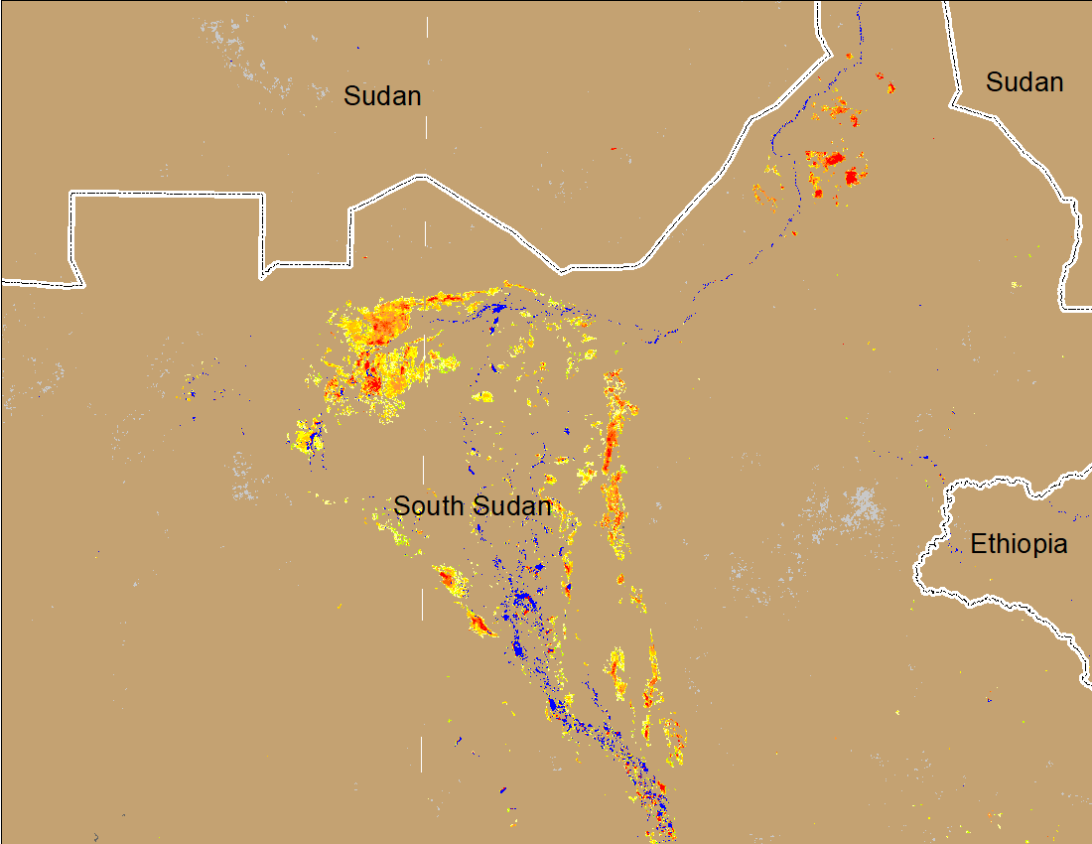

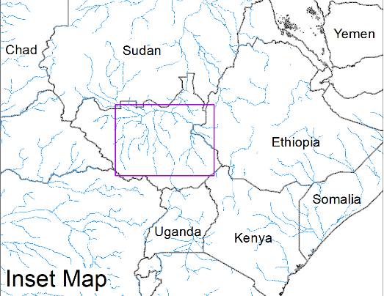
Inundation in the Sudd Wetlands
(% of the pixel)
(% of the pixel)
Northern Sudd Wetlands
Northern Sudd Wetlands
Sobet River
Sobet River
Akobo River
Akobo River
Pibor River
Pibor River
NOAA VIIRS 5-day composite: 12-16 Apr 2022
NOAA VIIRS 5-day composite: 20-24 Apr 2022
Flooding conditions are gradually improving in the Sudd Wetlands.

Slide 4
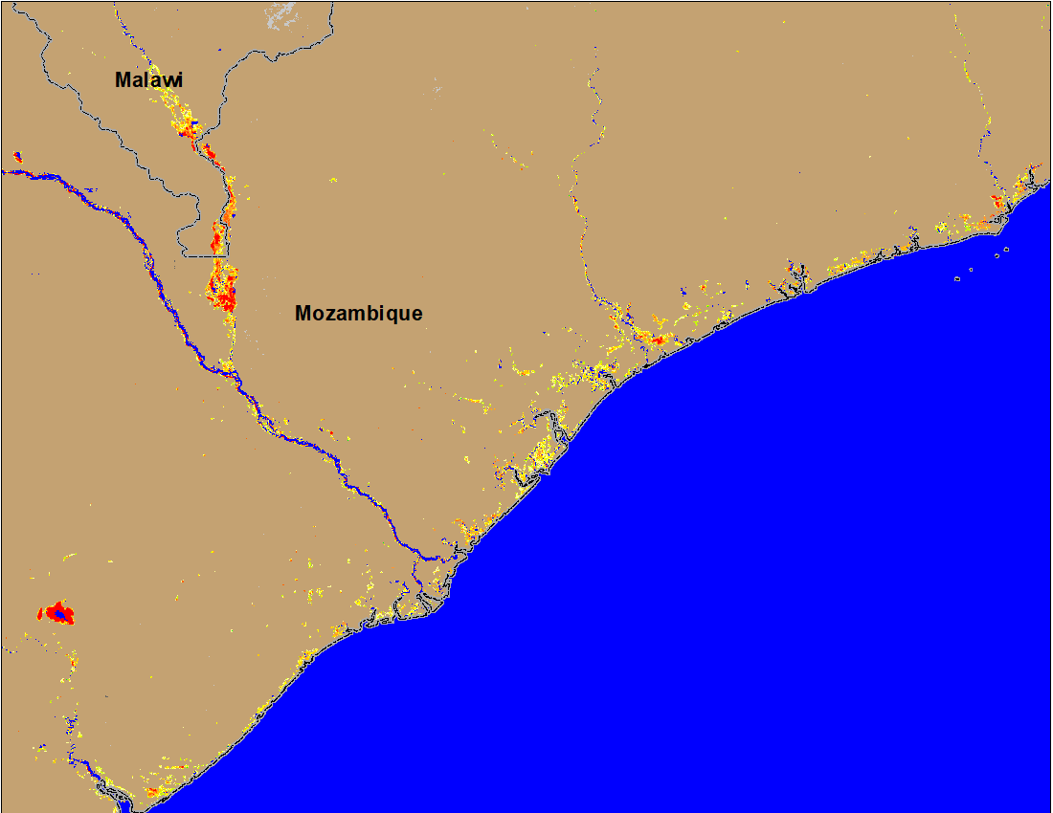
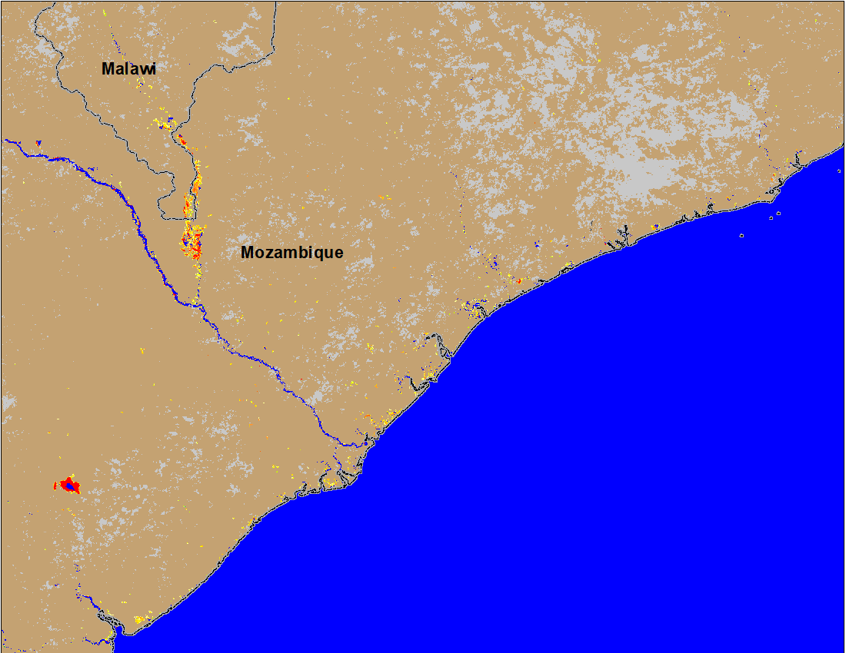
Flooding in Malawi and Mozambique
(% of the pixel)
(% of the pixel)
NOAA VIIRS 5-Day composite: 13-17 Apr 2022
NOAA VIIRS 5-Day composite: 20 -24 Apr 2022
The only area remained flooded is along the Shire River in Southern Malawi and Mozambique.

Slide 5
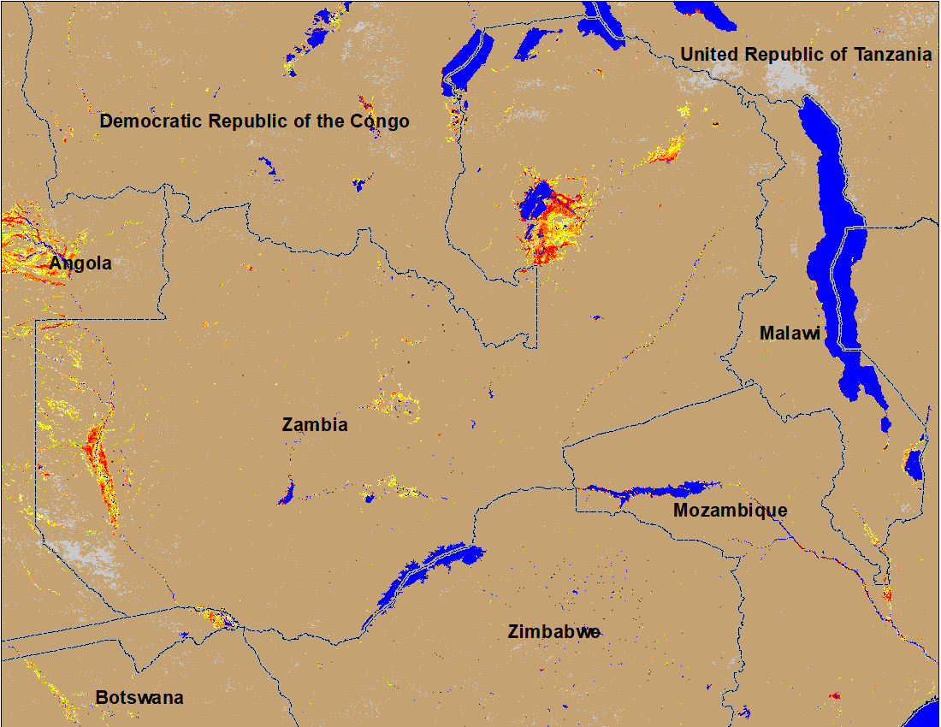
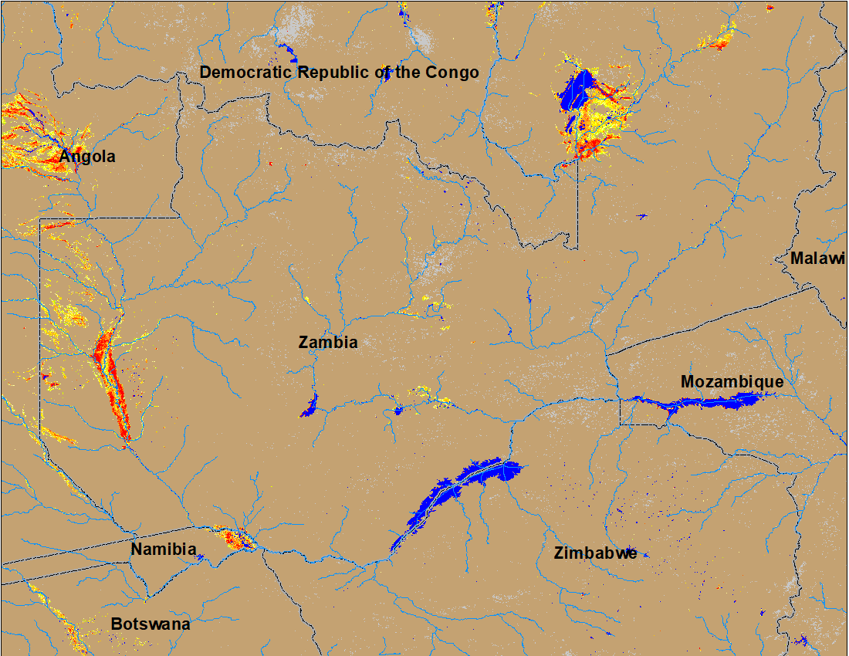
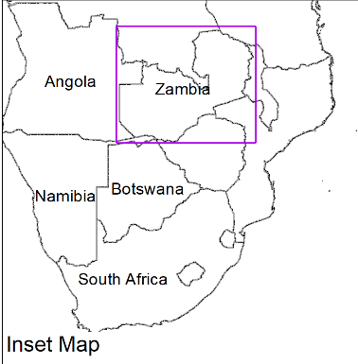
Flooding in Zambia
(% of the pixel)
(% of the pixel)
NOAA VIIRS 5-Day composite: 13-17 Apr 2022
NOAA VIIRS 5-Day composite: 20-24 Apr 2022
Flooding conditions gradually improving in Zambia, Namibia, and Botswana.

