Slide 1
FEWS NET Enhanced Flood Monitoring – East Africa, West Africa, southern Africa and Yemen
April 17, 2022, Hazard Briefing
FEWS NET Science Team:
USGS, NASA, NOAA, UCSB+Regional Scientists

Slide 2
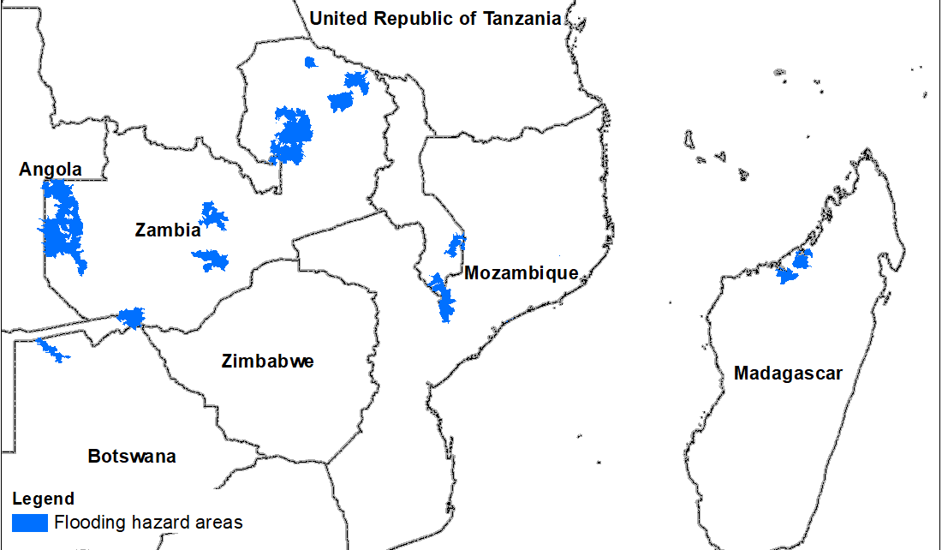
Flooding Polygons

Slide 3
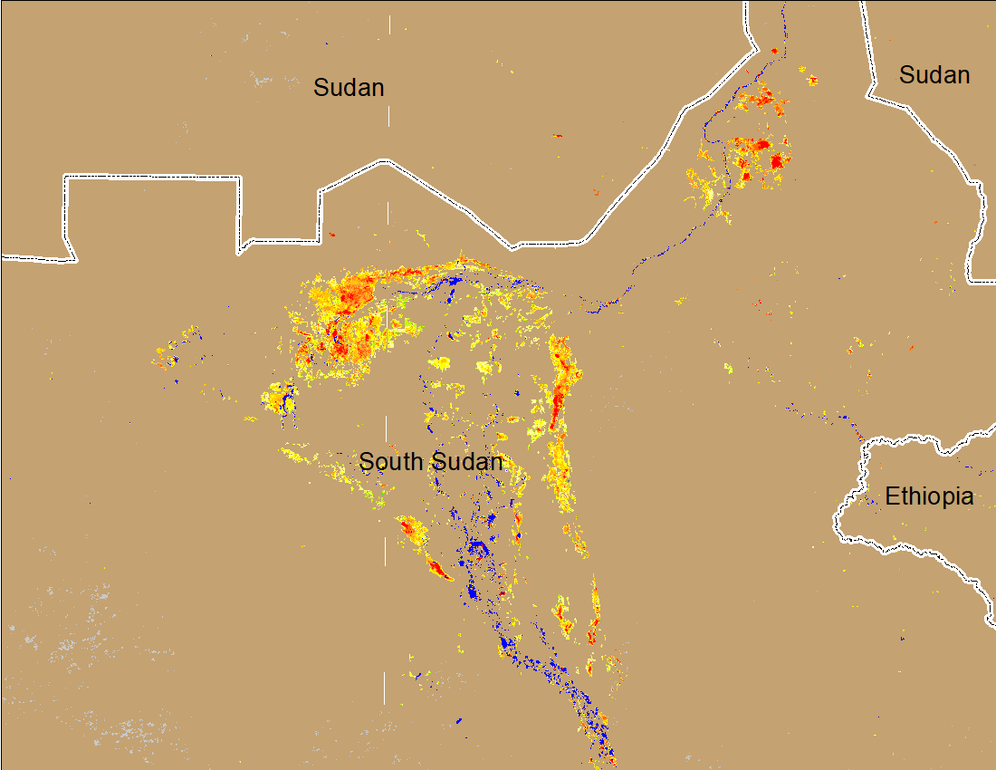
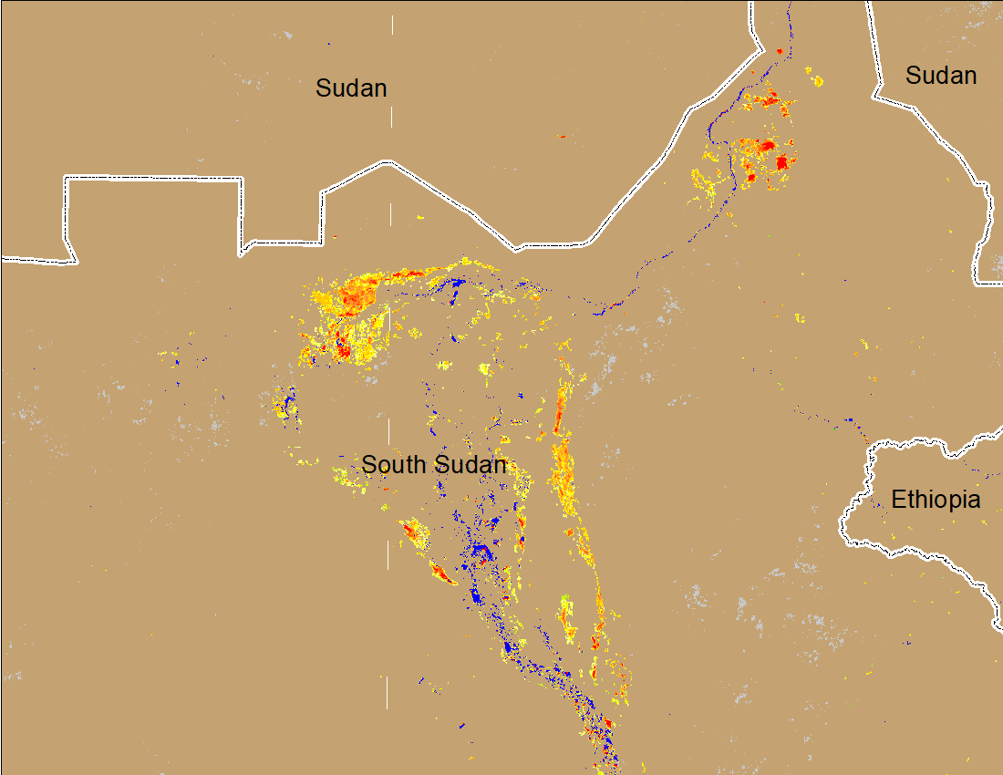
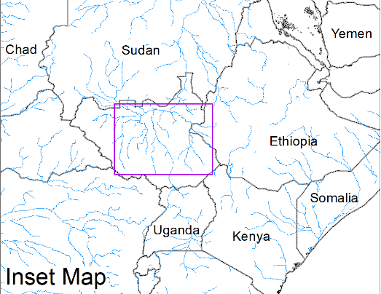
Inundation in the Sudd Wetlands
(% of the pixel)
(% of the pixel)
Northern Sudd Wetlands
Northern Sudd Wetlands
Sobet River
Sobet River
Akobo River
Akobo River
Pibor River
Pibor River
NOAA VIIRS 5-day composite: 06-10 Apr 2022
NOAA VIIRS 5-day composite: 12-16 Apr 2022
Flooding conditions have improved in the Sudd Wetlands.

Slide 4
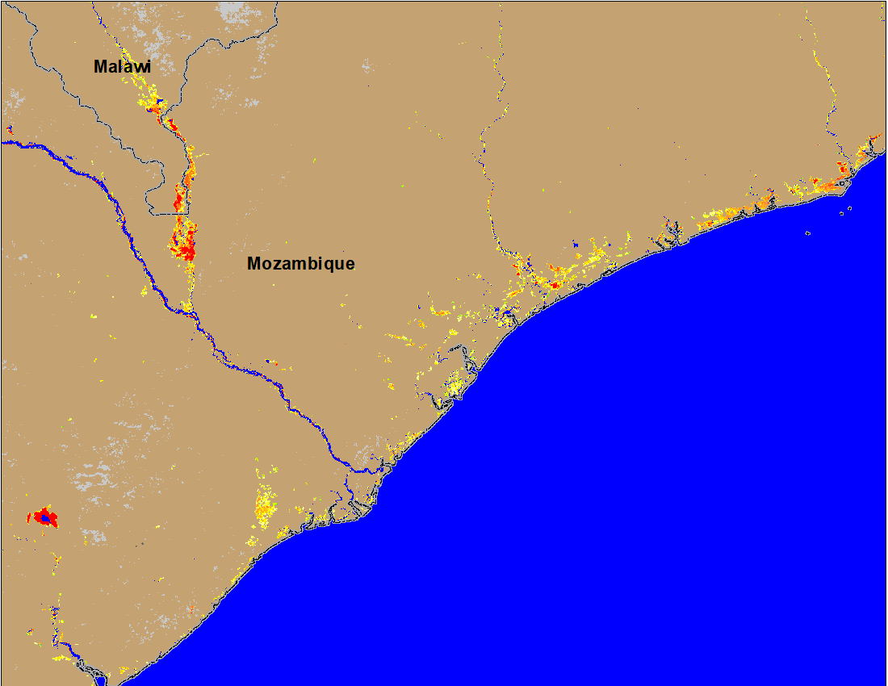
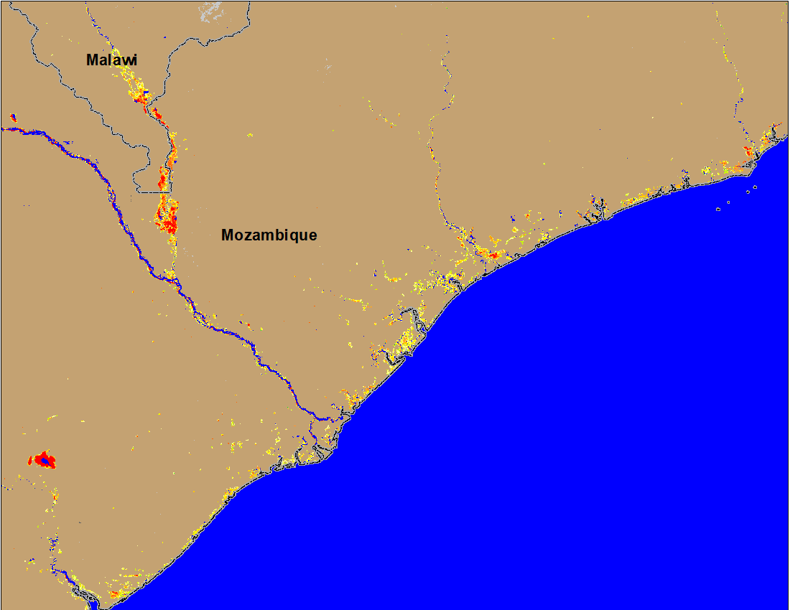
Flooding in Malawi and Mozambique
(% of the pixel)
(% of the pixel)
NOAA VIIRS 5-Day composite: 4-10 Apr 2022
NOAA VIIRS 5-Day composite: 13 -17 Apr 2022
Flooding conditions improved significantly over the past week specially along the coastal region.

Slide 5
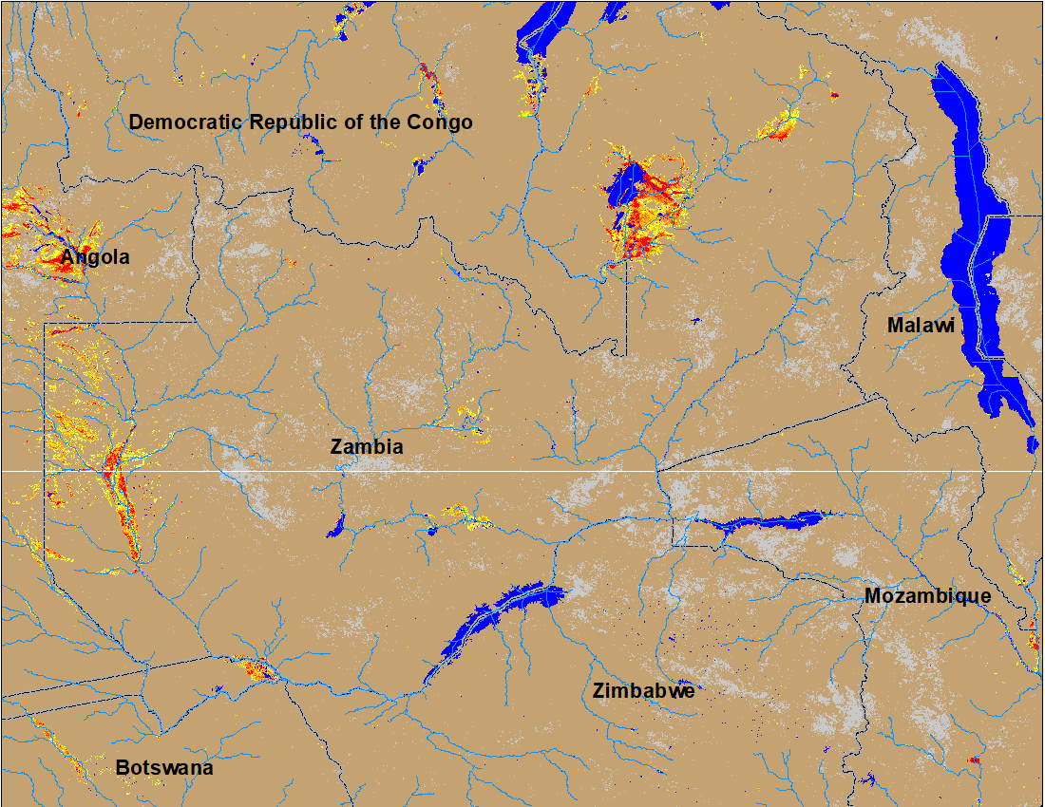
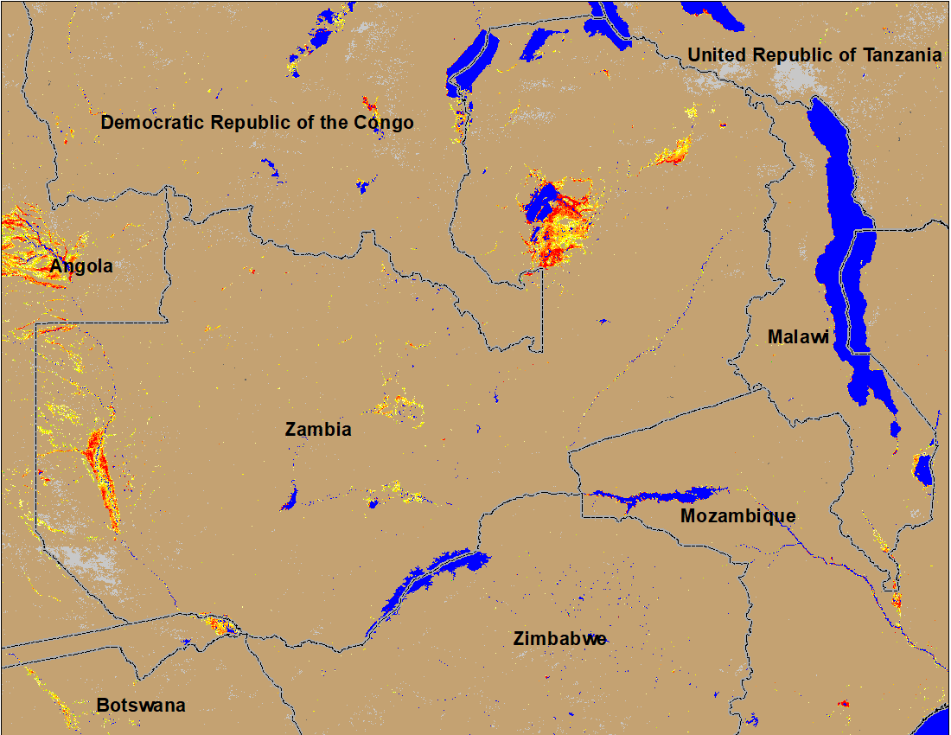
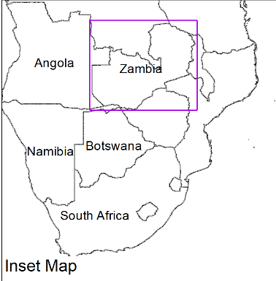
Flooding in Zambia Continues
(% of the pixel)
(% of the pixel)
NOAA VIIRS 5-Day composite: 6-10 Apr 2022
NOAA VIIRS 5-Day composite: 13-17 Apr 2022
No noticeable improvement in the flooding conditions in Zambia, Botswana and Namibia.

Slide 6
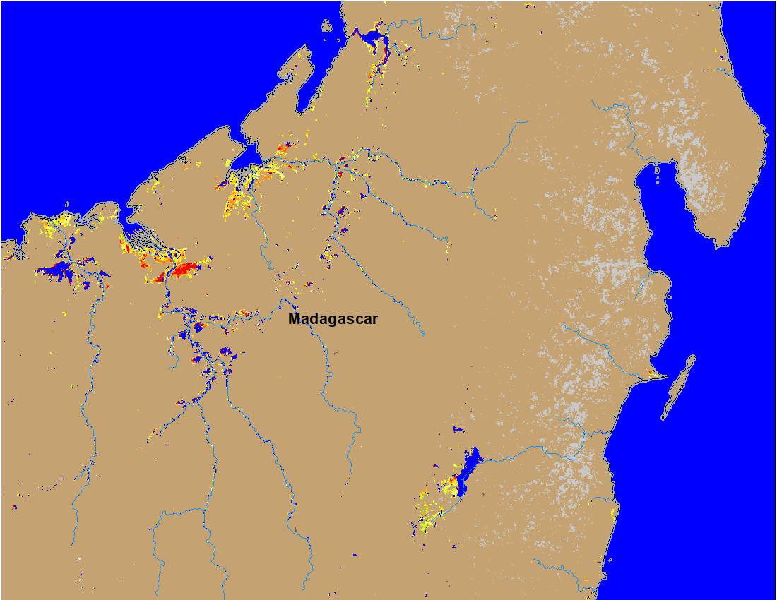
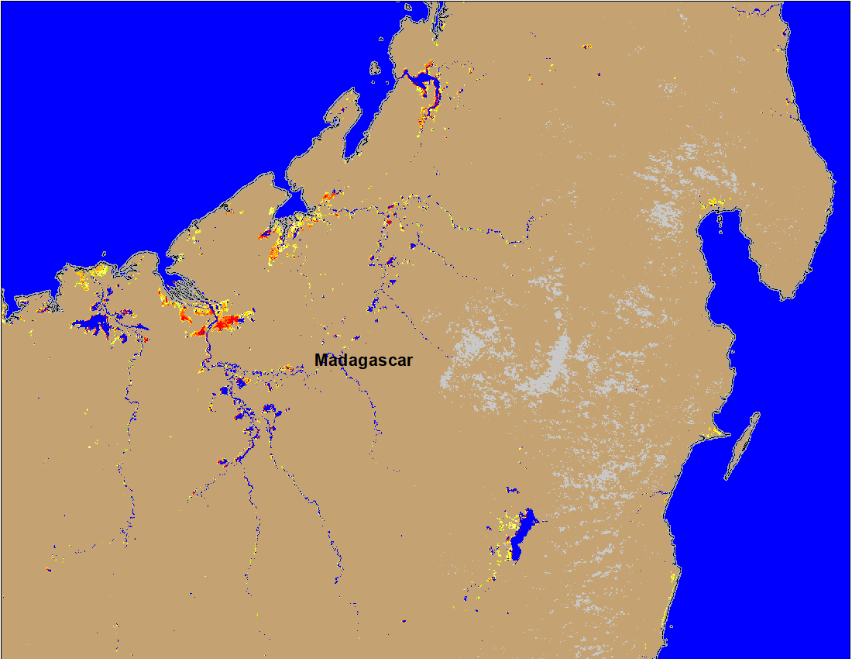
Flooding in Madagascar
(% of the pixel)
(% of the pixel)
NOAA VIIRS 5-day composite: 4-10 Apr 2022
NOAA VIIRS 5-day composite: 13-17 Apr 2022
Flooding conditions improved in northern Madagascar.

Slide 7
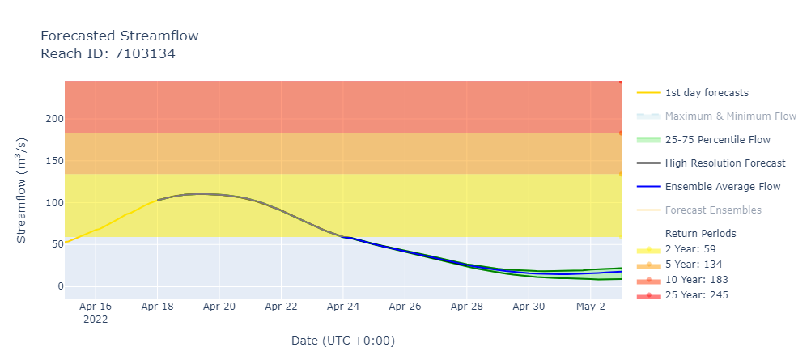
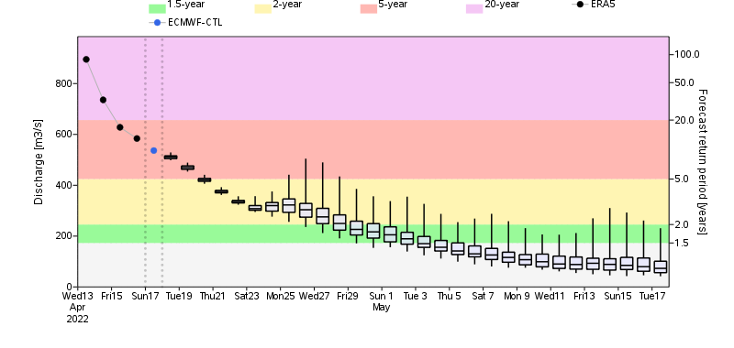
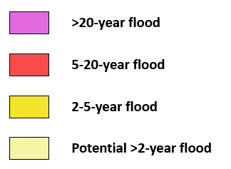
Streamflow Forecast
GEOGloWS
Molopo River in Southern Botswana
1-10 days forecast
GloFAS
Rivers in southern Botswana and KwaZulu Natal state in South Africa are expected to have 2 to 5-yr return period level streamflow in 1-10 days.
Umgeni River in South Africa
GloFAS

