Slide 1
FEWS NET Enhanced Flood Monitoring – East Africa, West Africa, southern Africa and Yemen
April 11, 2022, Hazard Briefing
FEWS NET Science Team:
USGS, NASA, NOAA, UCSB+Regional Scientists

Slide 2
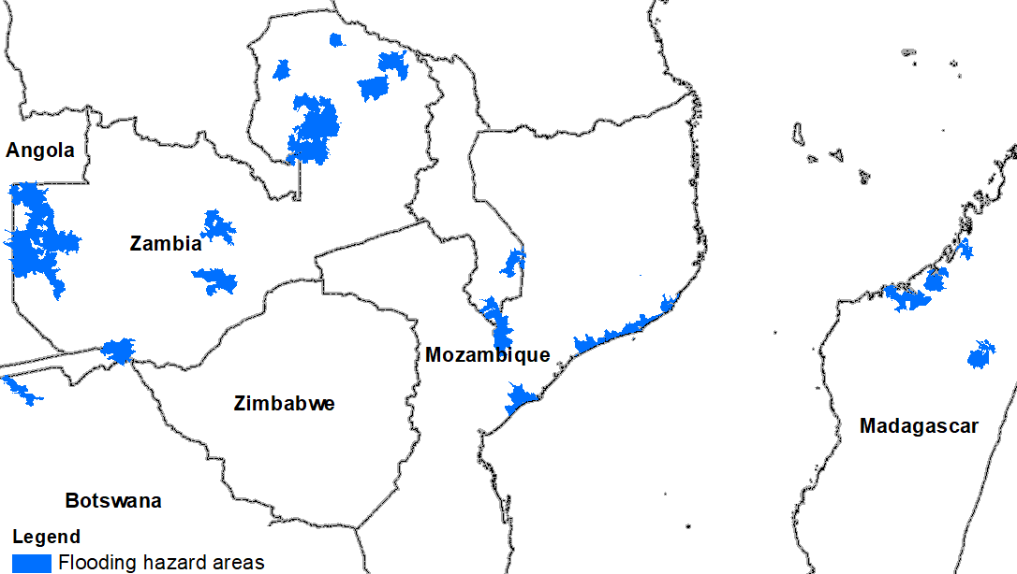
Flooding Polygons

Slide 3
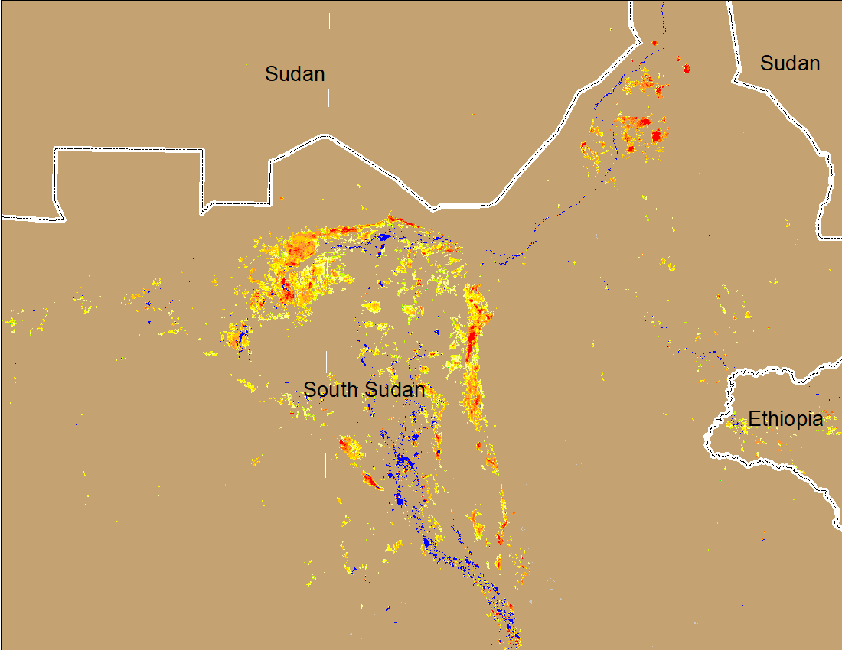
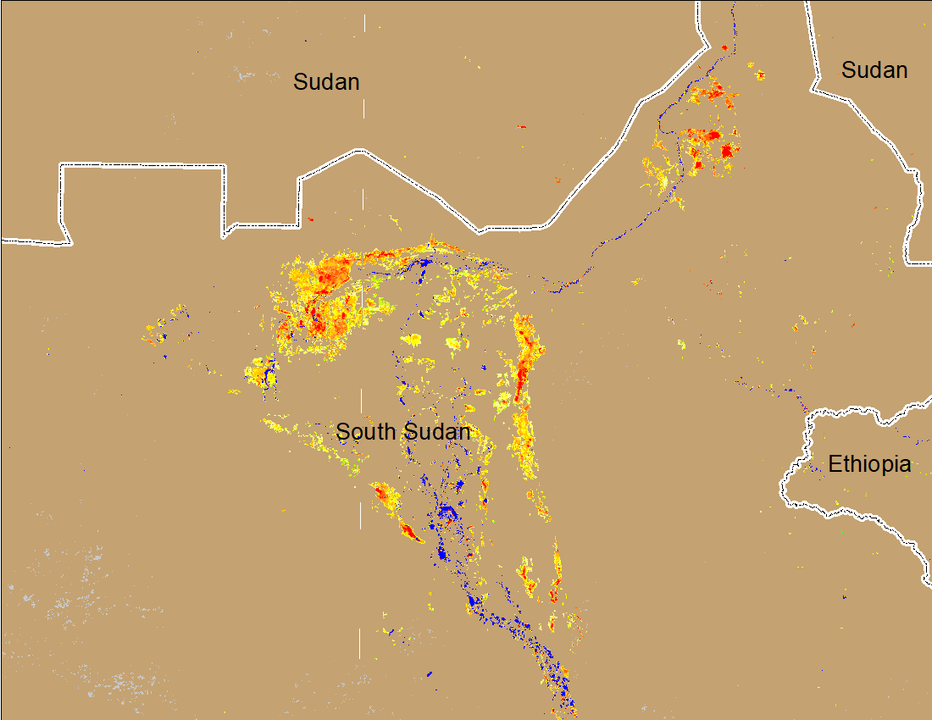
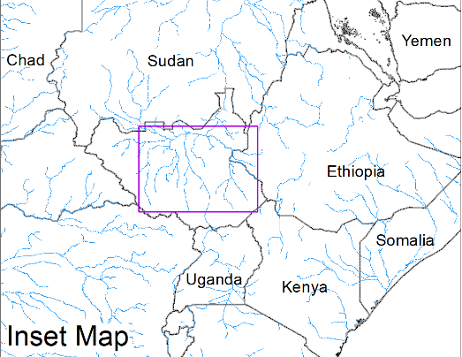
Inundation in the Sudd Wetlands
(% of the pixel)
(% of the pixel)
Northern Sudd Wetlands
Northern Sudd Wetlands
Sobet River
Sobet River
Akobo River
Akobo River
Pibor River
Pibor River
NOAA VIIRS 5-day composite: 30 Mar-04 Apr 2022
NOAA VIIRS 5-day composite: 6-10 Apr 2022
Flooding conditions remained unchanged in the Sudd Wetlands.

Slide 4
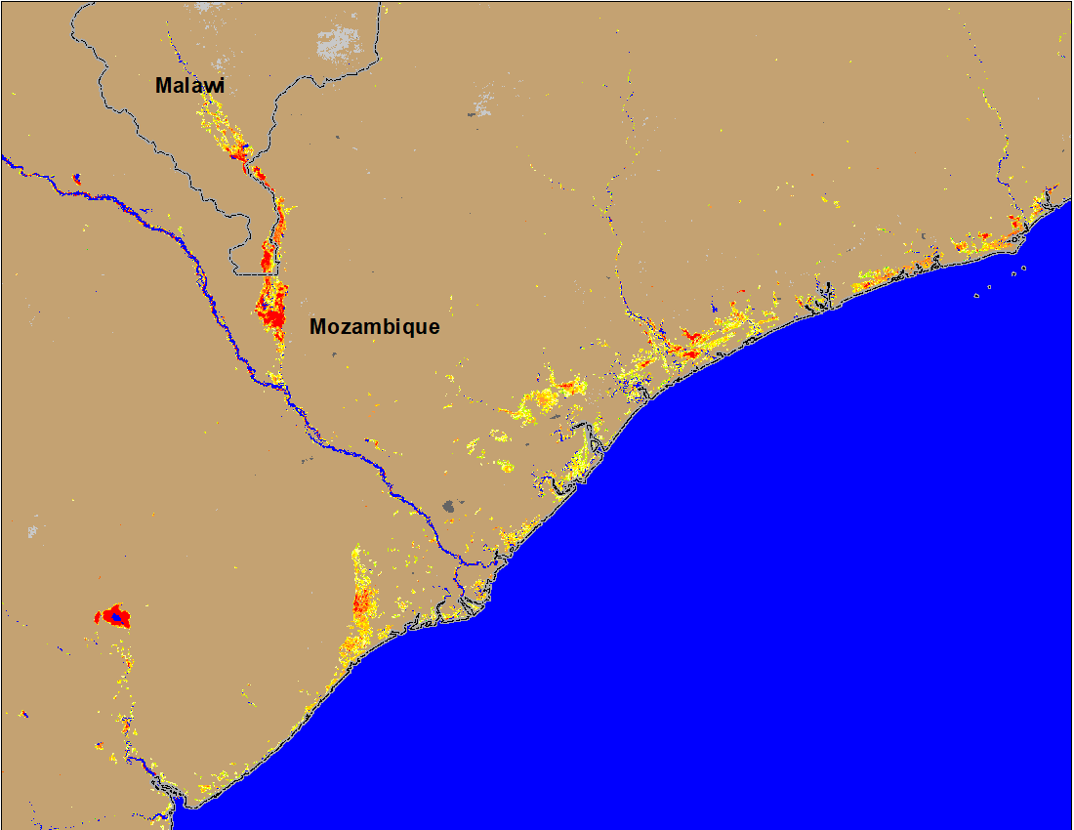
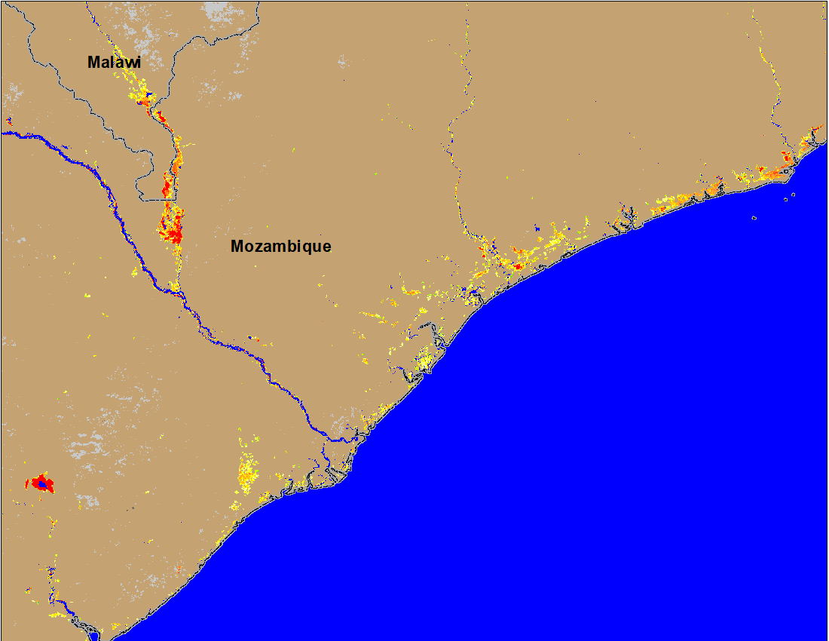
Flooding in Malawi and Mozambique
(% of the pixel)
(% of the pixel)
NOAA VIIRS 5-Day composite: 30 Mar – 04 Apr 2022
NOAA VIIRS 5-Day composite: 4 -10 Apr 2022
Flooding conditions improved significantly over the past week specially along the coastal region.

Slide 5
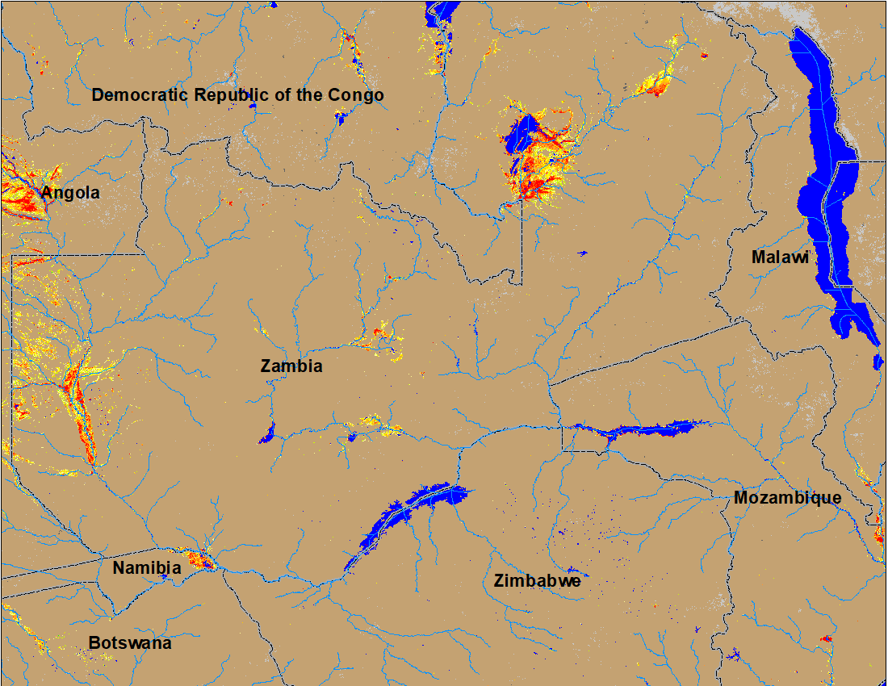
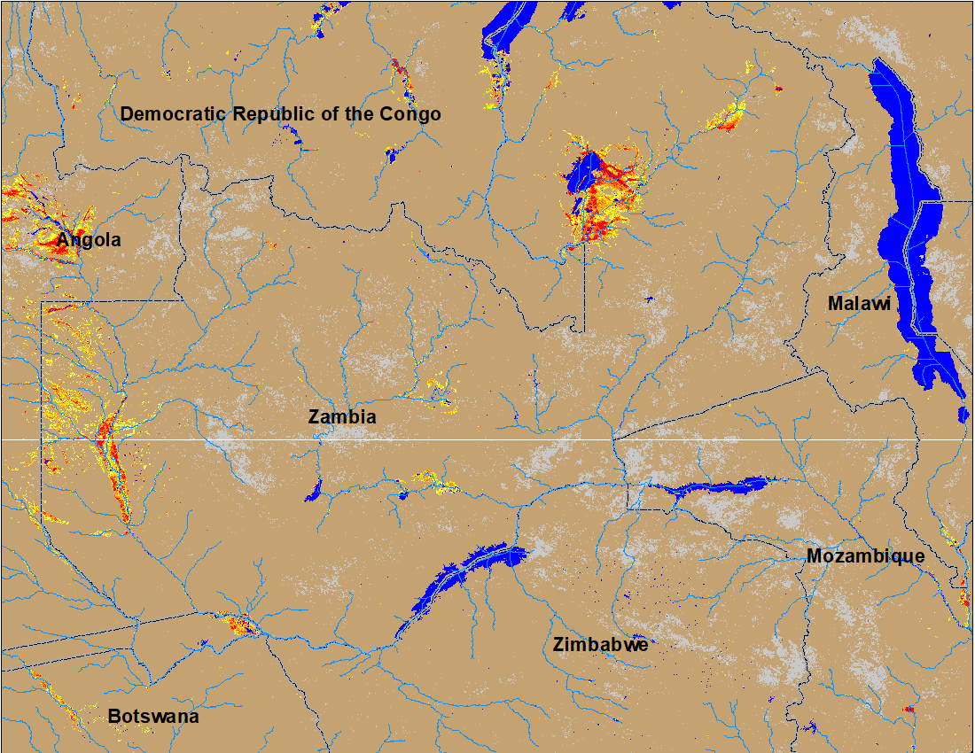
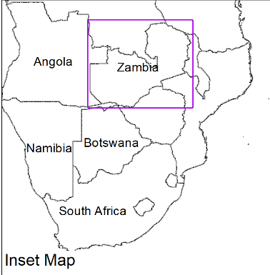
Flooding in Zambia Continues
(% of the pixel)
(% of the pixel)
NOAA VIIRS 5-Day composite: 30 Mar-04 Apr 2022
NOAA VIIRS 5-Day composite: 6-10 Apr 2022
No noticeable improvement in the flooding conditions in Zambia, Botswana and Namibia.

Slide 6
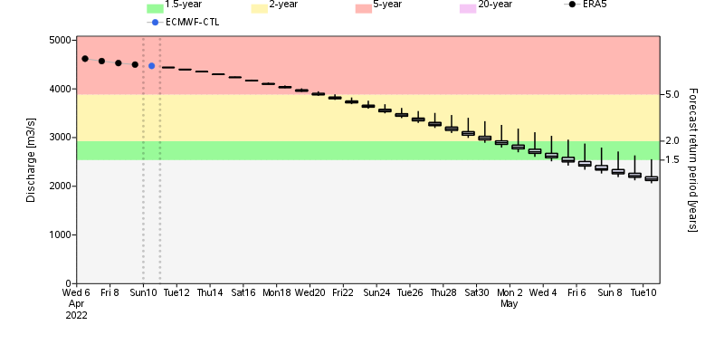
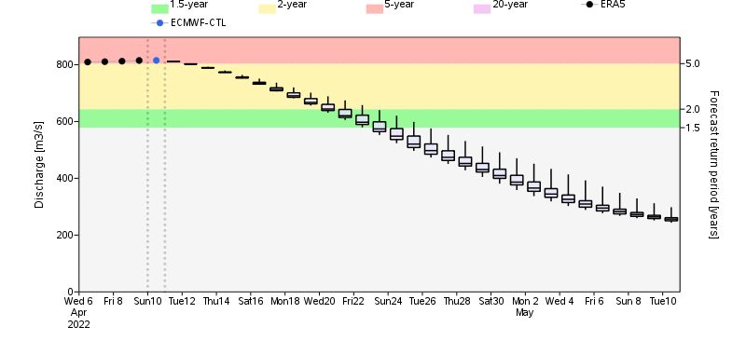
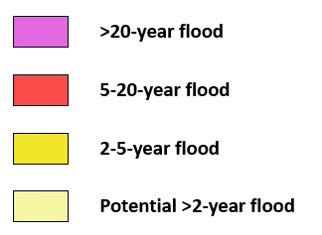
Flooding Likely to Continue in Zambia
Chambeshi River
Mushingashi River
Chambeshi River in Zambia
GloFAS streamflow forecast suggest, Chambeshi and Mushingashi Rivers are expected to produce discharge at 2 to 5-yr return period level in next two weeks.
Mushingashi River in Zambia

Slide 7
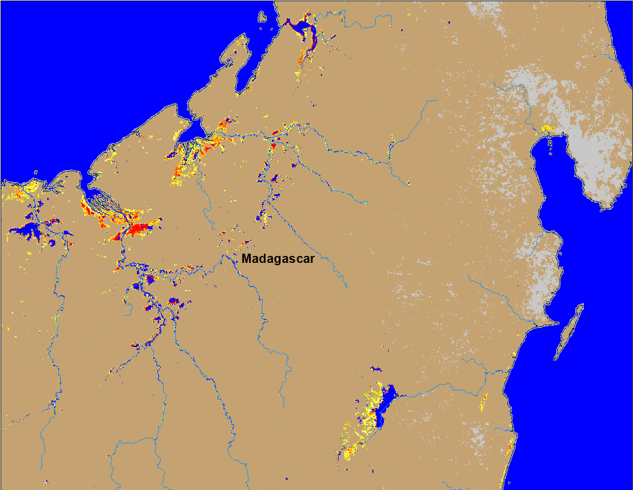
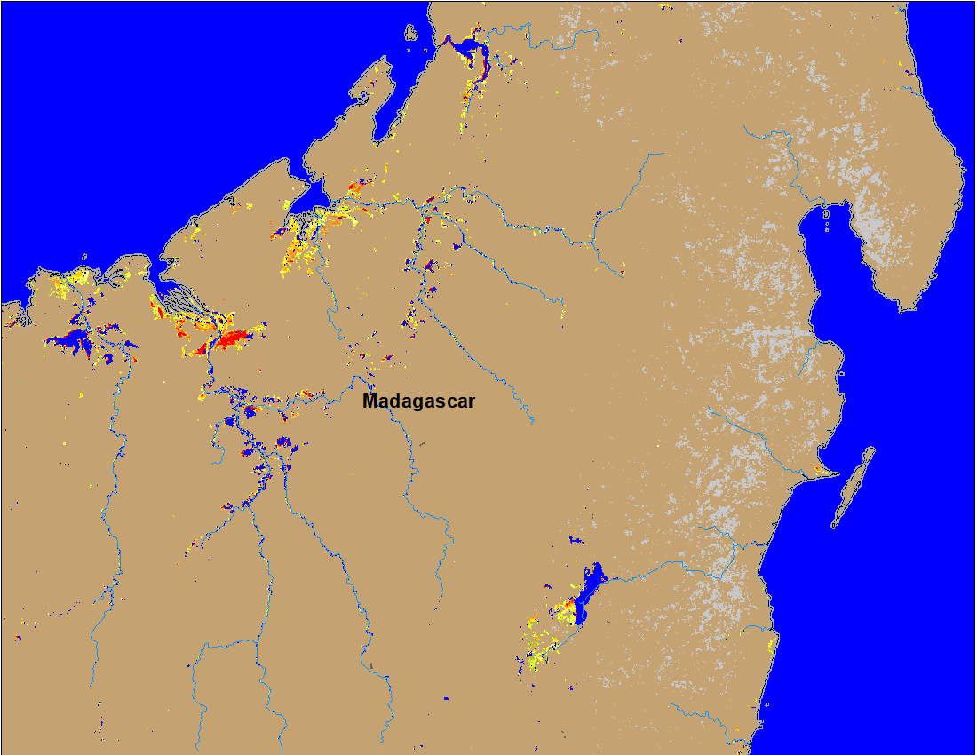
Flooding in Madagascar
(% of the pixel)
(% of the pixel)
NOAA VIIRS 5-day composite: 30 Mar-04 Apr 2022
NOAA VIIRS 5-day composite: 30 Mar – 04 Apr 2022
Flooding conditions improved in northern Madagascar.

Slide 8
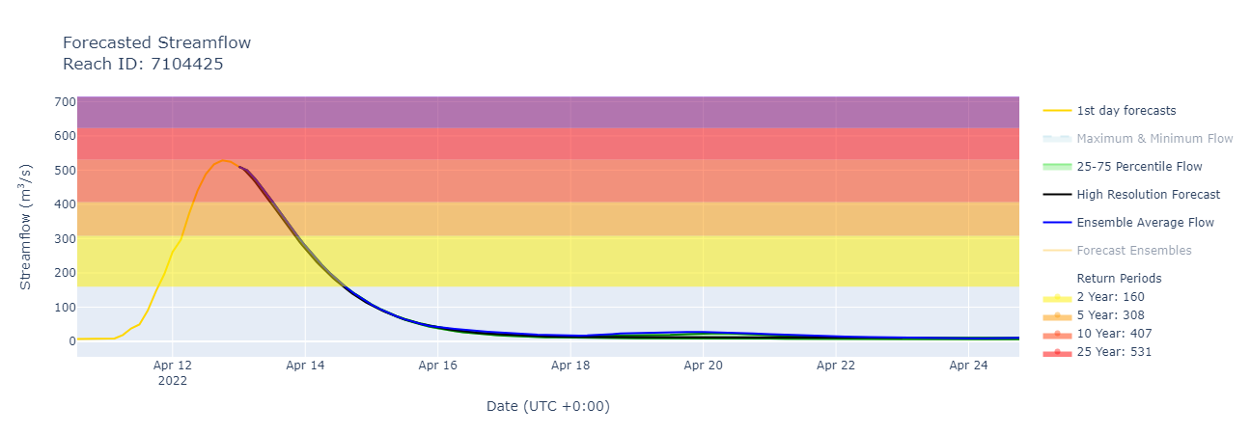
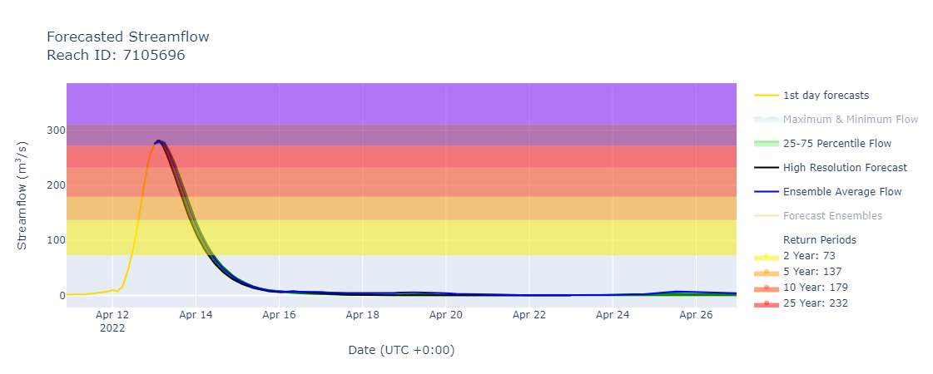
High Discharge in the Rivers in Kwa Zulu-Natal

Slide 9
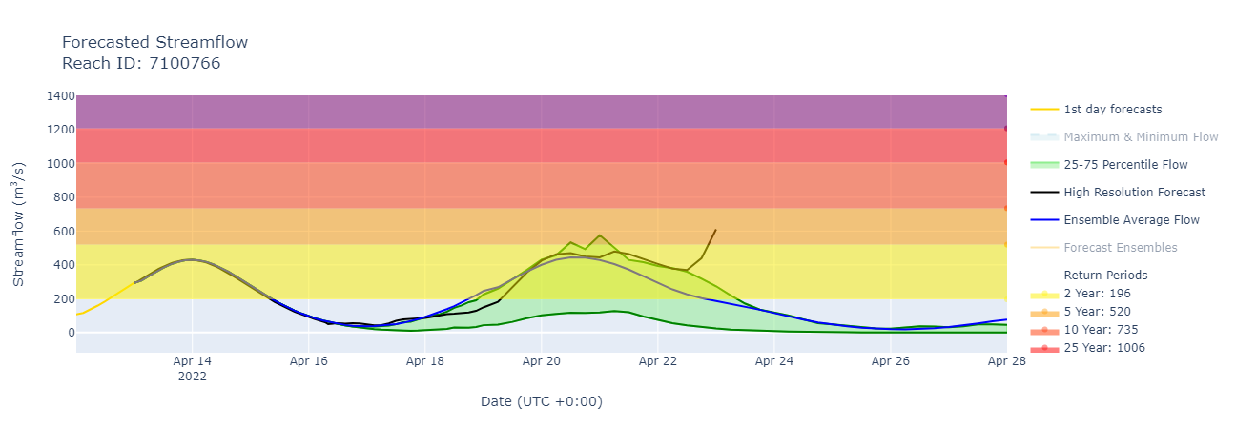
High Discharge in the Upstream of Limpopo River

