Slide 1
FEWS NET Enhanced Flood Monitoring and Forecast Assumptions-East Africa and Yemen
May 2023 Seasonal Forecast
FEWS NET Science Team:
USGS, NASA, NOAA, UCSB+Regional Scientists

Slide 2
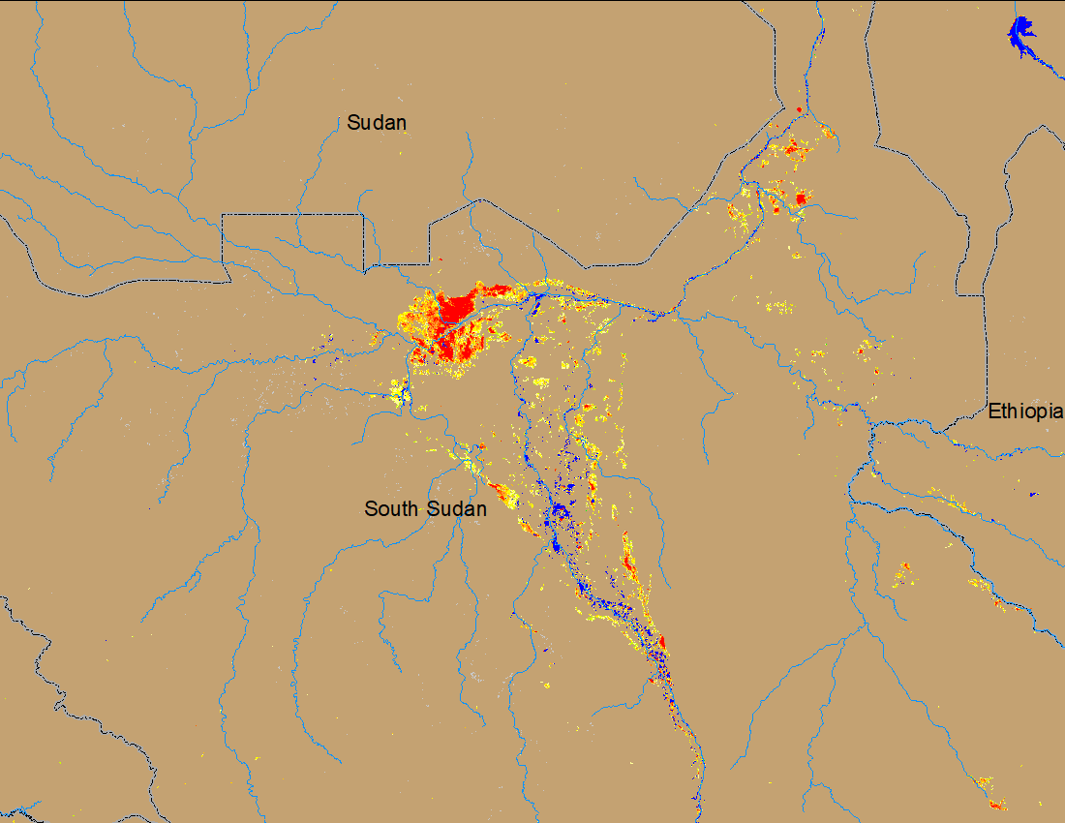
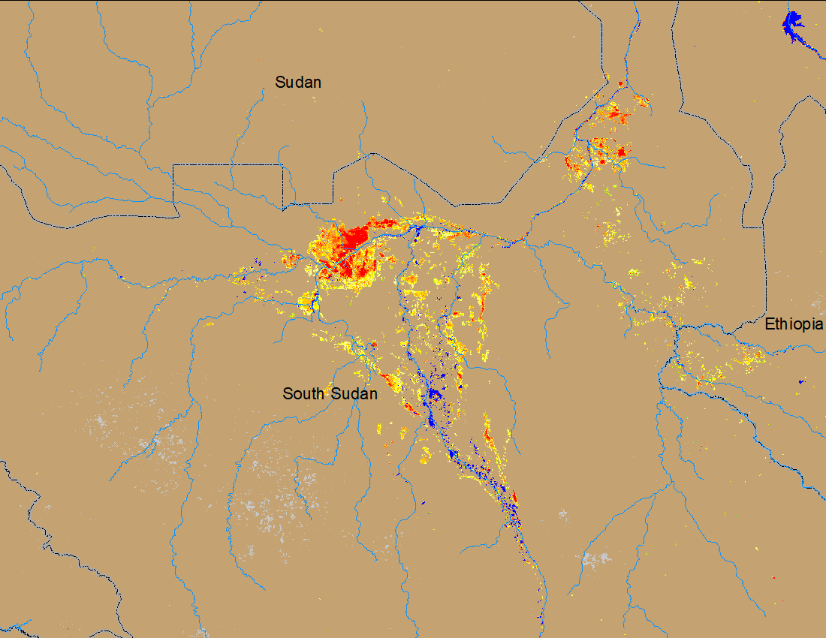
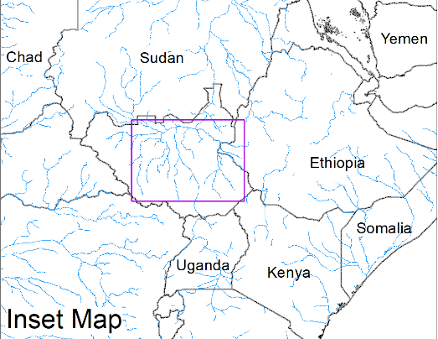
Flooding Conditions in South Sudan
(% of the pixel)
(% of the pixel)
White Nile
Sobet
Akobo
Pibor
NOAA VIIRS 5-day comp.: 5 – 9 Apr 2023
NOAA VIIRS 5-day comp.: 10 – 14 May 2023
More areas are flood free especially in Sobet, Akobo and Pibor catchments but still considerable amount of areas under water along the White Nile in South Sudan.

Slide 3
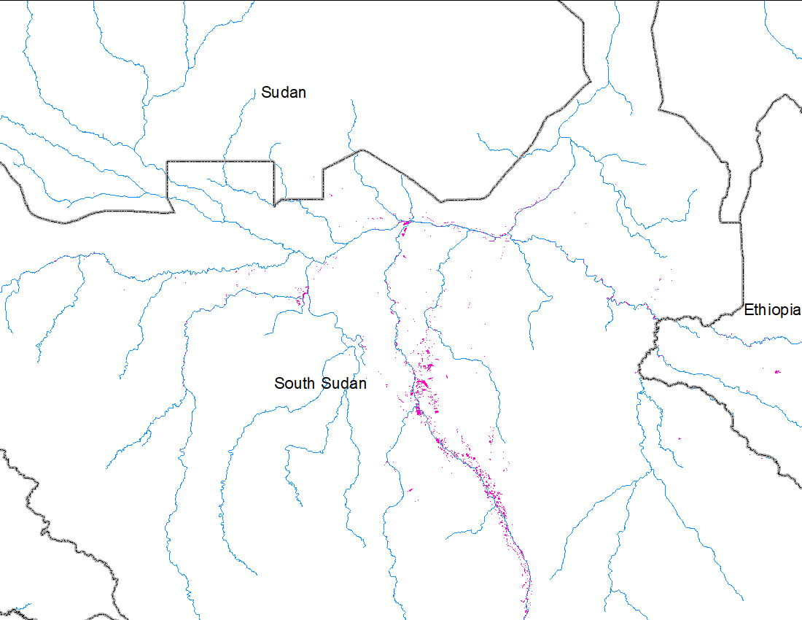
Minimum Extent of Sudd Wetlands
(% of the pixel)
White Nile
Sobet
Akobo
Pibor
Water
Minimum extent of water: JRC permanent water for six or more months in a year (2021).
NOAA VIIRS 5-day comp.: 10 – 14 May 2023
Inundated areas compared to naturally expected wetland extent in the Sudd Wetlands of South Sudan.

Slide 4
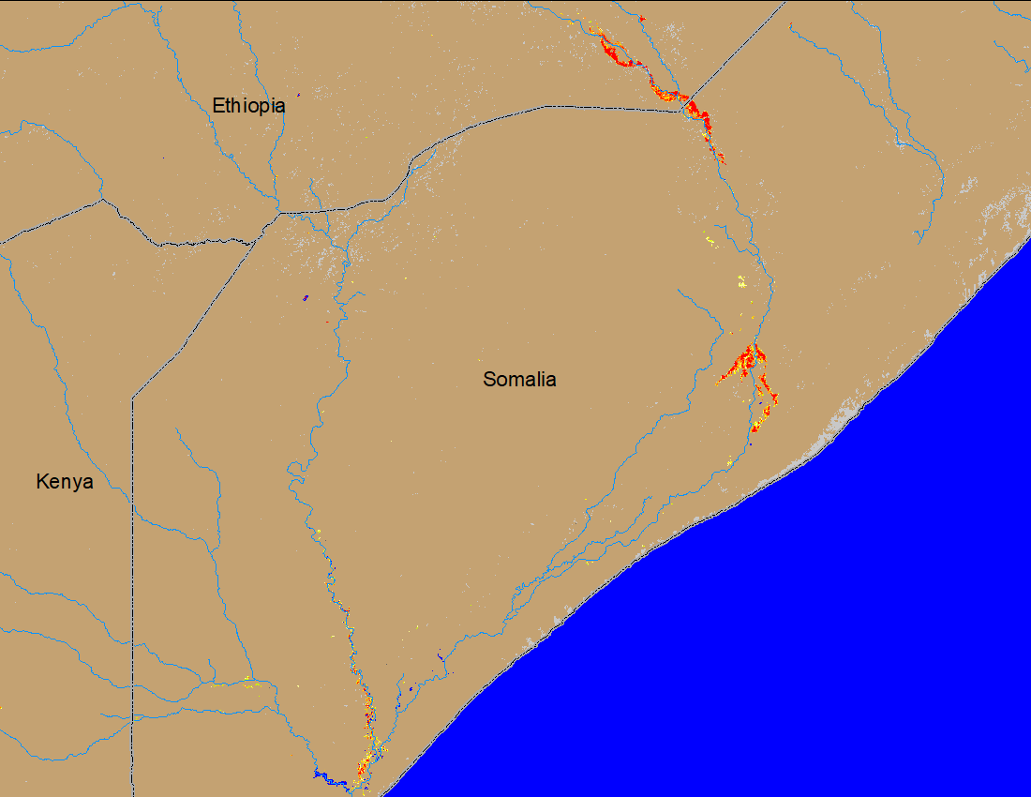
Flooding Conditions in Shebelle River
Beled Weyne
Beled Weyne
PlanetScope: 7 May 2023
PlanetScope: 12 May 2023
(% of the pixel)
Thanks to Laura Harrison for providing the PlanetScope images
NOAA VIIRS 5-day comp.: 11 – 14 Map 2023
Flooding intensifying along the Shabelle and downstream of Juba Rivers in Somalia.

Slide 5
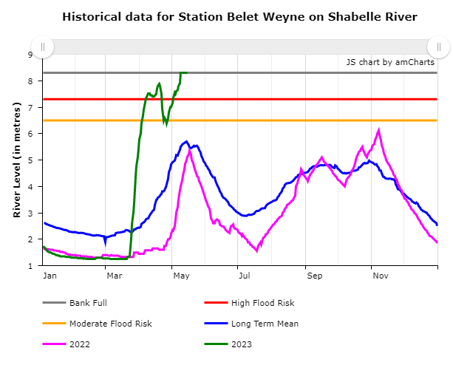
Flooding Conditions in Shebelle River
The water level in Shabelle at Belet Weyne, Somalia crossed danger level twice within a month.
Currently the water level at Belet Weyne is 1m above the flood danger level.
The water level at Bulo Burti, downstream of Belet Weyne is also very close to flood danger level.
High likelihood of flooding at Bulo Burti, Somalia.
SWALIM observed water level: 14 May 2023

Slide 6
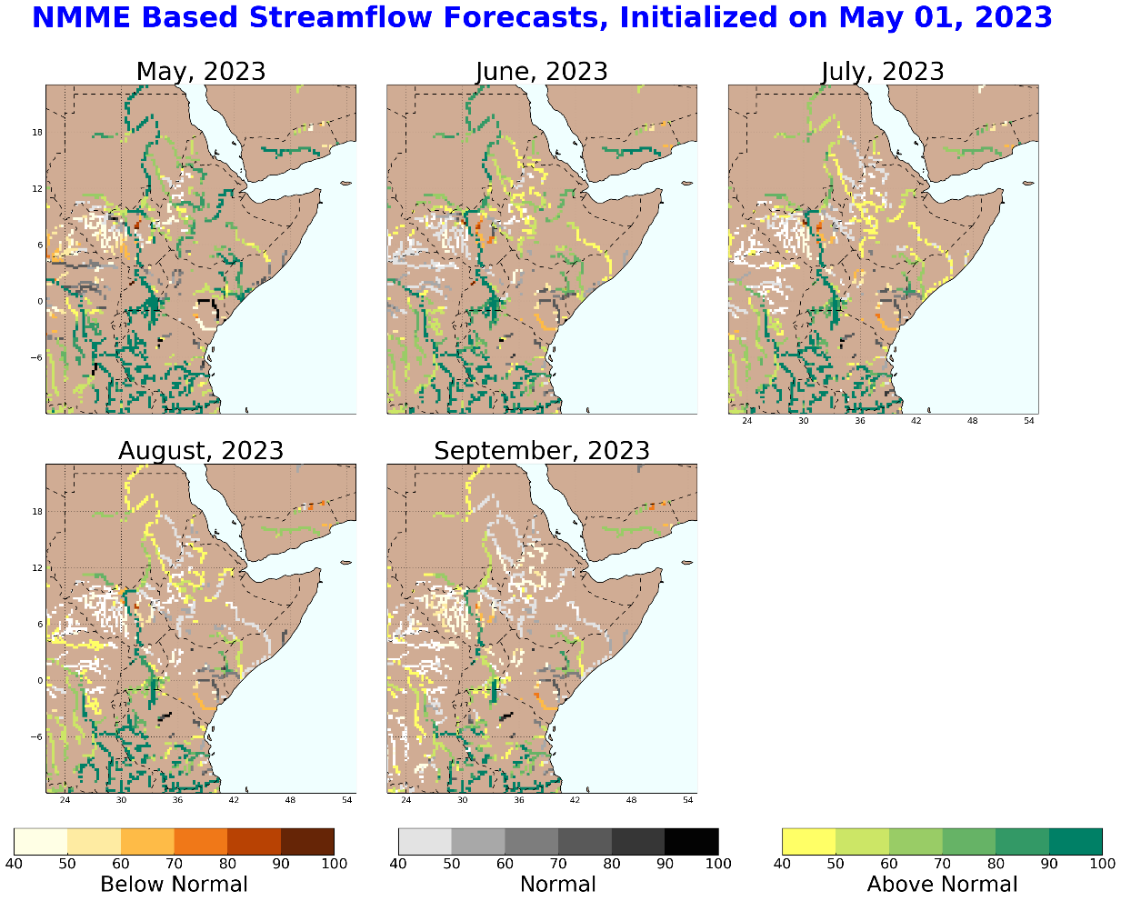
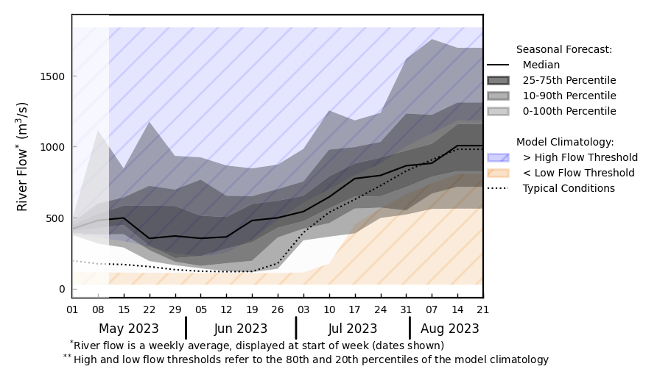
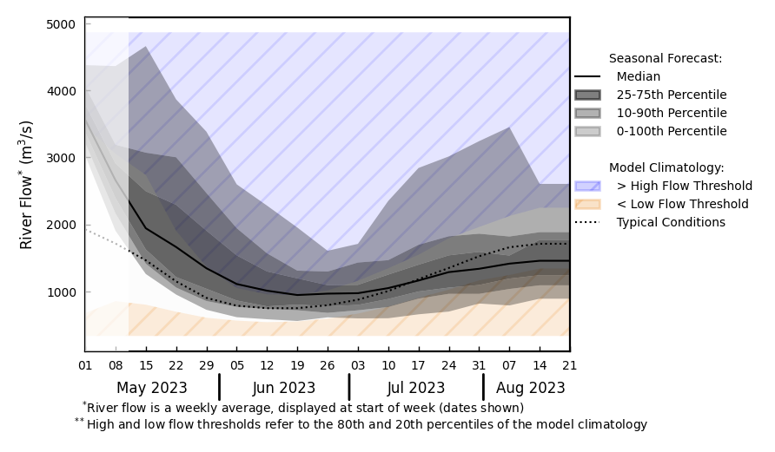
Seasonal Streamflow Forecast
@ point A: Awash River, Ethiopia
A
B
@ point B: Shebelle at Belet Somalia
Shebelle high water level to continue till early June, high likelihood for more flooding downstream.
Flooding also possible along the Awash River in Ethiopia.
However, discharges in White Nile and Nile are expected to be below average during Jun-Aug.
GloFAS monthly streamflow forecast (May - Aug 2023)

Slide 7
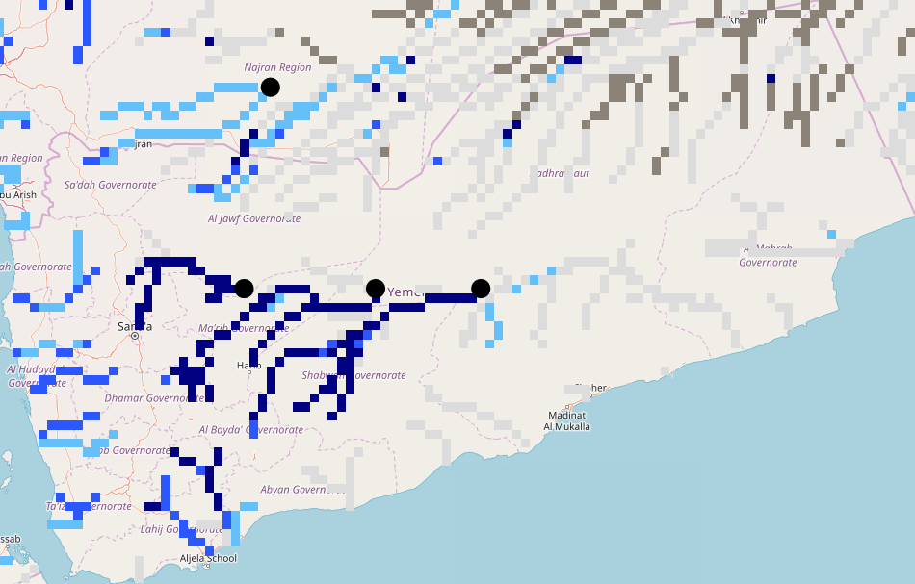
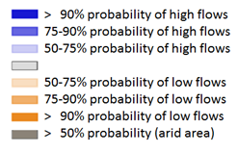
Seasonal Streamflow Forecast (Yemen)
A
GloFAS monthly streamflow forecast (May - Aug 2023)
NHyFAS Seasonal forecast (Jun-Sep 2023)
Above average streamflow is expected across much of western Yemen especially during Jun-Jul-Aug period. Flooding possible in the wadi’s in western Yemen.

Slide 8
Flooding Risk (seasonal forecast)
There are flooding along Shebelle River in Ethiopia and Somalia, and downstream of Juba River in Somalia.
Shabelle water level at Beled Weyne in Somalia currently running 1m above the flood danger level. Water level at Bulo Burti is also very close to flood danger level. Hight likelihood of flooding along the Shabelle River in Somalia.
Above average streamflow is expected in the Awash River in Ethiopia.
However, discharges are expected to be below average in the White Nile and Nile Rivers during Jun – Sep period.

