Slide 1
FEWS NET Enhanced Flood Monitoring and Forecast Assumptions-East Africa and Yemen
March 2023 Seasonal Forecast
FEWS NET Science Team:
USGS, NASA, NOAA, UCSB+Regional Scientists

Slide 2
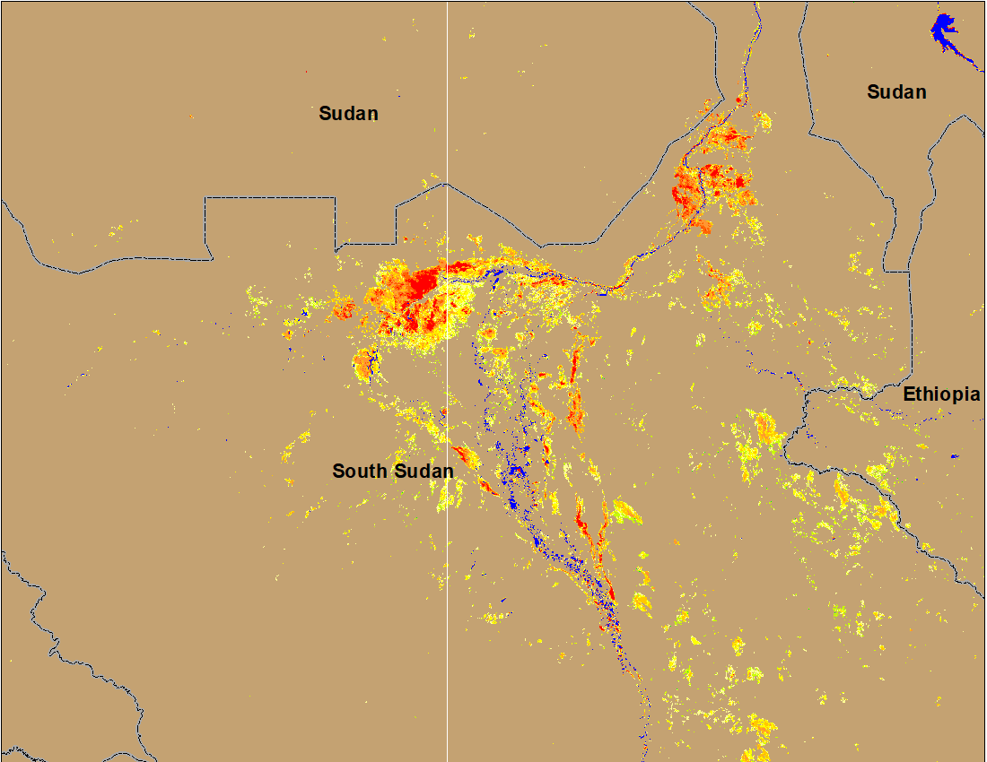
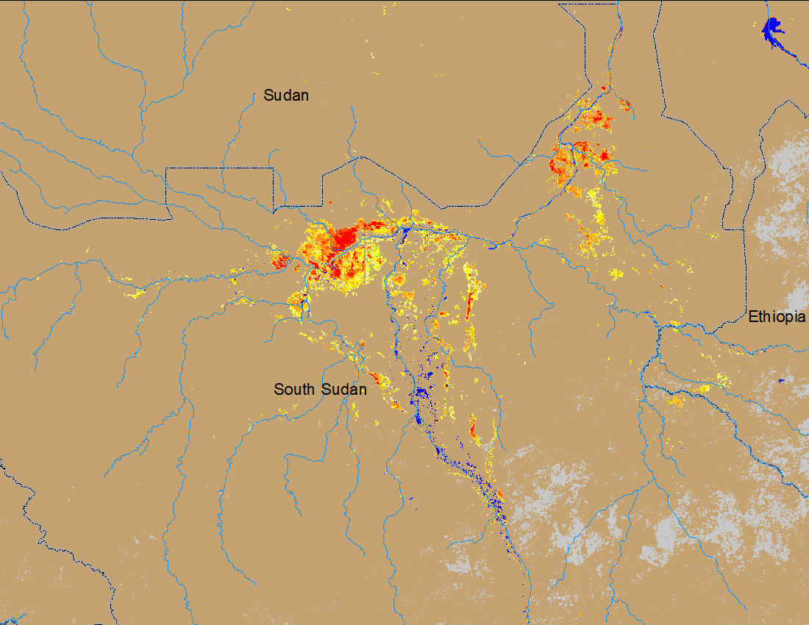
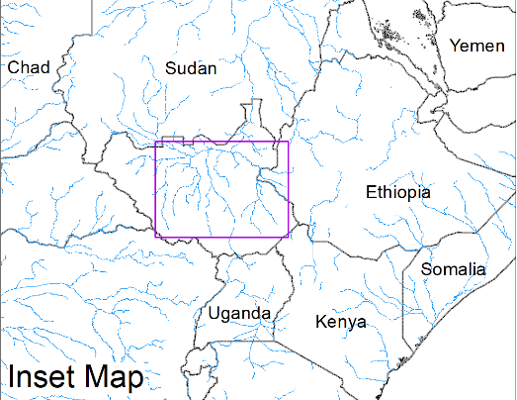
Flooding Conditions in South Sudan
(% of the pixel)
(% of the pixel)
White Nile
Sobet
Akobo
Pibor
NOAA VIIRS 5-day comp.: 8 – 12 Feb 2023
NOAA VIIRS 5-day comp.: 7 – 11 Mar 2023
Many of the areas in the Sobet, Akobo, and Pibor River catchments have dried out during last 30 days.

Slide 3
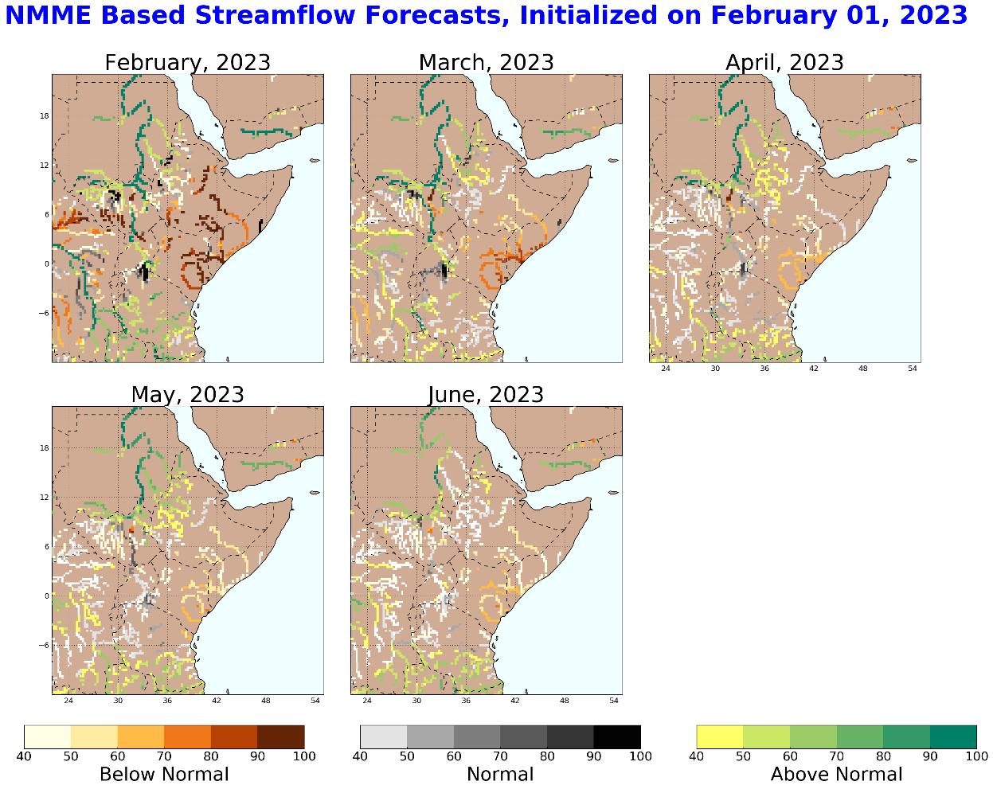
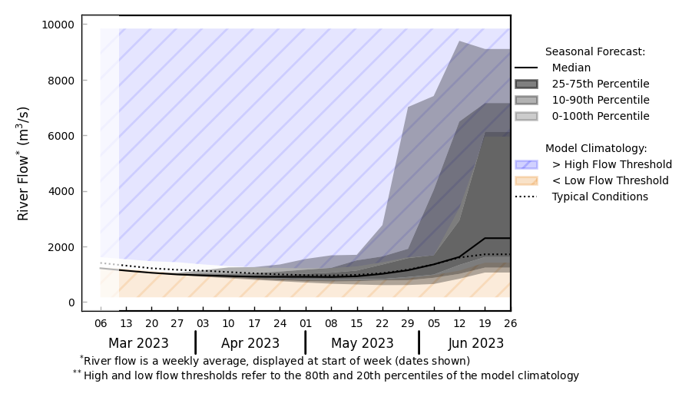
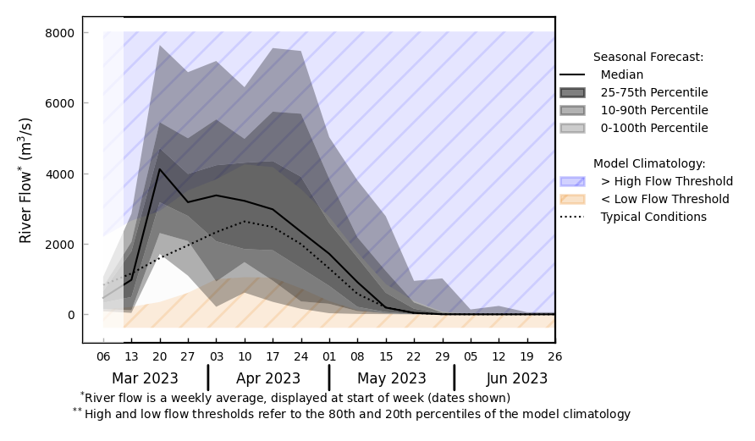
Seasonal Streamflow Forecast
Blue Nile in Ethiopia
@ Point A on the Blue Nile in Ethiopia.
- Average flow
A
B
Victoria Nile
@ point B on the Victoria Nile in Southern Uganda.
Seasonally low flow to continue till mid-April in Nile and Blue Nile Rivers.
However, Victoria Nile in Uganda is expected to have above average flow in March and April of 2023.
GloFAS monthly streamflow forecast (Mar - Jun 2023)

Slide 4
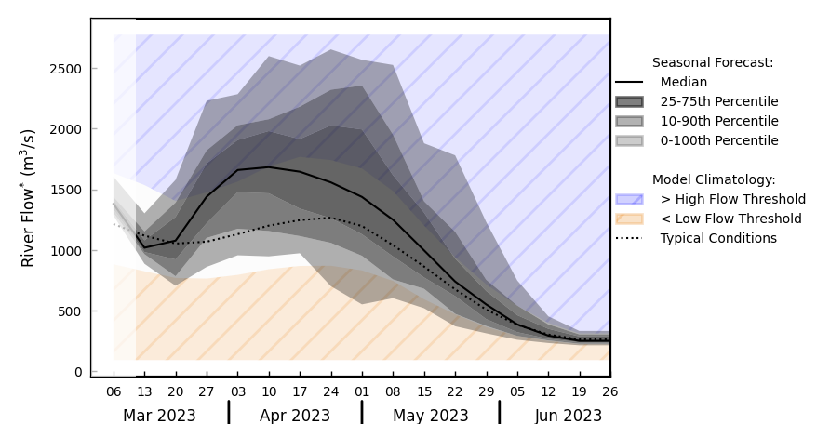
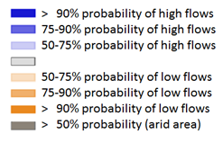
Seasonal Streamflow Forecast in Rwanda and Burundi
GloFAS monthly streamflow forecast (Mar - Jun 2023)
Above average streamflow is expected in Rwanda, average in Burundi.
Streamflow to peak in early April, flooding possible in low lying areas in Rwanda in April.
GloFAS seasonal streamflow forecast (Mar - Jun 2023)

Slide 5
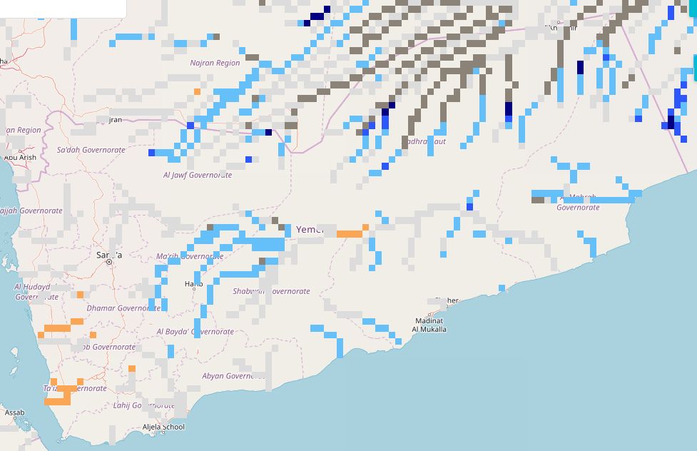
Seasonal Streamflow Forecast (Yemen)
A
GloFAS monthly streamflow forecast (Mar - Jun 2023)
NHyFAS Seasonal forecast (Mar-Jun 2023)
Average to above average streamflow is expected across much of Yemen especially during April-May-June period.

Slide 6
Flooding Risk (seasonal forecast)
Low flow continues in the rivers across East Africa, and discharges are not expected to increase until April of 2023.
Across Sudd Wetlands, areas have dried out in Sobet, Akobo, and Pibor River catchments.
However, upstream of Victoria Nile in Uganda, and rivers in Rwanda and Burindi is expected to have above average to average flow during Mar-April-May.
Flooding possible in low lying areas in Southern Uganda and Rwanda in April.

