Slide 1
FEWS NET Enhanced Flood Monitoring and Forecast Assumptions-East Africa and Yemen
June 2023 Seasonal Forecast
FEWS NET Science Team:
USGS, NASA, NOAA, UCSB+Regional Scientists

Slide 2
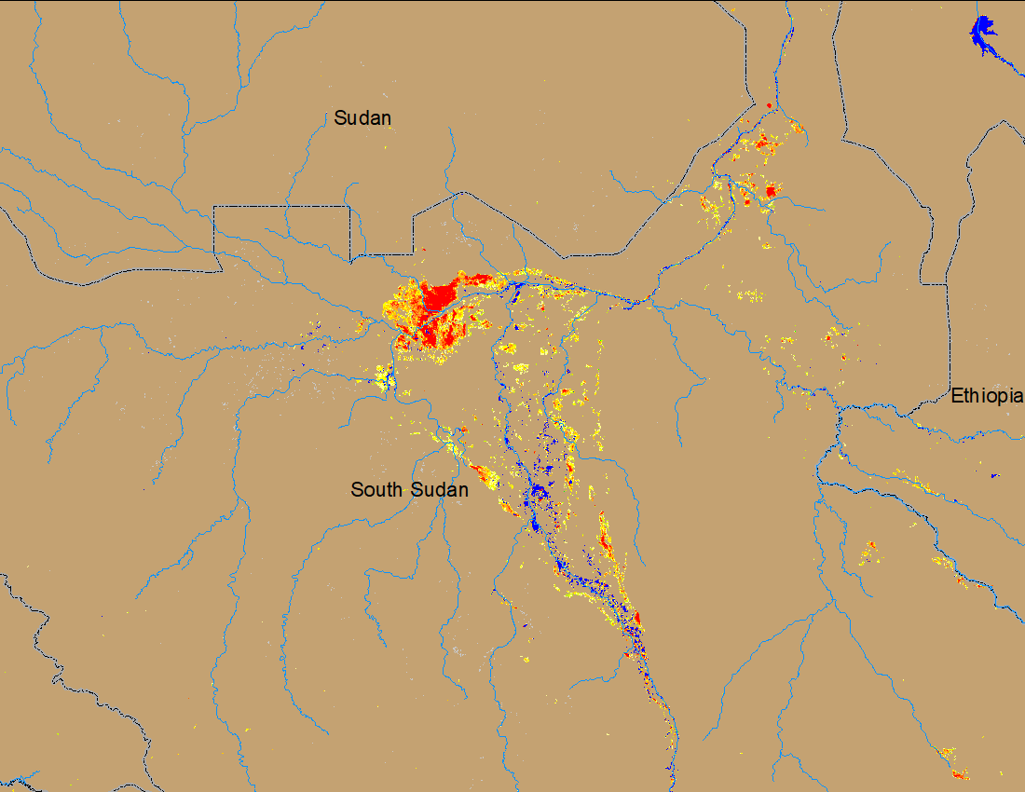
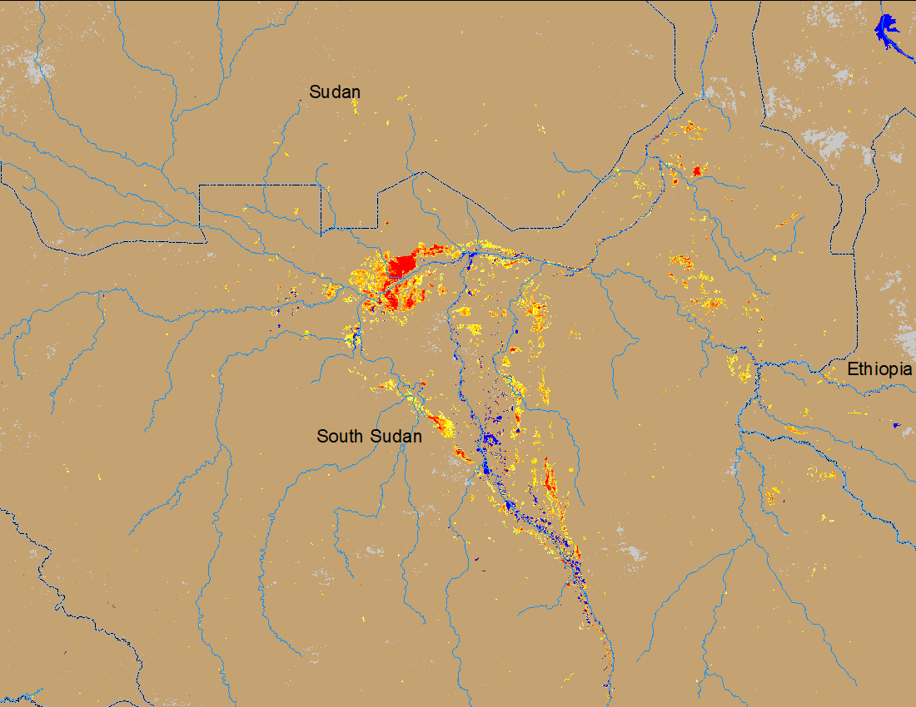
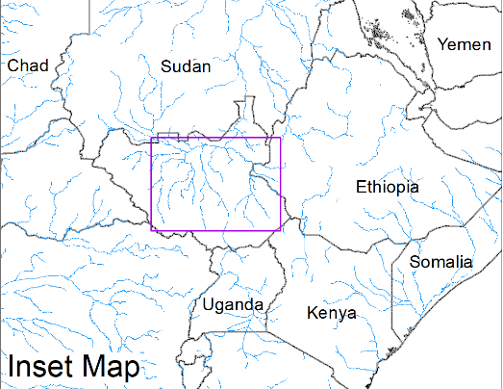
Flooding Conditions in South Sudan
(% of the pixel)
(% of the pixel)
White Nile
Sobet
Akobo
Pibor
NOAA VIIRS 5-day comp.: 10 – 14 May 2023
NOAA VIIRS 5-day comp.: 15 – 19 June 2023
New flooded areas are emerging along Sobet and Akobo catchments and considerable amount of areas under water along the White Nile in South Sudan.

Slide 3
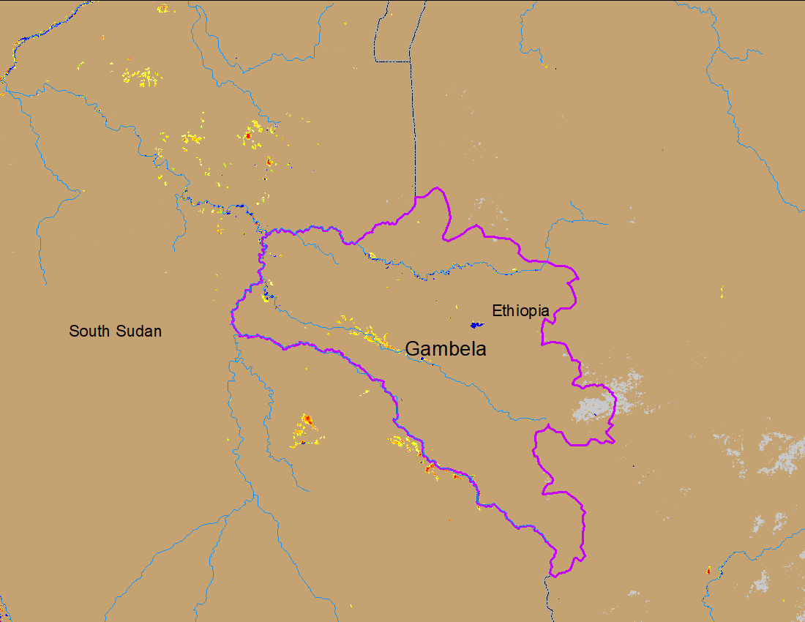
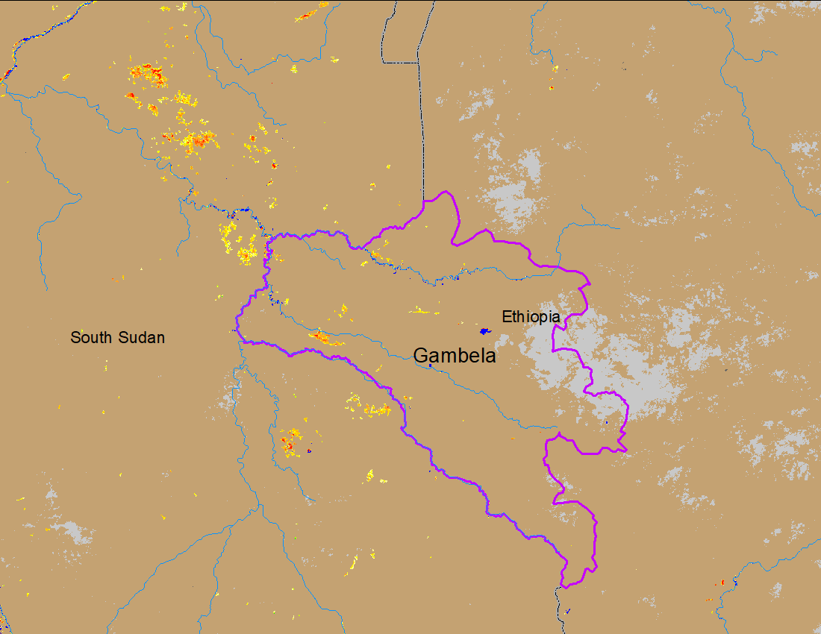
Flooding in Gambela region of Ethiopia
(% of the pixel)
(% of the pixel)
Sobet
Akobo
NOAA VIIRS 5-day comp.: 10 – 14 May 2023
NOAA VIIRS 5-day comp.: 15 – 19 June 2023
Flooding in the Sobet and Akobo catchment is increasing including in Gambela region of Ethiopia.
A Charter activation is in the process for flooding in Gambela region.

Slide 4
Receding Water Level in Shebelle River
Water level receded to well below bankfull at all gauge stations along Shabelle River.
SWALIM observed water level: 20 June 2023

Slide 5
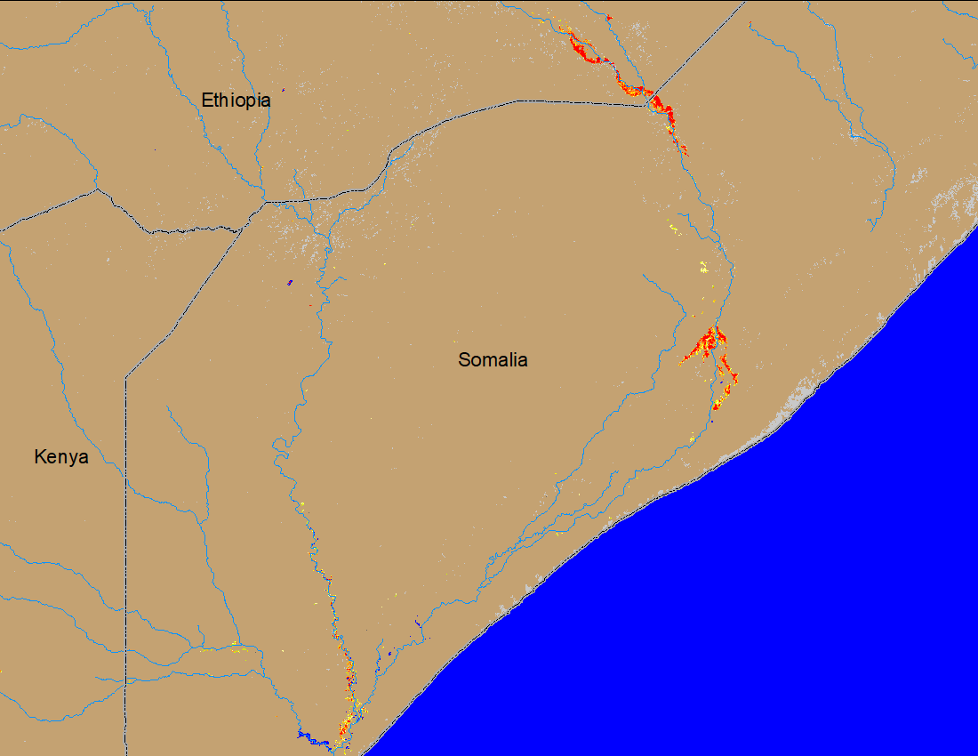
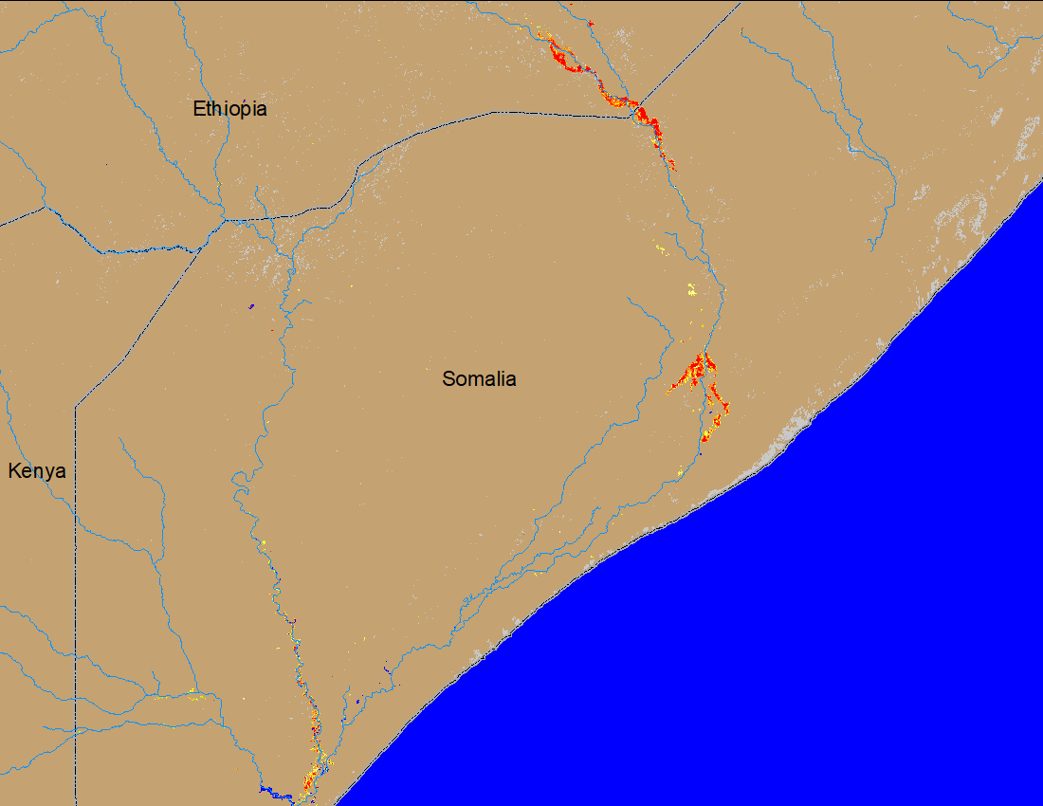
Flooding Conditions in Shebelle River
Beled Weyne
Johar
(% of the pixel)
(% of the pixel)
NOAA VIIRS 5-day comp.: 11 – 14 May 2023
NOAA VIIRS 5-day comp.: 15 – 19 June 2023
However, flood water have yet to receded completely in Beled Weyne and Johar regions.

Slide 6
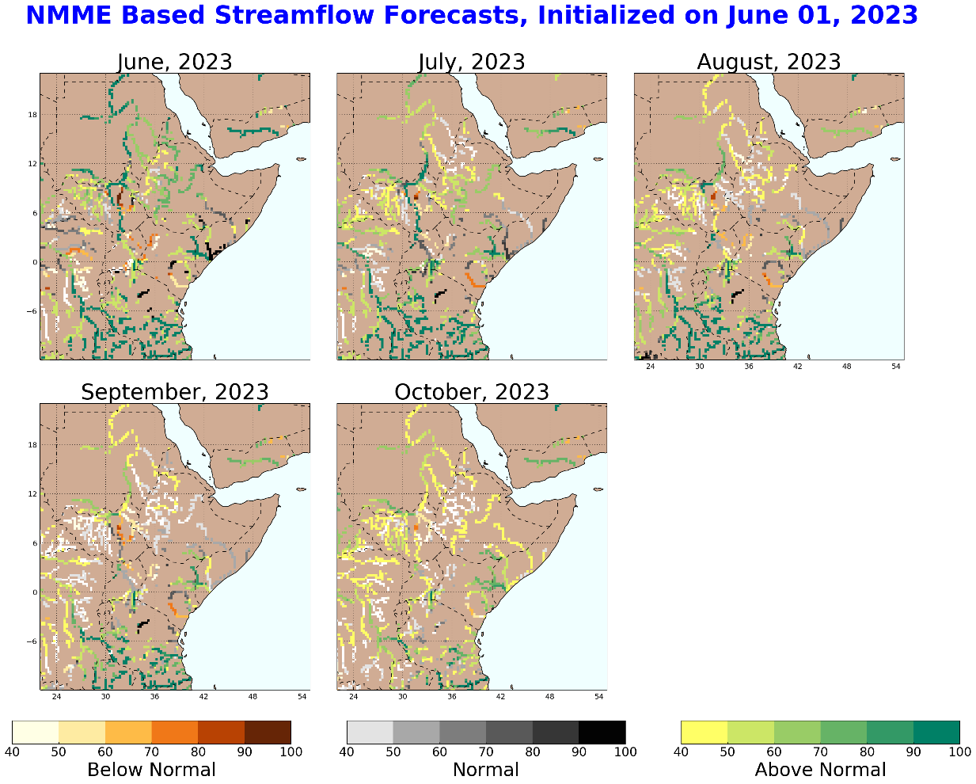
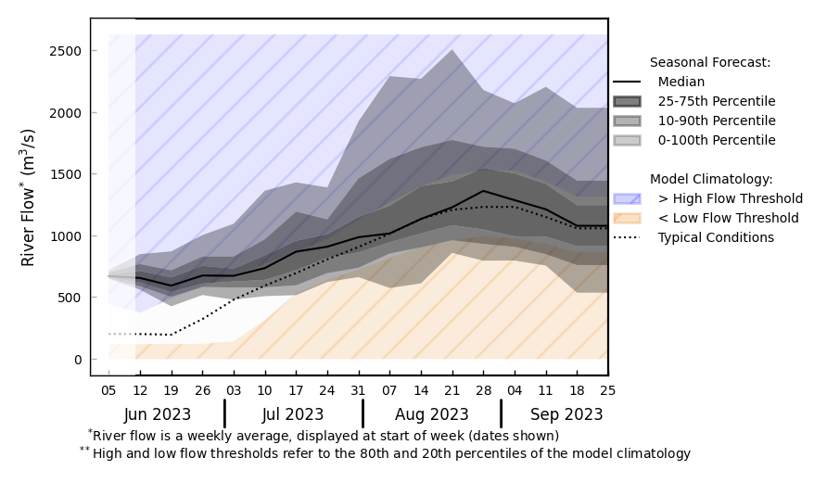
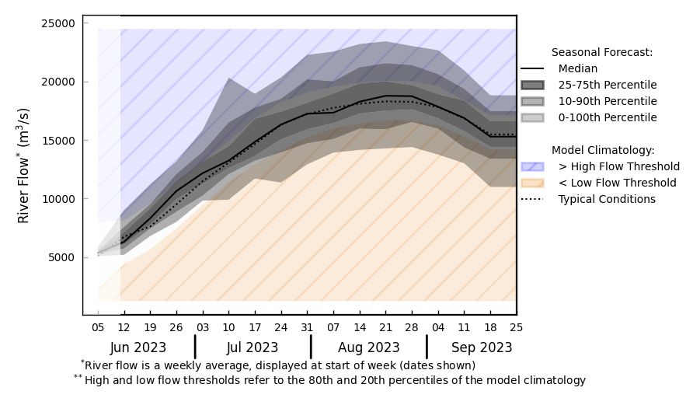
Seasonal Streamflow Forecast
@ point A: Awash River, Ethiopia
B
A
Discharges in the rivers across EA started to increase.
Average to above average discharges are expected in Awash, Blue Nile, and Atbara Rivers during Jun-Sep 2023.
Discharges in Shabelle expected to remain average to below average during Jun-Sep 2023.
@ point B: Blue Nile, Sudan
GloFAS monthly streamflow forecast (Jun - Sep 2023)

Slide 7
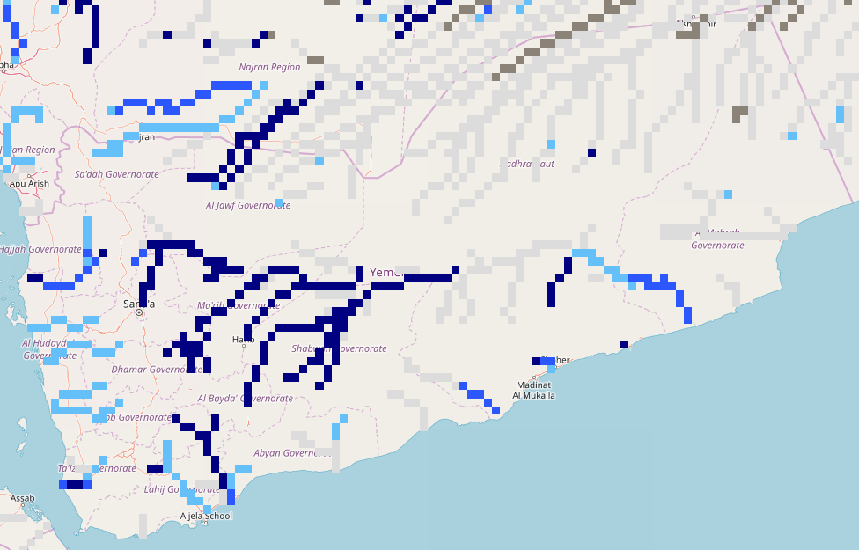
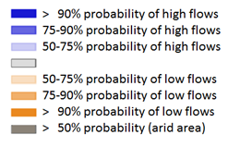
Seasonal Streamflow Forecast (Yemen)
A
NHyFAS Seasonal forecast (Jun-Sep 2023)
GloFAS monthly streamflow forecast (Jun - Sep 2023)
Above average streamflow is expected across much of Yemen during Jun-Sep period.
Increased likelihood of flooding in the wadi’s across Yemen.

Slide 8
Flooding Risk (seasonal forecast)
Flooding in the catchments of Sobet and Akobo Rivers in South Sudan and Ethiopia are increasing.
While water levels in the Shabelle River receded to well below average, the flood water have yet to recede completely in the Beletwyene and Johar regions.
Average to above average discharges are expected in Awash, Blue Nile, and Atbara Rivers during Jun-Sep 2023.

