Slide 1
FEWS NET Enhanced Flood Monitoring and Forecast Assumptions-East Africa and Yemen
January 2023 Seasonal Forecast
FEWS NET Science Team:
USGS, NASA, NOAA, UCSB+Regional Scientists

Slide 2
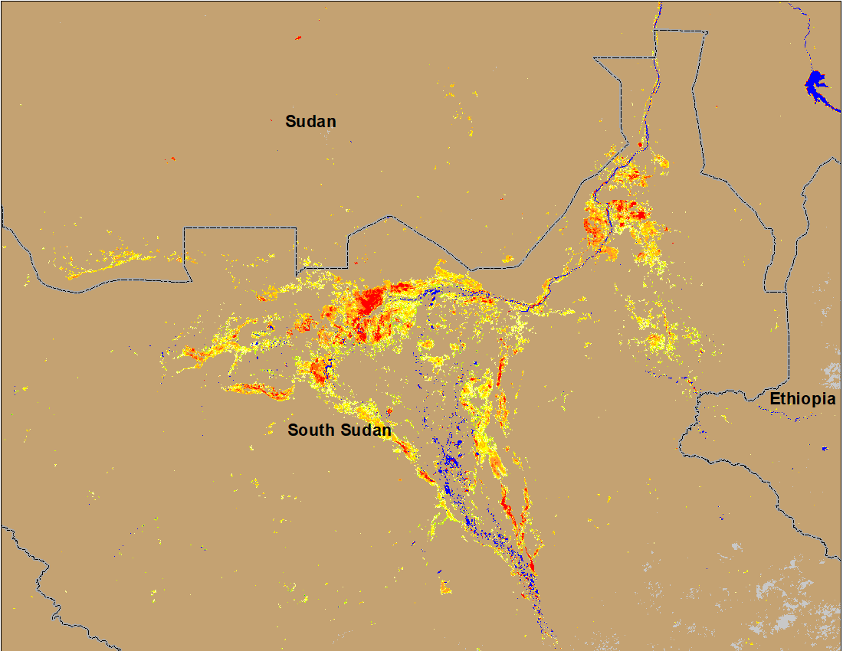
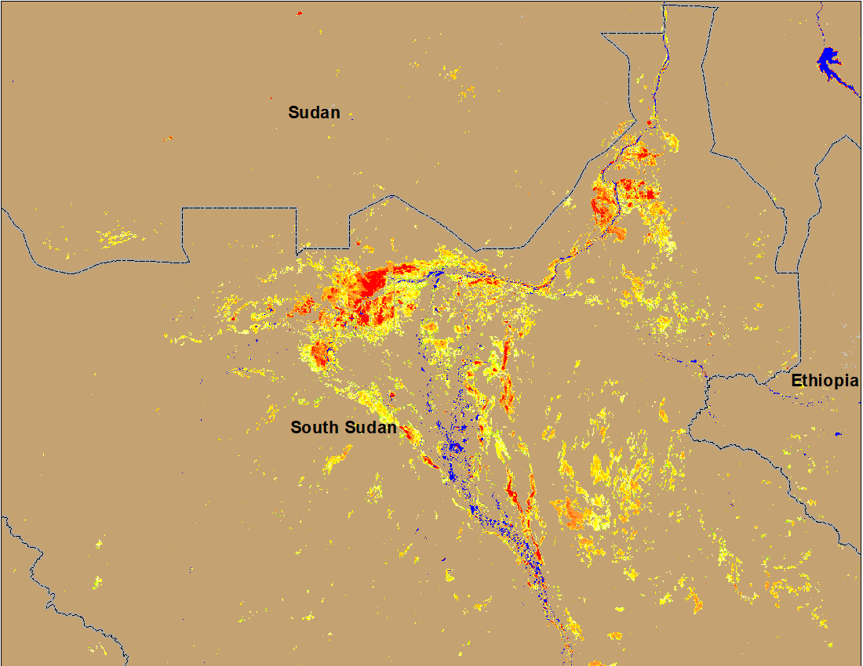
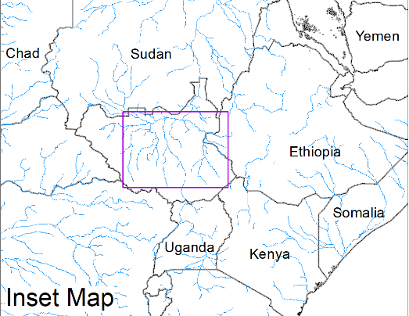
Flooding Conditions in South Sudan
(% of the pixel)
(% of the pixel)
White Nile
Sobet
Akobo
Pibor
NOAA VIIRS 5-day comp.: 9 – 13 Dec 2023
NOAA VIIRS 5-day comp.: 11 – 15 Jan 2023
Despite being in the dry period, inundation extent is increasing in the Sudd Wetlands.

Slide 3
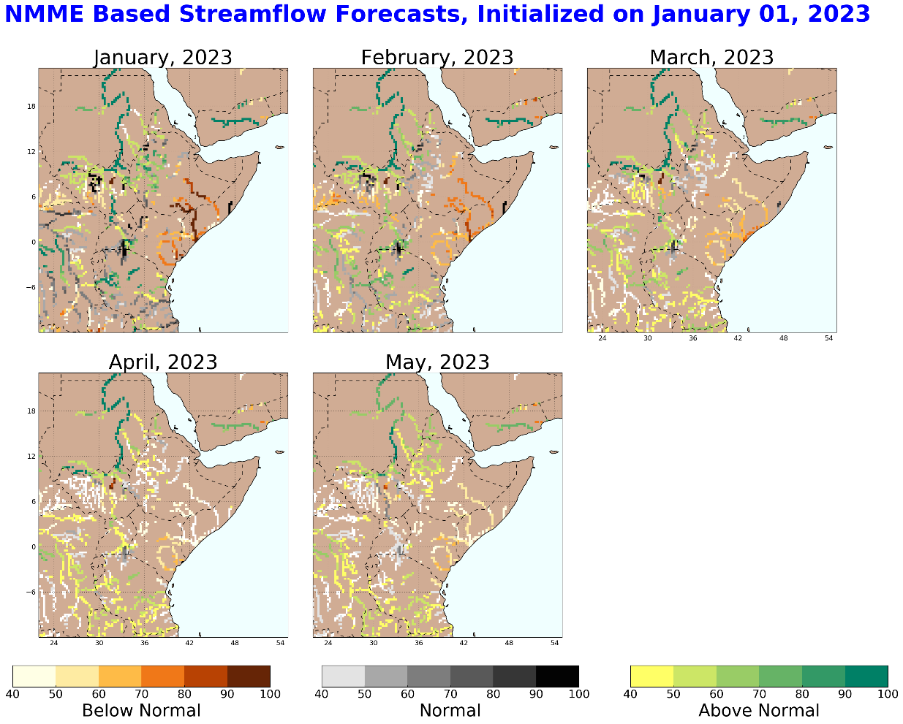
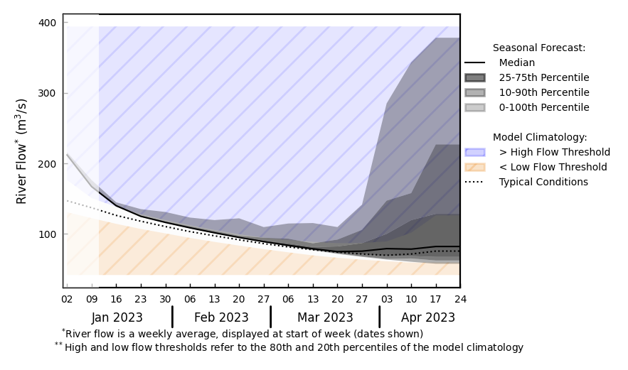
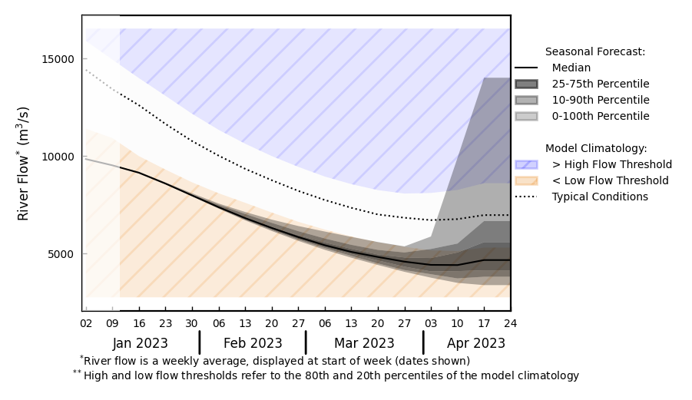
Seasonal Streamflow Forecast
@ Point A on upstream Blue Nile in Ethiopia.
- Average to above average flow
Upstream Blue Nile in Ethiopia
A
B
White Nile
@ point B on the White Nile.
-Below average flow
Climatologically dryer conditions are expected across East Africa. No concerns for flooding except in Sudd Wetlands area.
GloFAS monthly streamflow forecast (Jan - Apr 2023)

Slide 4
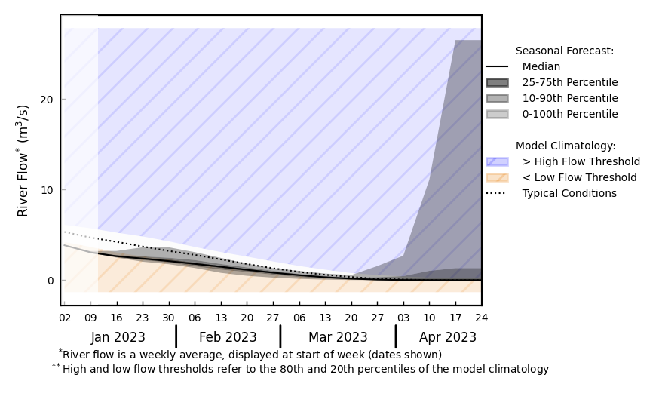
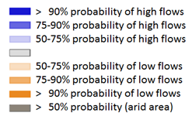
Seasonal Streamflow Forecast (Yemen)
@ Point A on a Wadi in Yemen.
A
GloFAS monthly streamflow forecast (Jan - Apr 2023)
GloFAS Seasonal forecast (Oct-Jan)
Climatologically below average flow is the forecast through the dry season.

Slide 5
Flooding Risk (seasonal forecast)
Climatologically below average discharges are expected through the dry period across East Africa except in the upstream of Blue Nile in Ethiopia.
However, inundated areas have increased significantly in South Sudan (Sudd Wetlands) most likely because of existing high-water levels and anomalous rainfall in the upstream.

