Slide 1
FEWS NET Enhanced Flood Monitoring and Forecast Assumptions-East Africa and Yemen
February 2023 Seasonal Forecast
FEWS NET Science Team:
USGS, NASA, NOAA, UCSB+Regional Scientists

Slide 2
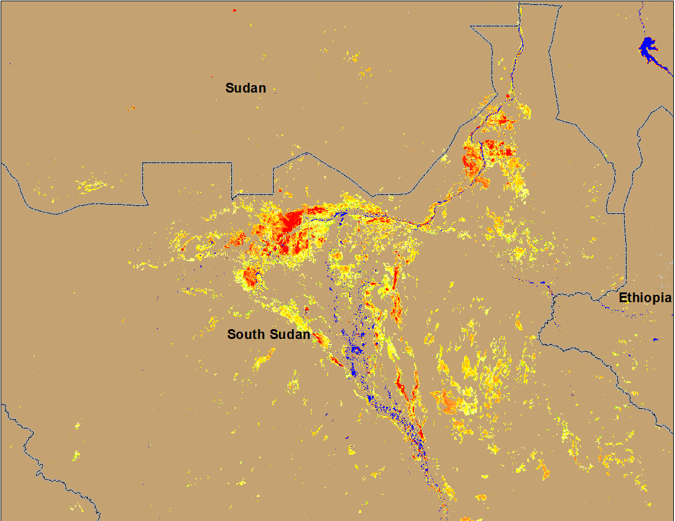
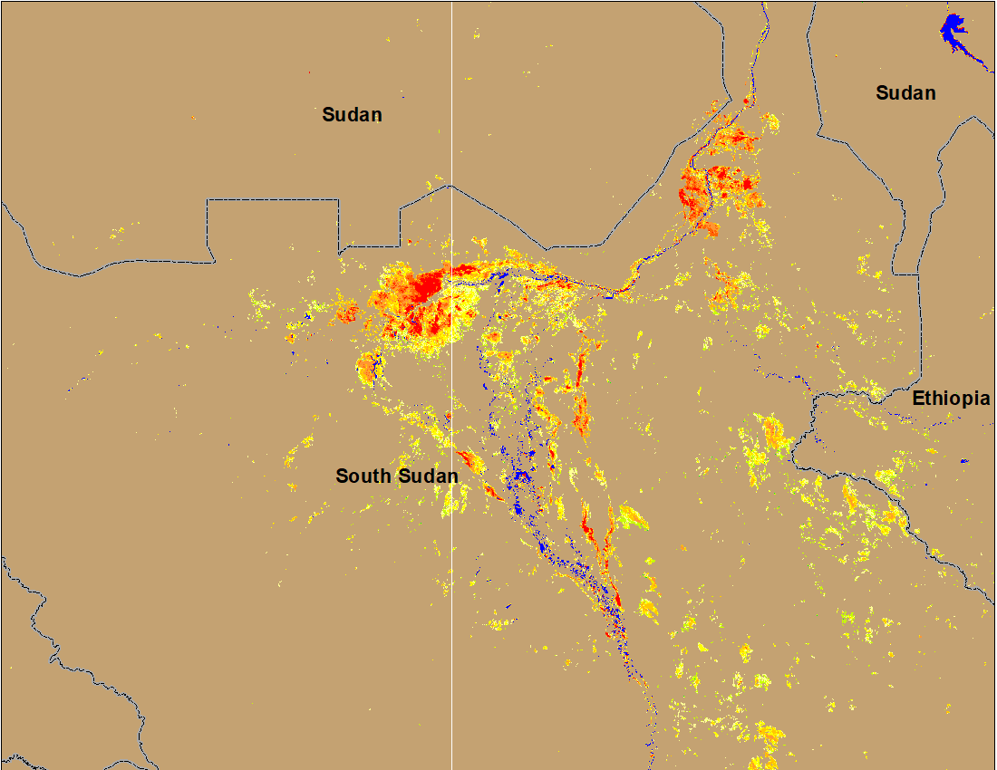
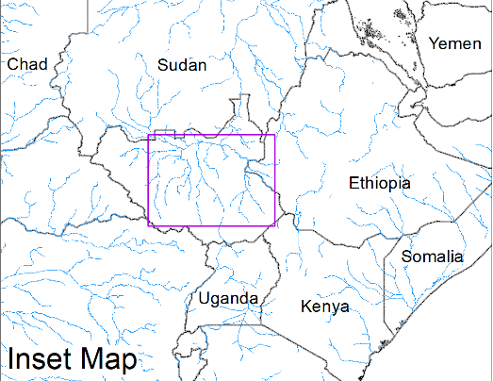
Flooding Conditions in South Sudan
(% of the pixel)
(% of the pixel)
White Nile
Sobet
Akobo
Pibor
NOAA VIIRS 5-day comp.: 11 – 15 Jan 2023
NOAA VIIRS 5-day comp.: 11 – 15 Jan 2023
Unusually large areas still under water in the Sudd Wetlands through to dry period.

Slide 3
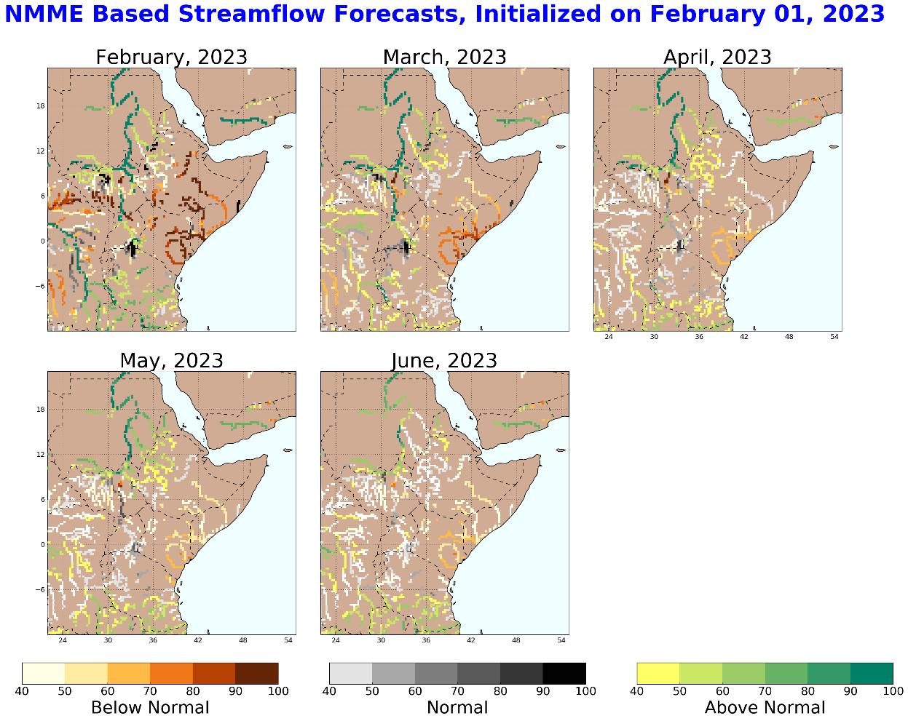
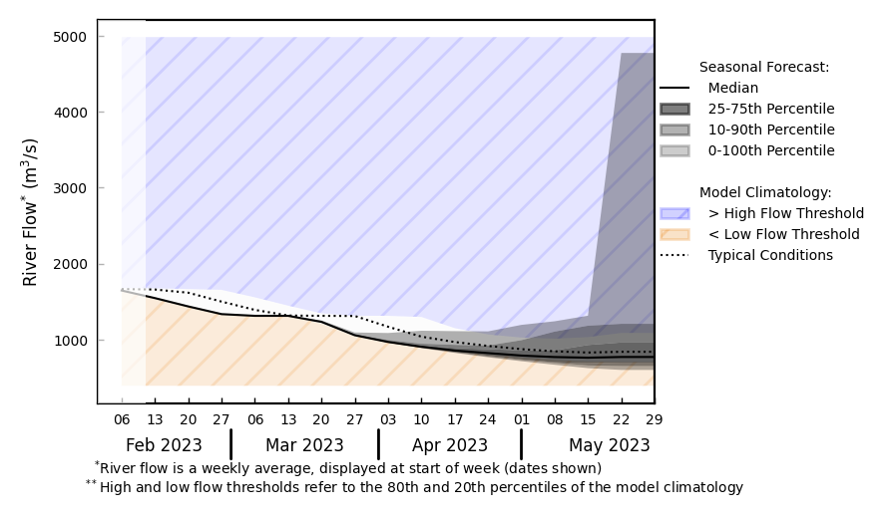
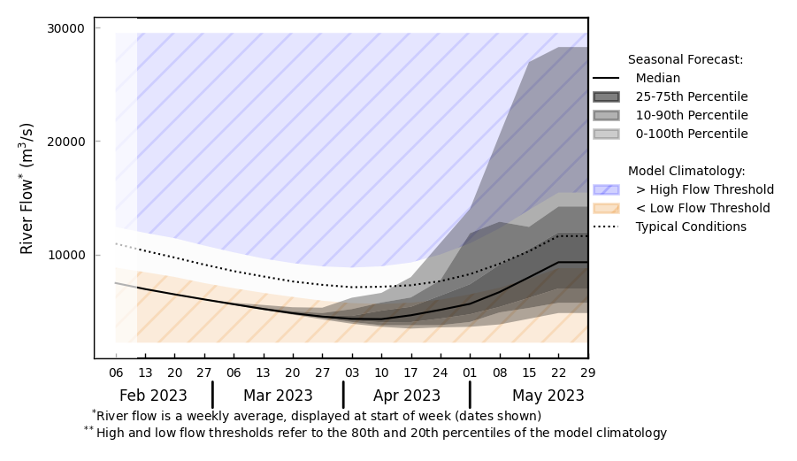
Seasonal Streamflow Forecast
@ Point A on the Blue Nile in Ethiopia.
- Average flow
Blue Nile in Ethiopia
B
A
White Nile
@ point B on the White Nile.
Seasonally low flow to continue till mid-April. No concerns for flooding except in Sudd Wetlands area.
GloFAS monthly streamflow forecast (Feb - May 2023)

Slide 4
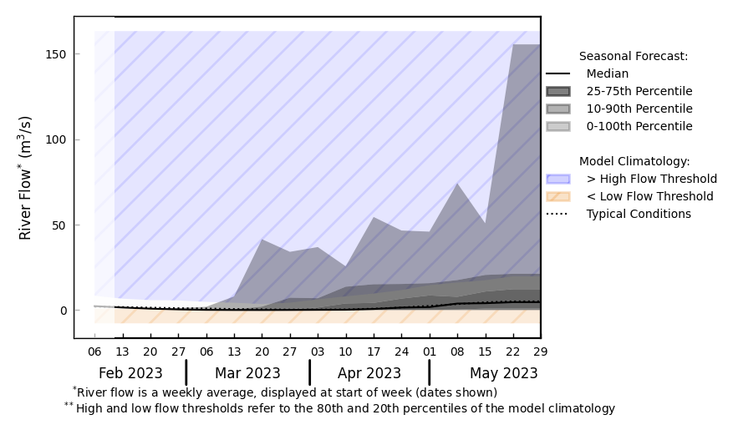
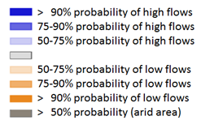
Seasonal Streamflow Forecast (Yemen)
@ Point A on a Wadi in Yemen.
A
GloFAS monthly streamflow forecast (Feb - May 2023)
GloFAS Seasonal forecast (Feb-May 2023)
Climatologically low flow continues, discharges are not expected to increase until mid-March.

Slide 5
Flooding Risk (seasonal forecast)
Low flow continues in the rivers across East Africa, and discharges are not extected to increase until April of 2023.
Unusually large areas are still under water through the dry period in Sudd Wetlands.
No concerns for flooding except in Sudd Wetlands.

