Slide 1
FEWS NET Enhanced Flood Monitoring and Forecast Assumptions-East Africa and Yemen
April 2023 Seasonal Forecast
FEWS NET Science Team:
USGS, NASA, NOAA, UCSB+Regional Scientists

Slide 2
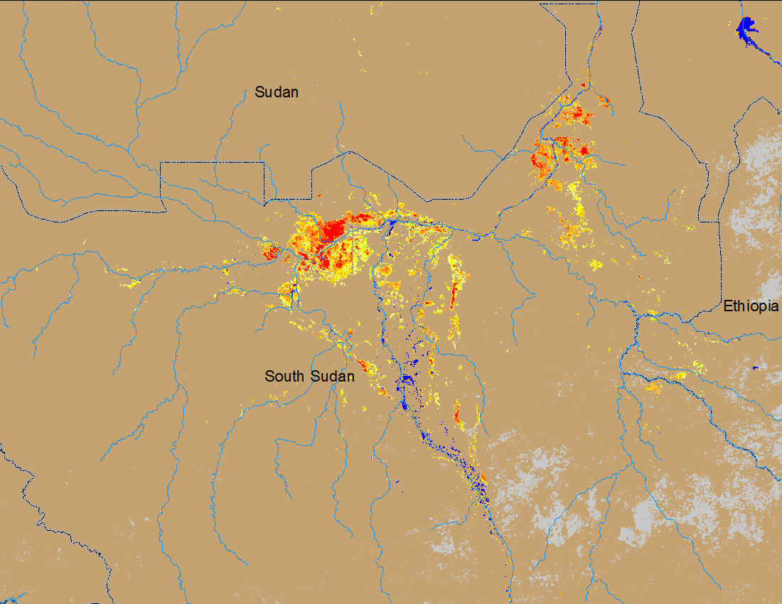
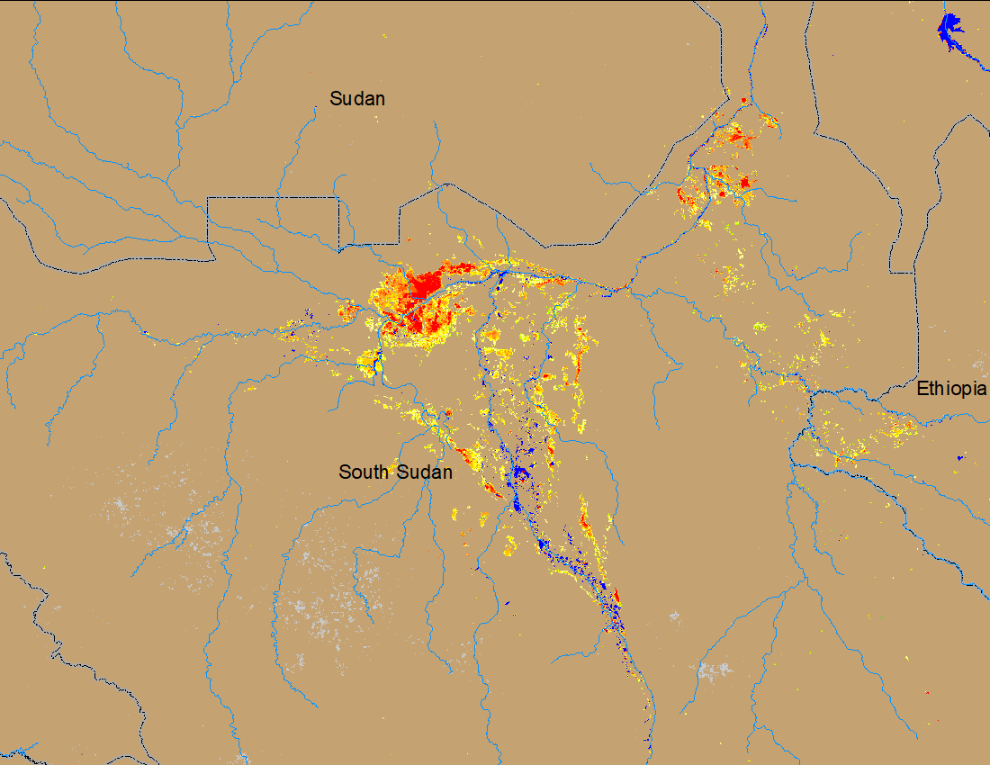
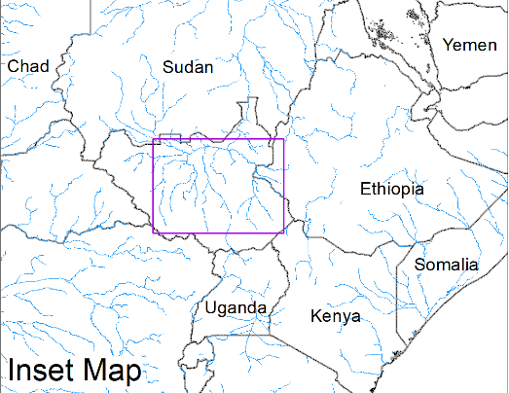
Flooding Conditions in South Sudan
(% of the pixel)
(% of the pixel)
White Nile
Sobet
Akobo
Pibor
NOAA VIIRS 5-day comp.: 7 – 11 Mar 2023
NOAA VIIRS 5-day comp.: 5 – 9 Apr 2023
Flooding conditions in South Sudan remained unchanged.

Slide 3
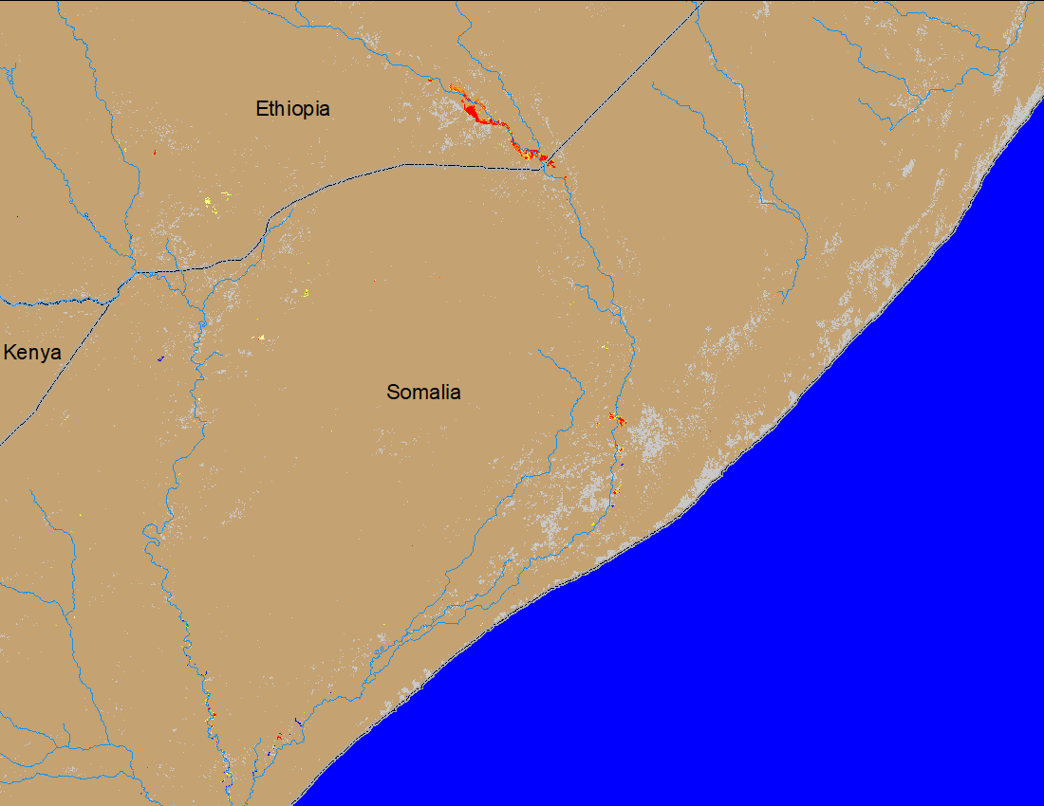
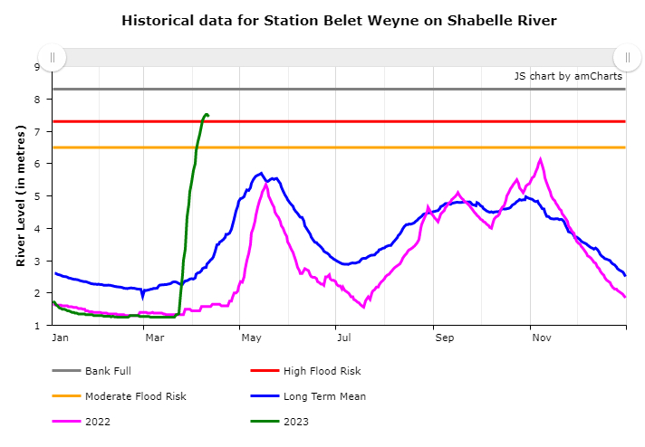
Flooding Conditions in Shebelle River
NOAA VIIRS 5-day comp.: 5 – 9 Apr 2023
SWALIM observed water level: 11 Apr 2023
Current water level in Shebelle between Ethiopia Somalia boarder is ABOVE the flood danger level with flooding in Ethiopia side, more flooding is expected downstream in Somalia.

Slide 4
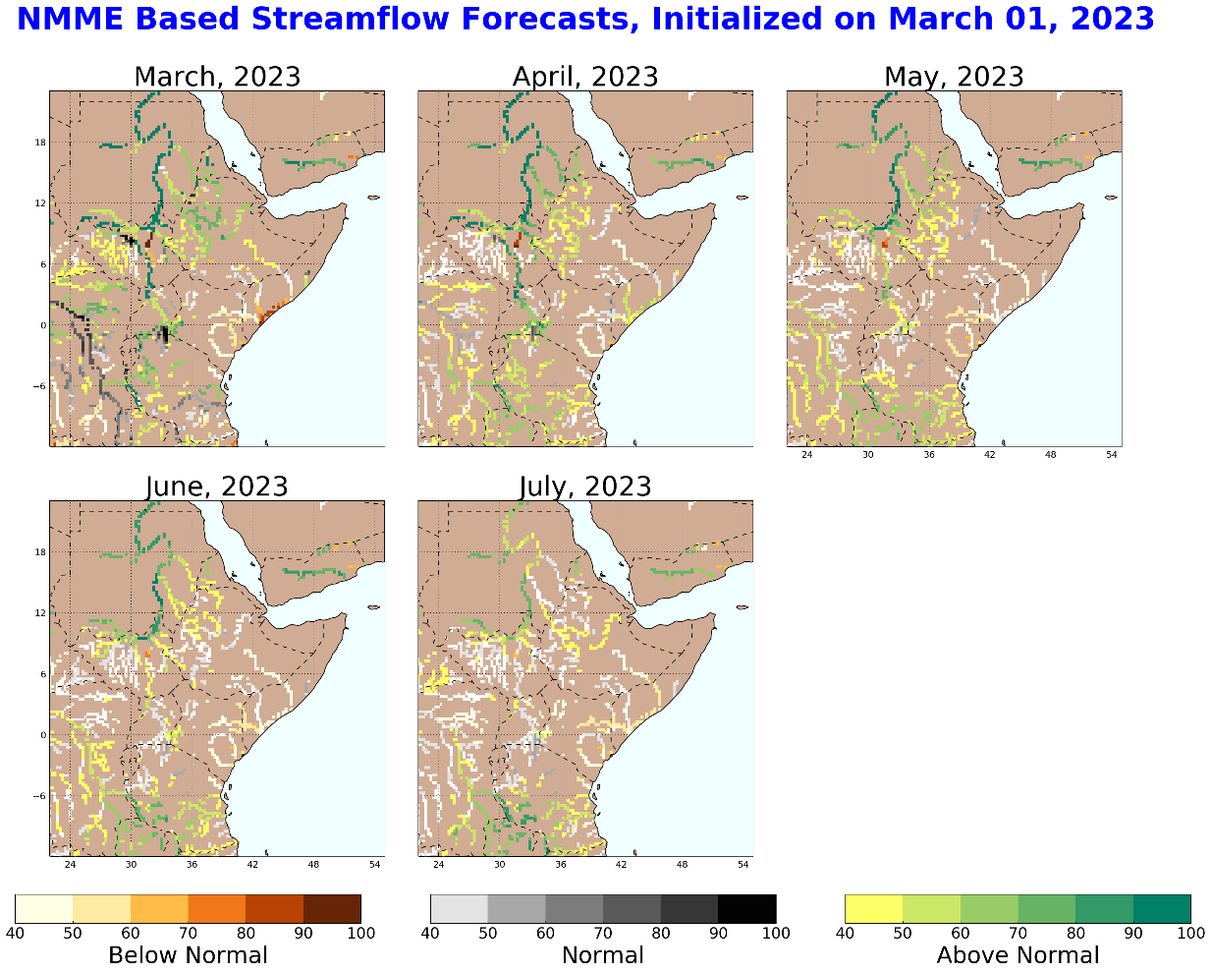
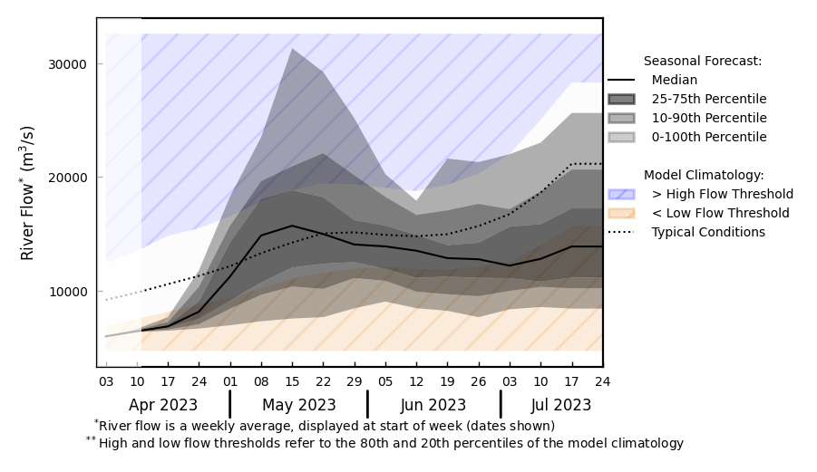
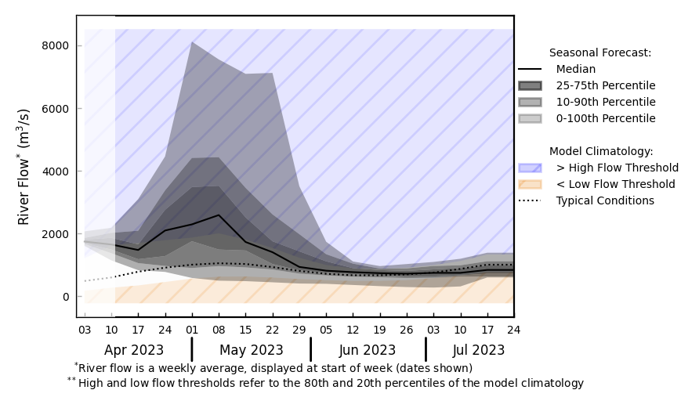
Seasonal Streamflow Forecast
@ point A: White Nile
A
B
@ point B: Shebelle at Belet Somalia
Shebelle high water level to continue till mid-May, high likelihood for more flooding downstream.
Discharges are expected to increase in the Nile in mid-April.
GloFAS monthly streamflow forecast (Apr - Jul 2023)

Slide 5
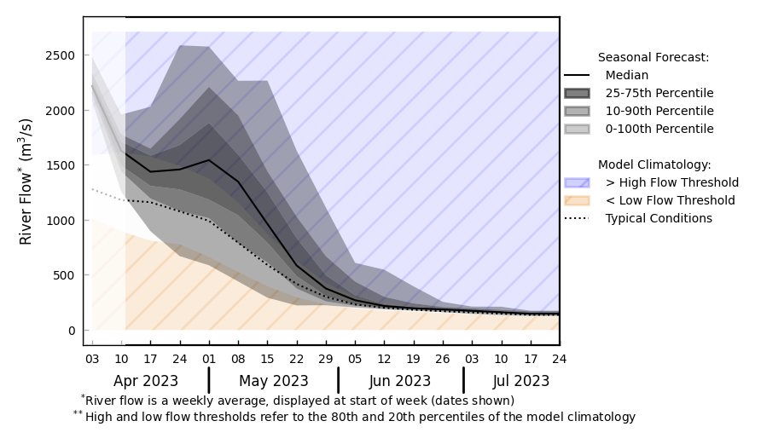
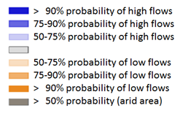
Seasonal Streamflow Forecast in Rwanda and Burundi
GloFAS monthly streamflow forecast (Apr - Jul 2023)
Above average streamflow is expected in Rwanda and Burundi, flooding possible in the lowlands.
GloFAS seasonal streamflow forecast (Apr - Jul 2023)

Slide 6
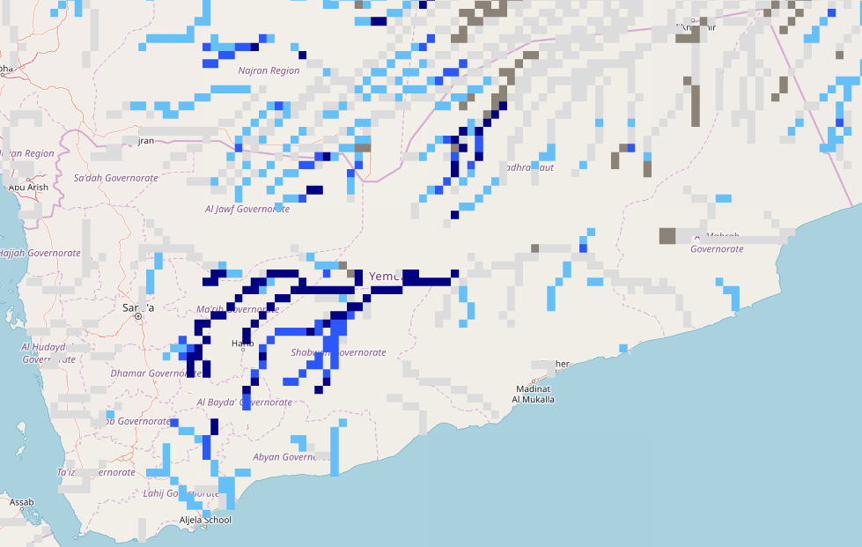
Seasonal Streamflow Forecast (Yemen)
A
GloFAS monthly streamflow forecast (Apr - Jul 2023)
NHyFAS Seasonal forecast (Mar-Jun 2023)
Above average streamflow is expected across much of Yemen especially during April-May-June period.

Slide 7
Flooding Risk (seasonal forecast)
Low flow continues in the rivers across East Africa, and discharges are not expected to increase until mid-April of 2023.
There are flooding along Shebelle River in Ethiopia and Somalia boarder.
Shebelle water level at Belet in Somalia currently running over the high risk flood level. Flooding is likely in the downstream.
Above average streamflow is expected in Rwanda and Burundi, flooding is expected in the lowlands.

