Slide 1
Bolivia Flood Monitoring and Forecast
FEWS NET Science Team
April 13, 2025

Slide 2
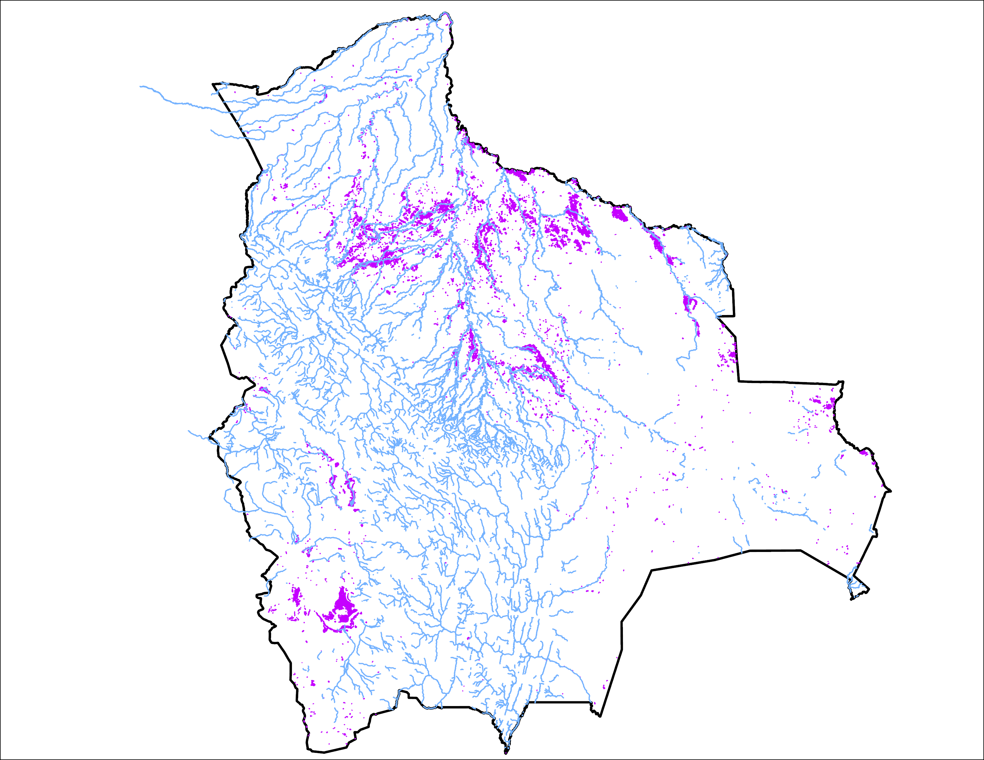
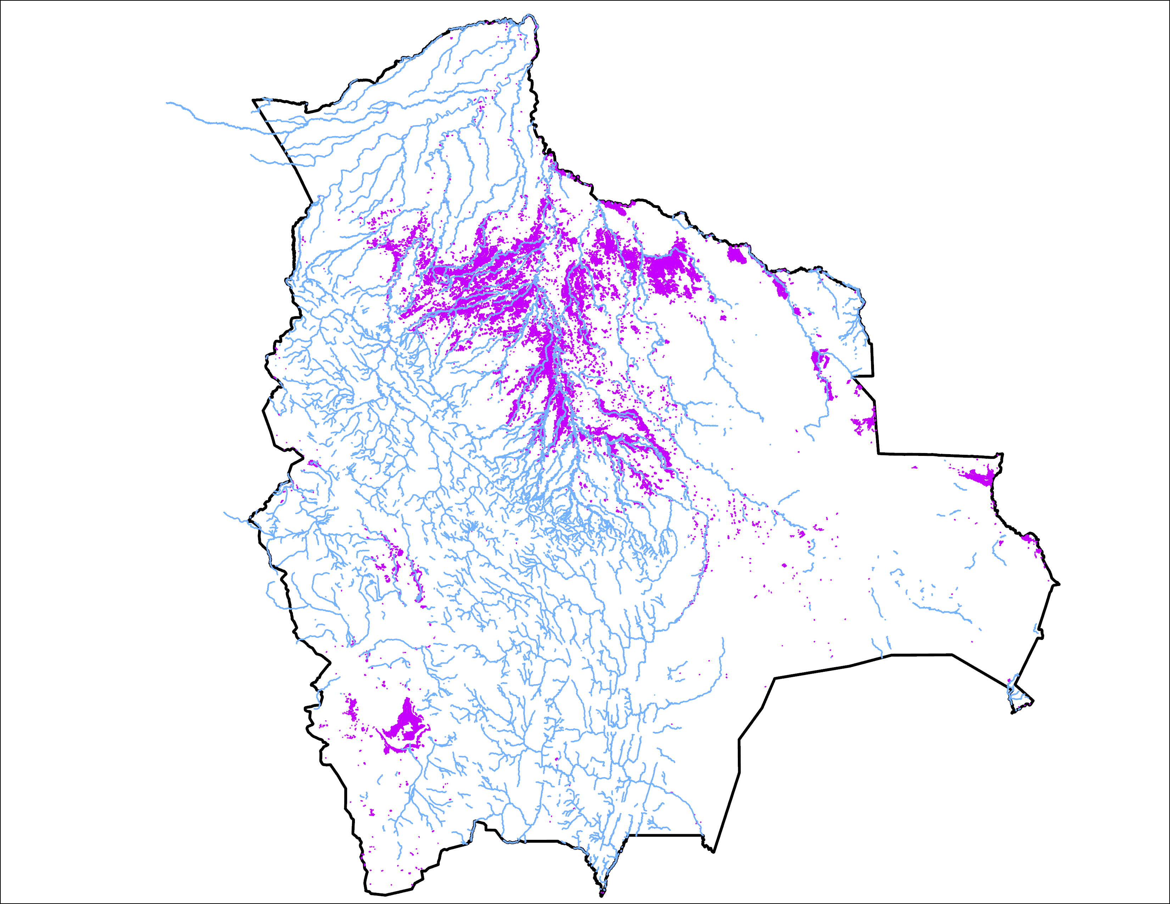
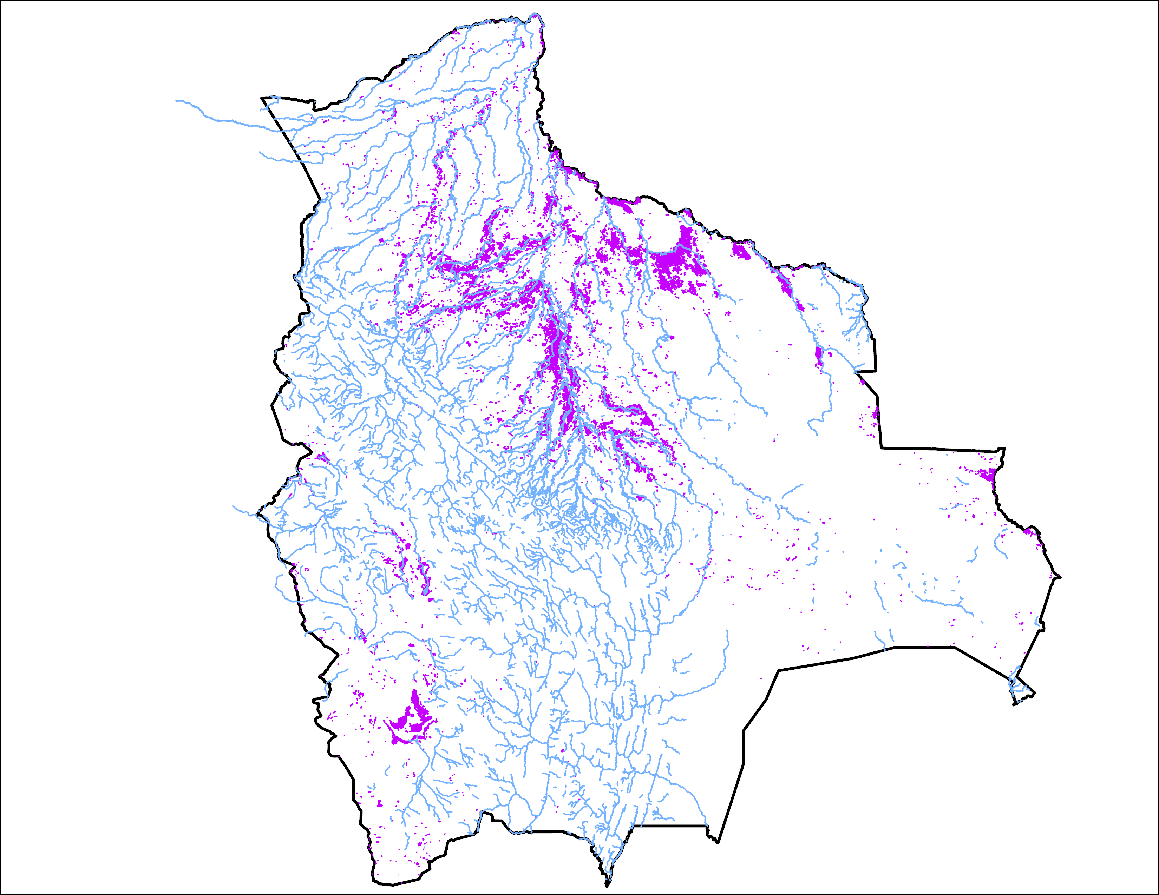
Flooding Progression in Bolivia
01 Apr 2025
06 Apr 2025
13 April 2025
15,700 km²
36,132 km²
26,274 km²
Flooding condition improved marginally.

Slide 3
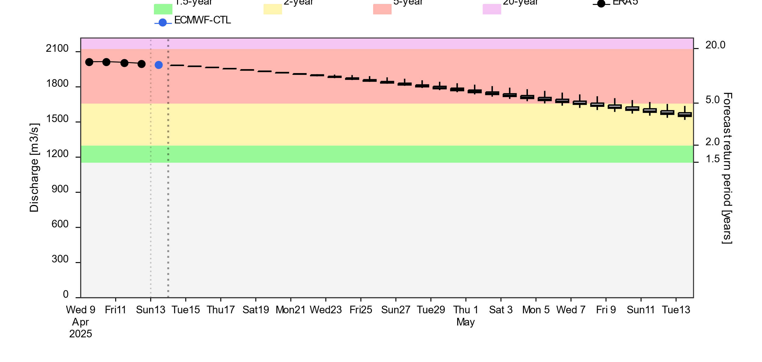
Streamflow Forecast
2-(yellow), 5-(red) and 20Year (purple) exceedance probabilities
@point A
A
Streamflow gradually diminishing across the country. However, they are expected to be at 5-yr return period level in the southwestern part of the country till the end of April.
GloFAS forecast: 13 April – 13 May 2025 (30 days)

Slide 4
Thank you

