Slide 1
Bolivia Flood Monitoring and Forecast
FEWS NET Science Team
April 06, 2025

Slide 2
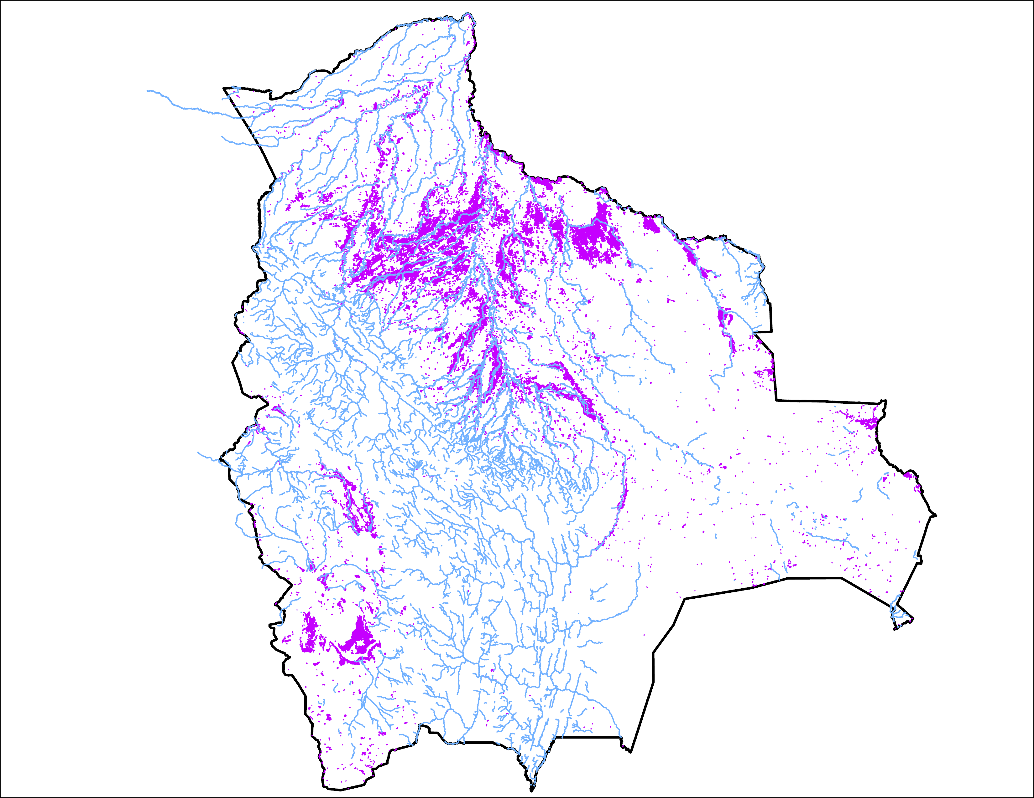
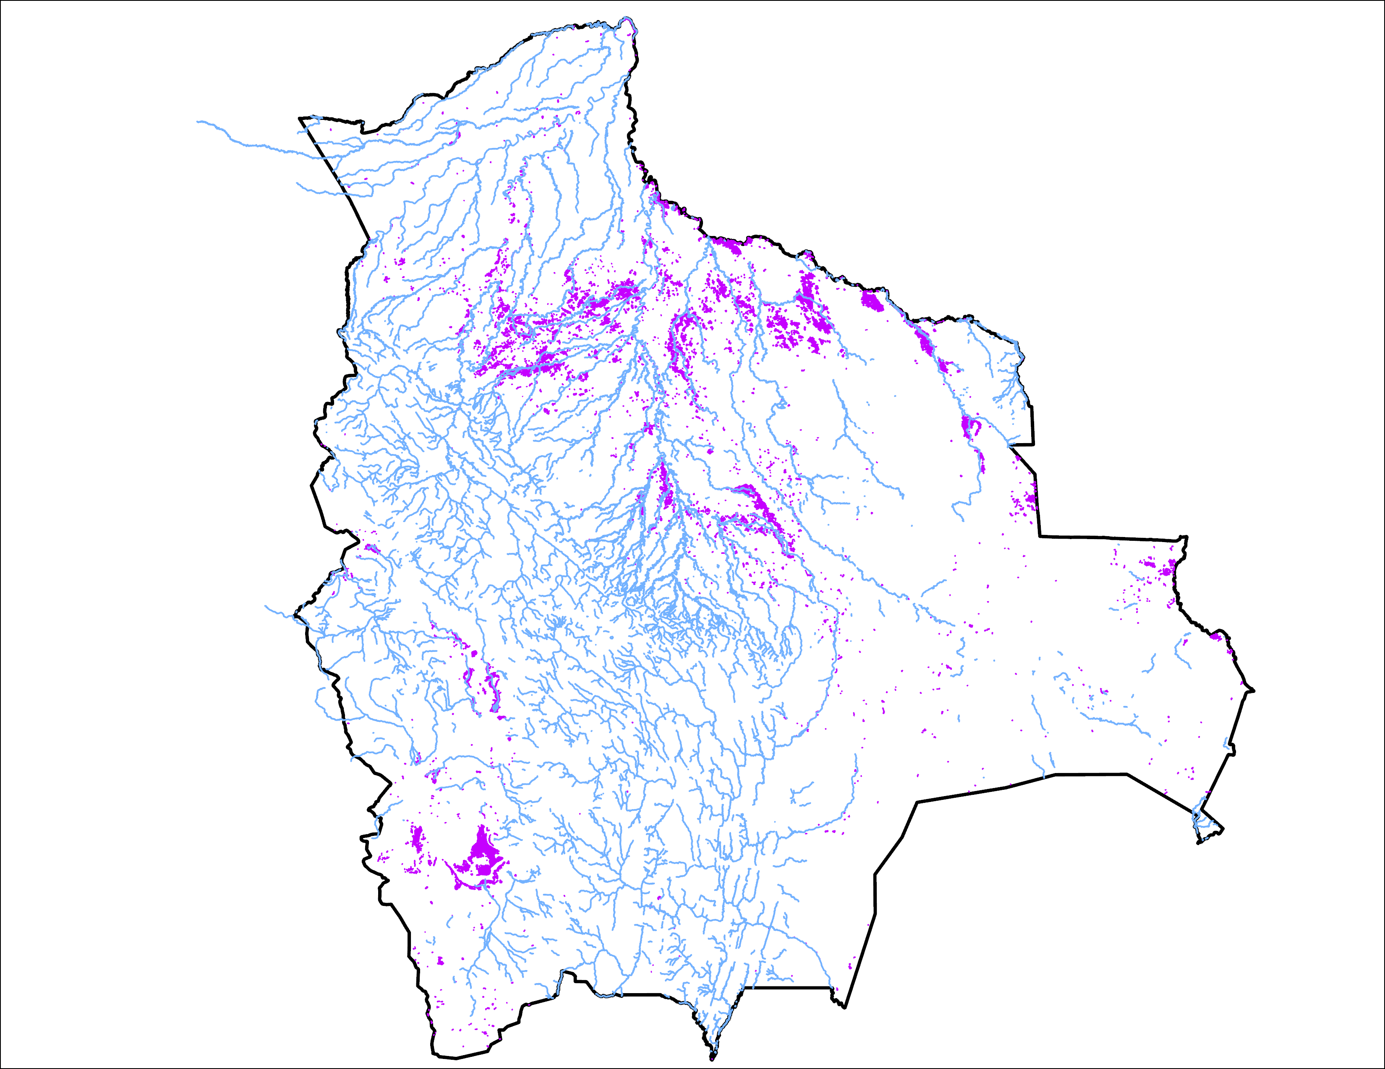
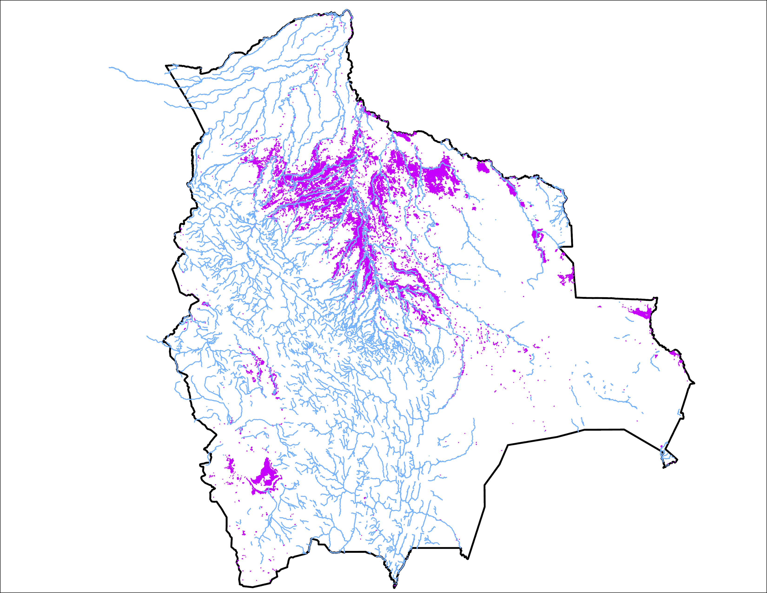
Flooding Progression in Bolivia
24 March 2025
01 Apr 2025
06 April 2025
40,567 km²
15,700 km²
36,132 km²

Slide 3
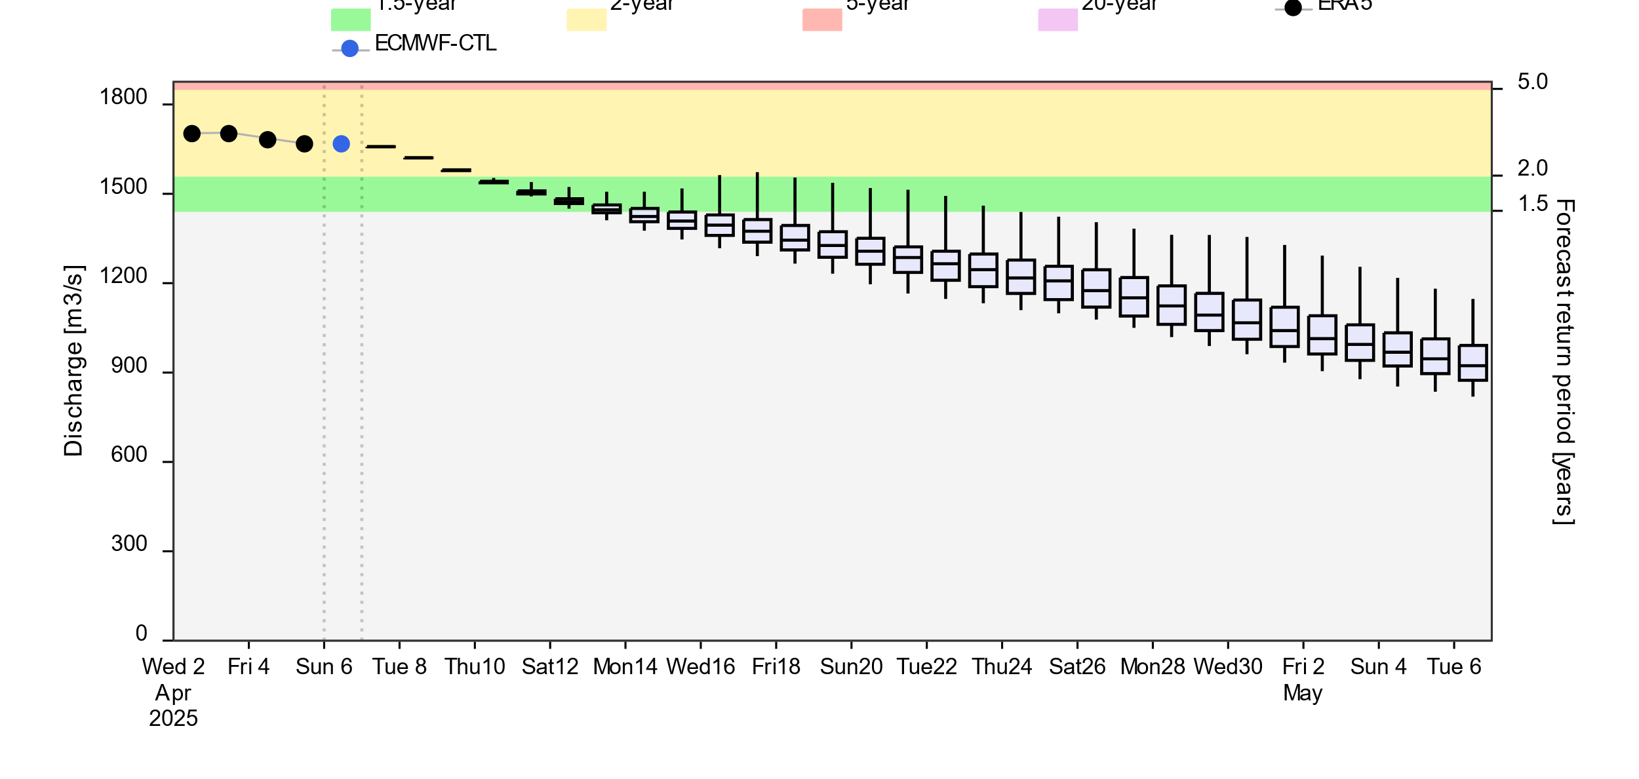
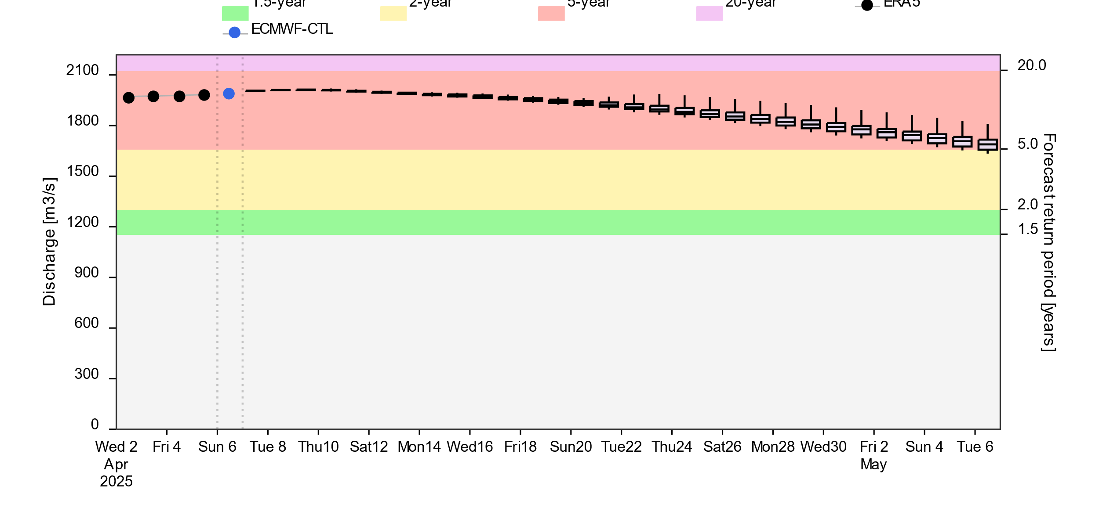
Streamflow Forecast
A
2-(yellow), 5-(red) and 20Year (purple) exceedance probabilities
@point A
B
@point B
GloFAS forecast: 06 April – 06 May 2025 (30 days)
Streamflow are expected to diminish in the north but continue to be at 5-yr return period level in the southwestern part of the country in next 30 days.

Slide 4
Thank you

