Slide 1
Bolivia Flood Monitoring and Forecast
FEWS NET Science Team
April 02, 2025

Slide 2
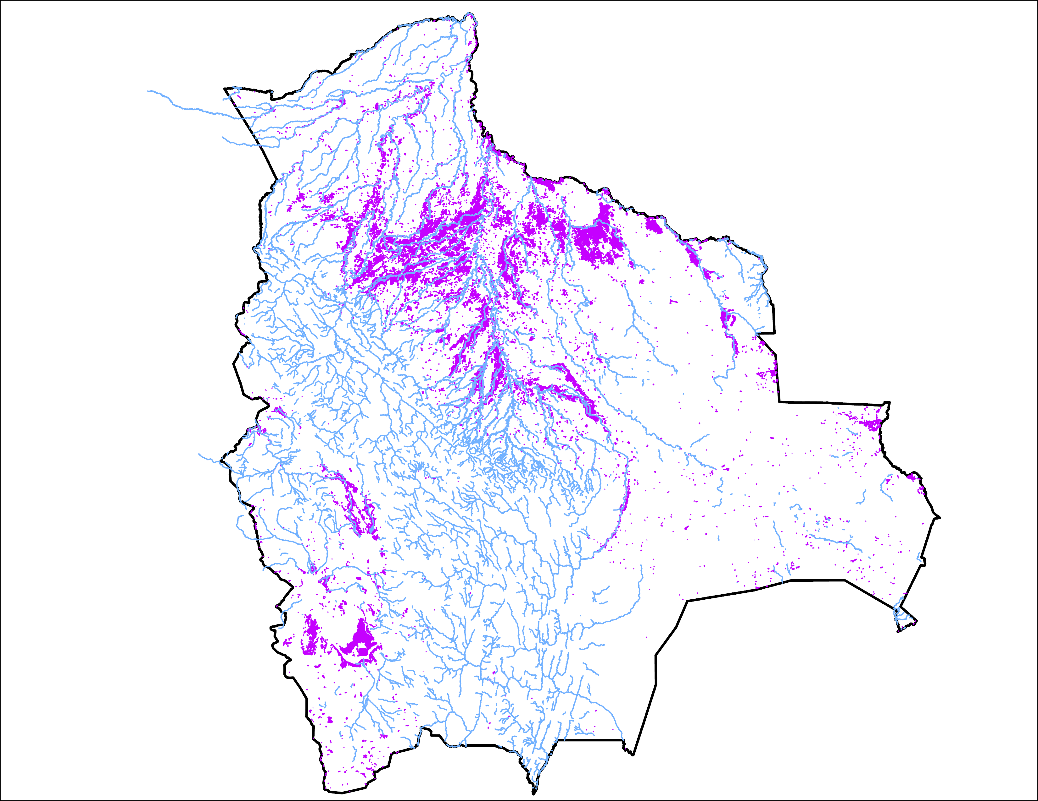
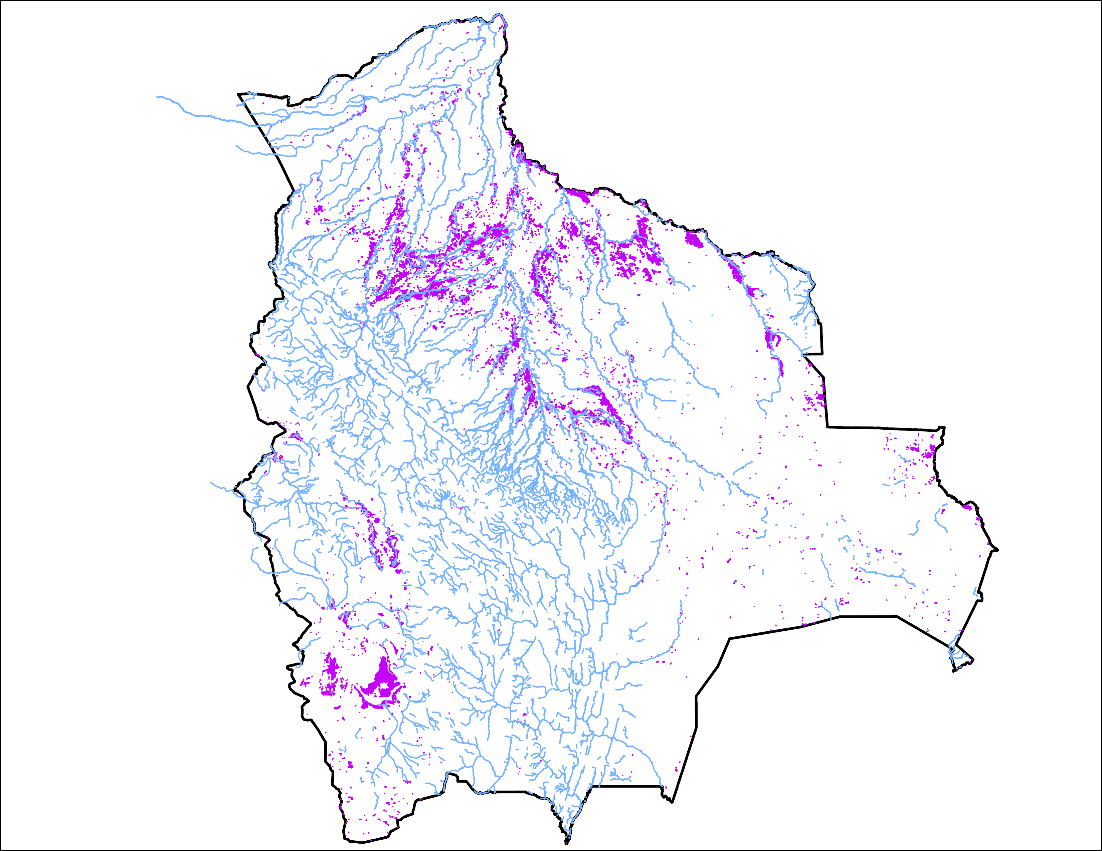
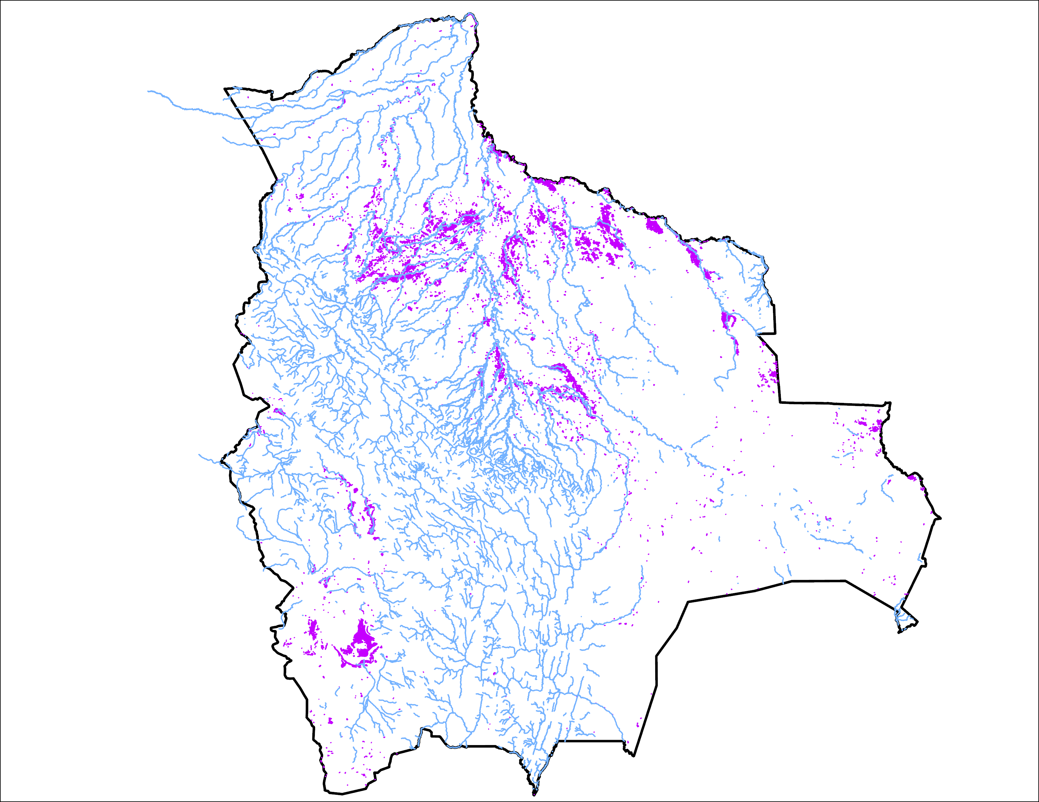
Flooding Progression in Bolivia
24 March 2025
28 March 2025
01 April 2025
40,567 km²
22,134 km²
15,700 km²

Slide 3
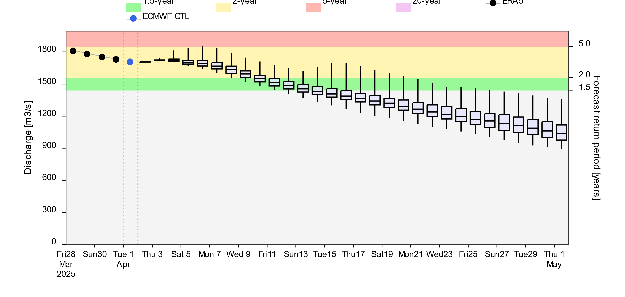
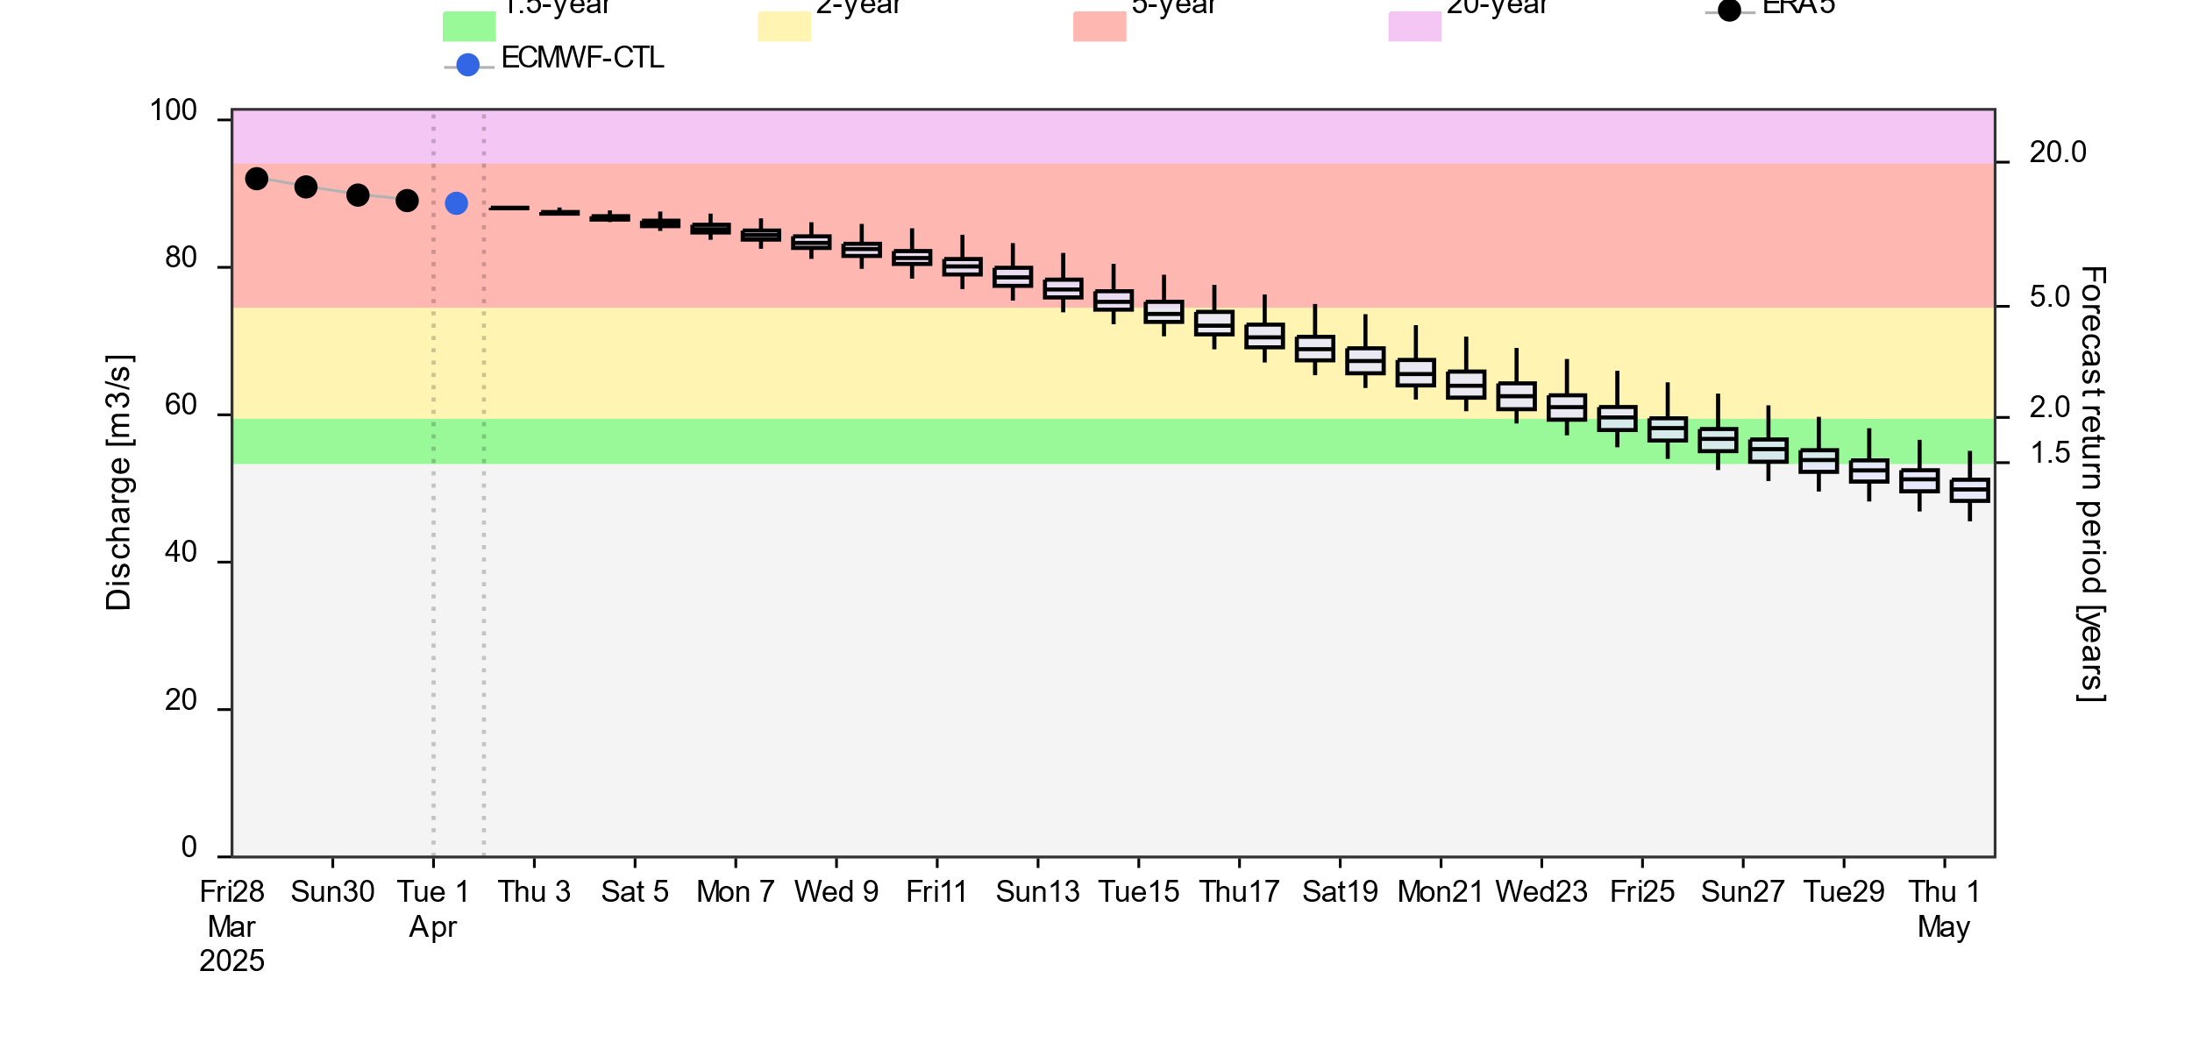
Streamflow Forecast
A
2-(yellow), 5-(red) and 20Year (purple) exceedance probabilities
@point A
B
@point B
GloFAS forecast: 02 April – 01 May 2025 (30 days)
Streamflow are expected to diminish in next 30 days across the country

Slide 4
Thank you

