Slide 1
Bolivia Flood Monitoring and Forecast
FEWS NET Science Team
May 19, 2025

Slide 2
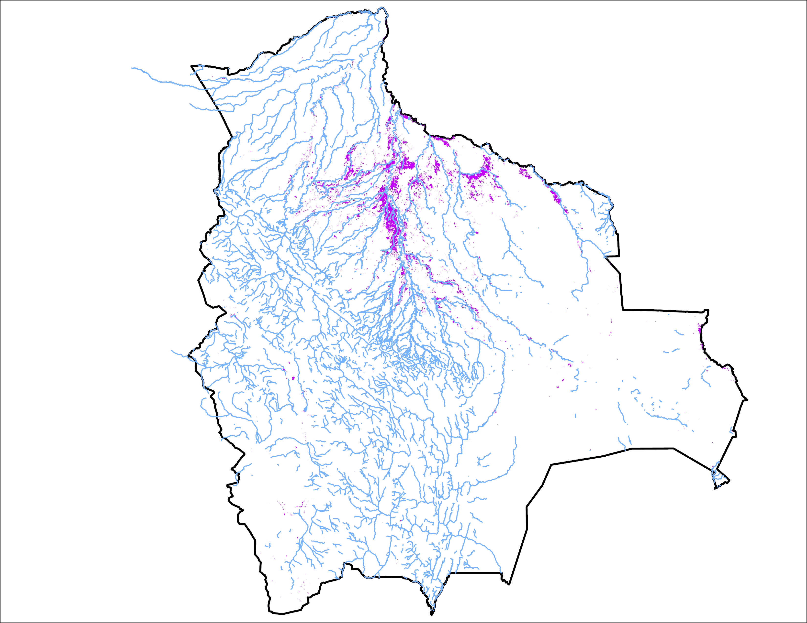
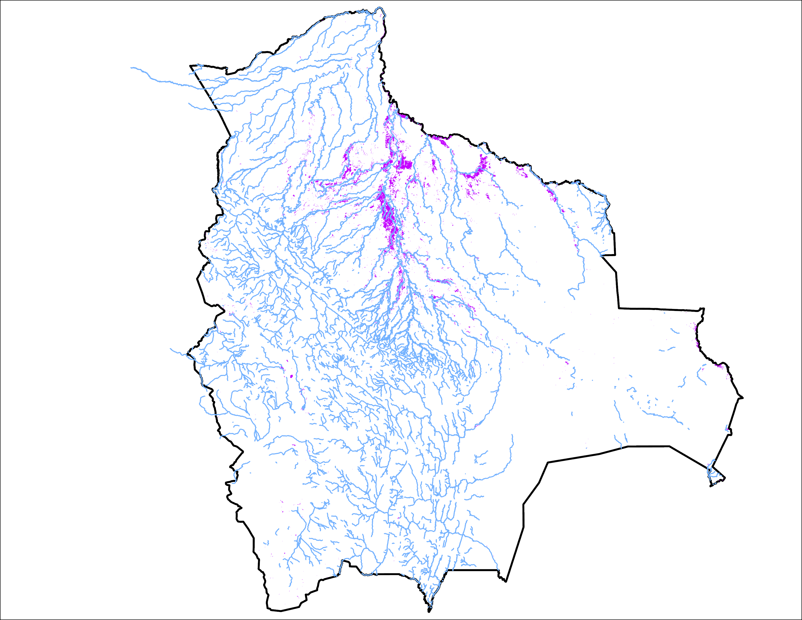
Flooding Progression in Bolivia
07-11 May 2025
14-18 May 2025
20,839 km²
16,522 km²
Inundation slowly receding in northern Bolivia.

Slide 3
Thank you

