Slide 1
Bolivia Flood Monitoring and Forecast
FEWS NET Science Team
May 11, 2025

Slide 2
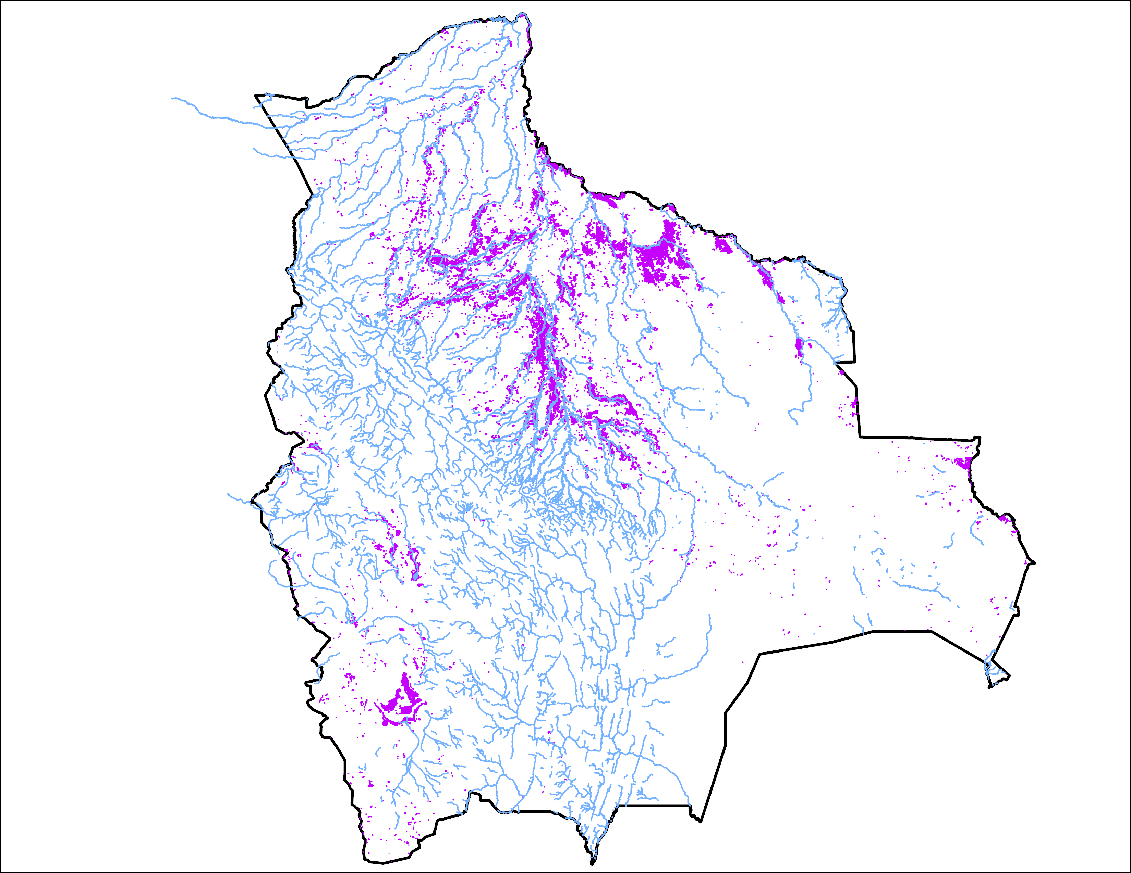
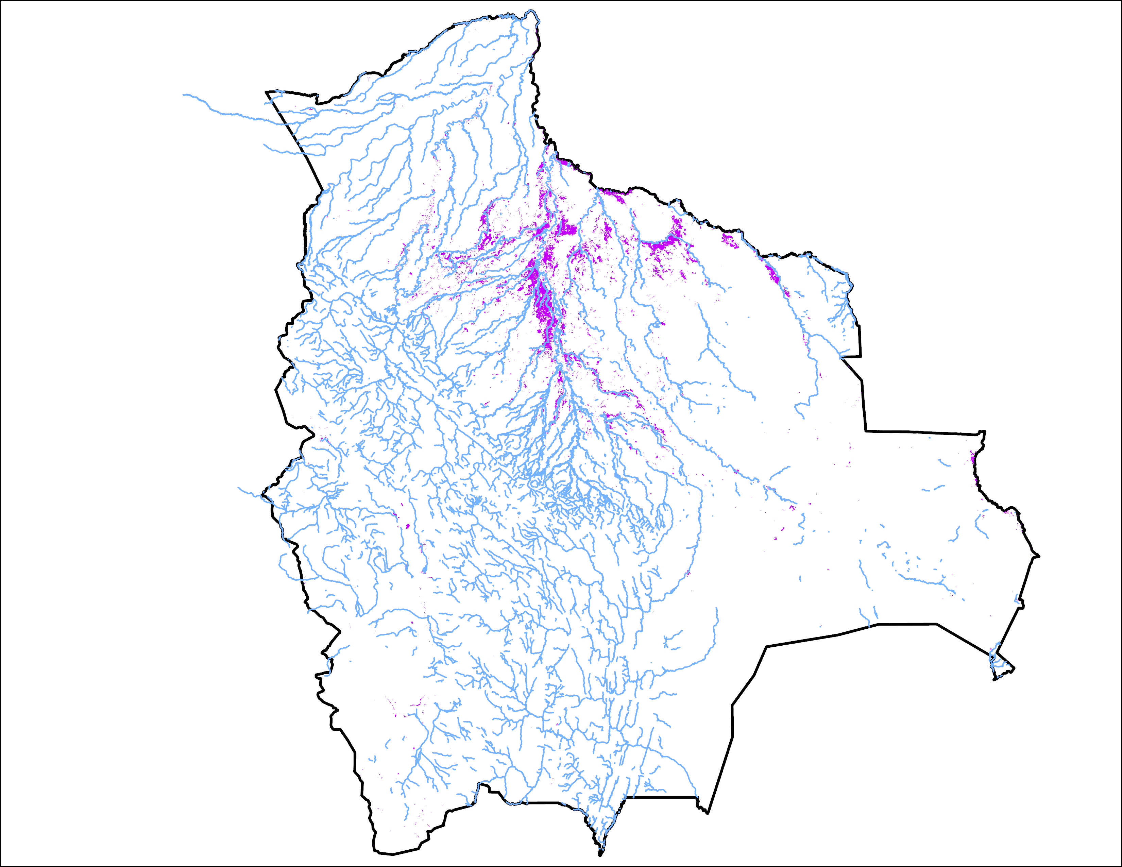
Flooding Progression in Bolivia
09-13 Apr 2025
07-11 May 2025
26,274 km²
20,839 km²
Flooding conditions improved substantially especially in the southwestern Bolivia.

Slide 3
Thank you

