Slide 1






Applications of FEWS NET Remote Sensing Products for Agro-climatological Analysis — Snow Monitoring
Shahriar Pervez
U.S. Geological Survey
spervez@usgs.gov

Slide 2
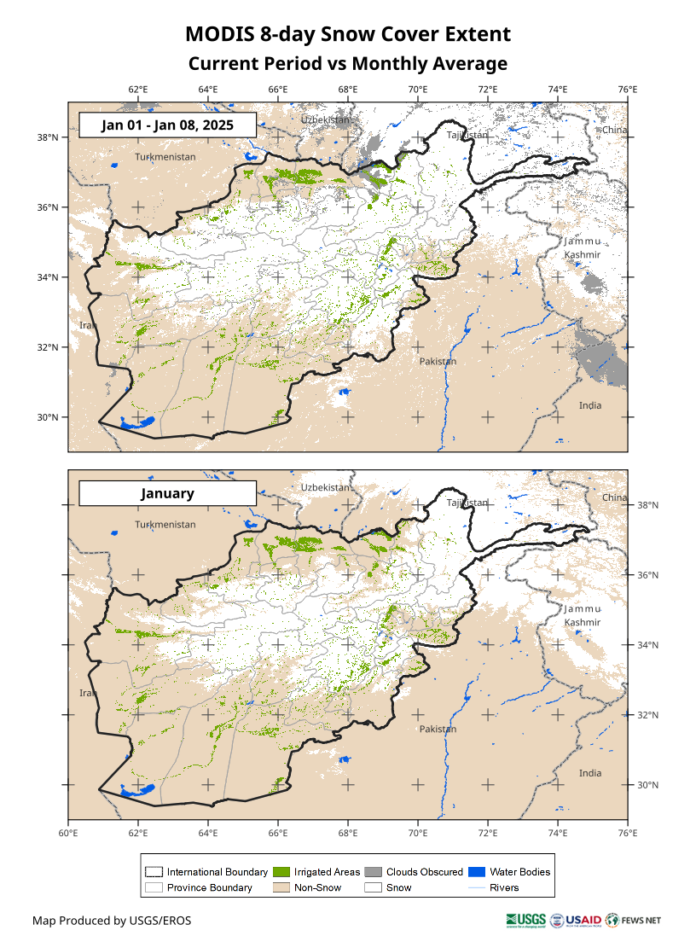
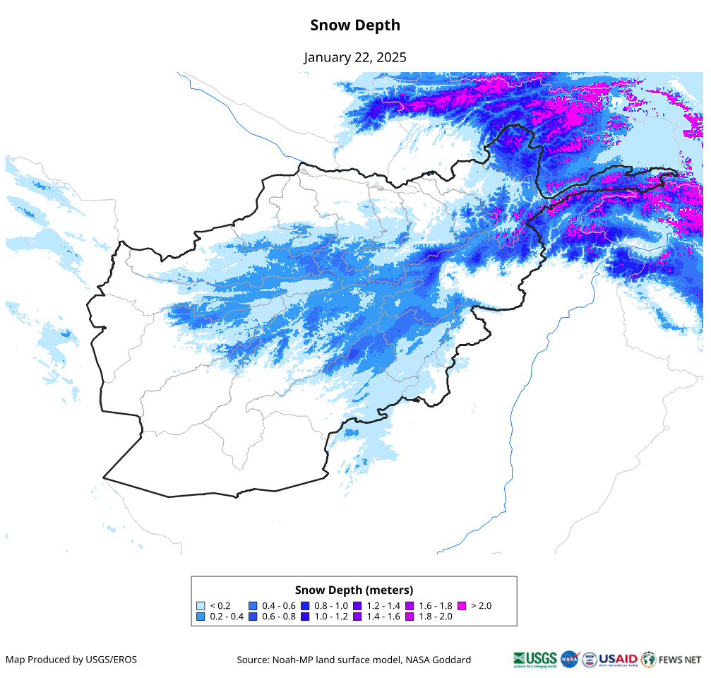
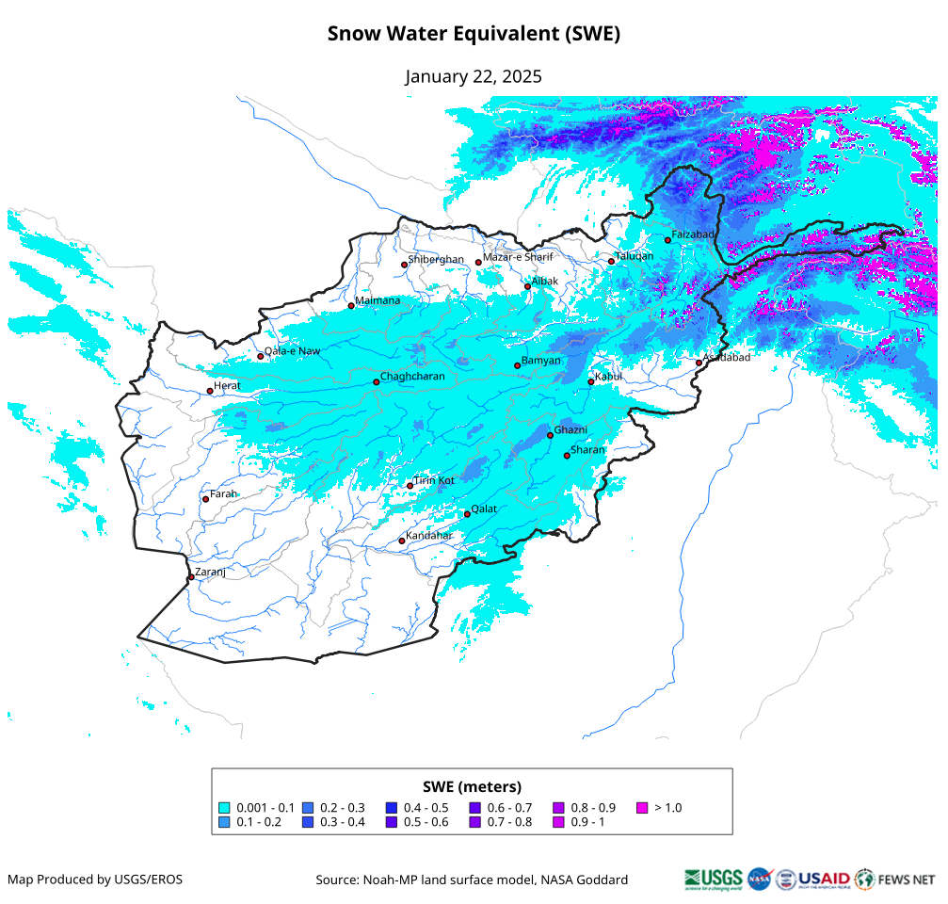
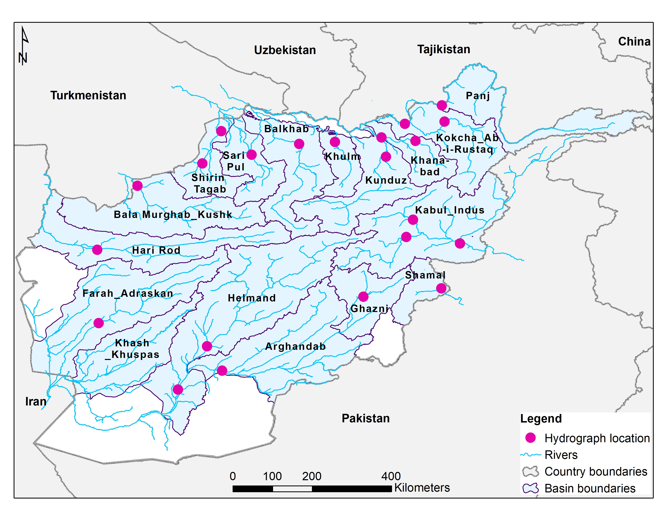
Snow Product Inventory
Snow Cover – provides us the areal extent of snow on the ground.
Snow Depth – provides us how deep the snow is on the ground.
Snow Water Equivalent – provides us how much of liquid water available in the snow we have on the ground.
Streamflow – tells us where does the water go when it starts to melt.
What’s common among these four?
They involve processes on the land surface
Measures of water availability

Slide 3
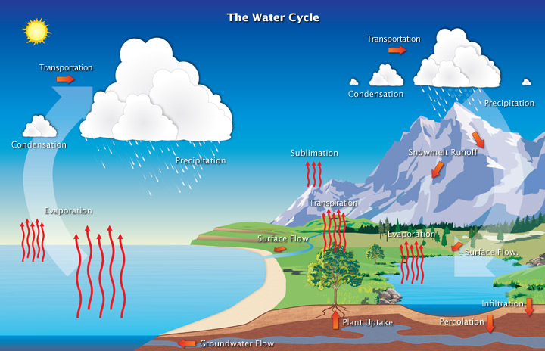
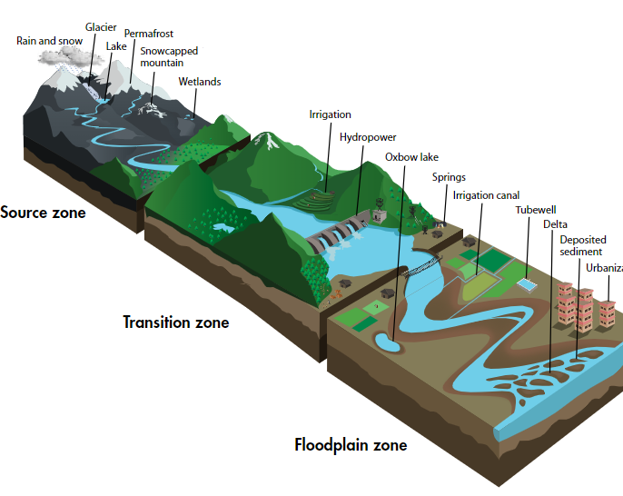
What Drives the Process and Change?
Global water cycle
Upstream, Midstream, and Downstream regions of a River catchment.
Why don’t we get same amount of rain and snow every season/year?

Slide 4
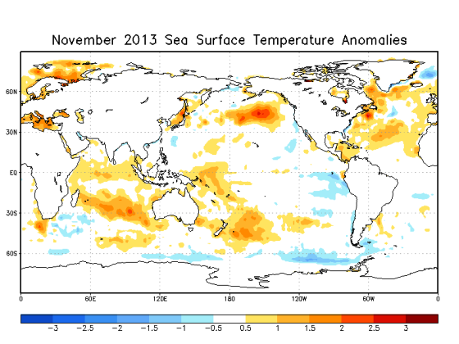
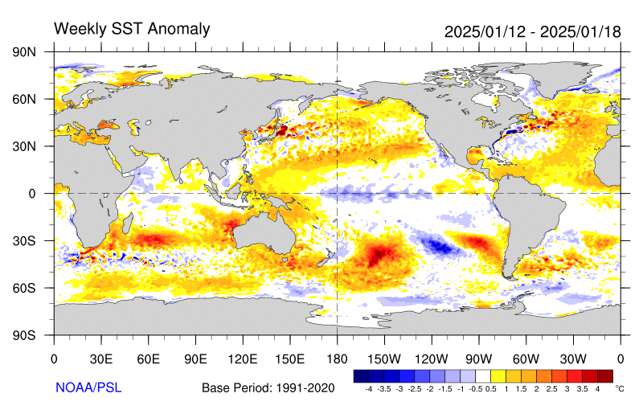
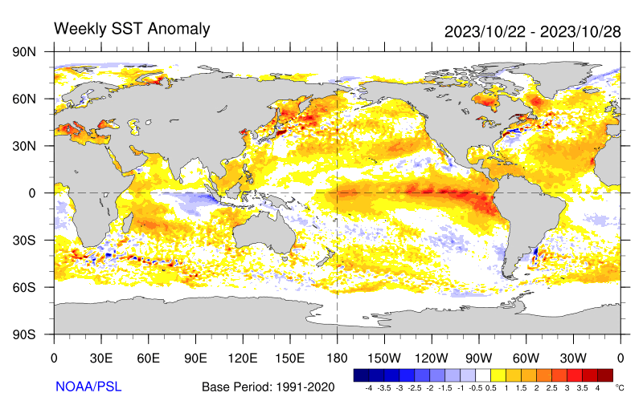
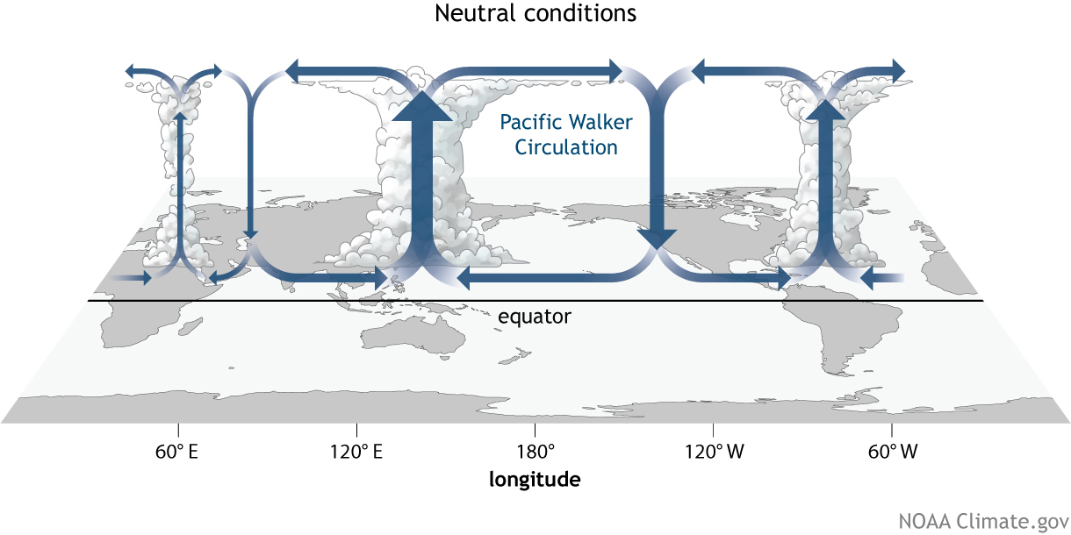
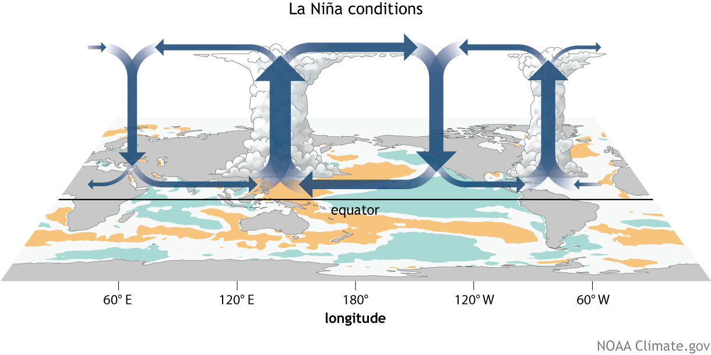
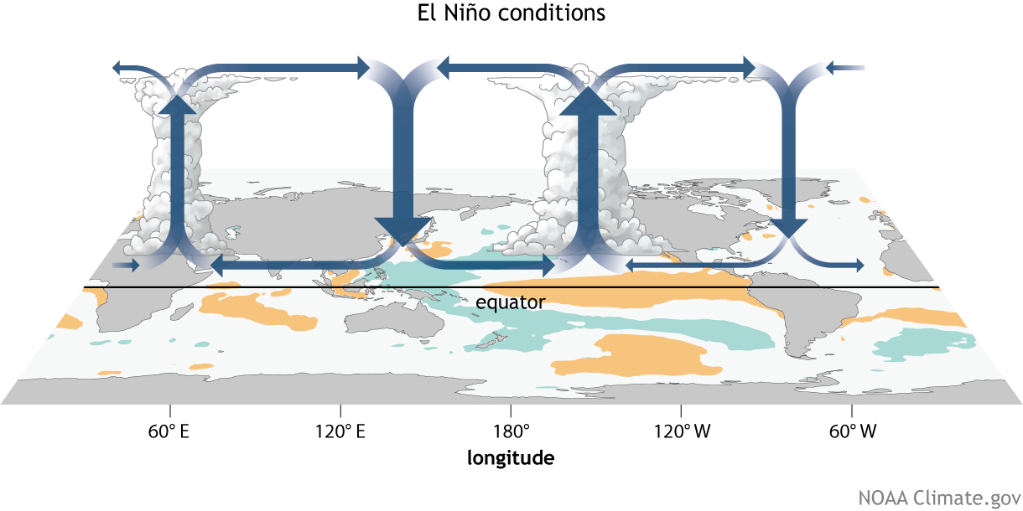
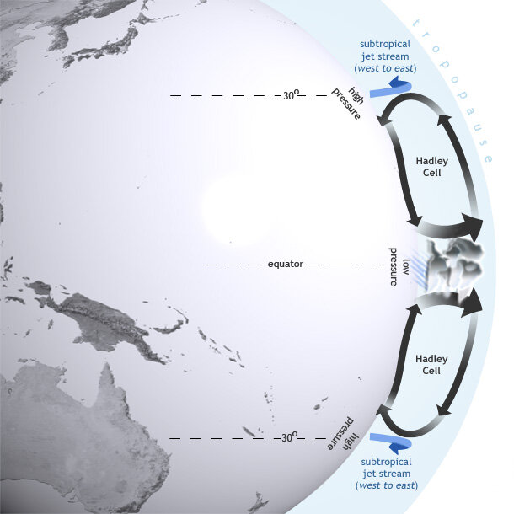
What Drives the Processes and Change?
Walker Circulation
Hadley Circulation

Slide 5
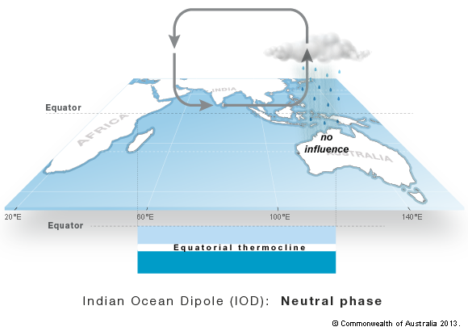
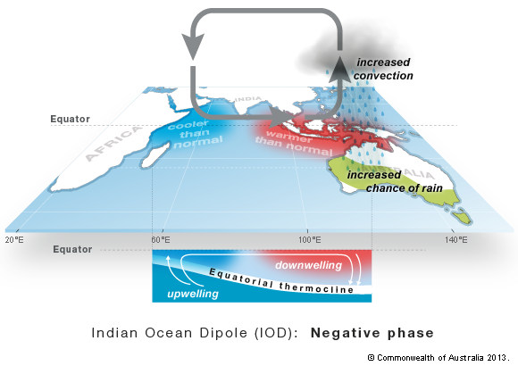
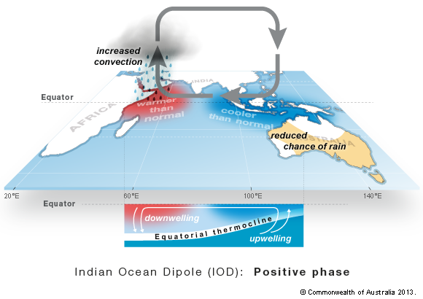
What Drives the Processes and Change?
Indian Ocean Dipole
Neutral
Negative
Positive

Slide 6
Monitoring of Snow

Slide 7

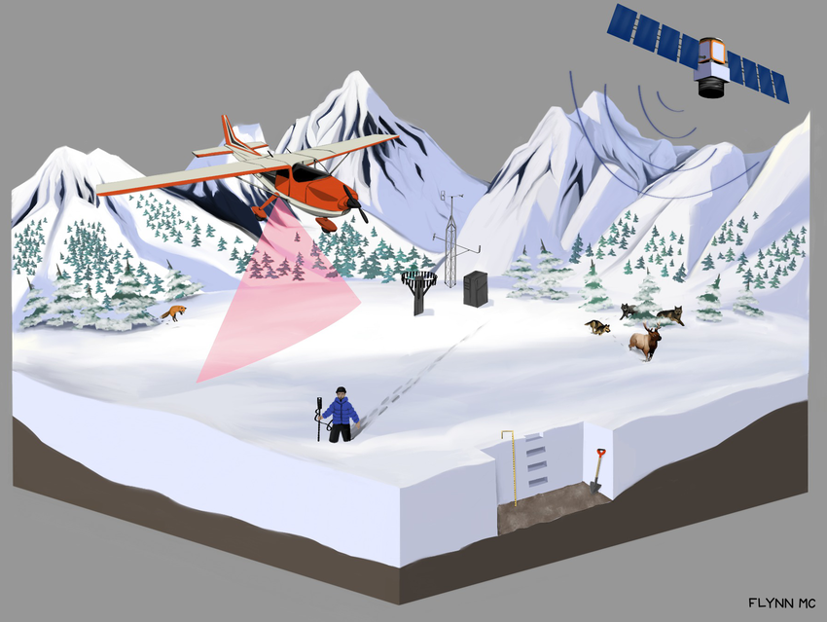
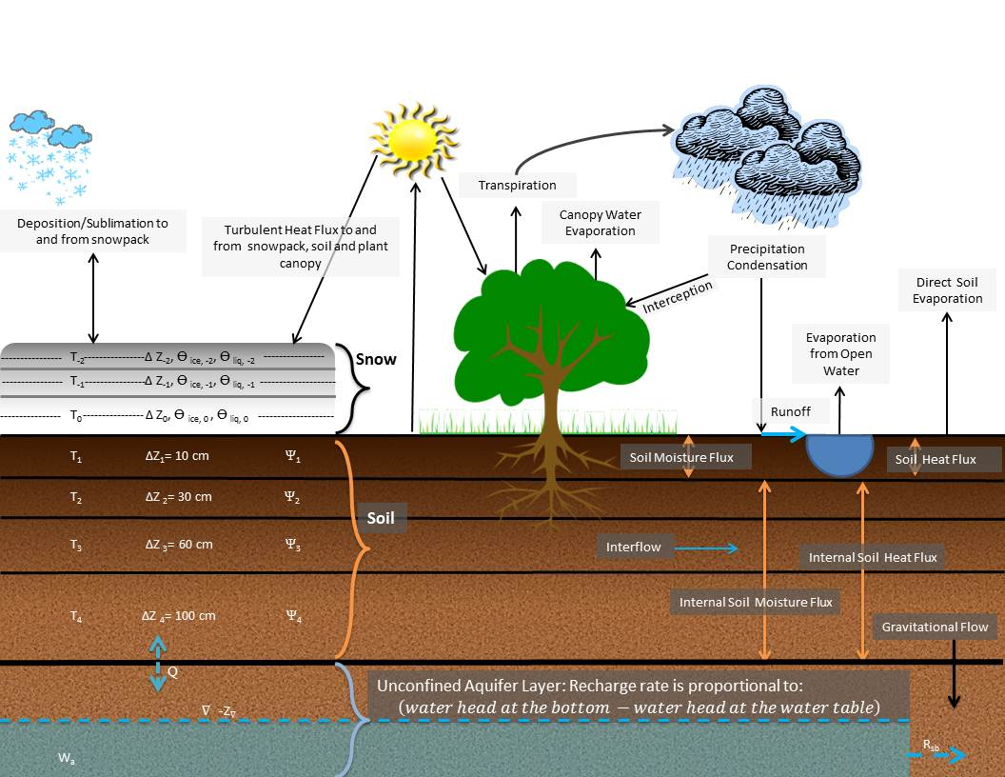
Ways to Monitor Snow
Snow — snow is a form of precipitation within the Earth’s atmosphere in the form of ice crystals that fall form the clouds. When temperatures drop below 0°C and there is sufficient humidity in the atmosphere, water vapor condenses directly into ice without going through the liquid stage. Once an ice crystal has formed, it absorbs and freezes additional water vapor from the surrounding air, growing into a snow crystal or snow pellet, which then falls to Earth because of the gravity.
In-situ measurements
Remote sensing
Land surface hydrology modeling

Slide 8
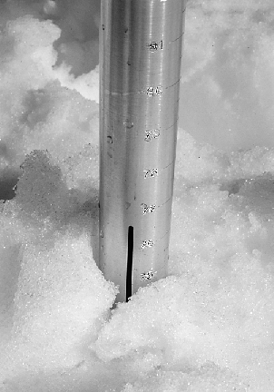
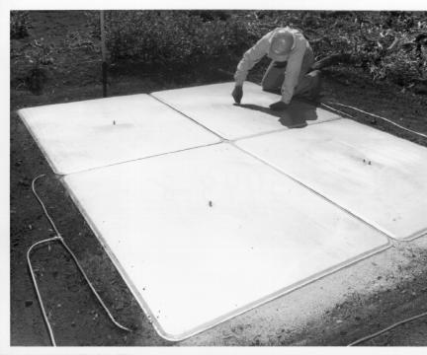
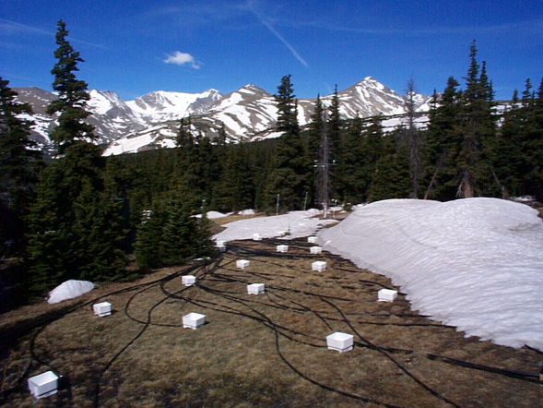
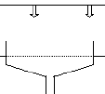
In-situ Measurements of Snow
Snow Tubes/depth gage for depth estimation
Snow pillows for snow water equivalent estimation
Snow Lysimeters for snow melt estimation
Meteorological Towers for local atmospheric condition estimates

Slide 9
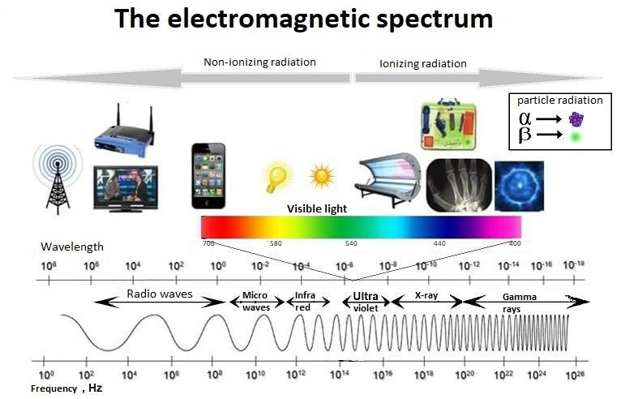
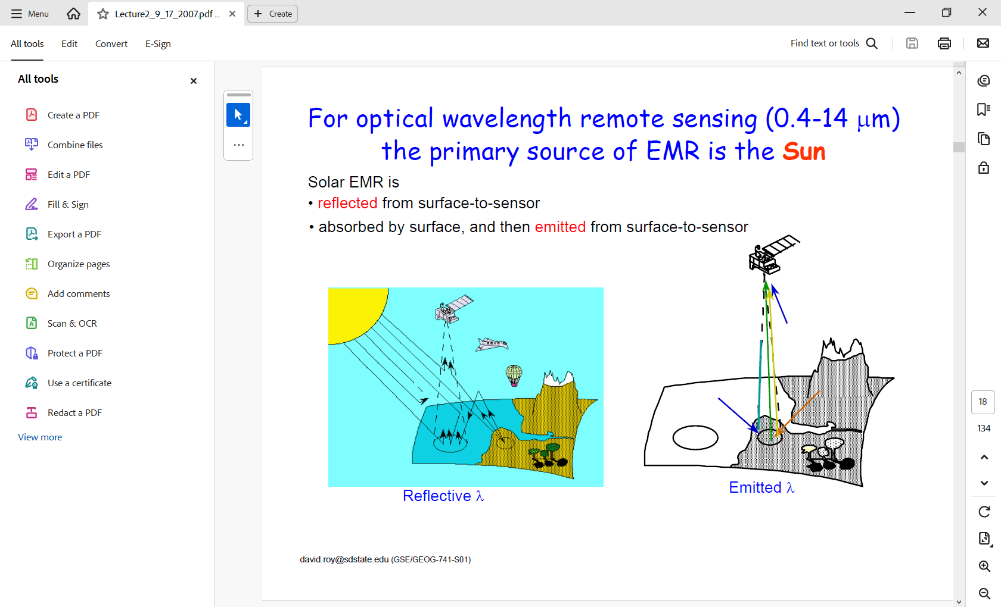
Remote Sensing of Snow
Remote sensing — it is the process of detecting and monitoring the physical characteristics of an area by measuring reflected and emitted radiation at a distance typically from satellite or aircraft.
reflective
emitted
All matters at temperature greater than absolute zero (0° K or -273° C) continuously emit EMR
Solar EMR is reflected from surface-to-sensor
Absorbed by surface and then emitted from surface-to-sensor.

Slide 10
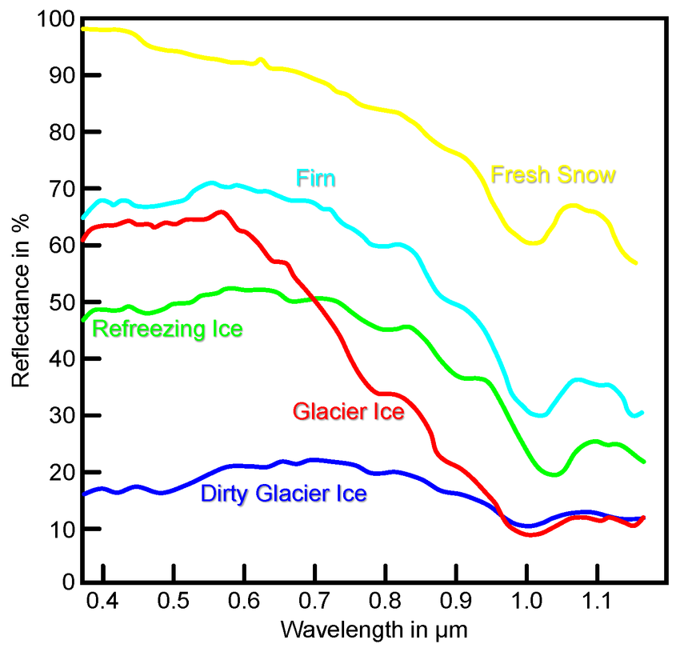
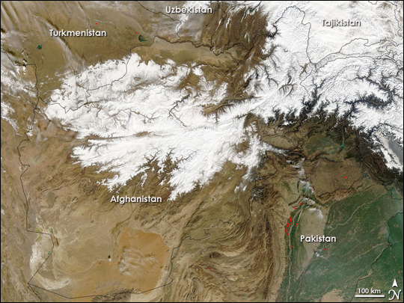
Spectral Signature of Snow
MODIS Image over Afghanistan

Slide 11

Production of MODIS Snow Cover Extent
MODIS scans the entire globe every one to two days. As such, most locations on Earth are imaged at least once per day.
The MODIS instrument provides 36 spectral bands ranging in wavelength from 0.4 μm to 14.4 μm. Two bands are imaged at a nominal resolution of 250 m at nadir, five bands at 500 m, and the remaining bands at 1000 m.
Snow cover is detected using the Normalized Difference Snow Index (NDSI). Snow-covered land typically has very high reflectance in visible bands and very low reflectance in shortwave infrared bands; the NDSI reveals the magnitude of this difference.
Typically, it takes five to seven days to reach a nearly cloud free map, thus 8-day composite is created.
The snow cover is created, archived and distributed by NASA National Snow and Ice Data Center.
USGS downloads the data, clips it to Afghanistan extent, and them creates the maps.
MODIS 500 m bands and their wavelengths
3 459–479 Shortwave/VIS
4 545–565 Shortwave/VIS
5 1230–1250 Shortwave/NIR
6 1628–1652 Shortwave Infrared/SWIR
7 2105–2155 Shortwave Infrared/SWIR

Slide 12
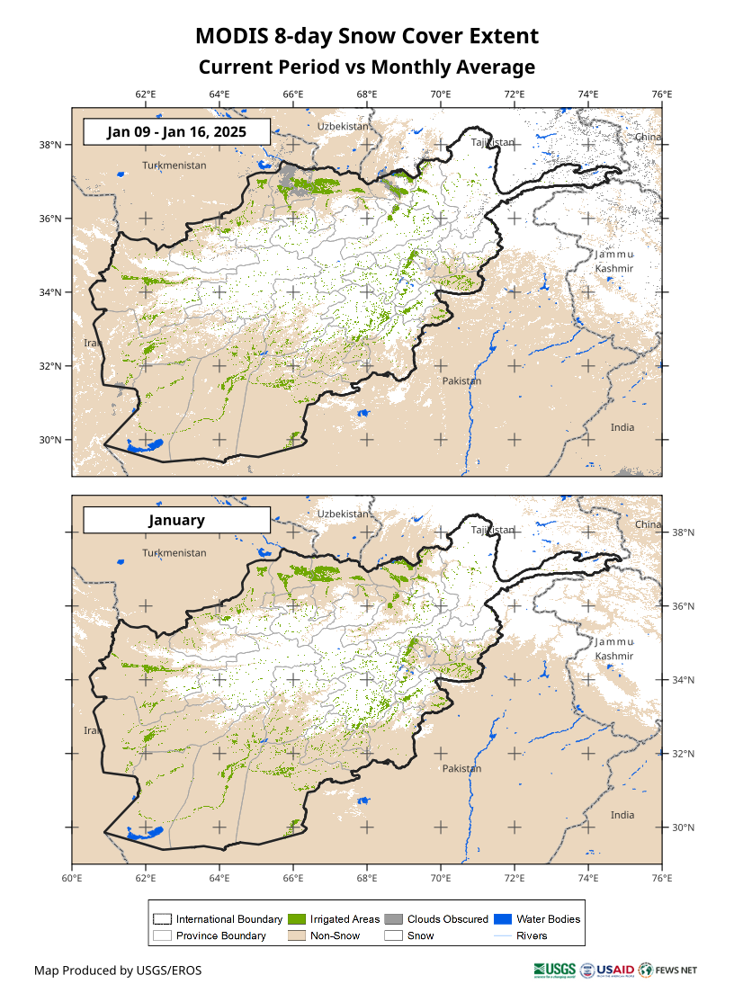
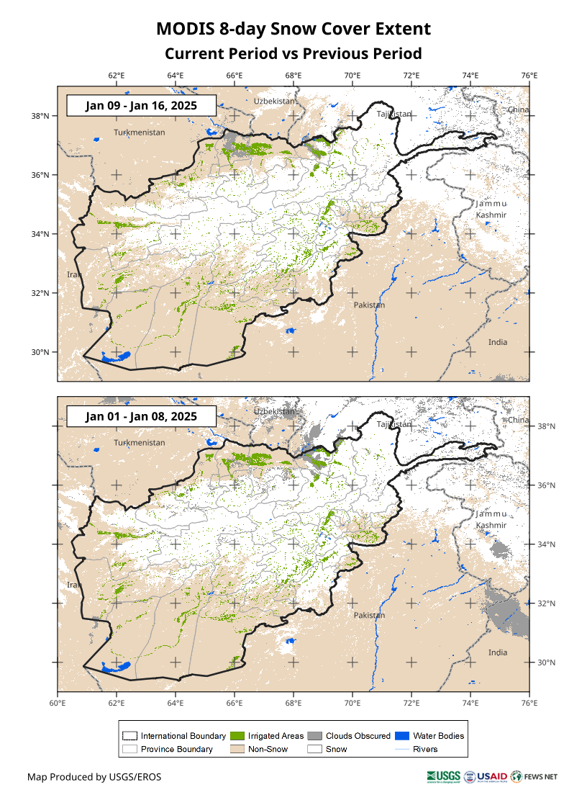
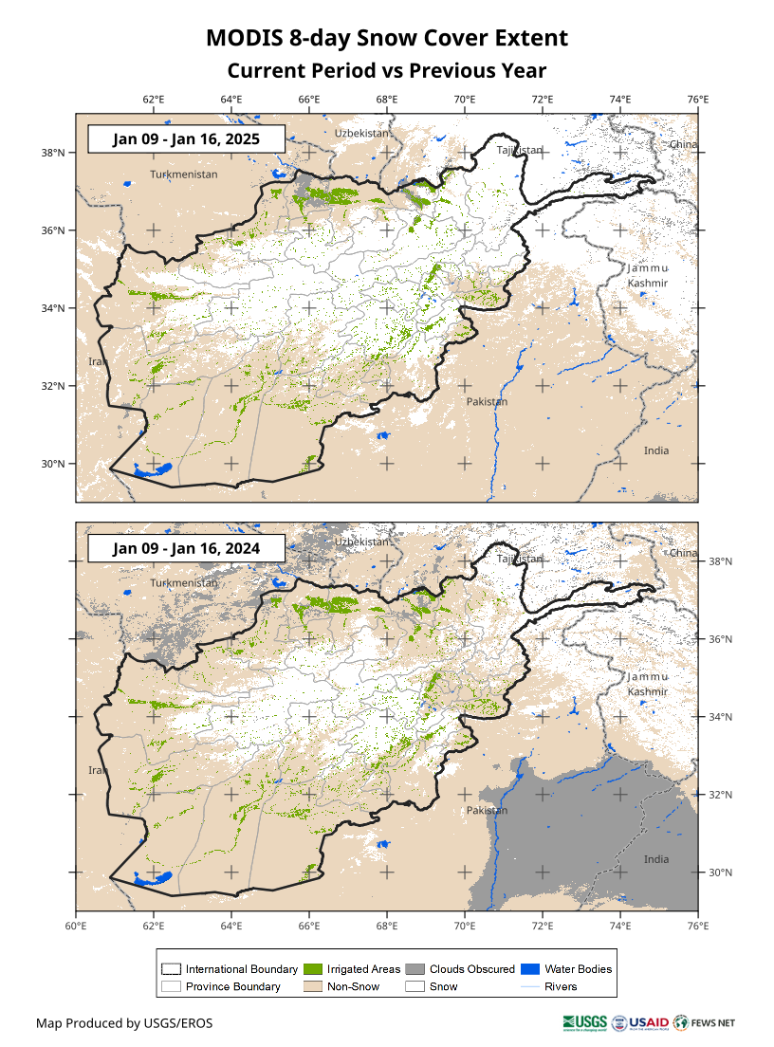
What Does SCEM Show?
Historical average for the month
Previous period
Previous year

Slide 13
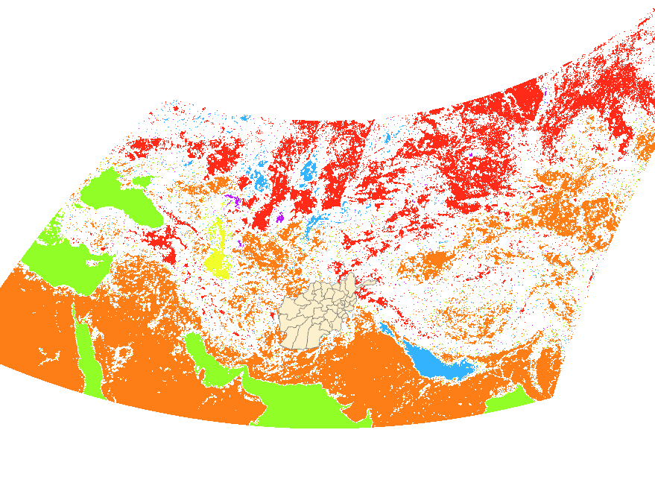
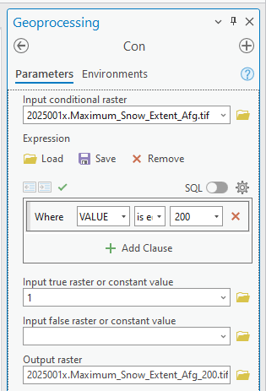
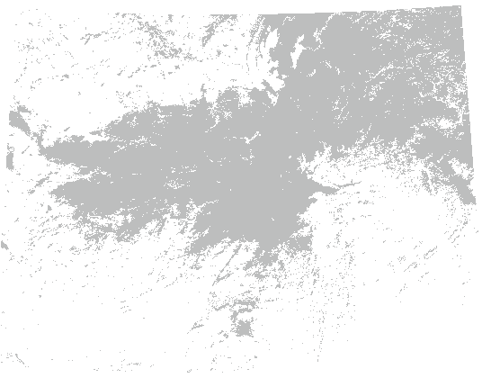
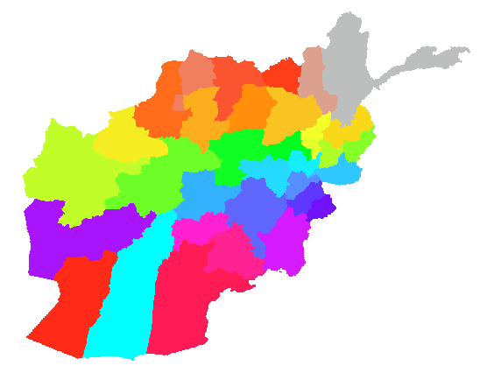
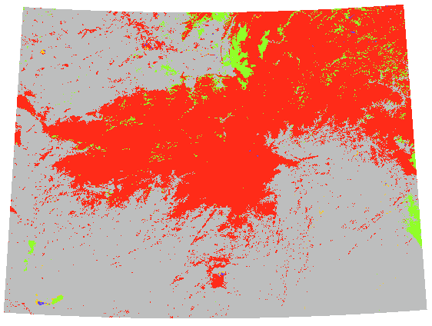
Snow Cover Depletion Computation
Download the MODIS snow cover data for the dates you would like to compute the snow cover change
Out put raster would be all the snow cells over Afghanistan.
Use Clip Raster in ArcGIS Pro to clip the data for Afghanistan based on Province or Basin layer.
Raster value 200=Snow
Run Polygon to Raster to create a raster with the Province or Basin layer matching the same cell size and cell alignment with clipped snow layer. This would be your Zone to summarize snow extent for.
Run a Con (conditional statement) to separate snow cells only.
CellValue = 200

Slide 14
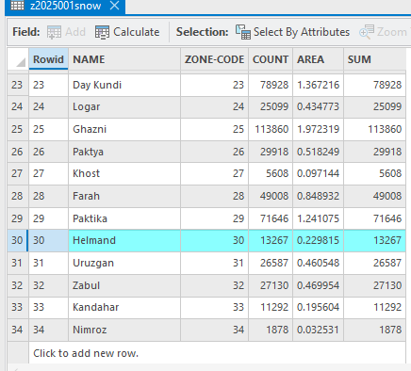
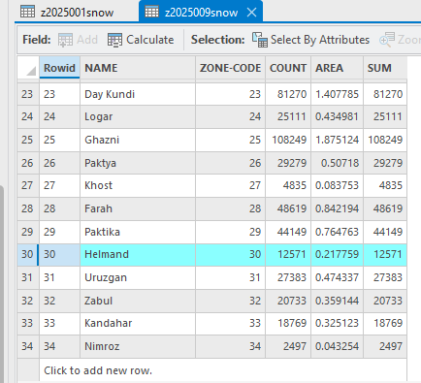
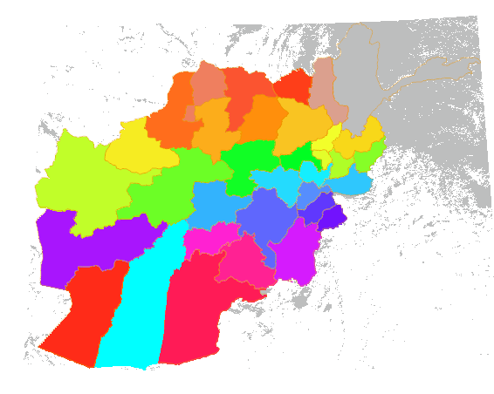
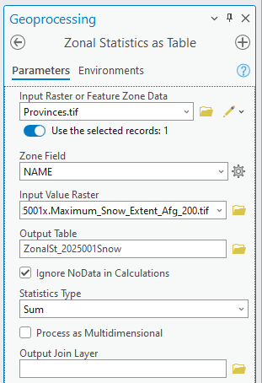
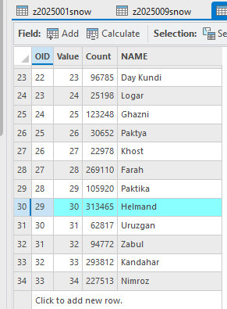



Snow Cover Depletion Computation
Snow cover over Helmand during Jan 1-8, and Jan 9-16, 2025 were:
$$\frac{13267}{313465}∗100=4.24\%$$
Run Zonal Statistics as Table using the Zone and only Snow Cells layers as inputs to summarize how many snow cells are within each zone. Zone would be either Provinces or Basins and Snow Cells layer would be the daily MODIS snow cover extent.
Run the Zonal Statistics as Table for all the dates you would like to use for snow depletion computation.
$$\frac{12571}{313465}∗100=4.01\%$$
Or $\frac{13267−12571}{13267}∗100=5.24\%$
Snow cover reduced in Jan 9-16, 2025 period

Slide 15
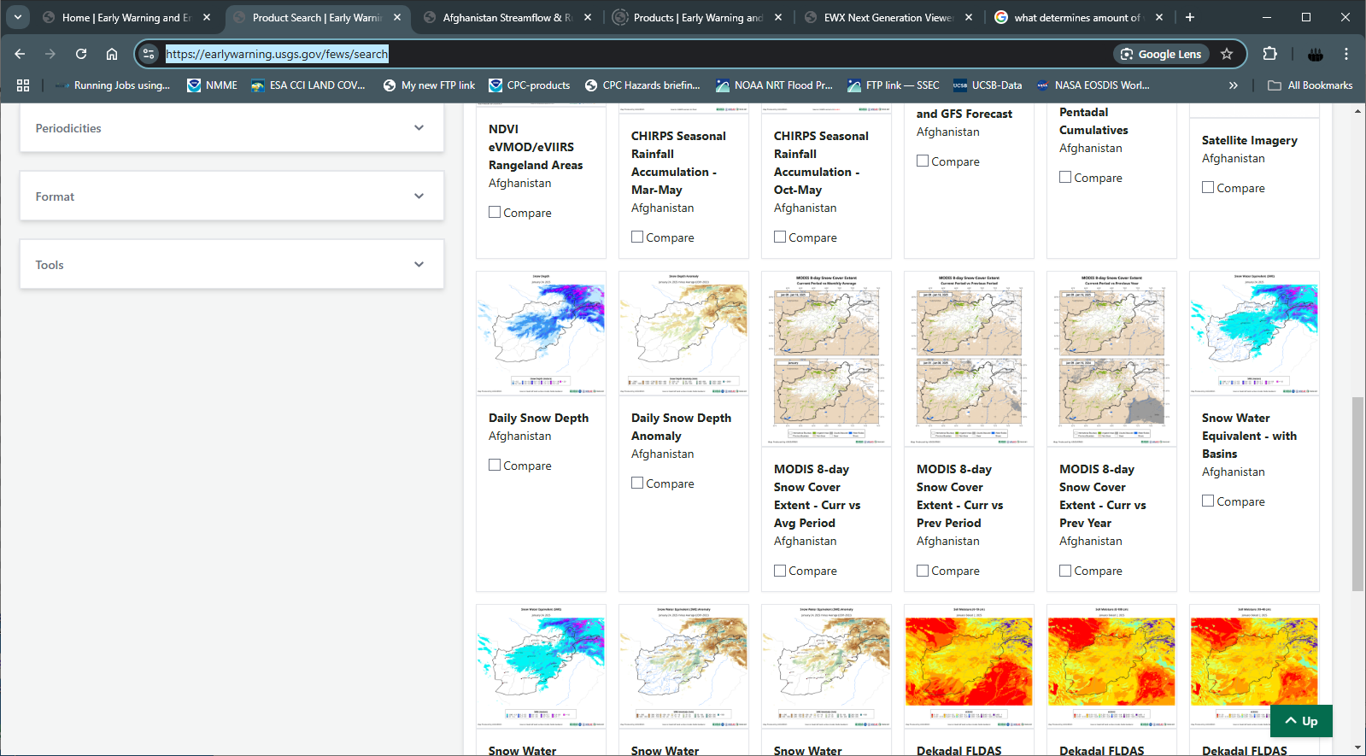
Snow Cover Extent
Let’s check it on the https://earlywarning.usgs.gov/fews/search

Slide 16
Remote Sensing of Snow Depth & SWE
Passive Microwave remote sensing — it is the process of detecting natural microwave energy emitted by objects or surfaces on the Earth. Passive microwave sensors typically measure thermal radiation emitted by the objects or surfaces at frequencies between 1 and 100 GHz.
However, microwave radiation energy level emitted from the Earth objects or surfaces are very low. This low energy levels make it difficult to measure small areas in detail. To measure a detectable level of energy the spatial resolution needs to be coarse (15km to 100km).
This is why microwave data (such as SSM/I, AMSR-E) or derivative products typically do not serve the purpose of FEWS NET, thus not used for FEWS NET.

Slide 17
Modeling of Snow and Streamflow

Slide 18
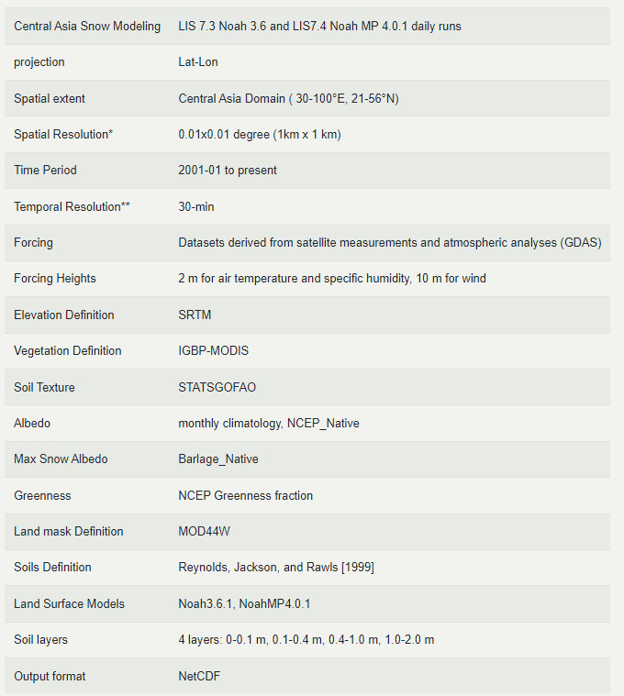
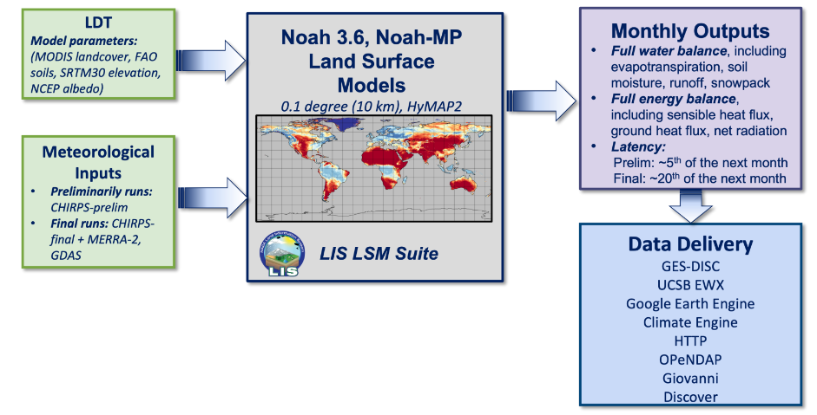
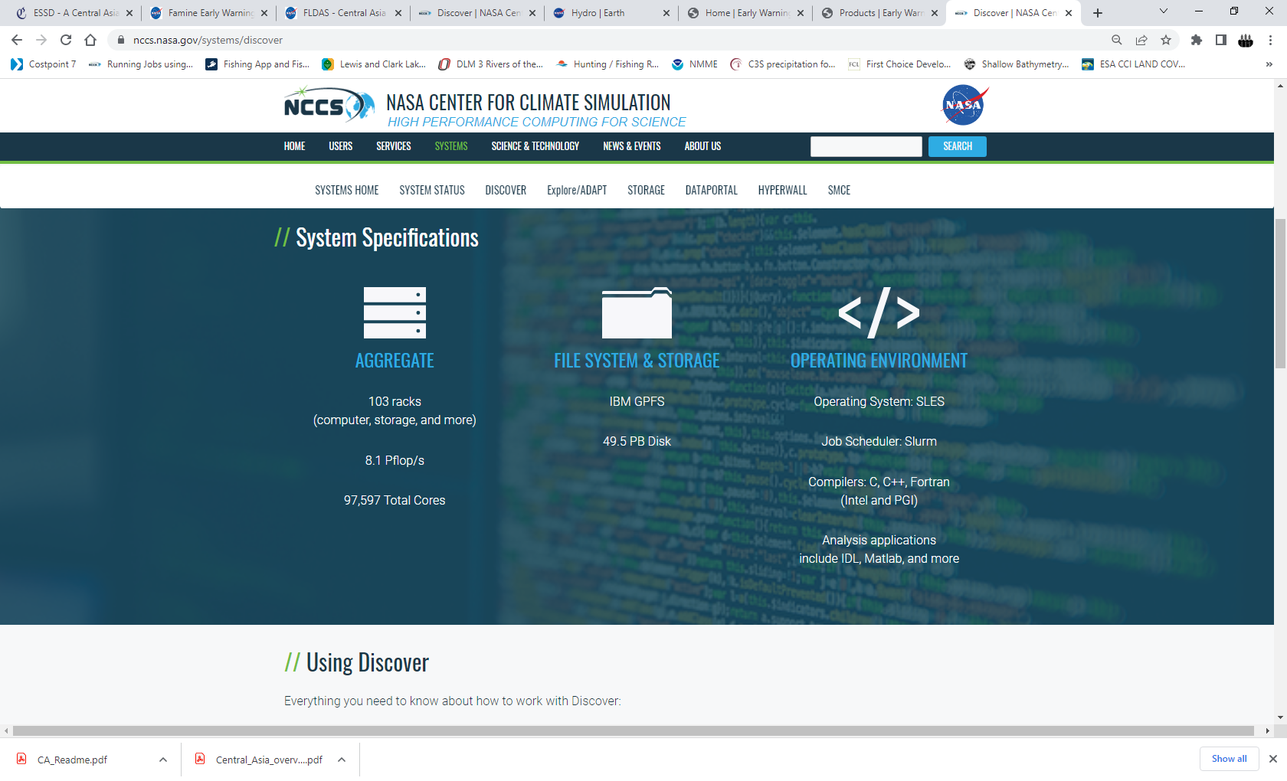
FEWS NET Land Data Assimilation System
97,597 total cores
8.1 PetaFlop/S
IBM GPFS
49.5 PB Disk
Operating System: SLES
Job Schedular: Slurm
Compilers: C, C++, Fortran
Discover

Slide 19
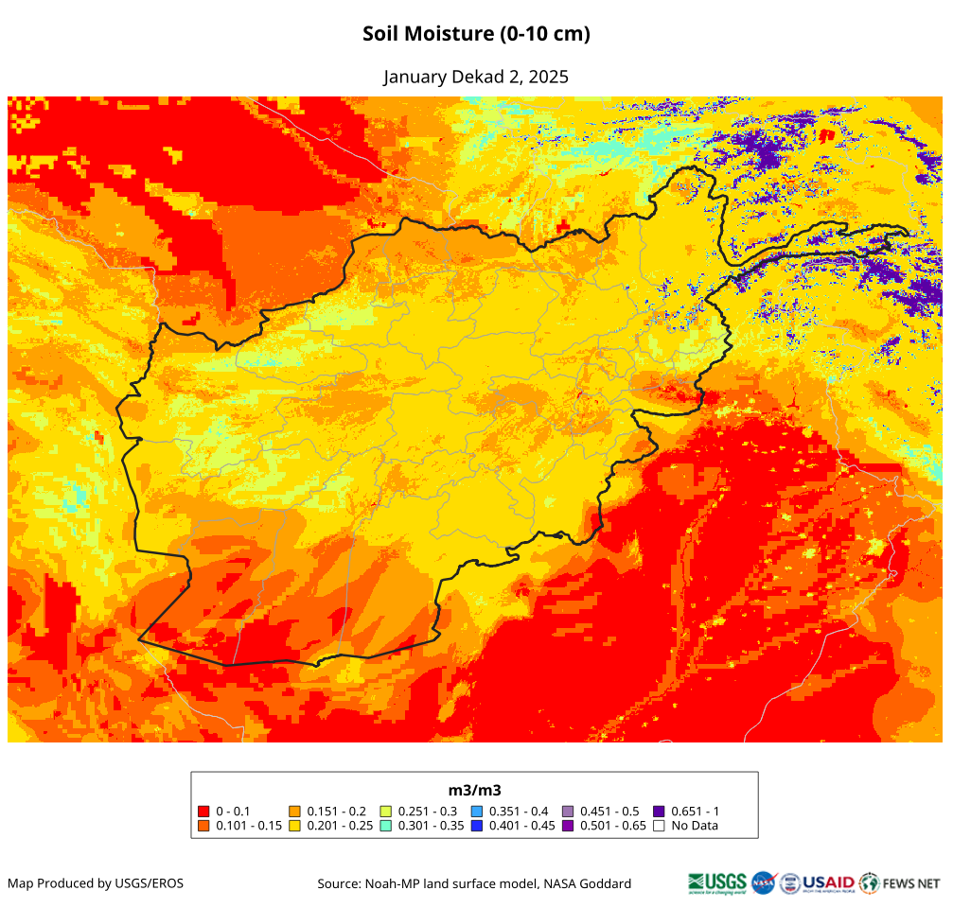
FLDAS Outputs
Snow Depth – provides us how deep the snow is on the ground.
Snow Water Equivalent – provides us how much of liquid water available in the snow we have on the ground.
Soil Moisture – provides us how much of water available at 4 different soil layers.
Streamflow – tells us where does the water go when it starts to melt.

Slide 20
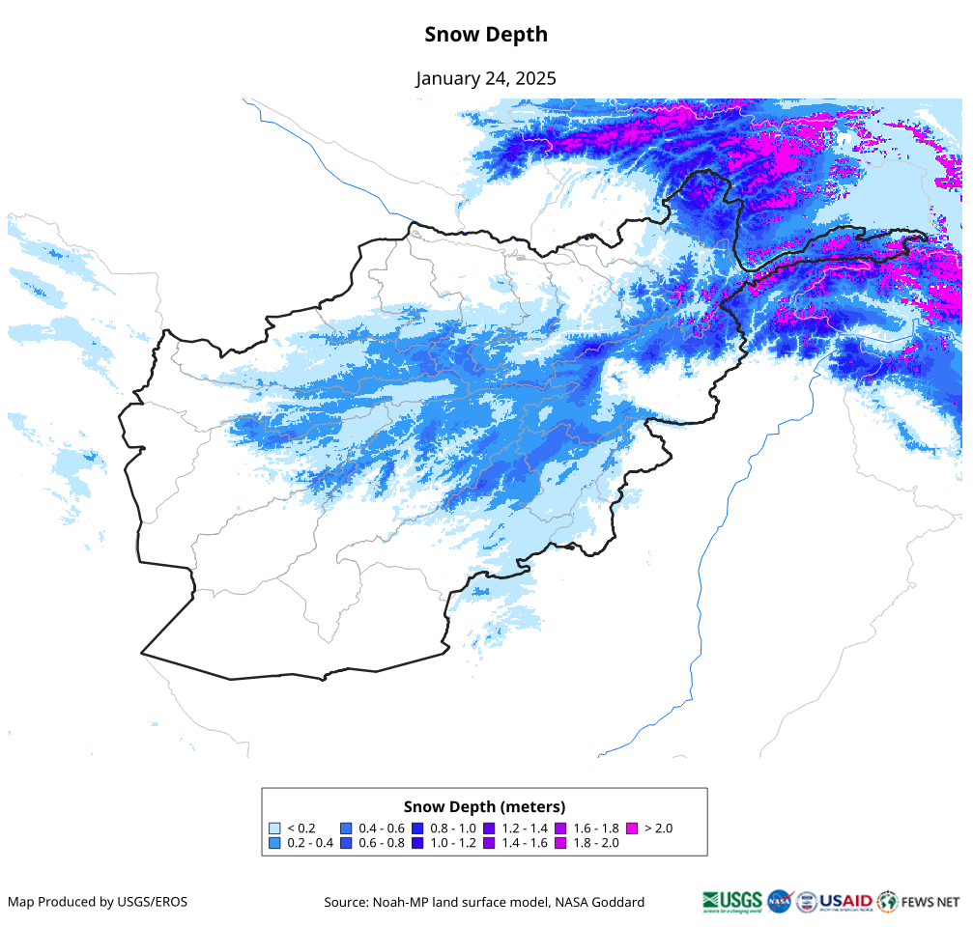
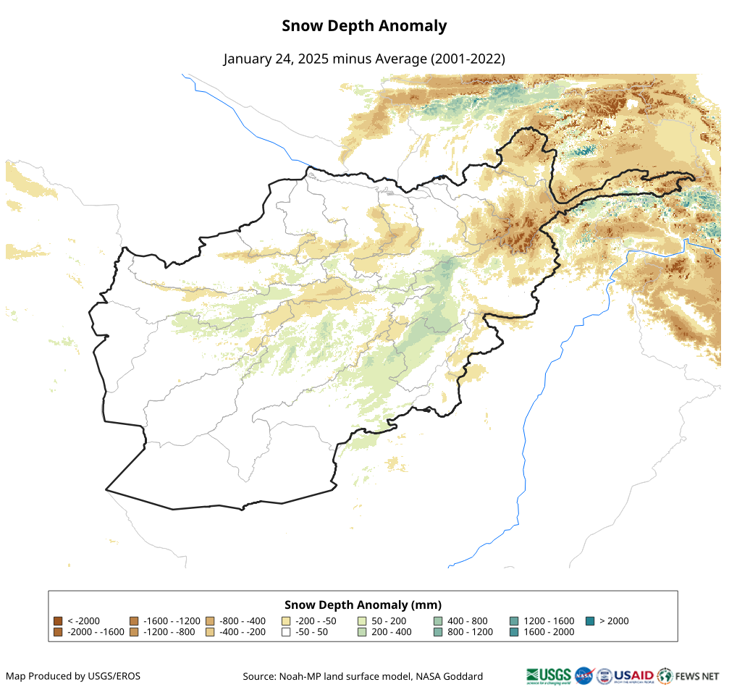
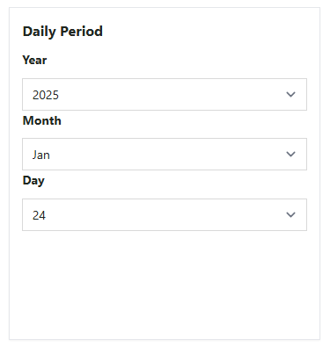
Snow Depth
Snow depth — it is the average depth of snow over a 1 km x 1 km area and gets updated daily.

Slide 21
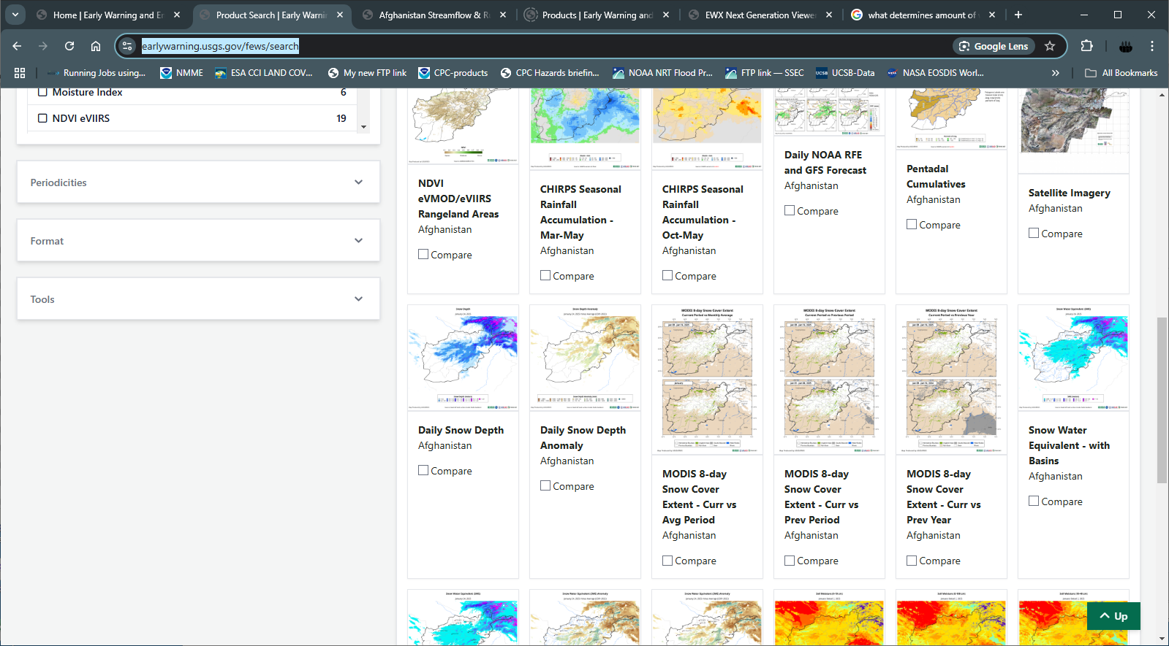
Snow Depth
Let’s check it on the https://earlywarning.usgs.gov/fews/search

Slide 22
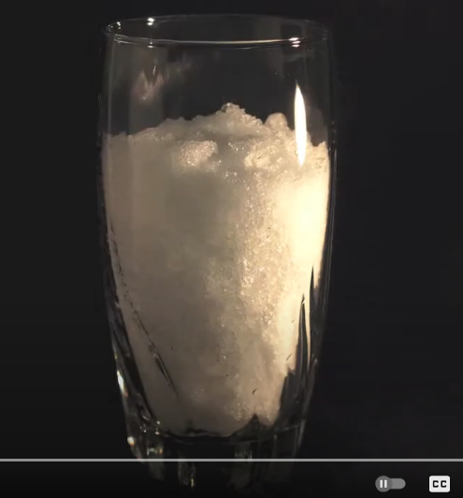
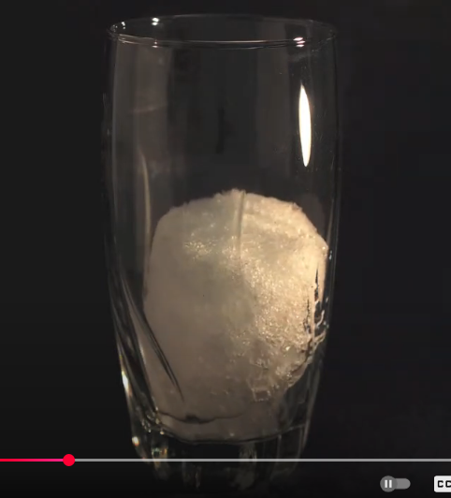


Snow Water Equivalent (SWE)
Snow water equivalent — it is the amount of liquid water available in the snow. Snow depth is measured in meters whereas SWE is measured in water volume such as cubic meters or cubic kilometers. Air temperature is the primary factor in determining how much water is held in the snow. Colder temperatures produce lighter, fluffier snowflakes containing less water per centimeter of snow, while warmer temperatures near freezing create heavier, wetter snowflakes with a higher water content.
snow
water

Slide 23


Snow Water Equivalent (SWE)
SWE — availability of liquid water over a 1 km x 1 km area and gets updated daily.

Slide 24


How to Compute SWE
999.97246766225 or roughly 1000 Kg m⁻² = 1 m of water
Average 180.3 kg m⁻²
or
180.3/1000 = 0.1803 m of water
36
25
26
150
250
2. Total area = 20 cells * cell resolution
3. Our cell resolution is 1 km x 1 km
or
1000 m x 1000 m
10
59
199
300
6
86
160
350
57
158
26
10
58
125
86
What was the total volume of water?
= 0.1803 m x 1000 m x 1000 m x 20
= 3,606,000 m³
= 3,606,000 / 1,000,000 million m³
= 3.6 million m³
On Jan 14 of 2025
In Kg m⁻²
Zonal average

Slide 25

SWE Curve
SWE curve — progression of SWE at a regular interval e.g. daily.

Slide 26


Difference Between SWE and SWE Curve
SWE – a snapshot of water availability
SWE curve – an evolution of seasonal water availability over an area (basin)

Slide 27


Water Availability in Dam Basins
Dams in Afghanistan
Dam catchment or upstream area

Slide 28

SWE Tool on Early Warning Explorer (EWX)
Let’s check it on the https://earlywarning.usgs.gov/fews/software-tools/1

Slide 29

What Happens when Snow Starts to Melt
The top of the saturated zone in the soil (the water table) is deep, so percolating meltwater infiltrates to raise the water table and induce increased groundwater flow to the stream.
The water table is at the soil surface, of the soil surface is impermeable (the ground may be still frozen), so percolating meltwater forms a basal saturated zone through which water migrates to the stream.
The lower portion of the water table has risen above the ground surface into the snowpack. Water in the upper part of the slope infiltrates to raise the water table and percolating water in lower part forms basal saturated zone then migrates to the stream.

Slide 30


Streamflow
Streamflow — it is the amount of water flowing in a river, it also refers as discharge. Typically, a hydrograph is used to study streamflow. A hydrograph is a chart showing most often streamflow/discharge (amount of water crossing a section of the river e.g. cubic meter per second) or river stage (height of the water above an arbitrary altitude e.g. MSL).
Bankfull — it is the water stage at which a river is at the top of its banks and any further rise in water state would result in water moving into the flood plain.
Return period — it is the average number of years between floods of a certain size. It is to compare how common some floods are annually.
NOAH 3.6/NOAH-MP + HyMAP2

Slide 31


Streamflow Monitoring
Streamflow monitoring system for Flood early warning

Slide 32


Streamflow Monitoring
Runoff based flood early warning

Slide 33

Flood Early Warning
Let’s check it on the https://earlywarning.usgs.gov/fews/search/Asia/Central%20Asia/Afghanistan

Slide 34
Snow Water Volume Assessment

Slide 35

Analog Year
Water year is October to September
A total of 10 analog years were identified by Andy Hoell of NOAA, they are as follows:
2000-01, 2003-04, 2005-06, 2007-08, 2010-11, 2017-2018, 2020-2021, 2021-2022, 2022-23, 2023-2024
Out of this list of weak La Niña years, average to below average rainfall were used for SWE.
They are: 2005-06, 2017-18, and 2022-23

Slide 36


Analog Years
La Niña Analog Years: 2000-01, 2003-04, 2005-06, 2007-08, 2010-11, 2017-2018, 2020-2021, 2021-2022, 2022-23, 2023-2024
El Niño Analog Years: 2004-05, 2006-07, 2009-10, 2010-11, 2014-15, 2016-17, 2018-19

Slide 37

Helmand
This figure with all identified La Niña years of SWE is to look at the typical signal of SWE during the La Niña years.
It suggests, while early spring (Jan-Mar) might be ok for water availability, there is high likelihood of well below average water availability during late spring (Mar-Apr).
Obviously, it will vary by basin across Afghanistan.

Slide 38


Helmand
Average to below average SWE during early spring (Jan-Feb), but well below average SWE in late spring (Mar-Apr).
Average streamflow during Mar-Apr, but well below average streamflow during the rest of the season.

Slide 39


Argandab
Average to below average SWE during early spring (Jan-Feb), but well below average SWE in late spring (Mar-Apr).
Chances of early completion of snowmelt at least two weeks in advance.
Average streamflow during Mar-Apr, but well below average streamflow during the rest of the season.

Slide 40


Ghazni
Average to below average SWE during early spring (Jan-Feb), but well below average SWE in late spring (Mar-Apr).
Chances of early completion of snowmelt. Given the size of the basin snowmelt could complete four to six weeks in advance.
Average streamflow during Mar-Apr, but well below average streamflow during the rest of the season.

Slide 41


Shamal
Average to below average SWE during early spring (Jan-Feb), but well below average SWE in late spring (Mar-Apr).
Chances of early completion of snowmelt. Given the size of the basin snowmelt could complete four to six weeks in advance.
Highly variable streamflow through the season mostly because of the smaller size of the basin.

Slide 42


Kabul-east
Average to below average SWE throughout the spring season (Jan-Apr).
Snowmelt could complete two to four weeks in advance.
Average streamflow with occasional chance of elevated flow in the river.

Slide 43


Kokcha_Ab-i-Rustaq-lower
SWE could be highly variable over the mountainous basins in the northeast throughout the season.
Streamflow could also be highly variable and could experience flood producing flow in May-Jun.

Slide 44


Panj
SWE could be highly variable over the mountainous basins in the northeast throughout the season.
Streamflow could also be highly variable and could experience flood producing flow in May-Jun.

Slide 45


Khanabad-lower
SWE could be highly variable in early spring (Jan-Mar), then likely to be below average in late spring (Apr-May).
Average to below average Streamflow with occasional chance for high flow in May.

Slide 46


Kunduz
Average to below average SWE with exceptionally above average SWE very late in the season in 2023.
Chances of early completion of snowmelt. Which could complete four to eight weeks in advance.
Average to below average Streamflow with occasional chance for high flow capable of causing floods.

Slide 47


Khulm
Average to below average SWE with exceptionally above average SWE very late in the season in 2023.
Chances of early completion of snowmelt. Which could complete four to six weeks in advance.
Average to below average Streamflow with occasional chance for high flow capable of causing floods.

Slide 48


Balkhab
Average to below average SWE thoughout the season.
Average to below average Streamflow with occasional chance for high flow in the river.

Slide 49


Sari Pul
Average to below average SWE throughout the season.
Chances of early completion of snowmelt, two to four weeks in advance.
Below average Streamflow with occasional chance for moderate flow in the river.

Slide 50


Shirin Tagab - lower
Average to below average SWE in early spring, but well below average in late spring.
Chances of early completion of snowmelt, four to six weeks in advance.
High likelihood of below average Streamflow throughout the season.

Slide 51


Bala Murghab
Average to below average SWE in early spring, but well below average in late spring.
Chances of early completion of snowmelt, two to four weeks in advance.
High likelihood of below average Streamflow throughout the season.

Slide 52


Hari Rod
Average to below average SWE in early spring, but well below average in late spring.
Chances of early completion of snowmelt.
High likelihood of below average Streamflow throughout the season.

Slide 53


Farah Adraskan
Average to below average SWE in early spring, but well below average in late spring.
Chances of early completion of snowmelt, four to six weeks in advance.
High likelihood of below average Streamflow throughout the season.

Slide 54
Observation summary
Average to below average SWE in early spring (Jan-Mar), but well below average in late spring (Apr-May).
SWE could be highly variable over the mountainous basin in the northeast.
High likelihood of early completion of snowmelt, which could be two to eight weeks in advance depending on location.
High likelihood of below average Streamflow throughout the season in southern southwestern basins.
Likelihood of average to below average streamflow in the eastern northeastern basins with occasional higher flow capable of causing floods.
Temperature would play a critical role for building up of snowpack and completion of snowmelt.

Slide 55
Then There are Flash Flooding
However, flash flood can occur anytime and anywhere depending on the nature of the precipitation and in combination with snowmelt.
There will always be moderate likelihood of flash flooding across Afghanistan.

Slide 56
Additional Resources
USGS Early Warning Portal: https://earlywarning.usgs.gov/
MODIS Snow Cover: https://nsidc.org/data/mod10a1f/versions/61
NASA LIS: https://lis.gsfc.nasa.gov/
NASA FLDAS: https://ldas.gsfc.nasa.gov/fldas/
FEWS NET Afghanistan: https://fews.net/middle-east-and-asia/afghanistan

Slide 57
Thank you and let me know if you have questions.

