Slide 1
SWV and Streamflow Analog Year Analysis
Shahriar Pervez
March 13 2025

Slide 2
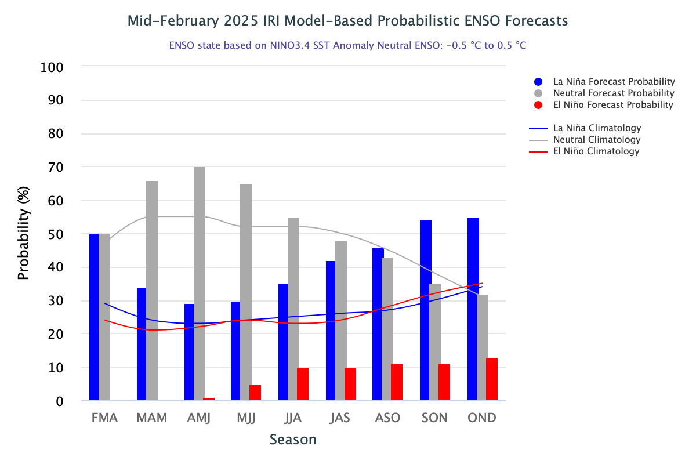
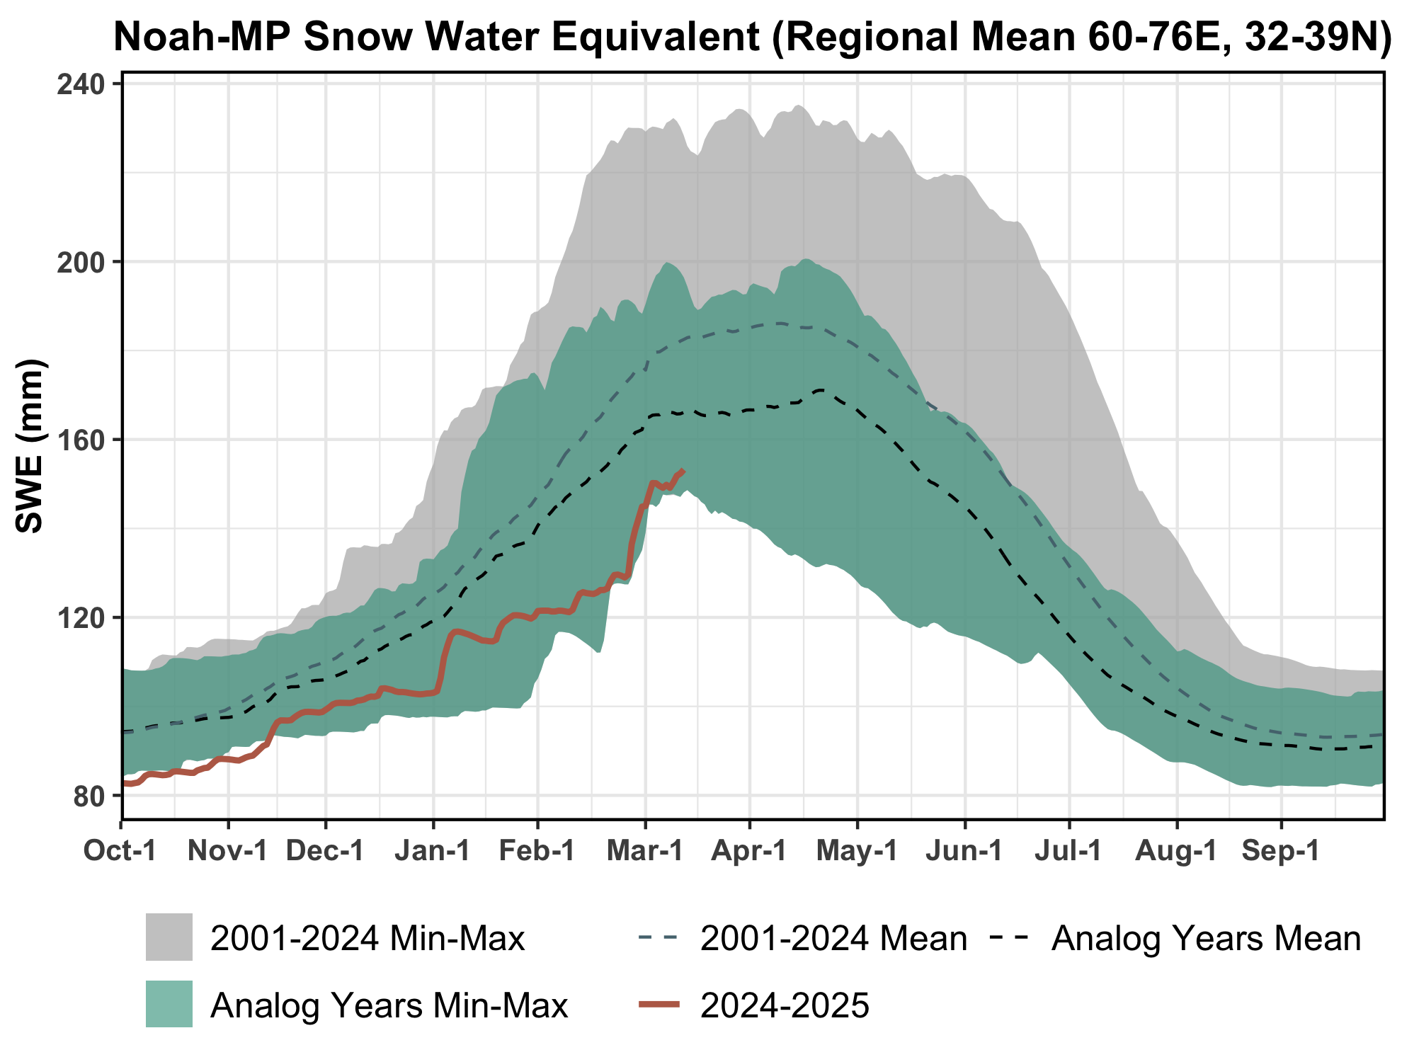
La Niña Analog Years
2000-01, 2003-04, 2005-06, 2007-08, 2010-11, 2017-2018, 2020-2021, 2021-2022, 2022-23, 2023-2024

Slide 3
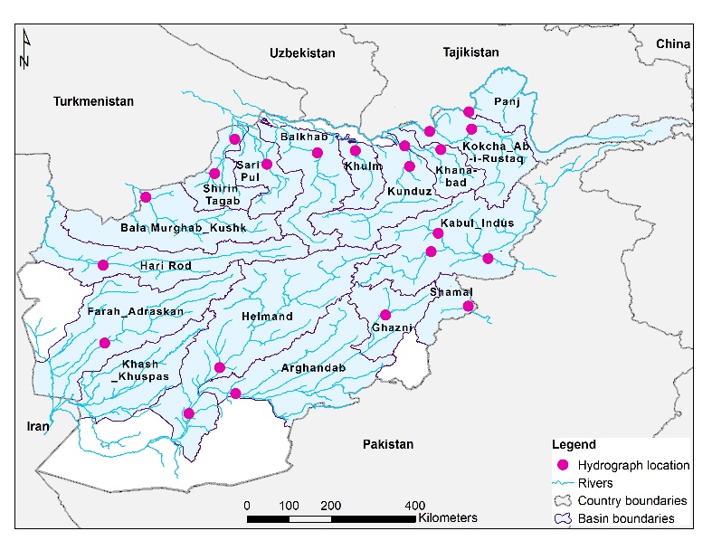
Basins & Monitoring Points
22 Streamflow monitoring points above or near populated areas or major agricultural areas
17 basins
We will look at four La Niña analog years of SWV and streamflow
2017-2018 and 2022-2023 in the northern basins
2005-2006 and 2010-2011 in the southern basins

Slide 4
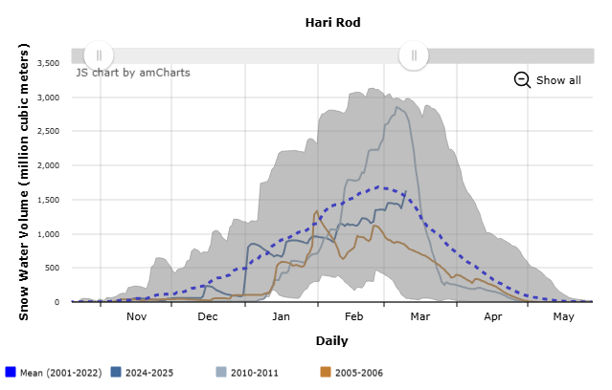
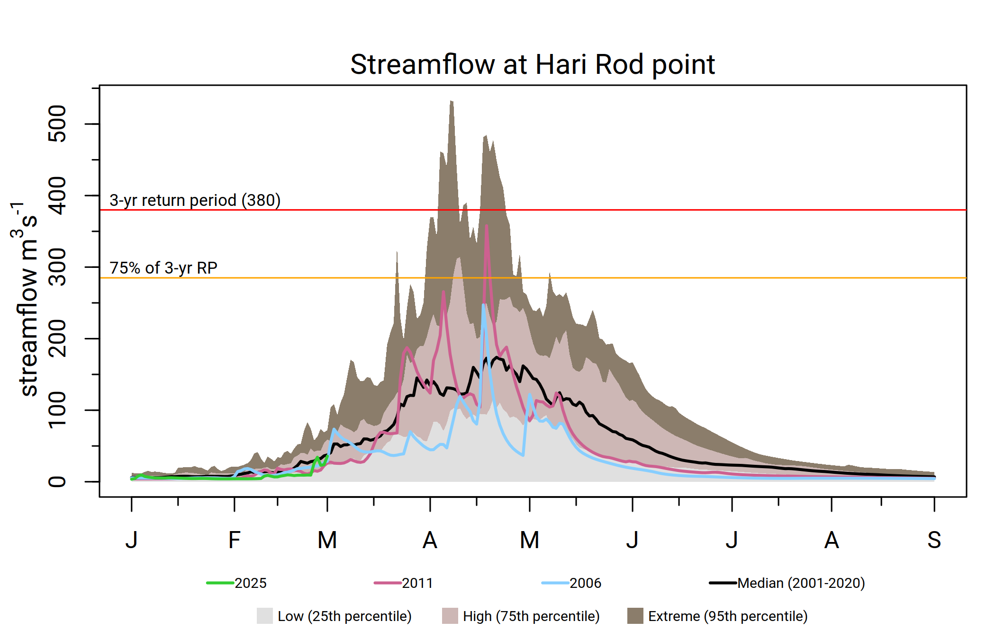
Hari Rod
Average SWE during spring (Jan-Feb), while there were a big uptake in SWE in 2011.
Chances of early completion of snowmelt at least two weeks in advance.
Average streamflow during Mar-Apr then below average thereafter. Less likelihood of flooding in the basin.

Slide 5
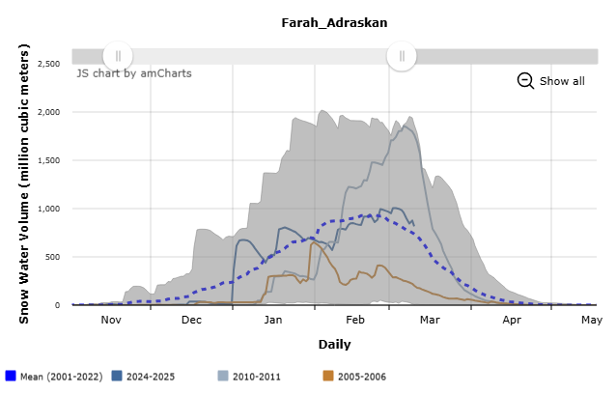
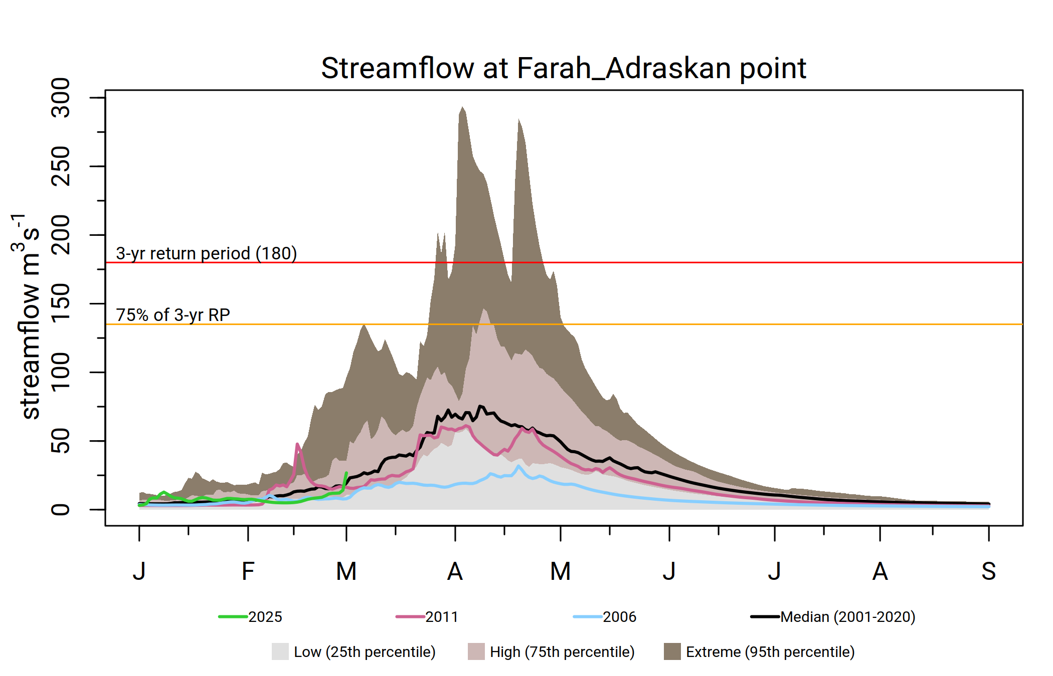
Farah Adraskan
Highly variable SWE.
High likelihood of below average Streamflow throughout the season.
Less likelihood of flooding in the basin.

Slide 6
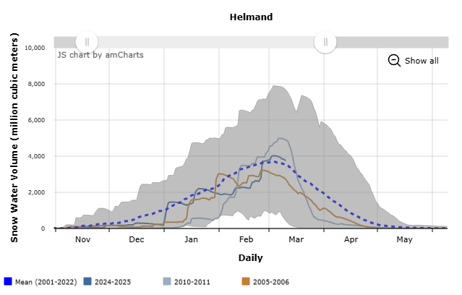
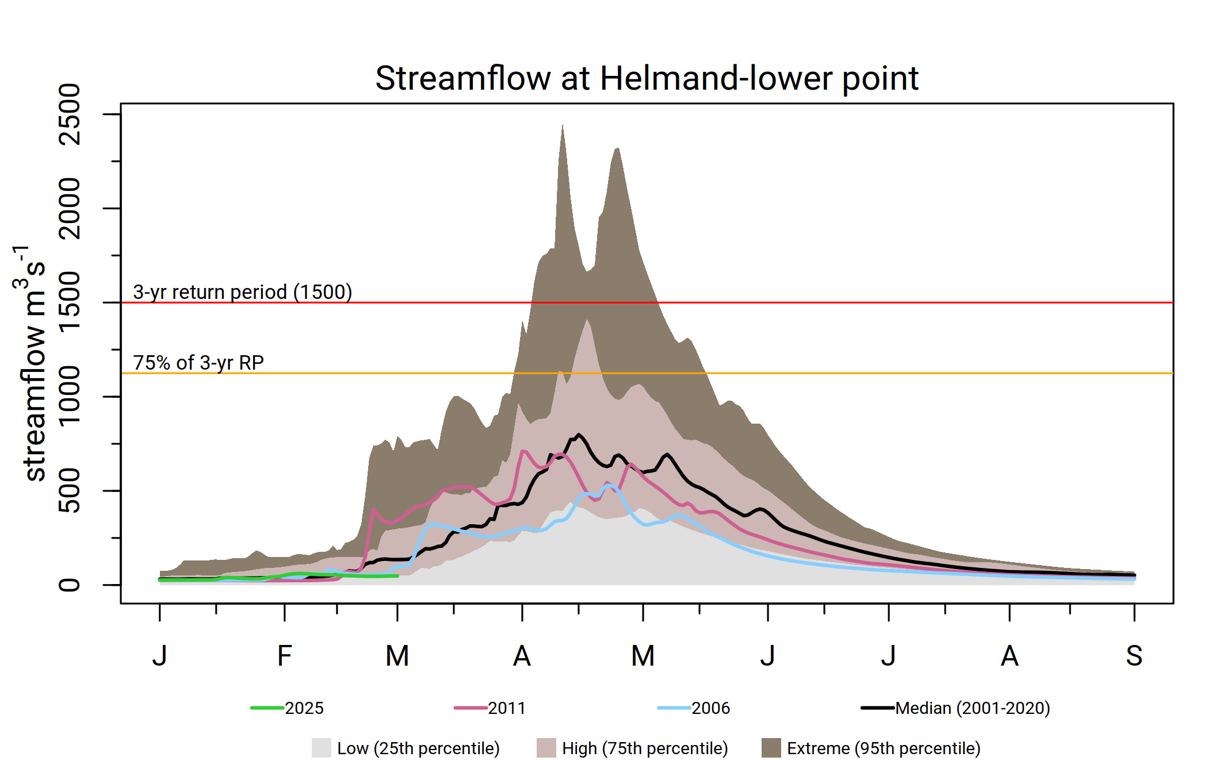
Helmand
Average SWE during spring (Jan-Feb), but below average SWE in late spring (Mar-Apr).
Chances of early completion of snowmelt at least two weeks in advance.
Average streamflow during Mar-Apr then below average thereafter. Less likelihood of flooding in the basin.

Slide 7
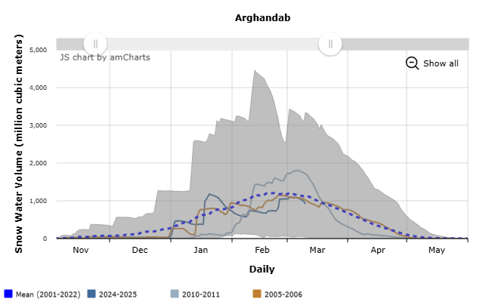
Argandab
Average SWE during spring (Jan-Feb), but below average SWE in late spring (Mar-Apr).
Chances of early completion of snowmelt at least two weeks in advance.
Average streamflow during Mar-Apr and below average thereafter. Less likelihood of flooding in the basin.

Slide 8
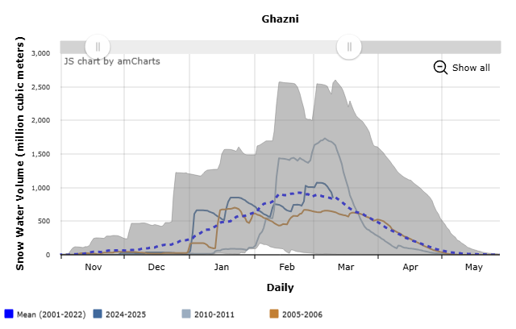
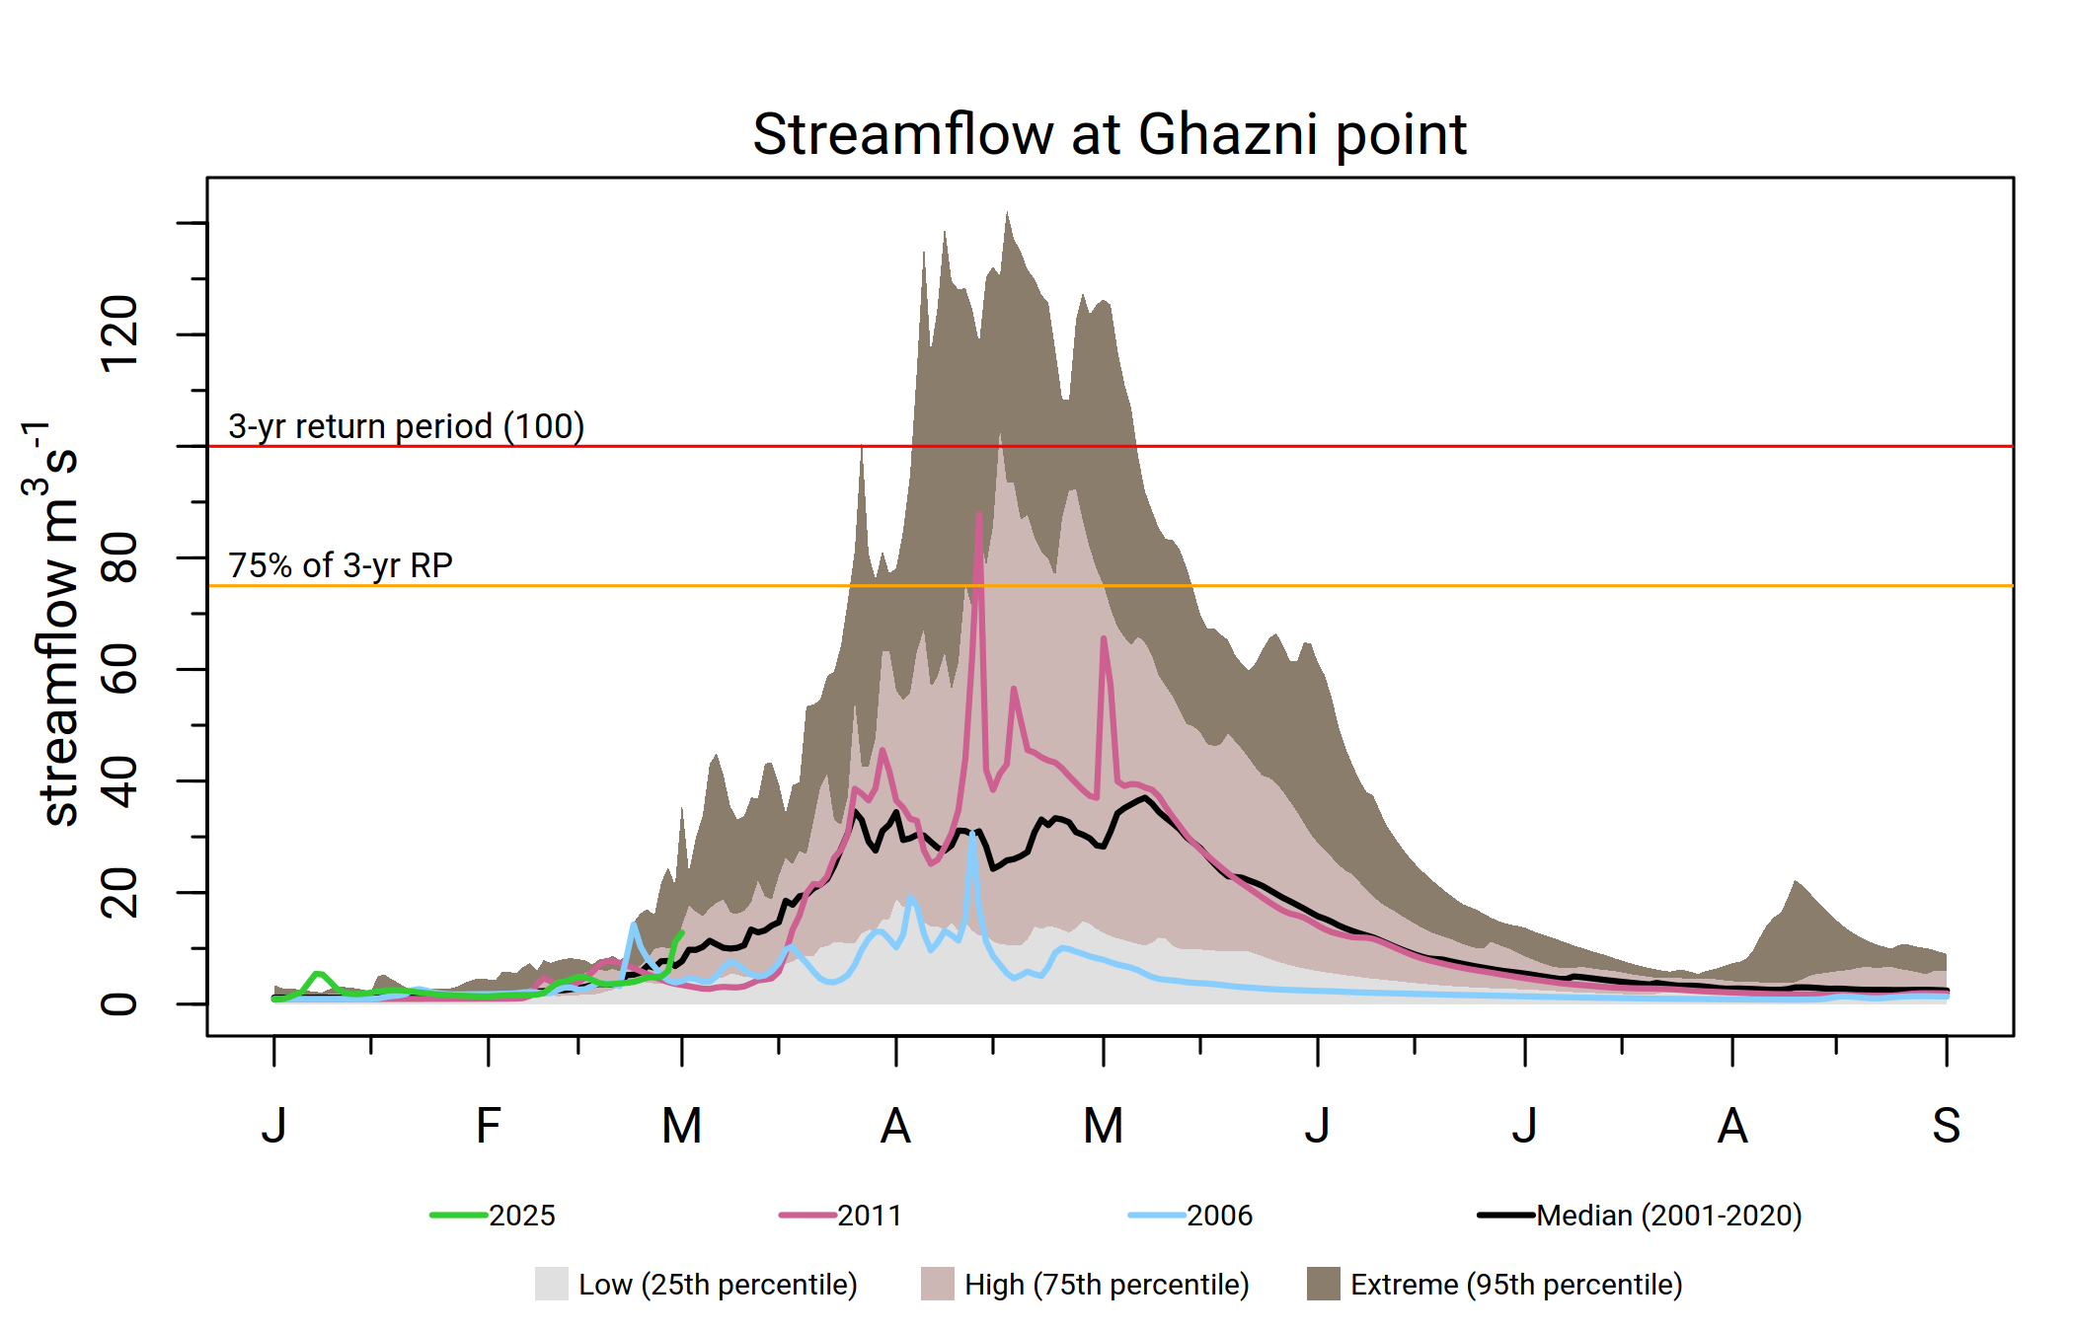
Ghazni
Average SWE throughout the season.
Progression of on time snowmelt can be expected.
Average streamflow during Mar-Apr with occasional chance of elevated flow in the river.

Slide 9
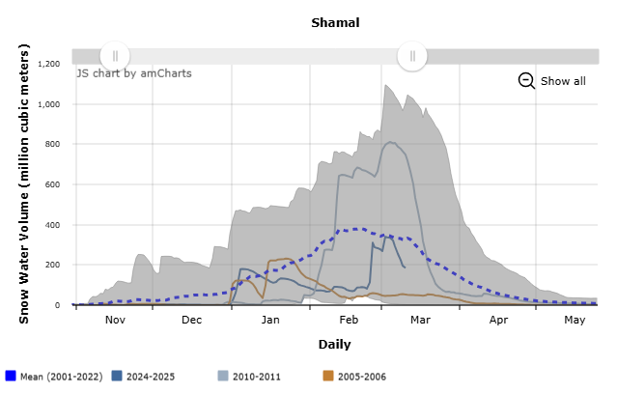
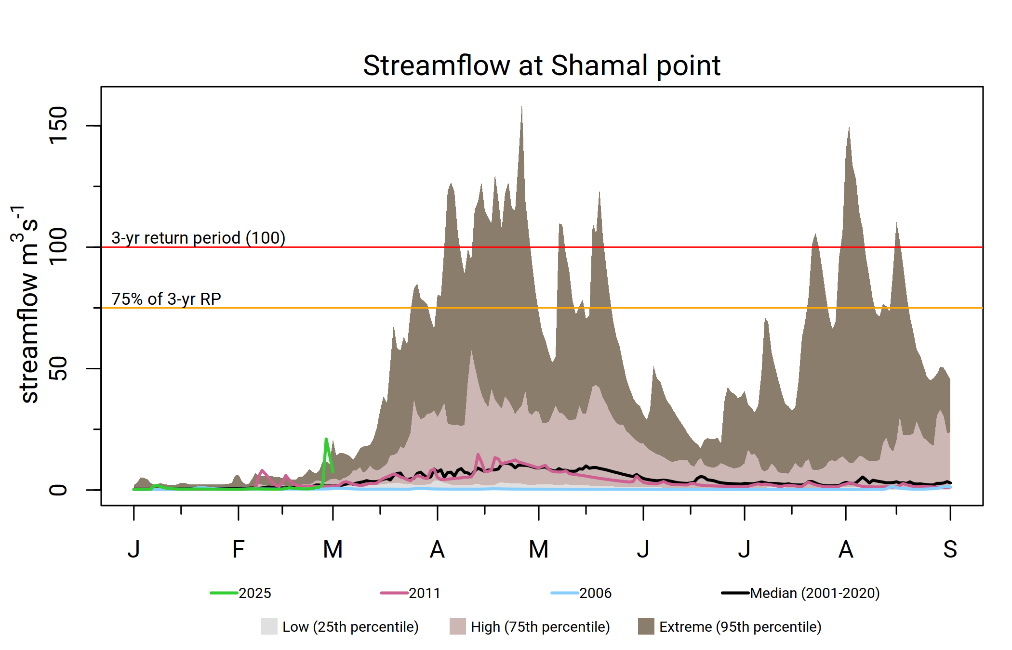
Shamal
SWE was highly variable.
Chances of early completion of snowmelt. Given the size of the basin snowmelt could complete four to six weeks in advance.
Highly variable streamflow through the season mostly because of the smaller size of the basin.

Slide 10
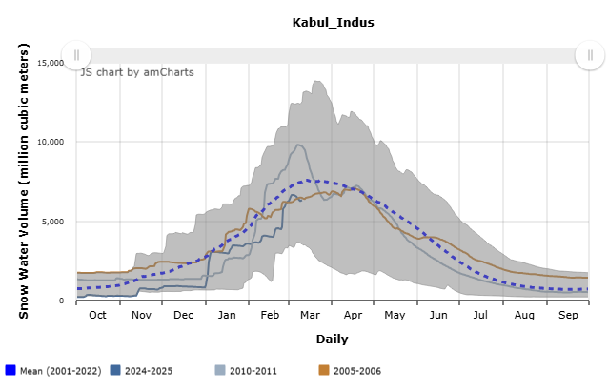
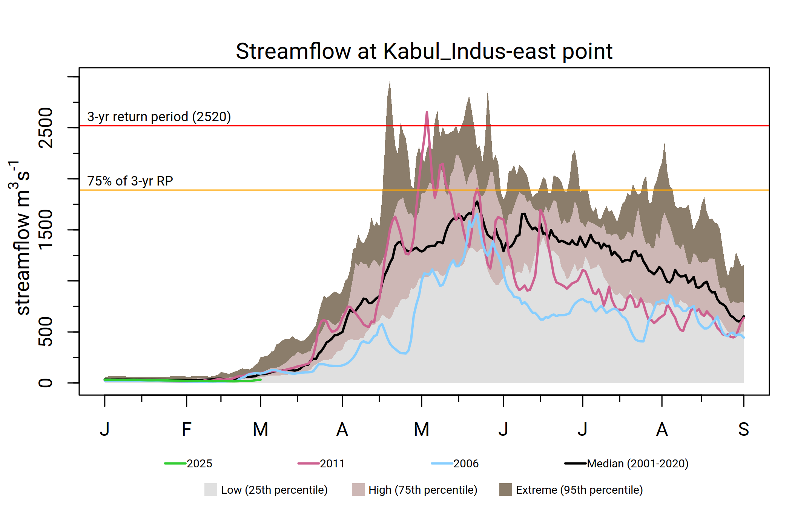
Kabul-east
Average SWE throughout the spring season (Jan-Apr).
Average streamflow with occasional chance of elevated flow in the river.
Moderate likelihood of flooding, especially in May.

Slide 11
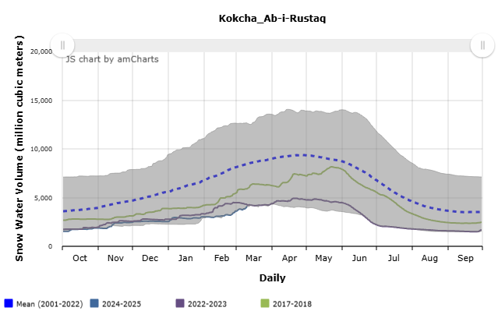
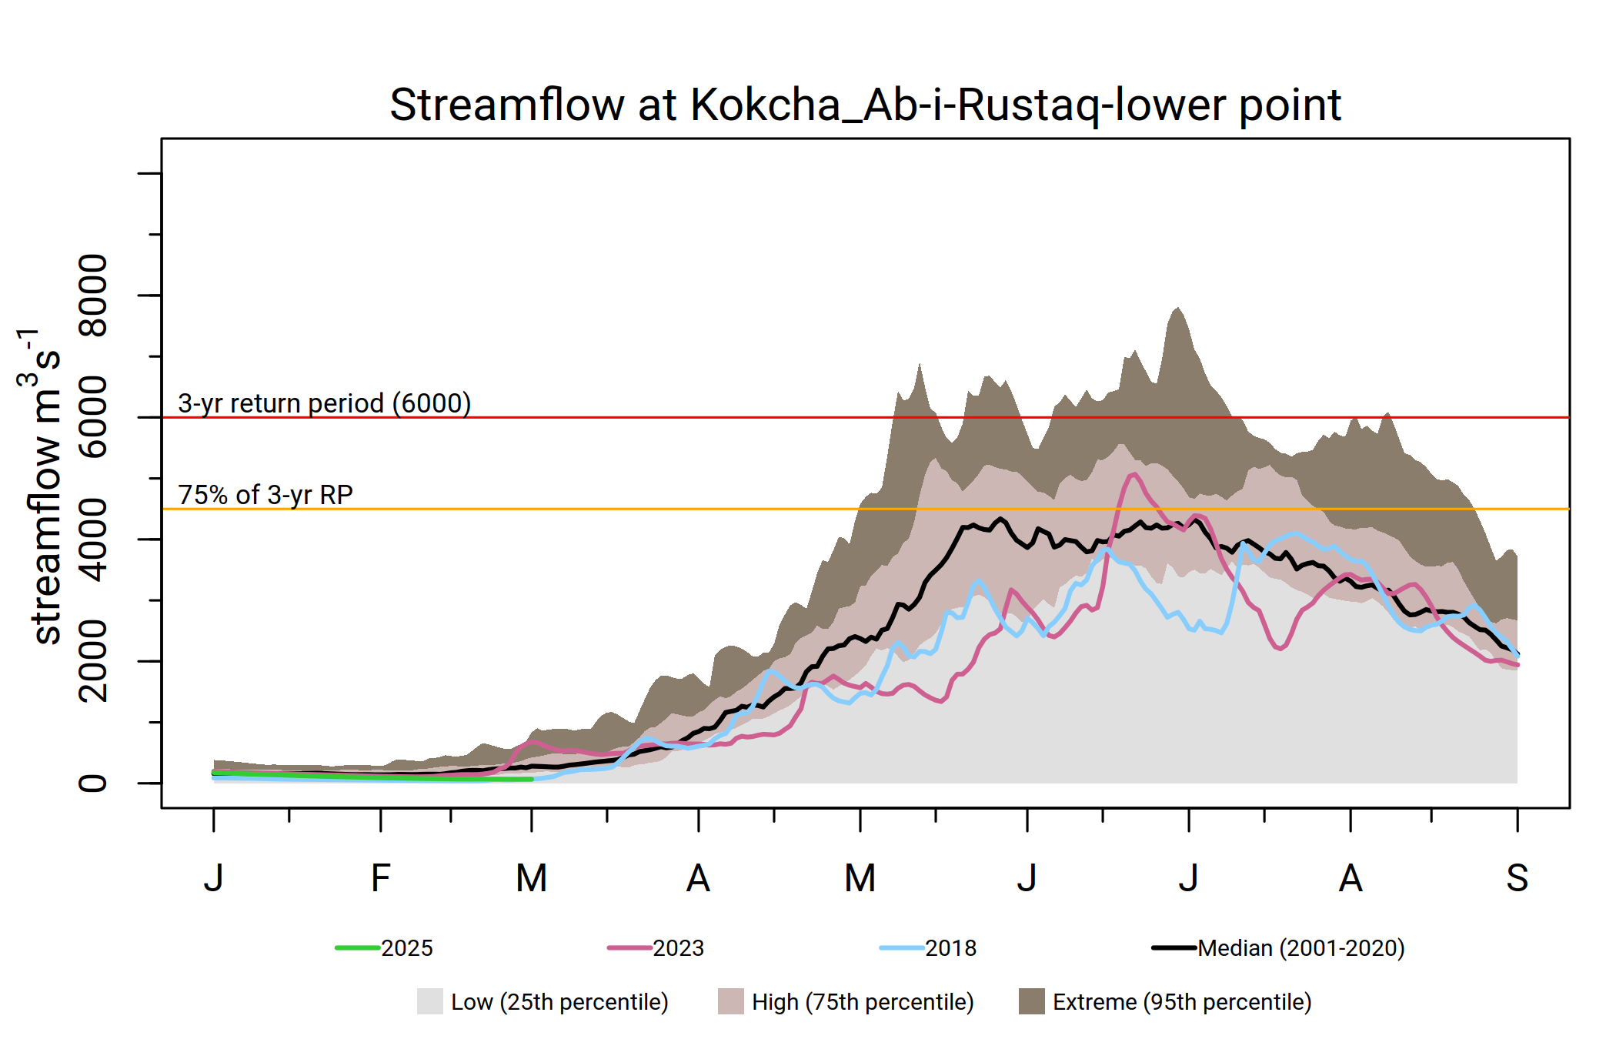
Kokcha_Ab-i-Rustaq-lower
Below average SWE throughout the season.
Chances of early completion of snowmelt, could be four to six weeks in advance.
Average to below average Streamflow throughout the season.

Slide 12
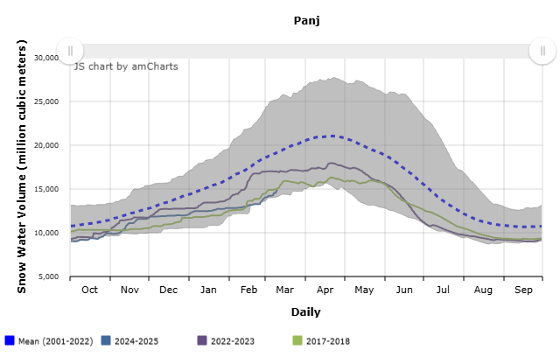
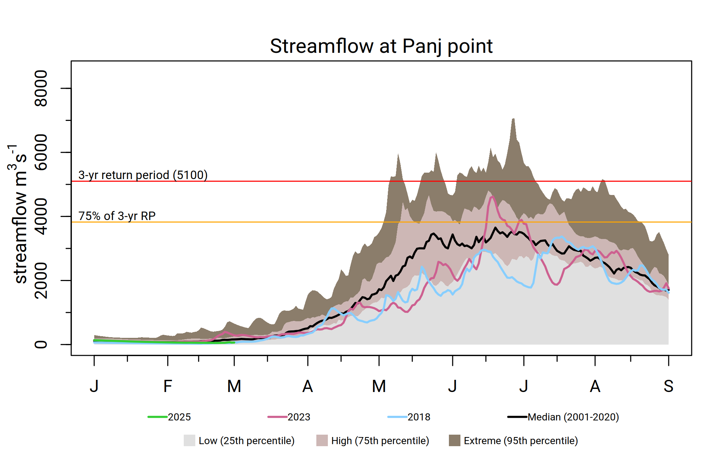
Panj
Below average SWE throughout the season.
Chances of early completion of snowmelt, could be six to eight weeks in advance.
Average to below average Streamflow.

Slide 13
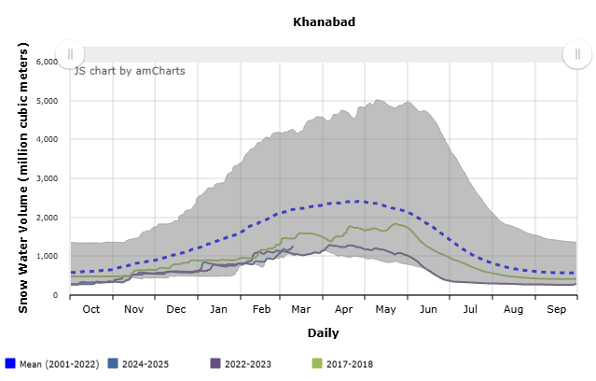
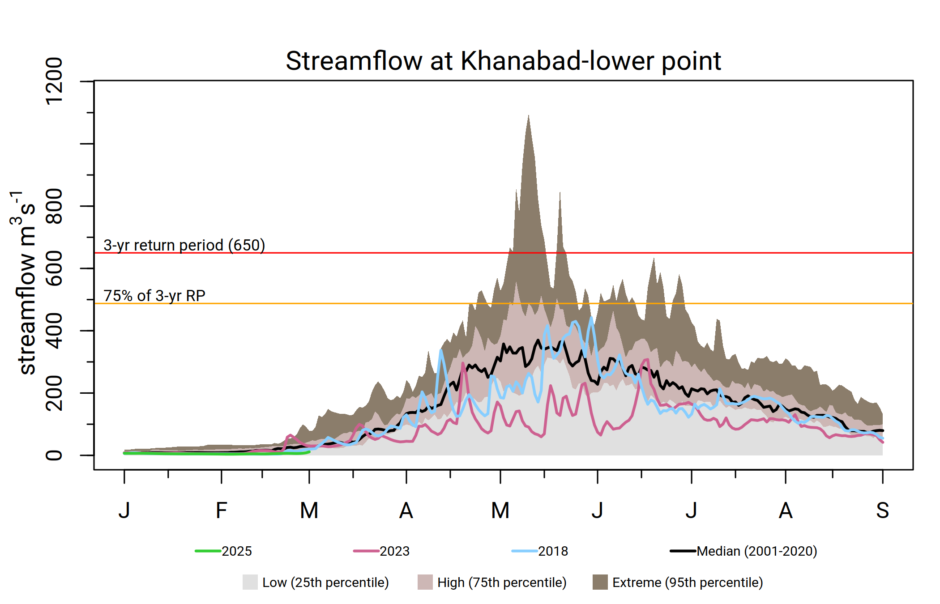
Khanabad-lower
Below average SWE throughout the season.
Chances of early completion of snowmelt, could be six to eight weeks in advance.
Average to below average Streamflow with occasional chance for high flow in May.

Slide 14
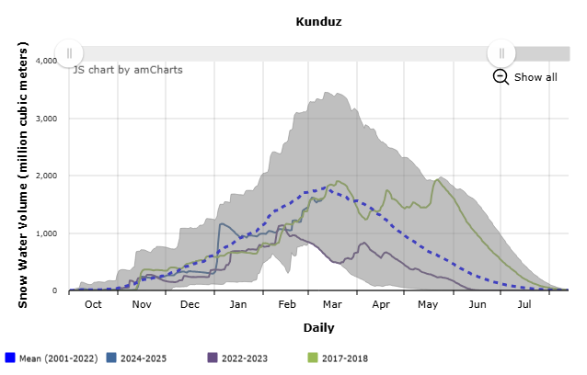
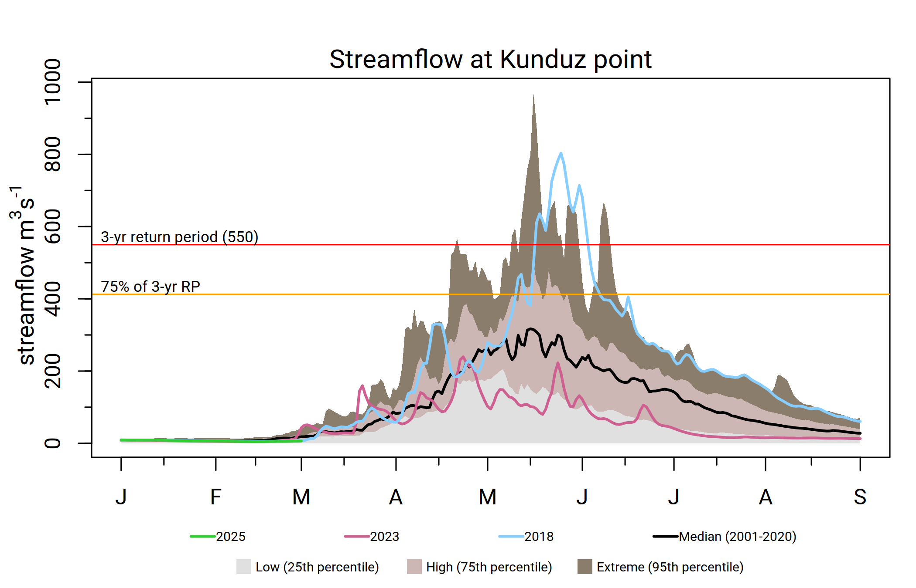
Kunduz
Below average SWE with exceptionally above average SWE very late in the season in 2018.
Chances of early completion of snowmelt. Which could complete four to six weeks in advance.
Generally, below average Streamflow with occasional chance for high flow capable of causing floods as it was in 2018.

Slide 15
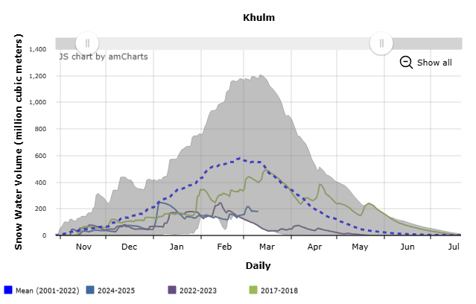
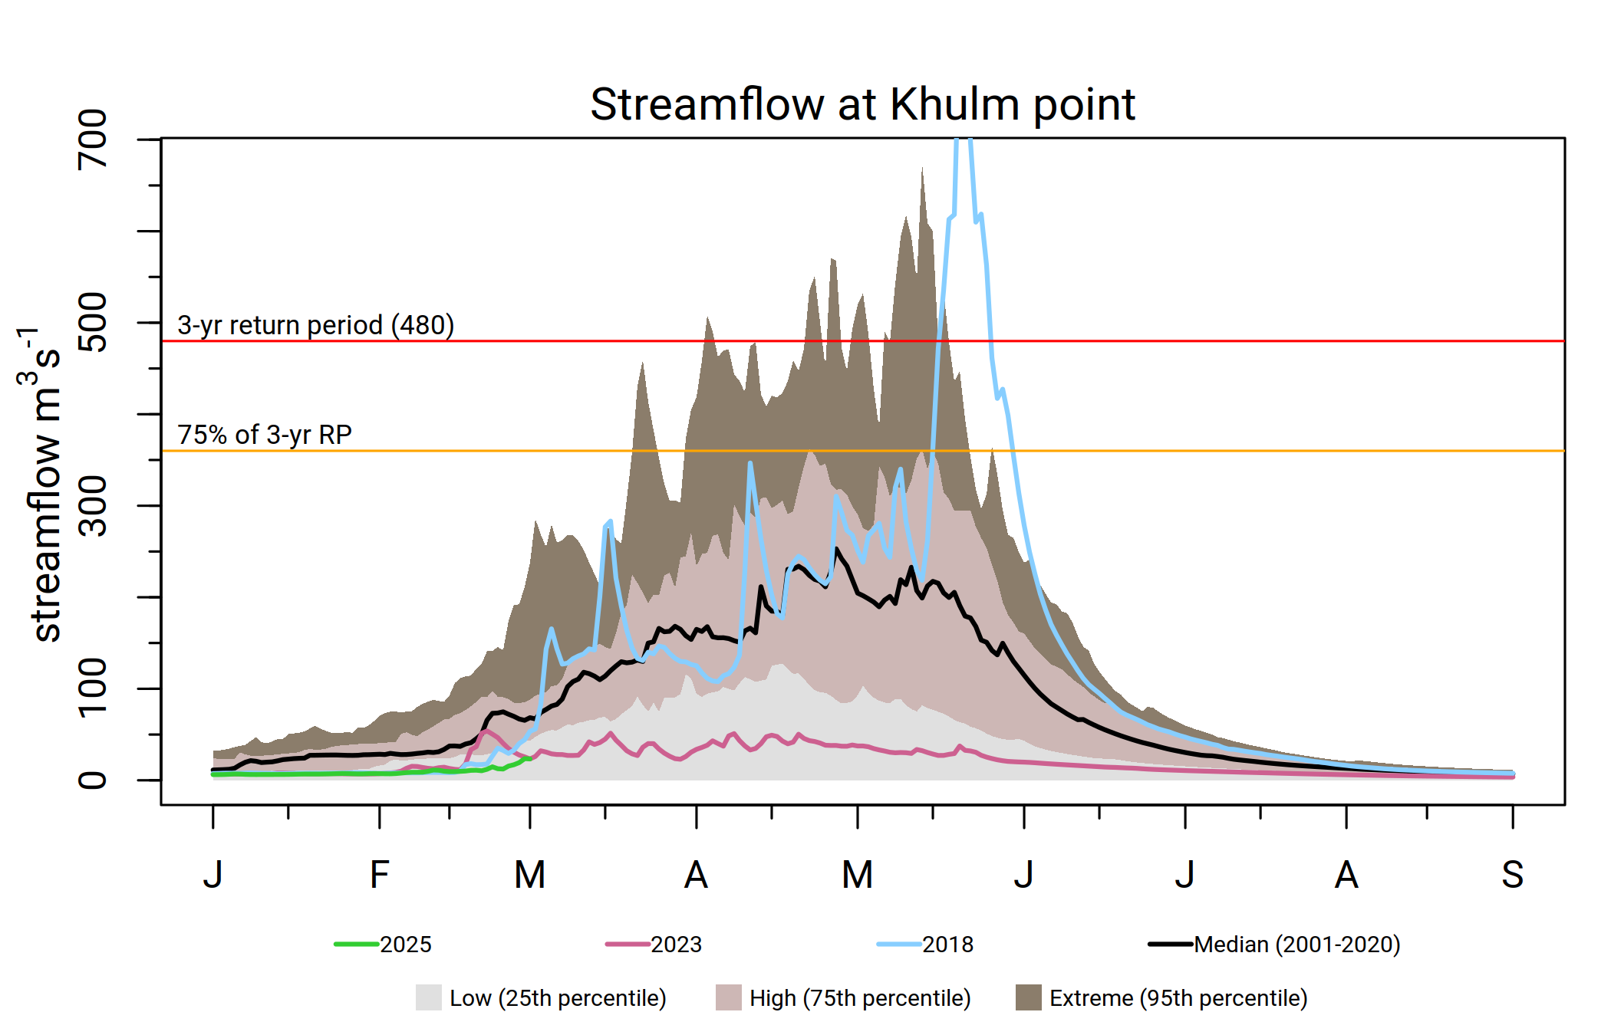
Khulm
Well below average SWE with exceptionally above average SWE very late in the season in 2018.
Chances of early completion of snowmelt. Which could complete four to six weeks in advance.
below average Streamflow with occasional chance for high flow capable of causing floods as it was in 2018.

Slide 16
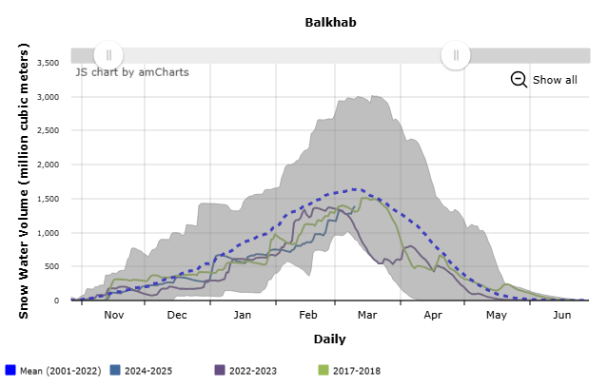
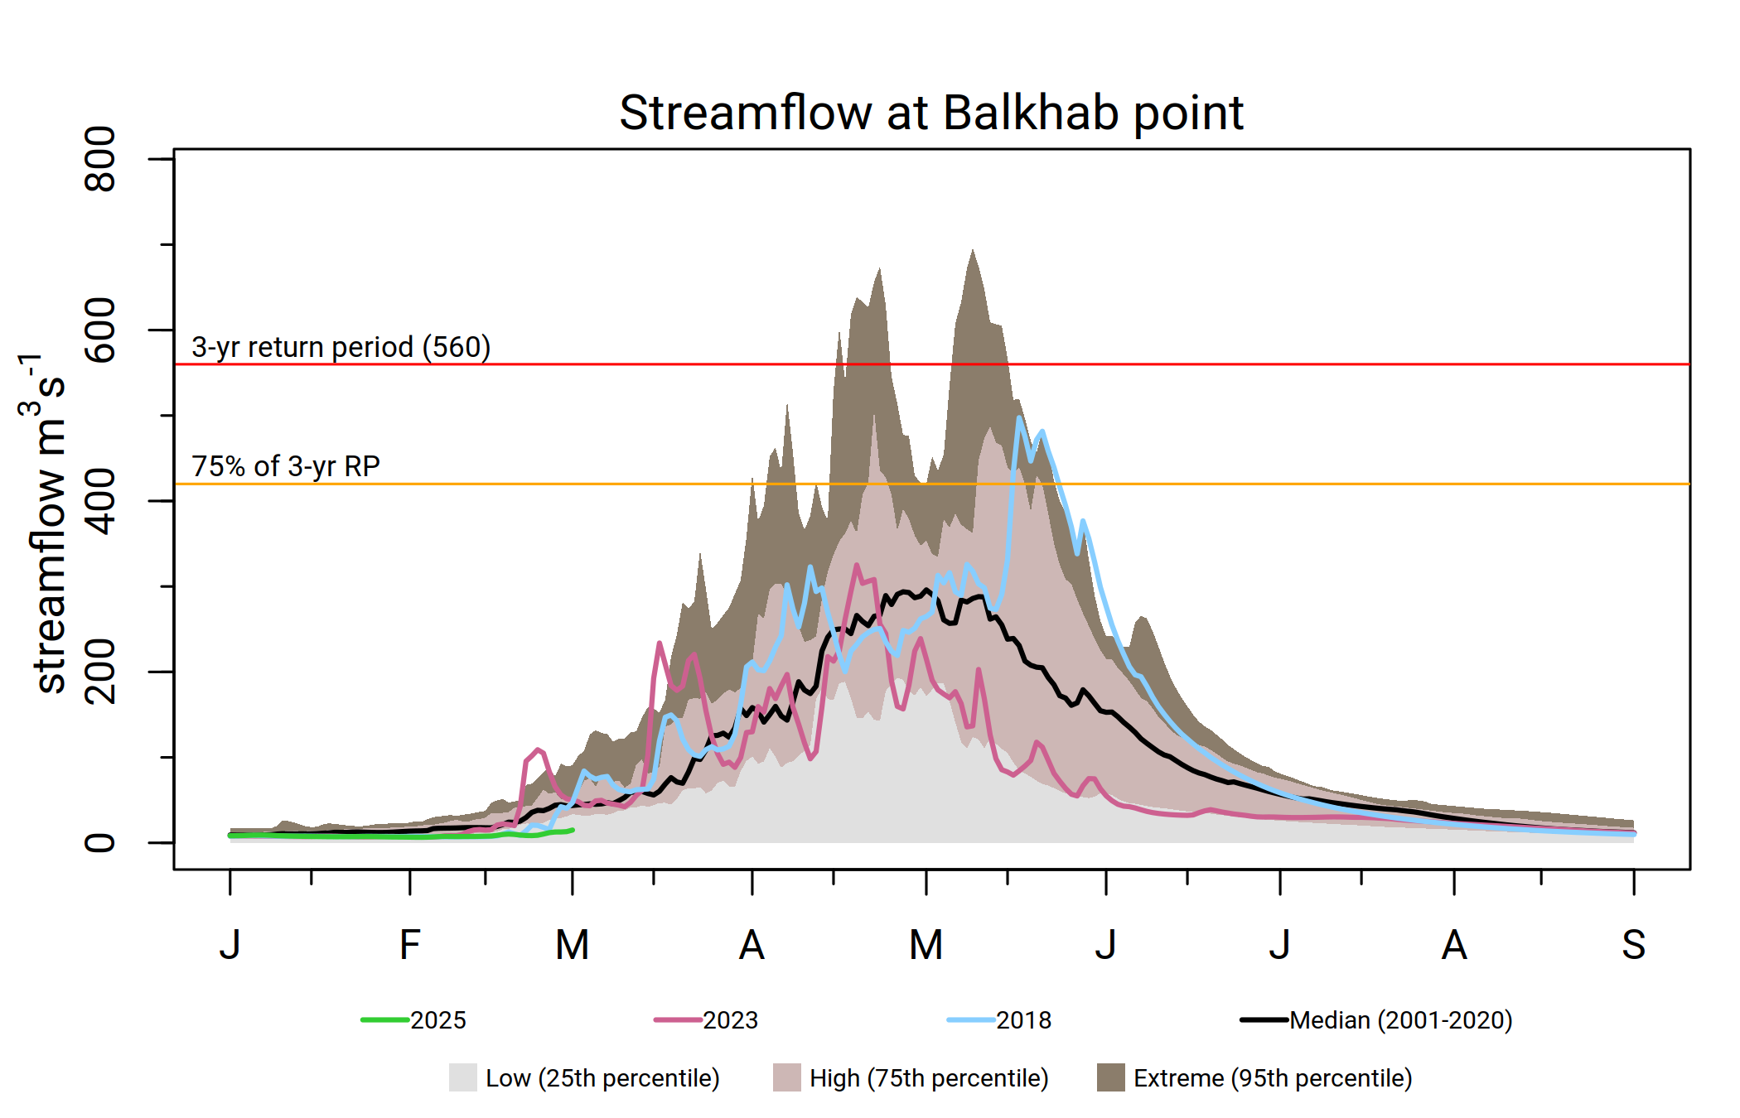
Balkhab
Average to below average SWE throughout the season.
Chances of early completion of snowmelt, one to two weeks in advance.
Average Streamflow with occasional chance for high flow in the river in late spring.

Slide 17
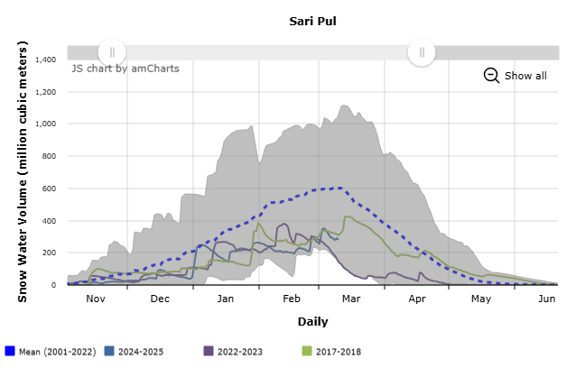
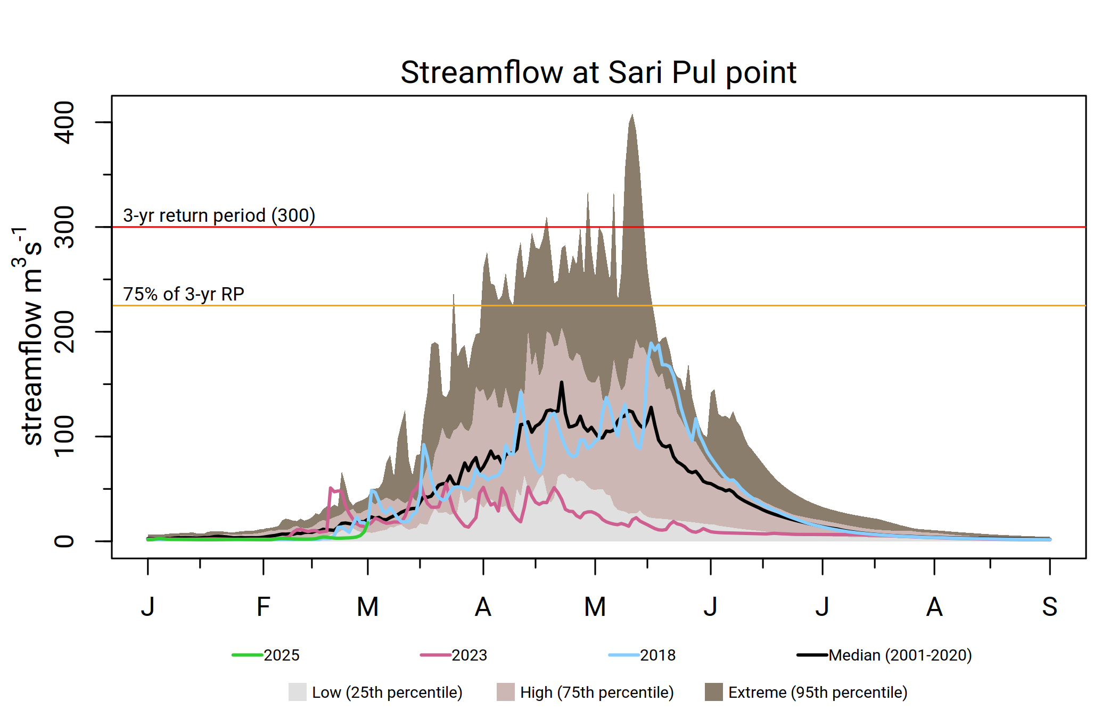
Sari Pul
Below average SWE through most of the season.
Chances of early completion of snowmelt, three to four weeks in advance.
Below average Streamflow with occasional chance for moderate flow in the river.

Slide 18
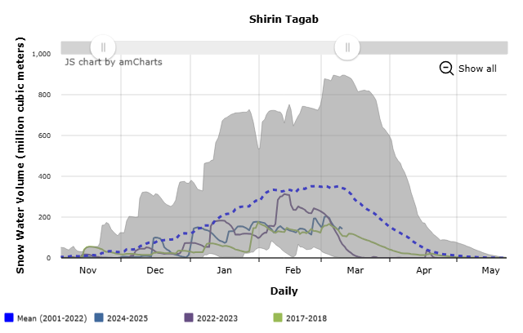
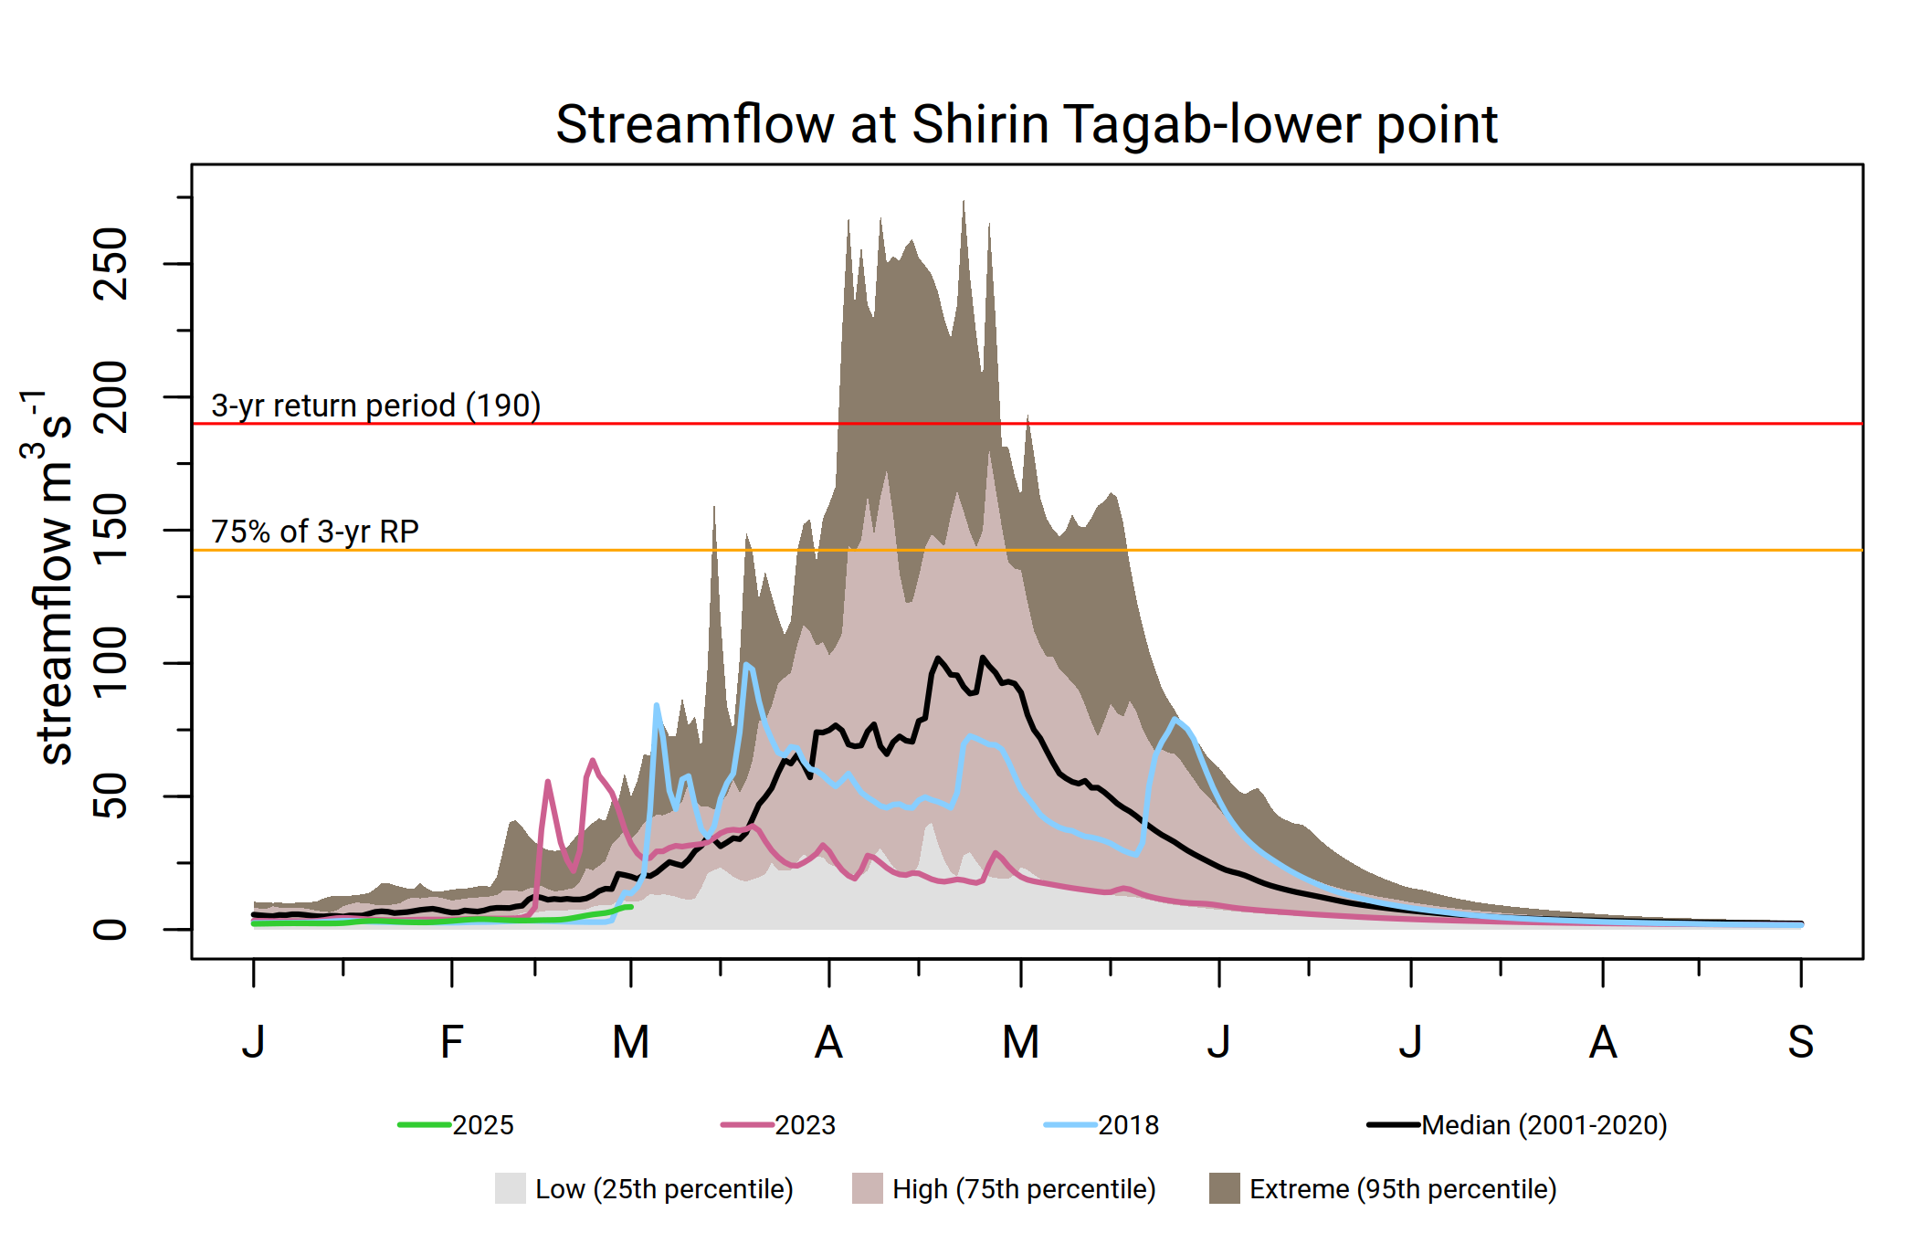
Shirin Tagab - lower
Well below average SWE in spring.
Chances of early completion of snowmelt, four to six weeks in advance.
High likelihood of below average Streamflow throughout the season.

Slide 19
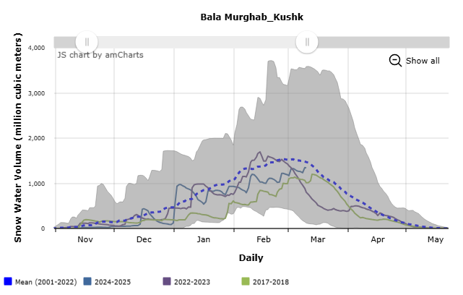
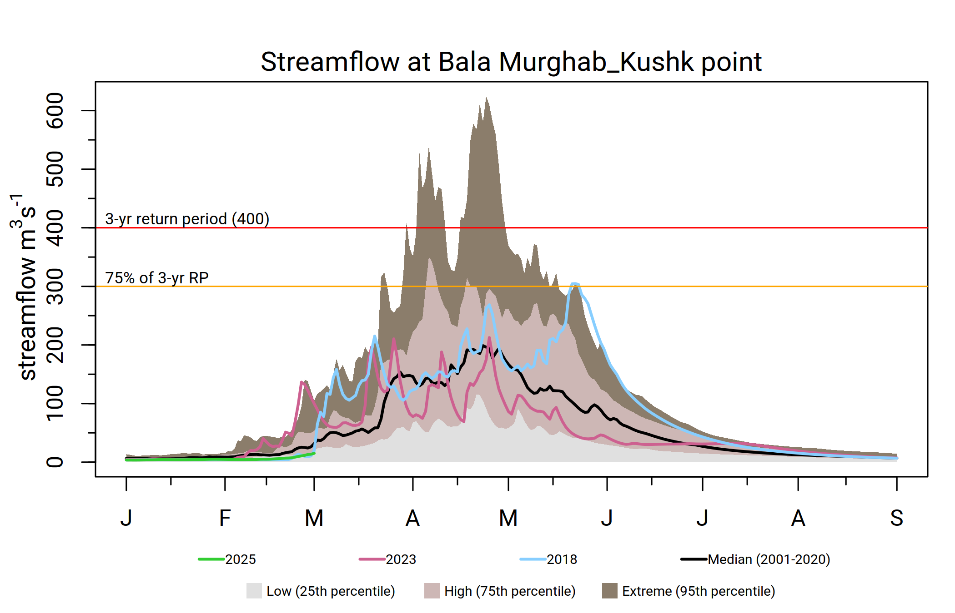
Bala Murghab
Average to below average SWE in spring.
Average SWE resulted in high streamflow in 2018.
With current average SWE, there is likelihood of elevated Streamflow in late spring.

Slide 20
Observation summary
Average to below average SWE in early spring (Jan-Mar), but below average SWE in late spring (Apr-May).
SWE could be highly variable over the mountainous basin in the northeast.
High likelihood of early completion of snowmelt, which could be two to eight weeks in advance depending on location.
High likelihood of average streamflow in southern basins and below average streamflow in northern basins.
Likelihood of average streamflow in the eastern basins with occasional higher flow capable of causing floods.
Temperature would play a critical role for building up of snowpack and completion of snowmelt.

Slide 21
Then There are Flash Flooding
However, flash flood can occur anytime and anywhere depending on the nature of the precipitation and in combination with snowmelt.
There will always be moderate likelihood of flash flooding across Afghanistan.

Slide 22
Thank you and let me know if you have questions.

