Slide 1
Snow Water Volume and Streamflow
Analog Year Analysis
Shahriar Pervez and Kimberly Slinski
February 03, 2026
Notes:
Default title slide

Slide 2
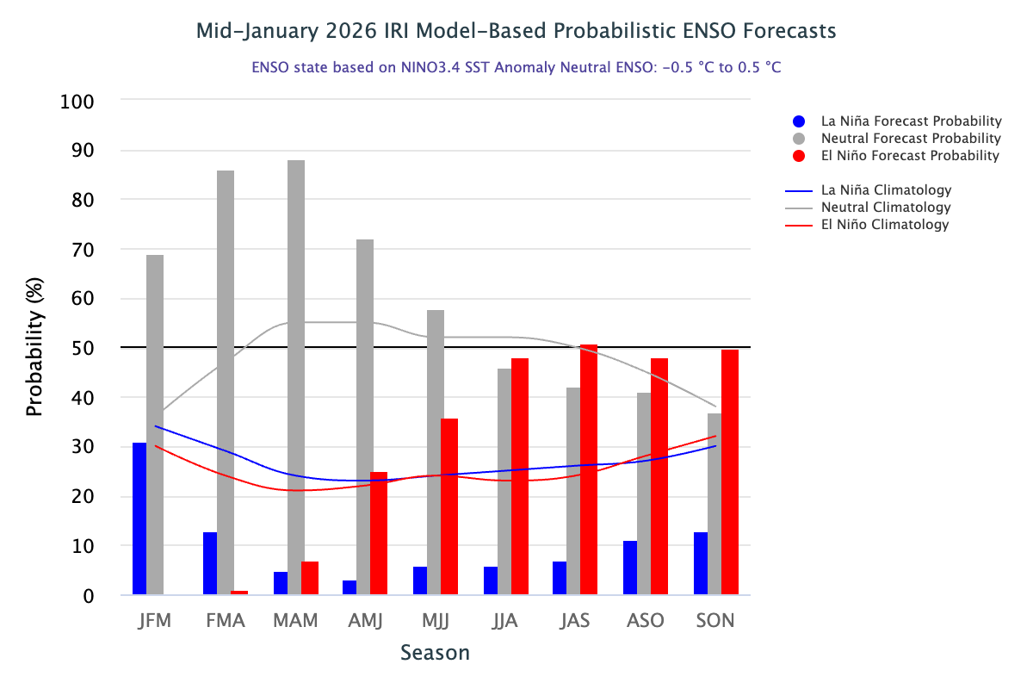
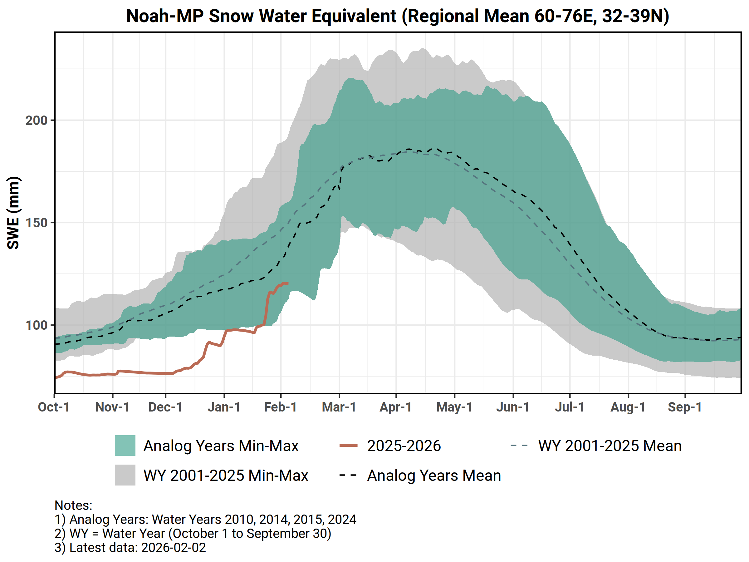
ENSO Forecast
ENSO likely to be neutral, and given the recent, significantly above-average rainfall during the last dekad of January and the forecasted precipitation in February, March, and April, the most likely scenario is near-average cumulative precipitation by the end of the season (May 2026).
Analog years with near-average precipitations are: 2009-2010, 2013-2014, 2014-2015, and 2023-2024.

Slide 3
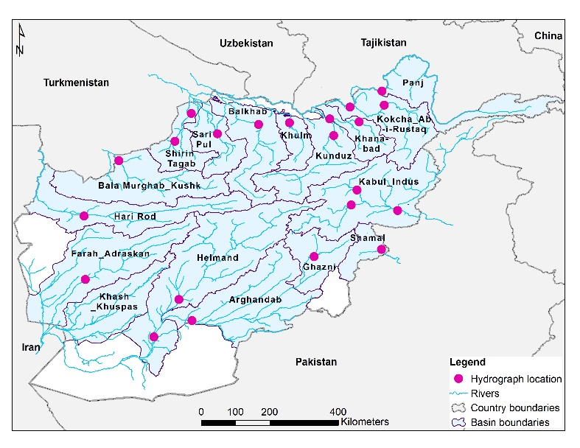
Basins and Monitoring Points
22 Streamflow monitoring points above or near populated areas or major agricultural areas.
17 basins
We will analyze the average SWV and average streamflow for the analog years 2009-2010, 2013-2014, 2014-2015, and 2023-2024.

Slide 4
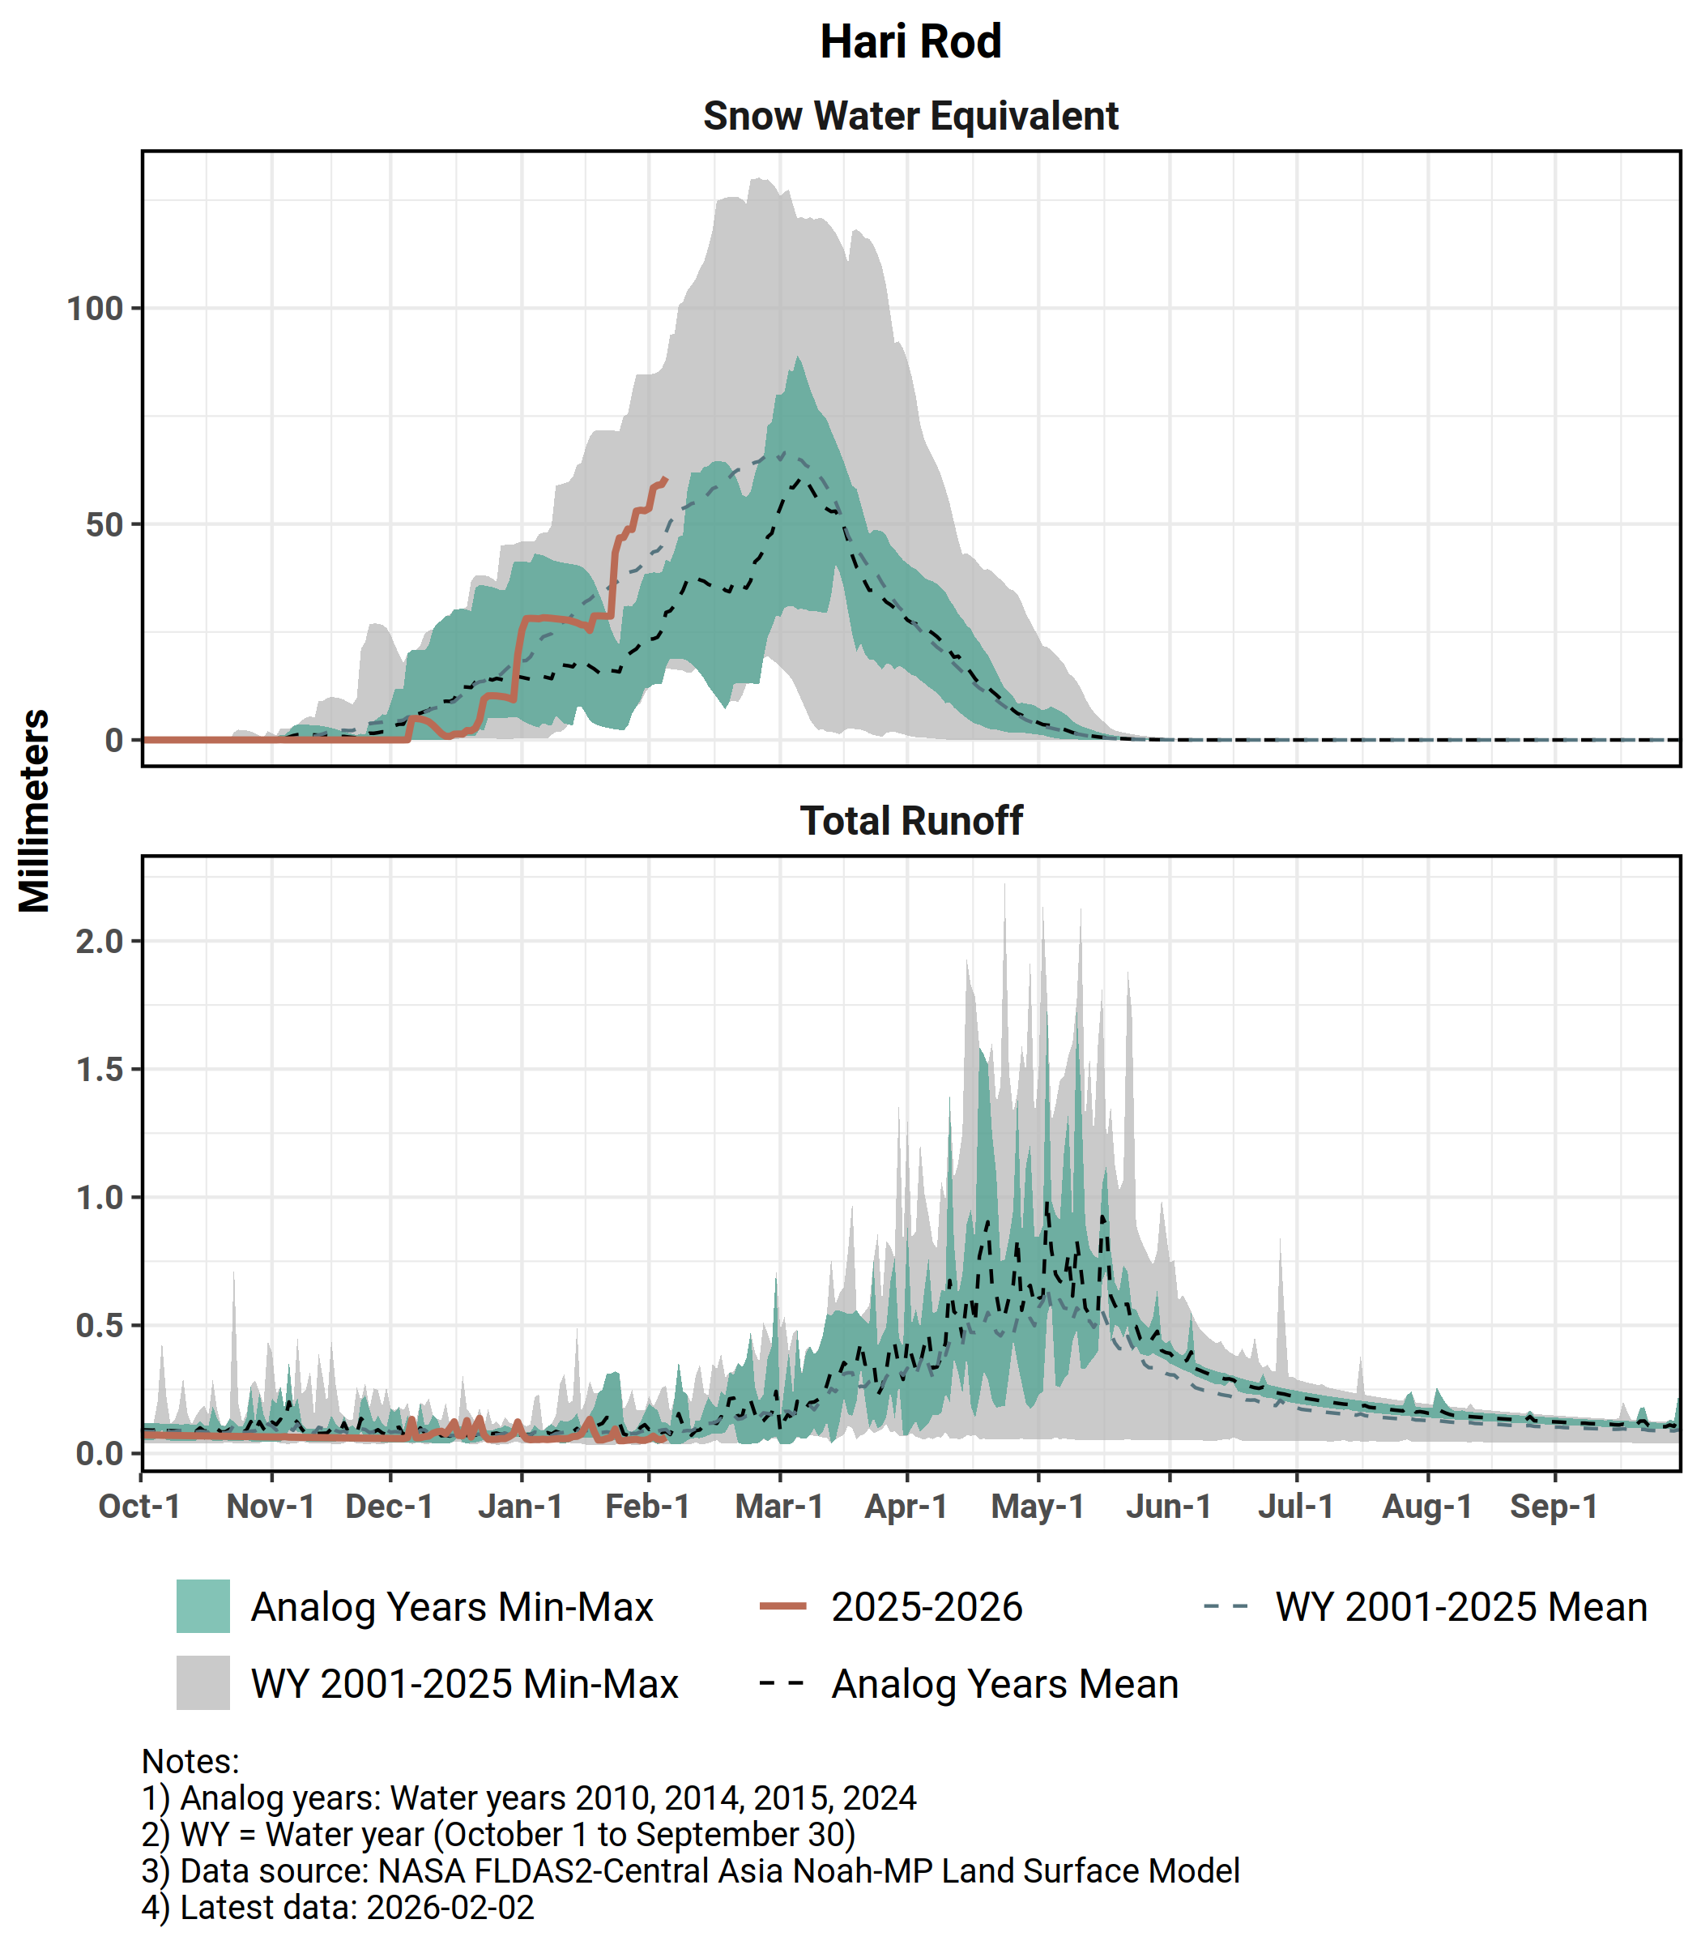
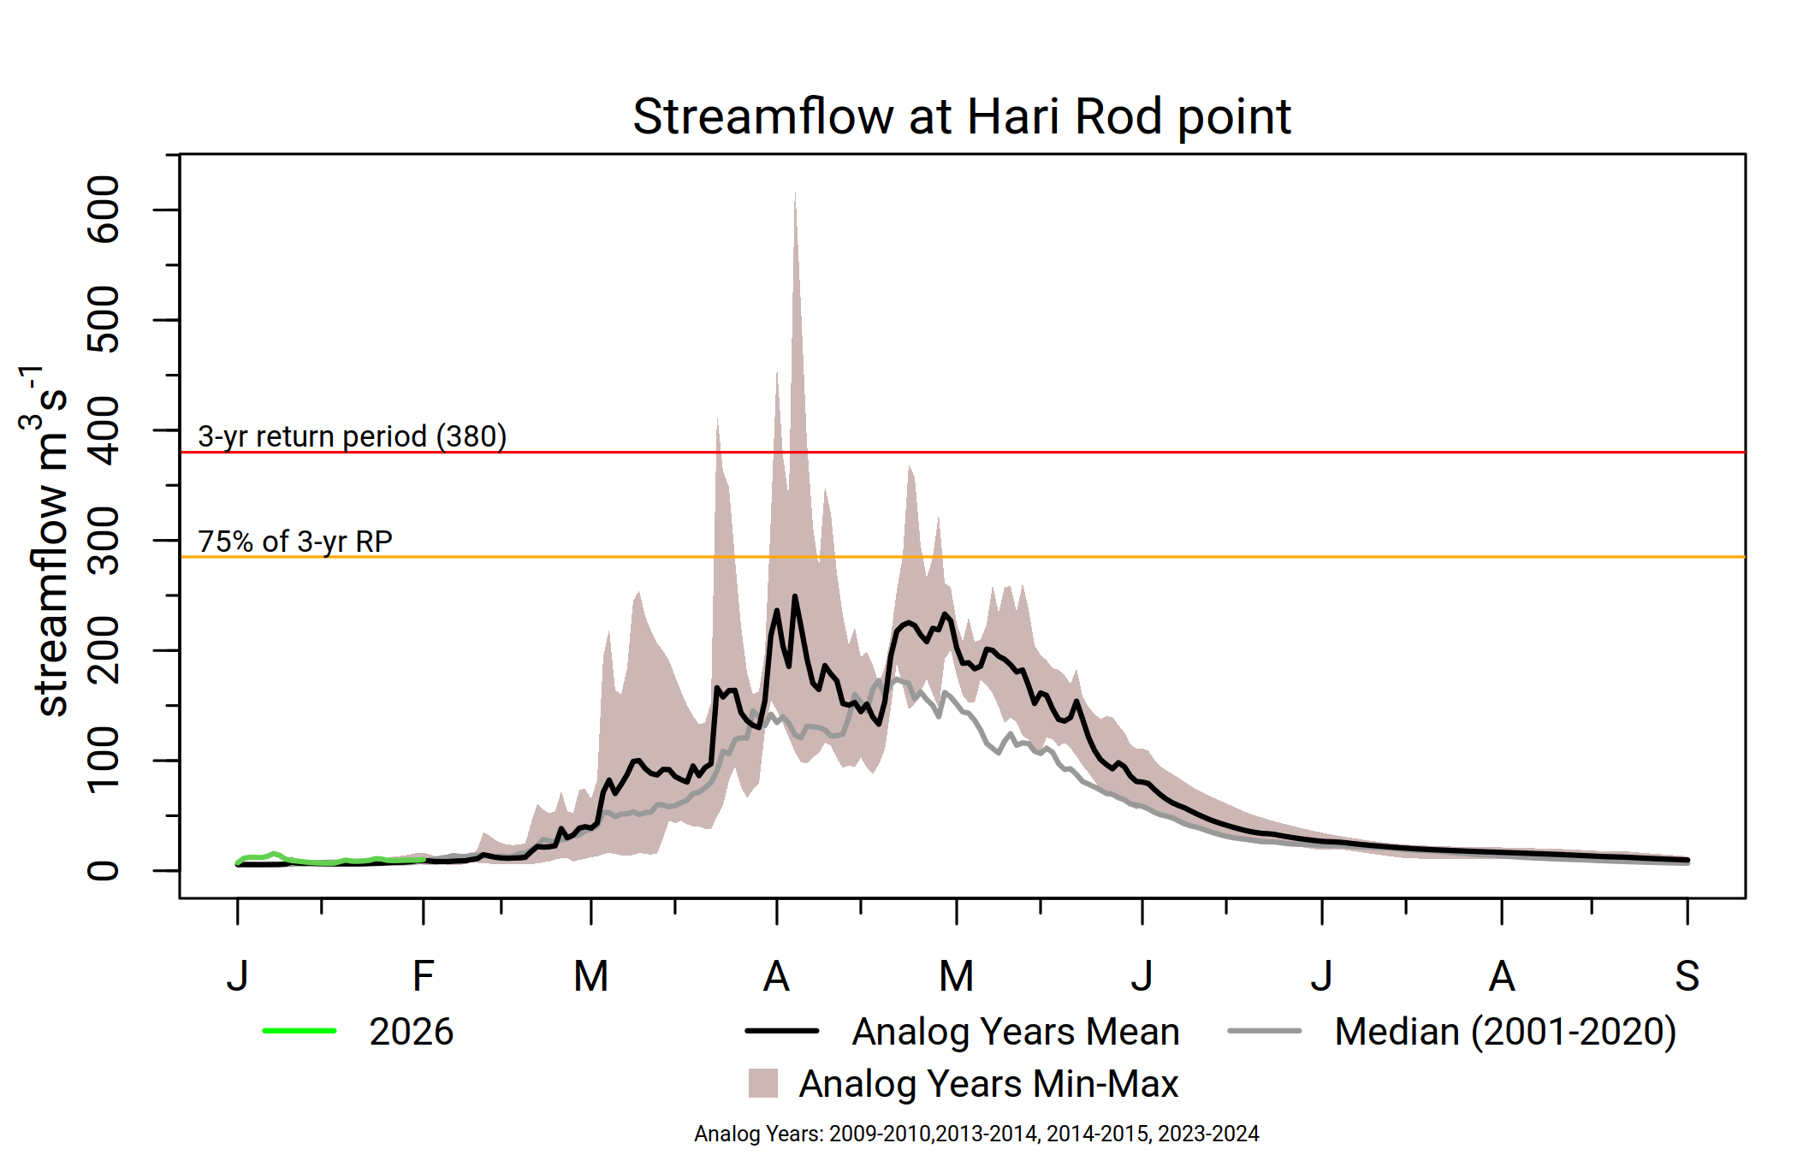
Hari Rod
Noticeable uptake in SWE in late January to early February.
Above-average streamflow likely, with chance of flooding in early April.
Snowmelt likely to conclude in normal time.

Slide 5
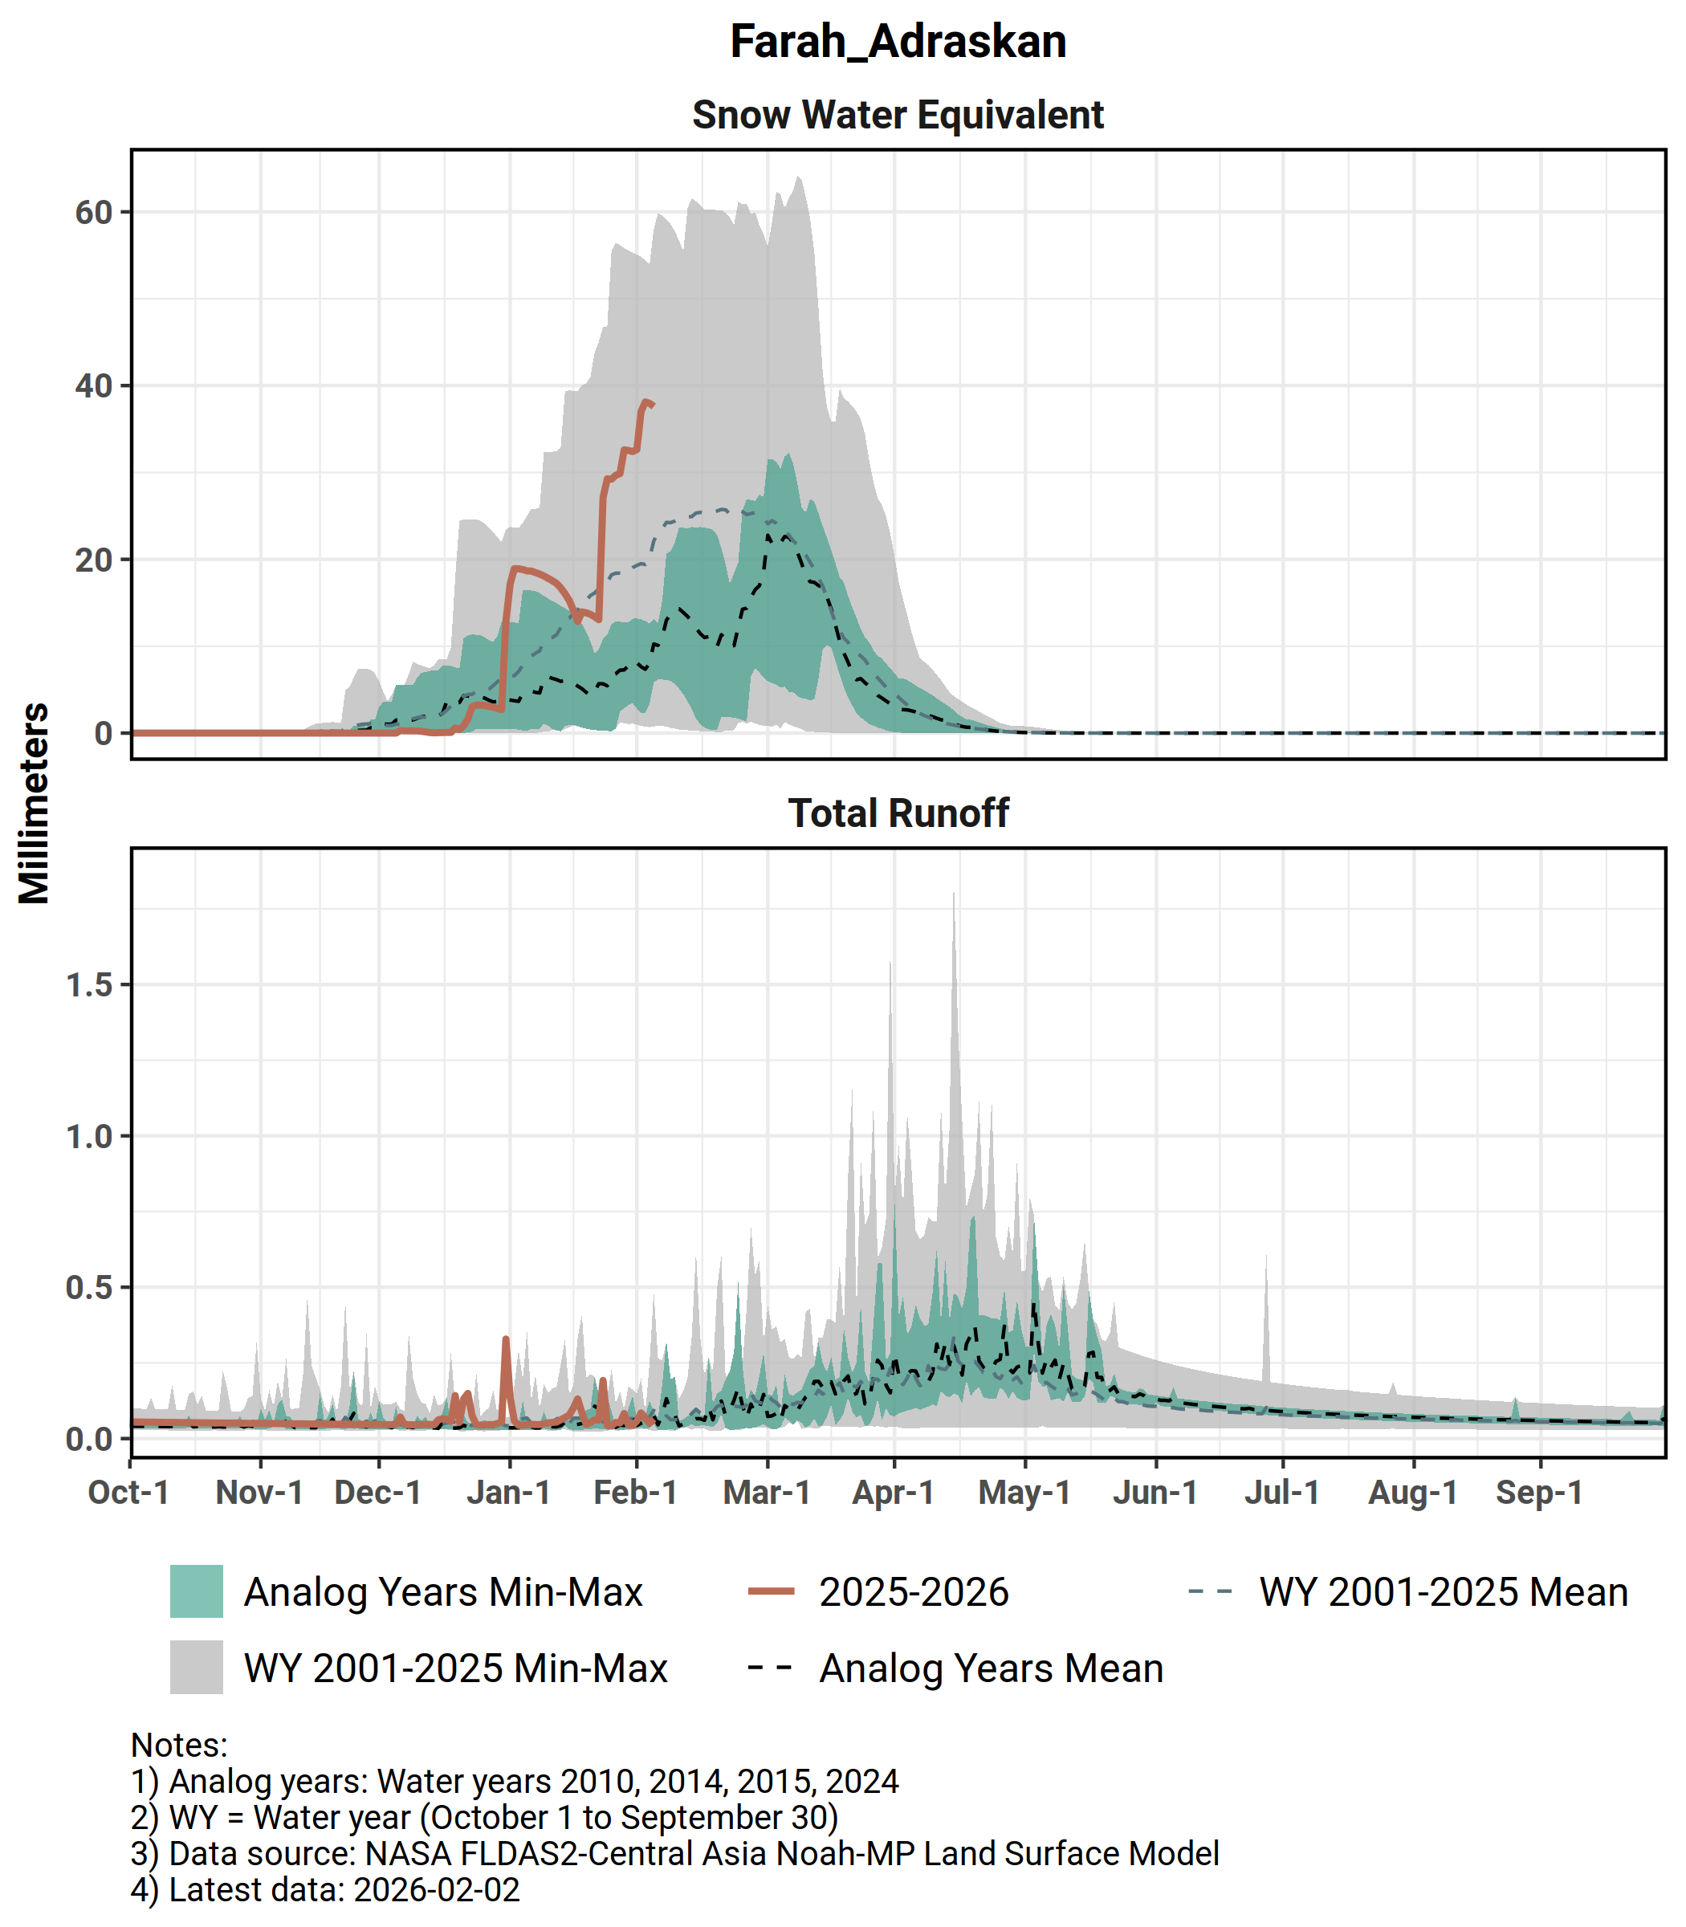
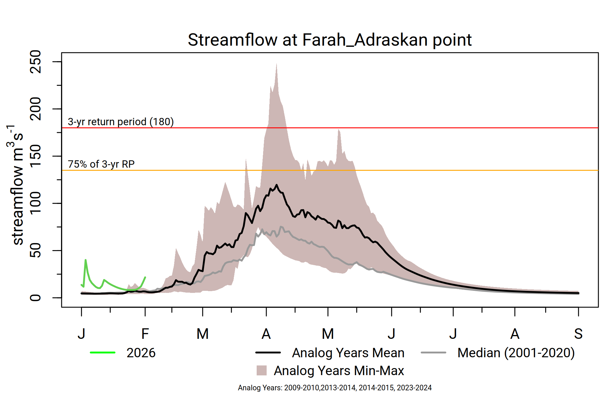
Farah Adraskan
Significant uptake in SWE in late January to early February.
Above-average streamflow likely, with chance of flooding in early April.
Snowmelt likely to conclude in normal time.

Slide 6
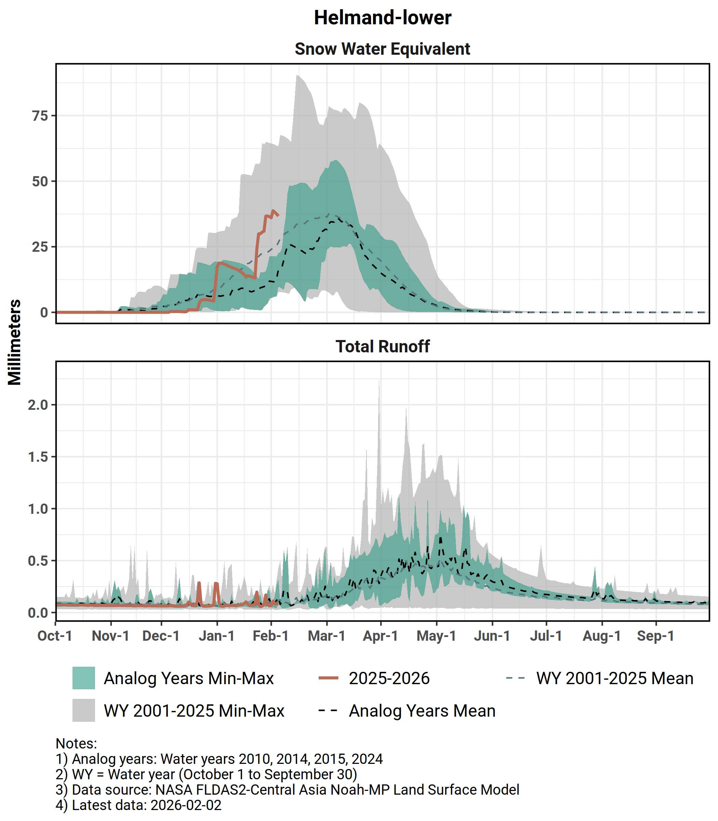
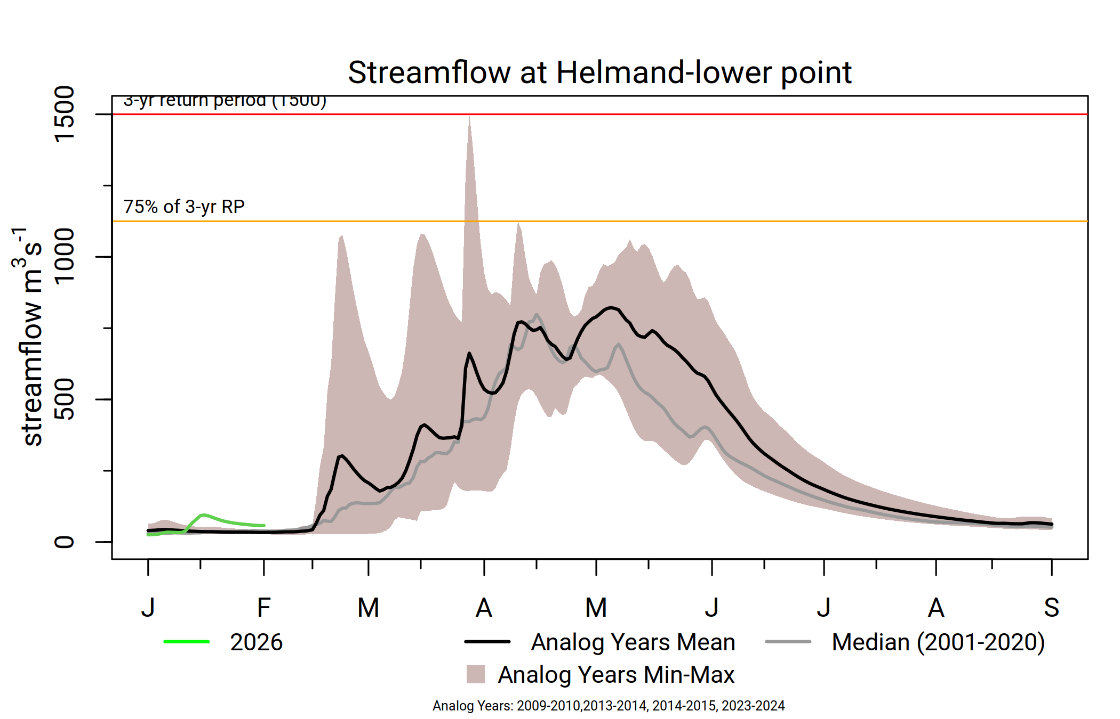
Helmand
Noticeable uptake in SWE in late January to early February.
Average streamflow likely but less likelihood of flooding.
Snowmelt likely to conclude in normal time.

Slide 7
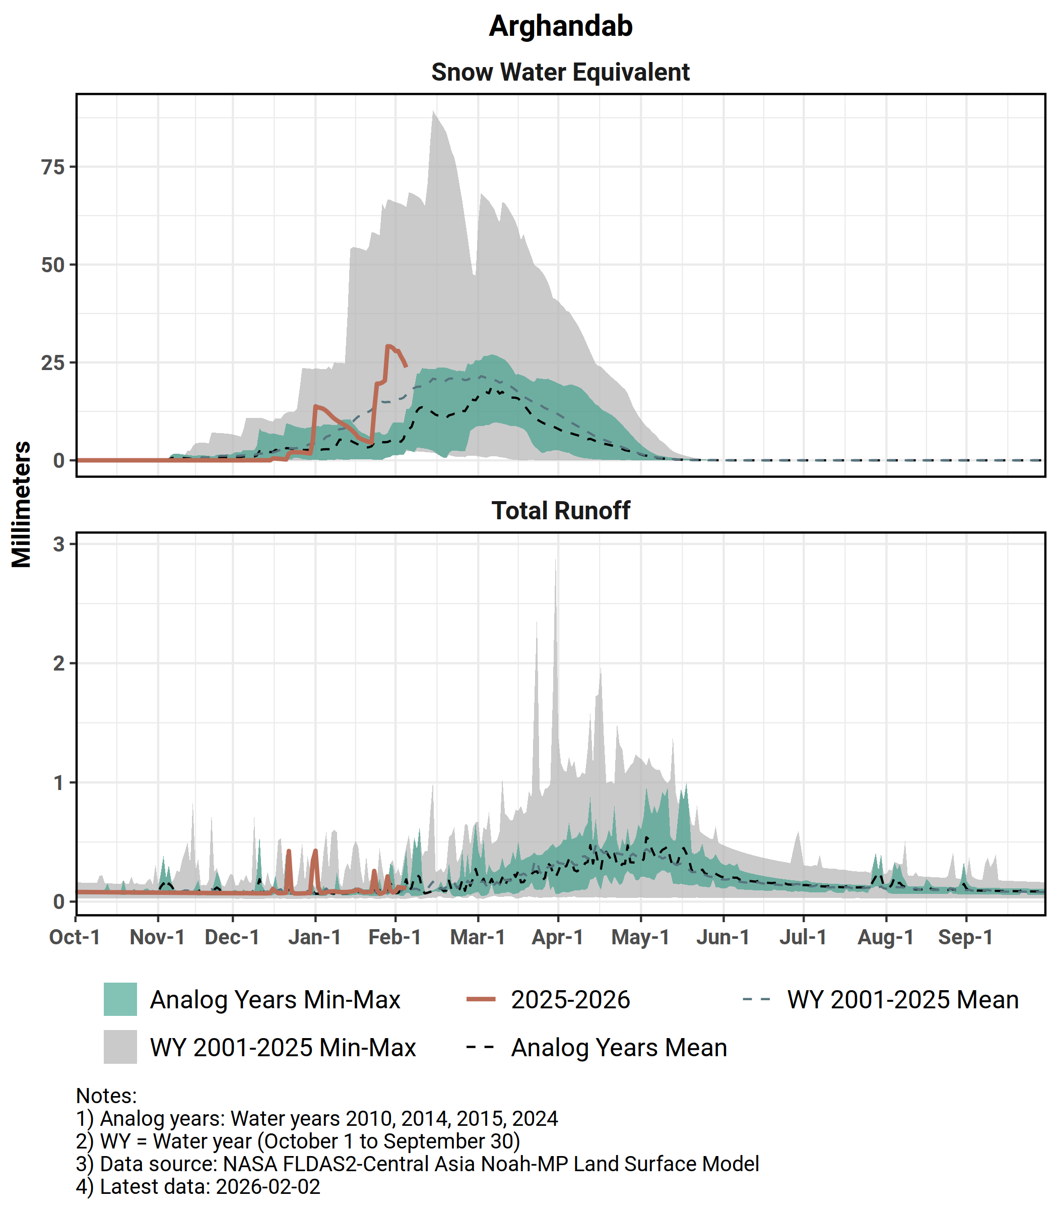
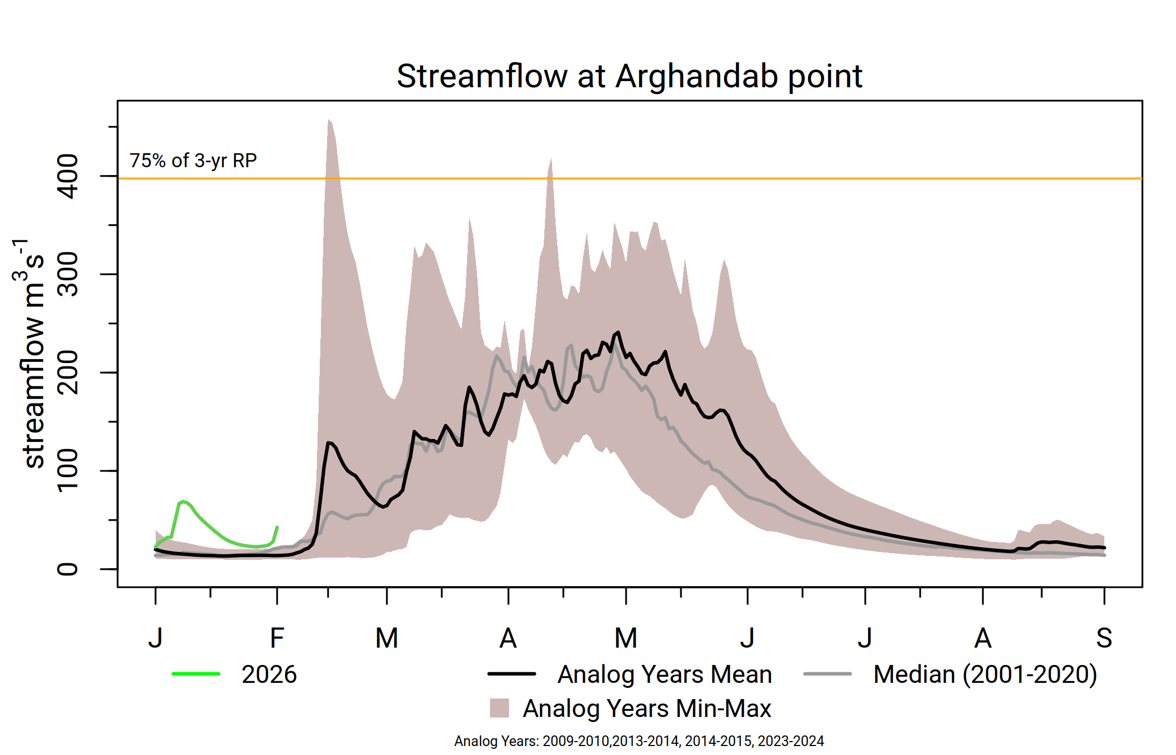
Arghandab
Noticeable uptake in SWE in late January to early February.
Average streamflow likely, with less likelihood of flooding.
Snowmelt likely to conclude in normal time.

Slide 8
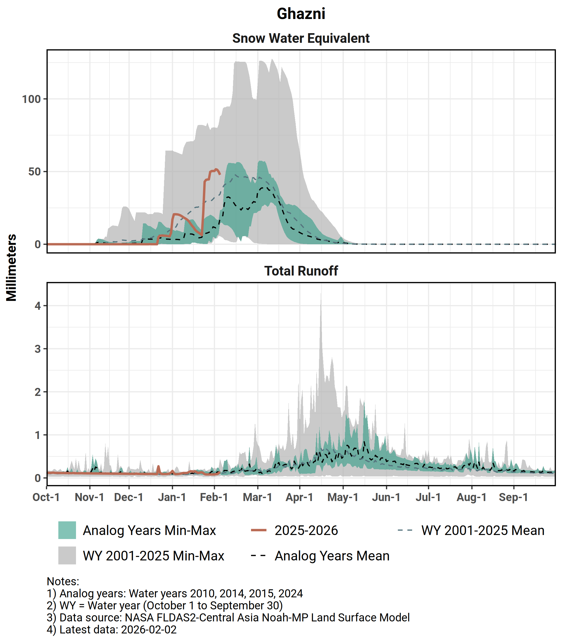
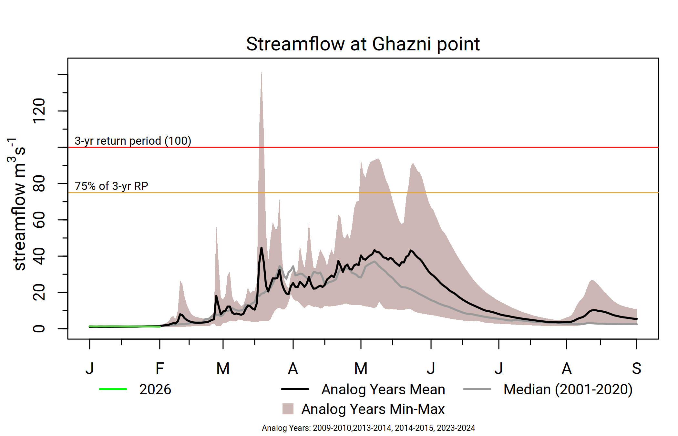
Ghazni
Significant uptake in SWE in late January to early February.
Average streamflow likely, less likelihood of flooding.
Snowmelt likely to conclude in normal time.

Slide 9
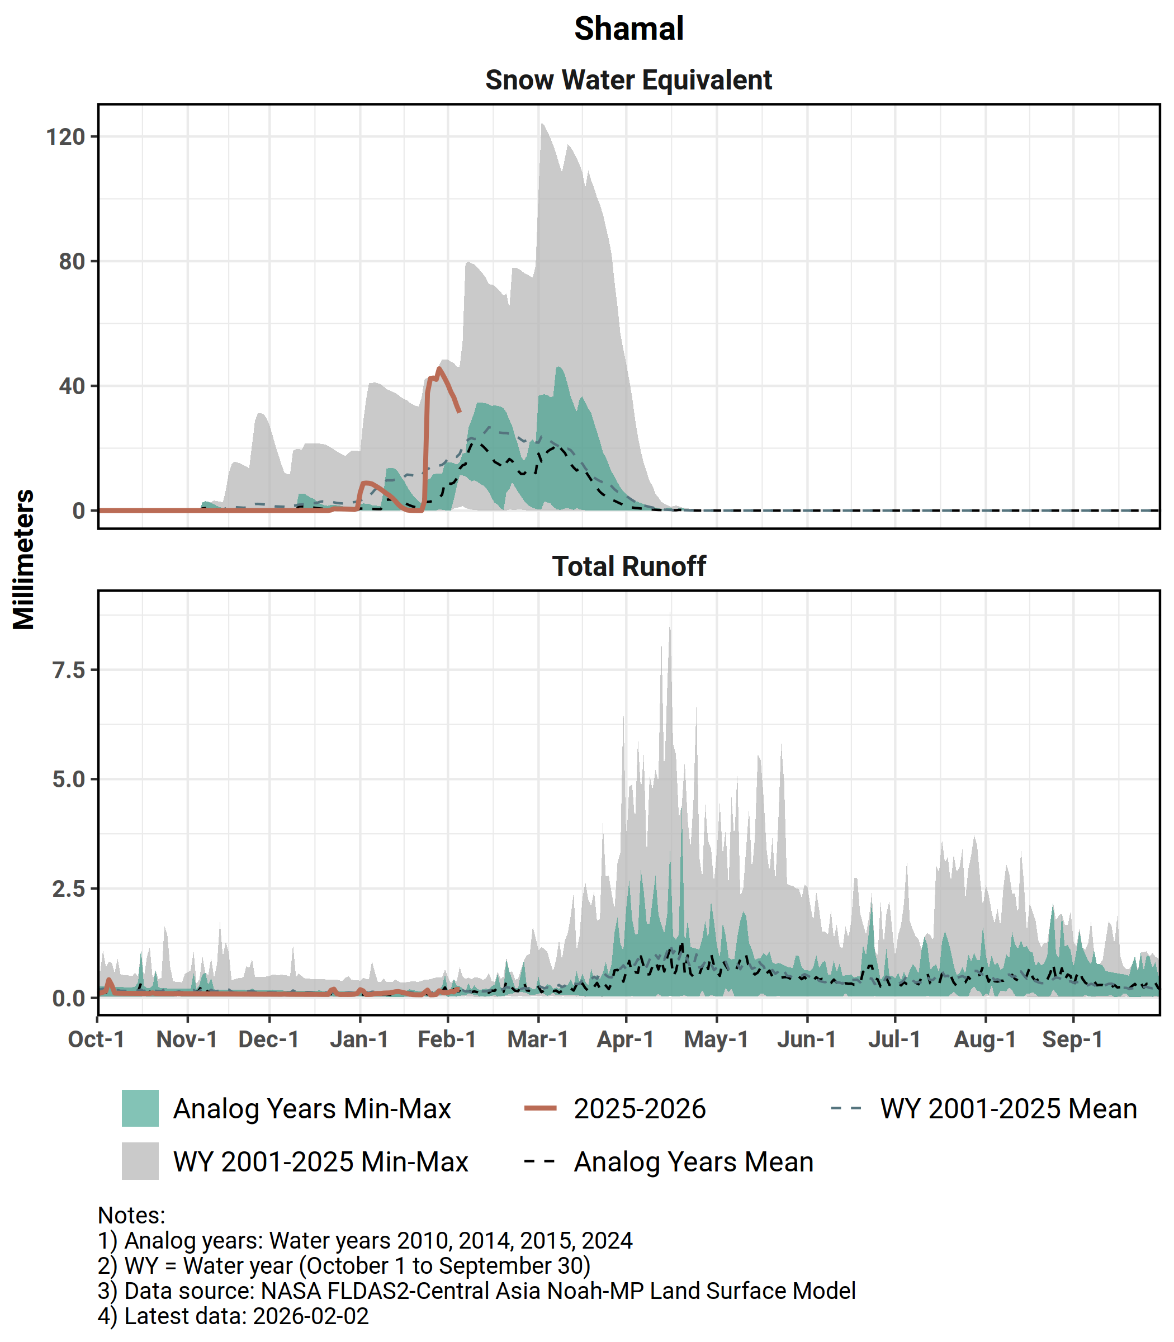
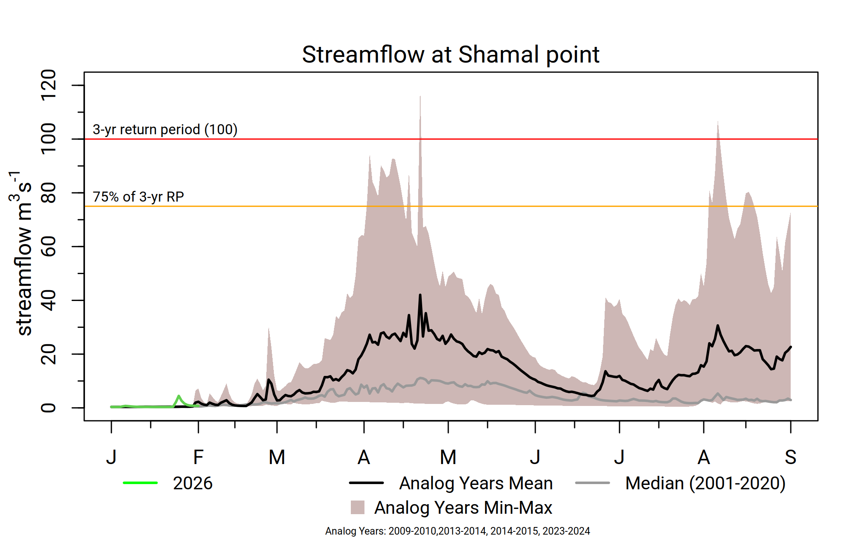
Shamal
Significant uptake in SWE in late January to early February.
Above-average streamflow likely, with moderate likelihood of flooding in early April.
Snowmelt likely to conclude in normal time.

Slide 10
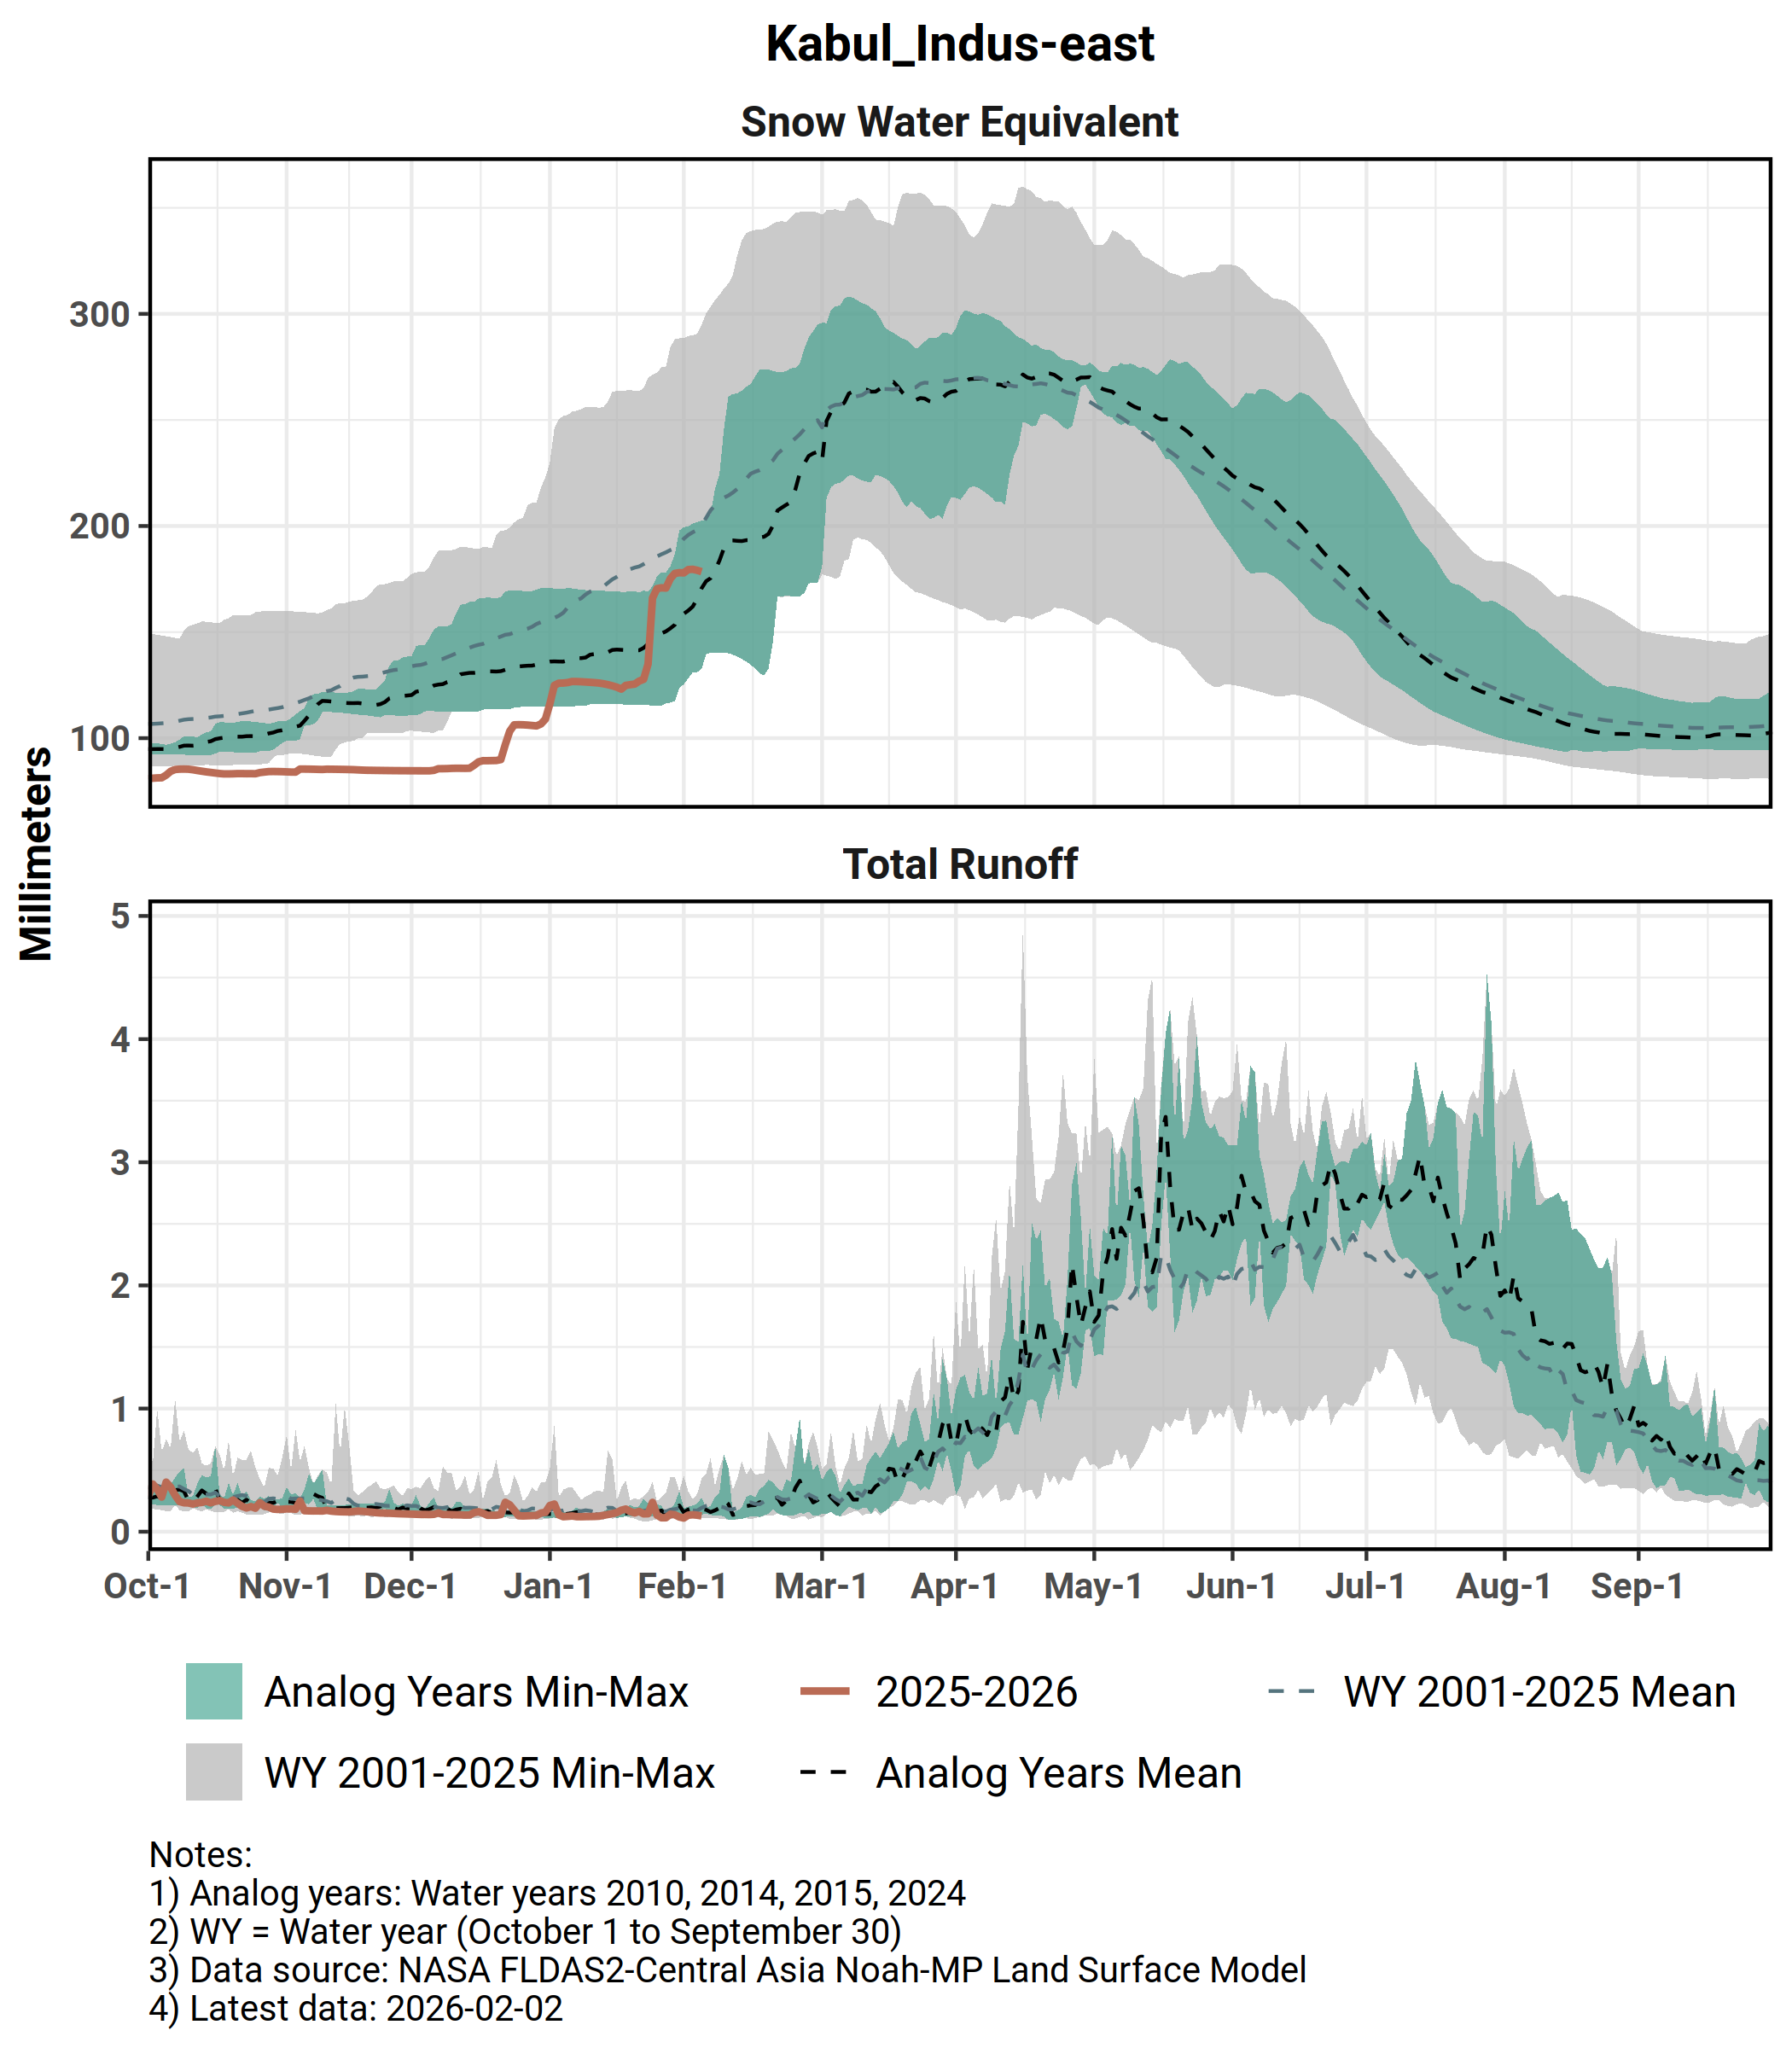
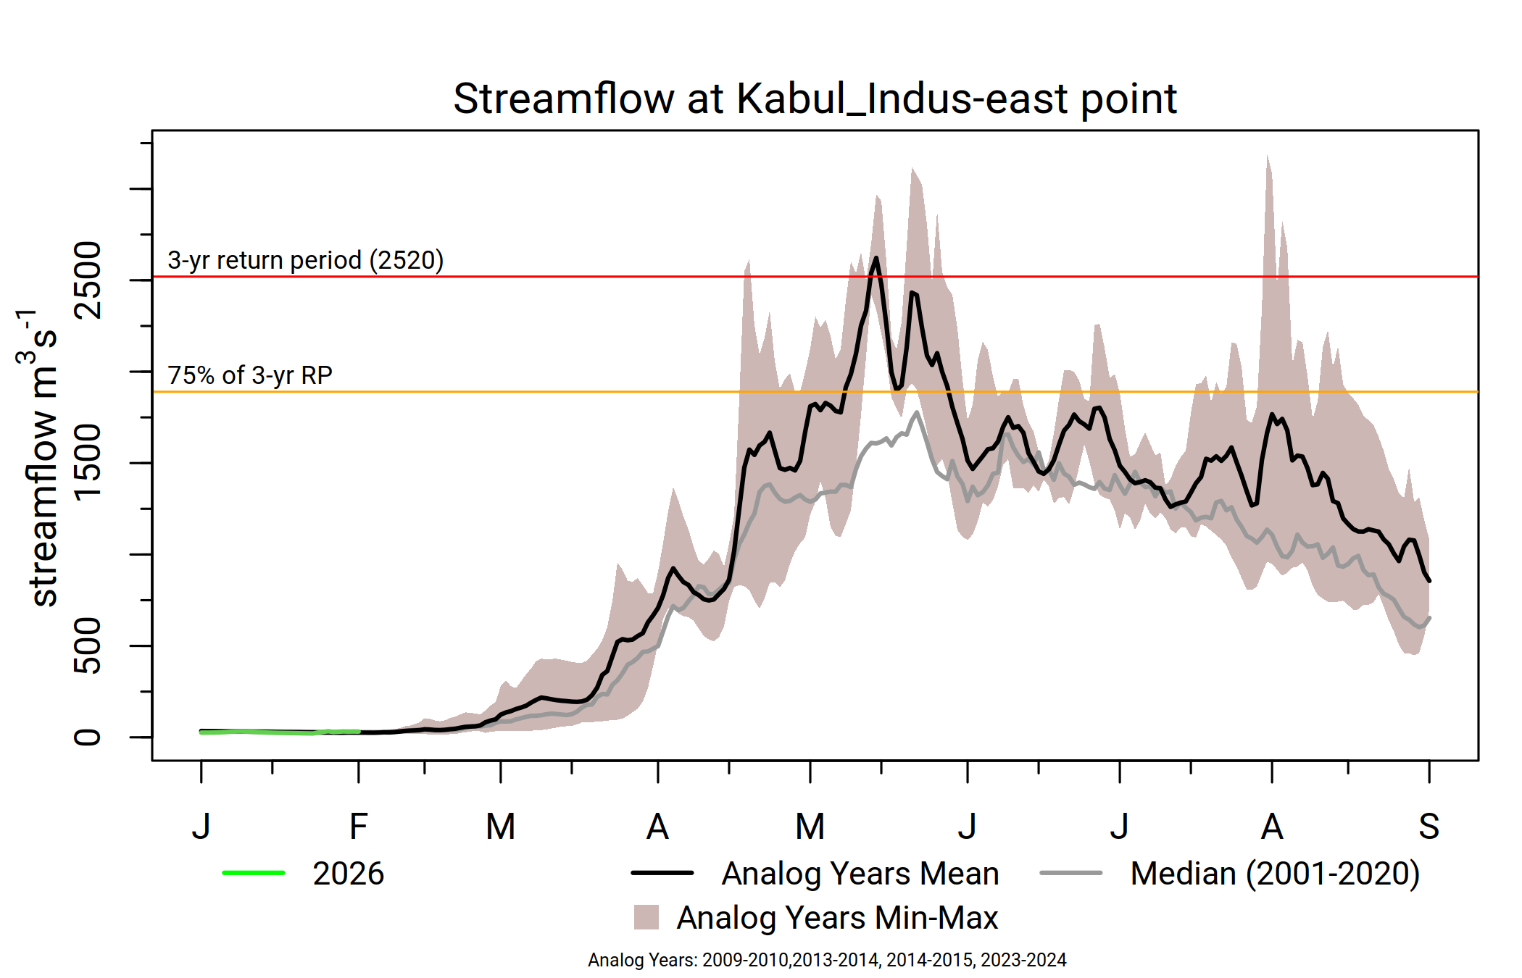
Kabul
Significant uptake in SWE in late January to early February.
Above-average streamflow likely, with high likelihood of flooding in May.
Snowmelt likely to conclude a week in advance.

Slide 11
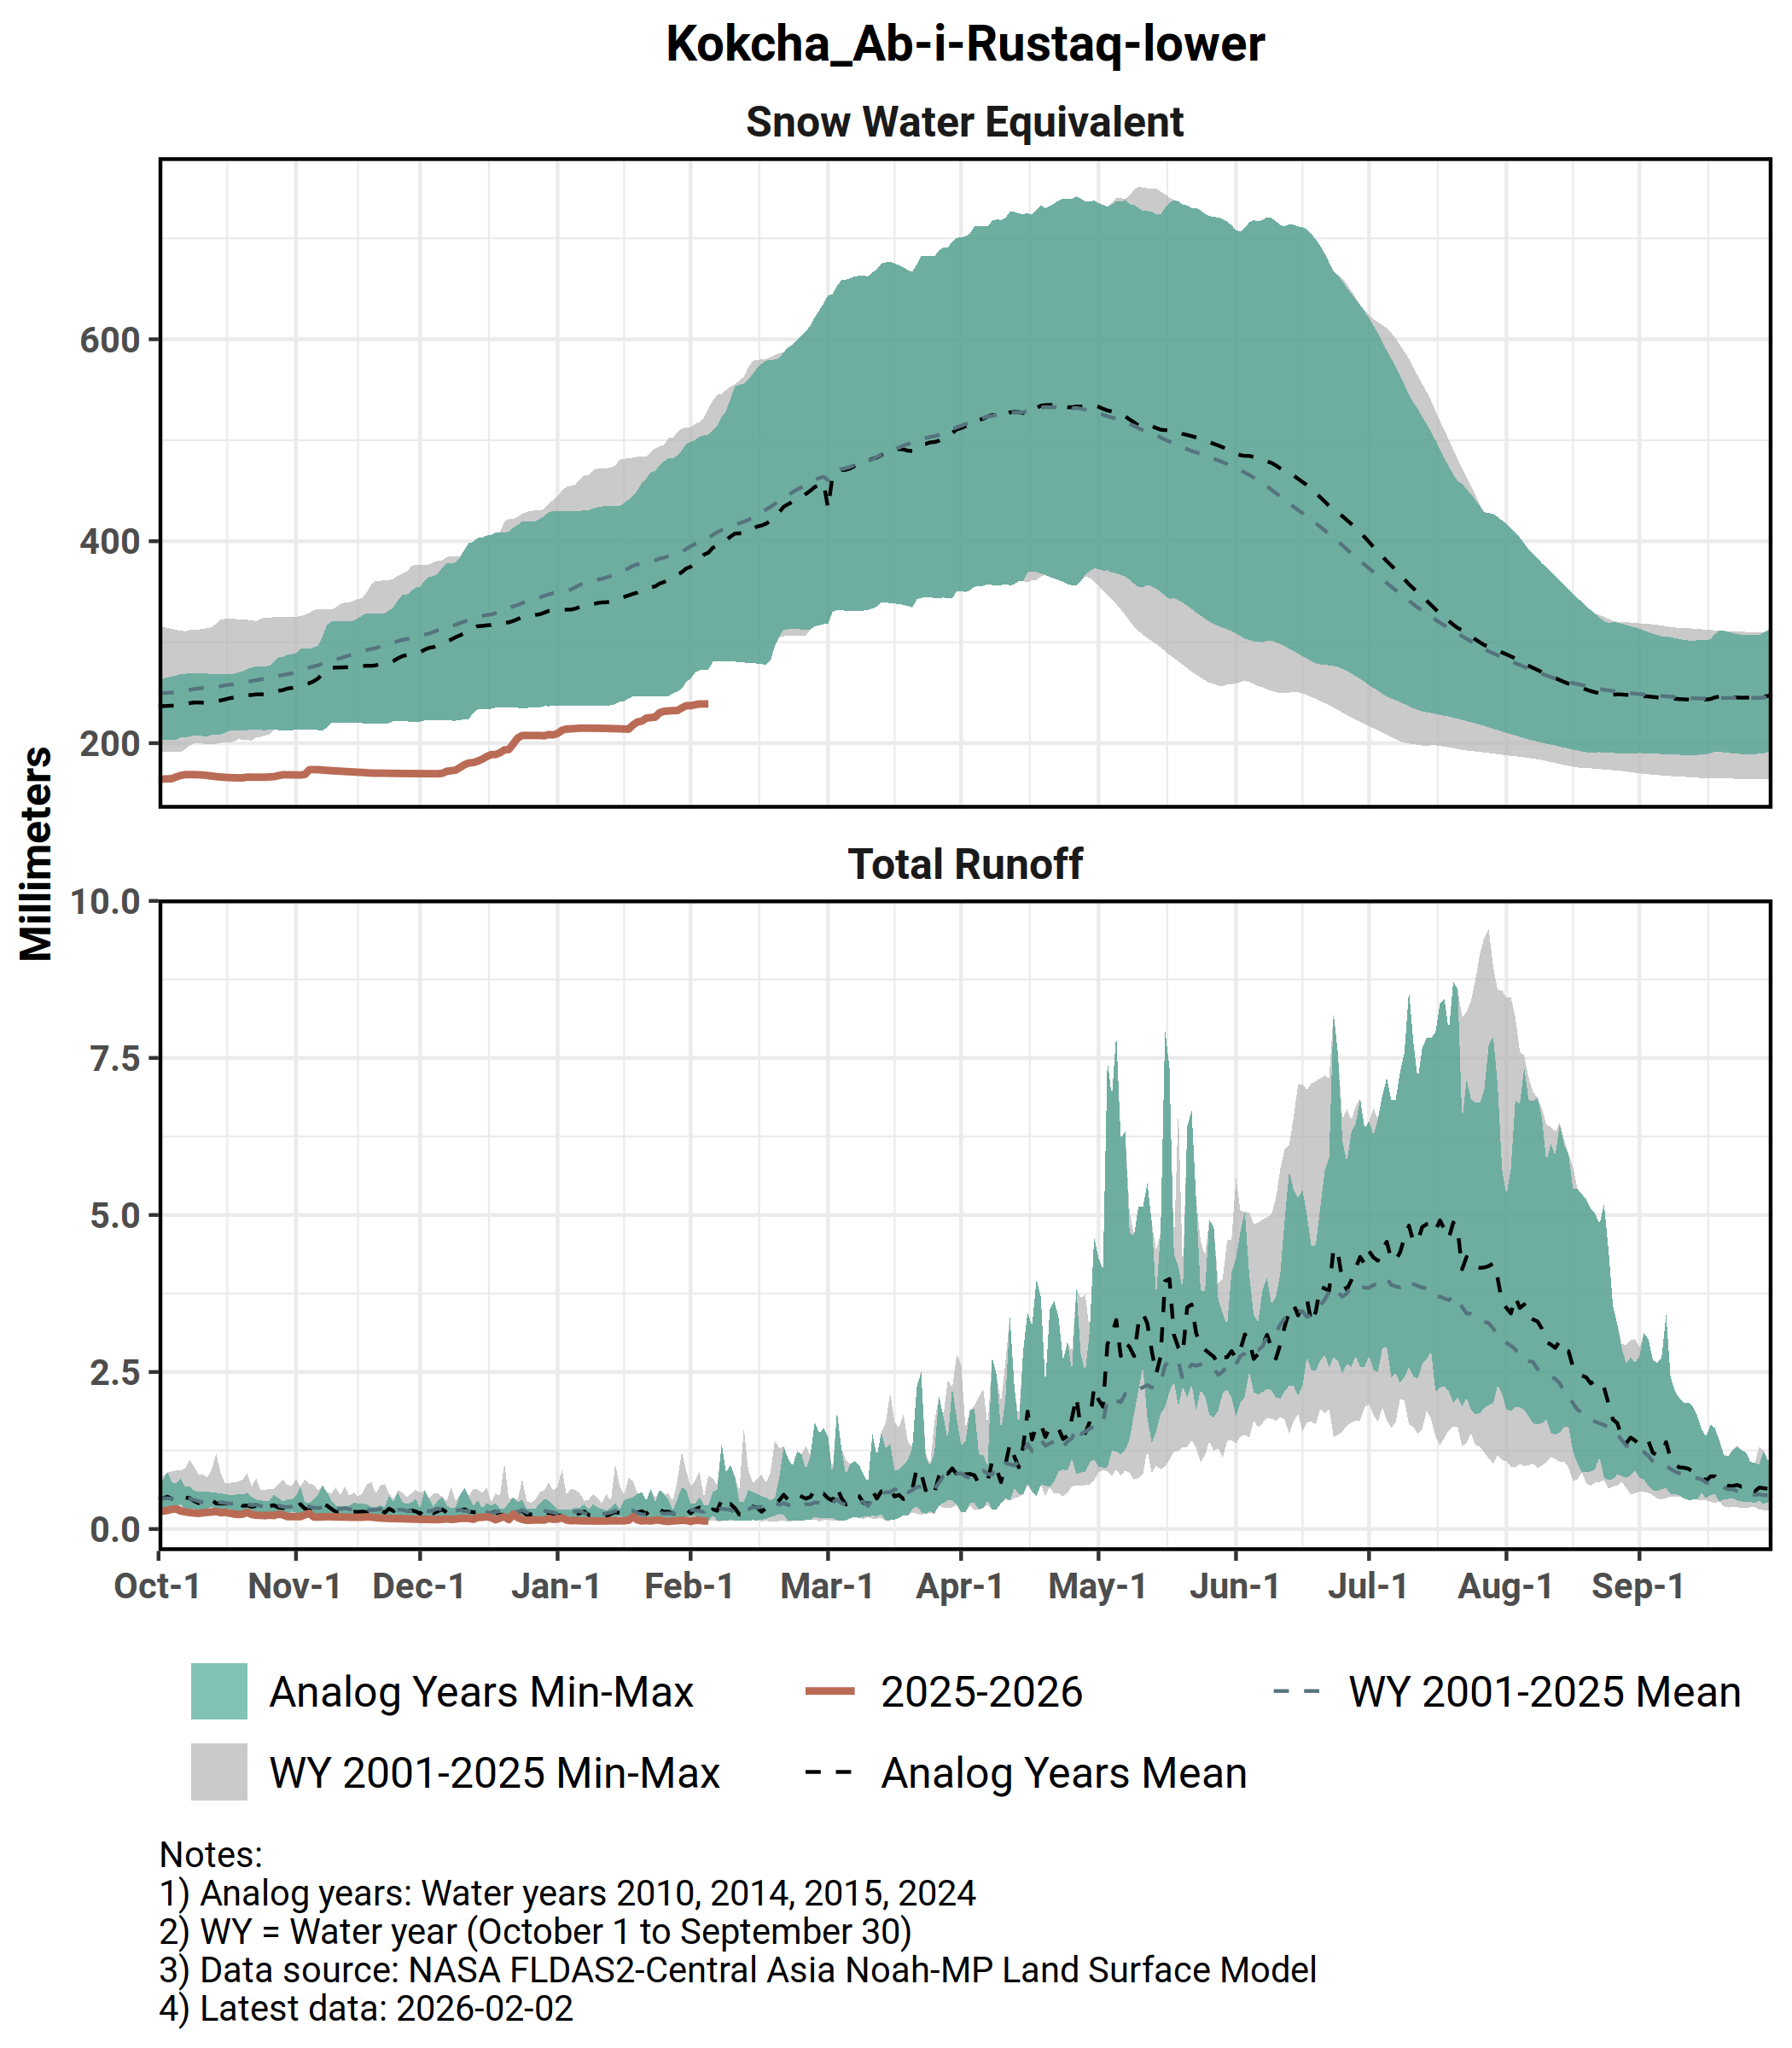
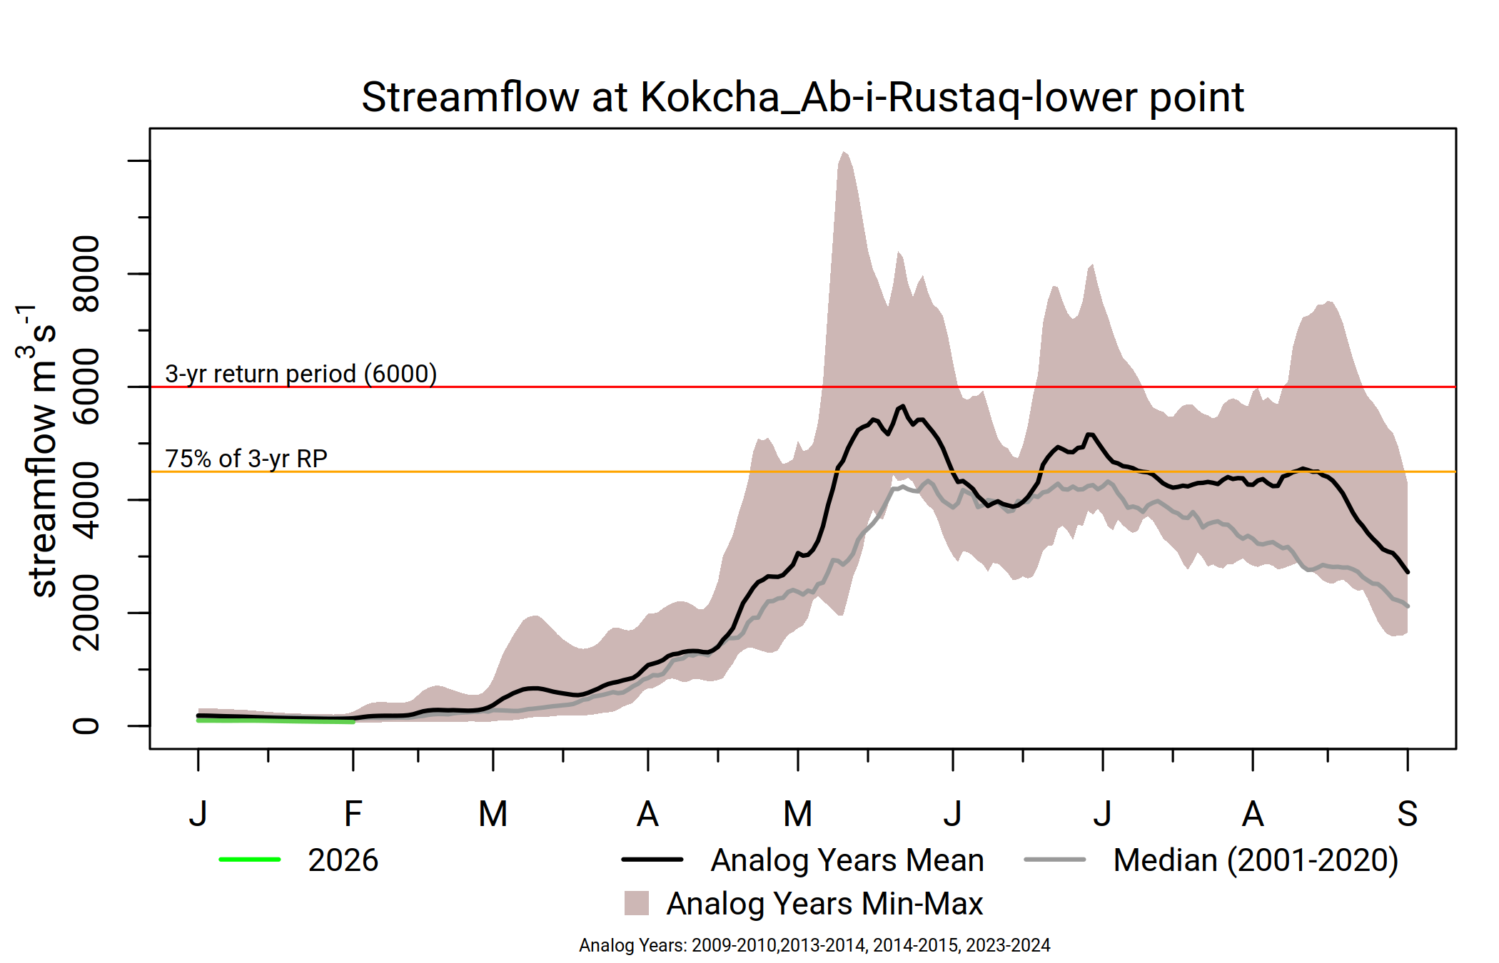
Kokcha Ab-i-rastaq
Record low SWE since the start of the season but expected average SWE in the rest of the season.
Average streamflow likely, with less likelihood of flooding.
Snowmelt likely to conclude in normal time.

Slide 12

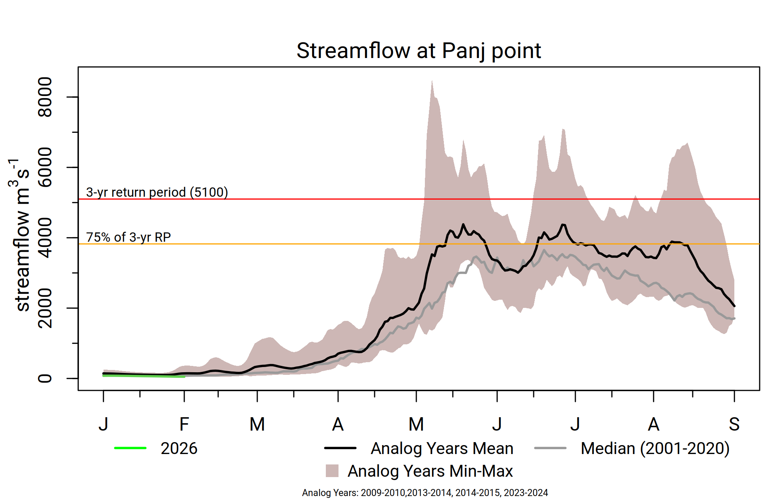
Panj
Record low SWE since the start of the season but expected average SWE in the rest of the season.
Average streamflow likely, with less likelihood of flooding.
Snowmelt likely to conclude in normal time.

Slide 13
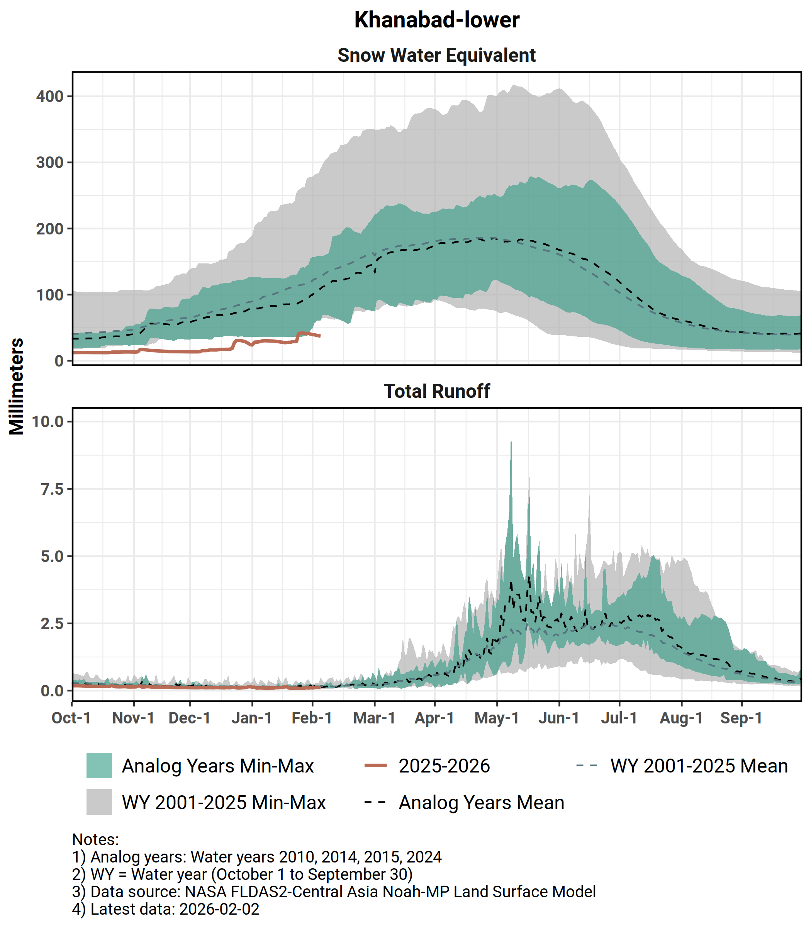
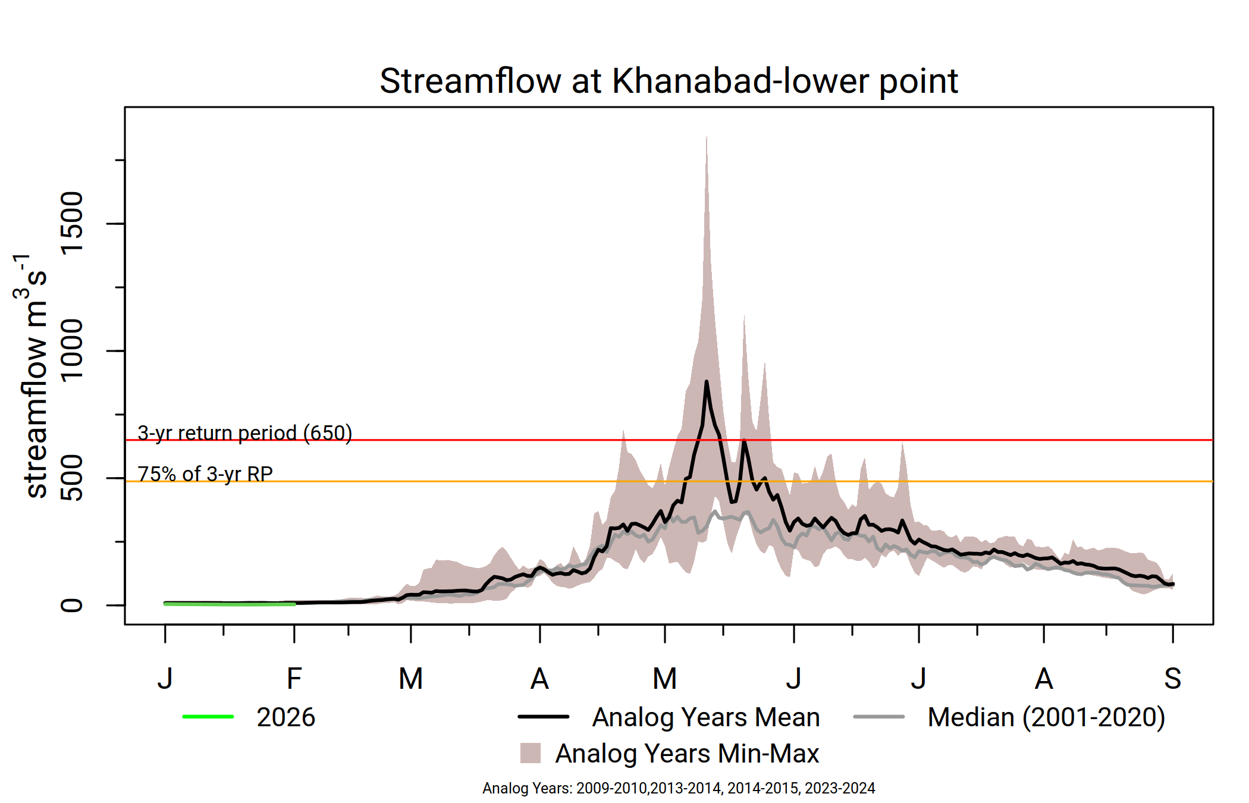
Khanabad
Record low SWE since the start of the season but expected average SWE in the rest of the season.
Average streamflow likely, with moderate likelihood of flooding in May.
Snowmelt likely to conclude in normal time.

Slide 14
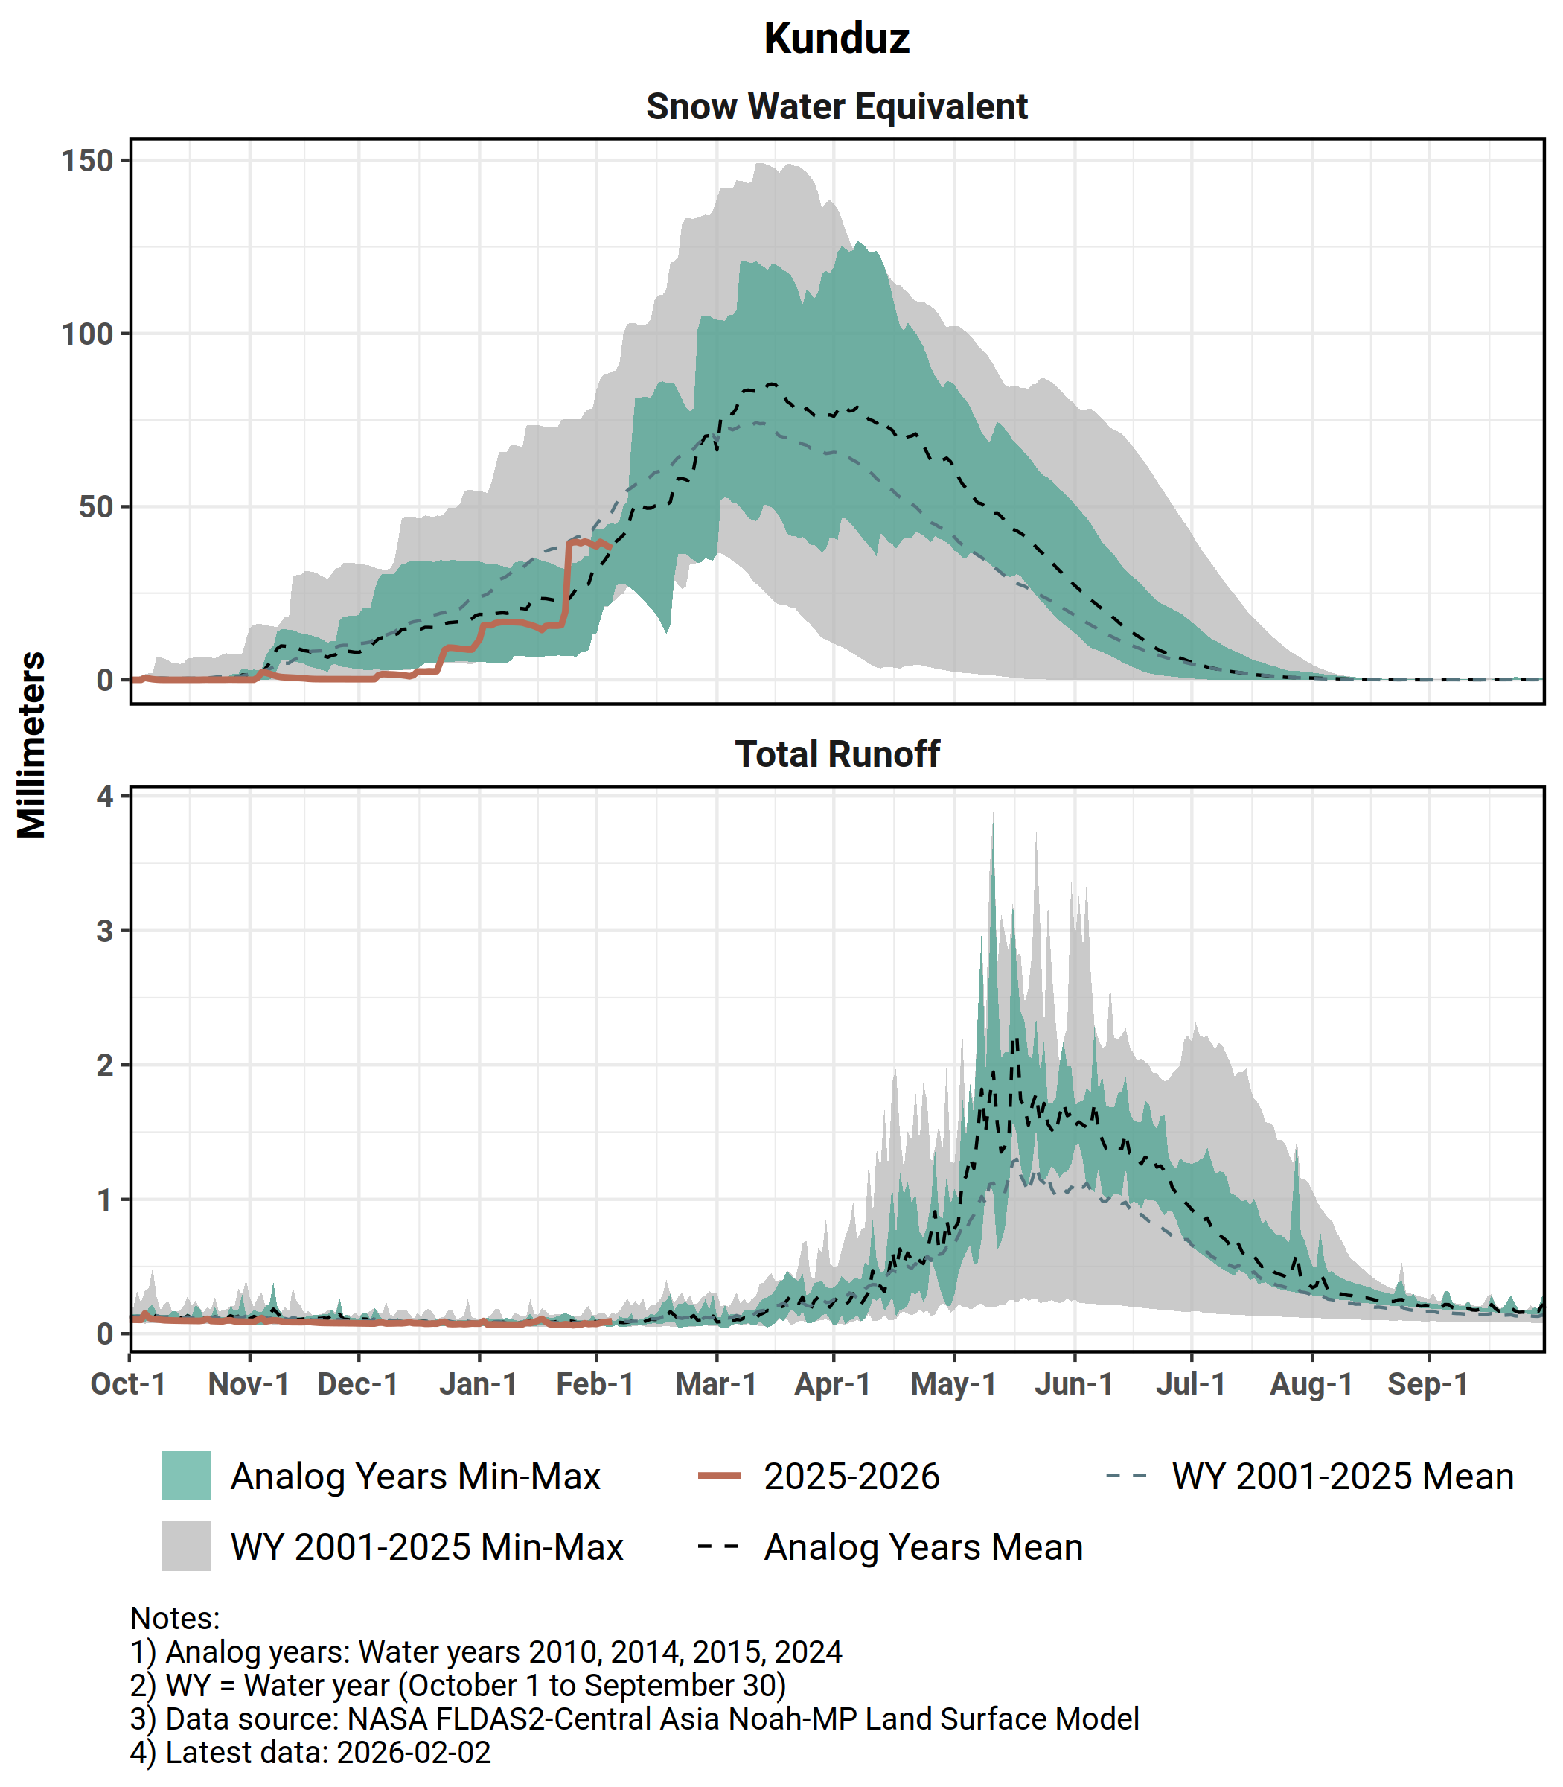
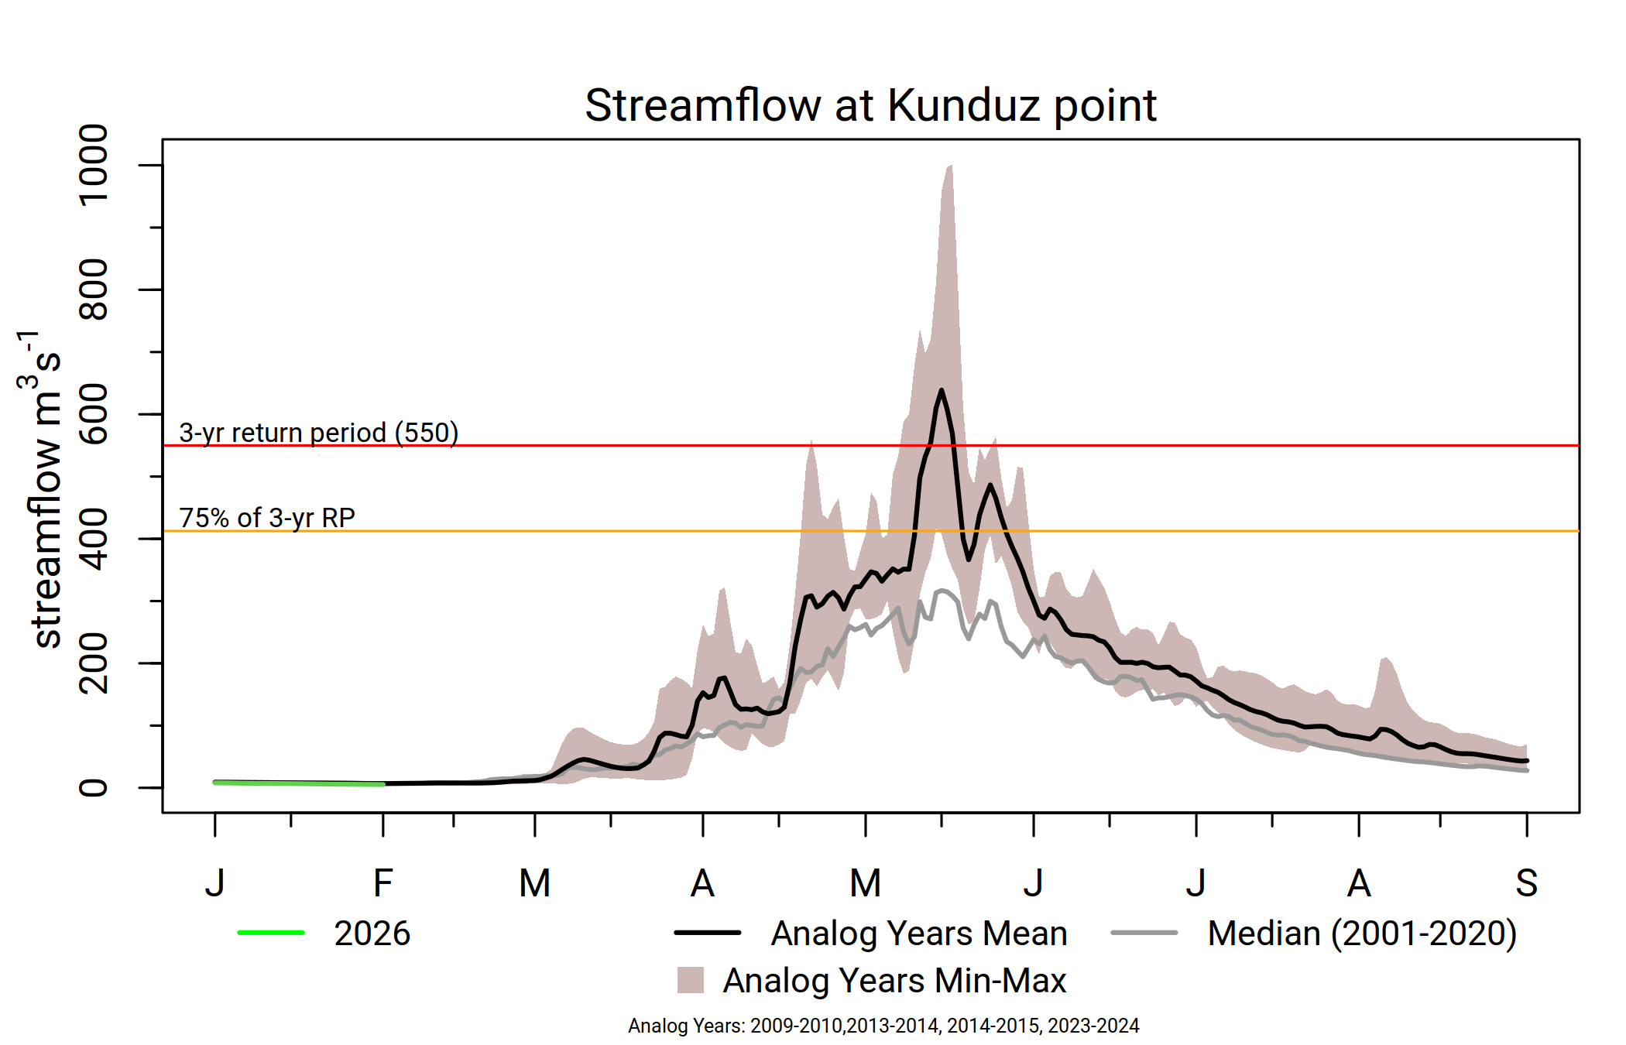
Kunduz
Noticeable uptake in SWE in late January to early February.
Above-average streamflow likely, with moderate likelihood of flooding in May.
Snowmelt likely to conclude in normal time.

Slide 15
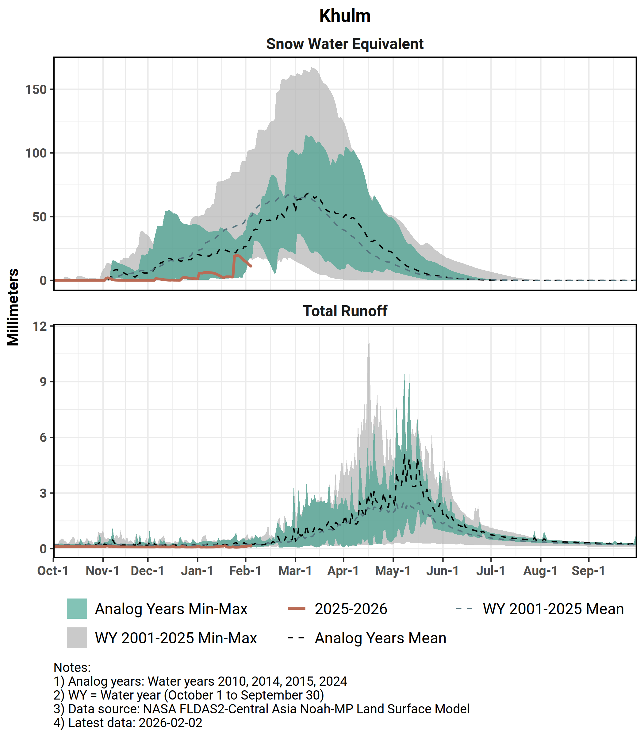
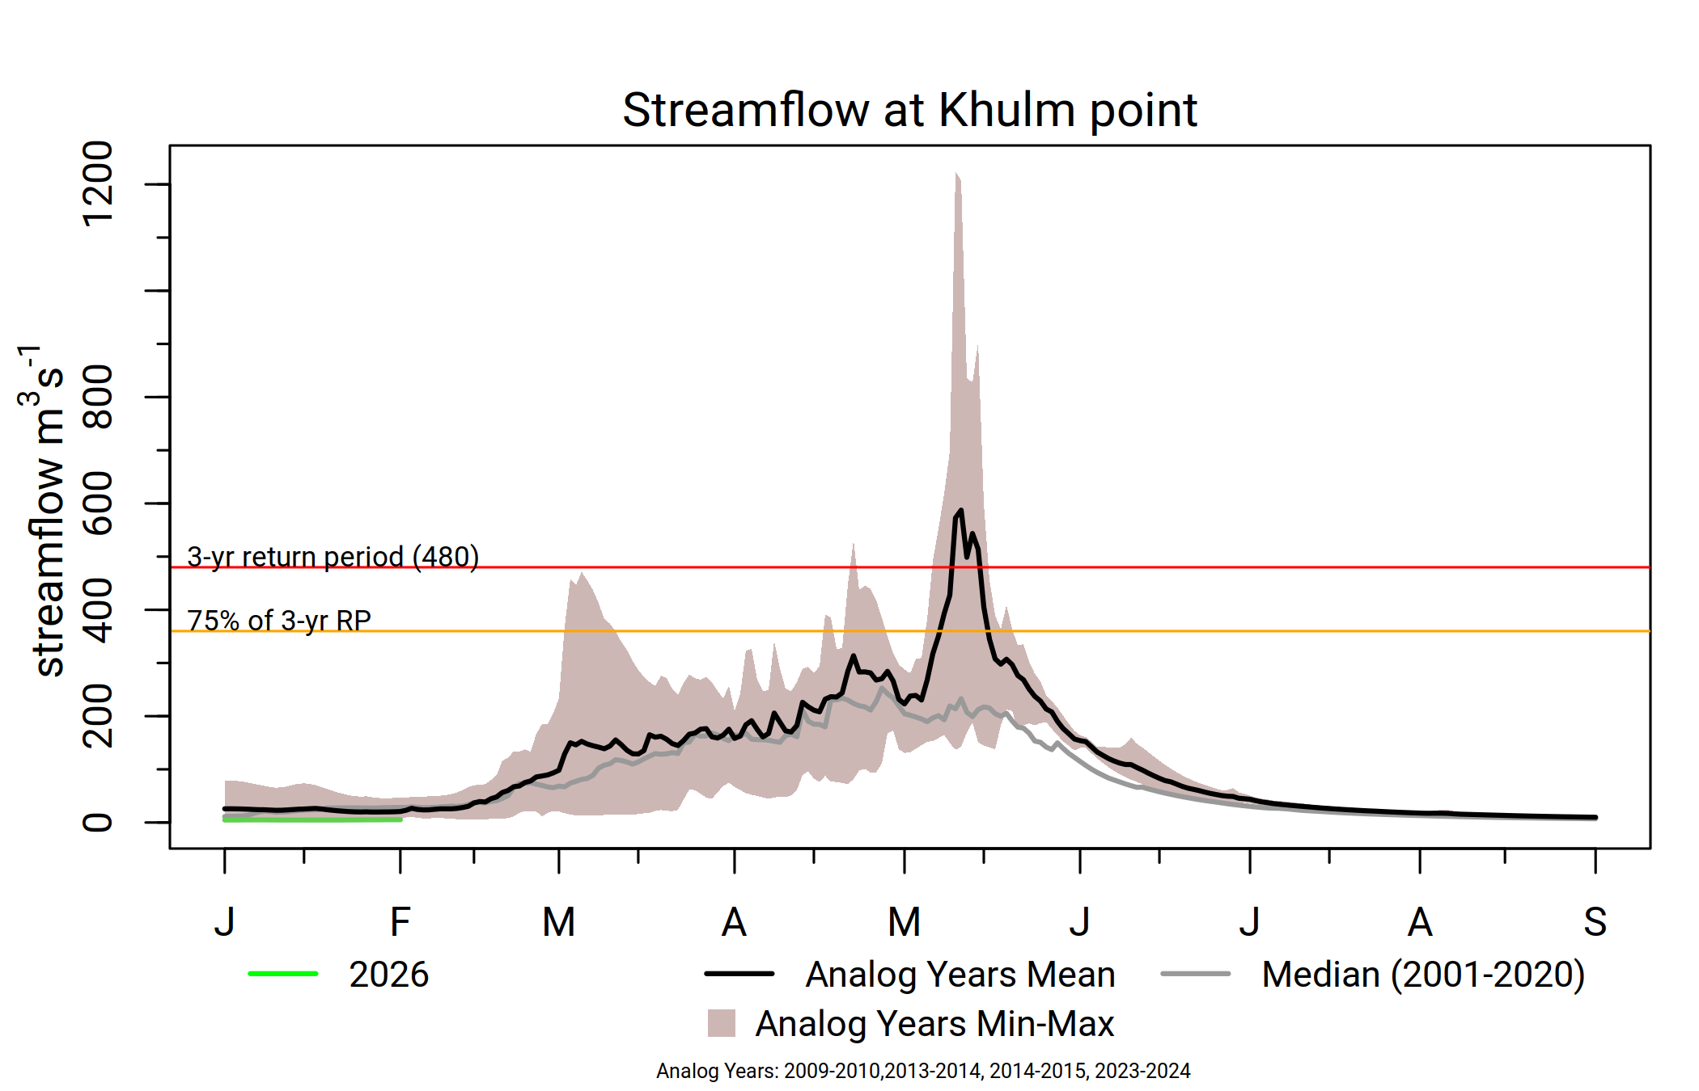
Khulm
Below-average SWE since the start of the season.
Average streamflow likely, with moderate likelihood of flooding in late May.
Snowmelt likely to conclude in normal time.

Slide 16
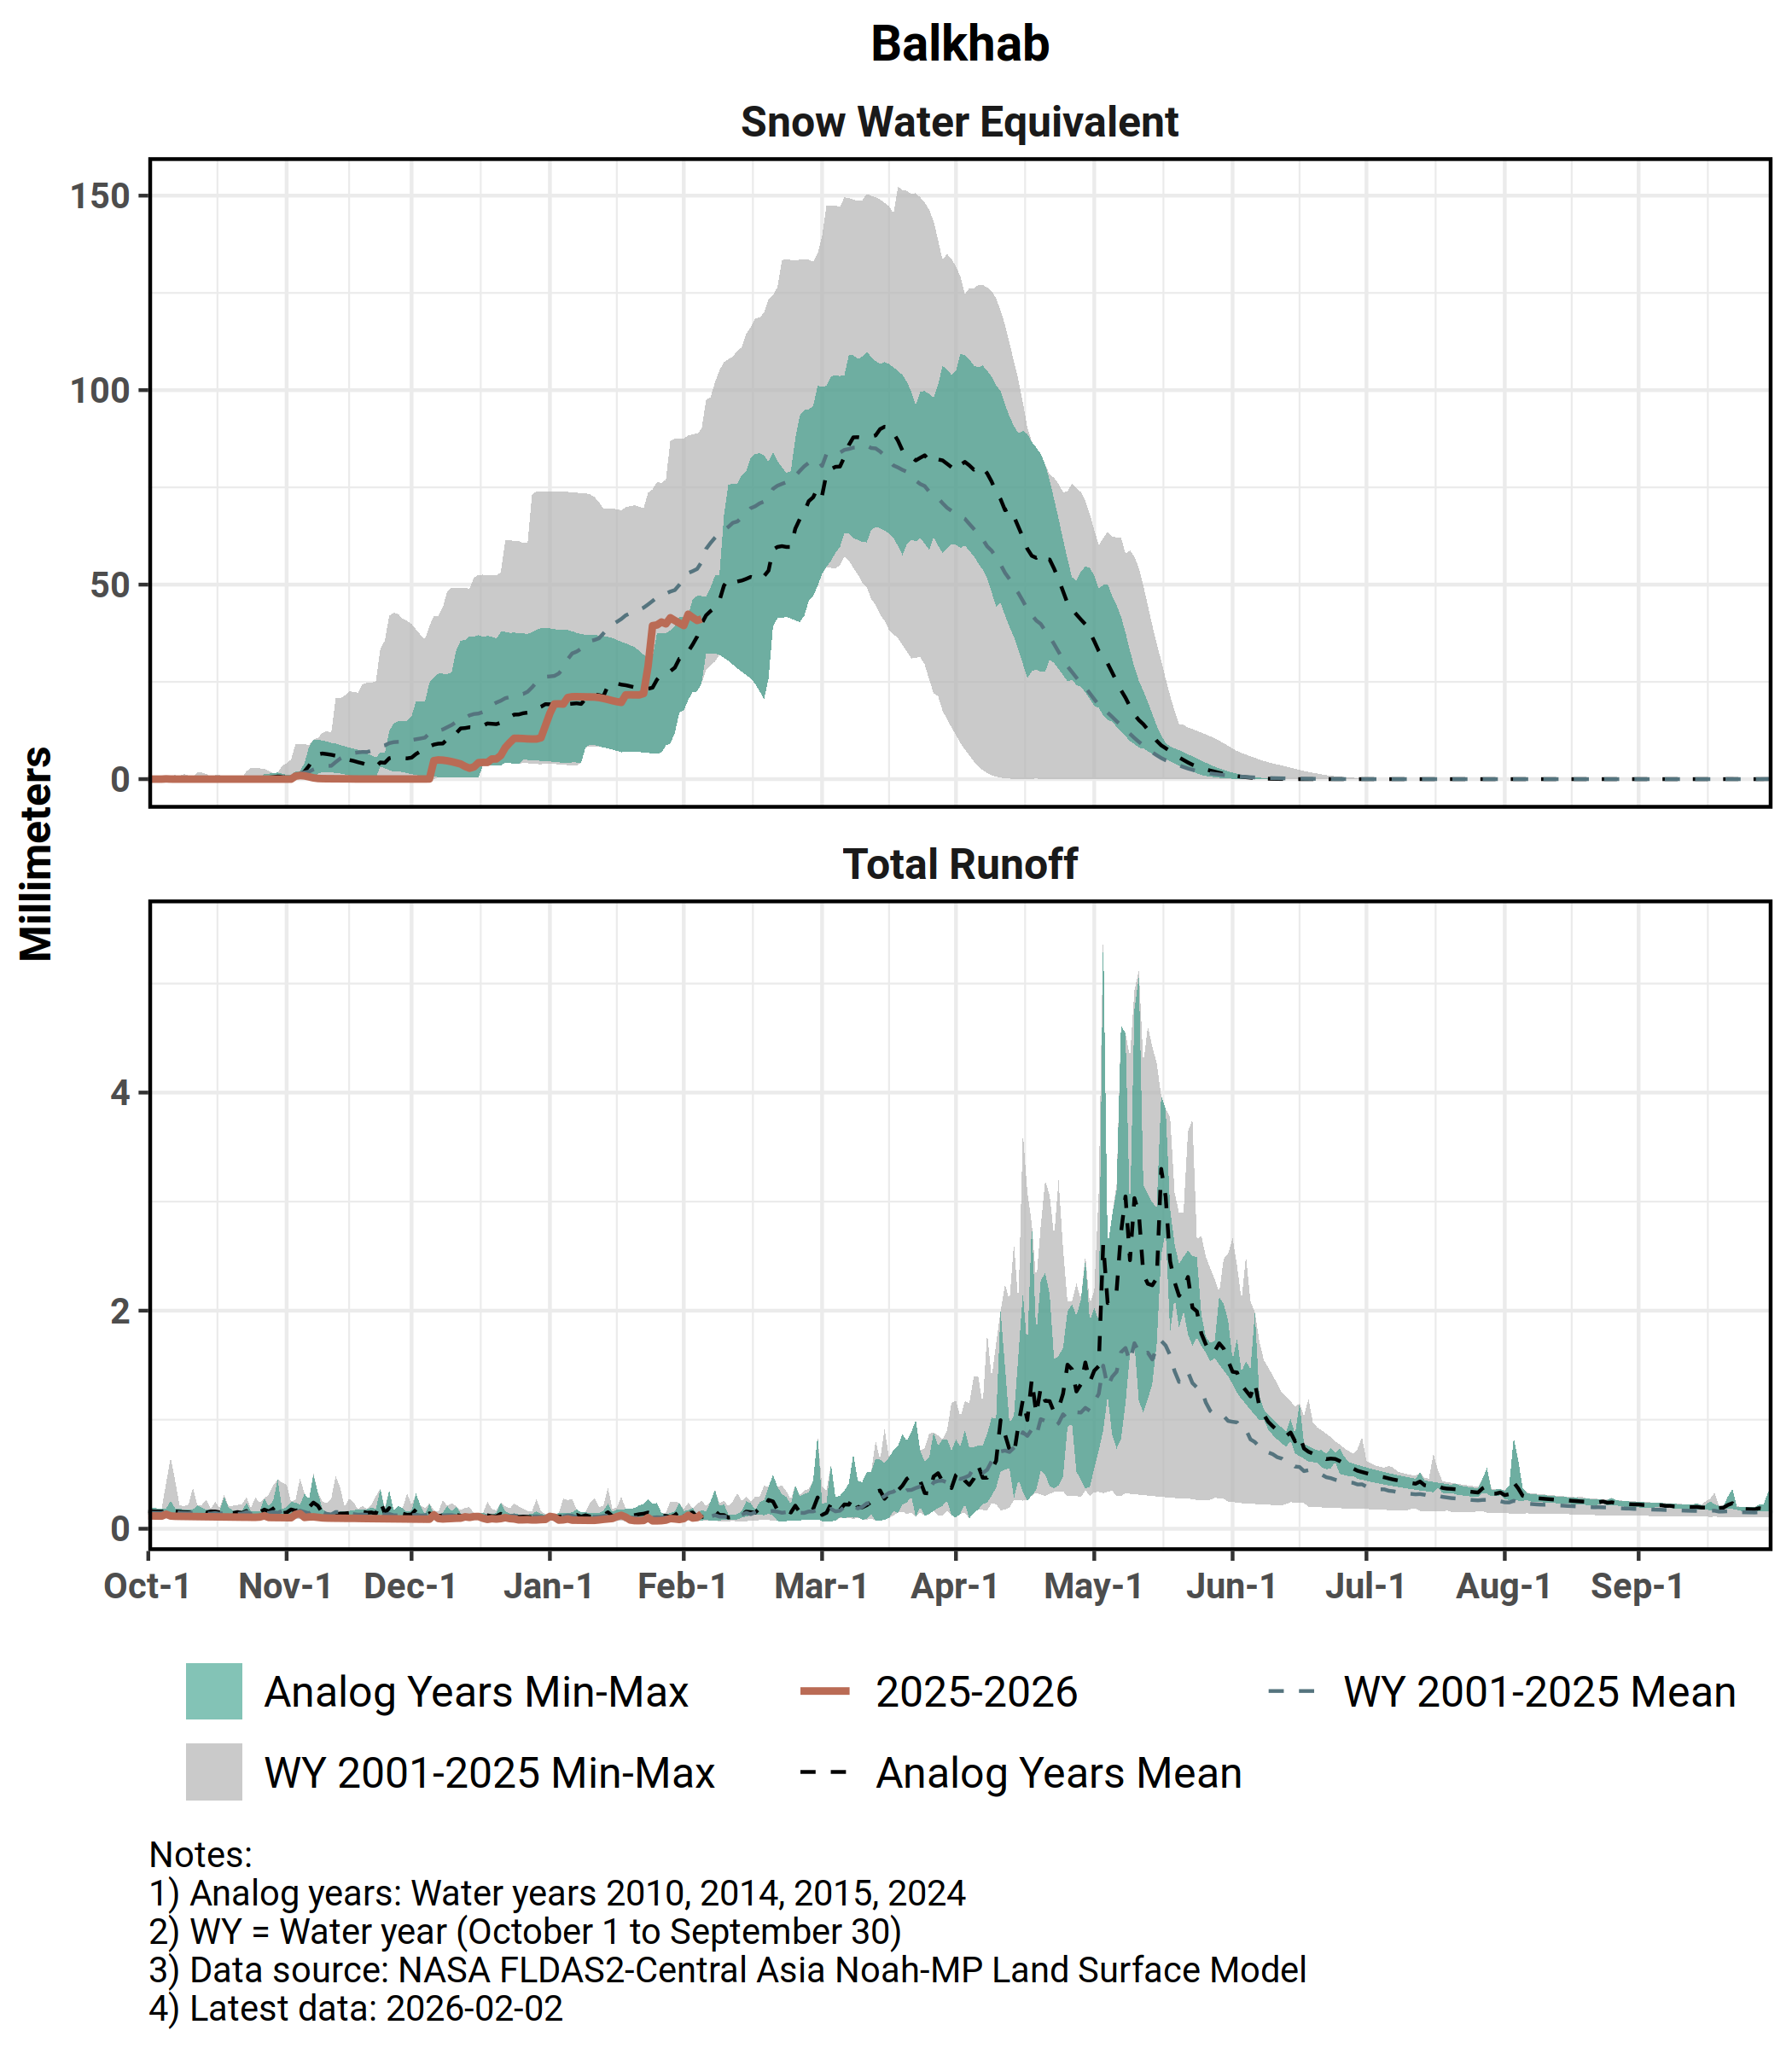
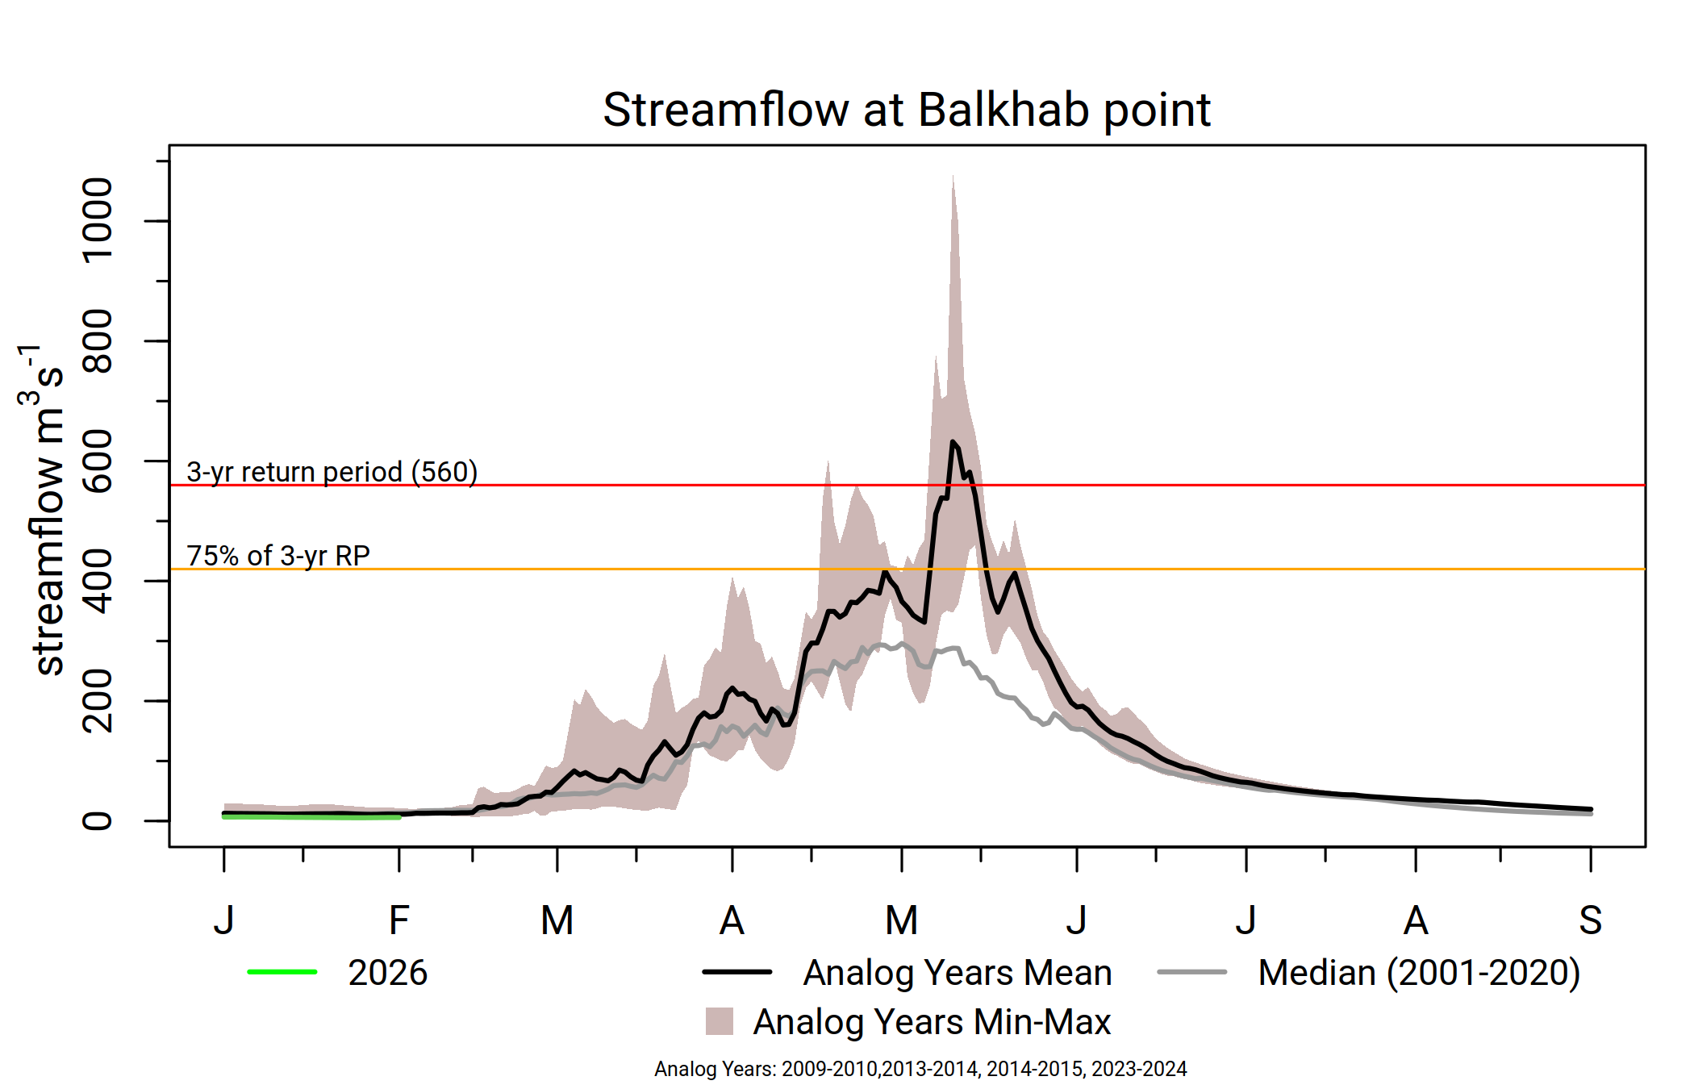
Balkhab
Average SWE since the start of the season.
Above-average streamflow likely, with moderate likelihood of flooding in late May.
Snowmelt likely to conclude in normal time.

Slide 17
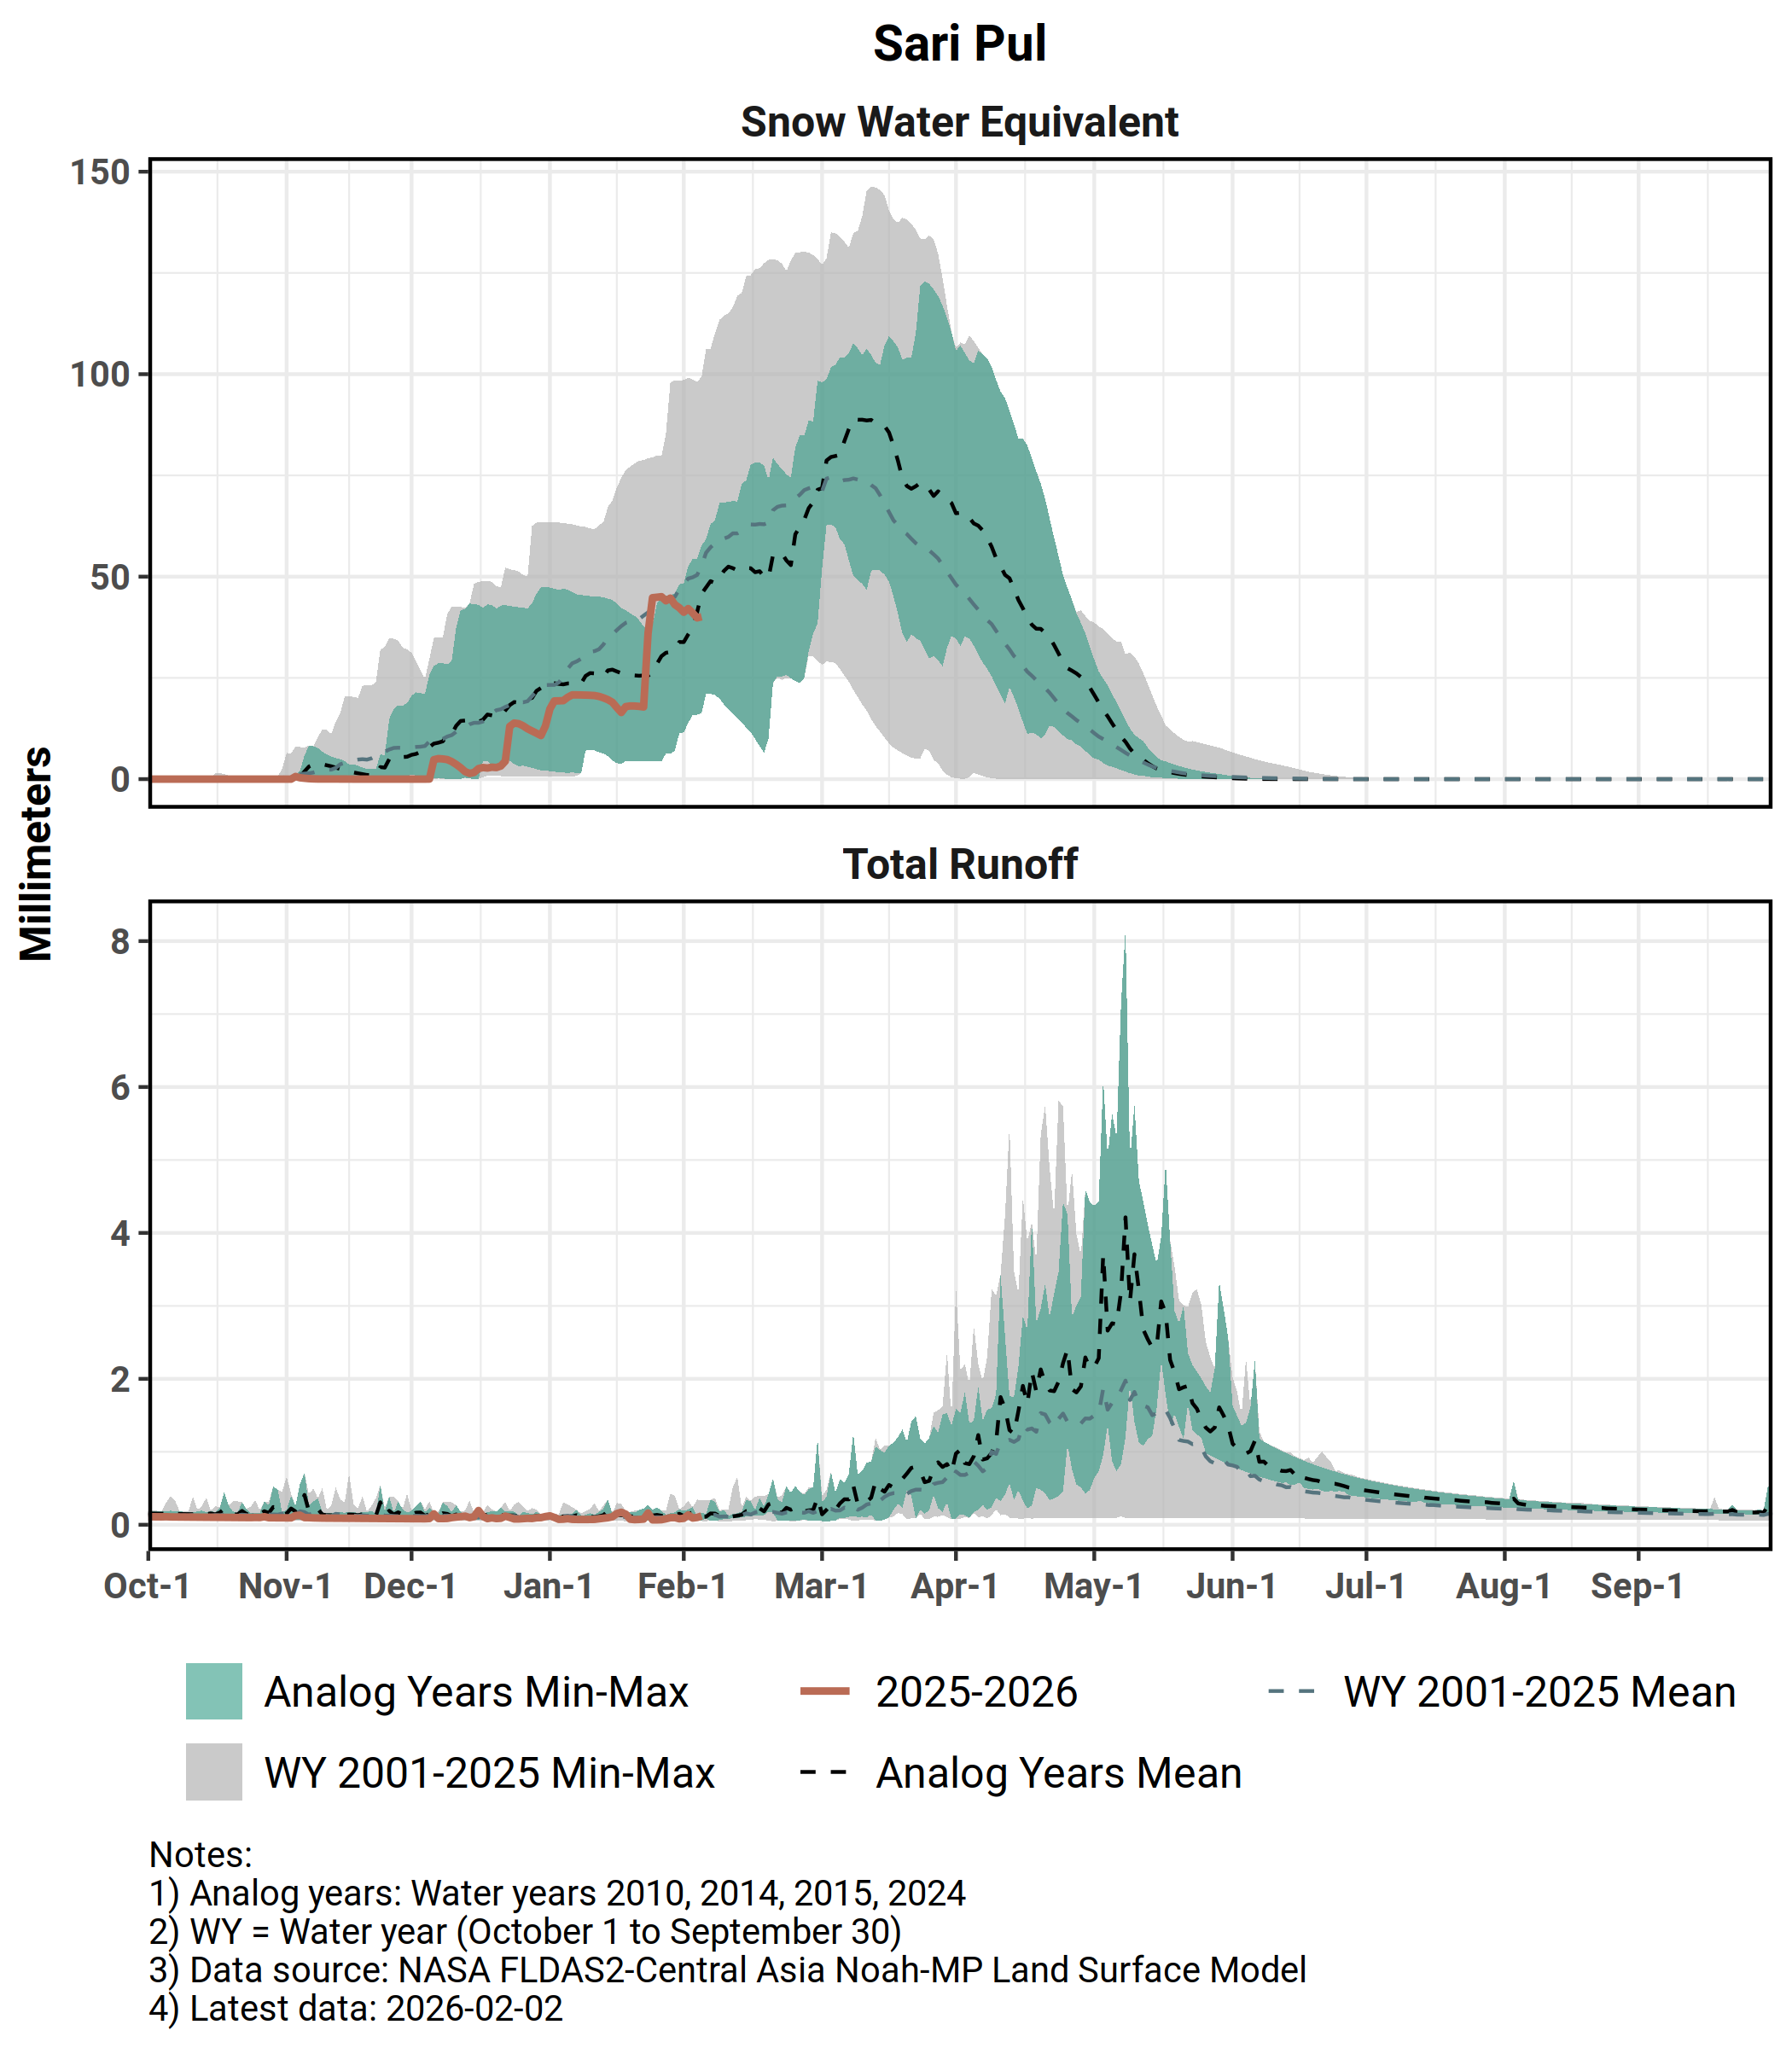
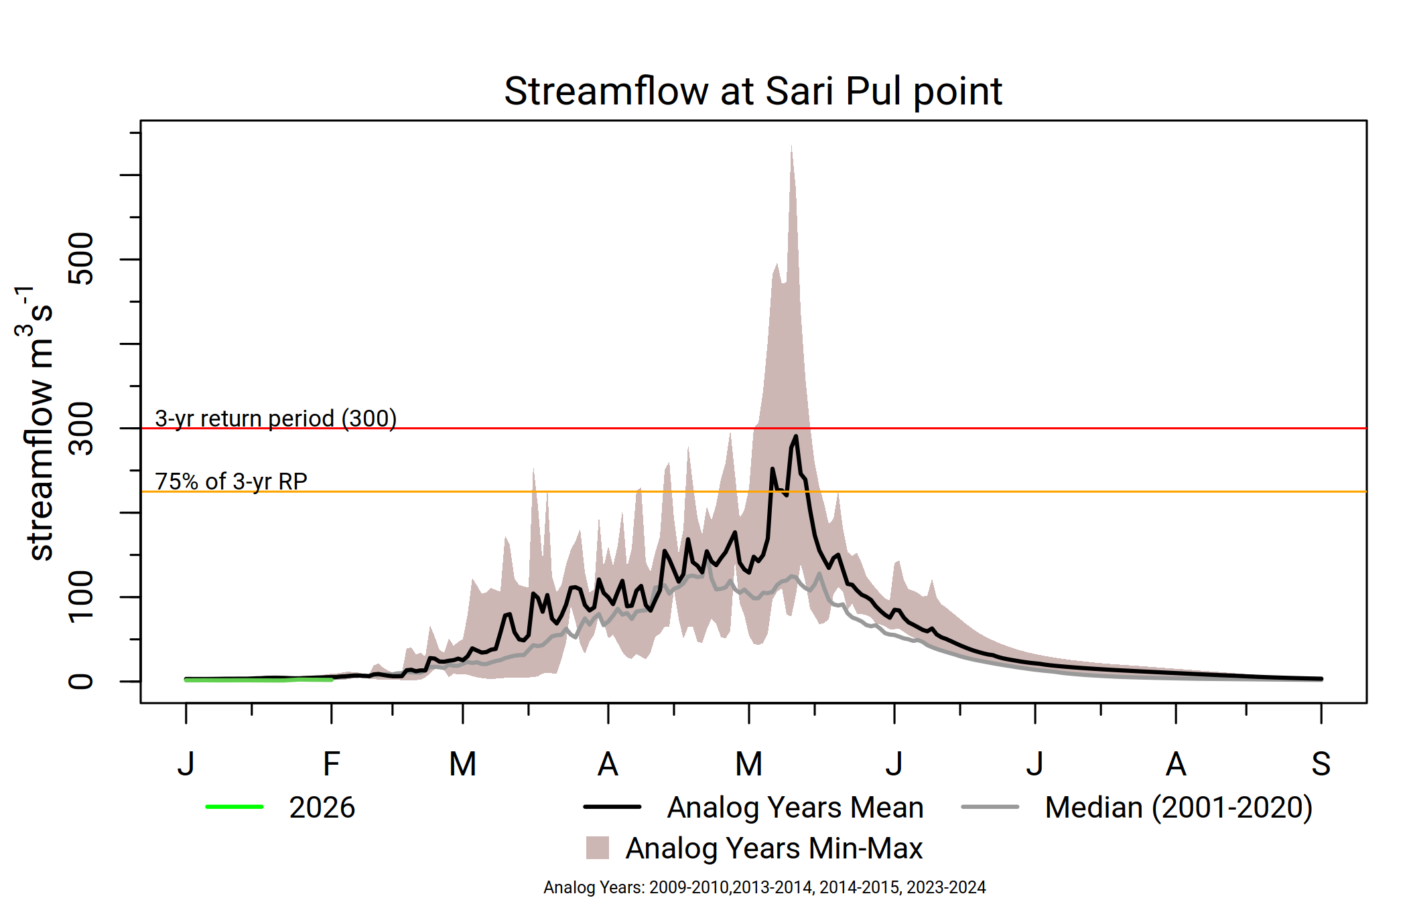
Sari Pul
Noticeable uptake in SWE in late January to early February.
Average streamflow likely, with less likelihood of flooding in May.
Snowmelt likely to conclude in normal time.

Slide 18
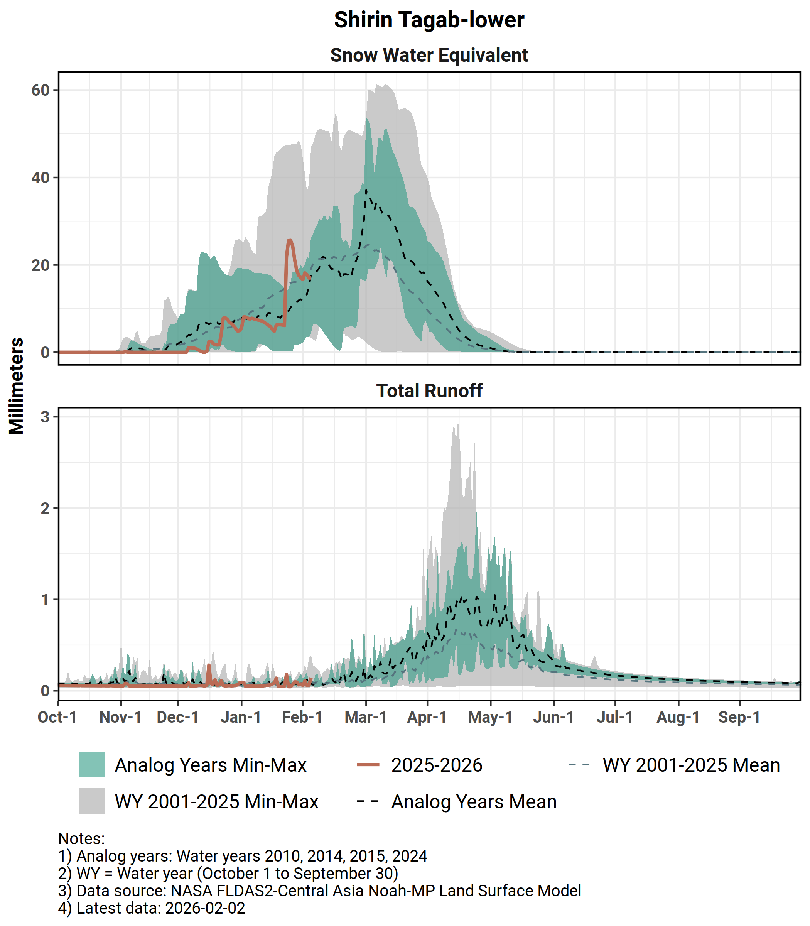
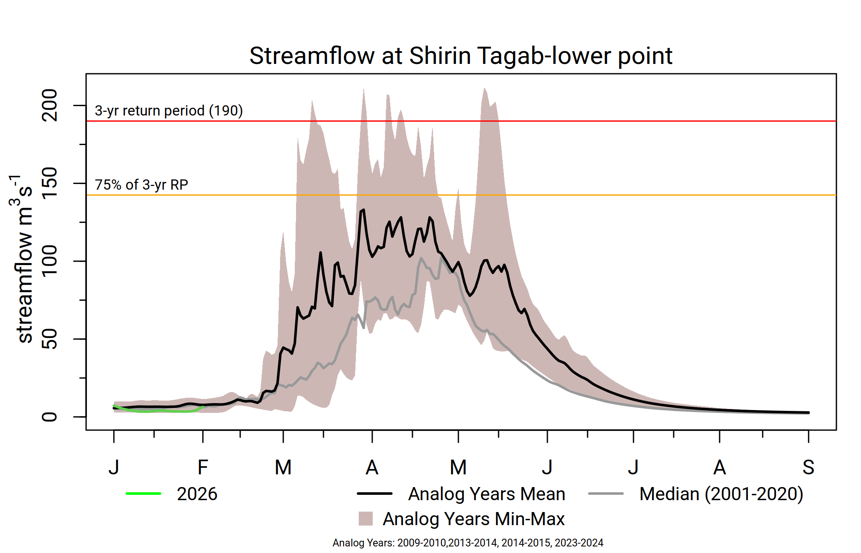
Shirin Tagab
Noticeable uptake in SWE in late January to early February.
Above-average streamflow likely, with moderate likelihood of flooding in April and May.
Snowmelt likely to conclude in normal time.

Slide 19
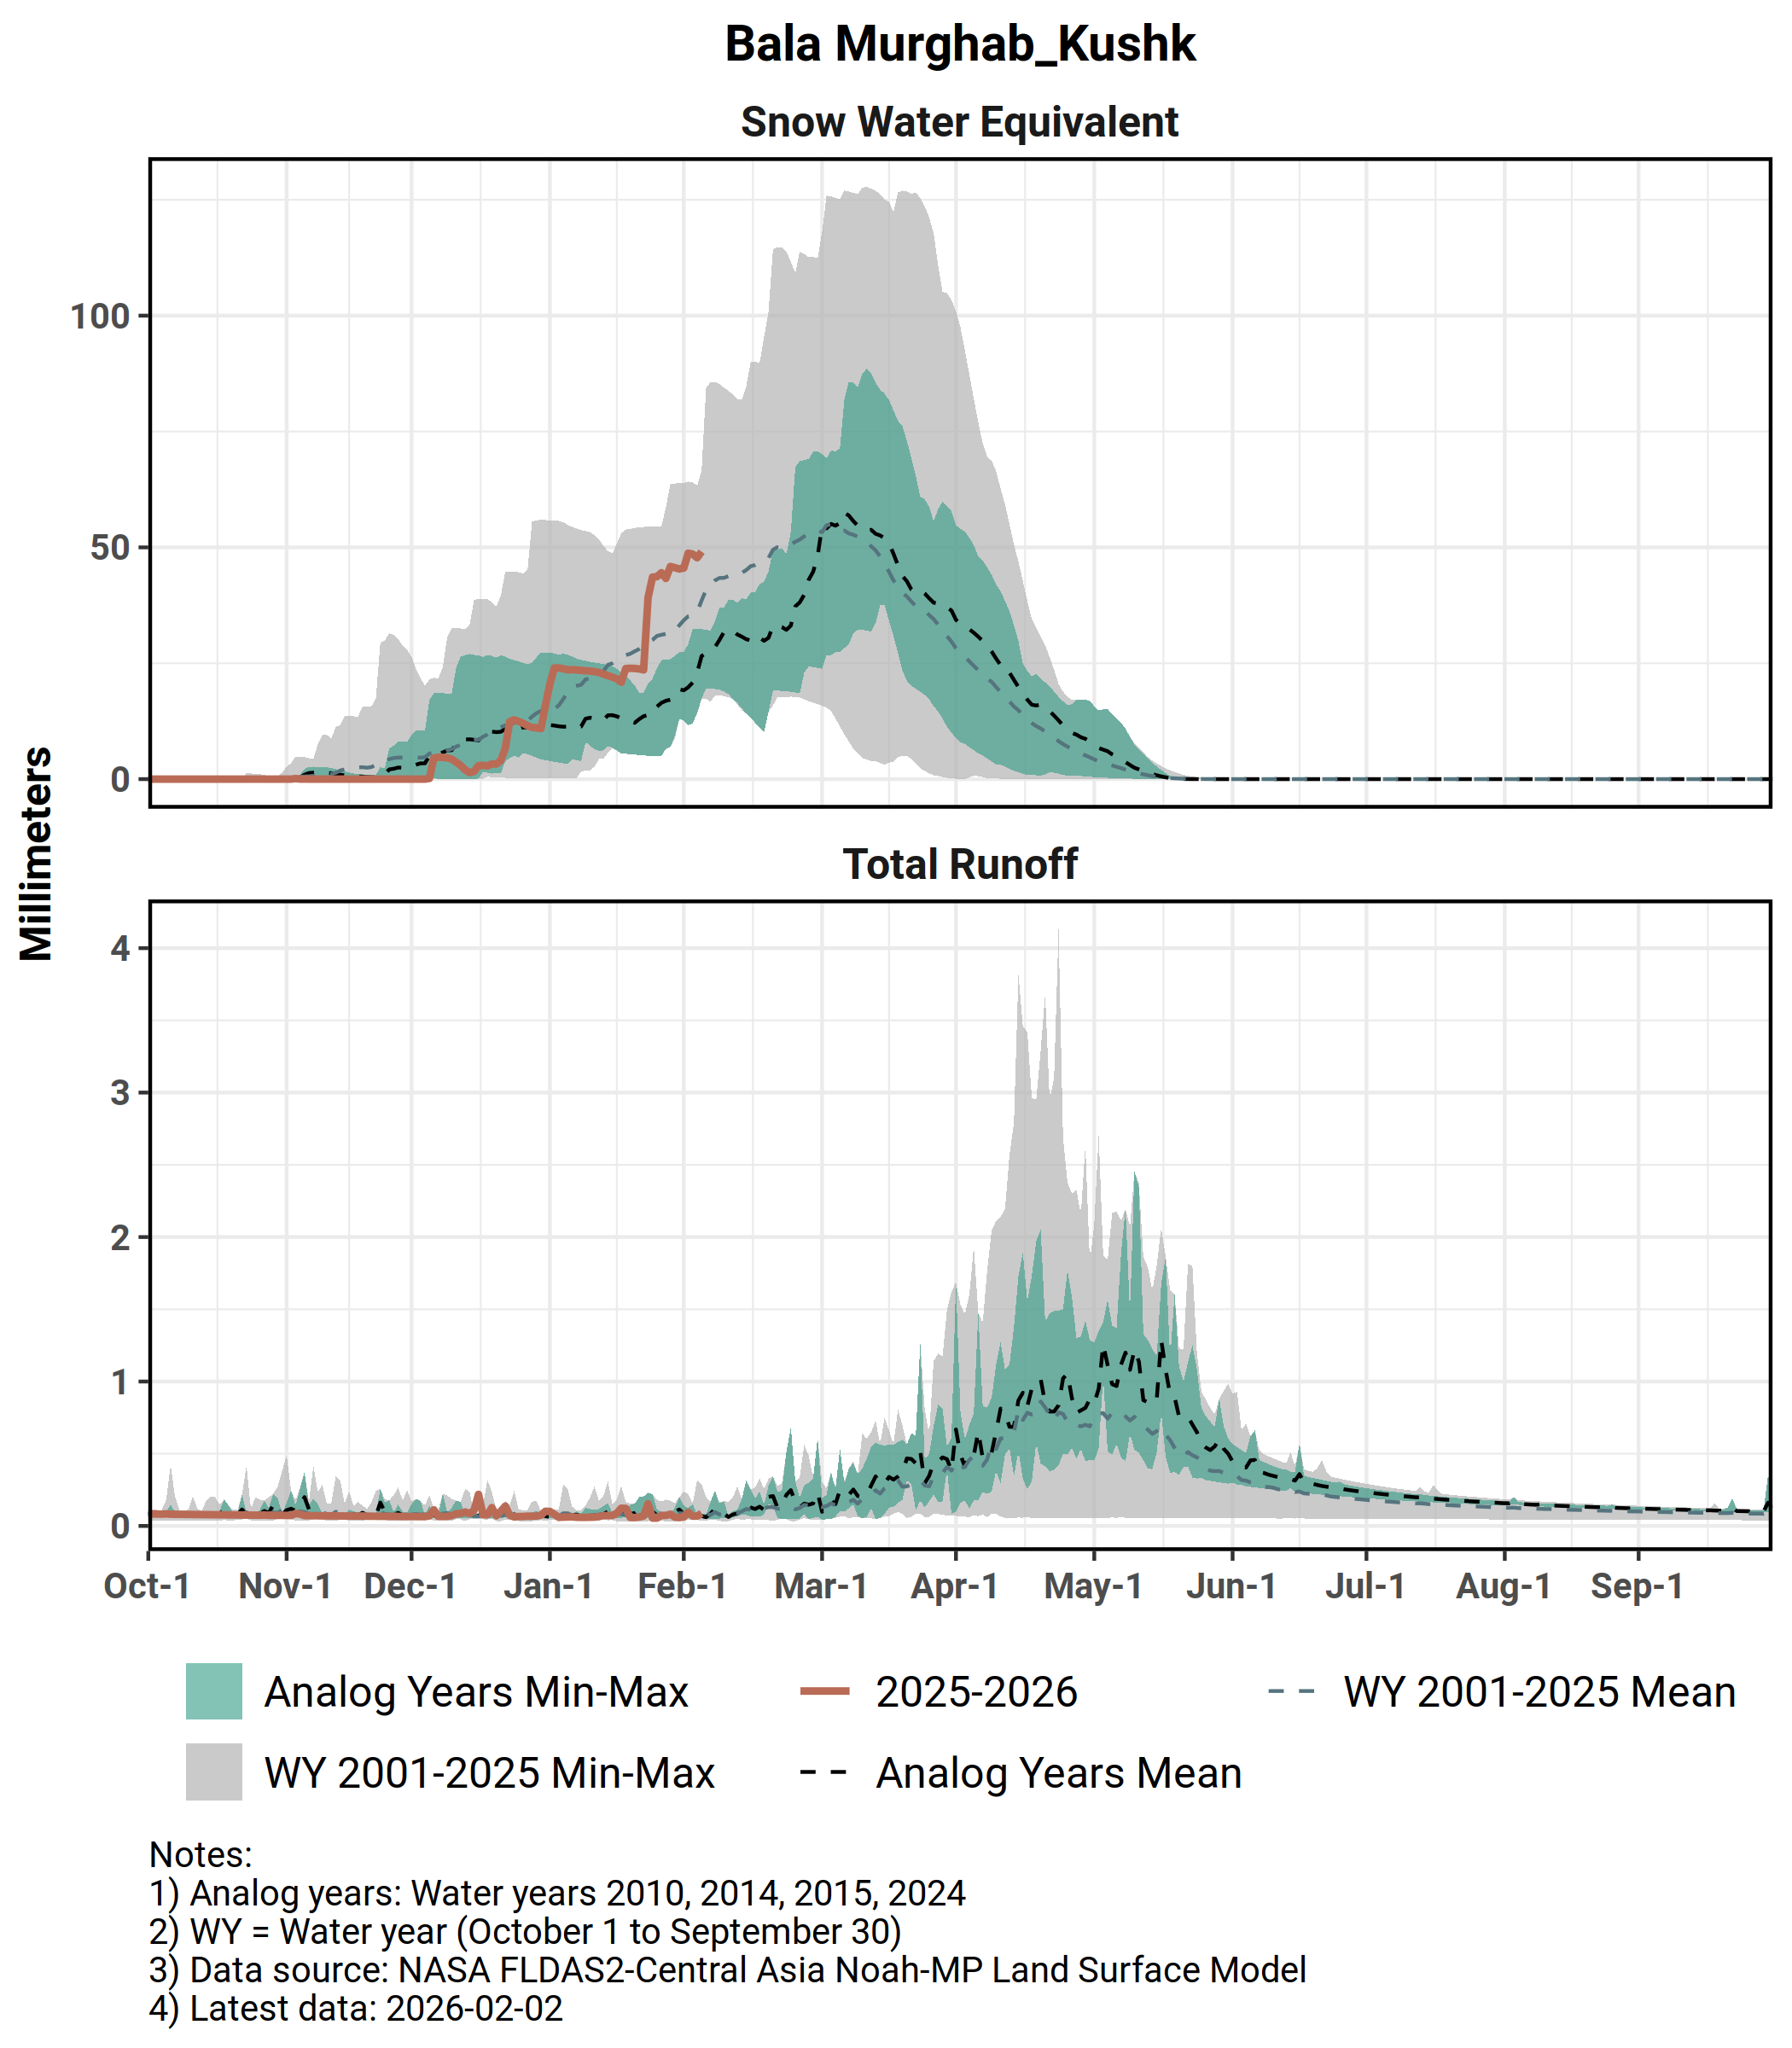
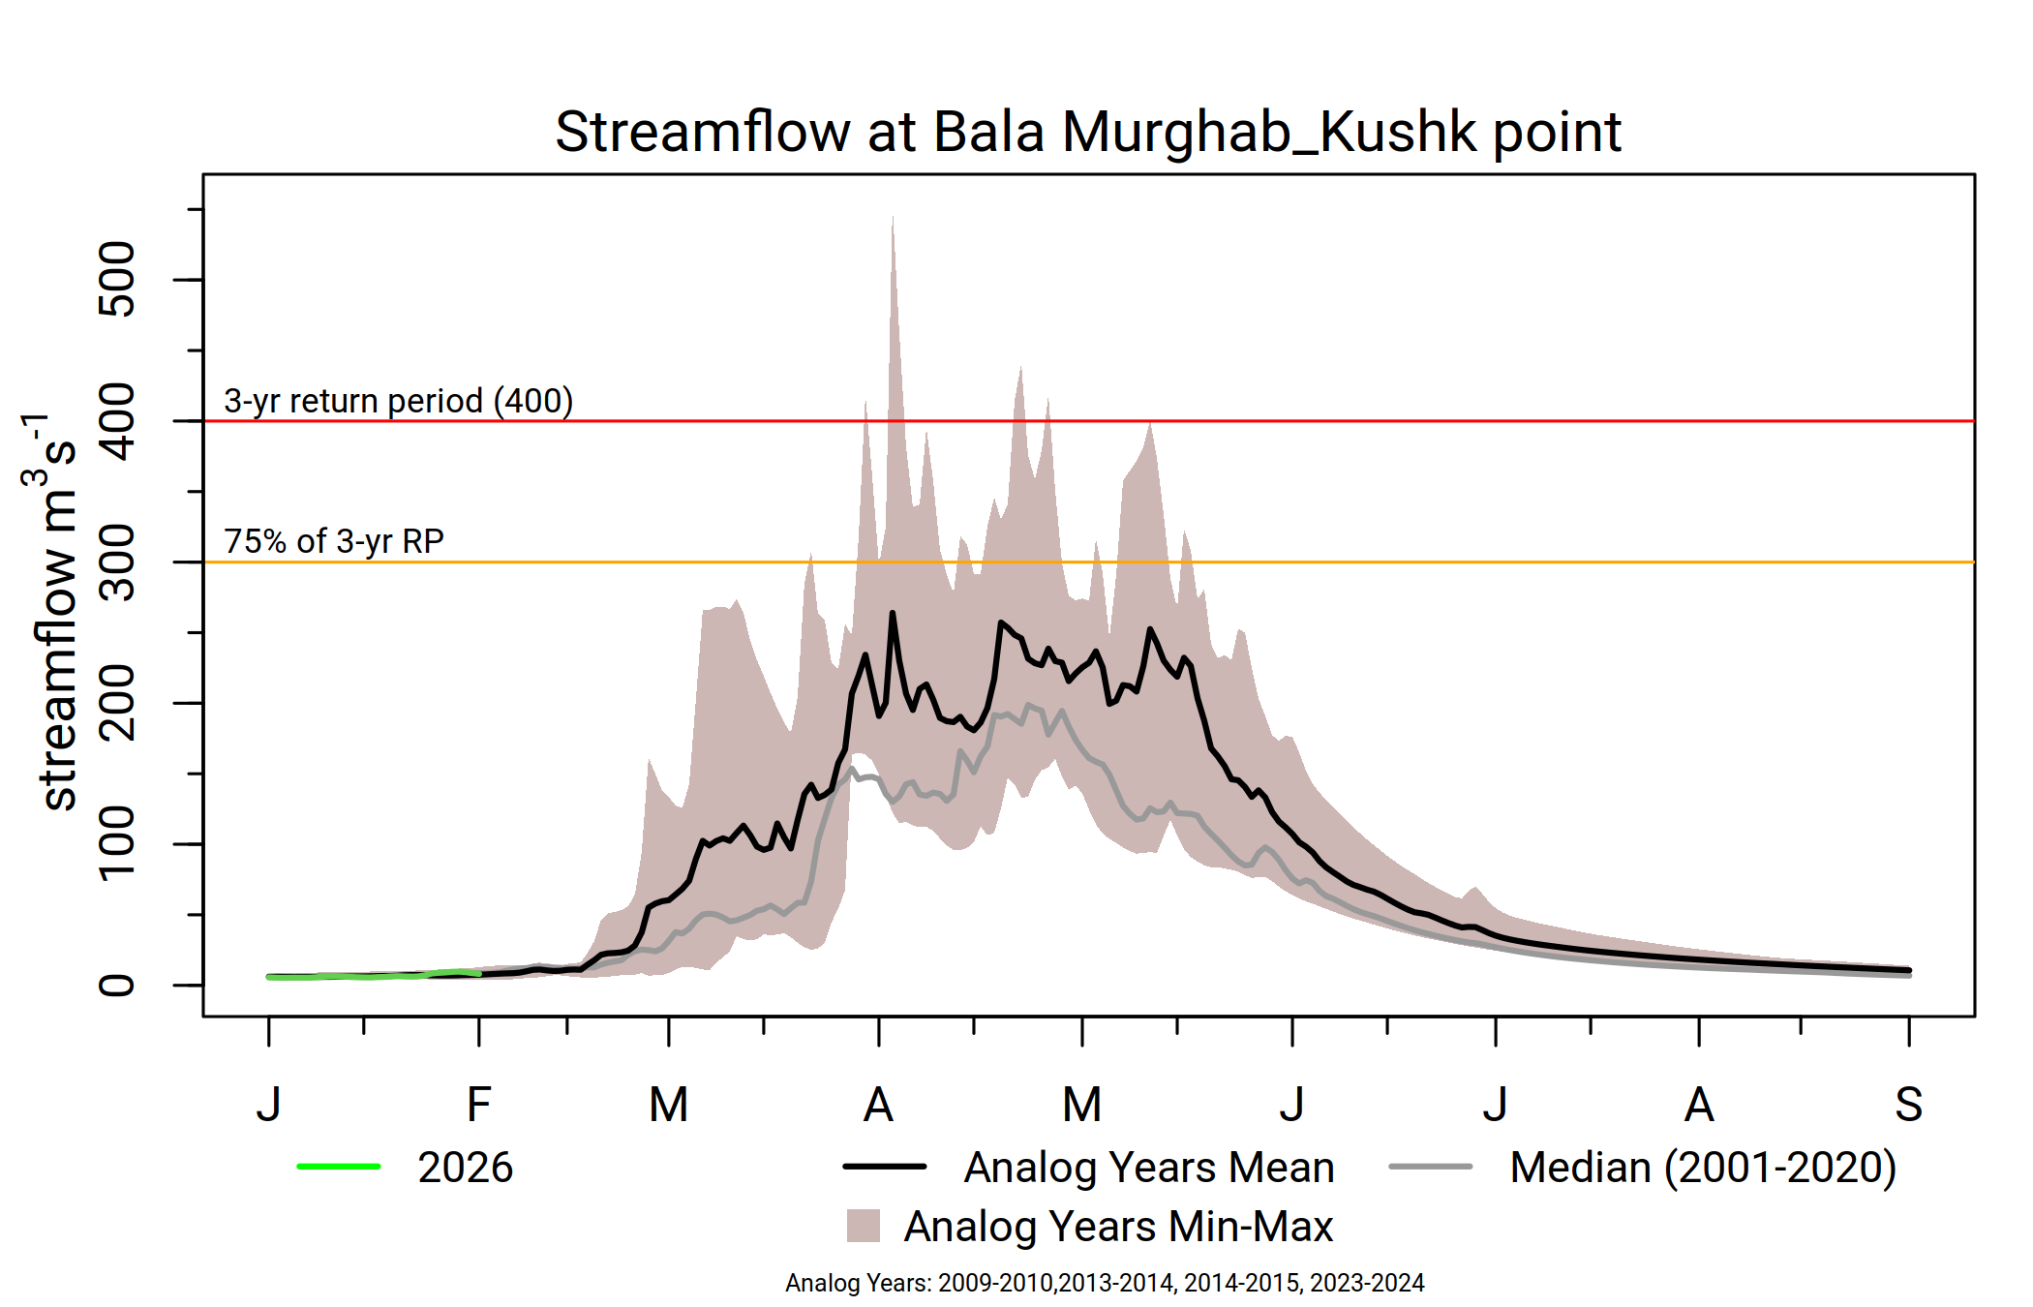
Bala Murghab
Significant uptake in SWE in late January to early February.
Above-average streamflow likely, with less likelihood of flooding in April.
Snowmelt likely to conclude in normal time.

Slide 20
Summary
While SWE was below-average at the beginning of the season, currently noticeable uptake in SWE occurred across most of the basins except over few northeastern basins.
Typical average to above-average SWE is expected across Afghanistan during the rest of the season.
However, few northeastern basins might not accumulate average snowpack mostly due to prolonged deficit of SWE in those basins for the last few years.
Average to above-average streamflow likely , with moderate likelihood of flooding in April and May across Afghanistan except in the few northeastern basins.
Unlike last few seasons, snowmelt likely to conclude in normal time.
Flooding intensifyting across Zambia.

Slide 21
Flash Flooding
However, flash flood can occur anytime and anywhere depending on the nature of the precipitation and in combination with snowmelt.
With expected average to above-average snowpack on the ground, there will be moderate to high likelihood of flash flooding across Afghanistan.

