Slide 1
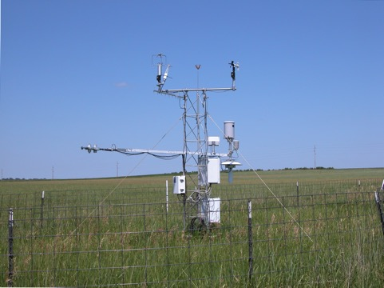
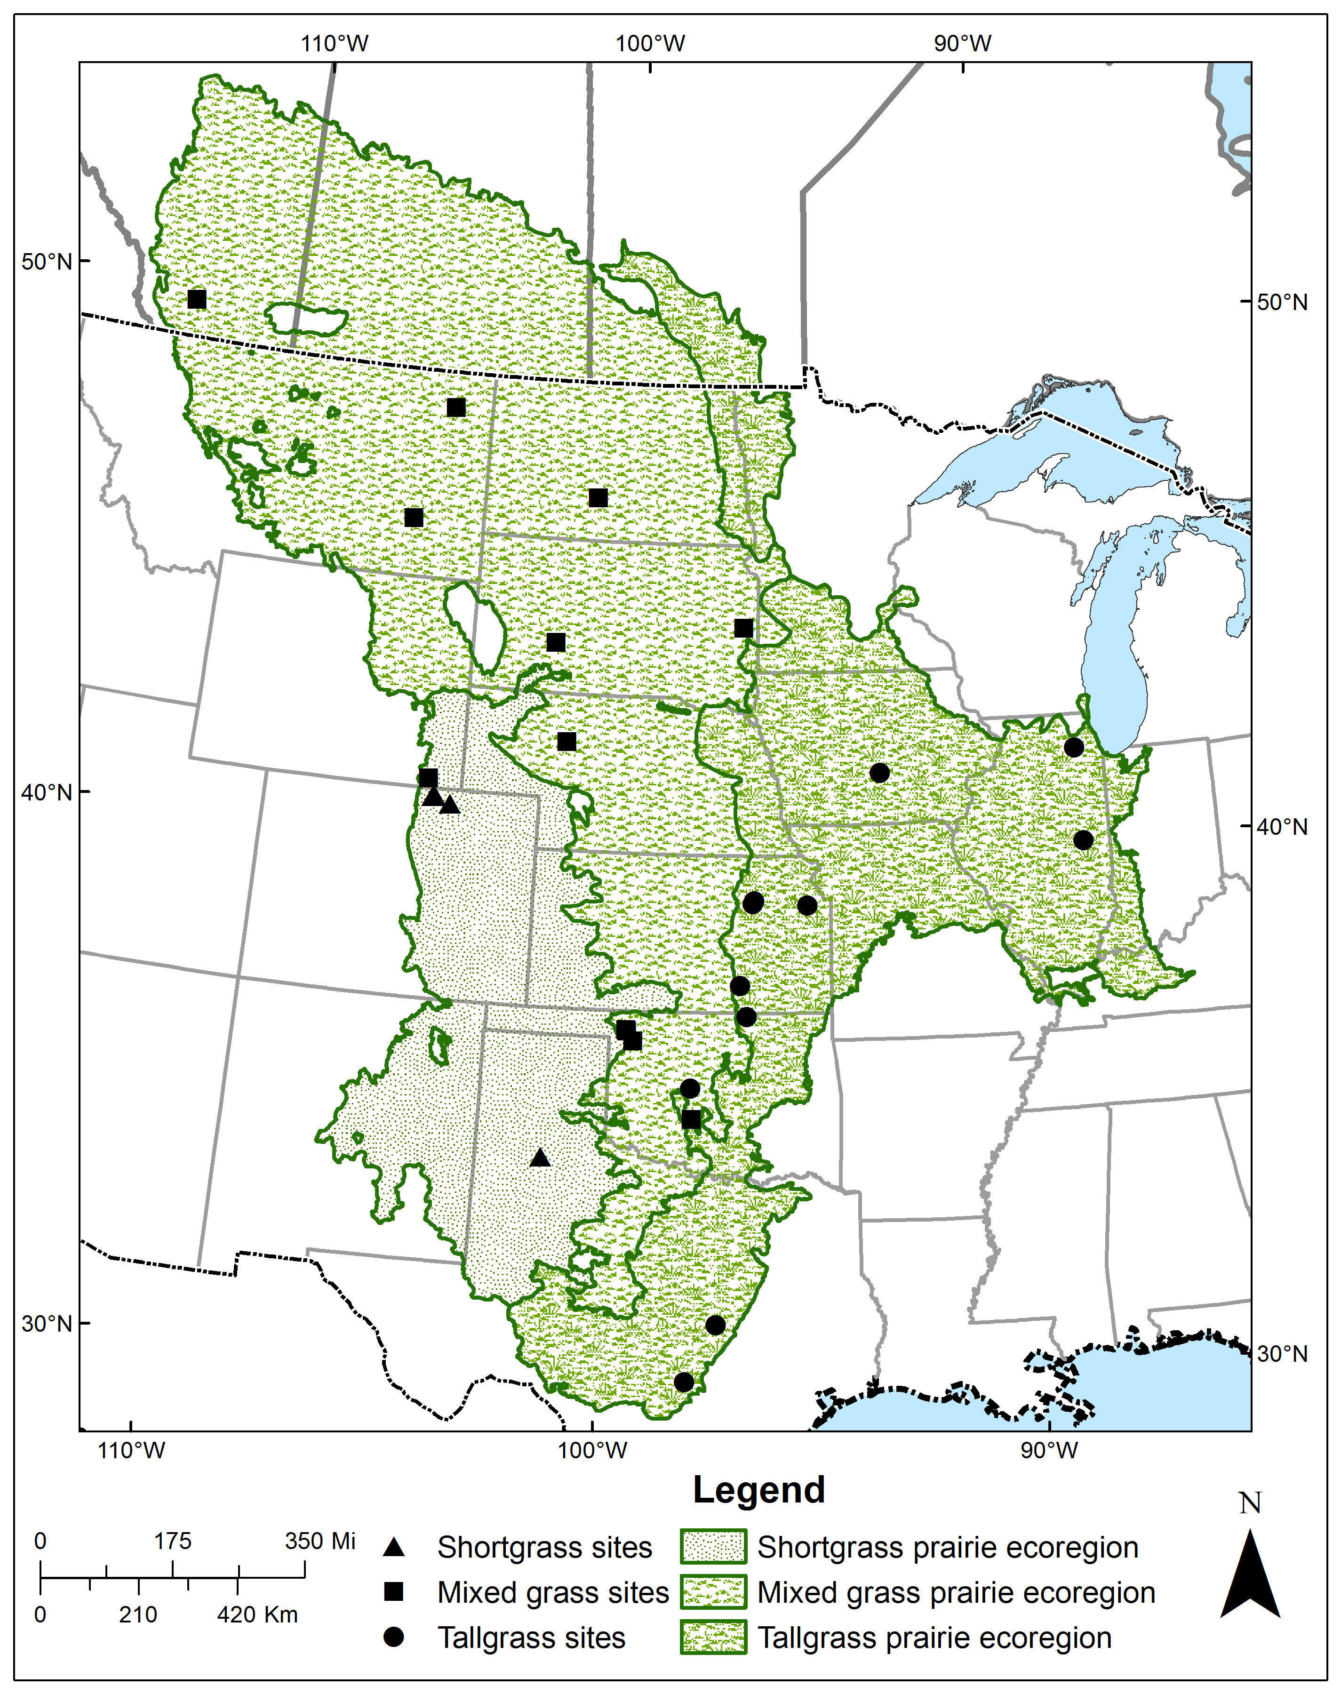
Empirical estimates of ecological light-use efficiency of Great Plains grasslands derived from long-term flux-tower measurements
Tagir G. Gilmanov¹, Bruce K. Wylie², and Daniel M. Howard³
¹Gilmanov Research & Consulting, LLP, grc1997@me.com; ² USGS EROS Center, wylie@usgs.gov; ³ Stinger Ghaffarian Technologies (SGT), Contractor to USGS EROS Center, danny.howard.ctr@usgs.gov
Introduction
Building predictive models of the ecosystem-scale CO₂ exchange is one of the major tasks of carbon cycle science. The family of Production Efficiency Models (PEM) is among the leaders in the field of terrestrial ecosystem modeling (McCallum et al. 2009). Measurement-based data on the magnitude and dynamic pattern of ecosystem-scale light-use efficiency is a crucial condition for successful PEM identification and validation.
The Great Plains megaregion of North America is one of the critical global carbon hotspots where high carbon storage is combined with significant human disturbance. The of carbon cycle in the region is highly vulnerable to climate change and anthropogenic impact and hence playing plays a key role in the North American and global carbon budgets.
Results
Seasonal and yearly dynamics of light-use efficiency
Ecological LUE in relation to remote sensing
Objectives and Study Sites
To characterize spatial and temporal dynamics of the ecological light-use efficiency (LUE) of Great Plains grasslands we used long-term flux tower measurements at 8 shortgrass steppe sites (23 site-years), 16 mixed prairie sites (73 site-years), and 10 tallgrass prairie sites (37 site years) covering areas from Alberta to Texas.
Fig. 9. Maximum ecological LUE in relation to maximum eMODIS NDVI (expedited Moderate Resolution Imaging Spectroradiometer product) (Jenkerson et al. 2010).
C
Fig. 2. Apparent quantum yield (A) and ecological LUE (B) of the managed grassland near Brookings, SD, 2004-2014 (C). Dots – mean weekly values; bars – standard errors of the means.
Ecoregion-specific multiparameter clusters
Fig. 5. Density-plot of maximum ecological LUE, ε_{max}(LAT, LONG) across the Great Plains ecoregion
Geographic gradients of ecological LUE, ε(LAT, LONG), ε(ELEV)
Climatic relationships of ecological LUE of the Great Plains grasslands
Fig. 10. Two-dimensional projections of the four-parametricparameter clusters of maximums of apparent quantum yield α, photosynthetic capacity A_{max}, ecological light-use efficiency ε, and daytime respiration r_{d} for shortgrass (S), mixed-grass (M), and tallgrass prairie (T) Great Plains ecosystems.
The Hotelling T² criterion reveals significant (p-value < 0.01) differences between the centers of multivariate parameter clusters of short-, mixed- and tallgrass Great Plains ecosystems.
Fig. 6. Ecological LUE in relation to annual precipitation.
Conclusions
TheLight light-soil temperature-VPD response method provides a robust parameterization of the tower-based CO₂ exchange data, generating physiologically meaningful parameter estimates.
Mean maximum daily LUE for shortgrass steppes was 16.2, standard deviation 4.9 and the range 6.8 to 28.7 mmol CO₂/mol incoming quanta, while for mixed and tallgrass prairies LUE characteristics were 21.2 (9.1), 6.7 to 48.1 mmol/mol and 32.1 (7.6), and 17.0 to 47.6 mmol/mol, correspondingly.
There are significant longitudinal and altitudinal trends of ecological LUE across the Great Plains.
Ecological LUE closely (r = 0.85) correlates with NDVI providing opportunities to include remote sensing data into predictive LUE models.
Geographically specific time series of LUE provide a valuable empirical basis for parameterization of predictive models of carbon cycling in Great Plains grasslands.
Fig. 1. Ecoregions of the North American Great Plains and location of the flux-tower sites.
Fig. 3. Geographic pattern of ecological LUE of Great Plains grasslands:
ε(LAT, LONG) = 91.3 + 0.048*LAT² + 0.036LAT*LONG
R² = 0.66; SE = 5.5 mmol mol^{-1;} p-value < 0.0001
Fig. 7. Ecological LUE in relation to annual temperature sum (5° C base).
Methods
Original sub-hourly CO₂ fluxes F were partitioned into gross photosynthesis P_{g} and ecosystem respiration R_{e} and gap-filled using nonrectangular hyperbolic light-soil temperature-VPD response method (Gilmanov et al. 2013, 2014; Morgan et al. 2016). From theWe computed three light-use efficiency measures resulting from the partitioning procedure: apparent quantum yield, α, physiological LUE, ε_{phys} = P_{g}/Q_{a}, and ecological LUE, ε = P_{g}/Q (Q is total, and Q_{a} absorbed PAR),. forFor ecosystem comparisons, we used ecological LUE, ε, which reflexesreflects not only physiological, but also ecological (including canopy leaf area and architecture) ecosystem-scale information.
Fig. 8. Ecological LUE in relation to radiation dryness index RDI = RNET/(λ*PCPN), where RNET is annual net radiation, and λ is the latent heat of vaporization
References.
Gilmanov, T.G. et al., 2013. Agric. Ecosyst. Envir. 164: 162-175. Gilmanov, T.G. et al., 2014. Agron. J. 106: 545-559. Jenkerson, C.B. et al., 2010. USGS Open File Report 1055, 10. McCallum, I., et al., 2009. Carbon Balance Manag., 4:8. Morgan, J.A. et al., 2016. Rangeland Ecol. Manag., 69:342-350.
Fig. 4. Altitudinal gradient of ecological LUE of Great Plains grasslands.
Acknowledgement. The work was supported by USGS EROS contract # G16PS00373 to Gilmanov Research & Consulting, LLP.
Presented at the 2017 Joint North American Carbon Program/AmeriFlux Principal Investigators meeting, Bethesda North Marriott & Conference Center in North Bethesda, MD, March 27–30, 2017.

