Slide 1
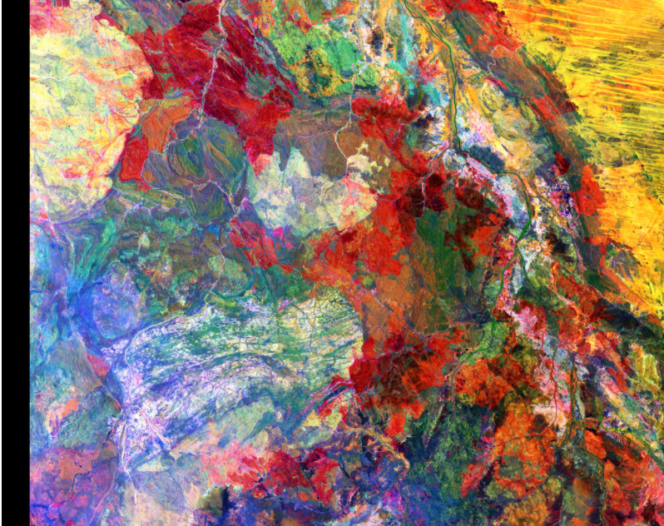

Mapping Water Use from Space – yes you can!
Tom Adamson and Stefanie Kagone
KBR, Inc. and ASRC Federal, contractor to the U.S. Geological Survey (USGS)
Earth Resources Observations and Science (EROS) Center, Sioux Falls, SD 57198, USA.
Work performed under USGS Contract [140G0119C0001].
November 2nd, 2023
University of Sioux Falls
U.S. Department of the Interior
U.S. Geological Survey

Slide 2
Overview
Introduction to EROS and Remote Sensing
Mapping Water from Space for
  Food Security
  Crops Water Use

Slide 3
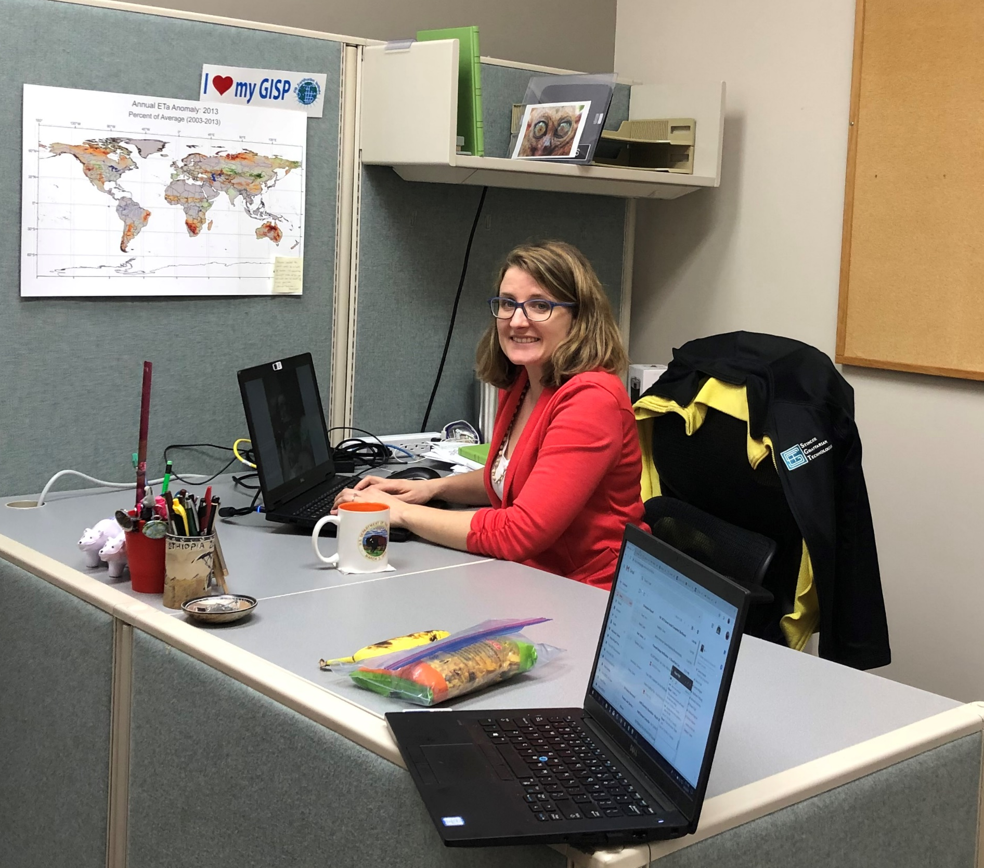
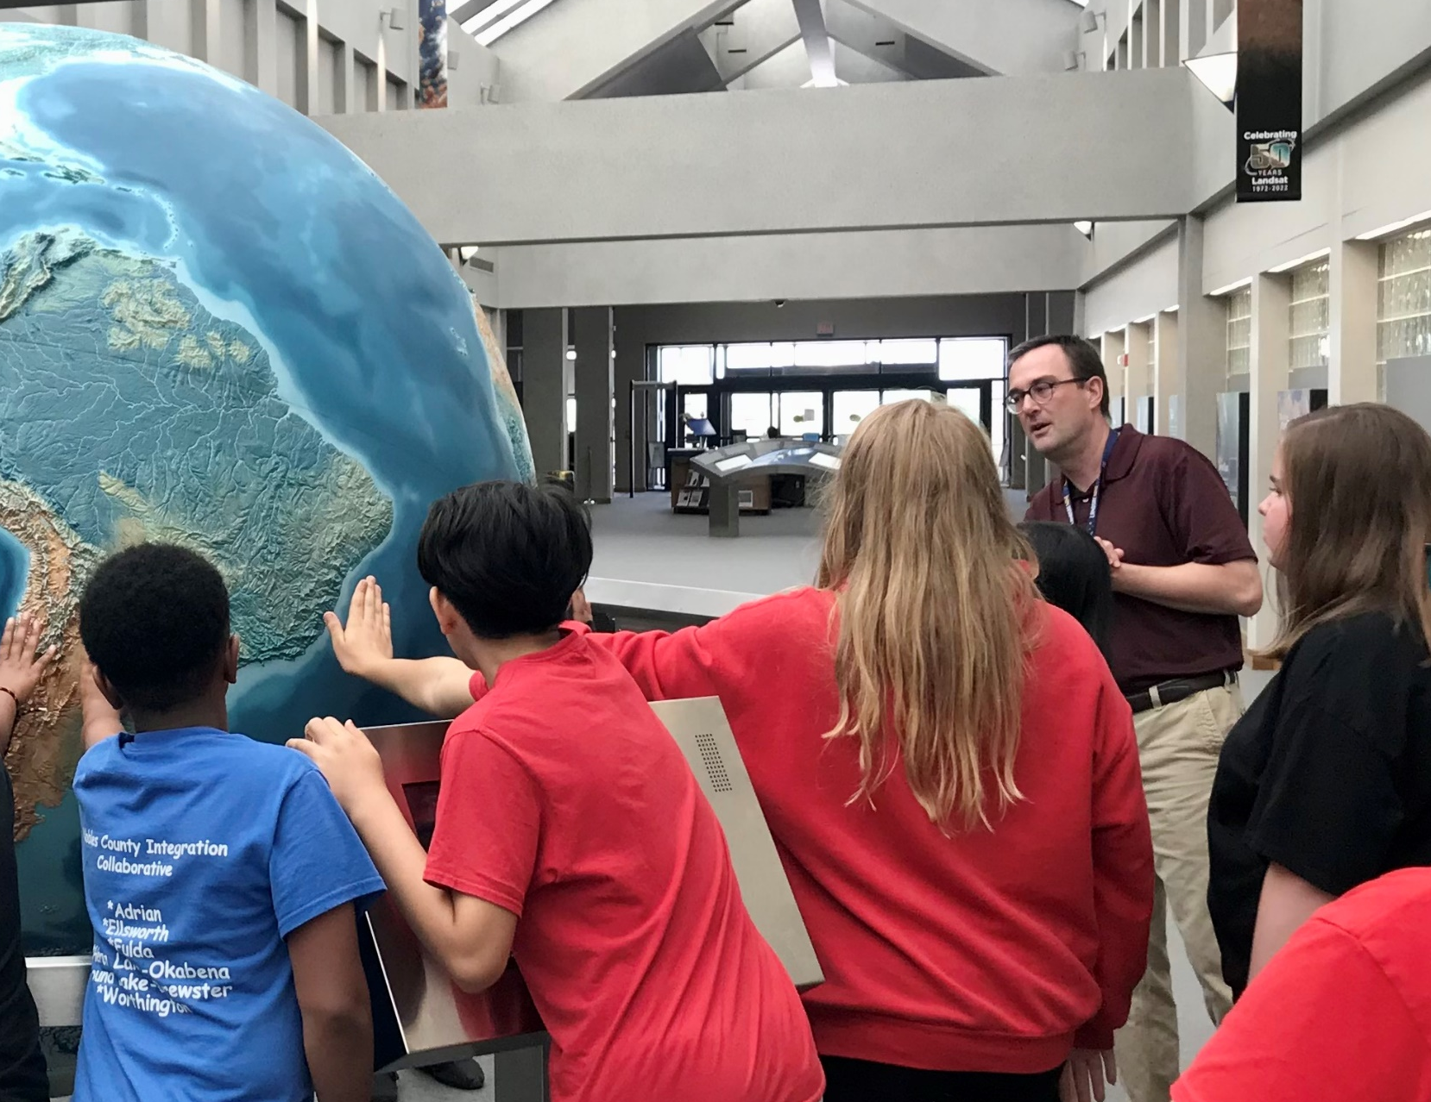
Who we are...
Tom Adamson - Publications Specialist
Stefanie Kagone - Research Scientist
Bachelor of Science in English
Master of Arts in English
Bachelor of Engineering in Land Surveyor/Cartography
Masters of Science in Geography

Slide 4
Why are we doing what we are doing?
Trying to find possible solutions for a world problem
Climate Change
Deforestation
War
Children’s access to healthcare and education
Water Use/contamination
Food security and Hunger

Slide 5
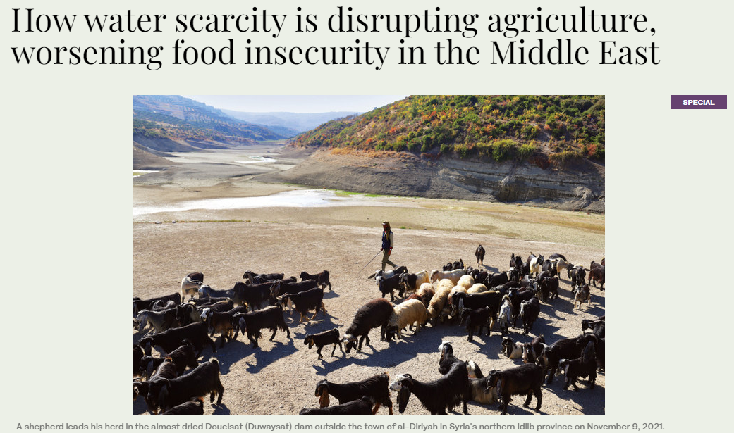


Food insecurity in the news

Slide 6
What causes food insecurity?
Climate: drought, flood, etc.
Food Price Increases
Lack of education
FOOD
INSECURITY
Poverty
Food Market Access
Lack of sufficient income

Slide 7


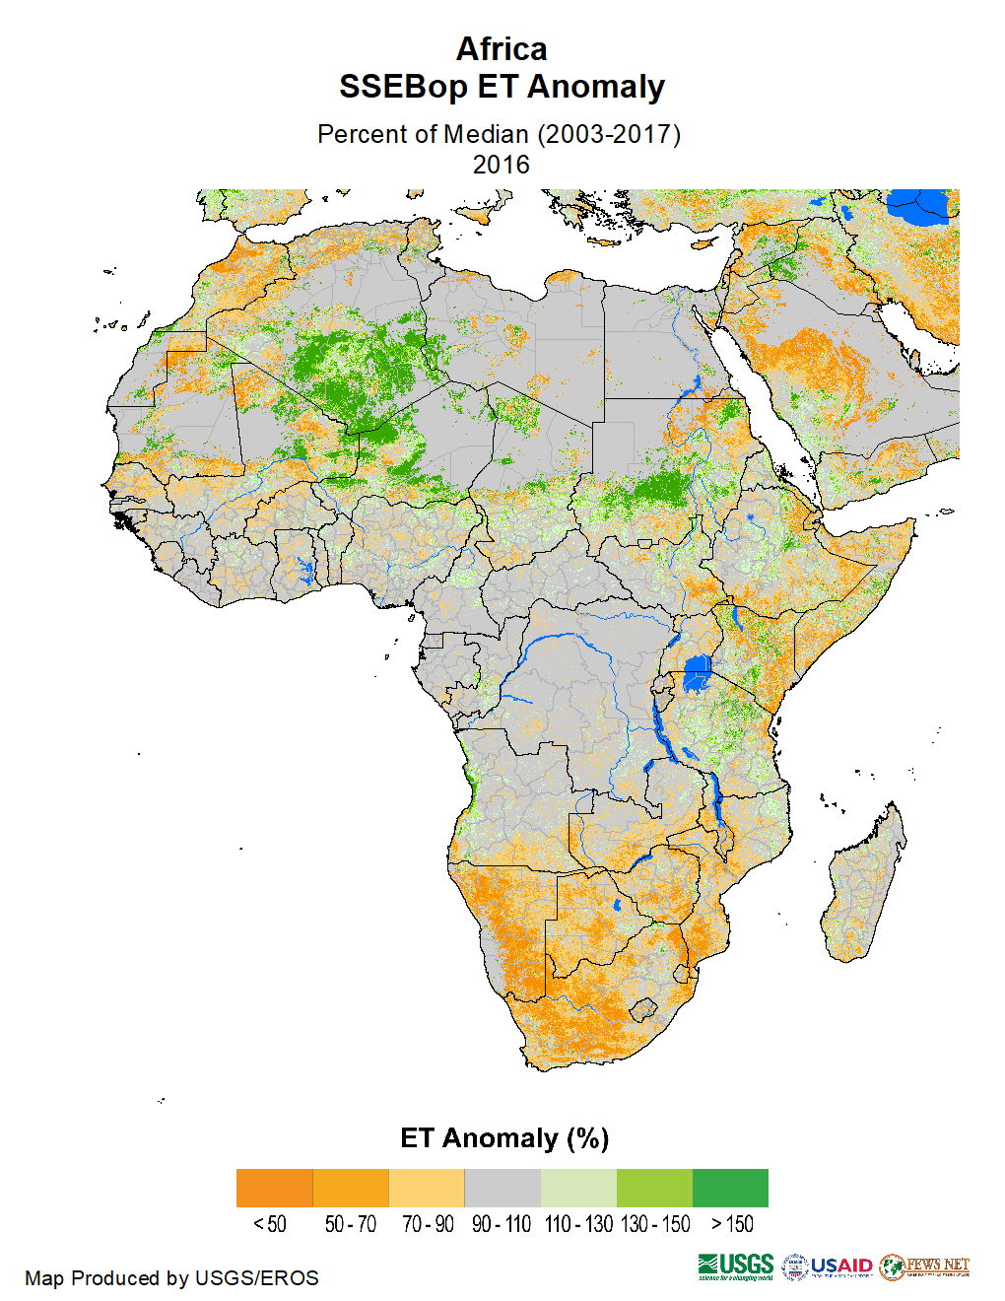
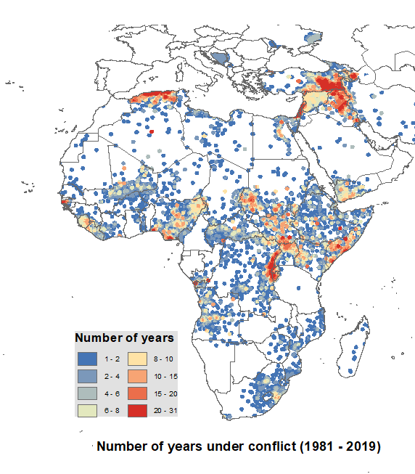

Application – Food security
Food for Peace
Requests for Food assistance
How do we know who needs
assistance due to drought, flood, conflict,…?
MAPS !!!
https://www.google.com/url?sa=i&url=https%3A%2F%2Fwww.usaid.gov%2Fsites%2Fdefault%2Ffiles%2Fdocuments%2F1866%2FFood%2520for%2520Peace%2520-%2520Voices%2520from%2520the%2520Field%2520-%2520online%2520version%2520rev.pdf&psig=AOvVaw0jVk7_kQhTMAZocalPADbY&ust=1634762839340000&source=images&cd=vfe&ved=0CAsQjRxqFwoTCOCov6es1_MCFQAAAAAdAAAAABAD
Determine areas/regions
that are in danger of a drought, flood,...
Notes:
$119 billion spend on SNAP a year
$4 billion spend on international food aid
$40 billion spend on foreign aid, about 1% of federal budget (2019)

Slide 8
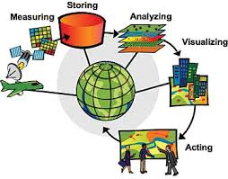
Our work at the USGS EROS Center

Slide 9
Where does the data come from?
Remote Sensing images collected by satellites, airplanes, drones
stored at the
USGS EROS Center

Slide 10
What is Remote Sensing?
“…the science of acquiring information about the Earth’s surface without being in direct contact with it”
Remote Sensing
situated at some distance away
not touching
getting data
acquiring information

Slide 11
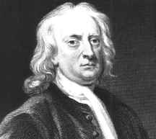
Remote Sensing started…..357 years ago
1666 - Sir Isaac Newton, while experimenting with a prism, found that he could disperse light into a spectrum of red, orange, yellow, green, blue, indigo, and violet. Utilizing a second prism, he found that he could recombine the colors into white light.
Wikipedia.org

Slide 12
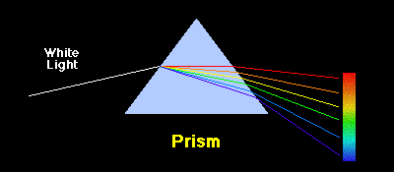
Wikipedia.org
“Newton’s first experiments with a prism helped change the view that white light was simply white. Passing a beam of sunlight through a prism, he saw that the beam spread out into a colored band of light, called a spectrum. Newton concluded through experimentation that sunlight is a combination of all the colors of the spectrum and that the sunlight separates when passed through the prism because its colors bend differently.”
http://library.thinkquest.org/J0112188/sir_isaac_newton.htm
Notes:
Because the colors of light travel at different speeds, they get bent by different amounts and come out all spread out instead of mixed up. Violet travels the slowest, so it is on the bottom and red travels the fastest so is on the top.

Slide 13
….. 120 years ago
In 1903, Julius Neubronner patented a breast-mounted camera for carrier pigeons that weighed only 70 grams.

Slide 14
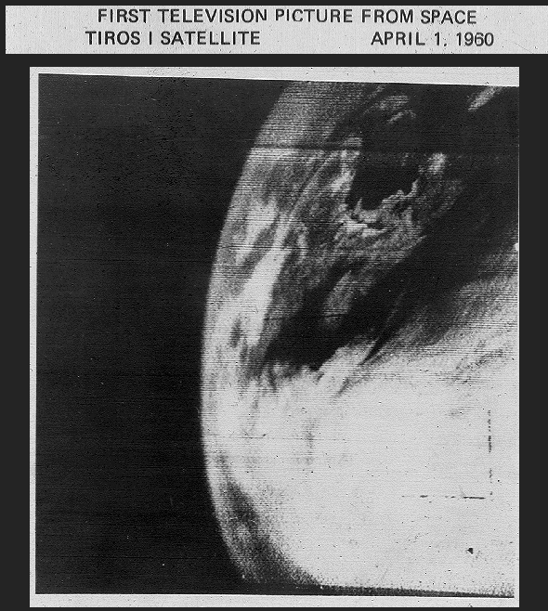
….. 63 years ago
Notes:
TIROS-1 (or TIROS-A) was the first full-scale weather satellite by NASA, April to June 1960

Slide 15
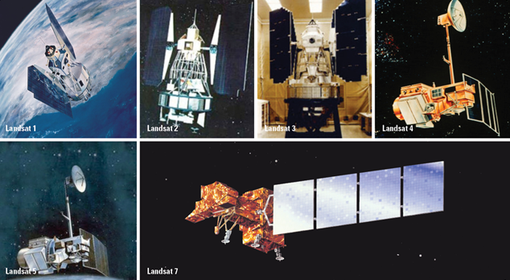
Landsat Program
Notes:
Landsat Program
Big focus on Landsat at EROS because that’s what got us started. So here’s some background on Landsat.
Landsat 1 – Launched July 1972 (We have had at least one Landsat in operation since then.)
Landsat 2 – Launched 1975
Landsat 3 – Launched 1978
Landsat 4 – Launched 1982
Landsat 5 – Launched 1984
Landsat 6 – Launched 1993 – failed to achieve orbit
Landsat 7 – Launched 1999
Landsat 5, expected lifetime 3 years, operated until November 2011 and was officially decommissioned in 2013. Landsat 5 has the Guinness World Record for longest operating Earth-observation satellite: 28 years, 10 months (officially).
Landsat 7 still operating…

Slide 16
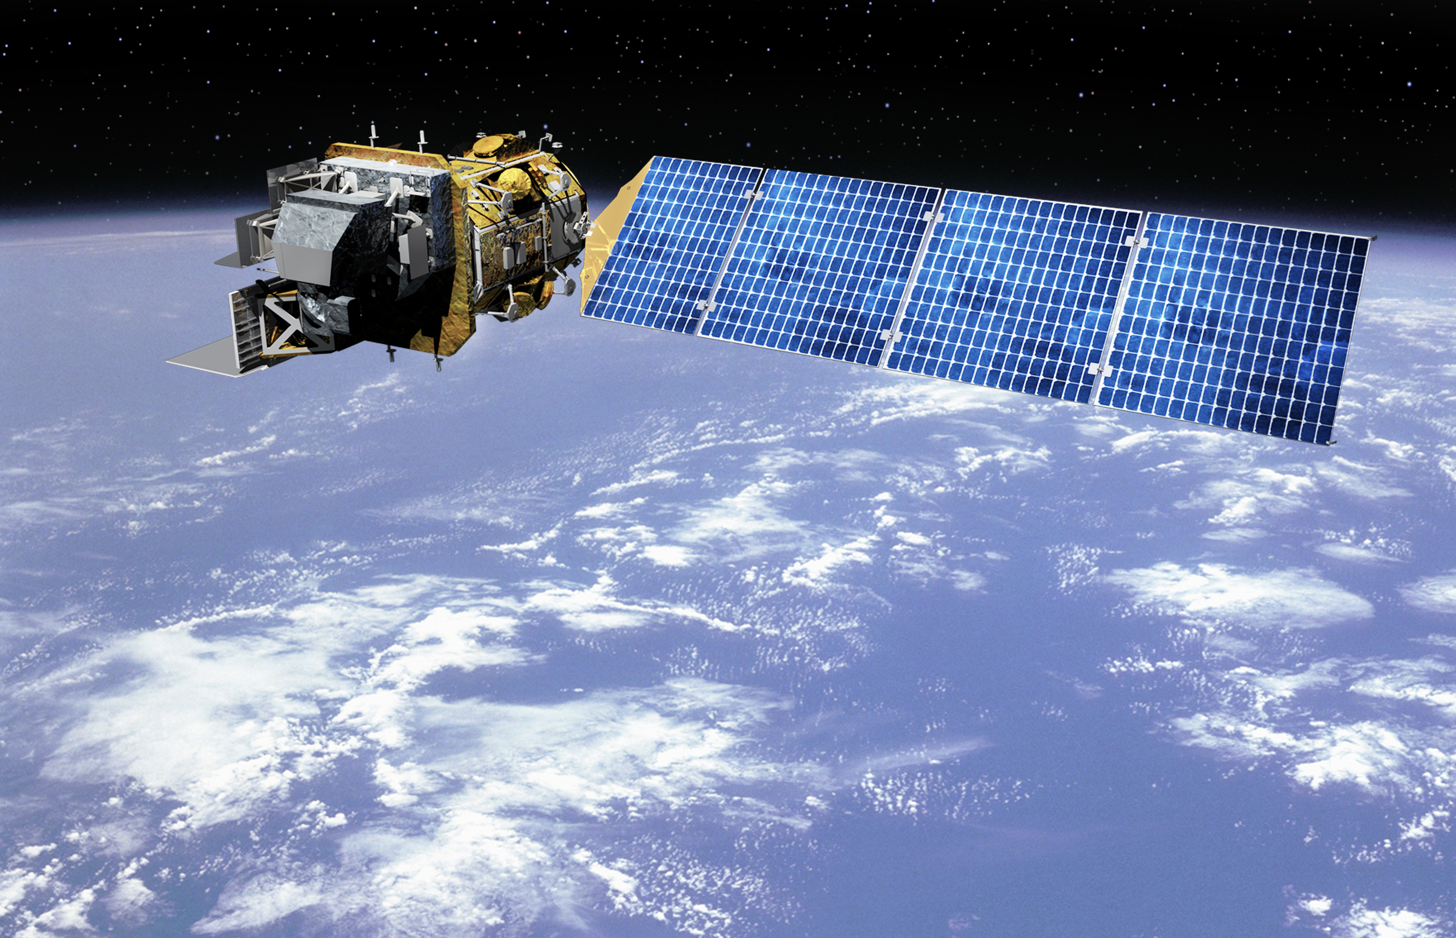
Landsat 8/9
Image courtesy of Orbital Sciences Corporation
Notes:
Landsat 8 launched on February 11, 2013.
That brings us to Landsat 9, which is a copy of Landsat 8 and launched in Sept. 2021.

Slide 17
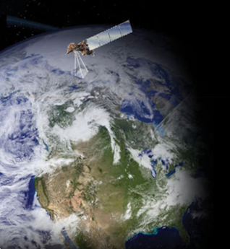
Landsat’s Orbit
Orbits at an altitude of 438 miles above the Earth
14 orbits per day (every 99 minutes)
Descending orbit from north to south
Crosses the equator between 10:00 a.m. and 10:15 a.m. local time on each pass
Orbits the Earth at 17,000 miles per hour
Total coverage of Earth’s surface occurs every 16 days
Notes:
Orbit (use basketball/globe)
At 55 mph, it would take you almost 3 weeks to go around the Earth. It takes Landsat only 99 minutes.
At 17,000 mph, it would only take you about one minute to get from here to Minneapolis.

Slide 18
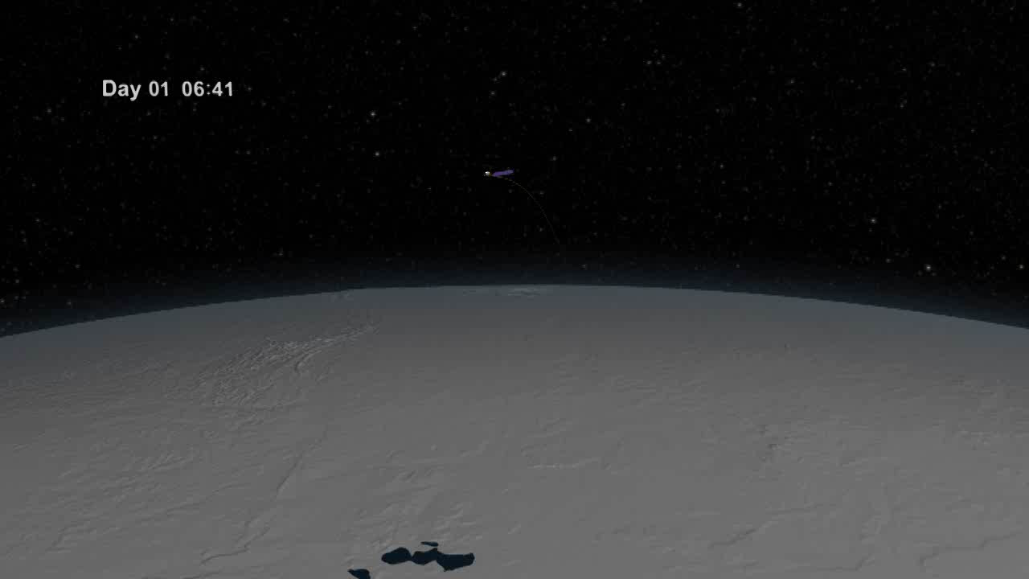

Slide 19
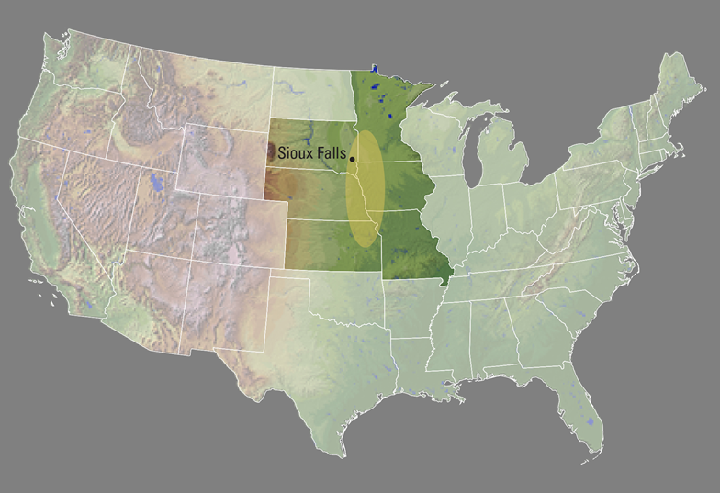
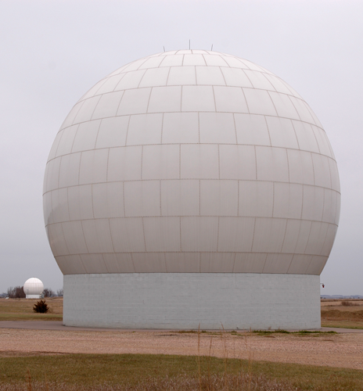
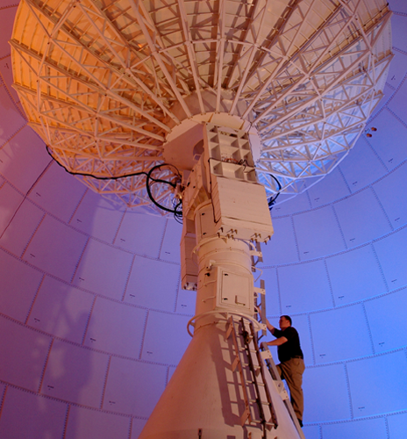
USGS EROS Center
Notes:
Sioux Falls was selected for two reasons
Technical
The receiving station for Earth-observing satellites needed to be in the middle of the continent so that when the satellite is passing over North America, we can receive the data directly.
Close to midpoint of the North American continent, east to west
We’re in a rural location to be away from tv/radio interference. The antennas out back have a clear view of the horizon.
Political
EROS could have been located anywhere in this oval, which extends across 6 different states. This is where politics comes into play.
Senator Mundt lobbied to attract high-tech jobs to SD
He also worked with business leaders in Sioux Falls to raise money to buy the land
Donated the land to the government
The building was completed and opened in 1973.
About 600 employees

Slide 20

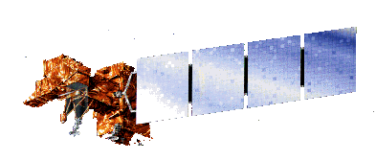
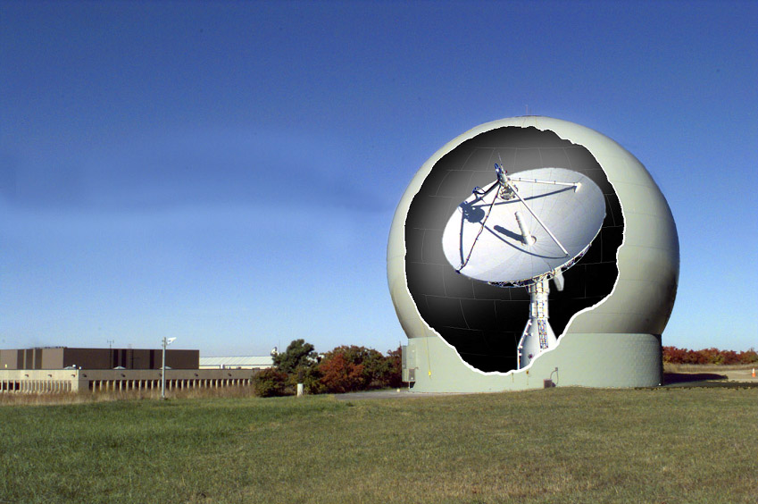
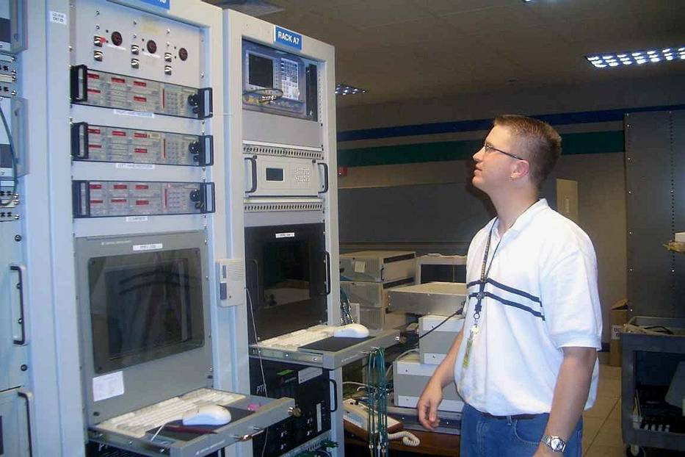

How does a satellite work?

Slide 21
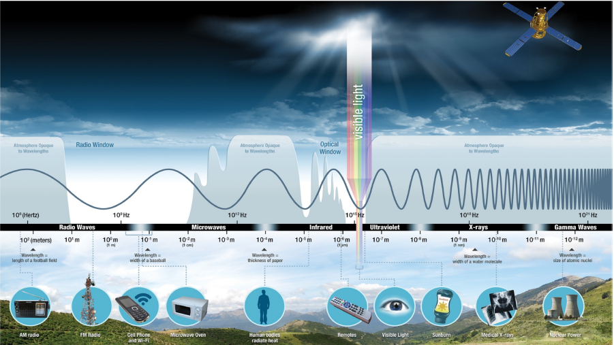
What are we measuring?
The Electromagnetic Spectrum

Slide 22
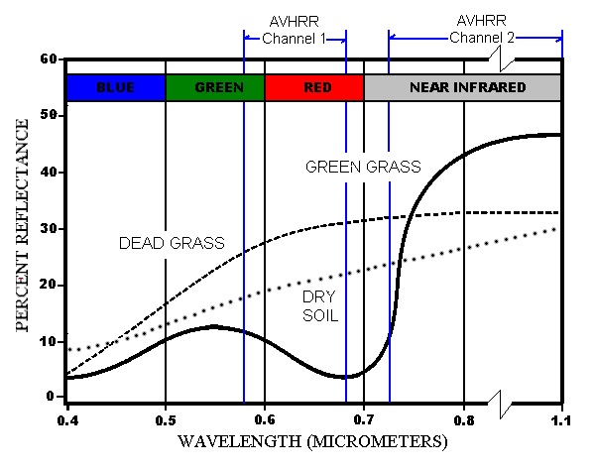
Spectral Signatures
WATER

Slide 23
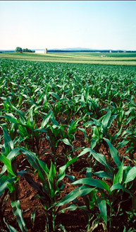
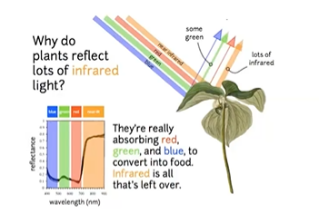
Visible and Infrared wavelengths are critical to monitoring the land surface.

Slide 24
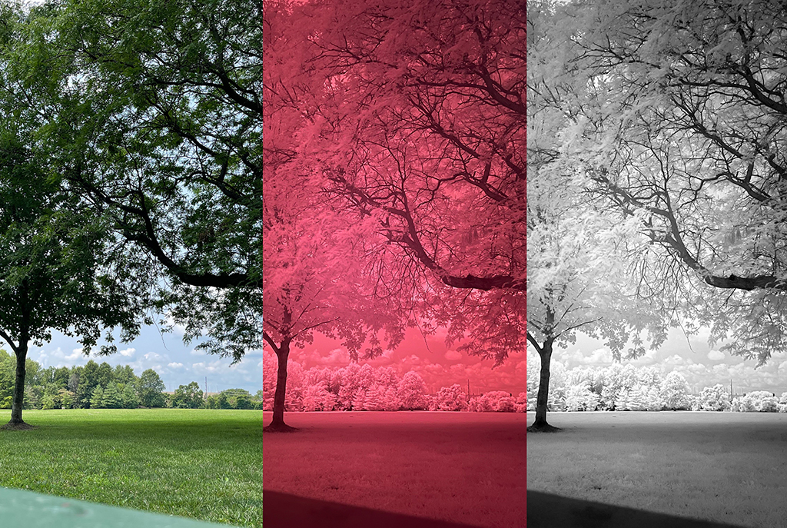
Visible and Infrared tree image
Wikipedia.org

Slide 25
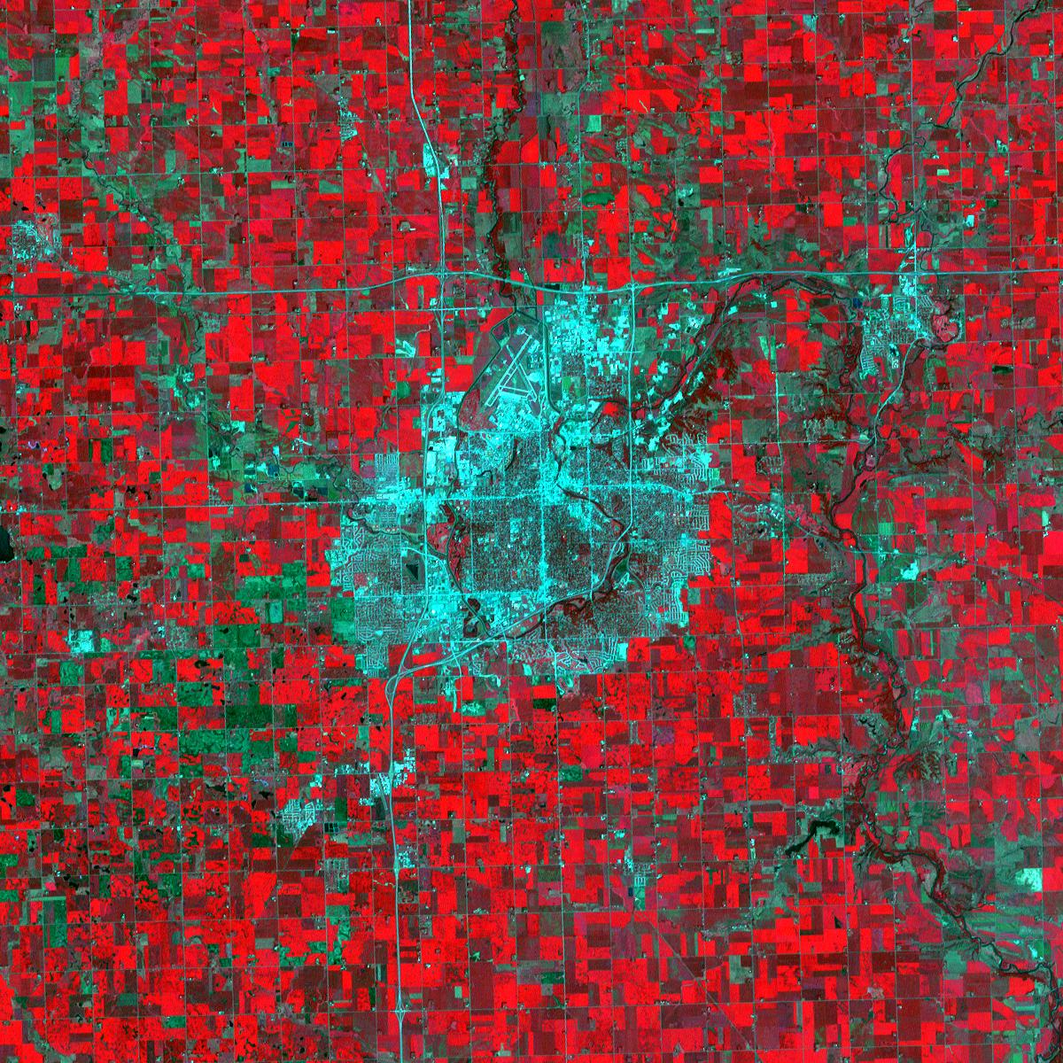
Satellite view of Sioux Falls
What are those red areas around Sioux Falls?

Slide 26
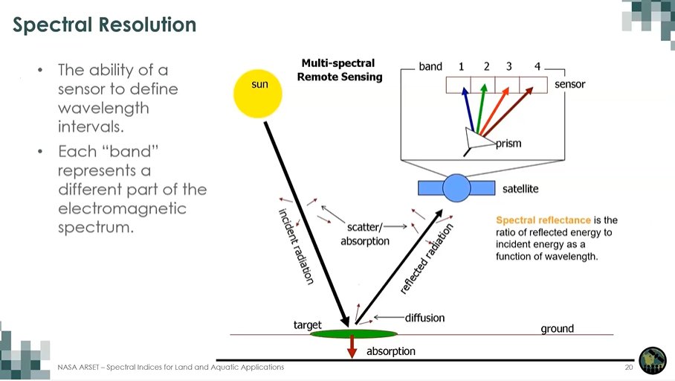

Slide 27
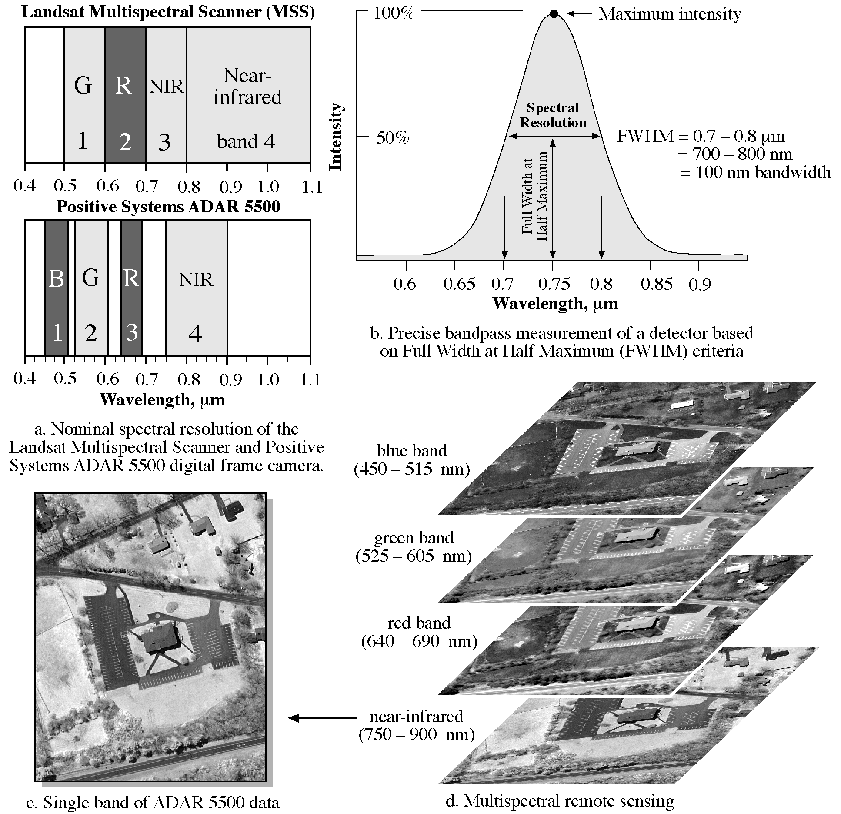
Spectral Resolution

Slide 28
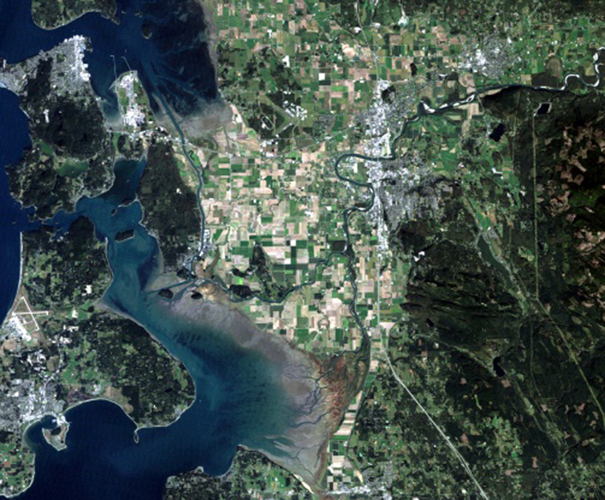
Bands 3 (red), 2 (green), 1 (blue-green)
Closest to natural color; used in urban studies and to detect sediment in water.
Notes:
Mount Vernon, WA

Slide 29
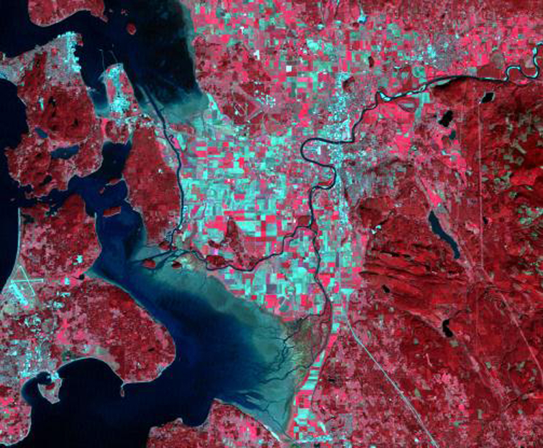
Bands 4 (near-infrared), 3 (red), 2 (green)
Commonly used to indicate vegetation, which appears red because band 4 (near-infrared) is assigned to the color red (vegetation reflects near-infrared light); urban areas = shades of light blue; soils = dark to light brown.

Slide 30
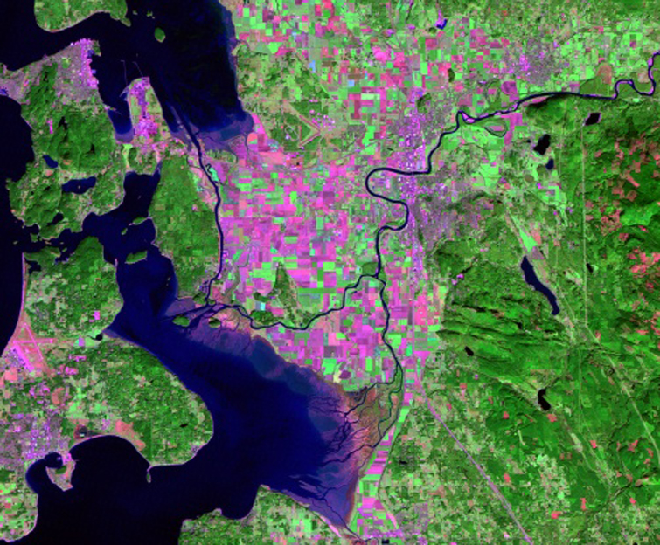
Bands 7 (mid-infrared), 4 (near-infrared), 2 (green)
Healthy vegetation = bright green; sparsely vegetated areas = oranges and browns; urban areas = varying shades of magenta; dry vegetation = orange; barren soil = pink

Slide 31
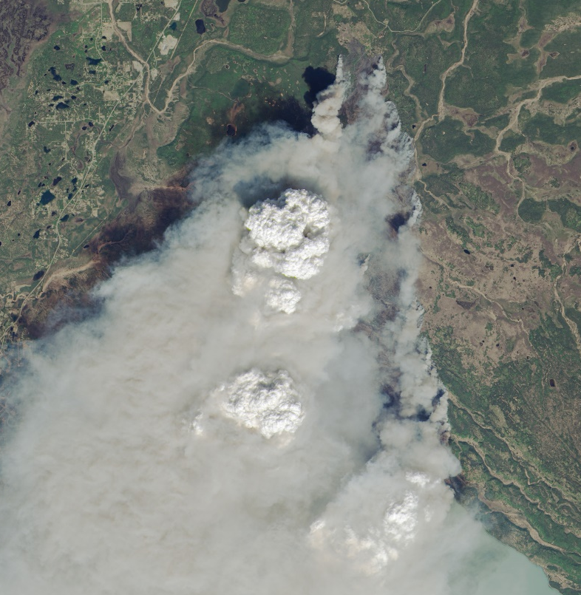
Funny River Fire, Alaska
Landsat 8, May 20, 2014

Slide 32
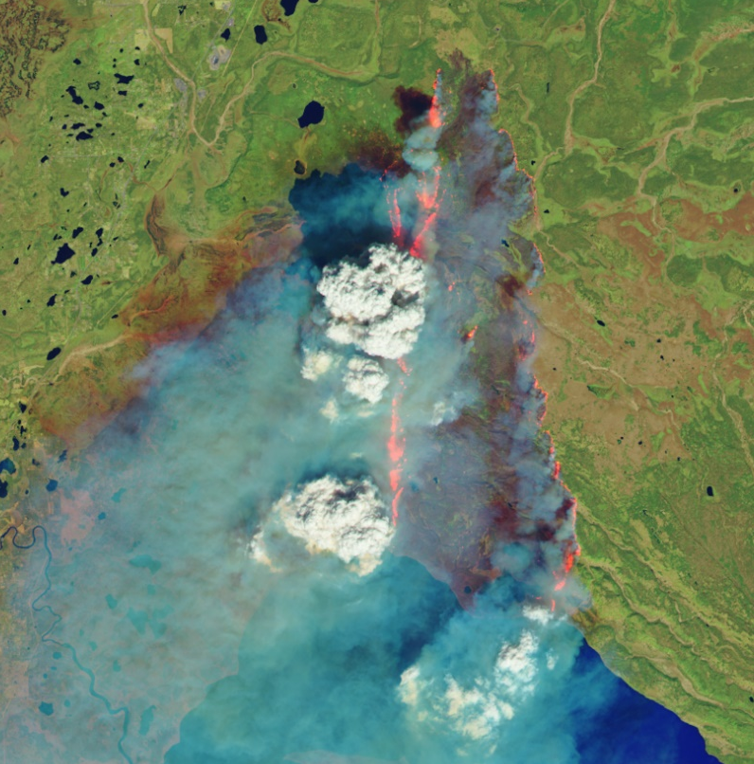
Funny River Fire, Alaska
Landsat 8, May 20, 2014
Notes:
Infrared wavelengths allow us to see through smoke from wildfires. First image is natural color; the second one uses 2 infrared wavelengths.

Slide 33
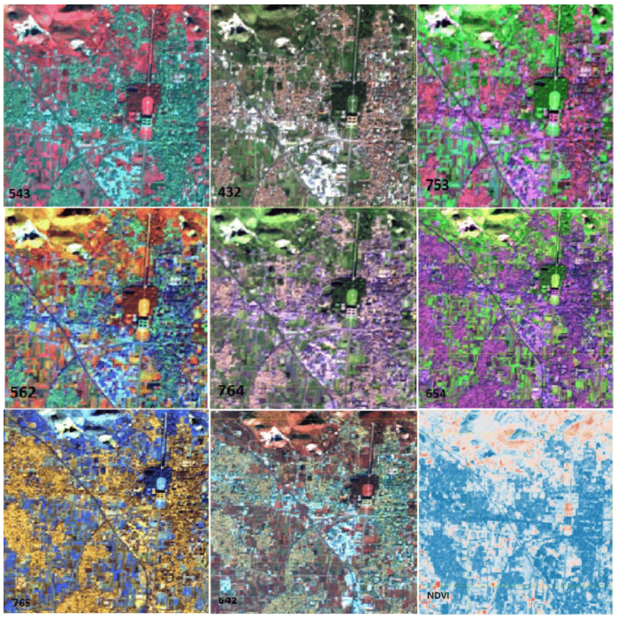
Examples of different combinations of bands
https://www.researchgate.net/publication/291969860_Combination_of_Landsat_8_and_Sentinel_1_data_for_the_characterization_of_a_site_of_interest_A_Case_Study_the_Royal_Palace_of_Caserta
543 = false colors (vegetation)
432 = true colors (natural look)
753 = geological studies
562 = vegetation and plant growth
764 = water studies
654 = agricultural studies
765 = soil studies
642 = topographical features (rocks)
NDVI = Normalized Difference Vegetation Index (vegetation health)
=> (4-3/(4+3)

Slide 34
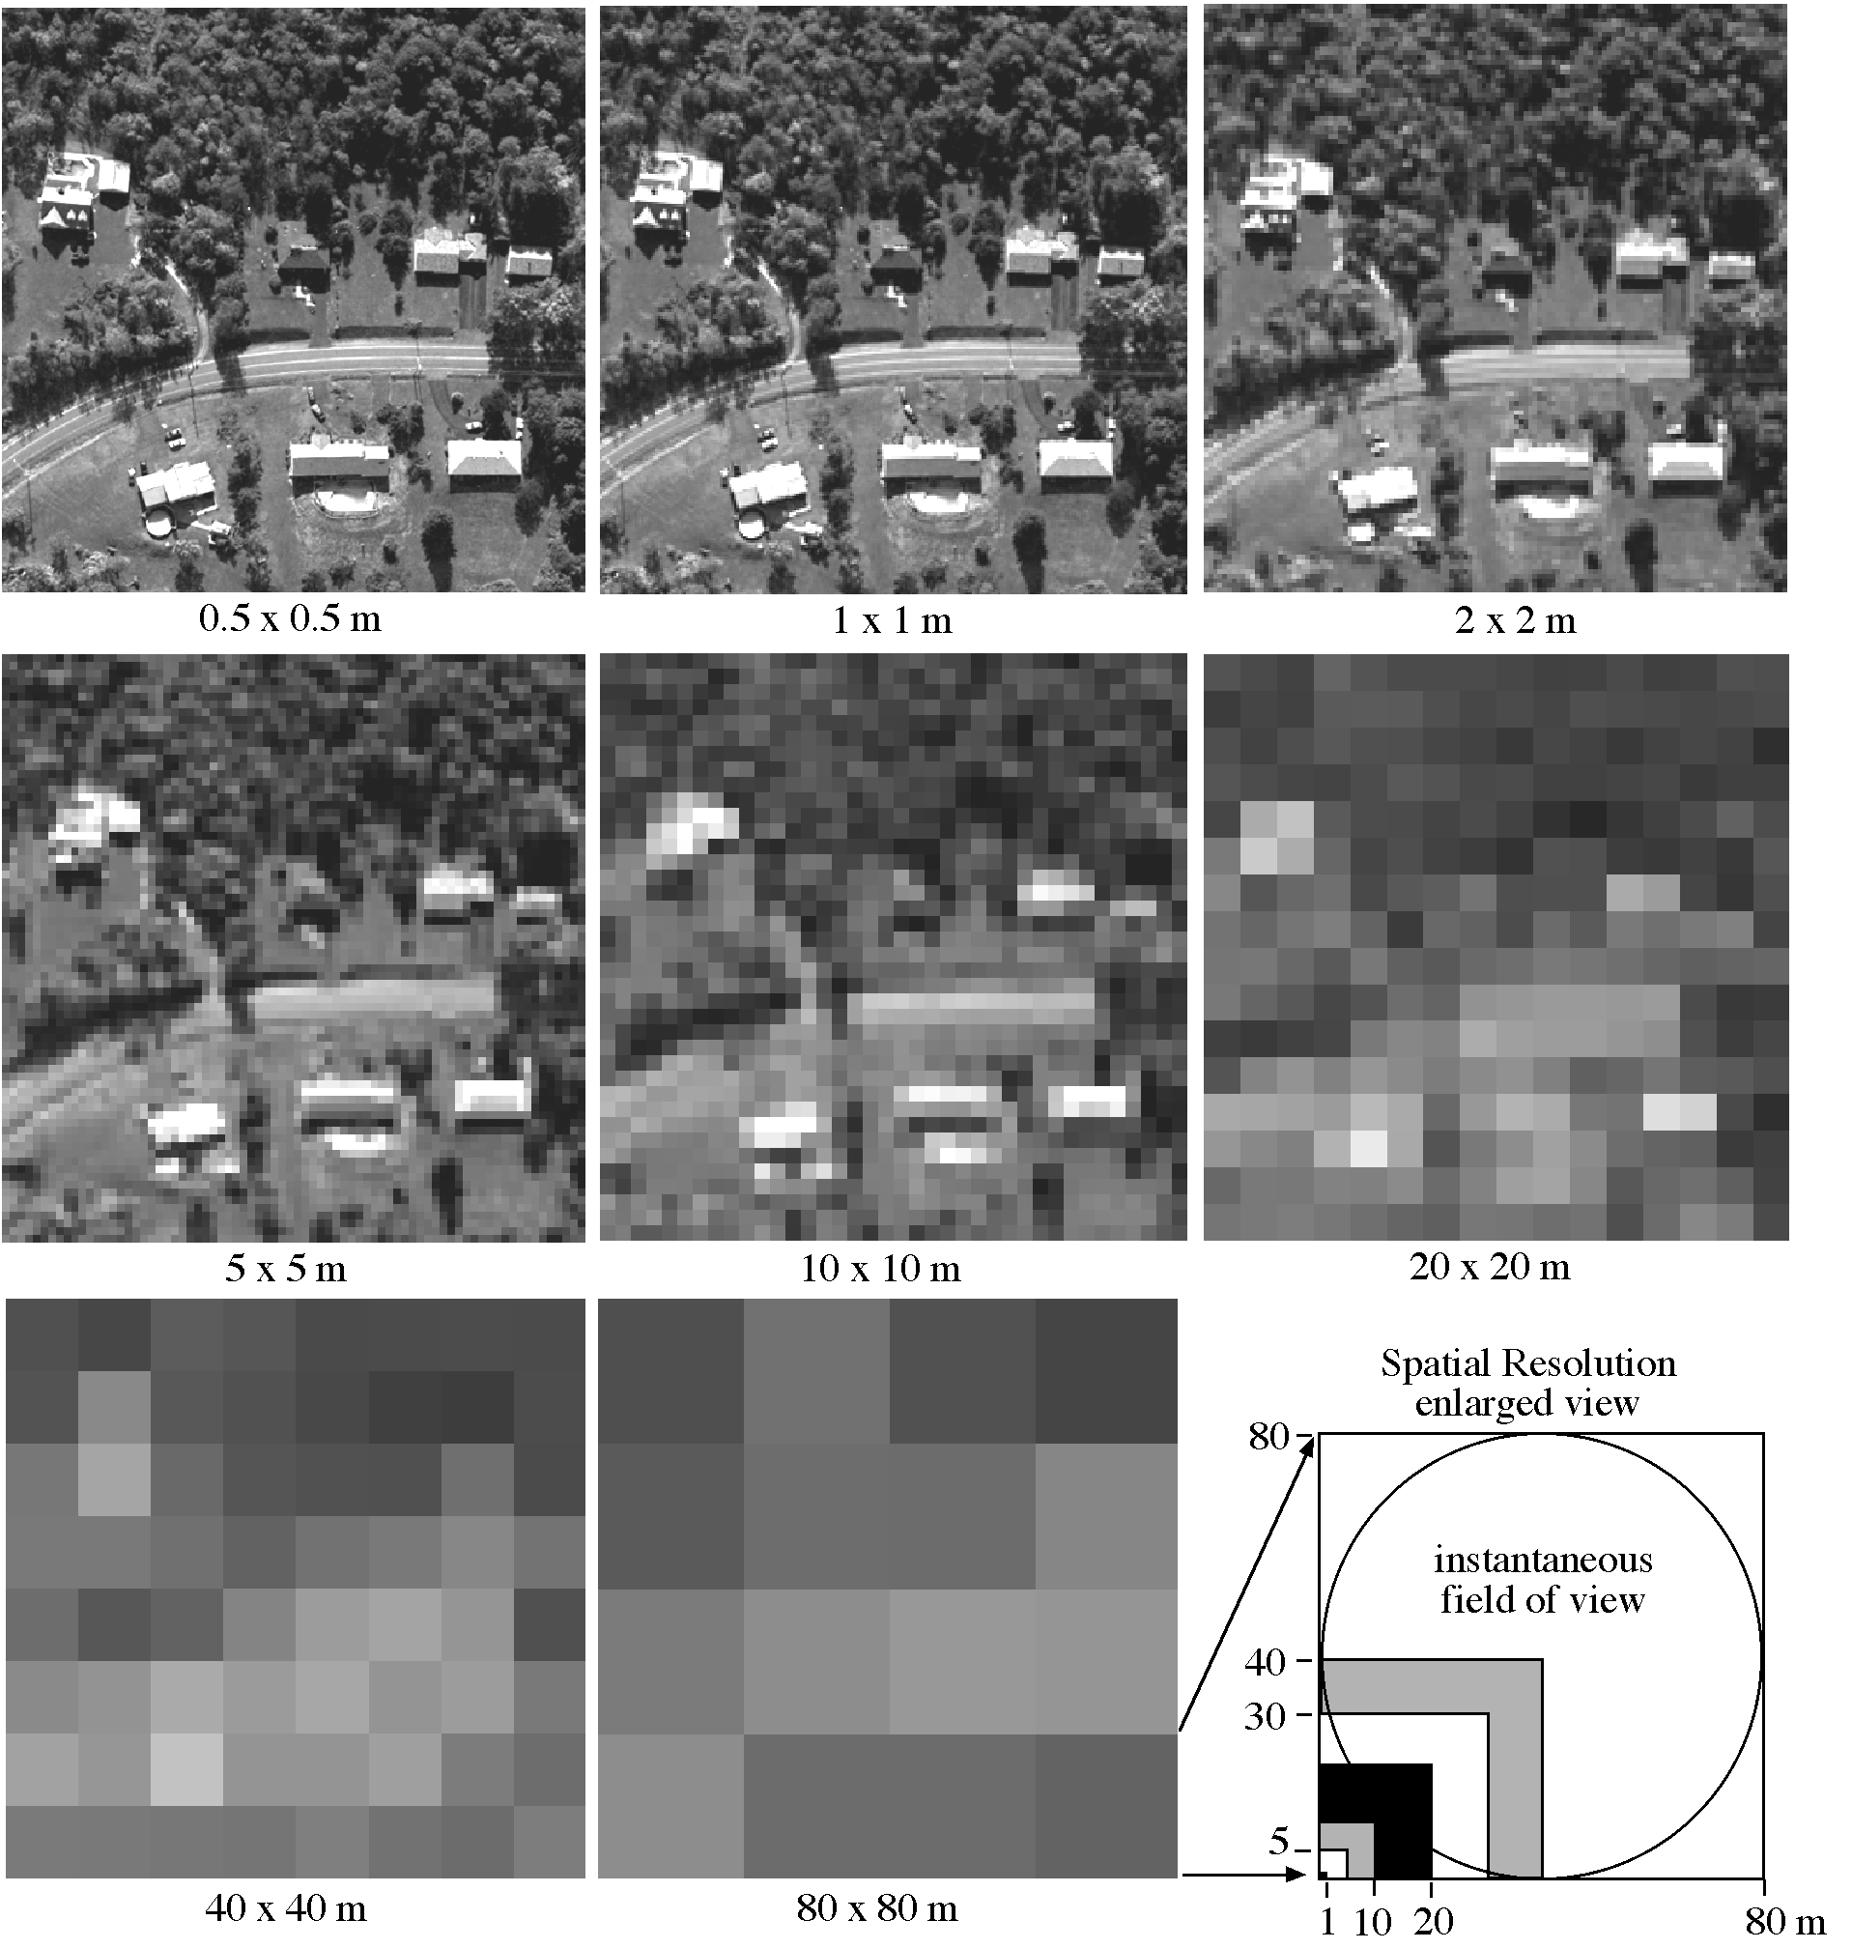
Spatial Resolution

Slide 35
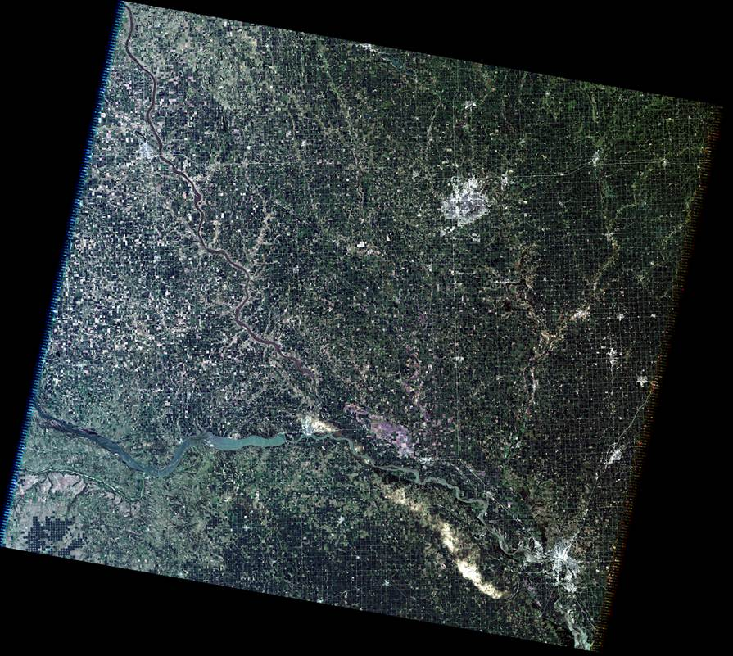
Notes:
This is the entire Landsat scene that Sioux Falls is in. (115 miles wide)
Point out Sioux Falls.
You’ll see that we cannot see individual buildings, houses in a Landsat image.
Each pixel in a Landsat image is 30 meters, or a little bigger than a baseball diamond.
So let’s zoom in on Sioux Falls and see what happens when we get really close.

Slide 37
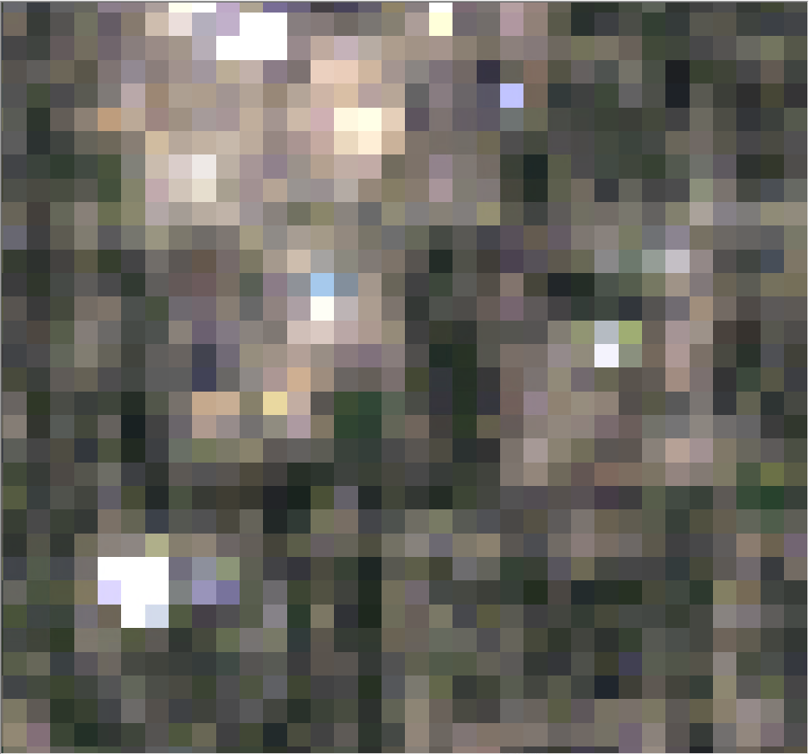
Notes:
Now we’re zoomed in so far, all we see is the pixels.
Each square here is 30 m by 30 m.
30-m resolution provides enough detail to see changes to cities, farms, forests—large areas.
When you look at Google Earth, you can zoom in and see a lot of detail, maybe even your car parked in the driveway.

Slide 38
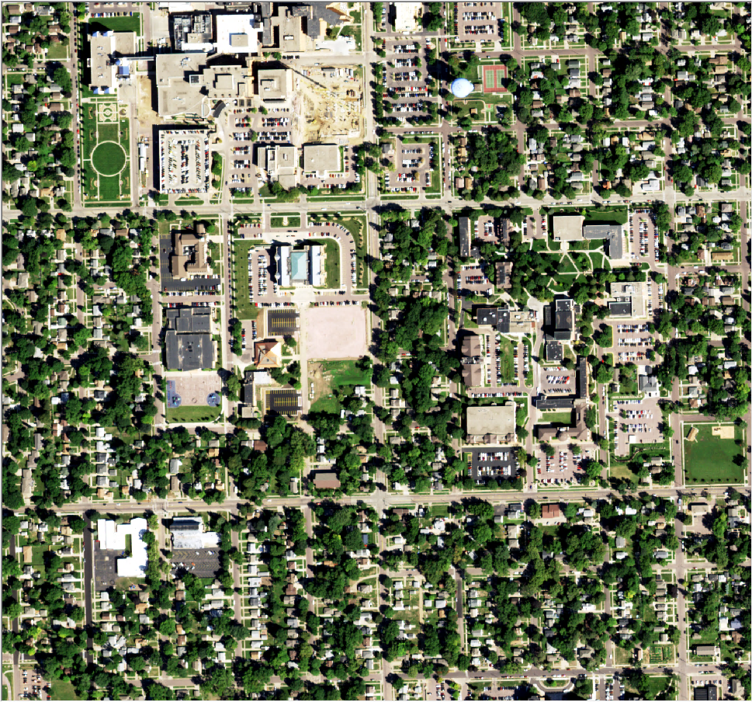
2022
Notes:
Here’s an aerial photo from NAIP (Aug 2022) of the exact same spot as the closeup Landsat pixelated image.
When zoomed in this close in Google Earth, Google uses commercial satellites that have a lot finer resolution. When looking at Google Earth and you see the entire state of South Dakota, that’s a Landsat image. When you’re this close, it’s a commercial satellite. The drawback with this hi-resolution imagery is that it doesn’t cover the entire globe. Landsat covers the entire world at 30-m resolution every 16 days. These commercial satellites cover only some areas at this high resolution.
If this was all you had for an image of Sioux Falls, it would not be as complete a picture as would be a series of 30-m images.
We also have a huge archive of older aerial photos at EROS…

Slide 39
1958
Notes:
USGS Aerial photo from 1958

Slide 40
1937
Notes:
USGS Aerial photo from 1937

Slide 41
1980 Digital Image Processing System
Notes:
Before showing this photo, show the old media.
High Density Digital Tape (HDDT): This held 2 gigabytes of data. Today we use these tape cartridges to archive the data, and this can hold 8 terabytes. The data from about 4,000 of these reels could fit on one of these tapes.
Just as proof that we used to use stuff like this…

Slide 42
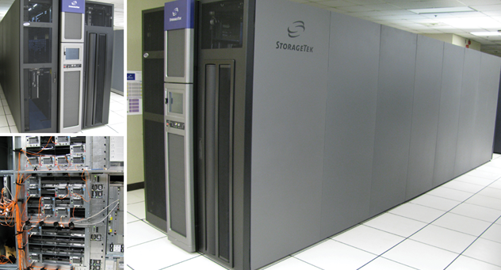
Data Archiving
Notes:
This mass storage system holds thousands of these tapes…

Slide 43
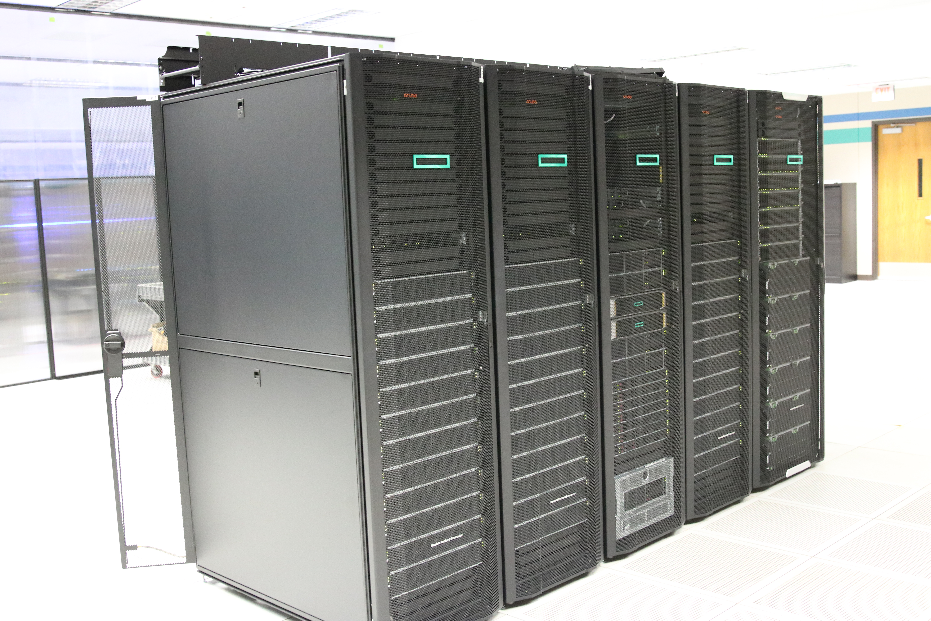
Data Processing
Notes:
This a high-performance computer called Hovenweep. Just installed this summer.

Slide 44



What to do with the Remote Sensing images?
Research and Analyze
Use different types of images to create a new image with different information
Notes:
Now that we know what satellite images measure and where they are stored, I would like to talk some more about the next 3 steps of our work.
First is analyzing, which begs the question: What to do with all those images we have stored?
We analyze them to answer questions like
How is the crop health in midseason in Kenya? Or How much irrigation of corn is needed to get the most yield/acre?
We take different images/bands and come up with models or calculations to create something new out of it to discover a new pattern, like increasing
Temperature, declining forest, etc. or find an anomaly, Why did Lake Chad nearly disappear in the country of Chad in West Africa

Slide 45
Researchers ask questions….
Where is water being used?
How much water is being used?
Which type of crops are using
more or less water?
Who is using the water?
Can water be used more
efficiently without impacting crop yield?
Notes:
As scientists or researchers, we are supposed to ask questions and be curious about the world.
We ask a lot of questions about water and crops.

Slide 46
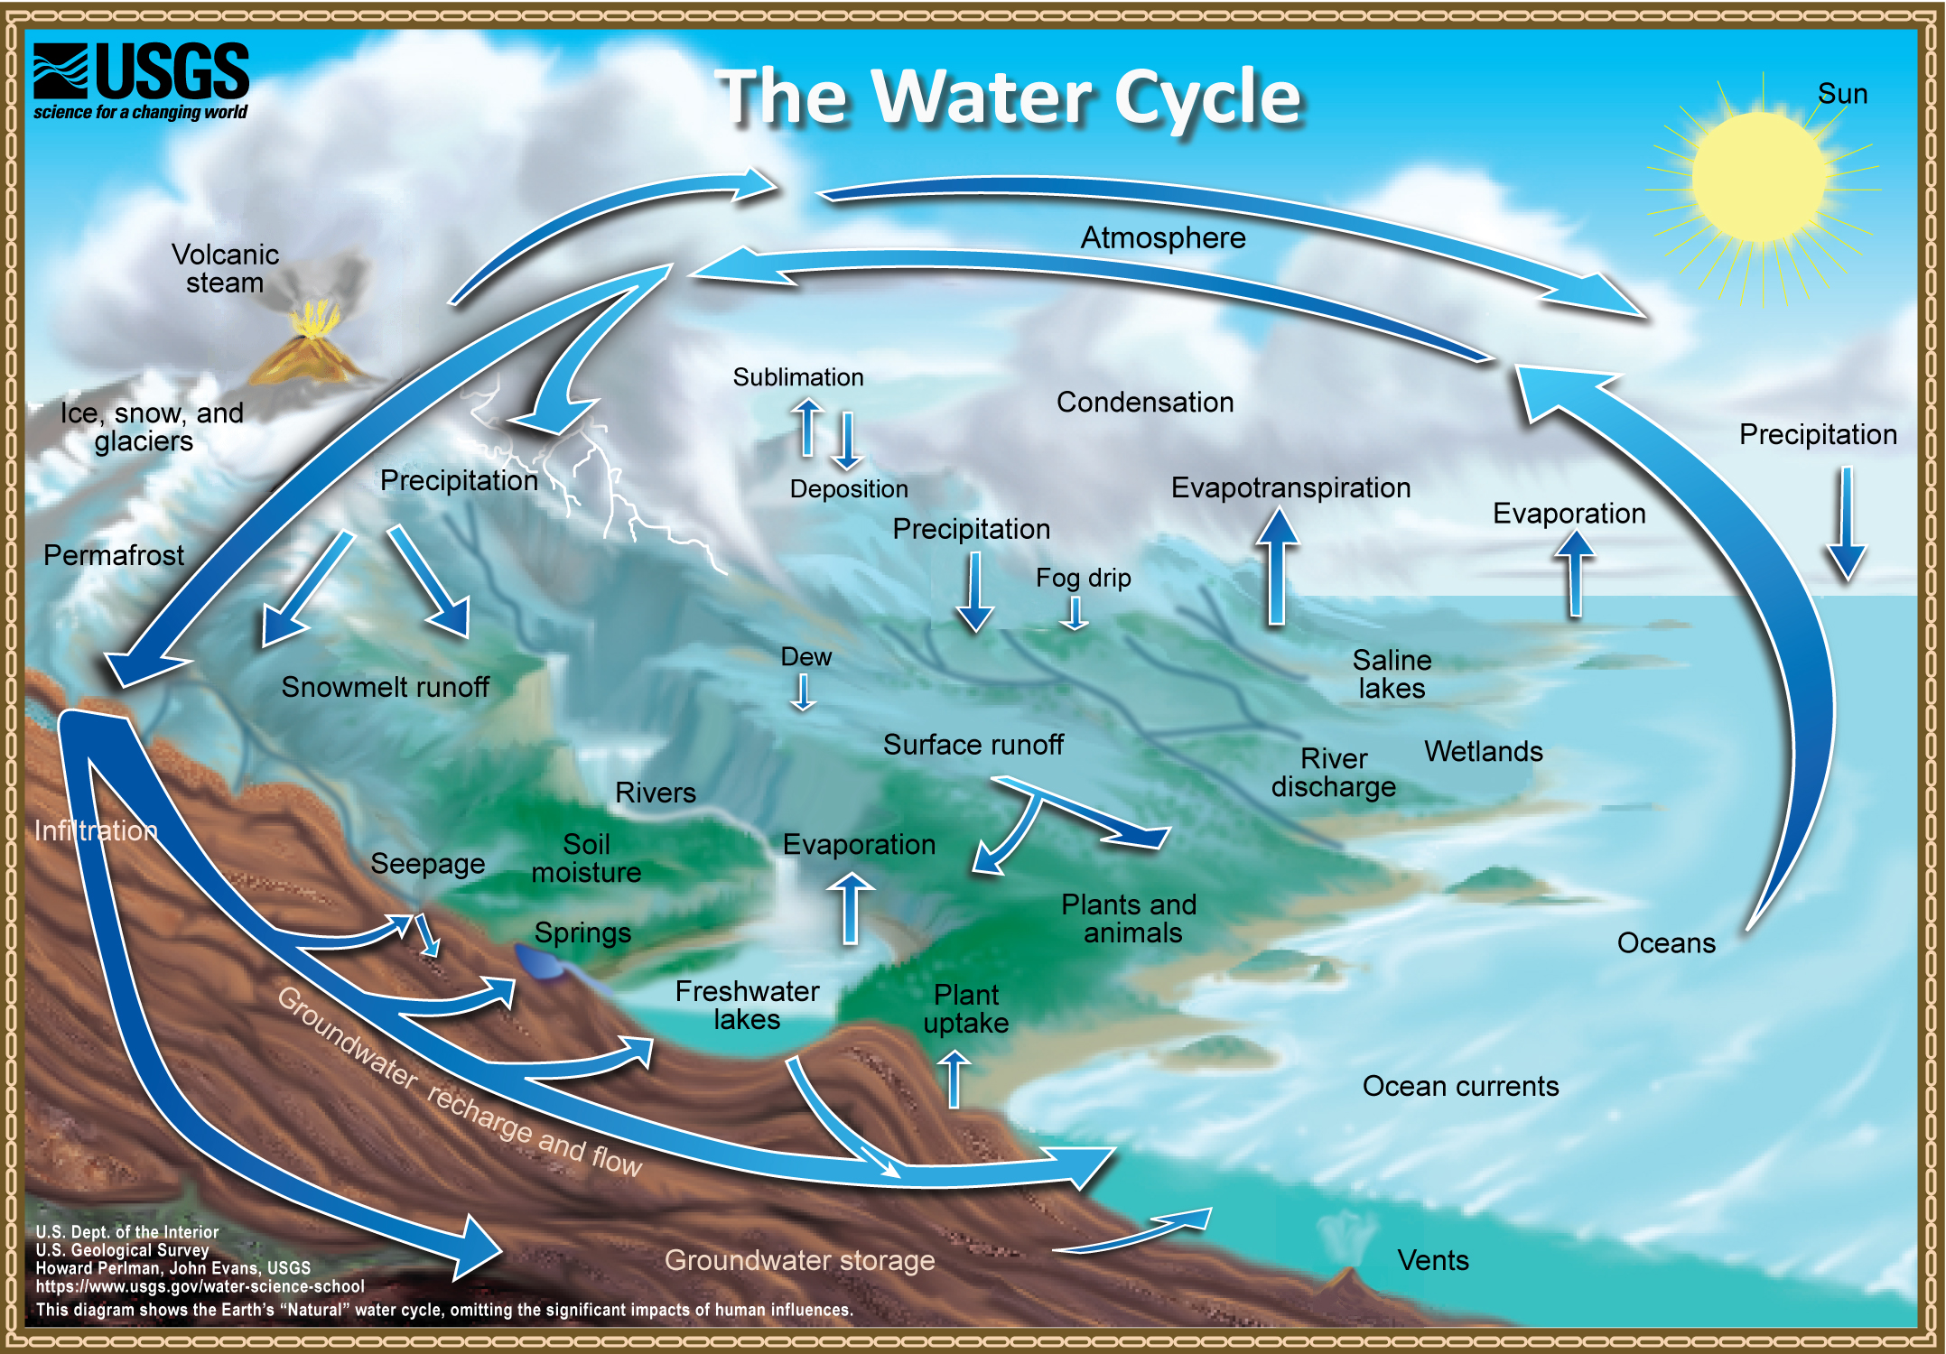
Water Cycle
Notes:
As it moves, water can change form between liquid, solid, and gas. Circulation mixes water in the oceans and transports water vapor in the atmosphere. Water moves between the atmosphere and the surface through evapotranspiration, and precipitation. Water moves across the surface through snowmelt, runoff, and streamflow. Water moves into the ground through infiltration and groundwater recharge. Underground, groundwater flows within aquifers. Groundwater can return to the surface through natural discharge into rivers, the ocean, and from springs.
Water moves naturally and because of human actions. Energy from the sun and the force of gravity drive the continual movement of water between pools. The sun’s energy causes liquid water to evaporate into water vapor. Evapotranspiration is the main way water moves into the atmosphere from the land surface and oceans. Gravity causes water to flow downward on land. It causes rain, snow, and hail to fall from clouds.

Slide 47
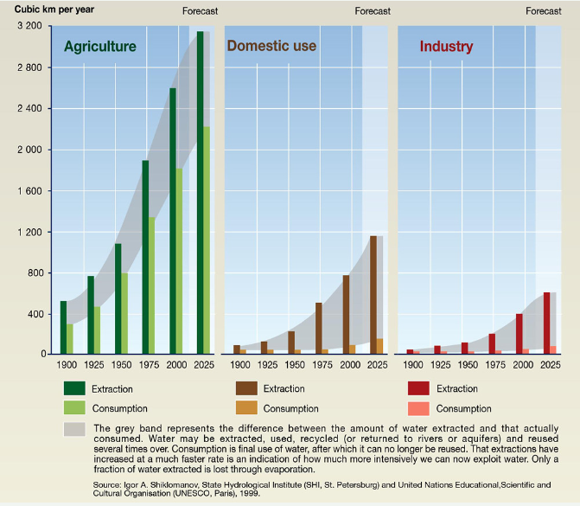
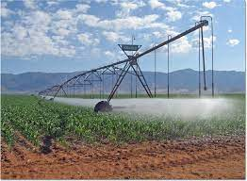
Why is ET important?
ET connects the soil-plant-atmosphere system and the hydrologic cycle through the transfer of mass and energy.
Agriculture is the main user of water by extraction and consumption → Water use for crop can be estimated using ET
ET provides crucial information for monitoring and assessing the extent and severity of drought in both rainfed and irrigated systems

Slide 48
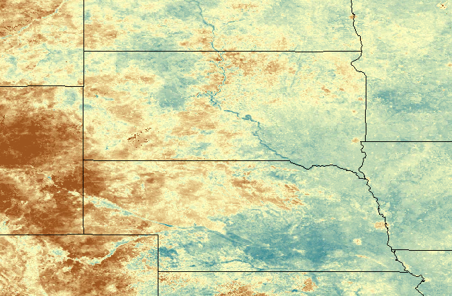
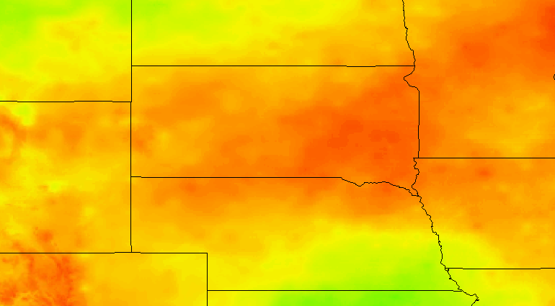
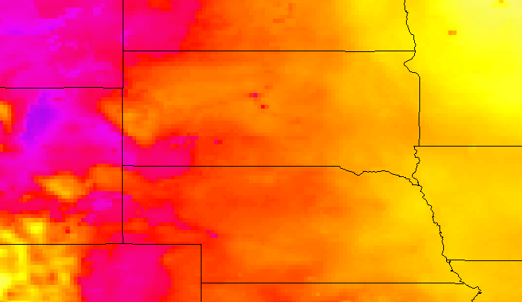
From Solar Radiation to EvapoTranspiration
Actual EvapoTranspiration
Land Surface Temperature
Solar radiation => energy
MODEL

Slide 49
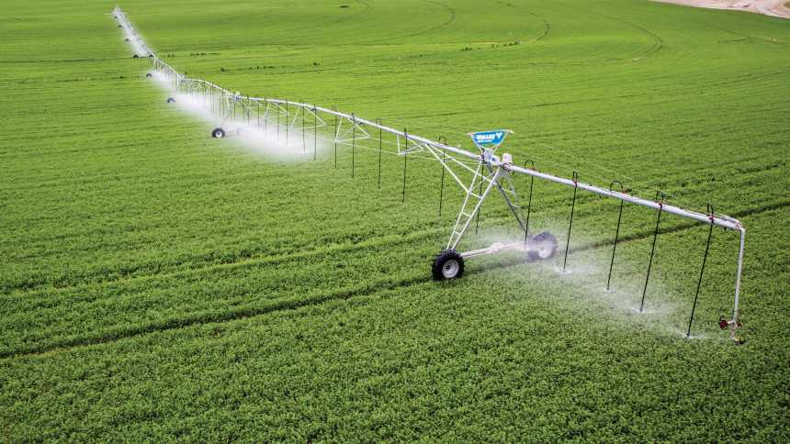
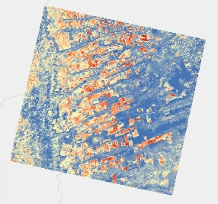
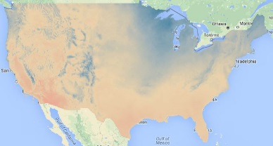
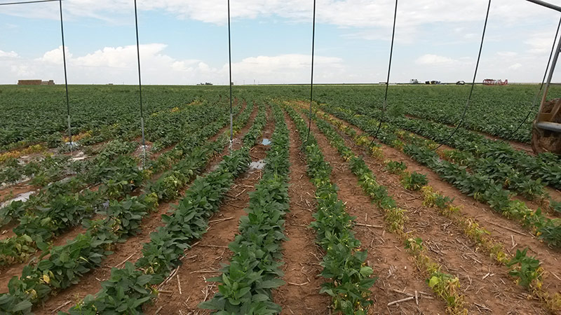



SSEBop Model – Simplified Surface Energy Balance
Land Surface Temperature
ET = Max
Weather Data
Radiation, Temp, Wind, RH, Pressure
300 K
Air Temperature
ET = moderate
ET_{fraction}
multiplied
310 K
Reference ET
ET = small
320 K
Actual Evapotranspiration (ET) in mm
Notes:
Land surface temperature differences are used to measure landscape water use rates through the effect of evaporative cooling.

Slide 50


30 m x 30 m pixels

Slide 51
Results, results, results
Visualizing
Making of a map

Slide 52






This is what Earth really looks like like…
Global political Map
National thematic map
Regional physical Map
The first picture of the Earth taken from the moon by the Apollo 8 crew in 1968 (NASA)
Local road map

Slide 53
History of maps
2300 BCE First city map created in stone for Lagash, Mesopotamia
610 BCE First world map created by Anaximander
206 BCE Invention of the compass by Chinese Scientists
190 BCE maps using Latitude and Longitude (Hipparchus)
253 Oldest preserved map of Europe (part of it)
1154 Al-Idrisi world map out of silver completed
1450 First circular world map of Europe, Asia and Africa
1904 First Rand McNally road map published of New York City
1989 First GPS satellite launched
From book: Interpreting out World (Joseph Kerski)

Slide 54

How to make a map….
Before you start:
think of the story that your map should tell
→ Raw data is usually
hard to interpret and
not meaningful
visualizing your data

Slide 55

Pre-process your data if needed → Most maps are oriented with north at the top.
Changing the orientation makes this area more recognizable

Slide 56

Color determines what we see.
What does the brown-green gradient tell you?
What could this map show?

Slide 57


Cool-warm colormap
is often associated
with air temperature.
But is it sufficient to have only 4 classes?

Slide 58

Select categories that allow
to spot patterns
and interpret data more easily

Slide 59

ADD LABELS

Slide 60

Elements of a map
MAP TITLE
NORTH ARROW
COUNTRY BOUNDARIES
LEGEND
SCALE BAR

Slide 61
Acting on the Findings
Maps and the information they provide
are invaluable to us:
Everyday life – road maps
Scientist who studies weather –weather maps
City planner decides where to put hospitals and parks
government makes policies regarding the environment, etc.
Business decides where to put the next profitable store

Slide 62






Maps used to make decisions:
Soil Moisture
Rainfall
EvapoTranspiration
Vegetation Health

Slide 63



Convergence of Evidence
Rainfall
Evapotranspiration
NDVI
Notes:
ET anomaly is the ET that happened divided by a 15 year average to see were there are areas of below or above what is considered normal. Orange is below normal and green is above normal conditions.

Slide 64


Annual ET Anomaly for South Dakota

Slide 65

From Maps to Food Security decisions
https://fews.net

Slide 66


Slide 67
Crop Water Use
represents soil evaporation and the water used by a crop for growth and cooling purposes. This water is extracted from the soil root zone by the root system, which represents transpiration and is no longer available as stored water in the soil.
EvapoTranspiration
https://crops.extension.iastate.edu/encyclopedia/crop-water-use-or-evapotranspiration#:~:text=Crop%20water%20use%2C%20also%20known,stored%20water%20in%20the%20soil.

Slide 68



Crop Water requirement
Each crop has a determined water requirement value.
Notes:
Crop water requirement refers to the amount of water that is used by a crop to meet the environmental demands of evapotranspiration

Slide 69


With irrigation the demand of a crop can be met, if precipitation alone is not enough to provide

Slide 70










Monthly Landsat ET for Farmington, New Mexico

Slide 71

Water footprint
Amount of fresh water that any given process or activity uses
Blue Water Footprint: The amount of surface water and groundwater required (evaporated or used directly) to produce an item. For food, this refers mainly to crop irrigation.
Green Water Footprint: The amount of rainwater required (evaporated or used directly) to make an item. For food, this refers to dry farming where crops receive only rainwater.
Grey Water Footprint: The amount of fresh water required to dilute pollutants and make water pure enough to meet EPA water quality standards. For food, the water would have become polluted from agricultural runoff or leaching from the soil.

Slide 72








How much water does it take to produce…
https://www.waterfootprint.org/resources/interactive-tools/product-gallery/
Notes:
On average, one large banana (200 gram) costs 160 litres of water.

Slide 73

Acting on results….
What do you think could be done about food insecurity?

Slide 74



Reduce Food Waste & Food Loss
Break the Cycle of Conflict and Hunger – stop fighting
Increase Sustainability and Build Resilience to Climate Change
Address Poverty & Inequality Through Social Safety Nets – Food pantries, SNAP, improve income
Help Rural Farmers Connect to Markets
Eliminate Malnutrition in Mothers & Children

Slide 75
Summary
EROS is providing remote sensing data to the public
Projects at EROS are using remotely sensed data to answer questions about different problem including food insecurity, drought, fire and land cover change
ET is an important variable to determine crop water use and help predict food insecurity
Maps are invaluable to understand the world around us and are great tool in solving this world’s problems

Slide 76
Visiting EROS
Hours: 8:00 a.m. to 4:00 p.m. Monday through Friday
Tours:
  Guided Tours: 10:00 a.m. and 2:00 p.m.
  Self-guided Tours: 8:00 a.m. to 4:00 p.m.
EROS website: https://www.usgs.gov/centers/eros
Instagram: usgs_eros
Twitter: @USGS_EROS
Eyes on Earth podcast: https://www.usgs.gov/centers/eros/eyes-earth

Slide 77

Thank you

