Slide 1
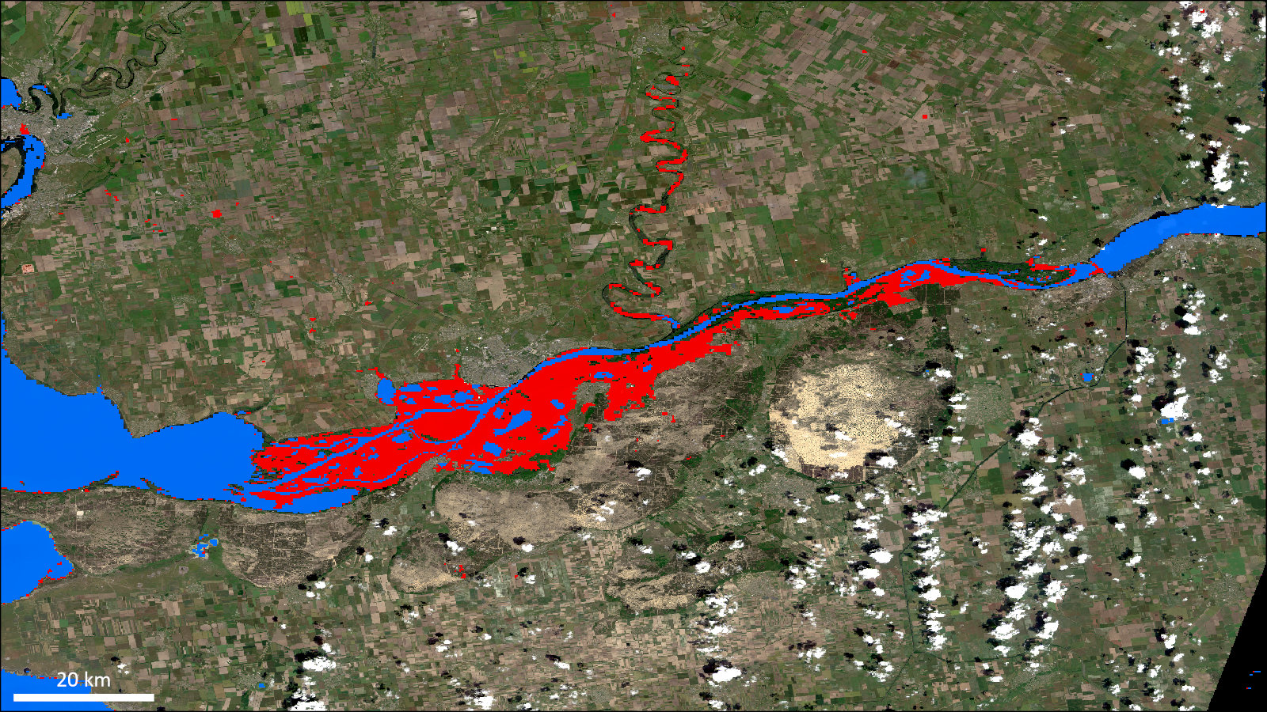
LANCE Flood Product: Archive Discussion
LANCE UWG 29 Nov 2023
Dan Slayback
(dan.slayback@nasa.gov)
NASA GSFC, SSAI

Slide 2
NRT Flood Product Archive: Background
Not a science product, so no automatic path for archiving and distribution via DAAC.
➔ Thus this discussion.
Historical events are important for understanding context of current flood events.
NRT applications: Is this flood unusual? What areas are at risk based on previous events? Is this an extreme event or a normal seasonal flood?
Scientific applications: Studies of local and global change in surface water, flooding, and associated impacts. Flood model training and validation.
Policy, government, industry (insurance) applications: Understanding and mapping flood risk.
Legacy product archive was available via web interface (2012-2021) until server retired in 2021.
GIBS/Worldview provides a visual archive of product from early 2022, but users are unable to access the corresponding product files, beyond those still live on nrt servers.
Typically receive ~1 request/week for archive data.
Typical request is for the product over several years (or all available), for a set of tiles.
Currently manually fulfilling requests, as able, from an unofficial NRT archive (can be labor intensive).

Slide 3
NRT Flood Product Archive: Proposal
Establish archive storage location and web interface.
Likely use LAADS archive storage and distribution channels (not DAAC).
Enter products in CMR/Earthdata search.
Forward processing: Copy NRT HDF products to archive storage.
Historical:
We plan to reprocess archive to update reference water mask (to begin shortly).
Ideally process full archive back to Aqua start (~June 2002), or at least 10 years.
Products can then be stored in the archive for public access.
Future reprocessing would only occur if strong justification and concurrence by ESDIS/MODAPS management.

Slide 4
NRT Flood Product Archive: Discussion
End-user uses & statements:
Bob Brakenridge:
“Mapping extents and impacts of flood events in near-real time is of utmost importance for first responders, whereas long term observations are instrumental for policymakers, government agencies, and insurance companies for quantifying flood risks.”
“…scientists rely on flood information - by using flooded area as a metric - to calibrate prediction models to assess model performance for future risk assessment and management.”
“There is no competing water surface area product. “
“The long term record is essential: extreme events cannot otherwise be mapped or otherwise distinguished from normal, though extensive, seasonal flooding.”
Training flood models in NASA Disasters funded Model of Models flood framework (Maggie Glasscoe et al)
“… having an additional 10 years would be invaluable so that we are able to test more scenarios.” Matthew Pressier, NASA FINNEST Fellow, UT Austin. (Modeling flood extent and depth).
UK Centre for Ecology & Hydrology: Use historical flooding in model of disease risk (India).
Morningstar: developing climate risk guidelines for governments and financial institutions (global).
Discussion:
Flood product is only an applications product, and not a science product: can we/should we do this?
Resources:
Use existing LAADS infrastructure for storage and distribution.
Data volumes not problematic: ~1 TB / year
Possibly as a temporary solution while pursuing adoption as a regular science product?

