Slide 1
Hurricane tracks data visualization
Data Source: International Best Track Archive for Climate Stewardship (IBTrACS) Project, Version 4. NOAA National Centers for Environmental Information.

Slide 2
Overview
Hurricane track data were downloaded from the following website: https://www.ncdc.noaa.gov/ibtracs/index.php?name=ib-v4-access
Product selected: IBTrACS.since1980.list.v04r00.lines (since 1980 - the modern era of satellite observations)
Storm tracks were buffered by 50 miles buffer on each side
To show coastlines in greater detail, only regional maps were created (Asia, Latin America and the Caribbean, and Africa-Middle East) (no global products)

Slide 3
Hurricane frequency (1981-2021)
The first set of maps shows frequency (number of years) of exposure to hurricanes
These maps were based on annual hurricane occurrence (all events from every individual year were aggregated into one annual raster, and the frequency was computed as a sum of annual rasters)
Category of hurricanes (their severity) or a number of events in a single year were not considered for this product

Slide 4
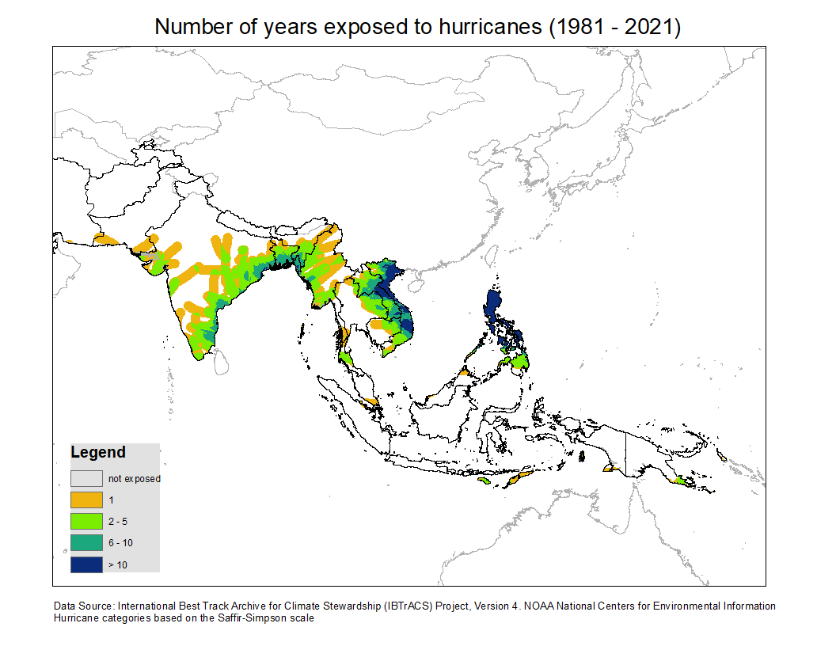

Slide 5
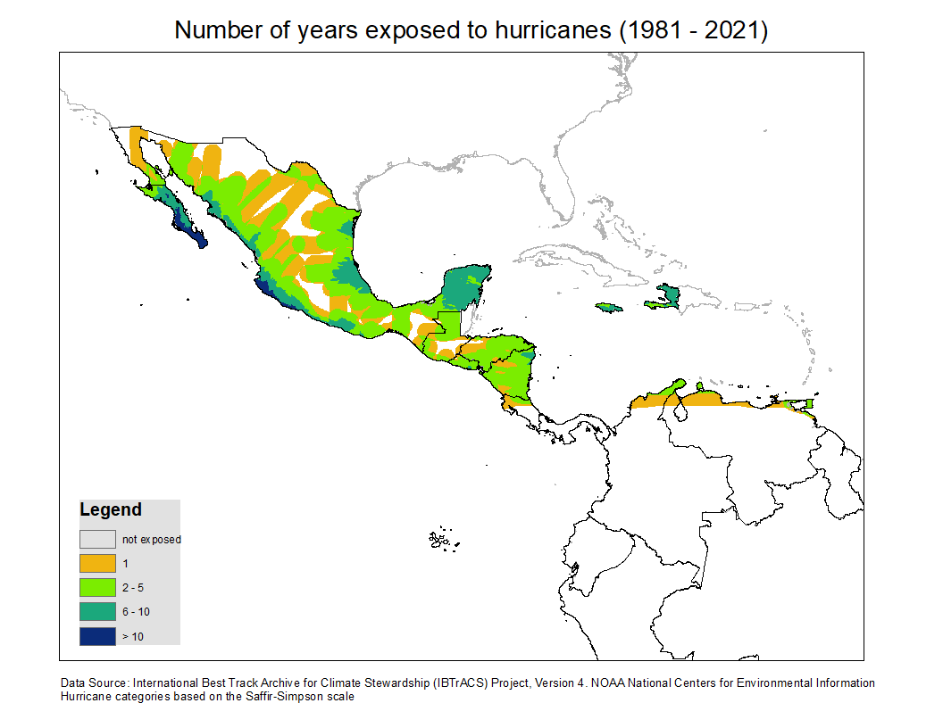

Slide 6
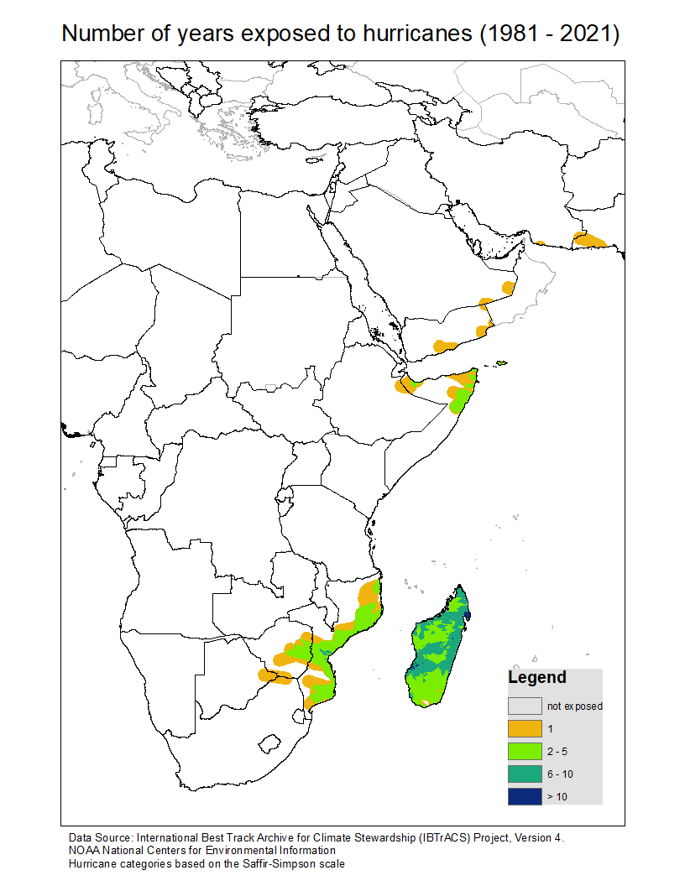

Slide 7
Maximum hurricane category (1981 – 2021)
The following maps show the maximum hurricane severity that the areas were exposed to
Note that one hurricane track is often split into smaller line segments, and they can have different severity in different places
Categories were based on the Saffir-Simpson scale:
0 = Tropical storm [34<W<64]
1 = Category 1 [64<=W<83]
2 = Category 2 [83<=W<96]
3 = Category 3 [96<=W<113]
4 = Category 4 [113<=W<137]
5 = Category 5 [W >= 137]

Slide 8
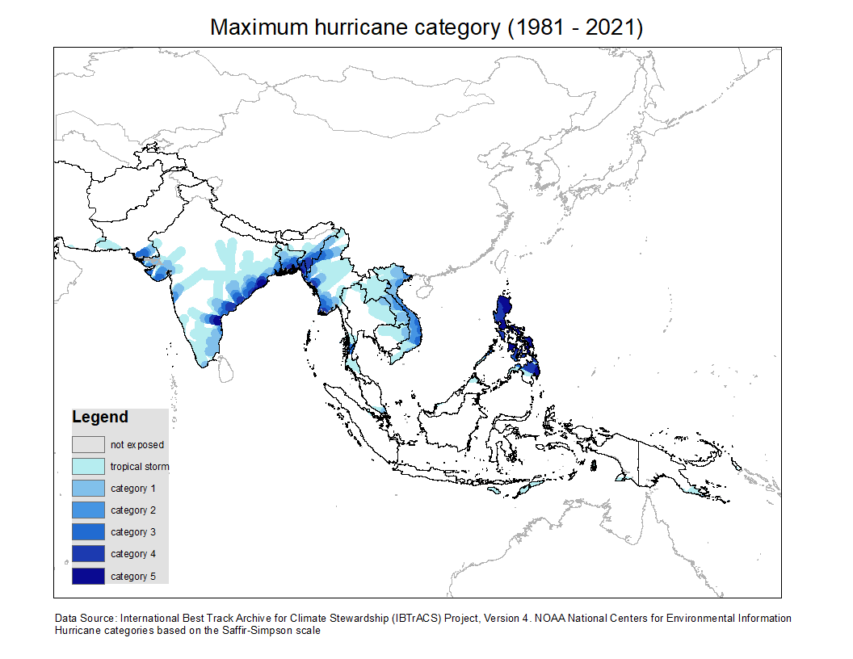

Slide 9
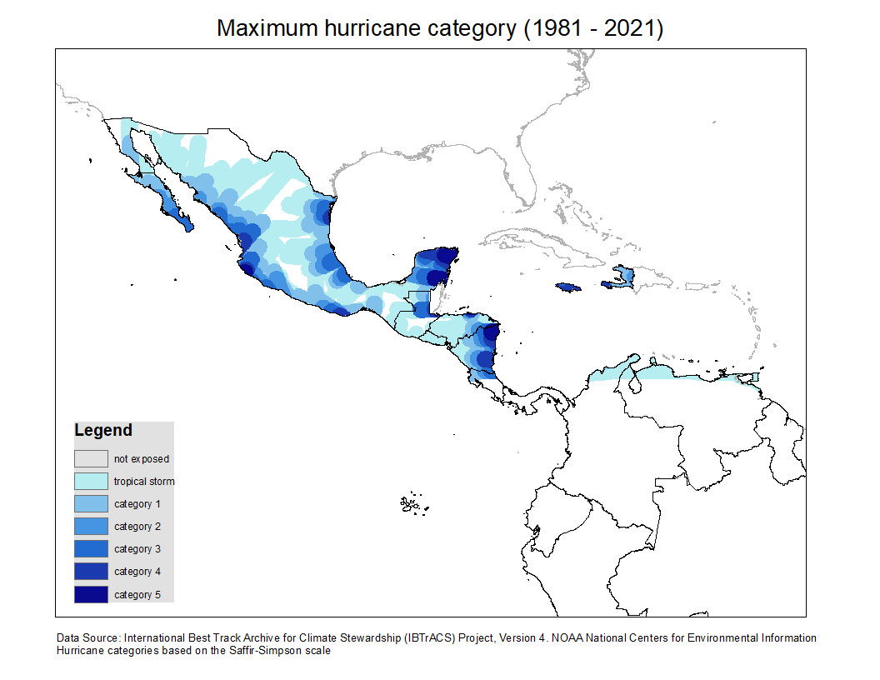

Slide 10
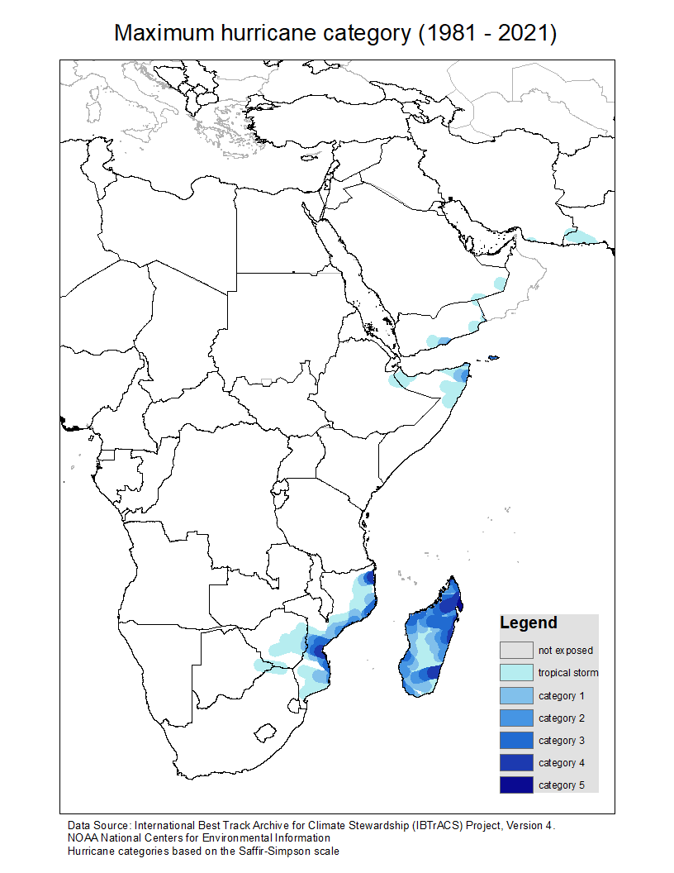

Slide 11
Trend index for hurricane frequency (1981 -2021)
The following maps are based on a custom trend index (developed for conflict and drought data)
Weighted scores were attributed for each year. The first half of the study period was attributed negative scores, and the second half of the study period was attributed positive scores (with the highest score for the most recent year). The range of annual scores was from -20 (for 1981) to 20 (for 2019)
Trend index was computed as a sum of annual scores
Possible range of values for hurricane frequency trend index is from -200 to 200

Slide 12
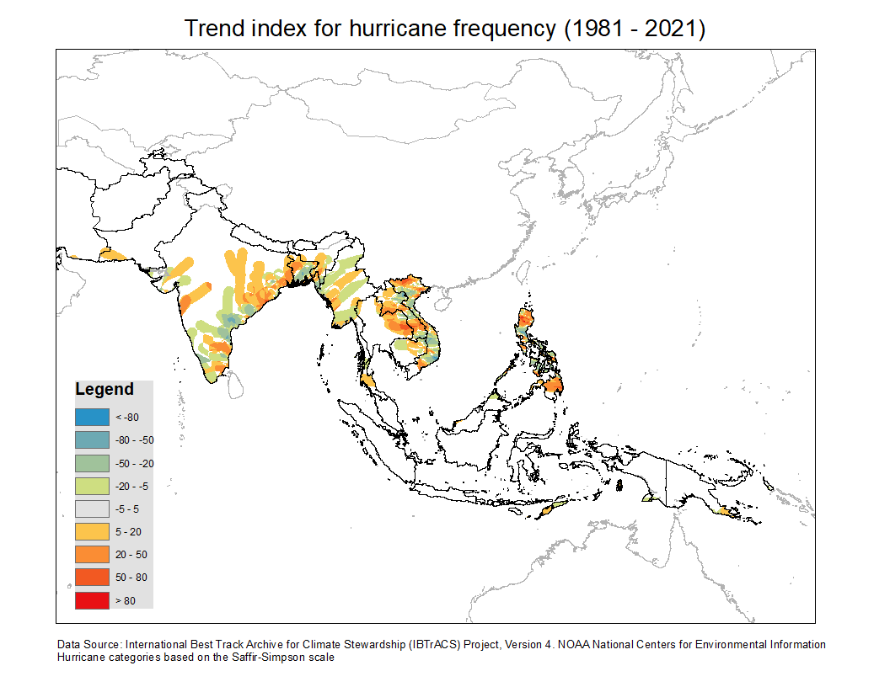

Slide 13
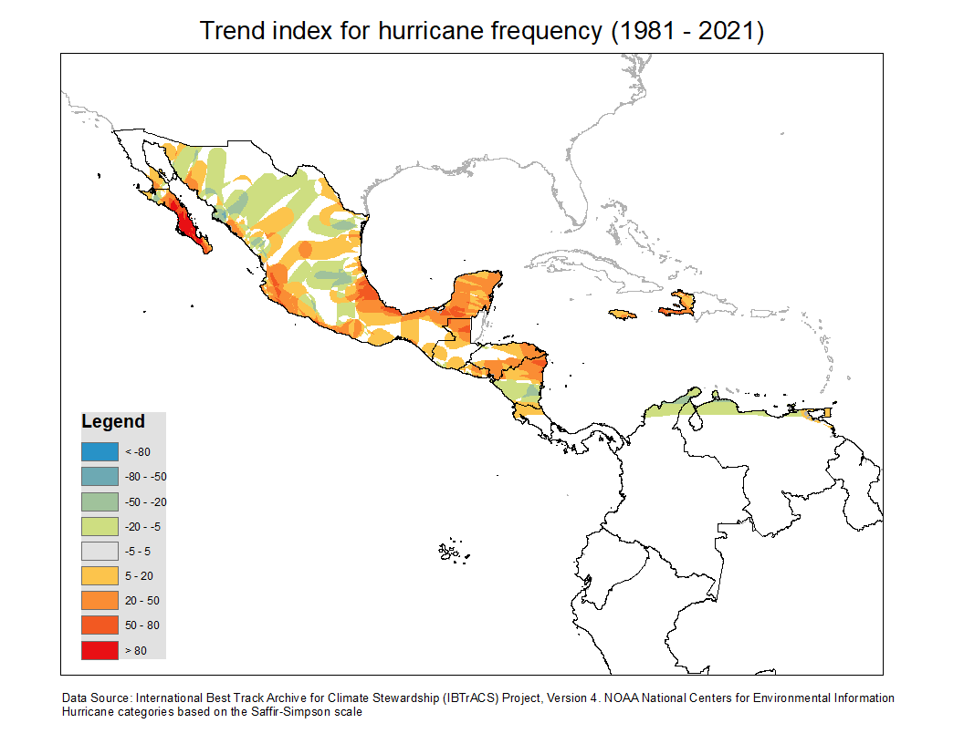

Slide 14
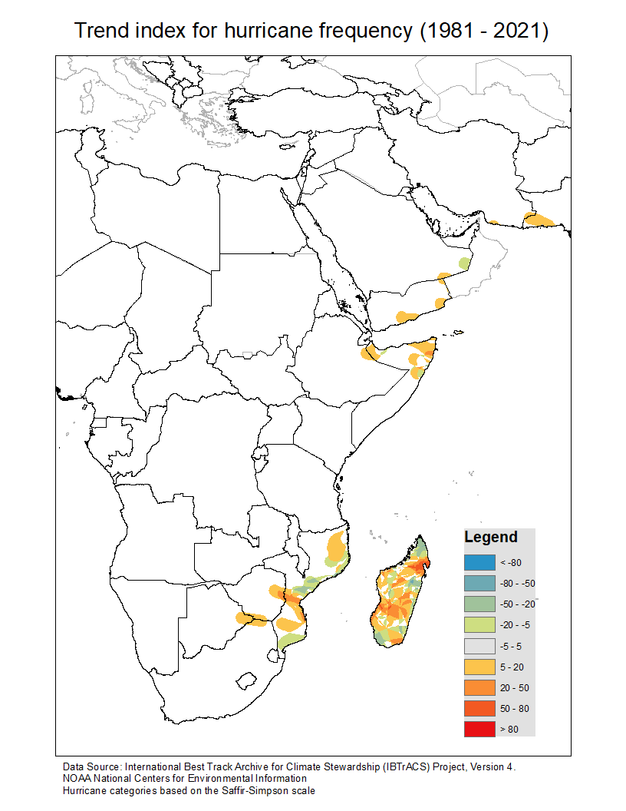

Slide 15
Severity-weighted frequency (1981 -2021)
To find severity-weighted frequency, annual rasters were computed as a sum of all hurricanes (for example, if the same area got hit by a hurricane of category 1 and a hurricane of category 3 in a single year, it gets an annual score of 4 for that year)
Frequency for full time series was computed as a sum of annual scores, and then reclassified to fit the range from 1 (low) to 6 (severe).
As a result, both frequency and severity was considered for these maps

Slide 16
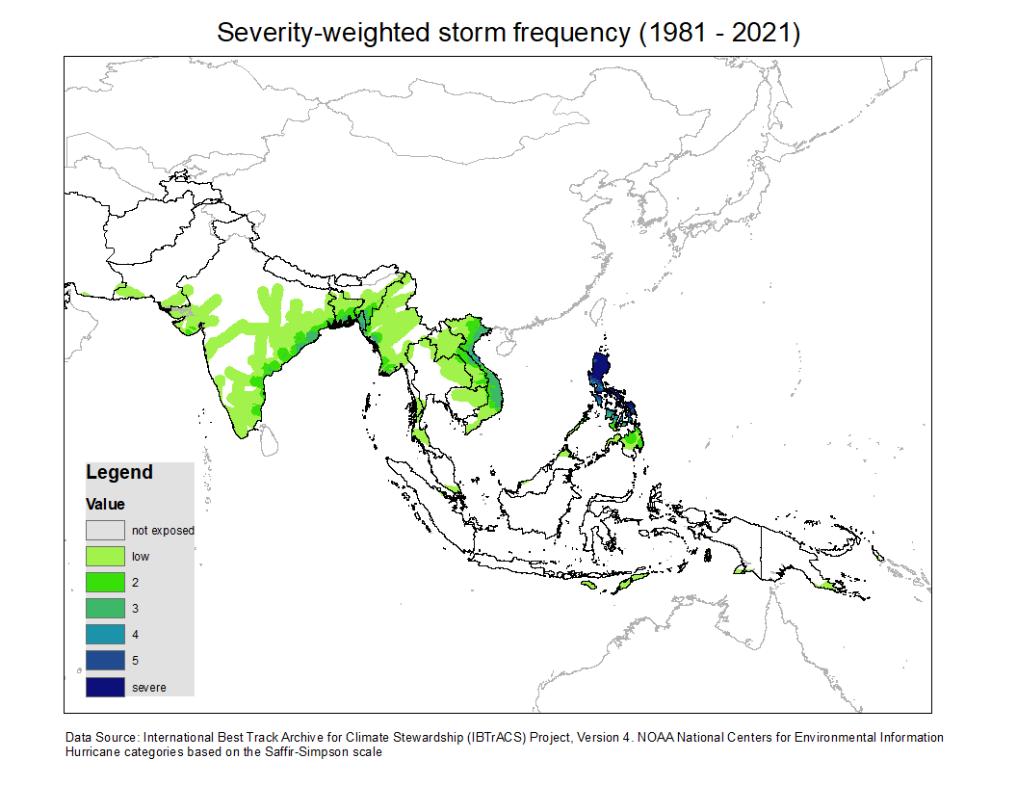

Slide 17
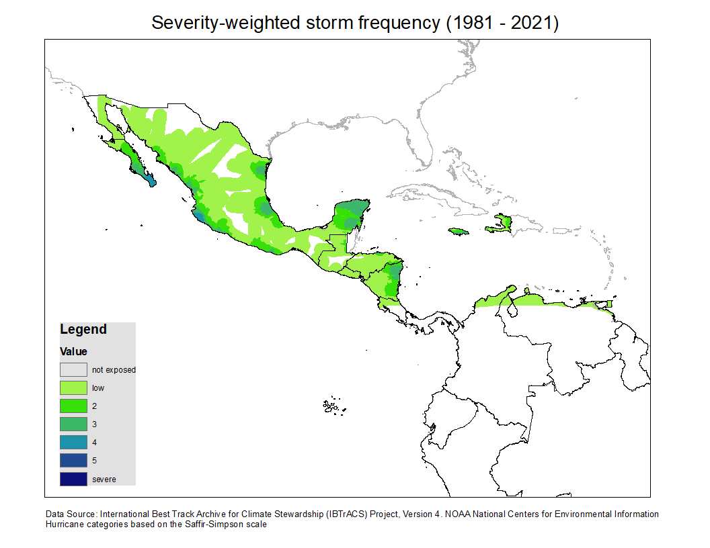

Slide 18
