Slide 1
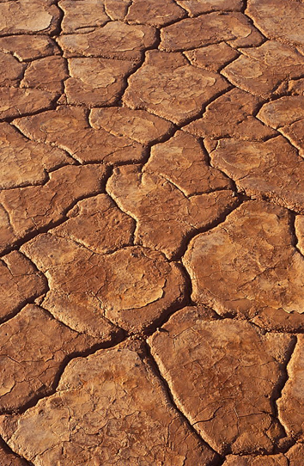
Managing Drought Risk in a
Changing Climate
Donald A. Wilhite
Professor, Applied Climate Science
School of Natural Resources
University of Nebraska-Lincoln
EROS Center – September 21, 2012
Notes:
Managing drought is about managing for climate variability. Society’s approach for dealing with drought historically has been through what is commonly referred to as ‘crisis management’. What this approach translates into is reacting to a drought event rather than preparing for it through building institutional capacity and well thought out risk-based management measures, decision support tools, etc.
Given our current concerns about observed and projected changes in both climate state (i.e., changes in the mean) and changes in variability (i.e., more fluctuations—thus more extremes), our inability to effectively ‘manage’ drought in the past is cause for concern in the future given the likelihood of more severe, more frequent, and longer duration droughts and growing societal vulnerability because of increasing pressure on finite water resources resulting from rapidly increasing population as well as many other factors in many part of the world.

Slide 2
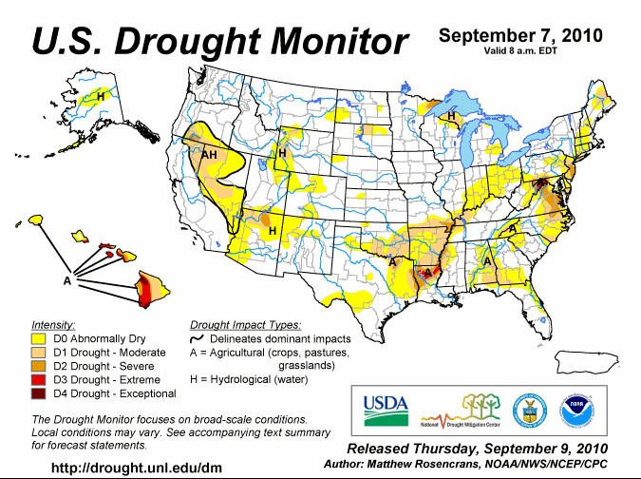
Introduction
24 month animation—USDM

Slide 3
Presentation Outline
Parts:
Introduction
The Climate Challenge
The Enigma of Drought
  Drought 101
Our Changing Vulnerability
Reducing Societal Vulnerability to Drought
  Building resilience/coping capacity
  Are we making progress?
Takeaway Points

Slide 4
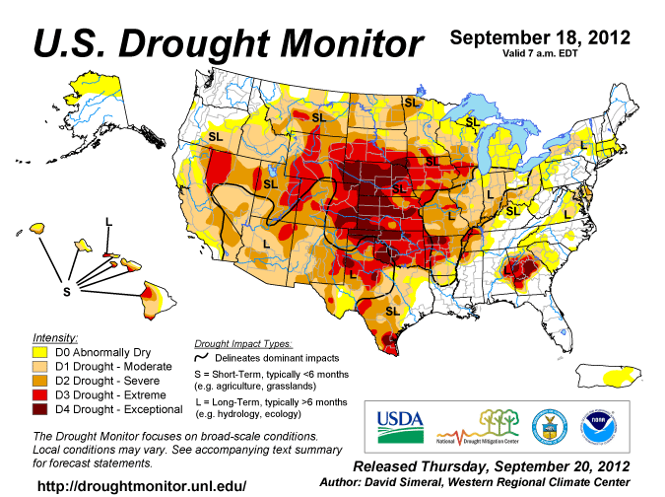

Slide 5
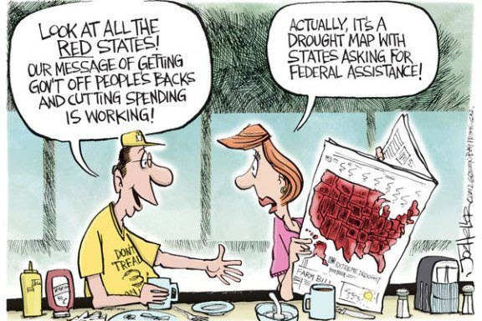
The Politics of Drought

Slide 6
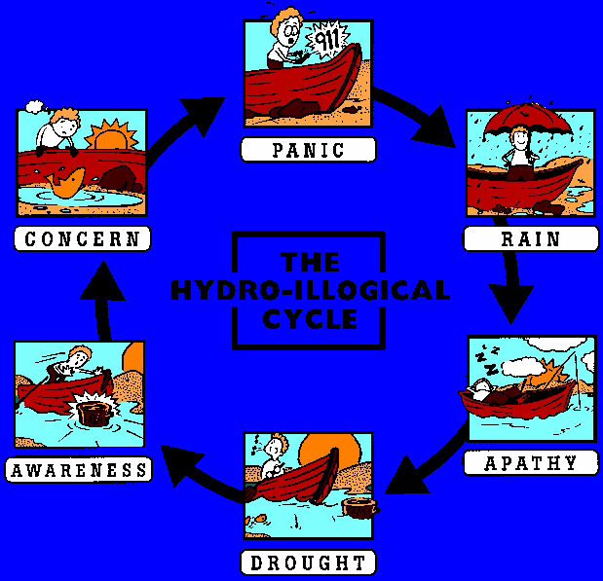
Breaking the Hydro-illogical Cycle:
An Institutional Challenge for Drought Management
Crisis Management
If you do what you’ve always done, you’ll get what you’ve always got.
Notes:
The focus is on the crisis rather than on preparing for the next event.

Slide 7
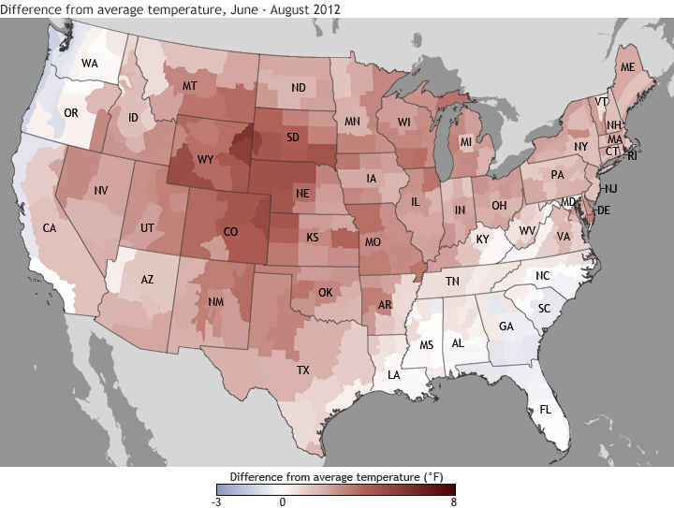
Difference from Average Temperature
June – August 2012

Slide 8
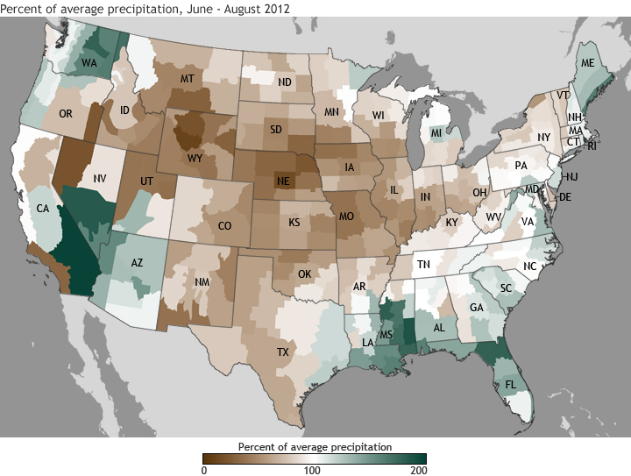
% of Average Precipitation
June – August 2012

Slide 9
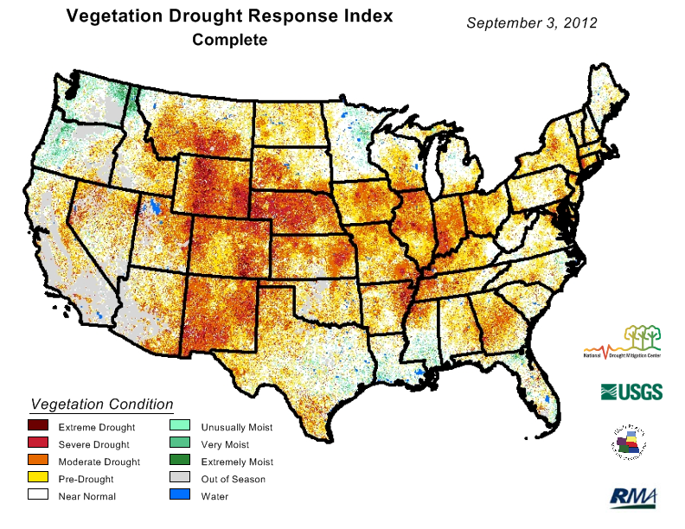

Slide 10
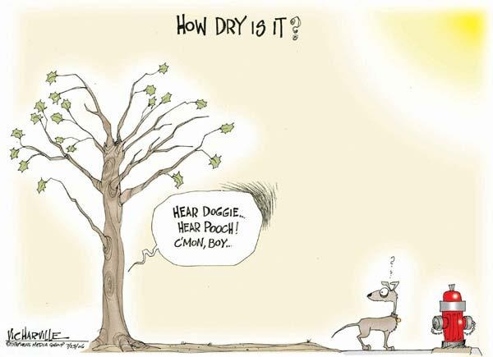

Slide 11
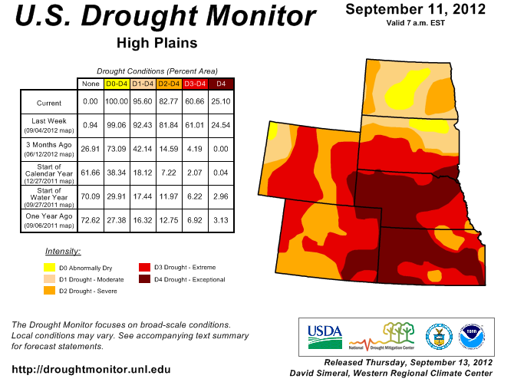
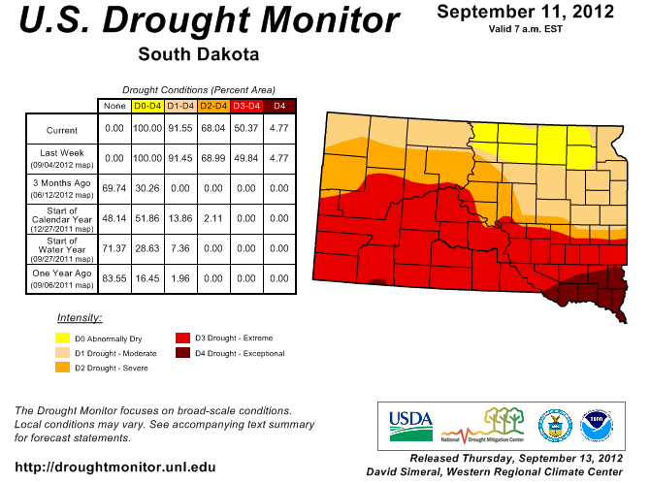
68%
0%

Slide 12
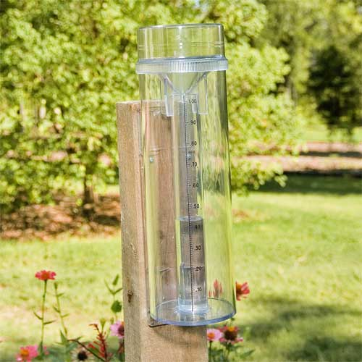

Standard Rainguage
New South Dakota rainguage

Slide 13
U.S. Drought Monitor Map
Drought Intensity Categories
D0 Abnormally Dry (30%tile)
D1 Drought – Moderate (20%tile)
D2 Drought – Severe (10%tile)
D3 Drought – Extreme (5%tile)
D4 Drought – Exceptional (2%tile)

Slide 14
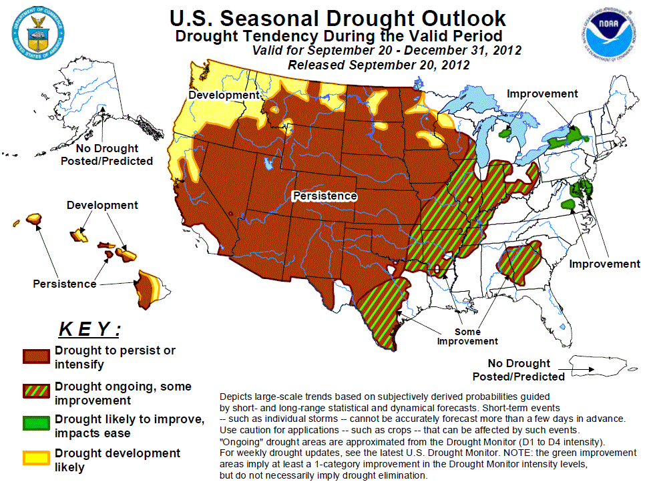

Slide 15
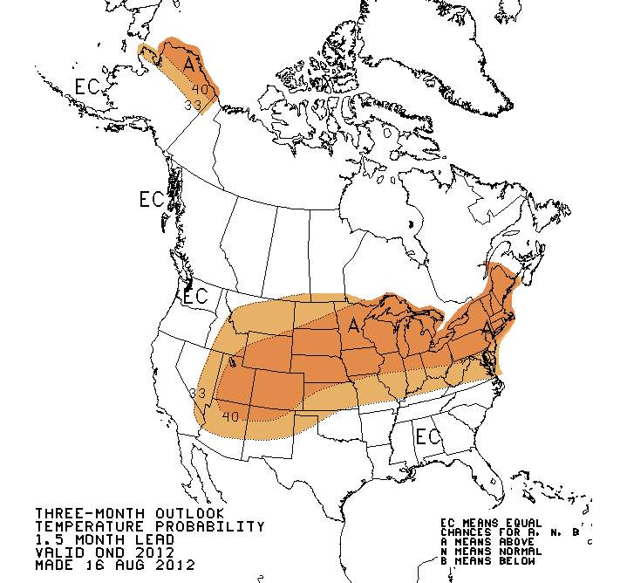
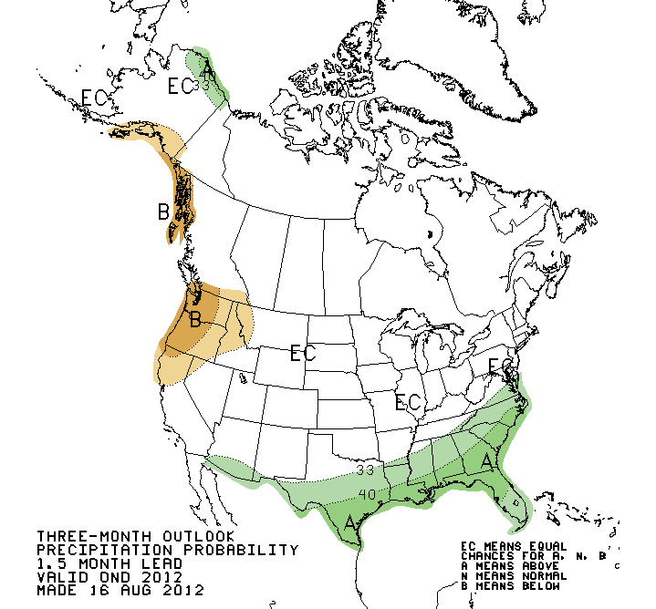
Temperature
Precipitation
Three-month Outlook (NOAA)

Slide 16
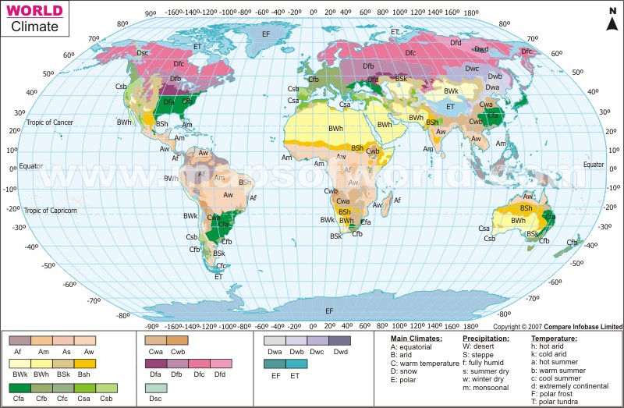
Part 1: The Climate Challenge

Slide 17
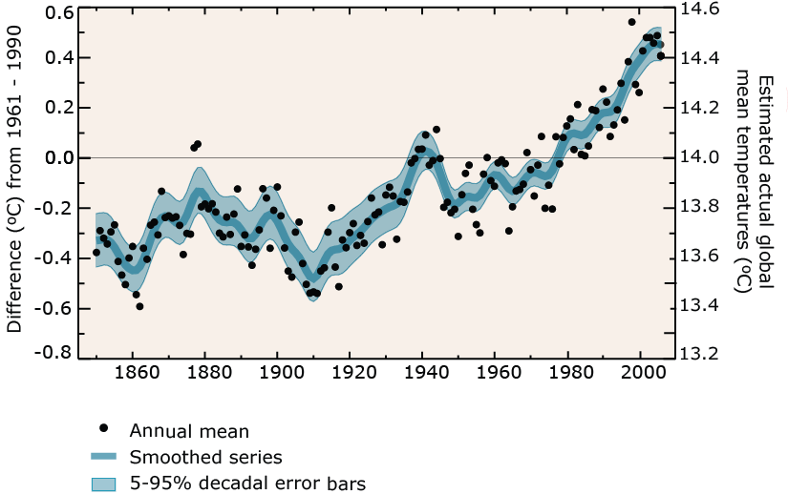
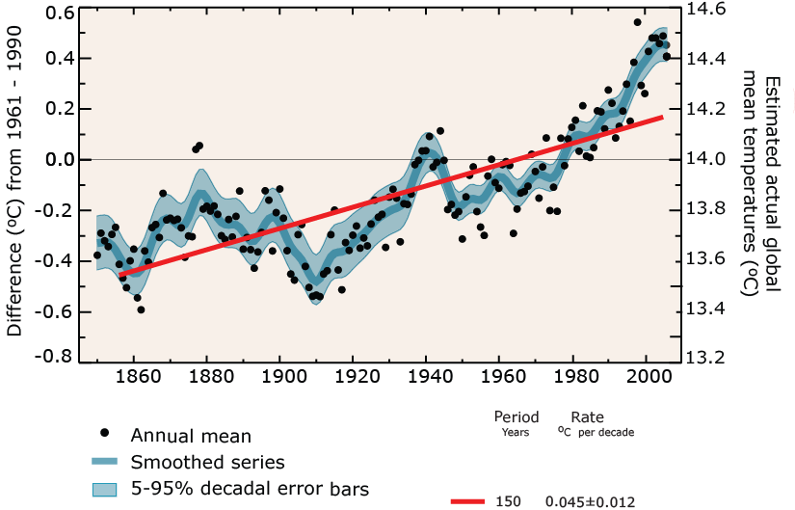

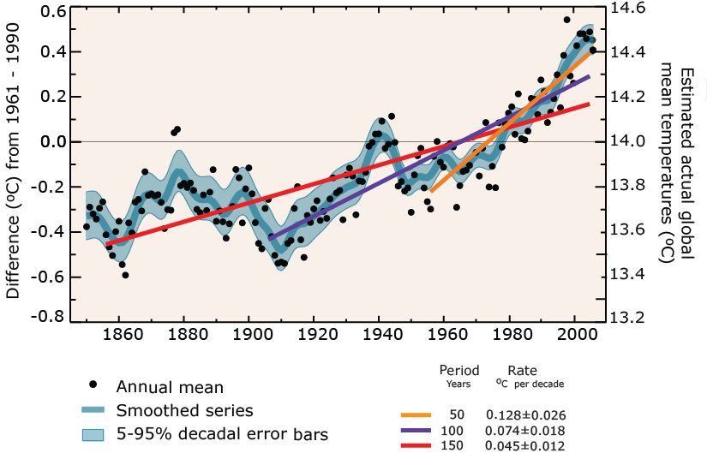
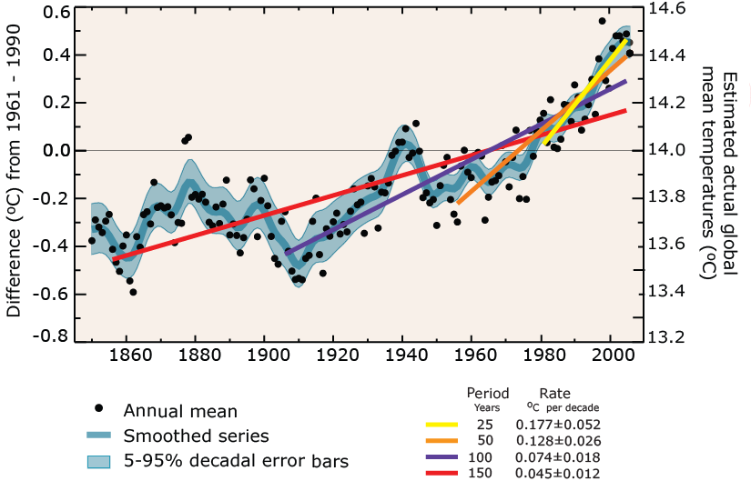
Global average temperature is rising
IPCC
Notes:
17

Slide 18
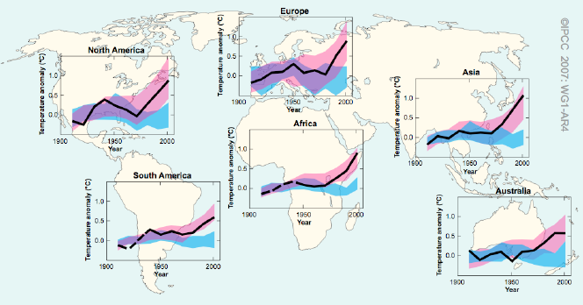
Scientific consensus:
Observed Change in Temperatures Match Computer Projections
IPCC AR4 WG1 SPM, 2007
Black lines are decadally averaged observations. Blue bands are computer models with natural forcings only. Pink bands are computer models with human + natural forcings.

Slide 19
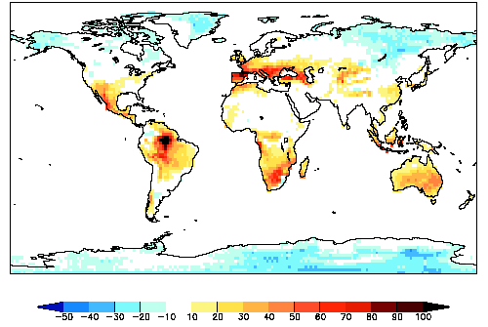
Where we’re headed: Droughts
Drought projections for IPCC‘s A1B scenario
Percentage change in average duration of longest dry period, 30-year average for 2071-2100 compared to that for 1961-1990.
Notes:
19

Slide 20
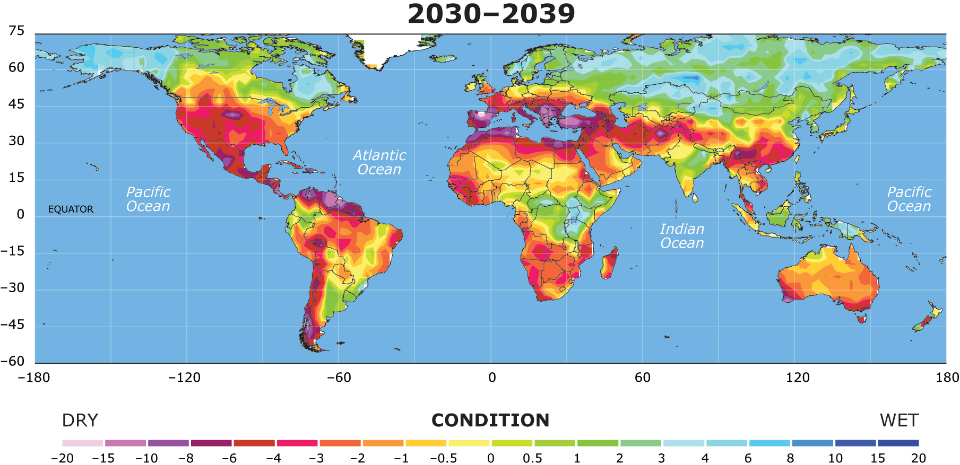
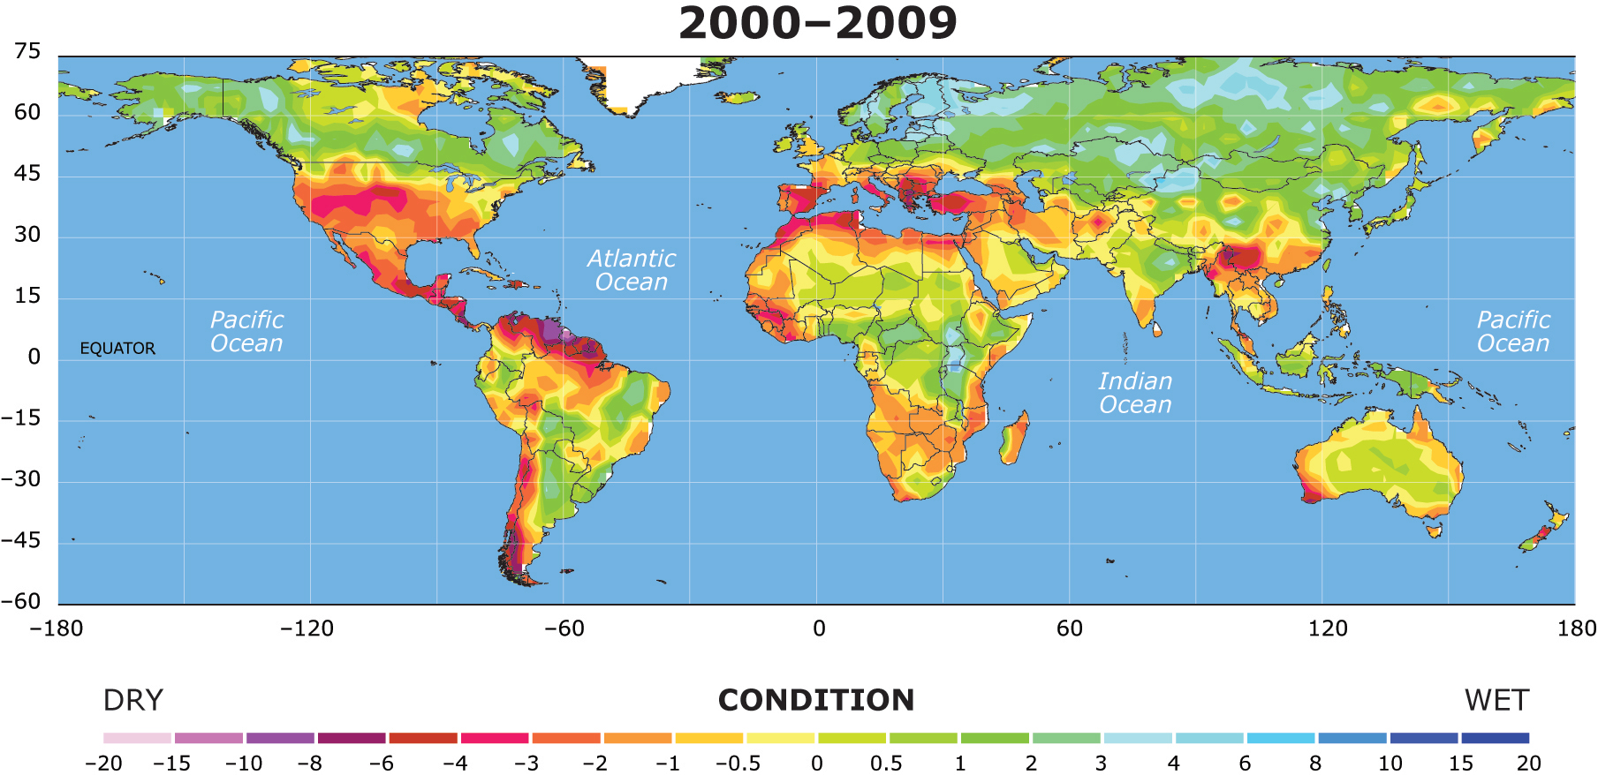
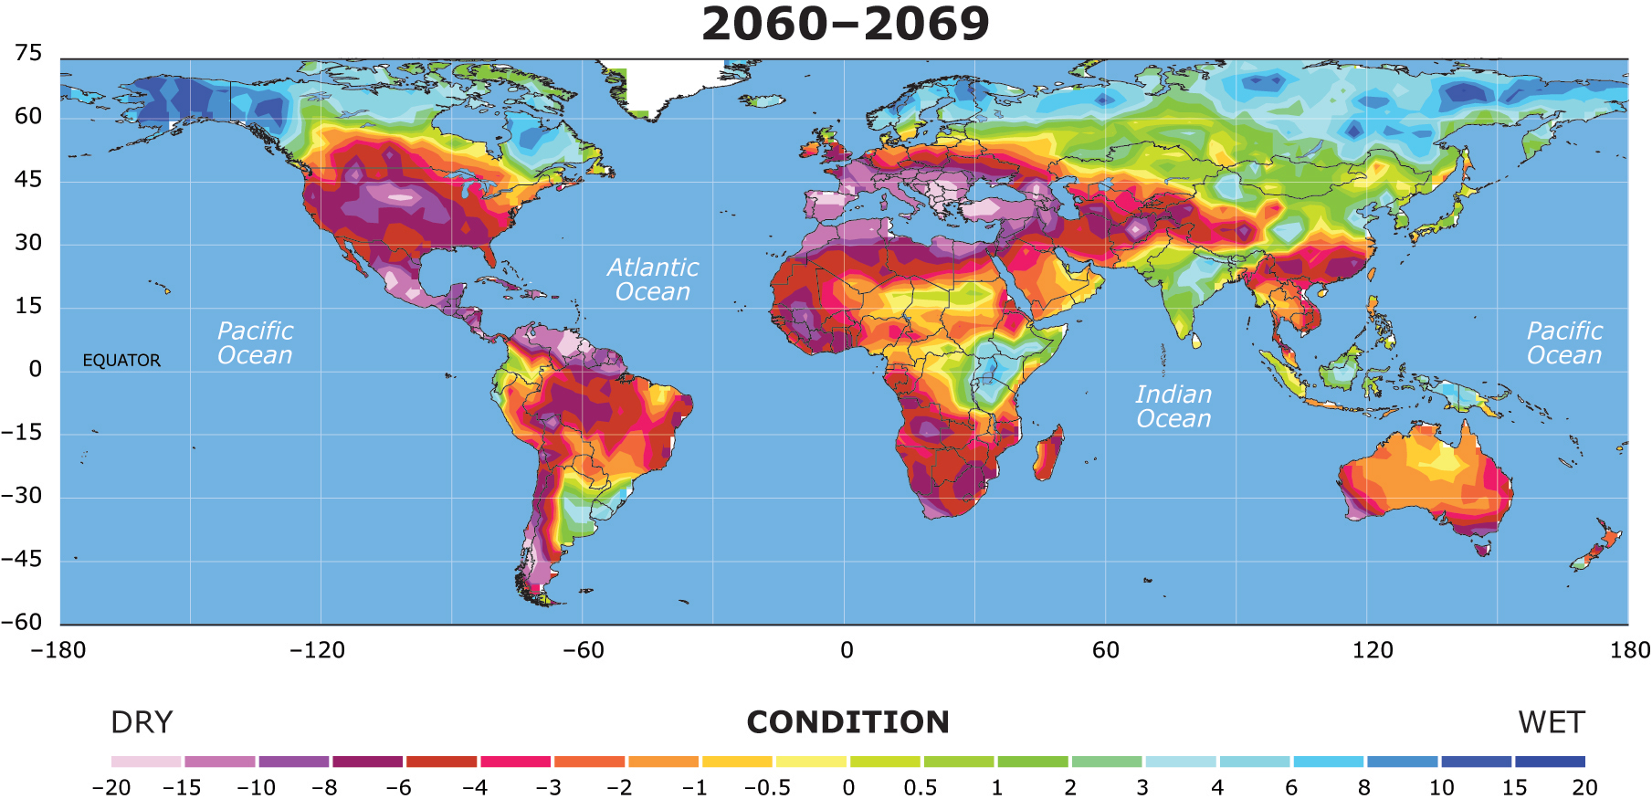
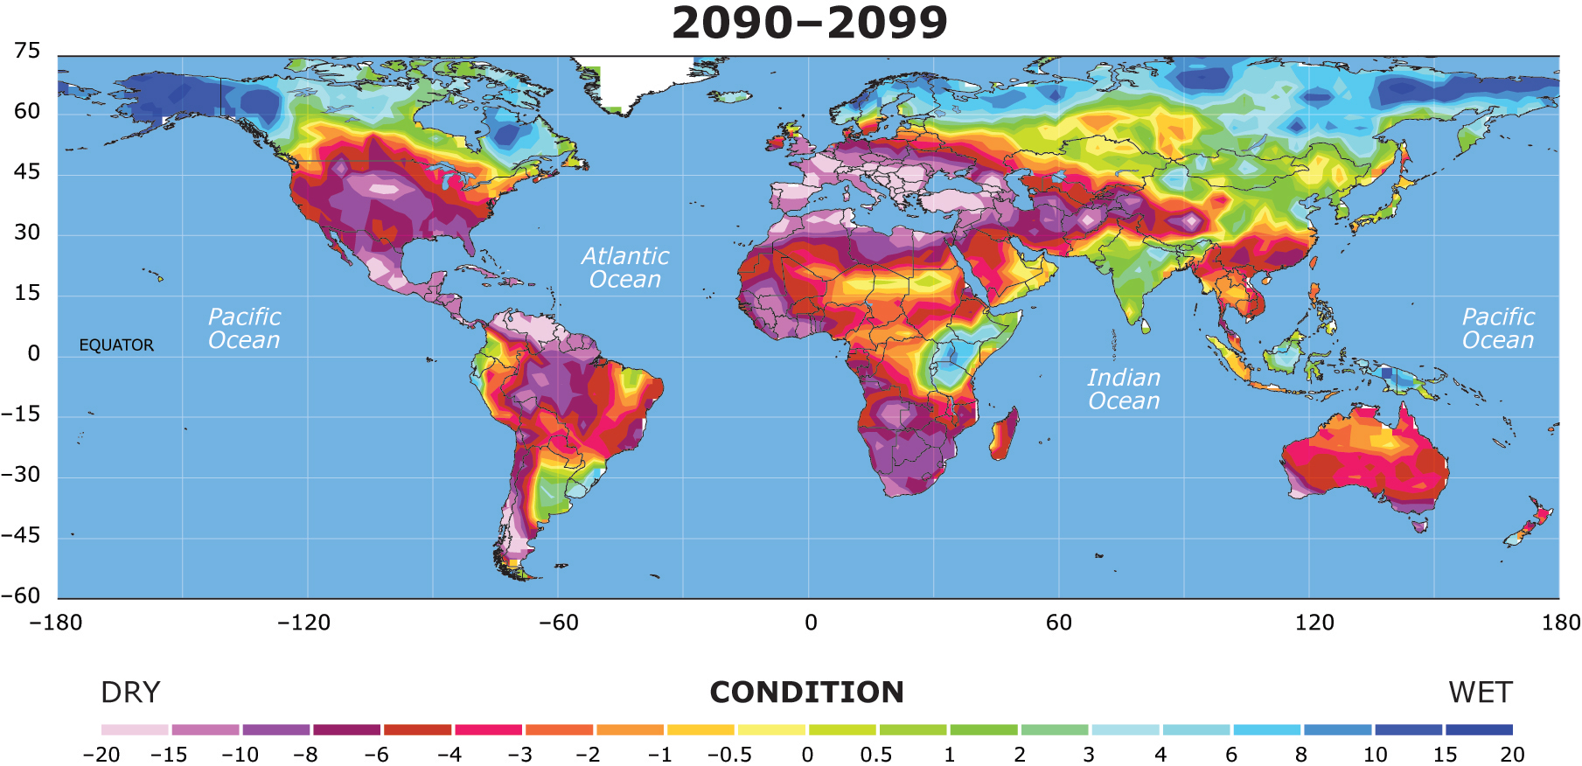
Global Drought Potential, 2000-2098
Source : University Corporation for Atmospheric Research - http://www2.ucar.edu/news/2904/climate-change-drought-may-threaten-much-globe-within-decades

Slide 21
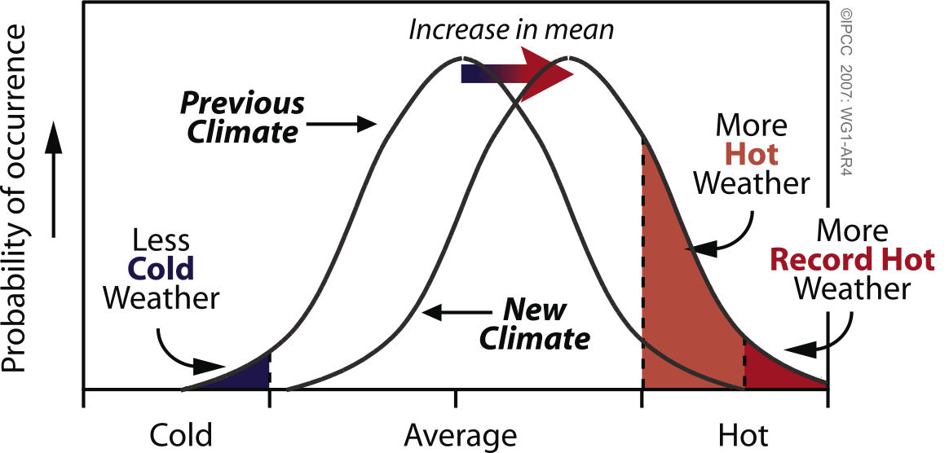
Mean Temperature Increase & Impact on Extreme Temperatures
Notes:
Box TS.5, Figure 1. Schematic showing the effect on extreme temperatures when the mean temperature increases, for a normal temperature distribution.

Slide 22
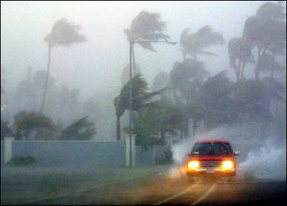
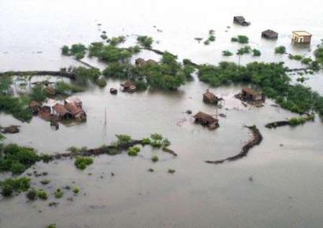
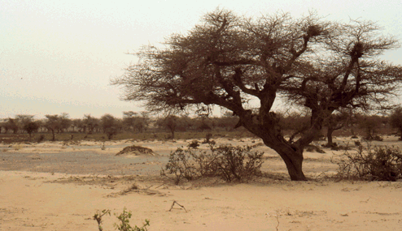
Managing for Climate Variability
Impacts of Global Climate Change:
Increased frequency of extreme weather events
Storms
Floods
Droughts
. . . . along with heat waves, snow storms, etc.

Slide 23
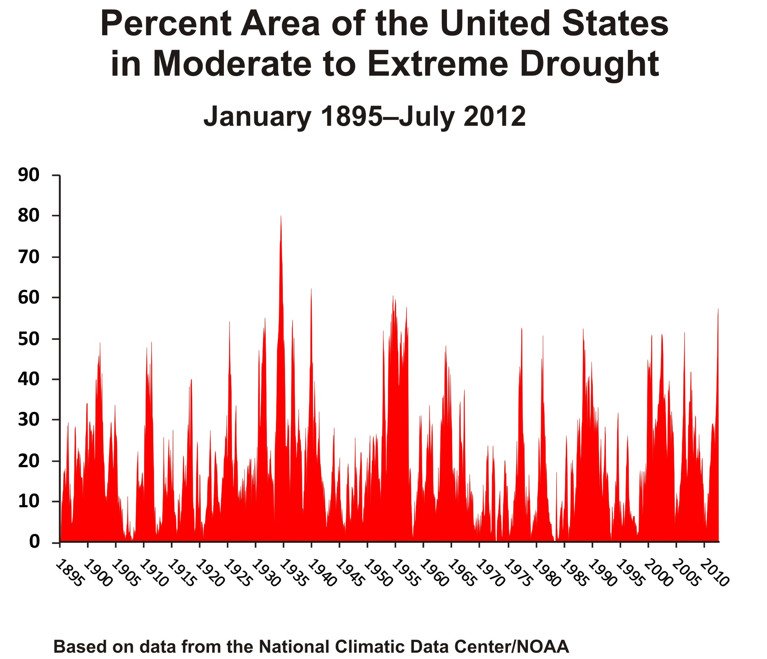
The Climate Challenge
Mean temperatures
High temp. stress and heat waves/longer growing seasons
Increased evaporation and transpiration
Changes in precipitation amount, distribution and intensity
Reduced soil moisture
Reduced groundwater recharge
Reduced runoff/streamflow for the Western U.S. via reduced snowpack/sublimation
$250 billion
1980-2012

Slide 24
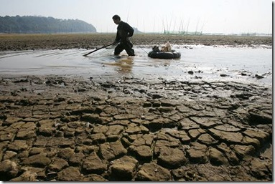
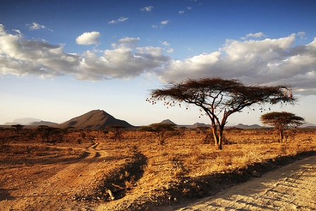
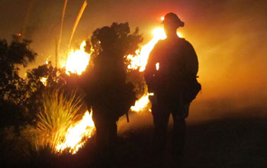
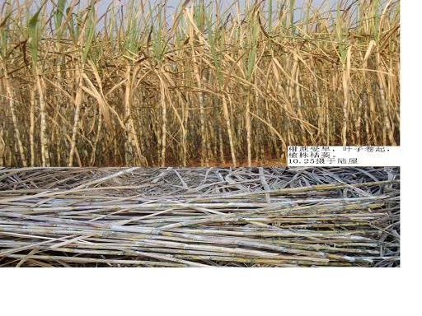
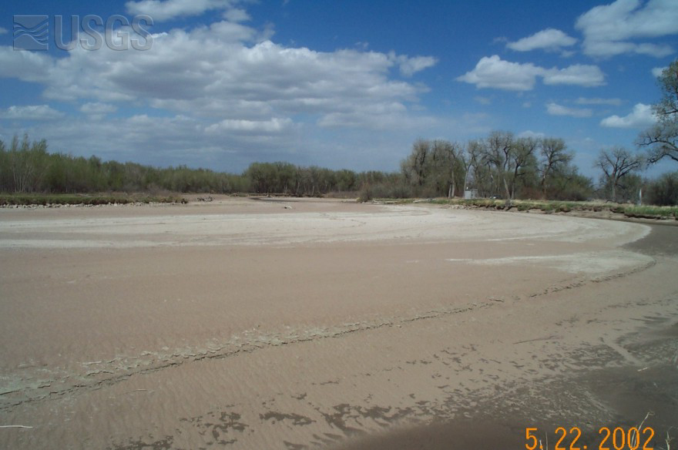
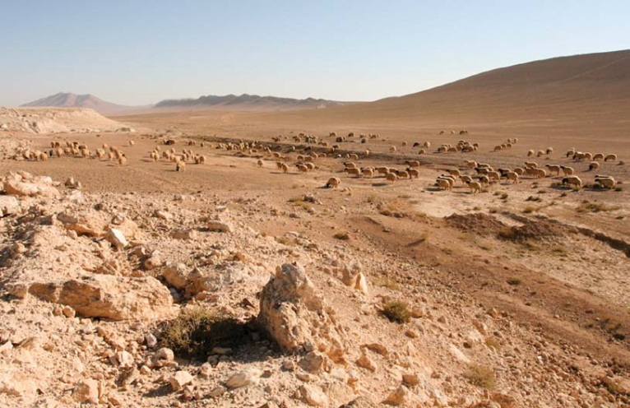
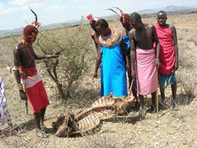
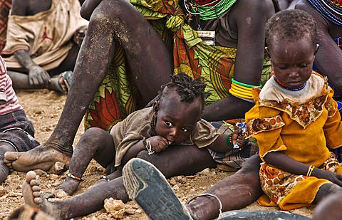
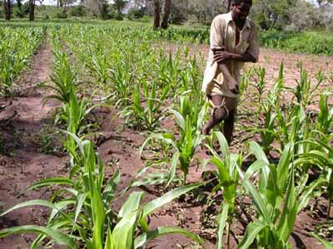
Part 2: The Enigma of Drought
Notes:
Drought is a global issue. It is not well understood by many but it is now drawing a great deal more attention from scientists, water and other natural resource managers, and policy makers.

Slide 25
Natural and Social Dimensions of Drought
Decreasing emphasis on the natural event (precipitation deficiencies)
Increasing emphasis on water/natural resource management & policy
Increasing complexity of impacts and conflicts
Rainfall
Deficiencies
Heat Stress
Soils
Crops
Range
Livestock
Forests
Water Supply
Snow Depth
Recreation
Tourism
Hydropower
Risk
Reduction
Hydrological
Agricultural
Meteorological
Socio-economic
Societal Impact
Time/Duration of the event

Slide 26
Comparing drought to other natural hazards–
slow onset, “creeping phenomenon”, a non-event
  drought onset and end difficult to determine
  commonality with climate change
Notes:
Drought shares some characteristics with other natural hazards, but is also very different in a number of ways.

Slide 27

Drought, it sneaks up on you!

Slide 28
Comparing drought to other natural hazards–
slow onset, “creeping phenomenon”, a non-event
  drought onset and end difficult to determine
  commonality with climate change
absence of a universal definition
impacts are nonstructural and spread over large areas
severity and impacts best defined by multiple indices and indicators
impacts are complex, affect many people, and vary on spatial and temporal timescales, multiple and migrating epicenters
Notes:
Drought shares some characteristics with other natural hazards, but is also very different in a number of ways.

Slide 29
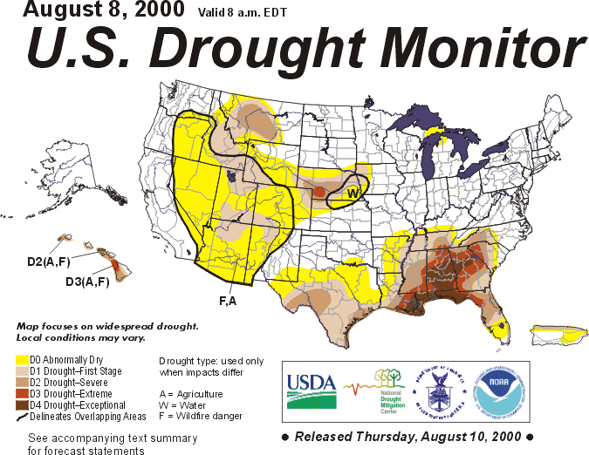
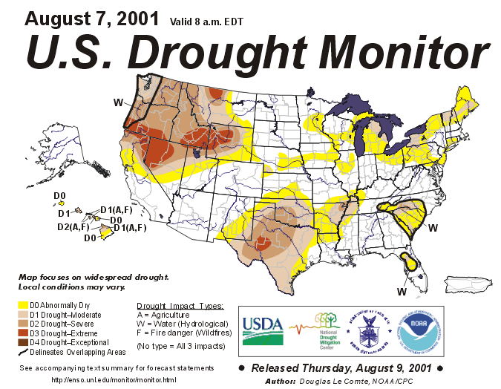
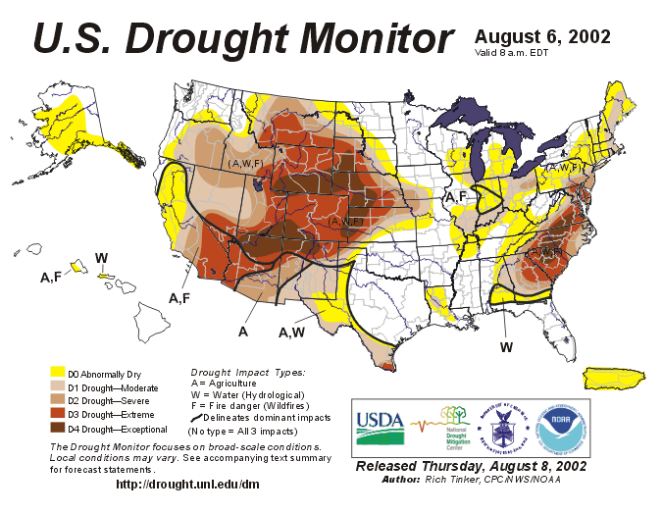
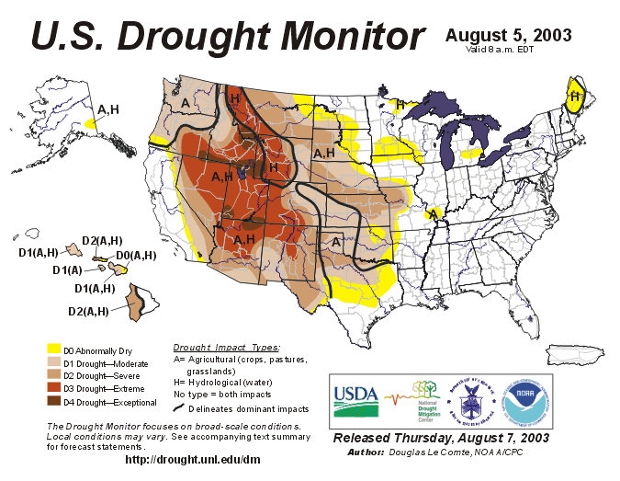
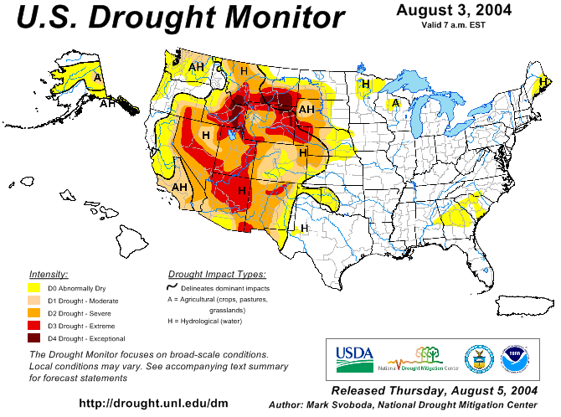
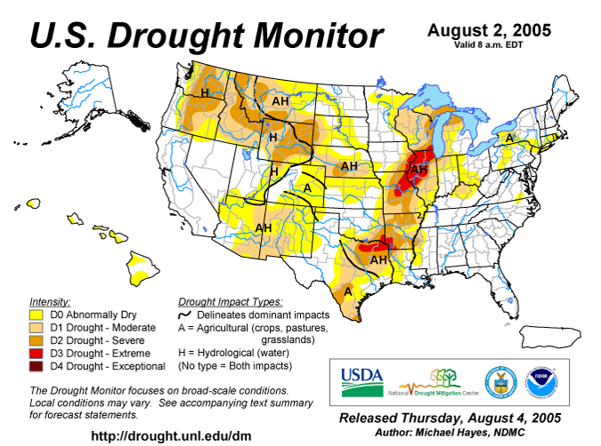
U.S. Drought Patterns, 2000-2005
2000
2001
2002
2003
2004
2005
Notes:
The USDM is shown to illustrate the broad pattern of drought in the US over the past decade. It illustrates both the severity of drought and also the spatial pattern of drought across the country—no region is immune to its occurrence, although some regions experience it much more frequently, with greater severity, and for longer periods of time.

Slide 30
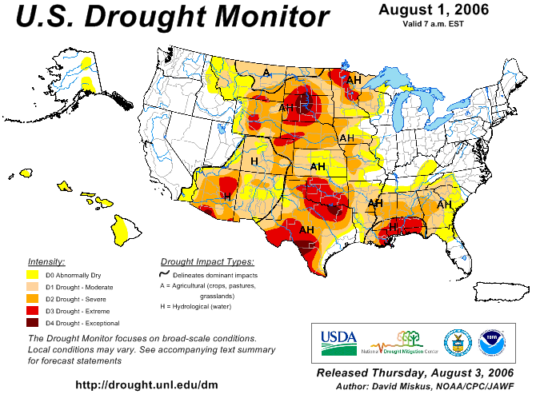
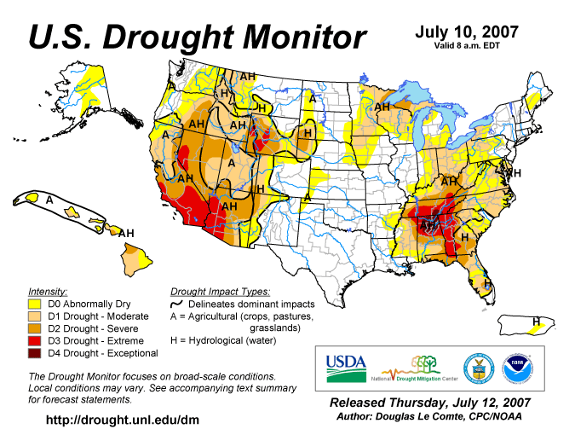
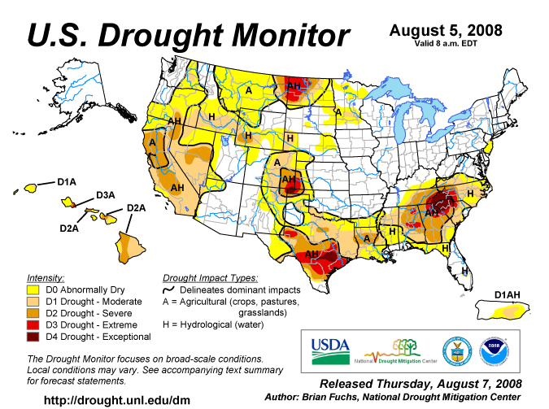
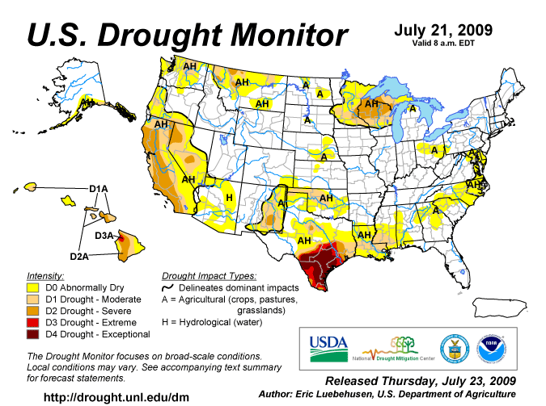


U.S. Drought Patterns, 2006-2011
2006
2007
2008
2009
2010
2011

Slide 31




Part 3: Our Changing Vulnerability
Drought impacts are more complex today as more economic sectors are affected, creating more conflicts between water users, i.e., societal vulnerability is dramatically different.
Agricultural production
Food security
Energy
Transportation
Tourism/Recreation
Forest/rangeland fires
Municipal water
Water quality/quantity
Environment
Ecosystem services
Health
Notes:
Why is vulnerability important? Each drought is superimposed on a society at a point in time with different vulnerabilities than the previous drought event.

Slide 32

“I’ve never seen corn this bad.”
New Yorker, Sept. 3, 2012

Slide 33
Hazard
Vulnerability
Risk
x
=
EXPOSURE Severity/Magnitude - Intensity/Duration Frequency Spatial extent Trends - Historical - Future Impacts Early warning | SOCIAL FACTORS Population growth Population shifts Urbanization Technology Land use changes Environmental Degradation Water use trends Government policies Environmental awareness | RISK
(social factors)
Widely adopted as the new paradigm for drought management.
Notes:
Managing risk translates into understanding both the physical and social characteristics of drought and how this intersects with society.

Slide 34
Natural Disasters in the U.S., 1980-2011
Number of Events, Annual Totals
2011 Total
171 Events
Risk = Hazard + Vulnerability
60
14
92
5
Geophysical events
(Earthquake, tsunami,
volcanic eruption)
Meteorological events
(Storm)
Hydrological events
(Flood, mass movement)
Climatological events
(Extreme temperature,
drought, forest fire)
Source: MR NatCatSERVICE
© 2011 Munich Re
34

Slide 35
Population Trends vs. Water/Capita
Billions
?
10
Water per Capita
8
3 Billion People
6
Developing World
4
Population increase
2
Industrial Countries
0
1750
1800
1850
1900
1950
2000
2050
Source: UN Population Div. & Population Reference Bureau 2004

Slide 36


14
12
19
14
31
24
16
13
12
16
28
13
15
19
18
16
13
12
Notes:
Migration is a huge issue in the U.S. and in some other parts of the world.

Slide 37


Median Changes in Runoff: 2041-2060
(based on 24 GCM runs)
(Percentages are fractions of the 24 GCM runs)
USGS water resources regions (Milly et al., 2005) general circulation model simulations for 2041-2060 relative to 1901-1970.

Slide 38

Part 4: Reducing Societal Vulnerability to Drought
National Drought Mitigation Center’s mission
To lessen societal vulnerability to drought by promoting planning and the adoption of appropriate risk management techniques.
Globally, we must improve our resilience to a variable climate.

Slide 39
Defining ‘Mitigation’
Mitigation in the context of drought management . .
  Actions taken in advance of or in the early stages of drought that reduce social, economic, and environmental impacts.
  Assessing and managing ‘risk’.
Mitigation in the context of climate change . .
  Reduction of greenhouse gas (GHG) emissions leading to a reduction in the degree of projected warming.

Slide 40
Specific ‘Mitigation’ Actions
Improve drought early warning and information delivery systems
Develop better decision-support tools to improve risk assessment/management
Develop and implement drought preparedness and mitigation plans
Implement water conservation plans
Augment water supplies
Education/awareness building
Drought policies—local to national that emphasize risk reduction
Drought is a normal part of climate!!

Slide 41

The Cycle of Disaster Management
Risk management increases coping capacity, builds resilience.
proactive
reactive
Crisis management treats the symptoms, not the causes.

Slide 42


Slide 43
Reducing Societal Vulnerability
Measuring success/impact: The Scorecard
+
Improving awareness of drought/risk factors
Better early warning and delivery systems
Improved decision support tools
Risk assessments of vulnerable sectors, population groups, regions
Improved understanding and quantification of drought impacts vs. mitigation costs
Adoption of drought preparedness plans
Adoption of national drought policies based on risk management concept
+
+
+
?
+
?

Slide 44


U.S. National Drought Policy
National Drought Policy Act, 1998
NIDIS, 2006

Slide 45


Improving Drought Early Warning

Slide 46


Global Initiatives—Drought Management
High-level Meeting on National Drought Policy
(Science and Policy Sessions)
11-15 March 2013
Geneva, Switzerland
Key sponsors: WMO, UNCCD, FAO, UNESCO, GWP

Slide 47
Part 5: Takeaway Messages
Climate is changing—climate state and climate variability.
Extreme climate events are increasing in frequency globally, managing impacts critically important.
Improved management of climate variability today will lead to improved management of/adaptation to climate change.
Drought preparedness planning, fully integrated with stakeholder participation, is critical to moving society from vulnerability to resilience.
Drought preparedness planning must be integrated across spatial scales.
Developing risk-based national drought policy ‘guidelines’ are critical to reducing societal vulnerability.
National and international initiatives are increasing momentum for changes in drought management.

Slide 48


Thanks for your attention!
School of Natural Resources dwilhite2@unl.edu
©2009 The Board of Regents of the University of Nebraska. All rights reserved.

