Slide 1



The USA National Phenology Network:
A national science and monitoring framework for phenology
Eric C. Wood
US Geological Survey

Slide 2
What is phenology?
Phenology is the study of seasonal plant and animal lifecycle events (phenophases) such as leafing, flowering, emergence and migration
These events affects abundance and diversity, species interactions and their response to environmental cues
These different shifts in timing are changing ecosystems and altering historical interactions and processes
Nature’s Notebook helps people identify lifecycle changes to better understand their impact on the world around us
Notes:
Basically Phenology is the study of seasonal plant and animal lifecycle events.
Study of the dynamics of the lifecylce events and how they are related or not related to the environment

Slide 3
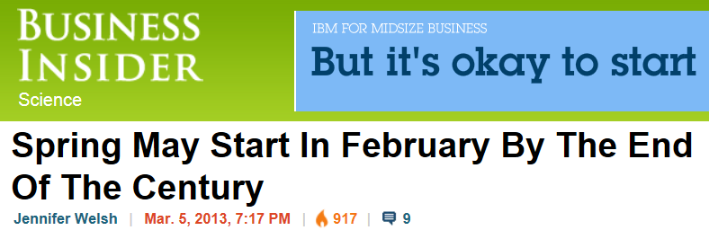
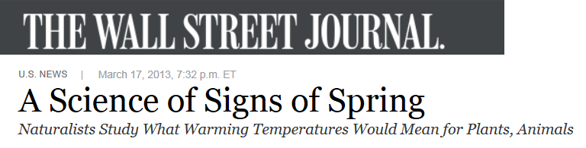
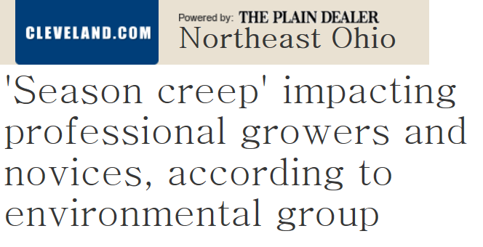
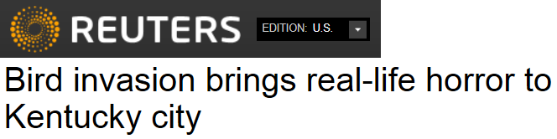
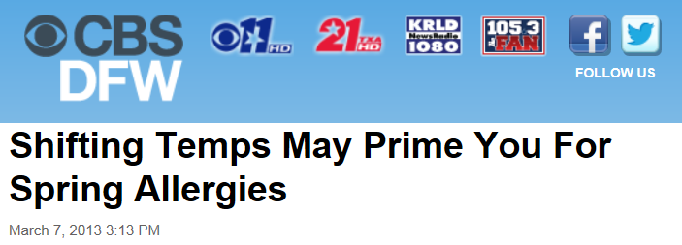
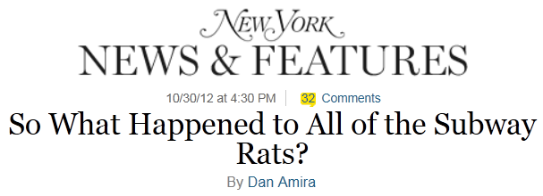
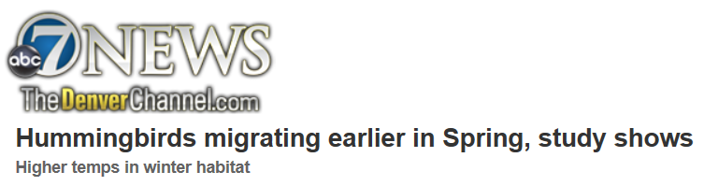
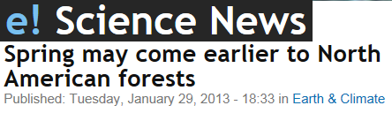
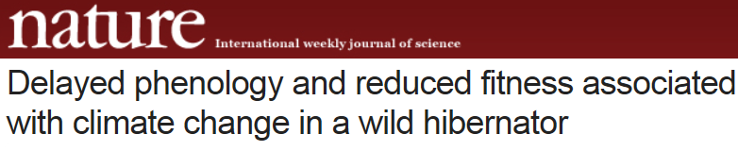


Phenology in the news

Slide 4
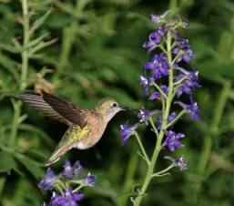
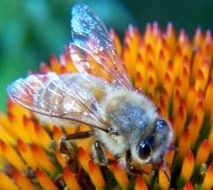
Why build
a national phenology network?
Phenology is…
Easy to observe
Sensitive to environmental variation
Links to populations, communities, ecosystems and ecosystem services
Scales from 'leaf to globe'
Notes:
4

Slide 5
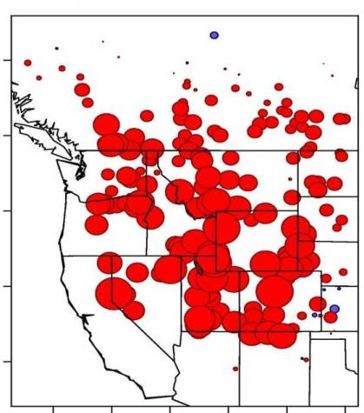
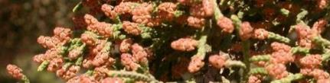

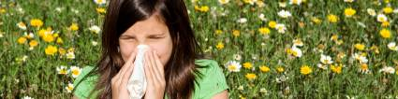
Why build
a national phenology network?
USA-NPN serves science and society by collecting, organizing and distributing phenological information to aid decision-making and adaptation to variable climates and changing environments.
Large fires in western US
Mean growing season length (d) 2001-2006
Ganguly et al. 2010
Betancourt et al. in prep
USA-NPN 5-year Strategic Plan
www.usanpn.org/pubs/reports
Notes:
USA-NPN makes phenology data, models, and related information freely available to empower scientists, resource managers, and the public in decision-making and adapting to variable and changing climates and environments. We also encourage people of all ages and backgrounds to observe and record phenology as a way to discover and explore the nature and pace of our dynamic world.
5

Slide 6
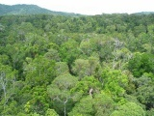



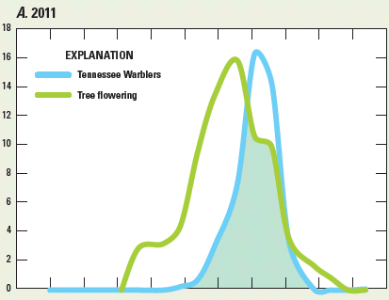
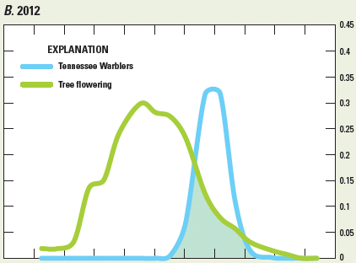
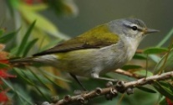


How do researchers…
understand bird migrations and habitats?
Proportion trees reported flowering
% eBird checklists/week
Williams et al., 2013
Derived from Kellermann et al., in prep
Notes:
We can start to integrate our dataset with other datasets like e-bird to do things never done before. This is described in more detail in the USGS Ecosystems Strategic Science Plan. (We also collect bird data, but our forte right now is plant data.)

Slide 7
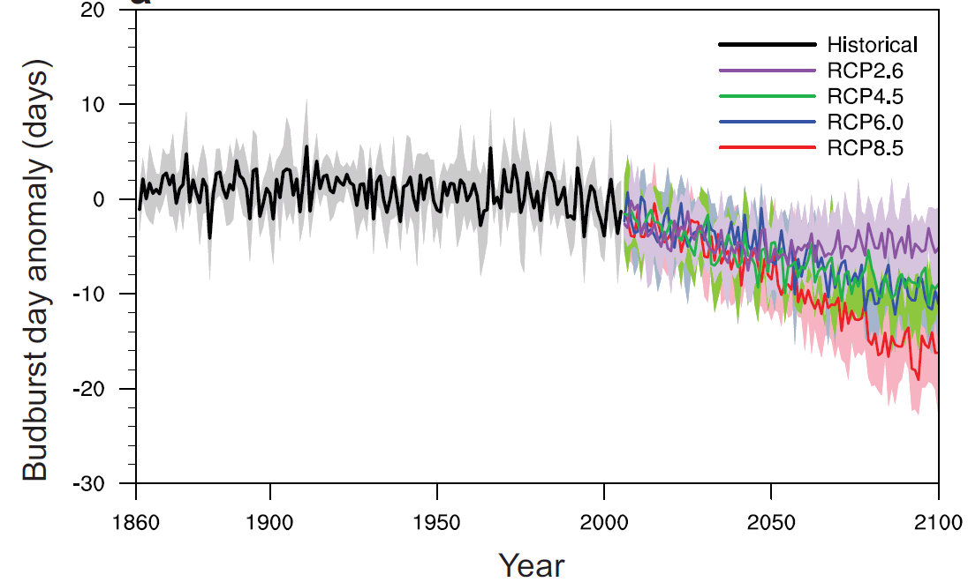
How do researchers…
forecast forest green-up at regional scales?
A. rubrum, 2080-2099
Red maple (A. rubrum)
Jeong et al., GRL 2013
Notes:
We can hindcast, and forecast, using models that are derived from our data…because we have data from across the entire range of species, we can easily parameterize regional models that link phenology to climate across huge regions, and backwards in time, and using CMIP5 projection of co2 emissions out to 2100. Basically, more co2 means earlier leafing, but that early response is most apparent at northern latitudes, which speeds up the rate of spring across the entire eastern half of the US.
Budburst date anomaly for A. rubrum. For each location, the anomaly are
computed relative to the 1980-1999 average budburst date. (a) Budburst date computed from
an area-weighted average over the continental U.S. The solid line in the figure indicates
ensemble mean of 6 kinds of CMIP5 models. The shading indicates the ensemble standard
deviation.
Right panel: Acer rubrum (Red maple) budburst date anomalies relative to the 1980–1999 average: Spatial patterns of budburst date anomaly
for the 2080–2099 period. The different maps correspond to the indicated RCPs. The domain is based on the current distribution
of A. rubrum from United States Department of Agriculture.
From:
Projecting future changes in spring phenology from backyard to continents
Su-Jong Jeong1,*, David Medvigy1, Elena Shevliakova2,3, and Sergey Malyshev2,3 Ronald J.
Stouffer3, and co-authors

Slide 8
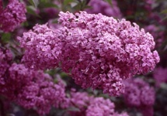
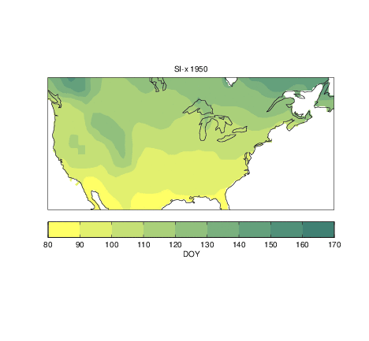
How do researchers…
understand impacts of anomalous climate?
Spring Onset, 1950-2012
From Ault et al., EOS 2013 and Ault et al., in prep
Notes:
Figure 1. Metrics of phenology during the spring and summer of 2012: a) Time series of station--‐‑
based extended spring indices anomalies with respect to the 1981--‐‑2010 climatology from 1900
through 2012 and averaged over the conterminous United States (the First Leaf Index described
in [Schwartz et al., 2006, 2012b]); b) Map of first leaf index anomalies (in days) with respect to
the 1981--‐‑2010 climatology; c) values of the Damage Index with respect to the 1981--‐‑2010
climatology (also described in [Schwartz et al., 2006]), which measures the anomalous number
of days between the last freeze event date and the First Leaf Index date (with high negative
numbers indicative of a long period of potential plant growth followed by a freeze event); d)
normalized anomalies, with respect to the 2001--‐‑2011 baseline, of the Thermal Time to Peak NDVI
(a metric of heat accumulated prior to peak spring greenness; cf. [de Beurs and Henebry 2005;
2008; 2010]); e) Normalized anomalies in modeled peak NDVI (again, with respect to 2001--‐‑2001),
indicating significantly lower values during the summer; and f) the NDVI time averaged across
the Corn Belt and around the western Great Lakes, shown by the box in panels d) and e) series
(in days from January 1 onward). The gray line in panel f) shows the 2001--‐‑2011 climatology,
and the black line shows the 2012 anomalies.

Slide 9
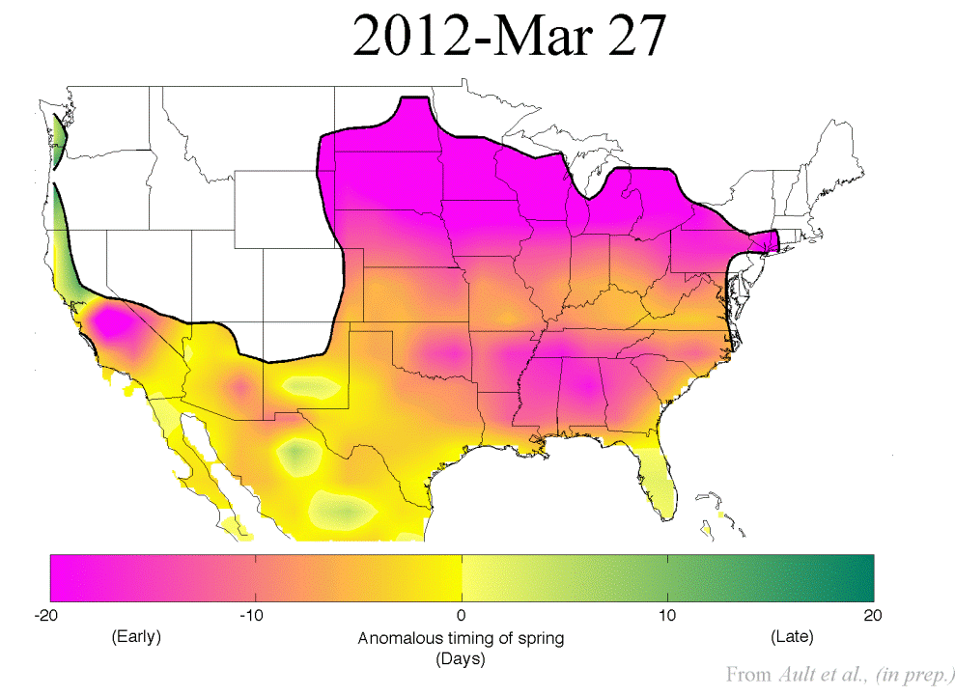
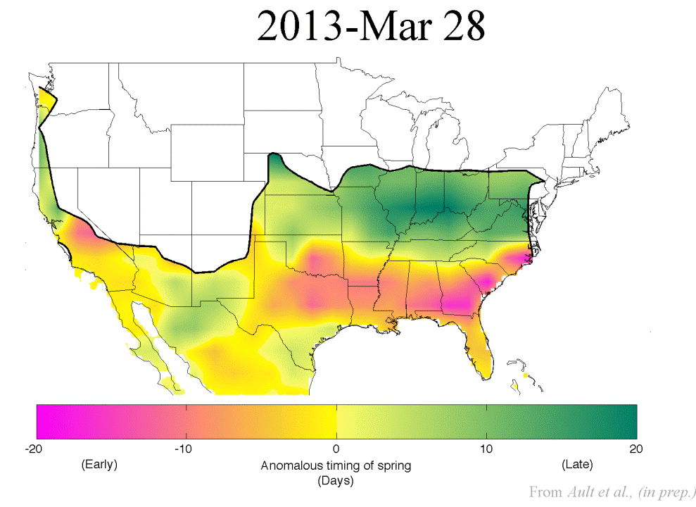
How do researchers understand…
spatio-temporal patterns at national scales?
Ault et al., in prep
Notes:
Placed side by side by Jake for viewing pleasure!

Slide 10
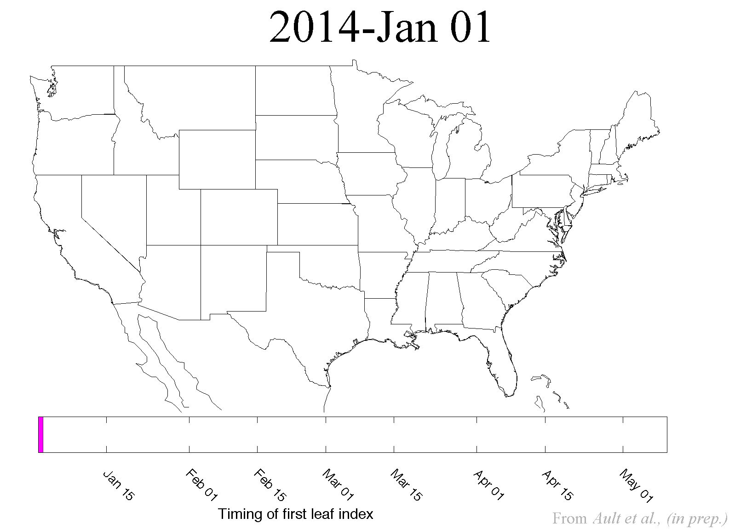
How do researchers understand…
spatio-temporal patterns at national scales?
Ault et al., in prep
Notes:
Placed side by side by Jake for viewing pleasure!

Slide 11
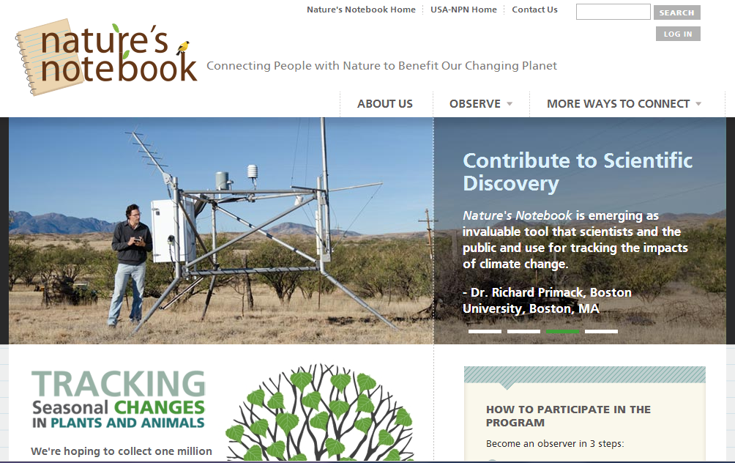

Slide 12

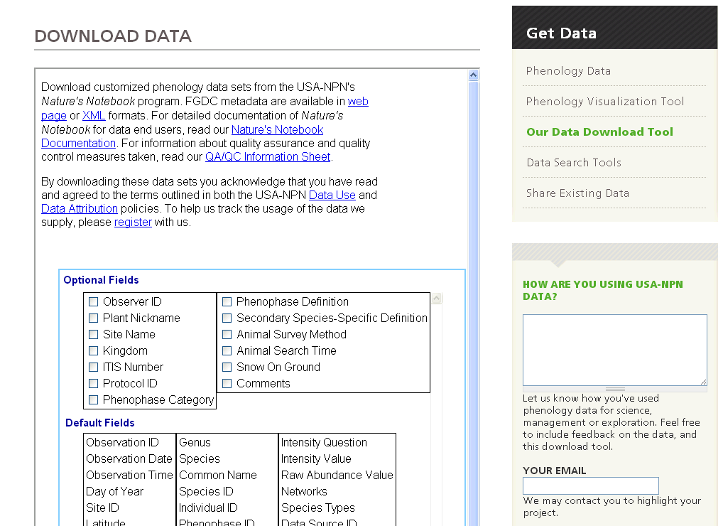
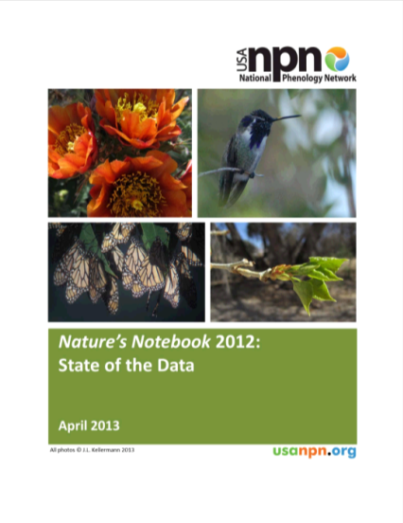
Data, metadata, documentation freely available
www.usanpn.org/results/data
Notes:
12
Hard to show "aggregation" so here's where you can get the data.
12

Slide 13
Monitoring Phenology at the USGS EROS Center
Gretchen Meier (ARTS)
with contributions from Jess Brown (USGS), Ross Evelsizer (USGS) and seven more awesome volunteers

Slide 14
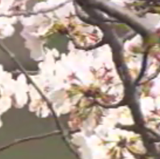
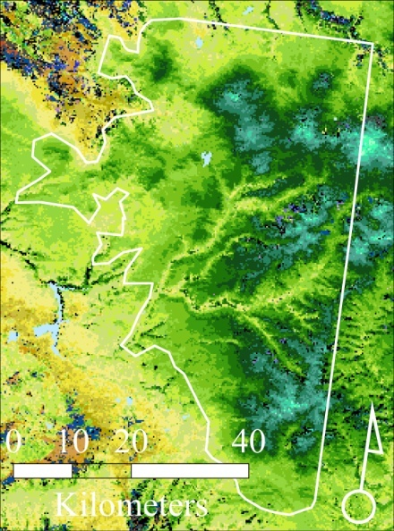
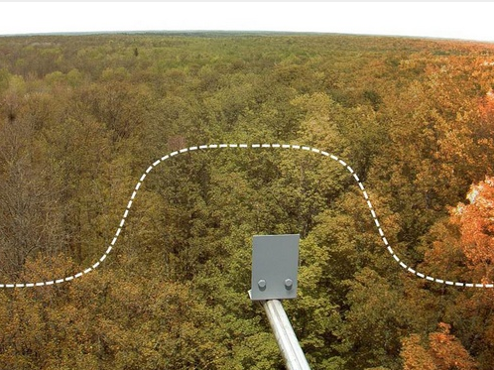
Ways we monitor phenology at EROS
Fine resolution
Stand level studies
cherry blossum record
Nature’s Notebook
Coarse resolution
250m eMODIS
Intermediate resolution
PhenoCam

Slide 15
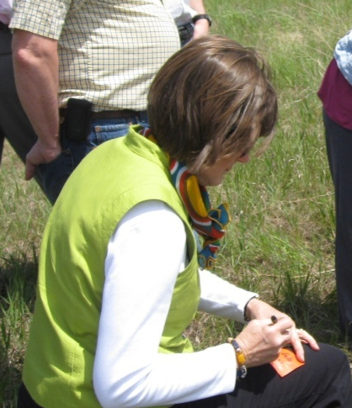
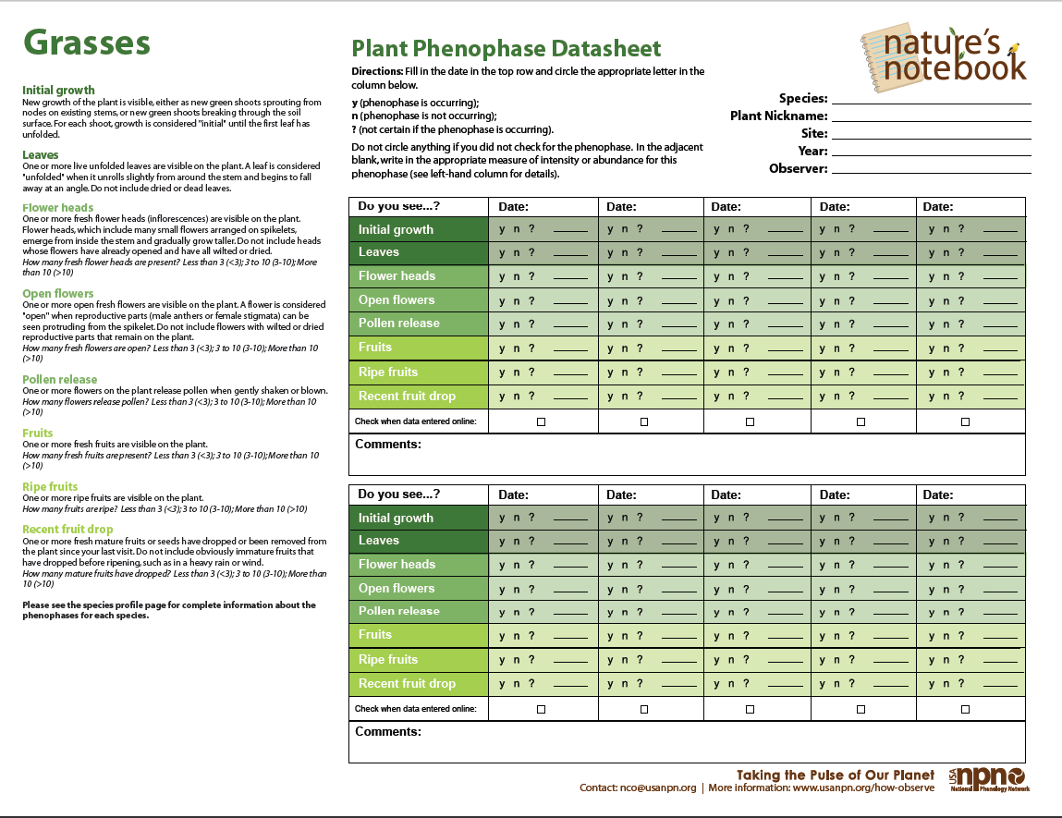
What we do …
Make weekly recording of phenophase on 14 plant species at 4 locations on the EROS grounds
Record observations for each species at https://www.usanpn.org
Program Goals
Contribute to phenology data resources used by scientists and others
Tie phenology observations and plot data to our satelite program
Increase participation to cover the growing season more thoroughly

Slide 16
Phenophases
 | Grasses | Forbs | Woody
Initial growth | ✓ | ✓ | ✓
Breaking leaf bud |  |  | ✓
Leaves | ✓ | ✓ | ✓
Increasing leaf size |  |  | ✓
Colored leaves |  |  | ✓
Falling leaves |  |  | ✓
Flower heads | ✓
Flowers | ✓ | ✓ | ✓
Open flowers |  | ✓ | ✓
Pollen release | ✓
Fruits | ✓ | ✓ | ✓
Ripe fruits | ✓ | ✓ | ✓
Recent fruit drop | ✓ | ✓ | ✓

Slide 17
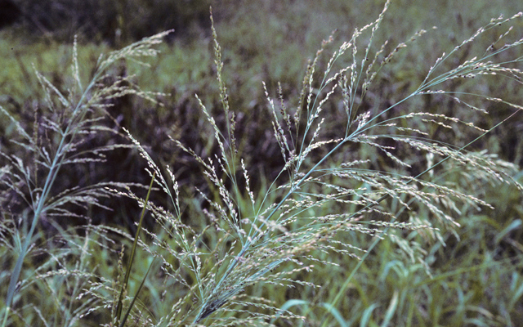
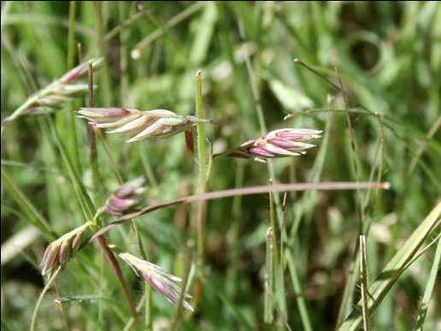
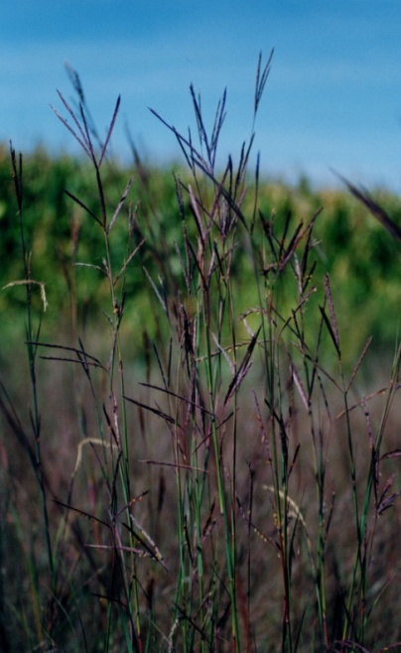
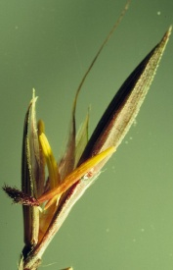
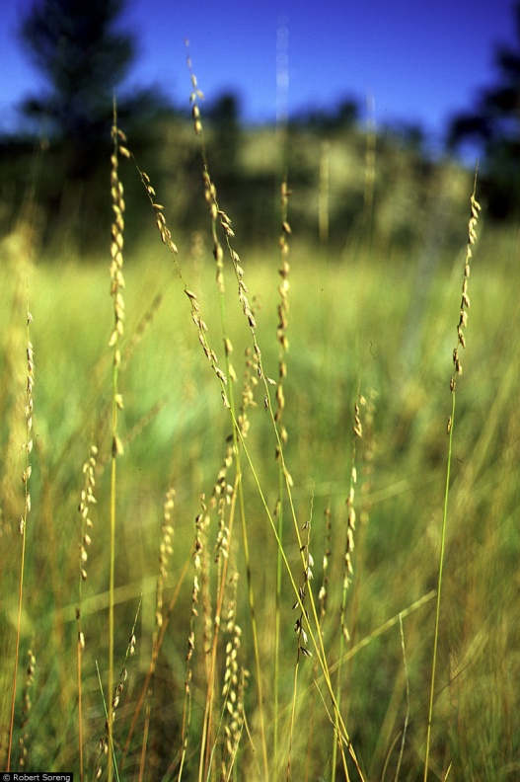
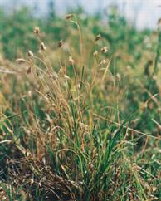
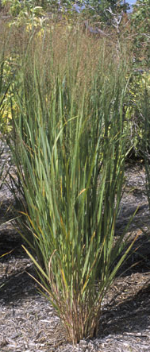
Site 1 – Grasses
Big Bluestem
Sideoats gramma
Switchgrass
Buffalograss
Notes:
Warm season grasses Switchgrass, Buffalograss, Big bluestem more efficient in drought high temps requires more energy
Became ecologically significant when grasses moved from shady forests to open environments. 46% of grasses
Sideoats gramma is a facultative C4 grass.
Buffalograss usually perfect flowers sometimes moneocious

Slide 18
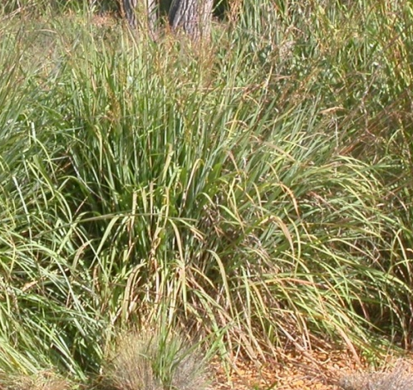
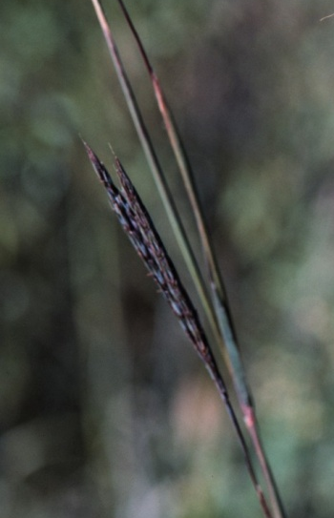
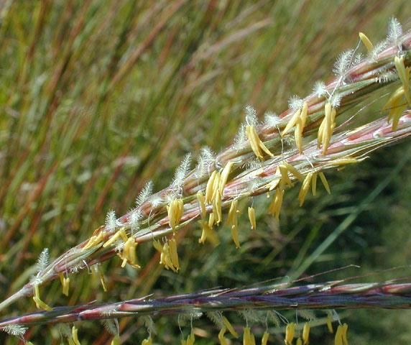
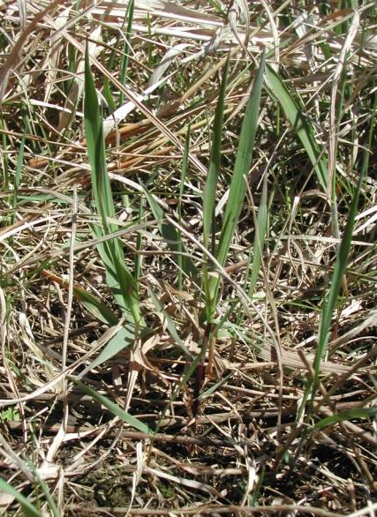

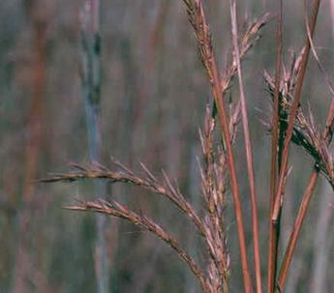
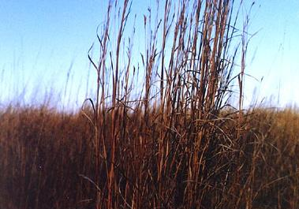
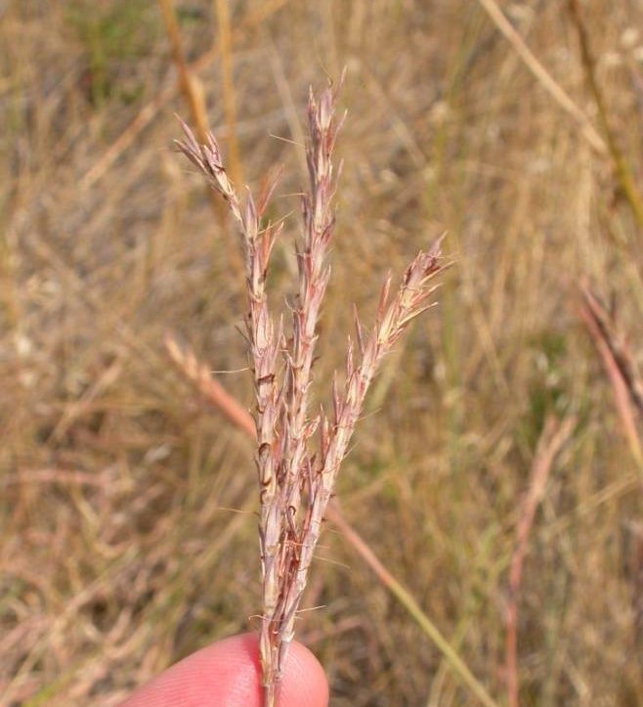
Phenophases of Big bluestem
Flower heads
Pollen release
Emerging growth
Leaves
Open flowers
Fruits
Ripe fruits
Recent fruit drop

Slide 19
Recording observations – grasses

Slide 20
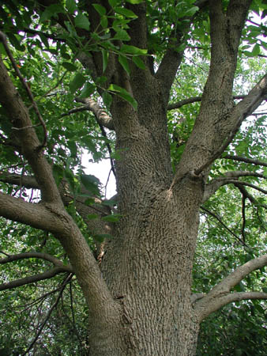
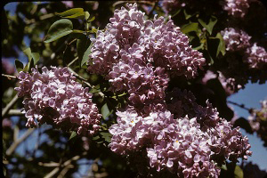
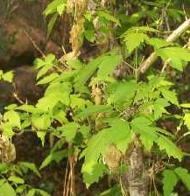
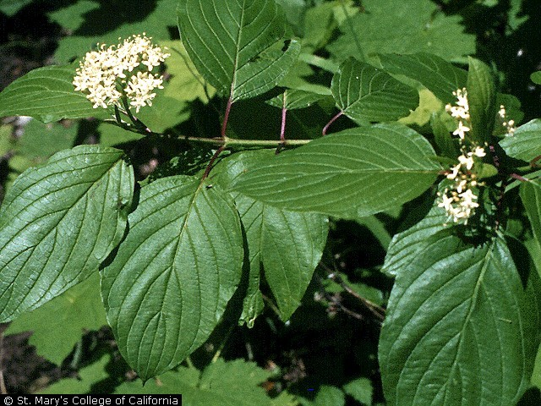




Site 2 – Deciduous trees and shrubs
Common lilac
Boxelder
Redosier dogwood
Green ash
European buckthorn

Slide 21








Phenophases of Redosier dogwood
Breaking leaf buds
Leaves
Colored leaves
Increasing leaf size
Recent fruit drop
Falling leaves
Ripe fruit
Open flowers

Slide 22

Recording observations for woody plants

Slide 23








Site 3 – Forbs
Common milkweed
Leafy spurge
Missouri goldenrod
Notes:
Spurge – Monoecious male and female separate but on the same plant
Explosive seed pods, can germinate anytime moisture is available
Large bracts, 2 flowers inferior ovary, large stigma and anthers
First plants to emerge in the spring. Asexual and sexual reproduction
Roots as deep as 9 meters
Leafy bracts no petals
2 subspecies and 1 hybrid – genetically variable can opccupy dry moist and wet sites.

Slide 24










Site 4 – Wood’s rose and Cloned lilac

Slide 25


Site locations
Site 1 Big bluestem
Switchgrass
Buffalograss
Side oats grama
Site 2 Boxelder
Common lilac
Green ash
Redosier dogwood European buckthorn
Site 3 Missouri goldenrod Common milkweed Spotted knapweed
Site 4 Cloned lilac, Wood’s rose
3
2
1
Cloned lilac
4

Slide 26

Dynamic tools for visualizing data
www.usanpn.org/data/visualizations
Notes:
We're doing a fair amount of work behind the scenes on derivation of data products…but, derivation involves being able to show data in a variety of ways.

Slide 27
Phenophases of Big bluestem
2011 National
2010 National
2011 EROS
2010 EROS
Julian day
Emerging
Leaves
Flowers
Seeds

Slide 28

http:// phenology.cr.usgs.gov

Slide 29



>22 year time-series supports monitoring of land change
Normalized Difference Vegetation Index (NDVI)
Phenological Metrics:
Start of Season
End of Season
Length of Season
Growing season production
Greenness “to-date”
Notes:
As a basis for national terrestrial monitoring, there is great value of the AVHRR satellite database that has been consistently processed and is provided by the USGS EROS Data Center as a standard product for over 20 years. We also calculate a number of other measures from the NDVI (Normalized Difference Vegetation Index—aka “Greenness”).

Slide 30


Slide 31


Slide 32
http:// phenology.cr.usgs.gov

Slide 33



Slide 34


Start of Season from 250m MODIS data
2010
2011

Slide 35









Start of season at EROS
2009
2010
2011
2012
 | 2009 | 2010 | 2011 | 2012
NPN 5 state mean |  | May wk3 | May wk2 | April wk3
USGS EROS |  | May wk3 | May wk2 | March wk 3
USGS RSP | April wk4 | April wk1 | April wk3 | April wk1

Slide 36


Slide 37
Phenology Websites
USGS Remote Sensing Phenology
http:// phenology.cr.usgs.gov
NPN’s Nature Notebook
https://www.usanpn.org/natures_notebook

