Slide 1
USGS EROS Center – The Landsat Archive
Access through the Landsat Look Viewer
U.S. Department of the Interior
U.S. Geological Survey

Slide 2
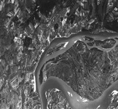
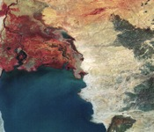
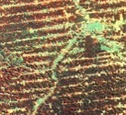
Satellite Collections
Declass 1 (Corona) 1960 – 1972
Declass 2 (KH-7, KH-9) 1963 – 1980
SPOT Pan/Multispectral 1986 – 1998
Landsat MSS 1972 – 1992
Landsat Thematic Mapper 1982 – Present
Landsat 7 ETM+ 1999 – Present
Landsat 8 OLI/TIRS 2013 -- Present
EOS/MODIS 2000 – Present
EOS/ASTER 2000 – Present
AVHRR LAC/HRPT 1986 – Present
EO-1 2001 – Present
SIR-C 1994
Commercial Data Purchases 2002 – Present

Slide 3
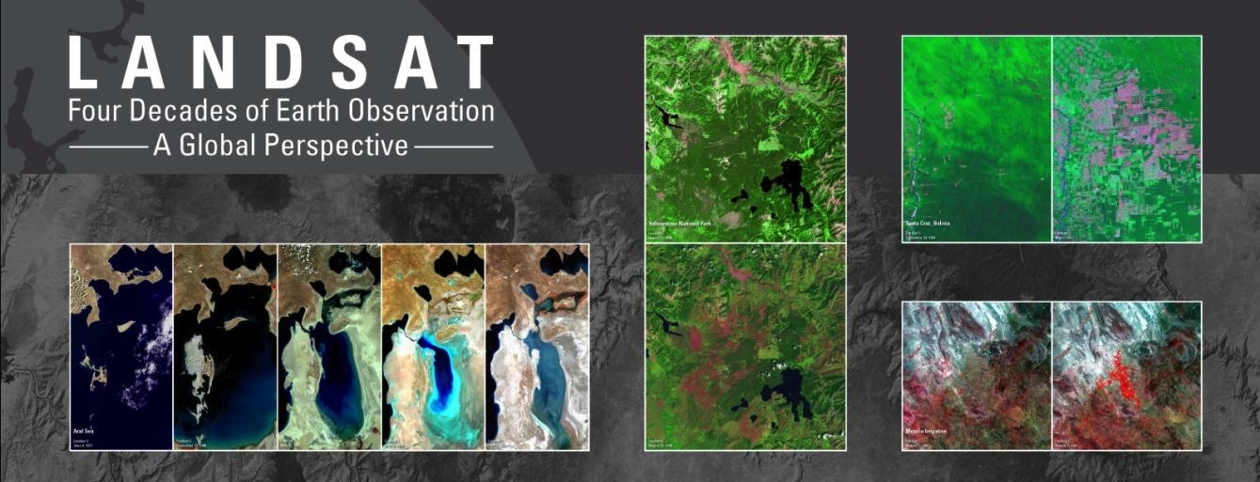
Landsat - the longest and most comprehensive record of the Earth’s condition ever assembled.
The EROS Landsat archive includes more than 4 million images from 1972 to the present – and spanning the globe.
All Landsat images are available to anyone at no cost.
Each year nearly 3 million images are distributed to users in over 180 nations and territories.
Notes:
An unprecedented record.

Slide 4
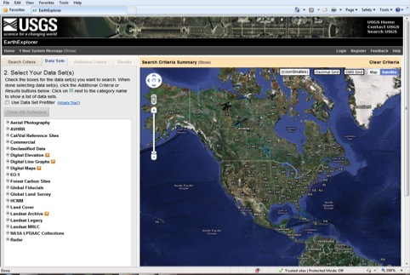
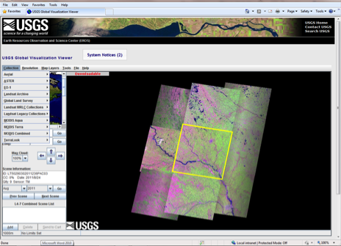
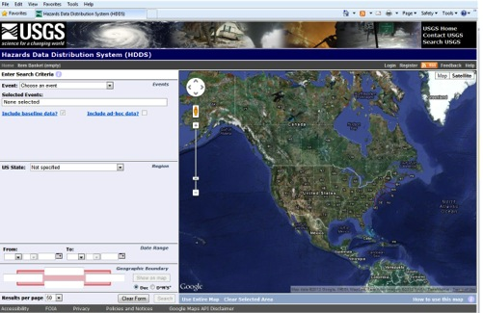
Accessing Data
EarthExplorer
http://earthexplorer.usgs.gov
Global Visualization Viewer
http://glovis.usgs.gov/
LandsatLook
http://landsatlook.usgs.gov/
NASA ECHO
https://wist.echo.nasa.gov/api/
Hazards Data Dist. System
http://hdds.usgs.gov/hdds

Slide 5
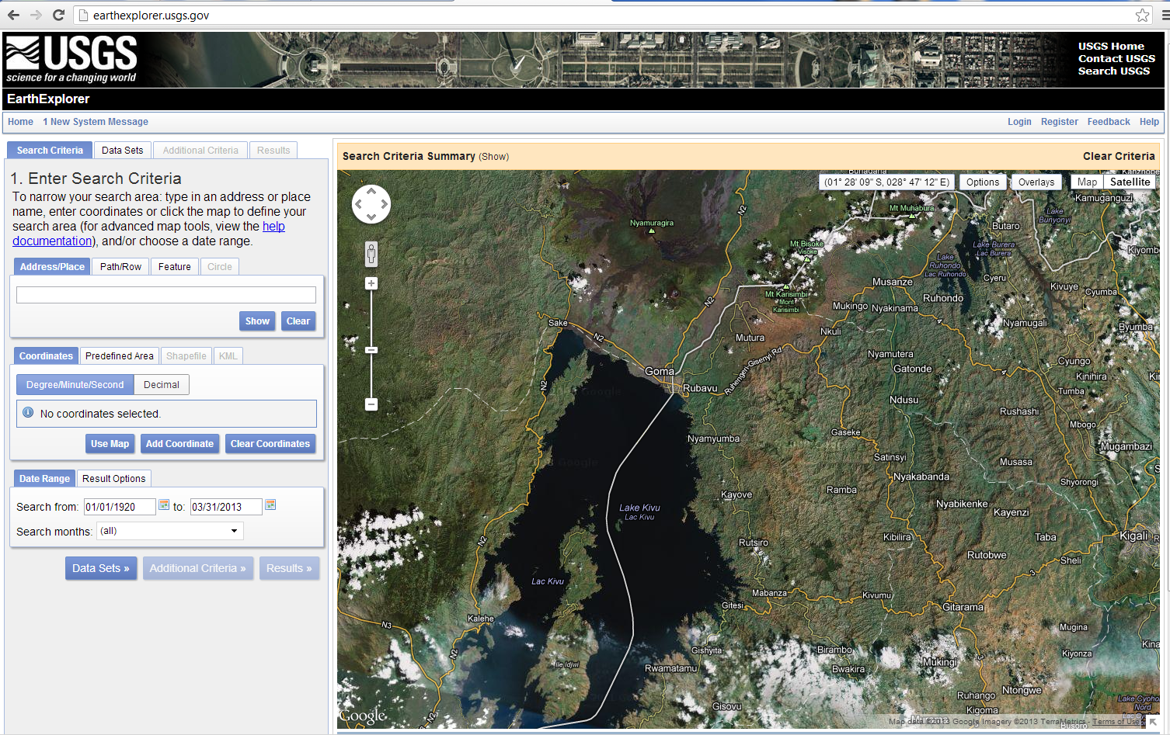
Landsat Imagery from Earth Explorer

Slide 6
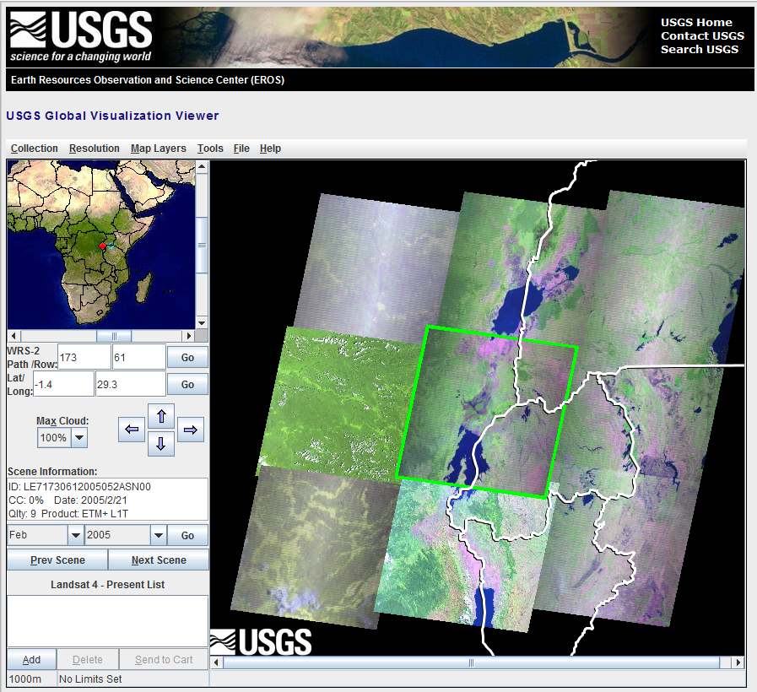
Landsat on GloVis

Slide 7
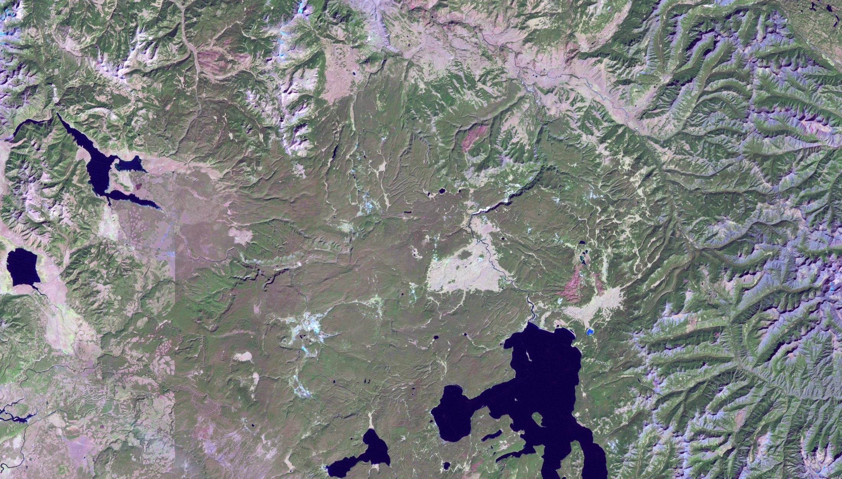
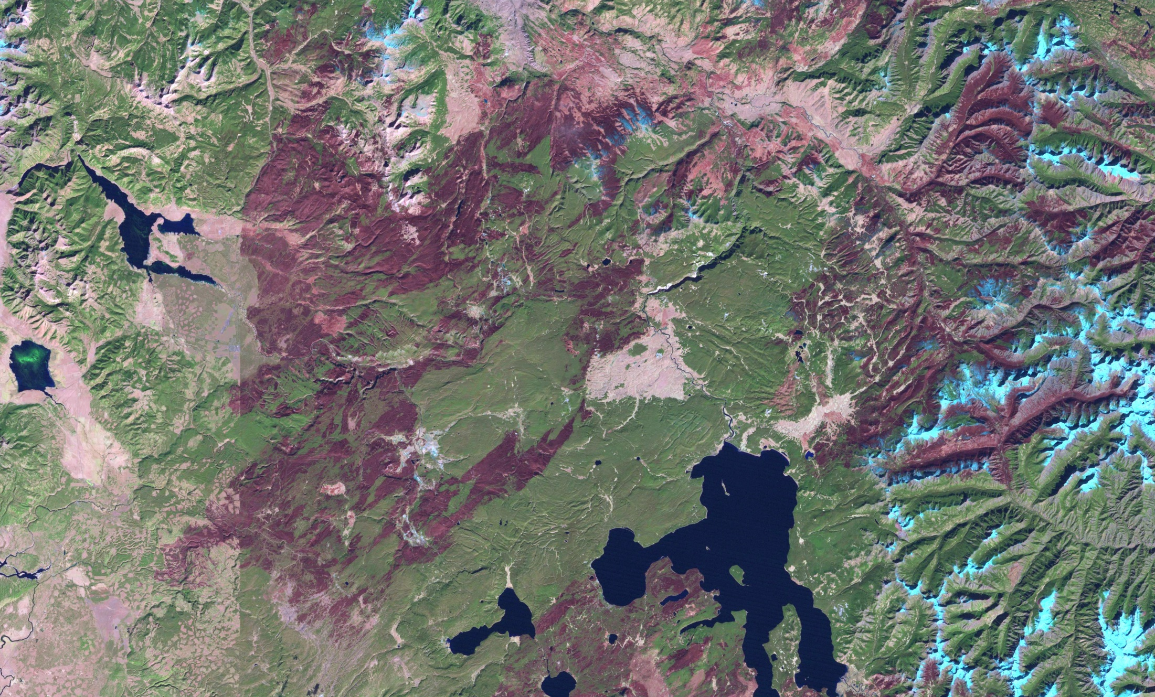
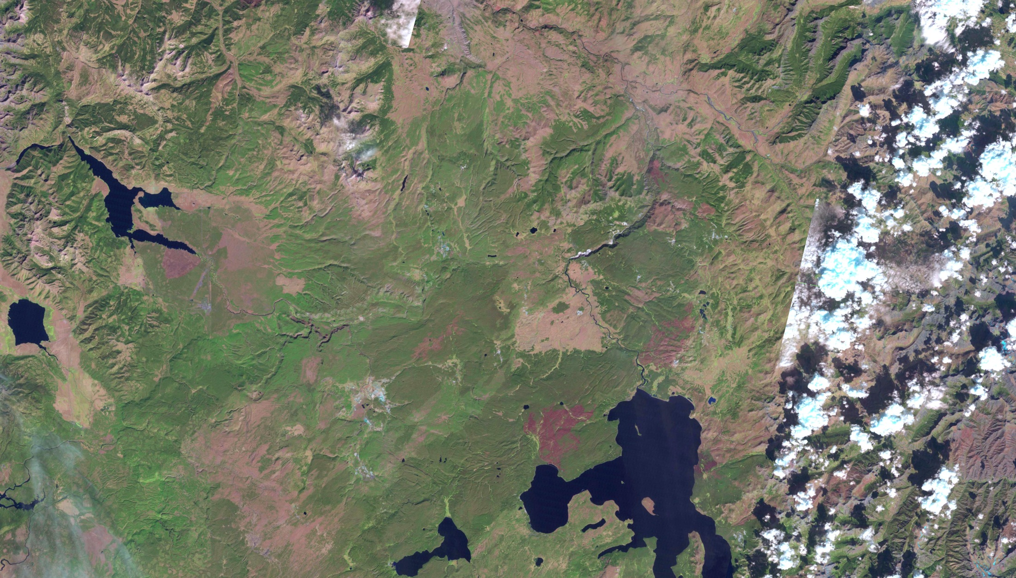
“But I just want a good browse image…..”

Slide 8
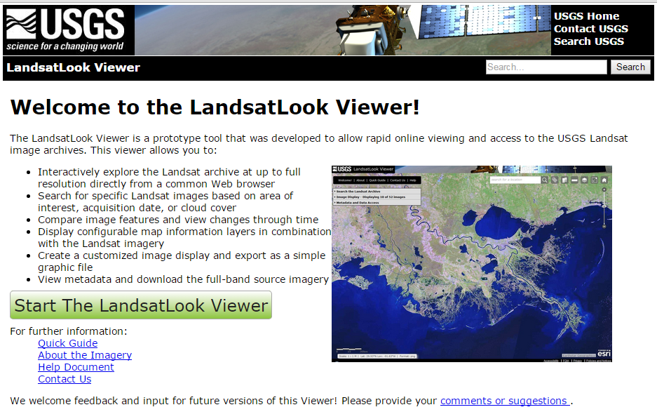

Slide 9
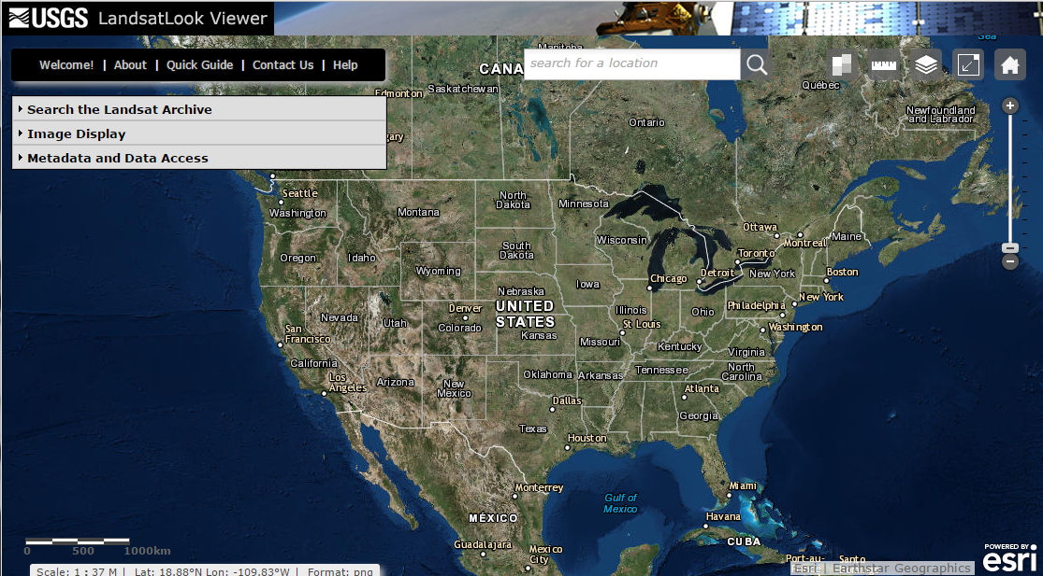
The LandsatLook Viewer
http://landsatlook.usgs.gov

Slide 10
What is the LandsatLook Viewer?
The LandsatLook Viewer allows user to quickly and easily explore the complete Landsat archive… through time… at full resolution.
Web-based tool displays all or part of Landsat 1-8 archive
Based on full-resolution browse (FRB) image services
3-band RGB composites
Immediate public access (no need for registration, log-in, etc.)
Allows image viewing and extraction (“screen scrape”) in multiple formats
No need to download/transfer, unpack (gz/tar), layer stack, etc.

Slide 11
Landsat on LandsatLook
(Full-Resolution Browse)

Slide 12
What is LandsatLook ?
Particularly useful for:
General public, outreach and communications, image sharing, students and educators, non-scientists and non-remote sensing specialists, scientific “quick looks”, low-bandwidth users, etc.

Slide 13
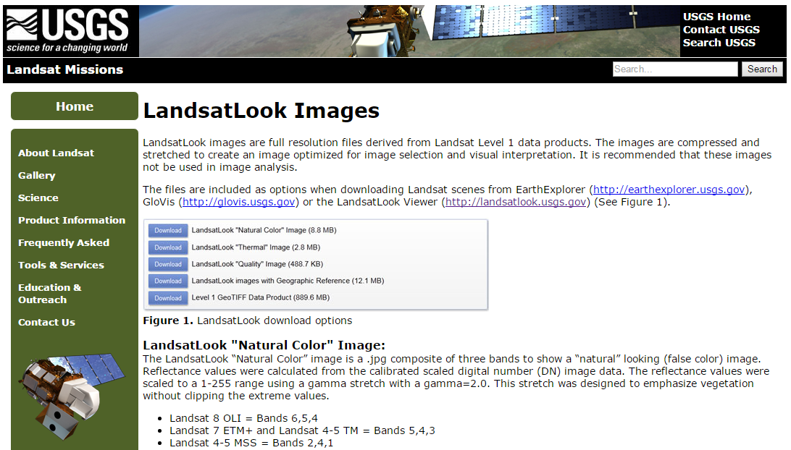

Slide 15
VIDEO

Slide 16
Thank You!
http://landsatlook.usgs.gov

