Slide 1

USGS EROS Center – An Idea that Worked
40 Years of Service to Our Planet
U.S. Department of the Interior
U.S. Geological Survey

Slide 2
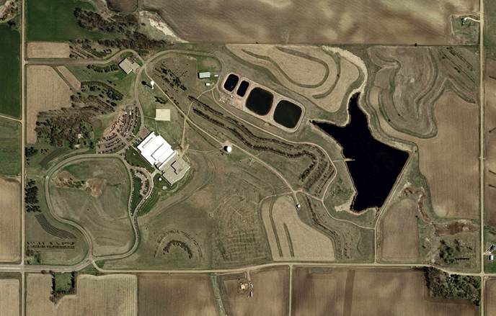
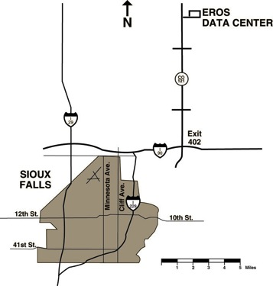
EROS Campus
Warehouse/Maintenance
GOES
Antenna
Heavy Equipment
and Fuel Storage
SCAN
Back-up
Generator Plant
Landsat
10M Antenna
1973
Lake EROS
AVHRR Antenna
1996
Future
Antenna
AERONET
RCS
CRN
ANSS
10M Fixed
Antenna
SURFRAD
CORS/GSOS
Landsat
5.4M Antenna
Security
2 acres
N
2004 aerial imagery
AERONET: Aerosol Robotic network CRN: US Climate Reference Network
SCAN: Soil Climate Analysis Network - USDA SURFRAD: Surface Radiation Network
ANSS: Advanced National Seismic Station - USGS
CORS/GSOS: Constantly Operating Reference Station / GPS Surface Observing System
RCS: Reference Climate Station – Canada – Future Site
Notes:
So, how has the 320 acres been used?

Slide 3

EROS Mission
… contributing to the understanding of a changing Earth.
Notes:
In 1966, then Secretary of the Interior Stewart Udall, at the encouragement of William Pecora the Director of the USGS at the time and a true visionary, announce Project EROS. The beginning of Earth observation for the Nation.
1969 - NASA began building the first land observing satellite (Landsat).
NASA and the Department of the Interior identified the need for a facility to be located in the middle of the continent to: collect, archive, analyze, and distribute satellite data.
1970 - South Dakota Senator Karl Mundt and Congressman Ben Reifel thought that putting EROS in Sioux Falls would bring many jobs to the state, and also would bring “space age” technology to South Dakota.

Slide 4
The EROS Center is…
A USGS science center and one of the world’s largest land remote sensing centers
Landsat satellite mission ground segment – developer and operator
National Satellite Land Remote Sensing Data Archive (NSLRSDA)
NASA Land Processes Distributed Active Archive Center (LPDAAC)
Member of the International Charter for Major Disasters and Space
United Nations Environment Programme Global Resources Information Databases (UNEP GRID) Office host
Co-leader of the USGS-South Dakota State University Geographic Information Sciences Center of Excellence (GIScCE)
Notes:
Reiterate the breakdown of the workforce today: 143 government and 466 contractors.
The contract workforce is spread across nine separate contracts, with the largest being a company called SGT, Inc. (Stinger Ghaffarian Technologies) – ~364 employees. The other contracts range from a science support contract (ARTS) to custodial services.
Sample set of skills at EROS.
Remote Sensing science Environmental modeling
Application development Product/Information development
Systems engineering Satellite systems operation and management
Systems development Archive management/preservation
Information science Network architecture, design and operations
Budget and finance Facility operations and maintenance

Slide 5
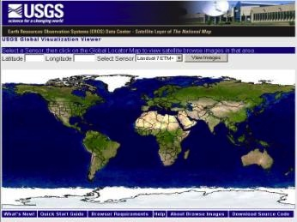
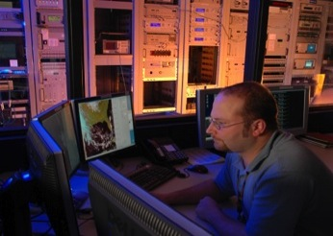
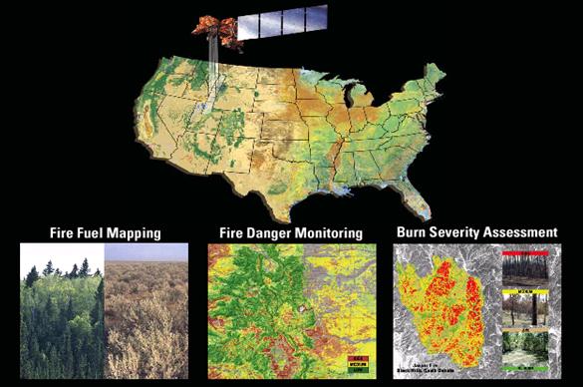
Key EROS Mission Functions…
Data Acquisition, Archiving and
Access: Expand and safeguard
the archive and ensure that
anyone, anywhere and at anytime
have ready access to land information
Development and Operations of
Ground Systems: Satellite mission
ground system designer, developer and
operator.
Science: Conduct research and
develop applications and promote
knowledge and use of land
information to better understand
the Earth
Notes:
The key functions that make up the EROS mission are:
Acquiring and preserving land remote sensing data. In fact, EROS is the largest civilian archive of land remote sensing data in the world. Much of what you see each day on Google and Microsoft Maps comes from EROS.
Ensuring timely ready access to that data to anyone, anywhere, anytime – for free! Tell the free data revolution …
Science - applying these and other data to understanding the changes that are occurring on the surface of the Earth.
Understanding the rates, causes, and consequences of land change.

Slide 6
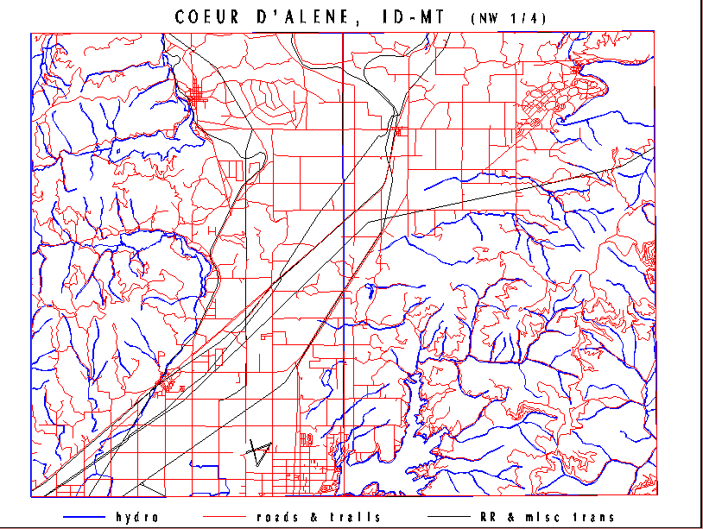
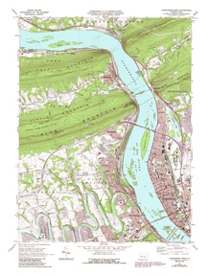
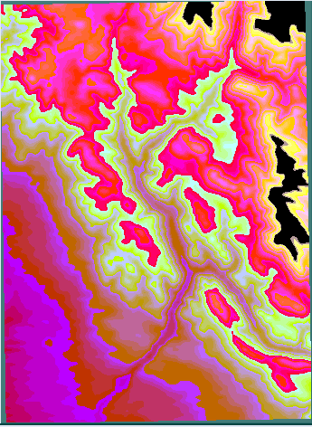
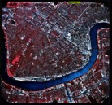

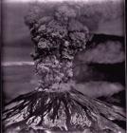
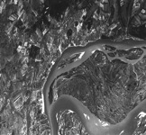
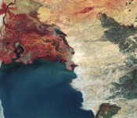
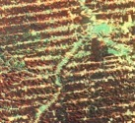
Long Term Archive
Aerial Photography Collections
U.S. Geological Survey Photography 1939 - 1995
National High Altitude Photography 1980 - 1989
National Aerial Photography Program 1987 - 2004
Space Acquired Photography 1969 - 1984
Other U.S. Federal Aerial Photography 1937 - 1999
Side-Looking Airborne Radar 1980 - 1994
High Resolution Orthorectified 2003 - Present
National Agriculture Imagery Program 2003 - Present
Cartographic - Topographic Collections
Digital Line Graphs
  1:24,000*
  1:100,000
Digital Elevation Models
  7.5º
  15’Alaska
  2 Arc Second**
  1:250,000
Digital Raster Graphics
  1:24,000
  1:100,000
  1:250,000
Digital Orthophoto Quads
National Atlas
National Elevation Database
SRTM
Satellite Collections
Declass 1 (Corona) 1960 – 1972
Declass 2 (KH-7, KH-9) 1963 – 1980
SPOT Pan/Multispectral 1986 – 1998
Landsat MSS 1972 – 1992
Landsat Thematic Mapper 1982 – Present
Landsat 7 ETM+ 1999 – Present
Landsat 8 OLI/TIRS 2013 -- Present
EOS/MODIS 2000 – Present
EOS/ASTER 2000 – Present
AVHRR LAC/HRPT 1986 – Present
EO-1 2001 – Present
SIR-C 1994
Commercial Data Purchases 2002 – Present
Collection Diversity
    Aerial
    Cartographic - Topographic
    Satellite
Digital and film archive media
Static and growing collections

Slide 7
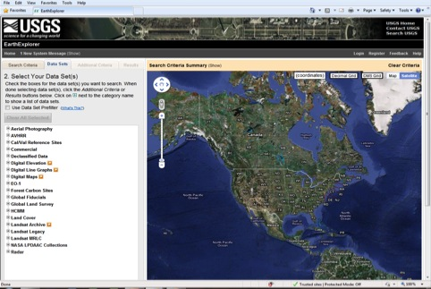
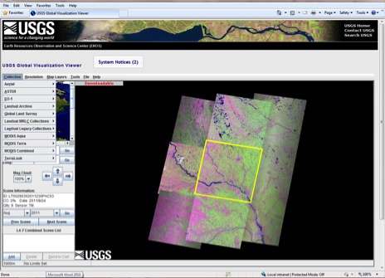
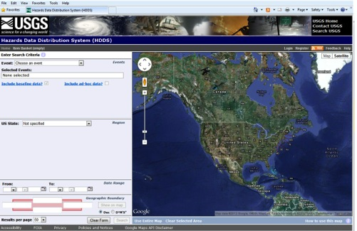
Accessing Data
EarthExplorer
  http://earthexplorer.usgs.gov
Global Visualization Viewer
  http://glovis.usgs.gov/
LandsatLook
  http://landsatlook.usgs.gov/
NASA ECHO
  https://wist.echo.nasa.gov/api/
Hazards Data Dist. System
  http://hdds.usgs.gov/hdds

Slide 8
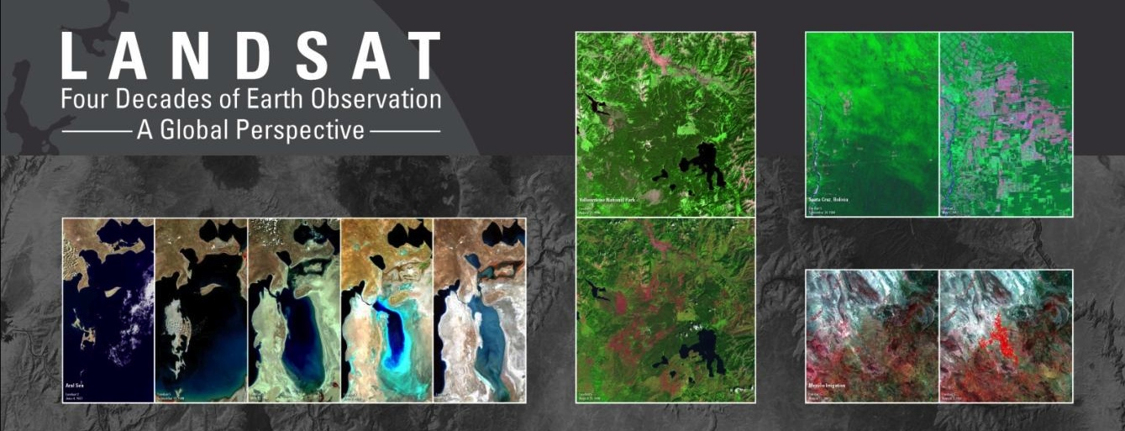
Landsat - the longest and most comprehensive record of the Earth’s condition ever assembled.
The EROS Landsat archive includes more than 4 million images from 1972 to the present – and spanning the globe.
All Landsat images are available to anyone at no cost.
  Each year nearly 3 million images are distributed to users in over 180 nations and territories.
Notes:
An unprecedented record.

Slide 9
Driving the need for Landsat…
Science – understanding a changing planet
Operational applications – managing and monitoring resources for economic and environmental quality, public health and human well-being, and national security
Both require:
  A global perspective
  A long-term record of observation
  Consistent measurement of key variables or indicators
  Affordability and accessibility
Diverse uses of Landsat data include:
Agricultural
Mapping
Fire/Disaster Management
Carbon Inventory/Credits
Land Use Planning
Deforestation
Global Change
Flood management
National Security
Ecosystem Management
Land Use/Land Cover Classification
Water Resources Management
Glacier Monitoring
Insurance Risk Management
International Treaty Management

Slide 10
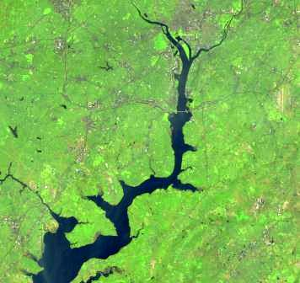
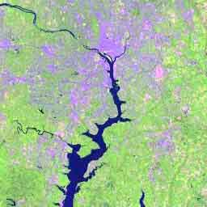
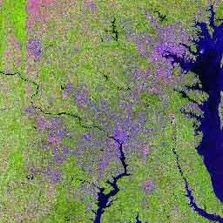
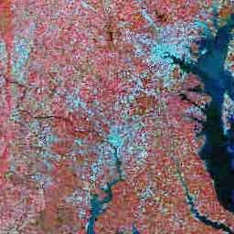
U.S. Landsat Archive
(August 1, 2013)
OLI-TIRS: Landsat 8
  63,548 scenes
    ~ 219 TB Raw and L0Ra Data
    average scene size 1813 MB
ETM+: Landsat 7
  1,615,620 scenes
    ~ 1,500 TB Raw and L0Ra Data
    average scene size 487 MB
TM: Landsat 4 & Landsat 5
  1,776,755 scenes
    ~ 891 TB Raw and L0Ra Data
    average scene size 263 MB
MSS: Landsat 1 through 5
  866,762 scenes
    ~ 52 TB Raw and L0Ra Data
    average scene size 32 MB
Total:
  4,322,685 scenes
    ~ 2662 TB Raw and L0Ra Data

Slide 11
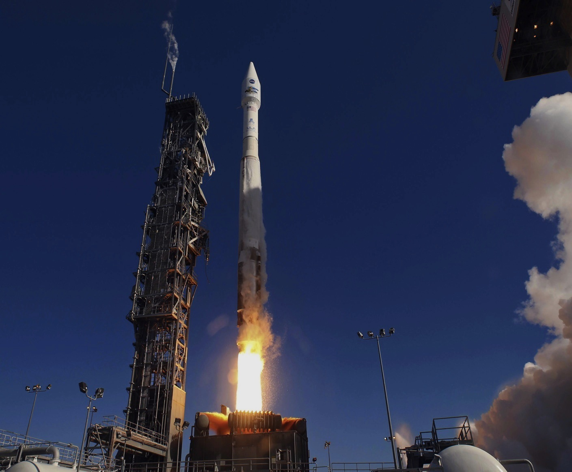
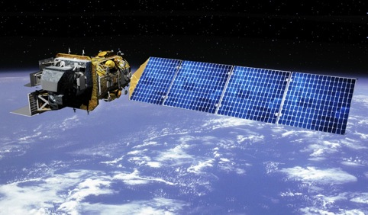
Landsat 8 Launched Feb. 11, 1013
Landsat 8 Operational
May 30, 2013

Slide 12
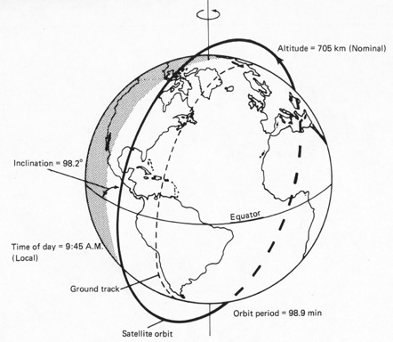
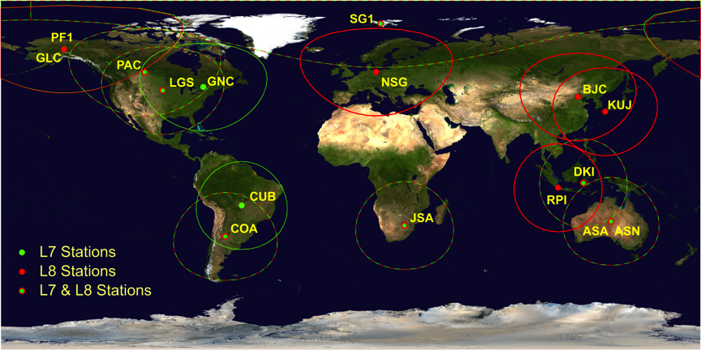
Landsat 8 Operations
Landsat 8 – 428 miles (705 km), near-polar, sun-synchronous orbit
  Global coverage every 16 days
All data are archived for long term preservation
Data are provide on a nondiscriminatory basis at no cost
Data are also broadcast to network of international ground stations

Slide 13
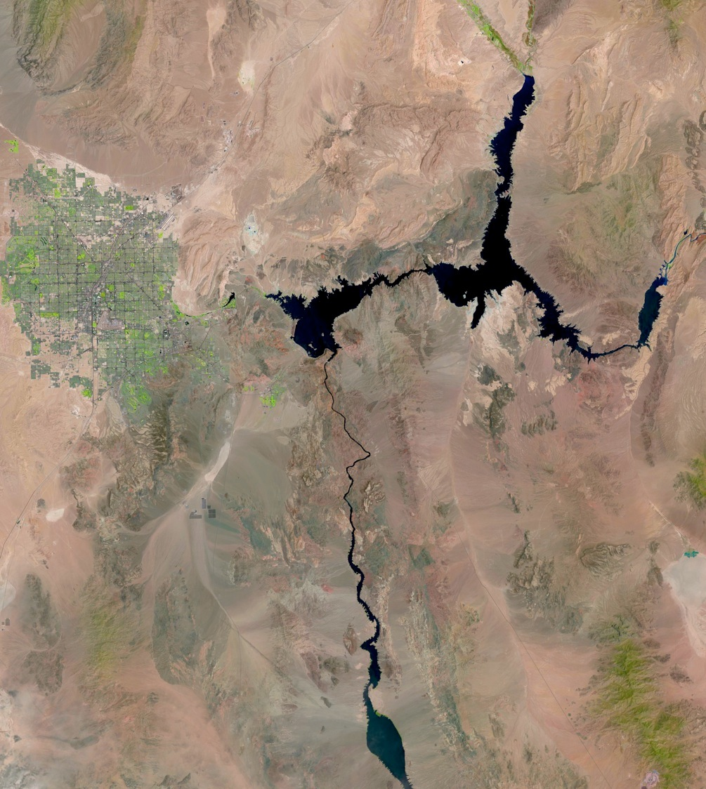
Landsat 8 Capabilities: More, Better, New Data
More image data - collecting approximately 500 new scenes per day
  New images are available to users in less than 8 hours after acquisition
  Restored 8 day revisit cycle lost when Landsat 5 was decommissioned
Better image data – improves surface characterization
  8-10x improvement in signal to noise ratios
  12 bit quantization permits improved measurement of subtle surface conditions and assessment of bright targets
  Improved pixel geo-location ~ 12m
New measurements – enabling new applications
  Coastal blue band (0.433–0.453 μm)
  Cirrus band (1.360–1.390 μm)
  Additional thermal band

Slide 14
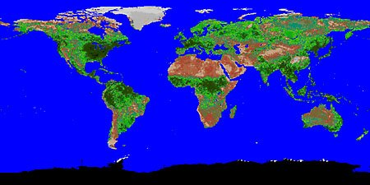
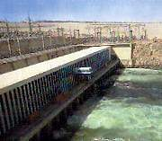
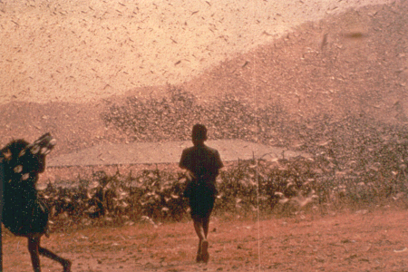
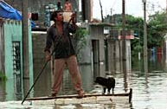
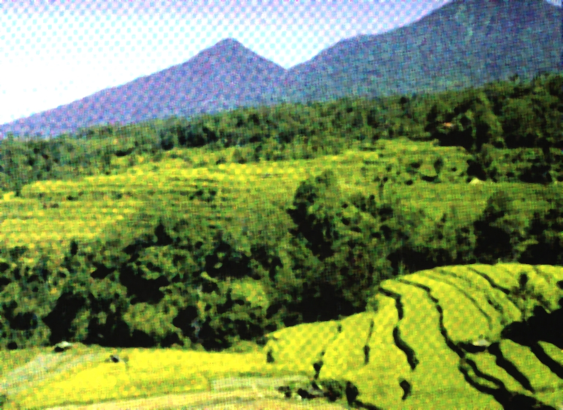

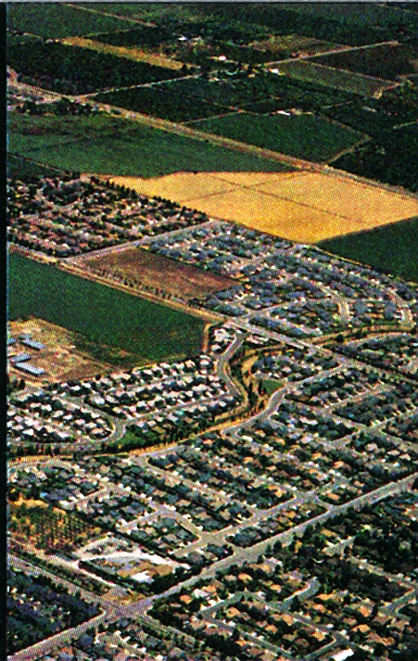
Land Change Science
Understanding patterns, processes, and consequences of land change, as it occurs, using a framework that is globally consistent and locally relevant – and that meets the needs of decision makers.
POPULATION / LANDCOVER
HUMAN HEALTH
WATER
RESOURCES
NATURAL DISASTER
MANAGEMENT
BIODIVERSITY
AGRICULTURAL / FOREST

Slide 15
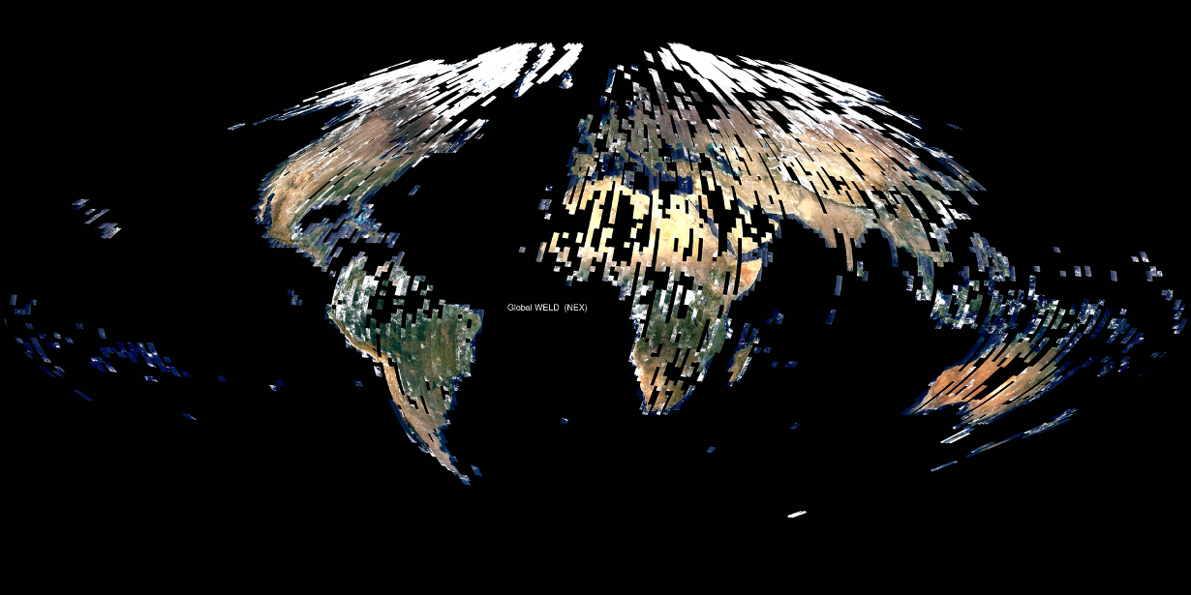

Moving toward global monitoring with Landsat
Provision of advanced geophysical time-series measurements is in the works –
  Surface reflectance, surface temperature
  Environmental variables (land cover, surface water, burned areas. leaf area index, albedo, etc.)
Delivery of seamless calibrated, temporal Landsat data
April 2010 – based on over 7000 Landsat 7 Images

Slide 16
Land Change Monitoring: Regional to Global
Notes:
NLCD products are created by the Multi-Resolution Land Characteristics (MRLC) Consortium, a partnership of Federal agencies led by the U.S. Geological Survey. All NLCD data products are available for download at no charge to the public from the MRLC Web site: http://www.mrlc.gov.
Land Cover Applications
NLCD supports thousands of applications in the private, public, and academic sectors, and offers the only national database portraying land cover change spatially as a comprehensive “wall-to-wall” 30-meter cell database. The broad spectrum of programmatic and user support for NLCD stems from this complete national spatial coverage. NLCD is used for a vast array of topical applications such as the assessment of ecosystem status and health, understanding spatial patterns of biodiversity, understanding climate change, and developing land management policy. It is a critical data layer in national assessments of biological carbon sequestration, water-quality monitoring, wildfire monitoring and modeling, and biodiversity conservation efforts.
Future Directions
NLCD strives to be the future primary land change monitoring “wall-to-wall” database for the United States, capable of delivering critical data for understanding the locations, magnitudes, and effects of land cover change.
Global 30 meter Land Cover
The aim of the project is to develop the first-ever comprehensive and up-to-date LCLCC database of the world at 30-m spatial resolution using Landsat satellite data. Specific research objectives of the project are to (1) produce global land cover estimates of percent tree (see image above), percent bare ground, percent other vegetation, and percent water presence for 2000 and 2010 at nominal 30-m resolution; (2) develop an initial global land cover (type) baseline for the 2010 period; (3) implement an ongoing monitoring system that provides periodic (annually, biennially, and quinquennially) land cover updates and change products; (4) improve the availability and accessibility of 30-m class satellite data (whenever possible); and (5) establish the capability and capacity to develop historical land change time series (1970s to present).

Slide 17
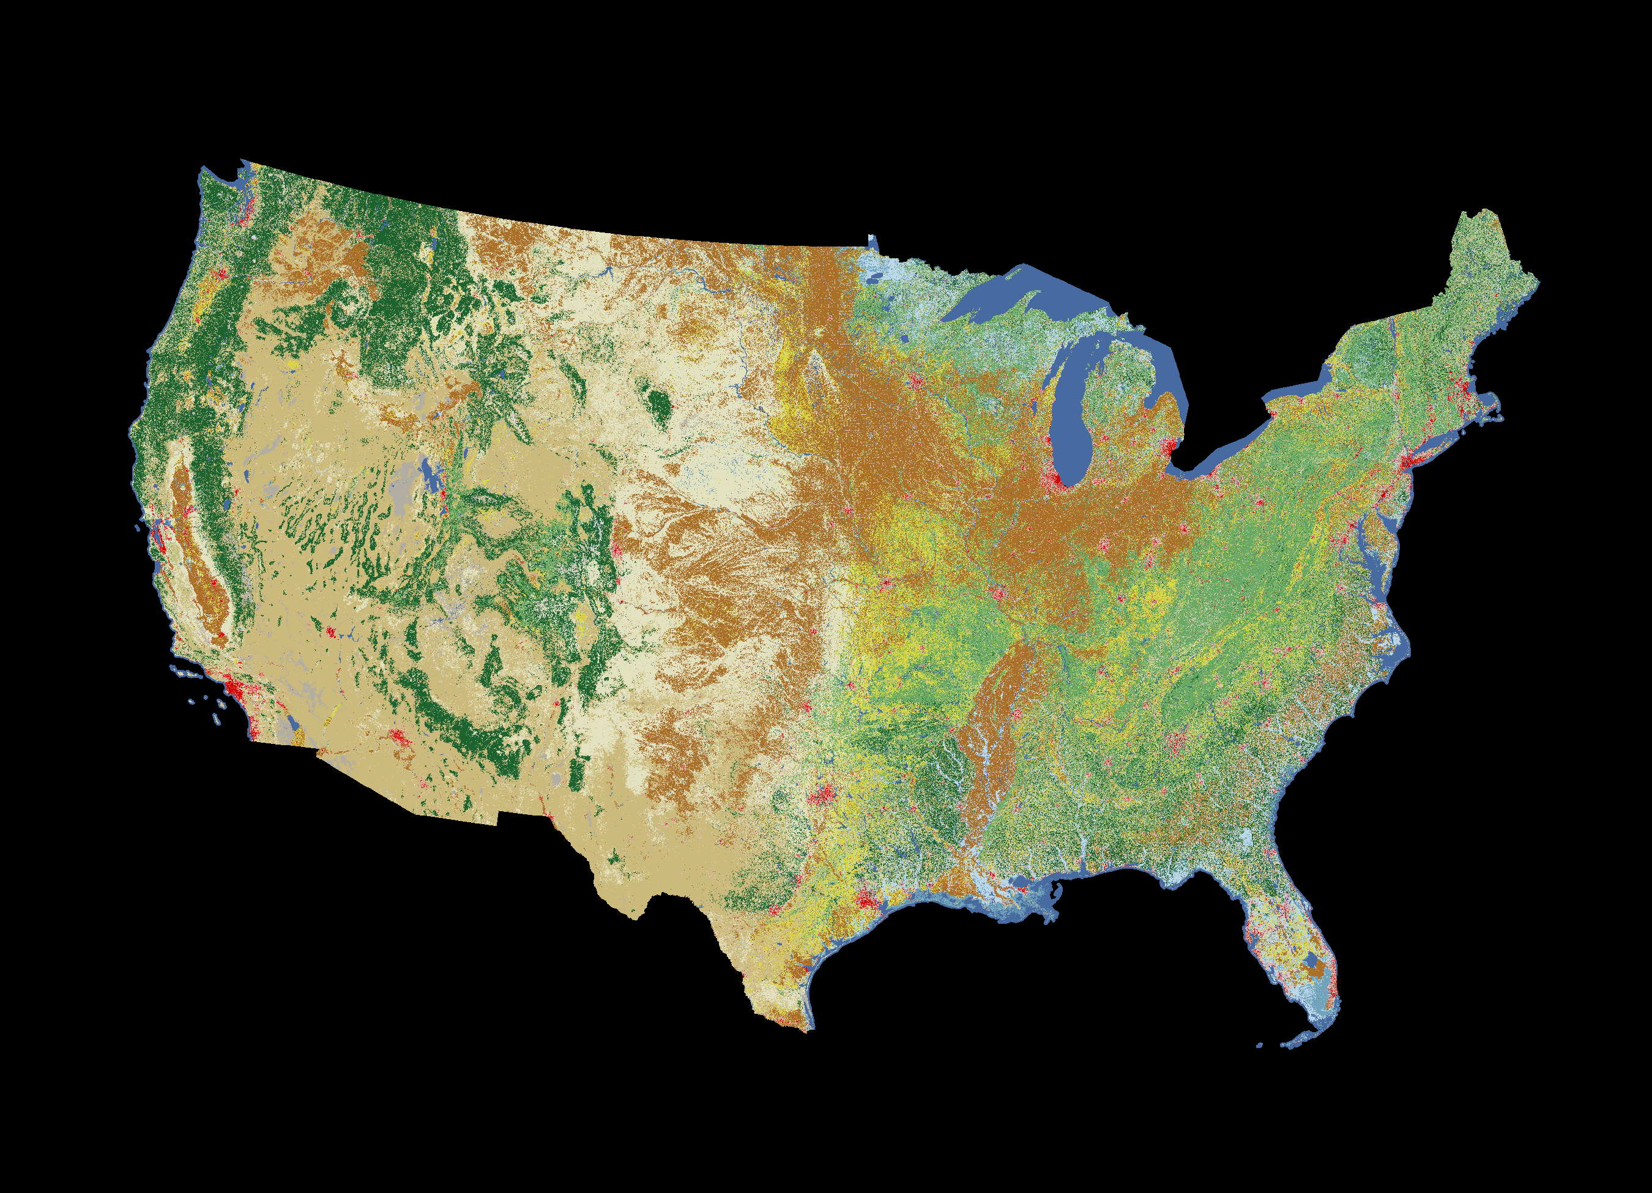
2006 National Land Cover

Slide 18
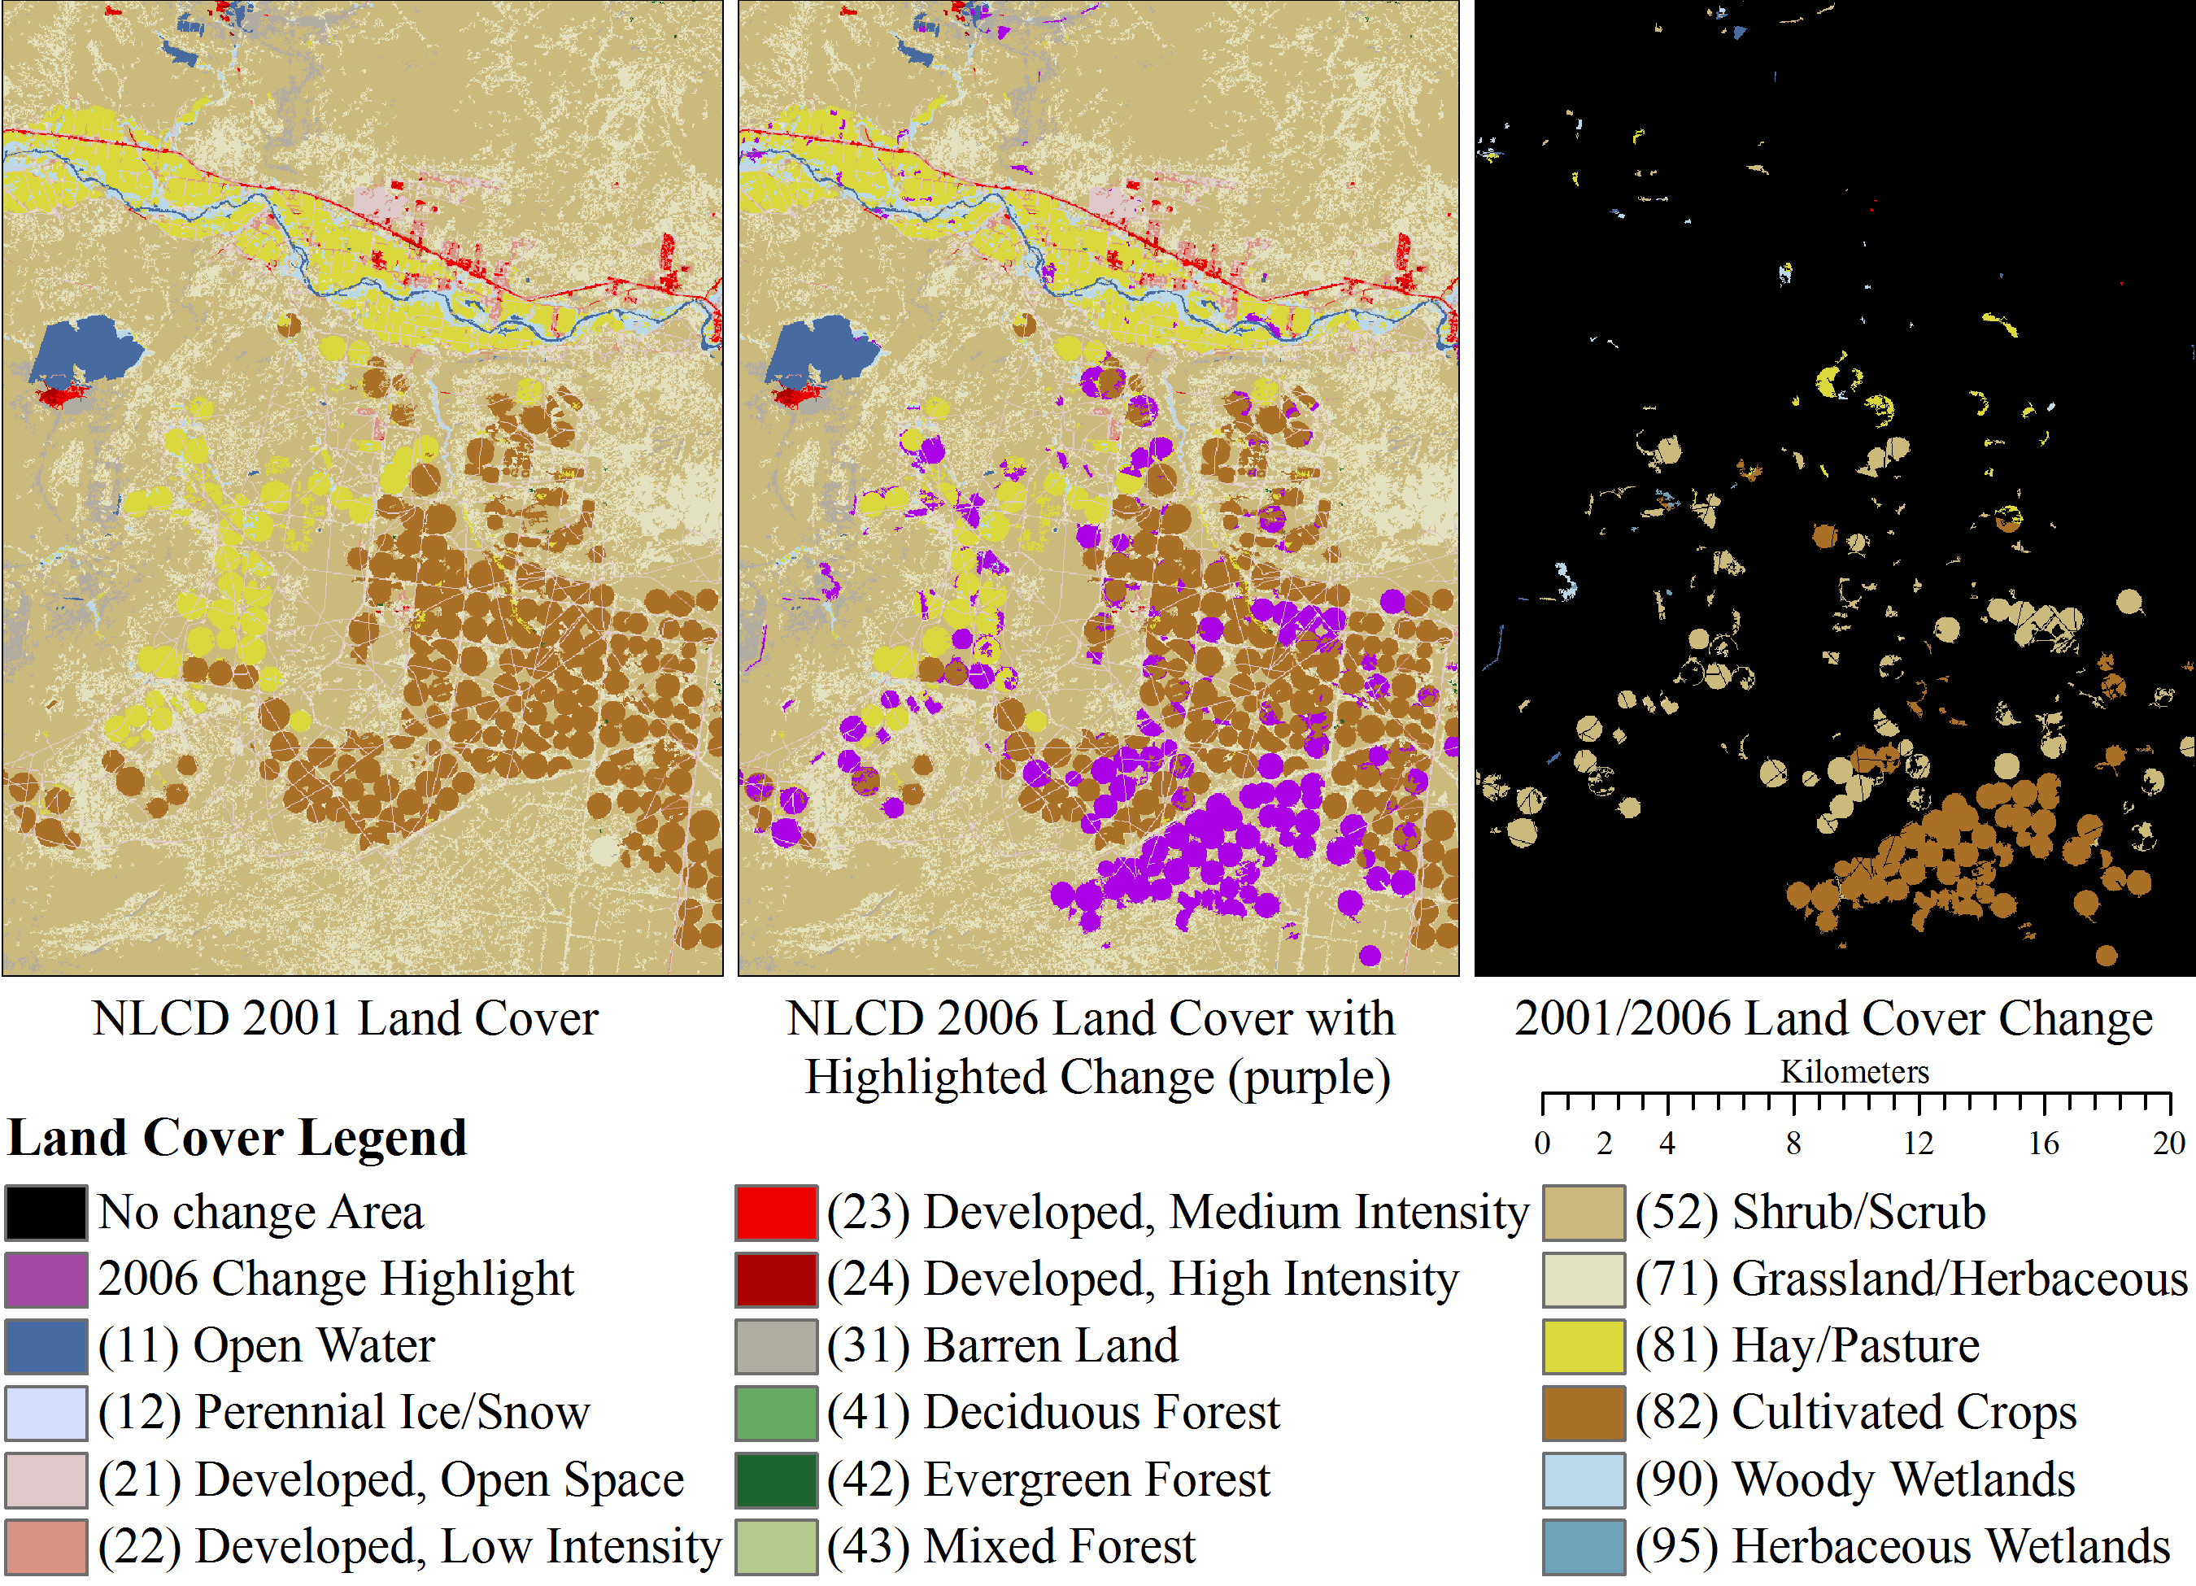
2001-2006 Agricultural Change: Farmington, NM

Slide 19
Global Forest Cover Gains and Losses - 2000 to 2012
Black Hills, South Dakota
Notes:
A new study based on Earth-observing satellite data comprehensively describes changes in the world's forests from the beginning of this century. Published in Science, this unparalleled survey of global forests tracked forest loss and gain at the spatial granularity of an area covered by a baseball diamond (30-meter resolution).
A team of scientists analyzed data from the Landsat 7 satellite to map changes in forests from 2000 to 2012 around the world at local to global scales. The uniform data from more than 650,000 scenes taken by Landsat 7 ensured a consistent global perspective across time, national boundaries, and regional ecosystems.

Slide 20
Monitoring Trends in Burn Severity

Slide 21
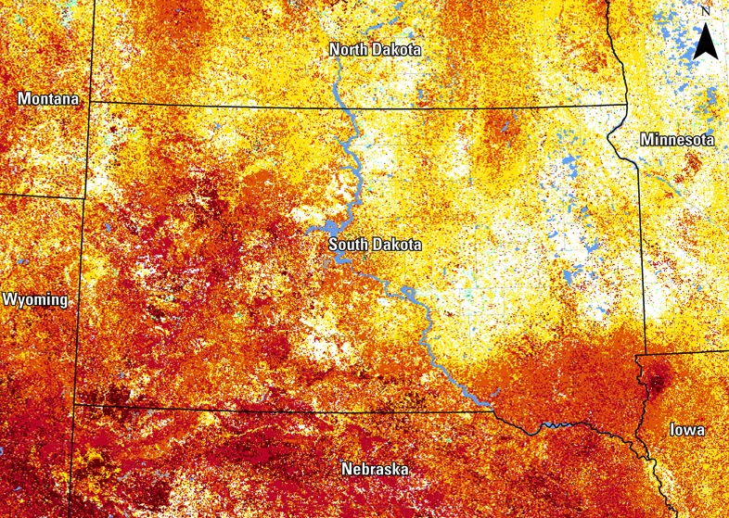
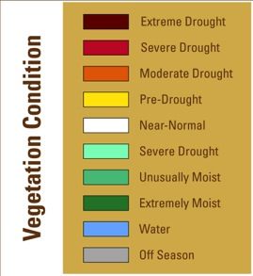
South Dakota Drought Conditions
September 30, 2012

